Slide 1
Student Name: KUMMURU DHEERAJ
Final Project
3/21/2024 Annual Review

Slide 2
PROJECT TITLE
Key logger and Security
3/21/2024 Annual Review

Slide 3


AGENDA
Problem Statement
Project overview
Who are the end users?
Your solution and its value preposition
The wow in your solution
Modeling
Results
Project link
3/21/2024 Annual Review

Slide 4
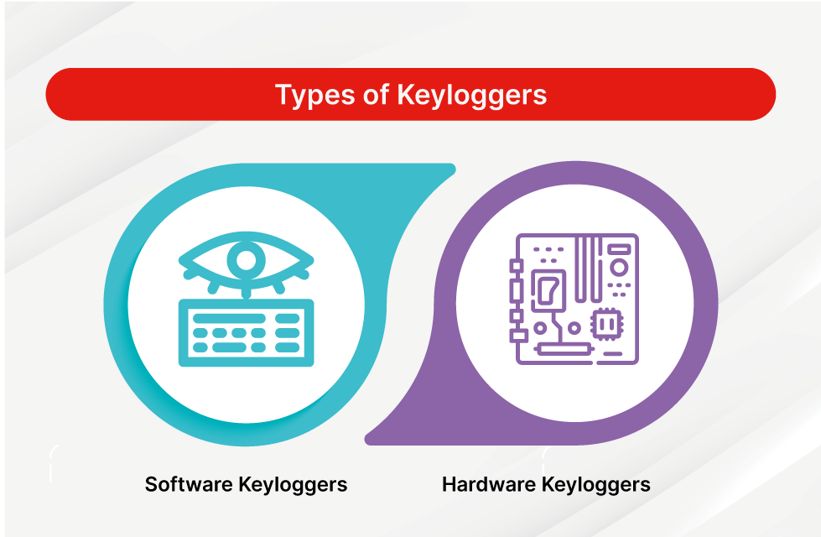
PROBLEM STATEMENT
key logger or keystroke logger/keyboard capturing is a form of malware or hardware that keeps track of and records your keystrokes as you type.
Security is protection from, or resilience against, potential harm (or other unwanted coercion).
Types of key loggers:
Software key-loggers:
JavaScript based key logger
Form Based Key loggers
Hardware Key-loggers:
USB key logger
Smartphone sensors
3/21/2024 Annual Review

Slide 5

PROJECT OVERVIEW
In this project I observed that how the key loggers are very essentials in hacking process :
Key loggers are malicious tools, either software-based or hardware-based, designed to record every keystroke made on a computer or mobile device. Cybercriminals use them to steal sensitive information such as passwords, credit card numbers, and personal messages. Software key loggers operate through installed programs, browser extensions, or deep system integration, while hardware key loggers are physical devices connected to the computer's keyboard. They are distributed through phishing emails, malicious downloads, and exploiting software vulnerabilities. Detecting and preventing key loggers involves using updated antivirus software, regular system scans, and being cautious with software installations and email attachments.
Types and Operation: Keyloggers can be software-based, running as hidden applications or browser extensions, or hardware-based, attached physically to the keyboard or computer.
Distribution and Prevention: Keyloggers are spread through phishing emails, malicious downloads, and exploiting software vulnerabilities.
3/21/2024 Annual Review

Slide 6

WHO ARE THE END USERS?
An end user is anyone who uses software and hardware assets in your organization to perform their job duties
To help you effectively answer this question, consider the following points:
Individual Users
Organizations
Specific Industries
Tailoring Solutions to Meet the Requirement of Various User Groups
3/21/2024 Annual Review

Slide 7

YOUR SOLUTION AND ITS VALUE PROPOSITION
In my view the solution is avoiding the key loggers
Use Antivirus and Anti-Malware Software
Keep Your System Updated
Use a Firewall
Use Two-Factor Authentication (2FA)
Regular System Scans
Comprehensive Protection Strategies:
Safeguarding Sensitive Information: Highlight methods to protect personal and organizational data from key logging threats.
Advanced Detection Tools: Introduce state-of-the-art tools and techniques to identify key loggers on various devices
3/21/2024 Annual Review

Slide 8

THE WOW IN YOUR SOLUTION
The WOW in Our Solution
Advanced Behavioral Analysis: Our solution stands out with its ability to detect keyloggers through sophisticated behavioral analysis, identifying even the most subtle anomalies in real time.
Unbreakable Encryption: By implementing end-to-end encryption and advanced data obfuscation, we ensure that any captured keystrokes are rendered useless to attackers.
Layered Defense: Our multi-layered approach, incorporating antivirus, anti-malware, and firewall protections, creates a robust security environment that key loggers cannot easily penetrate.
User-Centric Design: With seamless integration and an intuitive interface, our solution delivers top-notch security without compromising user experience.
Transparency and Control: Detailed reports and instant alerts provide users with full visibility and control over their security, ensuring they are always informed and prepared.
3/21/2024 Annual Review
8

Slide 9
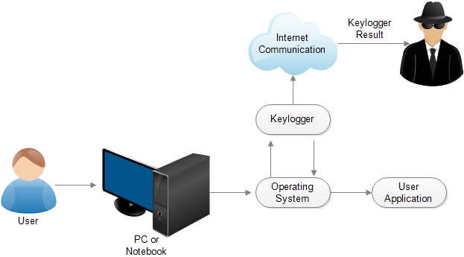
MODELLING
Modelling for Keyloggers and Cybersecurity Solution
3/21/2024 Annual Review
9

Slide 10
MODELLING
Threat Detection Model
Data Collection
Feature Extraction
Model Selection
Training and Validation
Real-Time Detection
Data Encryption Model
End-to-End Encryption
Key Management
Data Obfuscation
3/21/2024 Annual Review
10

Slide 11
MODELLING
User Behavior Analysis Model
Behavioral Biometrics
Anomaly Detection
Adaptive Authentication
Integration and Deployment
Seamless Integration
User-Friendly Interface
Continuous Monitoring and Updates

Slide 12
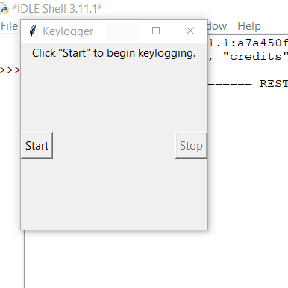
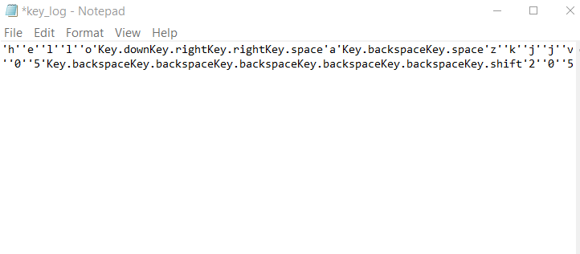
RESULTS
Outputs:
3/21/2024 Annual Review
12

Slide 13
Project link
https://github.com/lucky48121/Apssdc-project-my-.git

