Slide 1
Maxwell equations and material interfaces
PHY709 Advanced Electromagnetic Fields and Waves
15 October 2026
Dr. Junaid Ali
150-minute graduate class
PHY709 15 October 2026 1 / 42
Notes:
Sources: Jackson, Classical Electrodynamics, 3rd ed., Chapters 4-7. MIT OCW 6.641 L1-L3, L7-L8: https://ocw.mit.edu/courses/6-641-electromagnetic-fields-forces-and-motion-spring-2005/pages/lecture-notes/ . Instructor-created numerical exercises.
Discuss the assumptions and reproduce the relevant derivation in the separate booklet.

Slide 2
Learning outcomes
Write Maxwell equations with consistent free sources
Derive charge conservation and the four interface laws
Declare constitutive assumptions and normal directions
Solve dielectric and current-sheet interface problems
PHY709 15 October 2026 2 / 42
Notes:
Sources: Jackson, Classical Electrodynamics, 3rd ed., Chapters 4-7. MIT OCW 6.641 L1-L3, L7-L8: https://ocw.mit.edu/courses/6-641-electromagnetic-fields-forces-and-motion-spring-2005/pages/lecture-notes/ . Instructor-created numerical exercises.
Discuss the assumptions and reproduce the relevant derivation in the separate booklet.

Slide 3
Opening diagnostic
Is E = −∇Φ sufficient when B changes in time?
Can a charge-free region contain a nonzero field?
Is the full electric-field vector continuous at an uncharged interface?
Individual prediction, then paired justification
PHY709 15 October 2026 3 / 42
Notes:
Sources: Jackson, Classical Electrodynamics, 3rd ed., Chapters 4-7. MIT OCW 6.641 L1-L3, L7-L8: https://ocw.mit.edu/courses/6-641-electromagnetic-fields-forces-and-motion-spring-2005/pages/lecture-notes/ . Instructor-created numerical exercises.
Allow 10 minutes: individual prediction, paired reasoning, discussion.

Slide 4
Macroscopic fields and free sources
E [V/m] and B [T] describe electric and magnetic fields
D [C/m²] includes electric polarization
H [A/m] separates the magnetization response
ρ_f [C/m³] and J_f [A/m²] are free sources
PHY709 15 October 2026 4 / 42
Notes:
Sources: Jackson, Classical Electrodynamics, 3rd ed., Chapters 4-7. MIT OCW 6.641 L1-L3, L7-L8: https://ocw.mit.edu/courses/6-641-electromagnetic-fields-forces-and-motion-spring-2005/pages/lecture-notes/ . Instructor-created numerical exercises.
Discuss the assumptions and reproduce the relevant derivation in the separate booklet.

Slide 5
Gauss laws
∮ D · da = Q_free
∮ B · da = 0
∇ · D = ρ_f
∇ · B = 0
Closed-surface normals point outward
PHY709 15 October 2026 5 / 42
Notes:
Sources: Jackson, Classical Electrodynamics, 3rd ed., Chapters 4-7. MIT OCW 6.641 L1-L3, L7-L8: https://ocw.mit.edu/courses/6-641-electromagnetic-fields-forces-and-motion-spring-2005/pages/lecture-notes/ . Instructor-created numerical exercises.
Discuss the assumptions and reproduce the relevant derivation in the separate booklet.

Slide 6
Circulation laws
∮ E · dℓ = −d/dt ∫ B · da
∮ H · dℓ = ∫ J_f · da + d/dt ∫ D · da
∇ × E = −∂B/∂t
∇ × H = J_f + ∂D/∂t
Contours and spanning surfaces are fixed
PHY709 15 October 2026 6 / 42
Notes:
Sources: Jackson, Classical Electrodynamics, 3rd ed., Chapters 4-7. MIT OCW 6.641 L1-L3, L7-L8: https://ocw.mit.edu/courses/6-641-electromagnetic-fields-forces-and-motion-spring-2005/pages/lecture-notes/ . Instructor-created numerical exercises.
Discuss the assumptions and reproduce the relevant derivation in the separate booklet.

Slide 7
Integral and differential forms
Divergence theorem converts flux to a volume integral
Stokes theorem converts circulation to a surface integral
Arbitrary small regions identify the local integrands
Use integral laws at interfaces where fields jump
PHY709 15 October 2026 7 / 42
Notes:
Sources: Jackson, Classical Electrodynamics, 3rd ed., Chapters 4-7. MIT OCW 6.641 L1-L3, L7-L8: https://ocw.mit.edu/courses/6-641-electromagnetic-fields-forces-and-motion-spring-2005/pages/lecture-notes/ . Instructor-created numerical exercises.
Discuss the assumptions and reproduce the relevant derivation in the separate booklet.

Slide 8
Displacement current
J_displacement = ∂D/∂t
The displacement term permits time-dependent free charge
It supplies the capacitor-gap contribution to Ampere law
Its physical interpretation differs from free-charge transport
PHY709 15 October 2026 8 / 42
Notes:
Sources: Jackson, Classical Electrodynamics, 3rd ed., Chapters 4-7. MIT OCW 6.641 L1-L3, L7-L8: https://ocw.mit.edu/courses/6-641-electromagnetic-fields-forces-and-motion-spring-2005/pages/lecture-notes/ . Instructor-created numerical exercises.
Discuss the assumptions and reproduce the relevant derivation in the separate booklet.

Slide 9
Charge conservation
∇ · (∇ × H) = 0
0 = ∇ · J_f + ∂(∇ · D)/∂t
∇ · D = ρ_f
∂ρ_f/∂t + ∇ · J_f = 0
PHY709 15 October 2026 9 / 42
Notes:
Sources: Jackson, Classical Electrodynamics, 3rd ed., Chapters 4-7. MIT OCW 6.641 L1-L3, L7-L8: https://ocw.mit.edu/courses/6-641-electromagnetic-fields-forces-and-motion-spring-2005/pages/lecture-notes/ . Instructor-created numerical exercises.
Discuss the assumptions and reproduce the relevant derivation in the separate booklet.

Slide 10
Charging capacitor
Uniform vacuum gap: D_n = Q/A
I_d = A ∂D_n/∂t = dQ/dt
C = ε₀A/d and I_d = C dV/dt
A = 0.010 m², d = 1.0 mm, dV/dt = 10⁶ V/s
I_d = 88.5 μA
PHY709 15 October 2026 10 / 42
Notes:
Sources: Jackson, Classical Electrodynamics, 3rd ed., Chapters 4-7. MIT OCW 6.641 L1-L3, L7-L8: https://ocw.mit.edu/courses/6-641-electromagnetic-fields-forces-and-motion-spring-2005/pages/lecture-notes/ . Instructor-created numerical exercises.
Discuss the assumptions and reproduce the relevant derivation in the separate booklet.

Slide 11
Polarization and displacement
D = ε₀E + P
P is electric dipole moment per unit volume
Bound volume charge: ρ_b = −∇ · P
Bound surface charge: σ_b = P · n_outward
PHY709 15 October 2026 11 / 42
Notes:
Sources: Jackson, Classical Electrodynamics, 3rd ed., Chapters 4-7. MIT OCW 6.641 L1-L3, L7-L8: https://ocw.mit.edu/courses/6-641-electromagnetic-fields-forces-and-motion-spring-2005/pages/lecture-notes/ . Instructor-created numerical exercises.
Discuss the assumptions and reproduce the relevant derivation in the separate booklet.

Slide 12
Magnetization and magnetic field
B = μ₀(H + M)
M is magnetic dipole moment per unit volume
Bound bulk current: J_b = ∂P/∂t + ∇ × M
Macroscopic Ampere law uses free current J_f
PHY709 15 October 2026 12 / 42
Notes:
Sources: Jackson, Classical Electrodynamics, 3rd ed., Chapters 4-7. MIT OCW 6.641 L1-L3, L7-L8: https://ocw.mit.edu/courses/6-641-electromagnetic-fields-forces-and-motion-spring-2005/pages/lecture-notes/ . Instructor-created numerical exercises.
Discuss the assumptions and reproduce the relevant derivation in the separate booklet.

Slide 13
Constitutive models
Linear, local, isotropic, nondispersive response
P = ε₀χ_eE and M = χ_mH
D = εE and B = μH
Ohmic conduction: J_cond = σE
Free current may also include impressed sources
PHY709 15 October 2026 13 / 42
Notes:
Sources: Jackson, Classical Electrodynamics, 3rd ed., Chapters 4-7. MIT OCW 6.641 L1-L3, L7-L8: https://ocw.mit.edu/courses/6-641-electromagnetic-fields-forces-and-motion-spring-2005/pages/lecture-notes/ . Instructor-created numerical exercises.
Discuss the assumptions and reproduce the relevant derivation in the separate booklet.

Slide 14
Anisotropy and dispersion
Anisotropy: D_i = Σ_j ε_ij E_j
Dispersion: ε depends on frequency and response has memory
Nonlinearity: response depends on field strength
Scalar interface ratios require scalar ε and μ
PHY709 15 October 2026 14 / 42
Notes:
Sources: Jackson, Classical Electrodynamics, 3rd ed., Chapters 4-7. MIT OCW 6.641 L1-L3, L7-L8: https://ocw.mit.edu/courses/6-641-electromagnetic-fields-forces-and-motion-spring-2005/pages/lecture-notes/ . Instructor-created numerical exercises.
Discuss the assumptions and reproduce the relevant derivation in the separate booklet.

Slide 15
Frequency convention
Use fields proportional to exp(−iωt)
∇ × E = iωB
∇ × H = J_f − iωD
For J_f = σE: ε_eff = ε + iσ/ω
Avoid counting conductivity twice
PHY709 15 October 2026 15 / 42
Notes:
Sources: Jackson, Classical Electrodynamics, 3rd ed., Chapters 4-7. MIT OCW 6.641 L1-L3, L7-L8: https://ocw.mit.edu/courses/6-641-electromagnetic-fields-forces-and-motion-spring-2005/pages/lecture-notes/ . Instructor-created numerical exercises.
Discuss the assumptions and reproduce the relevant derivation in the separate booklet.

Slide 16
Guided dielectric example
Interface z = 0, normal n = ẑ
ε₁ = 2ε₀, ε₂ = 5ε₀ and σ_f = 0
E₁ = 30x̂ + 50ẑ V/m
Predict E₂ using normal and tangential components
10-minute break follows this calculation
PHY709 15 October 2026 16 / 42
Notes:
Sources: Jackson, Classical Electrodynamics, 3rd ed., Chapters 4-7. MIT OCW 6.641 L1-L3, L7-L8: https://ocw.mit.edu/courses/6-641-electromagnetic-fields-forces-and-motion-spring-2005/pages/lecture-notes/ . Instructor-created numerical exercises.
Allow 10 minutes to predict and calculate, then a 10-minute break.

Slide 17
Interface notation
Normal n points from medium 1 to medium 2
Resolve each field into normal and tangential components
σ_f denotes free sheet charge [C/m²]
K_f denotes tangential free sheet current [A/m]
Stationary ordinary interface, finite bulk fields
PHY709 15 October 2026 17 / 42
Notes:
Sources: Jackson, Classical Electrodynamics, 3rd ed., Chapters 4-7. MIT OCW 6.641 L1-L3, L7-L8: https://ocw.mit.edu/courses/6-641-electromagnetic-fields-forces-and-motion-spring-2005/pages/lecture-notes/ . Instructor-created numerical exercises.
Discuss the assumptions and reproduce the relevant derivation in the separate booklet.

Slide 18
Normal electric displacement
Gauss pillbox: (D₂n − D₁n)A + side flux = Q_free
As height tends to zero, regular bulk terms vanish
Free surface charge σ_f A survives
n · (D₂ − D₁) = σ_f
For scalar media: ε₂E₂n − ε₁E₁n = σ_f
PHY709 15 October 2026 18 / 42
Notes:
Sources: Jackson, Classical Electrodynamics, 3rd ed., Chapters 4-7. MIT OCW 6.641 L1-L3, L7-L8: https://ocw.mit.edu/courses/6-641-electromagnetic-fields-forces-and-motion-spring-2005/pages/lecture-notes/ . Instructor-created numerical exercises.
Discuss the assumptions and reproduce the relevant derivation in the separate booklet.

Slide 19
Normal magnetic flux density
Apply ∮ B · da = 0 to the same pillbox
Side flux vanishes with pillbox height
n · (B₂ − B₁) = 0
B₂n = B₁n
For scalar media: μ₂H₂n = μ₁H₁n
PHY709 15 October 2026 19 / 42
Notes:
Sources: Jackson, Classical Electrodynamics, 3rd ed., Chapters 4-7. MIT OCW 6.641 L1-L3, L7-L8: https://ocw.mit.edu/courses/6-641-electromagnetic-fields-forces-and-motion-spring-2005/pages/lecture-notes/ . Instructor-created numerical exercises.
Discuss the assumptions and reproduce the relevant derivation in the separate booklet.

Slide 20
Tangential electric field
Apply Faraday law to a shrinking rectangular loop
Finite ∂B/∂t makes the flux term vanish with area
The long-edge circulation survives
n × (E₂ − E₁) = 0
Valid during induction at an ordinary interface
PHY709 15 October 2026 20 / 42
Notes:
Sources: Jackson, Classical Electrodynamics, 3rd ed., Chapters 4-7. MIT OCW 6.641 L1-L3, L7-L8: https://ocw.mit.edu/courses/6-641-electromagnetic-fields-forces-and-motion-spring-2005/pages/lecture-notes/ . Instructor-created numerical exercises.
Discuss the assumptions and reproduce the relevant derivation in the separate booklet.

Slide 21
Tangential magnetic field
Apply Ampere-Maxwell law to the shrinking loop
Regular bulk current and displacement flux vanish
Free sheet current survives
n × (H₂ − H₁) = K_f
H₂t − H₁t = K_f × n
PHY709 15 October 2026 21 / 42
Notes:
Sources: Jackson, Classical Electrodynamics, 3rd ed., Chapters 4-7. MIT OCW 6.641 L1-L3, L7-L8: https://ocw.mit.edu/courses/6-641-electromagnetic-fields-forces-and-motion-spring-2005/pages/lecture-notes/ . Instructor-created numerical exercises.
Discuss the assumptions and reproduce the relevant derivation in the separate booklet.

Slide 22
Current-sheet sign check
Take n = ẑ and K_f = Kx̂
K_f × n = −Kŷ
Therefore ΔH_t = −Kŷ
Check: ẑ × (−Kŷ) = Kx̂
Reversing the normal also reverses the jump convention
PHY709 15 October 2026 22 / 42
Notes:
Sources: Jackson, Classical Electrodynamics, 3rd ed., Chapters 4-7. MIT OCW 6.641 L1-L3, L7-L8: https://ocw.mit.edu/courses/6-641-electromagnetic-fields-forces-and-motion-spring-2005/pages/lecture-notes/ . Instructor-created numerical exercises.
Discuss the assumptions and reproduce the relevant derivation in the separate booklet.

Slide 23
Four interface laws
D₂n − D₁n = σ_f
B₂n − B₁n = 0
E₂t − E₁t = 0
n × (H₂ − H₁) = K_f
Zero free sheet sources give the corresponding continuity
PHY709 15 October 2026 23 / 42
Notes:
Sources: Jackson, Classical Electrodynamics, 3rd ed., Chapters 4-7. MIT OCW 6.641 L1-L3, L7-L8: https://ocw.mit.edu/courses/6-641-electromagnetic-fields-forces-and-motion-spring-2005/pages/lecture-notes/ . Instructor-created numerical exercises.
Discuss the assumptions and reproduce the relevant derivation in the separate booklet.

Slide 24
Uncharged dielectric solution
ε₁ = 2ε₀ and ε₂ = 5ε₀
E₂x = E₁x = 30 V/m
ε₂E₂z = ε₁E₁z gives E₂z = 20 V/m
E₂ = 30x̂ + 20ẑ V/m
Normal E changes despite zero free sheet charge
PHY709 15 October 2026 24 / 42
Notes:
Sources: Jackson, Classical Electrodynamics, 3rd ed., Chapters 4-7. MIT OCW 6.641 L1-L3, L7-L8: https://ocw.mit.edu/courses/6-641-electromagnetic-fields-forces-and-motion-spring-2005/pages/lecture-notes/ . Instructor-created numerical exercises.
Discuss the assumptions and reproduce the relevant derivation in the separate booklet.

Slide 25
Charged dielectric solution
ε₁ = 2ε₀ and ε₂ = 4ε₀
E₁ = 100x̂ + 200ẑ V/m
σ_f = 3.542 × 10⁻⁹ C/m²
E₂x = 100 V/m and E₂z ≈ 200 V/m
Selected sheet charge permits equal normal E
PHY709 15 October 2026 25 / 42
Notes:
Sources: Jackson, Classical Electrodynamics, 3rd ed., Chapters 4-7. MIT OCW 6.641 L1-L3, L7-L8: https://ocw.mit.edu/courses/6-641-electromagnetic-fields-forces-and-motion-spring-2005/pages/lecture-notes/ . Instructor-created numerical exercises.
Discuss the assumptions and reproduce the relevant derivation in the separate booklet.

Slide 26
Free current-sheet solution
K_f = 6x̂ A/m, n = ẑ
H₁ = 2ŷ + 3ẑ A/m, μ₂ = 2μ₁
ΔH_t = −6ŷ A/m
Normal B gives H₂z = 1.5 A/m
H₂ = −4ŷ + 1.5ẑ A/m
PHY709 15 October 2026 26 / 42
Notes:
Sources: Jackson, Classical Electrodynamics, 3rd ed., Chapters 4-7. MIT OCW 6.641 L1-L3, L7-L8: https://ocw.mit.edu/courses/6-641-electromagnetic-fields-forces-and-motion-spring-2005/pages/lecture-notes/ . Instructor-created numerical exercises.
Discuss the assumptions and reproduce the relevant derivation in the separate booklet.

Slide 27
Perfect electric conductor
With the usual initially field-free interior: E = 0, B = 0
For the outward conductor normal: E_t = 0 and D_n = σ_f
B_n = 0 and n × H = K_f
Infinite conductivity alone allows trapped static flux
Meissner expulsion requires additional superconducting physics
PHY709 15 October 2026 27 / 42
Notes:
Sources: Jackson, Classical Electrodynamics, 3rd ed., Chapters 4-7. MIT OCW 6.641 L1-L3, L7-L8: https://ocw.mit.edu/courses/6-641-electromagnetic-fields-forces-and-motion-spring-2005/pages/lecture-notes/ . Instructor-created numerical exercises.
Discuss the assumptions and reproduce the relevant derivation in the separate booklet.

Slide 28
Electrostatic potential at interfaces
E = −∇Φ gives ∇ · (ε∇Φ) = −ρ_f
Uniform scalar ε gives ∇²Φ = −ρ_f/ε
Ordinary interface without an ideal dipole sheet: Φ₁ = Φ₂
ε₁∂Φ₁/∂n − ε₂∂Φ₂/∂n = σ_f
Both derivatives use the same normal direction
PHY709 15 October 2026 28 / 42
Notes:
Sources: Jackson, Classical Electrodynamics, 3rd ed., Chapters 4-7. MIT OCW 6.641 L1-L3, L7-L8: https://ocw.mit.edu/courses/6-641-electromagnetic-fields-forces-and-motion-spring-2005/pages/lecture-notes/ . Instructor-created numerical exercises.
Discuss the assumptions and reproduce the relevant derivation in the separate booklet.

Slide 29
Wave-equation preview
Homogeneous, source-free, lossless scalar medium
Curl Faraday law and use Ampere-Maxwell law
∇ × (∇ × E) = ∇(∇ · E) − ∇²E
With ∇ · E = 0: ∇²E − με ∂²E/∂t² = 0
Interface laws will constrain reflected and transmitted waves
PHY709 15 October 2026 29 / 42
Notes:
Sources: Jackson, Classical Electrodynamics, 3rd ed., Chapters 4-7. MIT OCW 6.641 L1-L3, L7-L8: https://ocw.mit.edu/courses/6-641-electromagnetic-fields-forces-and-motion-spring-2005/pages/lecture-notes/ . Instructor-created numerical exercises.
Discuss the assumptions and reproduce the relevant derivation in the separate booklet.

Slide 30
Exit assessment
Identify continuous components when ε₂ = 3ε₁ and sheet sources vanish
Derive charge conservation from Ampere-Maxwell law
Find ΔH_t for n = ẑ and K_f = 4ŷ A/m
Complete the original post-class problem set
Use the derivation booklet for revision
PHY709 15 October 2026 30 / 42
Notes:
Sources: Jackson, Classical Electrodynamics, 3rd ed., Chapters 4-7. MIT OCW 6.641 L1-L3, L7-L8: https://ocw.mit.edu/courses/6-641-electromagnetic-fields-forces-and-motion-spring-2005/pages/lecture-notes/ . Instructor-created numerical exercises.
Allow 8 minutes. Answers remain in the separate instructor key.

Slide 31
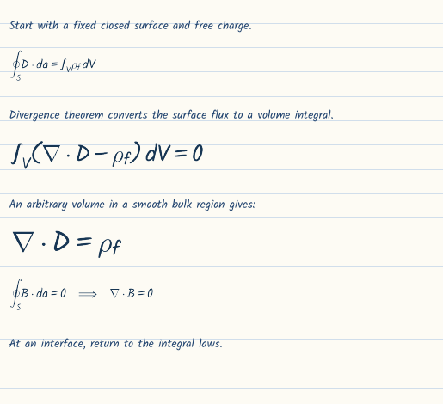
Derivation 1: supplementary board work
PHY709 Derivation booklet page 1 31 / 42
Notes:
Supplementary reference with enlarged equation region. The separate full-resolution derivation PDF includes interface sketches and page labels. Sources: Jackson, Classical Electrodynamics, 3rd ed., Chapters 4-7. MIT OCW 6.641 L1-L3, L7-L8: https://ocw.mit.edu/courses/6-641-electromagnetic-fields-forces-and-motion-spring-2005/pages/lecture-notes/ . Instructor-created numerical exercises.

Slide 32
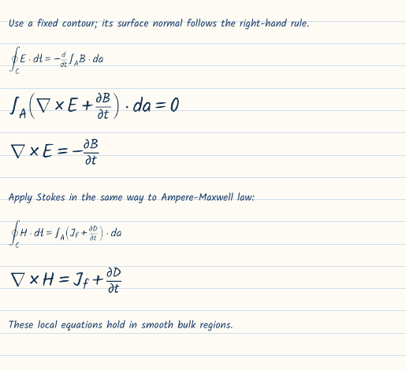
Derivation 2: supplementary board work
PHY709 Derivation booklet page 2 32 / 42
Notes:
Supplementary reference with enlarged equation region. The separate full-resolution derivation PDF includes interface sketches and page labels. Sources: Jackson, Classical Electrodynamics, 3rd ed., Chapters 4-7. MIT OCW 6.641 L1-L3, L7-L8: https://ocw.mit.edu/courses/6-641-electromagnetic-fields-forces-and-motion-spring-2005/pages/lecture-notes/ . Instructor-created numerical exercises.

Slide 33
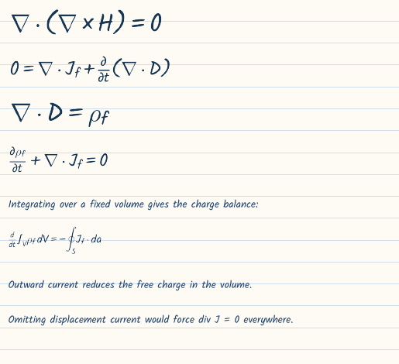
Derivation 3: supplementary board work
PHY709 Derivation booklet page 3 33 / 42
Notes:
Supplementary reference with enlarged equation region. The separate full-resolution derivation PDF includes interface sketches and page labels. Sources: Jackson, Classical Electrodynamics, 3rd ed., Chapters 4-7. MIT OCW 6.641 L1-L3, L7-L8: https://ocw.mit.edu/courses/6-641-electromagnetic-fields-forces-and-motion-spring-2005/pages/lecture-notes/ . Instructor-created numerical exercises.

Slide 34
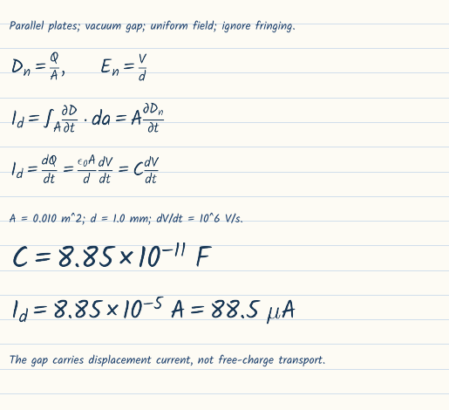
Derivation 4: supplementary board work
PHY709 Derivation booklet page 4 34 / 42
Notes:
Supplementary reference with enlarged equation region. The separate full-resolution derivation PDF includes interface sketches and page labels. Sources: Jackson, Classical Electrodynamics, 3rd ed., Chapters 4-7. MIT OCW 6.641 L1-L3, L7-L8: https://ocw.mit.edu/courses/6-641-electromagnetic-fields-forces-and-motion-spring-2005/pages/lecture-notes/ . Instructor-created numerical exercises.

Slide 35
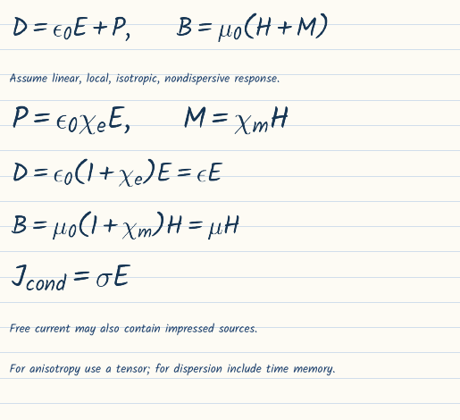
Derivation 5: supplementary board work
PHY709 Derivation booklet page 5 35 / 42
Notes:
Supplementary reference with enlarged equation region. The separate full-resolution derivation PDF includes interface sketches and page labels. Sources: Jackson, Classical Electrodynamics, 3rd ed., Chapters 4-7. MIT OCW 6.641 L1-L3, L7-L8: https://ocw.mit.edu/courses/6-641-electromagnetic-fields-forces-and-motion-spring-2005/pages/lecture-notes/ . Instructor-created numerical exercises.

Slide 36
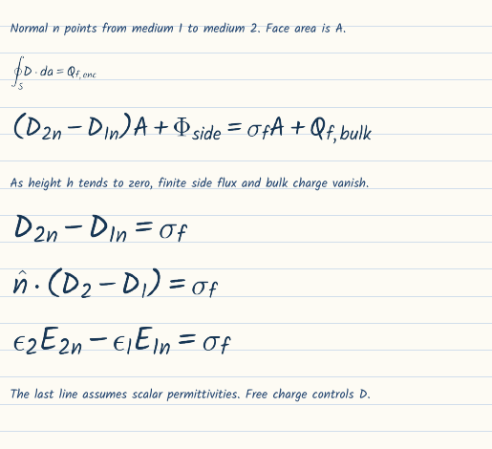
Derivation 6: supplementary board work
PHY709 Derivation booklet page 6 36 / 42
Notes:
Supplementary reference with enlarged equation region. The separate full-resolution derivation PDF includes interface sketches and page labels. Sources: Jackson, Classical Electrodynamics, 3rd ed., Chapters 4-7. MIT OCW 6.641 L1-L3, L7-L8: https://ocw.mit.edu/courses/6-641-electromagnetic-fields-forces-and-motion-spring-2005/pages/lecture-notes/ . Instructor-created numerical exercises.

Slide 37
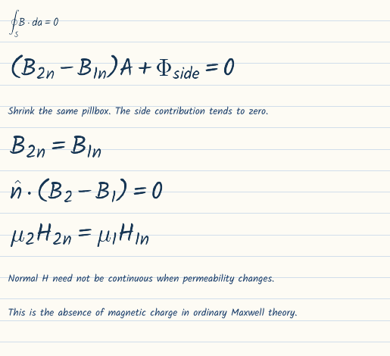
Derivation 7: supplementary board work
PHY709 Derivation booklet page 7 37 / 42
Notes:
Supplementary reference with enlarged equation region. The separate full-resolution derivation PDF includes interface sketches and page labels. Sources: Jackson, Classical Electrodynamics, 3rd ed., Chapters 4-7. MIT OCW 6.641 L1-L3, L7-L8: https://ocw.mit.edu/courses/6-641-electromagnetic-fields-forces-and-motion-spring-2005/pages/lecture-notes/ . Instructor-created numerical exercises.

Slide 38
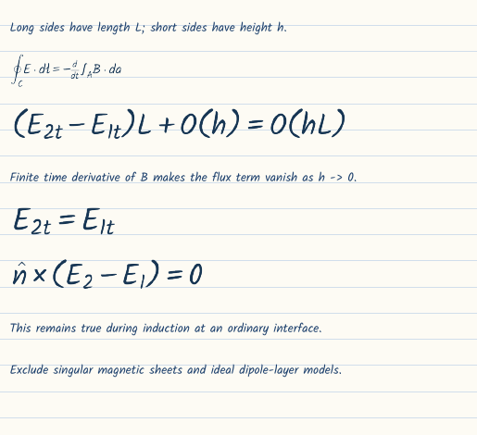
Derivation 8: supplementary board work
PHY709 Derivation booklet page 8 38 / 42
Notes:
Supplementary reference with enlarged equation region. The separate full-resolution derivation PDF includes interface sketches and page labels. Sources: Jackson, Classical Electrodynamics, 3rd ed., Chapters 4-7. MIT OCW 6.641 L1-L3, L7-L8: https://ocw.mit.edu/courses/6-641-electromagnetic-fields-forces-and-motion-spring-2005/pages/lecture-notes/ . Instructor-created numerical exercises.

Slide 39
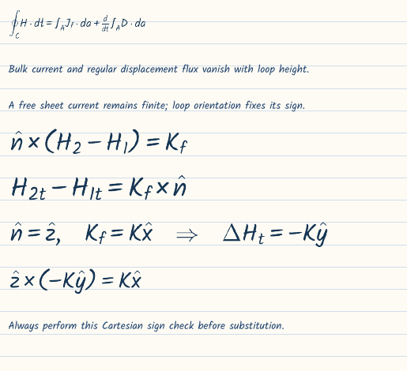
Derivation 9: supplementary board work
PHY709 Derivation booklet page 9 39 / 42
Notes:
Supplementary reference with enlarged equation region. The separate full-resolution derivation PDF includes interface sketches and page labels. Sources: Jackson, Classical Electrodynamics, 3rd ed., Chapters 4-7. MIT OCW 6.641 L1-L3, L7-L8: https://ocw.mit.edu/courses/6-641-electromagnetic-fields-forces-and-motion-spring-2005/pages/lecture-notes/ . Instructor-created numerical exercises.

Slide 40
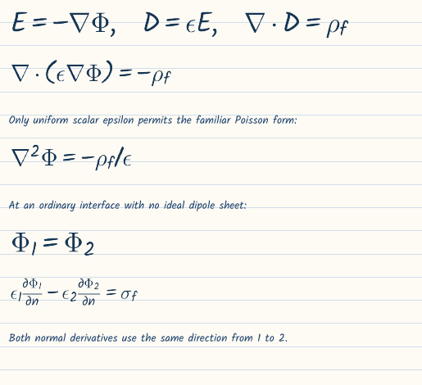
Derivation 10: supplementary board work
PHY709 Derivation booklet page 10 40 / 42
Notes:
Supplementary reference with enlarged equation region. The separate full-resolution derivation PDF includes interface sketches and page labels. Sources: Jackson, Classical Electrodynamics, 3rd ed., Chapters 4-7. MIT OCW 6.641 L1-L3, L7-L8: https://ocw.mit.edu/courses/6-641-electromagnetic-fields-forces-and-motion-spring-2005/pages/lecture-notes/ . Instructor-created numerical exercises.

Slide 41
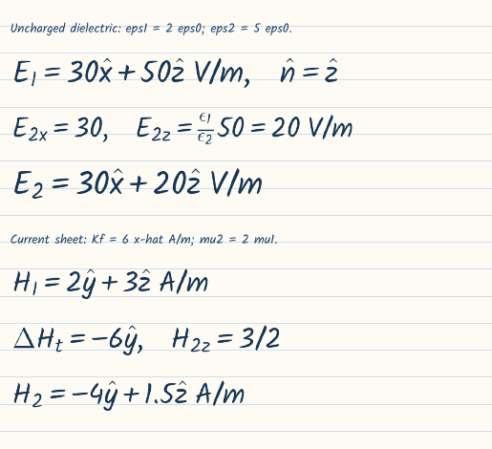
Derivation 11: supplementary board work
PHY709 Derivation booklet page 11 41 / 42
Notes:
Supplementary reference with enlarged equation region. The separate full-resolution derivation PDF includes interface sketches and page labels. Sources: Jackson, Classical Electrodynamics, 3rd ed., Chapters 4-7. MIT OCW 6.641 L1-L3, L7-L8: https://ocw.mit.edu/courses/6-641-electromagnetic-fields-forces-and-motion-spring-2005/pages/lecture-notes/ . Instructor-created numerical exercises.

Slide 42
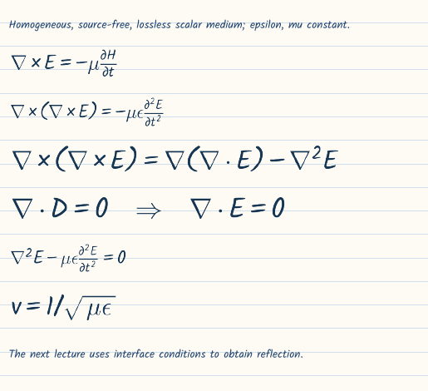
Derivation 12: supplementary board work
PHY709 Derivation booklet page 12 42 / 42
Notes:
Supplementary reference with enlarged equation region. The separate full-resolution derivation PDF includes interface sketches and page labels. Sources: Jackson, Classical Electrodynamics, 3rd ed., Chapters 4-7. MIT OCW 6.641 L1-L3, L7-L8: https://ocw.mit.edu/courses/6-641-electromagnetic-fields-forces-and-motion-spring-2005/pages/lecture-notes/ . Instructor-created numerical exercises.

