Slide 1
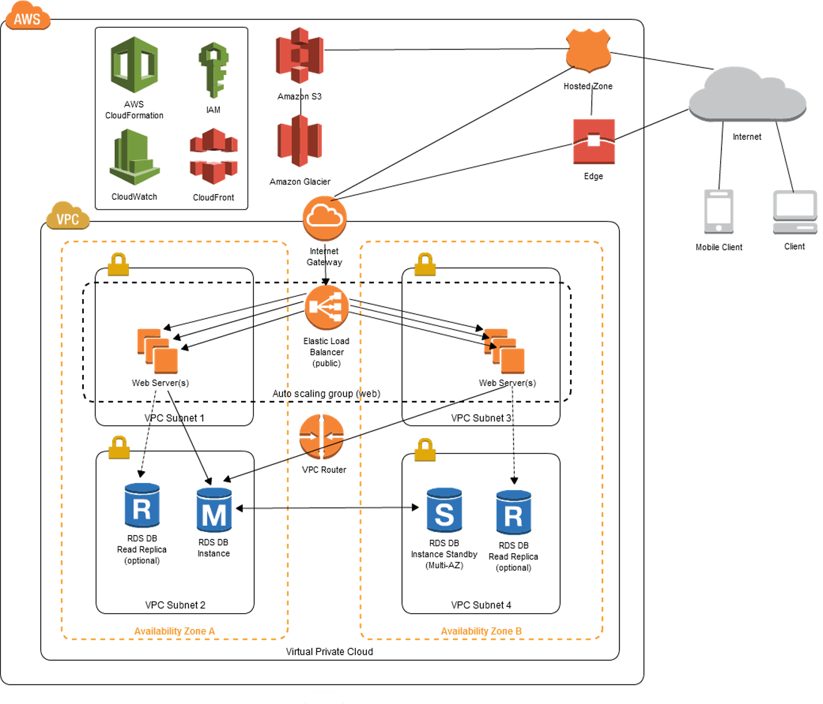
Challenge -1

Slide 2
Challenge -2
#Connect to Ec2 instance and retive meta data scripts by invoking powershell commands
$token = Invoke-RestMethod -Headers @{"X-aws-ec2-metadata-token-ttl-seconds" = "21600"} -Method PUT –Uri http://169.254.169.254/latest/api/token
$params = @{
Uri = 'http://169.254.169.254/latest/meta-data/'
Headers = @{ 'X-aws-ec2-metadata-token' = "$token" }
Method = 'GET'
ContentType = 'application/json'
}
Invoke-RestMethod @params

Slide 3
Challenge -3
<script>
var nestedObjectobject = {"x":{"y":{"z":"a"} }};
var value = readNestedObject(nestedObjectobject);
console.log(value);
function readNestedObject(obj)
{
const iterate = (obj) => {
Object.keys(obj).forEach(key => {
//console.log(key: ${key}, value: ${obj[key]})
console.log('key: '+ key + ', value: '+obj[key]);
if (typeof obj[key] === 'object') {
iterate(obj[key])
}
else
return obj[key];
})
}
iterate(obj);
}
</script>

