Slide 1
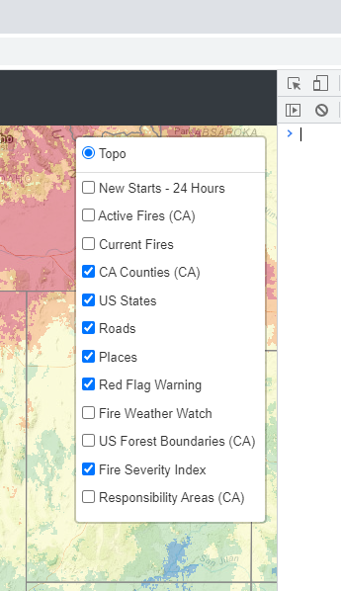



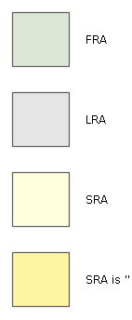

New Fire Starts – 24 hours
CalFire Active Fires
Current Fires
Red Flag Warning
Fire Weather Watch
Forest Boundaries
Current Fire Perimeters
National Park Boundaries
Responsibility Areas
Federal
State
Local
Fire Severity Index
Red Flag Warning
Low
Fire Severity Index
Moderate
Low
High
Moderate
Very High
High
Severe
Very High
Severe

Slide 2












