Slide 1
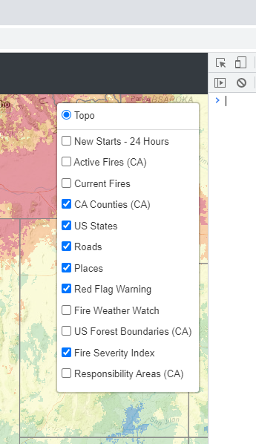



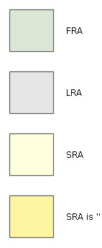

New Fire Starts – 24 hours
CalFire Active Fires
Current Fires
Red Flag Warning
Fire Weather Watch
Forest Boundaries
Current Fire Perimeters
National Park Boundaries
Responsibility Areas
Federal
State
Local
Fire Severity Index
Low
Moderate
High
Very High
Severe

