Slide 1
Analysis of Socio-Economic Data from the 2021 Census in England
Insights into Income Distribution, Education, Gender, Ethnicity, and Marital Status
PRESENTED BY: EZEIHUAKU LUCKY EBUKA
STUDENT NUMBER: 2355701

Slide 2
OVERVIEW OF THE DATASET
Dataset Description:
- Variables analyzed: Gender, Age, Income, Marital Status, Ethnicity, Level of Education, Housing.
- 27,410 entries, with each entry representing an individual in England.
Objective: The main aim of this analysis is to explore how socio-economic factors like Gender, Ethnicity, Marital Status, and Level of Education influence average income. I’d also be highlighting the patterns and disparities based on the demographics.
Data Source: Office for National Statistics (2022) Census 2021 England Household Data. Available at: www.ons.gov.uk (Accessed: 13 November 2024).

Slide 3
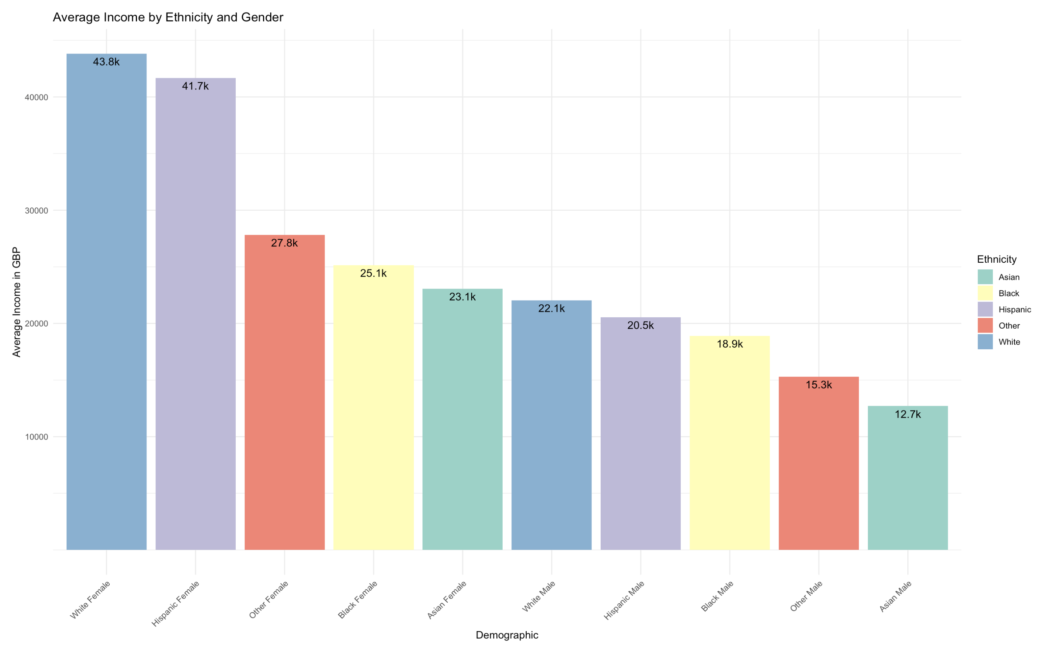
INCOME DISTRIBUTION BY GENDER AND ETHNICITY
Findings:
- White Females earn the highest with an average annual income of GBP 43,800.
- Asian Males earn the lowest, with an average annual income of GBP 12,700.
- I also observed that females generally earn more than males across the ethnic groups.
Insights:
- There’s a very notable disparity in income which is influenced heavily by both gender and ethnicity.
- Females notably earning more than Males is a bit unusual compared to other countries, and this might be a result of gender-specific employment for certain jobs, or other unique factors.
Office for National Statistics (2022) Effects of taxes and benefits on UK household income: Financial year ending 2021. Available at: www.ons.gov.uk (Accessed: 13 November 2024)

Slide 4
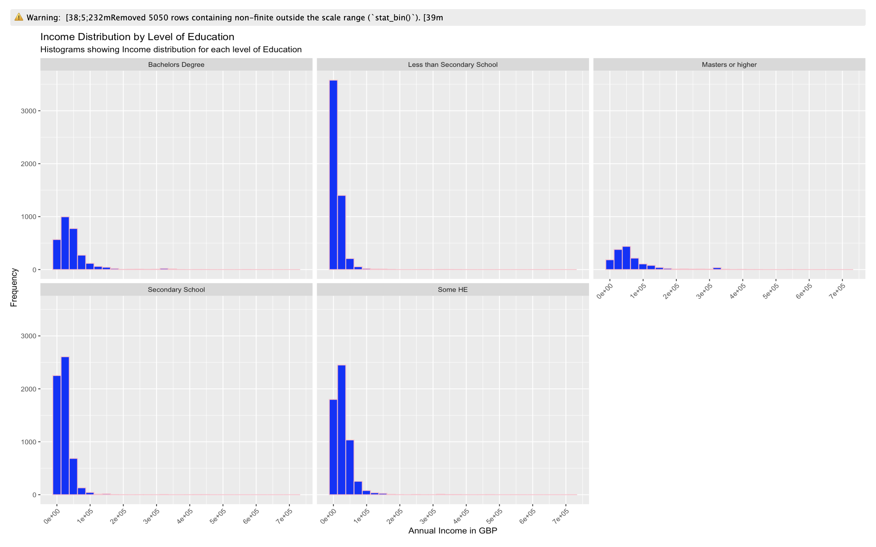
EDUCATION AND INCOME CORRELATION
Findings:
- Higher education levels like Bachelor’s and Master’s usually translate to the individual having a higher average income.
- Lower education levels like Secondary School and below usually show lower average income earned.
Insights:
- From my observations, education levels have a direct positive impact on how much individuals could be earning.
- There’s a visible trend where higher educational levels create more opportunities to get higher-paying jobs.
According to Johnson (2020), in his journal ‘Income Inequality and Education in the UK’, education is very important in having a stable and high-earning society, and this trend highlights exactly that.
Johnson, W. (2020) ‘Income Inequality and Education in the UK’, Journal of Economic Studies, 35(4), pp. 45-62

Slide 5
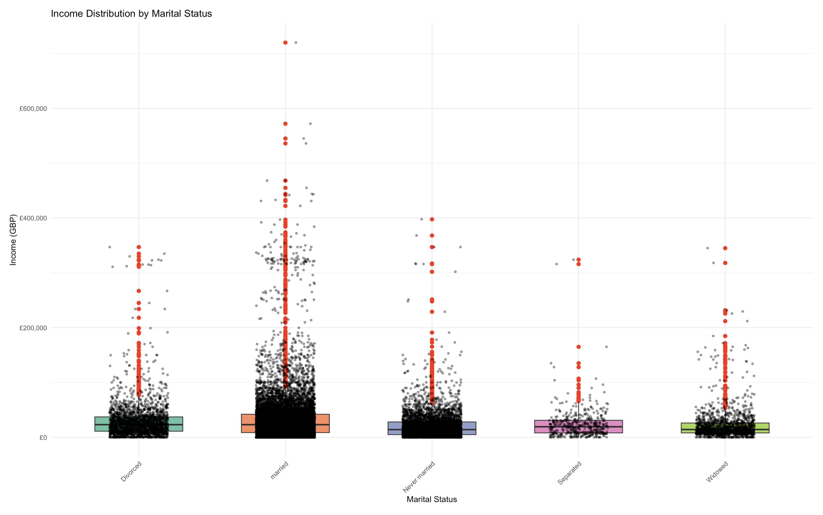
MARITAL STATUS AND INCOME DISTRIBUTION
Findings:
- Individuals who are married tend to have a higher median income when compared to other marital categories like separated, widowed, and never married.
- This could be due to dual-income households, and better financial stability from both couples earning and dividing bills.
Insight:
- According to Brown and Smith (2021), marriage provides financial gains and benefits for couples as they usually take on shared responsibilities with double income dynamics within the home. This plot and analysis share similar sentiments.
Brown, M. and Smith, J. (2021) ‘Marriage, Income, and Economic Stability: An Analysis’, Social Economics Journal, 28(2), pp. 78-91.

Slide 6
CRITIQUE AND LIMITATIONS OF THE DATA SET
Data Limitations:
- Outliers: The presence of outliers and extreme income values in some of the groups could lead to skewed results and these could potentially affect conclusions and make it harder to generalize findings gotten from the analysis.
- Lack of contextual variables: There was a clear lack of other variables like industry employed in, years of work experience, and others, which could have provided more context to help analyze the data set better and reach more concise conclusions.
- Static snapshot of data: The census data being analyzed is from a single year (2021), and this does not capture and factor in how life evolves with changes in income and marital status. Growth and changes across a few years could impact income earning patterns, especially among older individuals.
Conclusion:
Even with the limitations mentioned above, the dataset provides solid and very valuable insights into different demographic and socio-economic patterns, showing how these variables influence the average income earned by individuals in England. Further analyses could definitely benefit from making room for additional context and recognizing data limitations when inferring about income earned and demographic patterns.

Slide 7
REFERENCES
Office for National Statistics (2022) Census 2021 England Household Data. Available at: www.ons.gov.uk (Accessed: 13 November 2024).
Office for National Statistics (2022) Effects of taxes and benefits on UK household income: Financial year ending 2021. Available at: www.ons.gov.uk (Accessed: 13 November 2024).
Johnson, W. (2020) ‘Income Inequality and Education in the UK’, Journal of Economic Studies, 35(4), pp. 45-62.
Brown, M. and Smith, J. (2021) ‘Marriage, Income, and Economic Stability: An Analysis’, Social Economics Journal, 28(2), pp. 78-91.

