Slide 1
Docker basic practice
EAE31-XC competence
01.Dec.2023

Slide 2
Agenda
Docker command basic
Docker basic practice
Docker Networking and Volumes practice
Docker compose practice
Advanced topic (optional)

Slide 3
https://docs.docker.com/get-docker/
Docker Installation Docker Desktop
Docker Installation Docker Engine for Linux
https://docs.docker.com/engine/install/ubuntu/

Slide 4
docker run: Create and start a new container from an image.
I. Docker command basic
docker run [options] image [command] [args]
Ex: docker run -d --name my-nginx -p 8080:80 nginx
-d: Run the container in the background.
--name my-nginx: Assign the name "my-nginx" to the container.
-p 8080:80: Map port 8080 on the host to port 80 on the container.
nginx: Use the official Nginx image.

Slide 5
docker ps: List running containers.
Docker command basic
docker ps
docker ps -a: List all containers (including stopped ones).
docker ps -a

Slide 6
docker stop: Stop a running container.
Docker command basic
docker stop container_id
docker start: Start a stopped container.
docker start container_id
docker restart: Stop and start a container.
docker restart container_id

Slide 7
docker exec: Run a command in a running container.
Docker command basic
docker exec [options] container_id command [args]
docker exec -it my-nginx /bin/bash
docker build: Build an image from a Dockerfile.
docker build [options] path_to_dockerfile
docker build -t my-node-app .
docker pull: Pull an image or a repository from a registry.
docker pull image[:tag]

Slide 8
docker push: Push an image or a repository to a registry.
Docker command basic
docker push image[:tag]
docker exec -it my-nginx /bin/bash
docker images: List local images.
docker images [options]
docker rmi: Remove one or more images.
docker rmi image_id

Slide 9
docker rm: Remove one or more containers.
Docker command basic
docker rm container_id
docker exec -it my-nginx /bin/bash
docker network ls: List networks.
docker network ls
docker volume ls: List volumes.
docker volume ls

Slide 10
docker-compose up: Create and start containers defined in the docker-compose.yml file.
Docker command basic
docker-compose up [options]
docker-compose down: Stop and remove containers defined in the docker-compose.yml file.
docker-compose down [options]

Slide 11
docker info: Display system-wide information.
Docker command basic
docker info
docker logs: Fetch the logs of a container.
docker logs container_id
docker inspect: Display detailed information on one or more containers, images, or networks.
docker inspect container_id

Slide 12
https://hub.docker.com/
Docker hub

Slide 13
1. Running Containers:
II. Practice Docker basics
Pulling images from Docker Hub.
Running containers with docker run.
Listing running containers.

Slide 14
2. Interacting with Containers:
II. Practice Docker basics
Executing commands inside containers.
Accessing container logs.
Copying files in and out of containers:
Copying into Containers:
docker cp <localfile> <container_id>:/<path/in/container>
Copying out of Containers:
docker cp <container_id>:/<path/in/container>/<filename> <local/path/on/host>

Slide 15
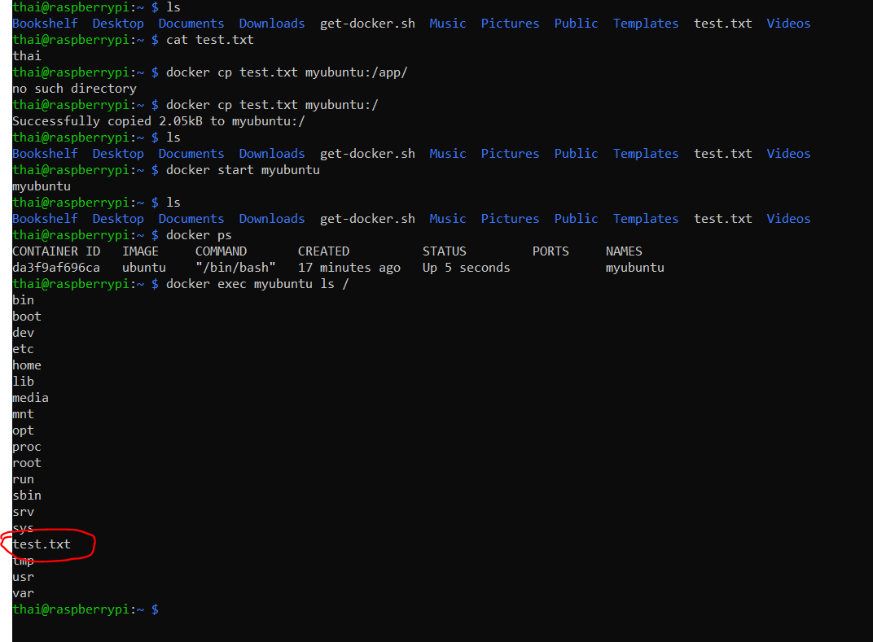
2. Interacting with Containers:
II. Practice Docker basics

Slide 16
3. Managing Images:
II. Practice Docker basics
Building images with Dockerfile.
Listing and removing images.
Pushing images to Docker Hub (if desired).

Slide 17
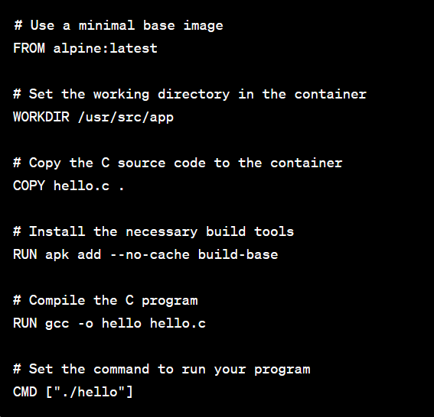
Create the docker file:
II. Practice Docker basics
Base Image: FROM alpine:latest - This uses the Alpine Linux distribution as a minimal base image.
Step 1: Create the Dockerfile:
Working Directory: WORKDIR /usr/src/app - Sets the working directory within the container.
Copy Source Code: COPY hello.c . - Copies the hello.c file from the local directory to the container.
Install Build Tools: RUN apk add --no-cache build-base - Installs the necessary build tools (compiler) using Alpine's package manager.
Compile the Program: RUN gcc -o hello hello.c - Compiles the C program into an executable named hello.
Working Directory: WORKDIR /usr/src/app - Sets the working directory within the container.

Slide 18
II. Practice Docker basics
Here are some common types of images:
Base Images:
These are the fundamental images upon which other images are built.
Examples include official images from Docker Hub like ubuntu, alpine, nginx, etc.
Scratch Image:
A special type of minimal image that has nothing in it. It is often used for building very lightweight and specialized images.
It's typically used in the context of multi-stage builds.
Custom Images:
Imges created by users for specific applications or services.
You can create custom images by writing a Dockerfile that specifies the base image, along with additional instructions to install software, configure settings, etc.

Slide 19
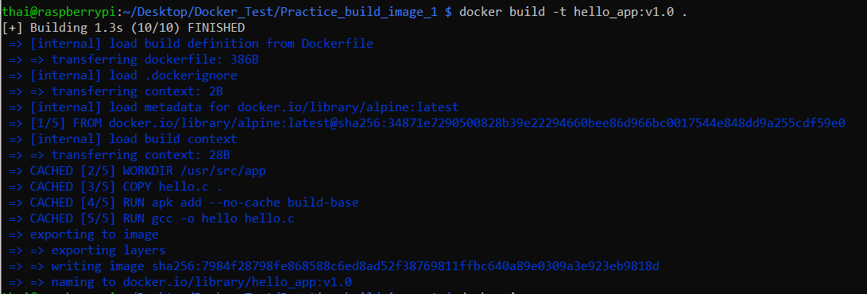
Create the docker file:
II. Practice Docker basics
-t: tag option
hello_app: name image
v1.0: tag name
Step 2: Build the docker image

Slide 20
Create the docker file:
II. Practice Docker basics
hello_app: name image
v1.0: tag name
Step 3: Run docker image

Slide 21
Some others useful command in docker file
II. Practice Docker basics
ADD: Similar to COPY, but with additional features like URL support and automatic extraction of compressed files.
Example: ADD http://example.com/file.tar.gz /tmp/
ENV: Sets environment variables in the image.
Example: ENV MY_VARIABLE=myvalue
ENTRYPOINT: Configures a container that will run as an executable.
Example: ENTRYPOINT ["python", "app.py"]
VOLUME: Creates a mount point for externally mounted volumes or other containers.
Example: VOLUME /data

Slide 22
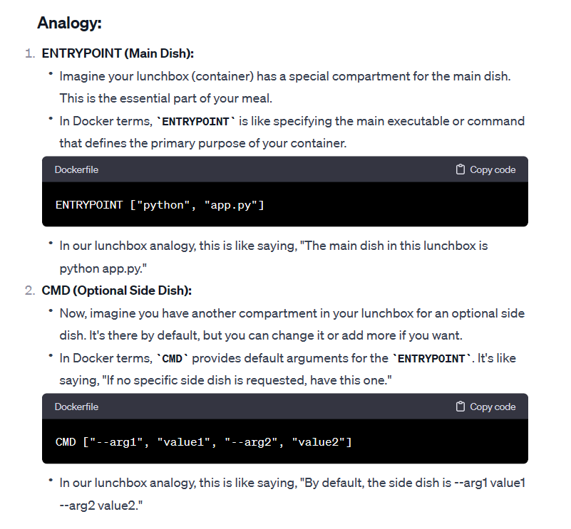
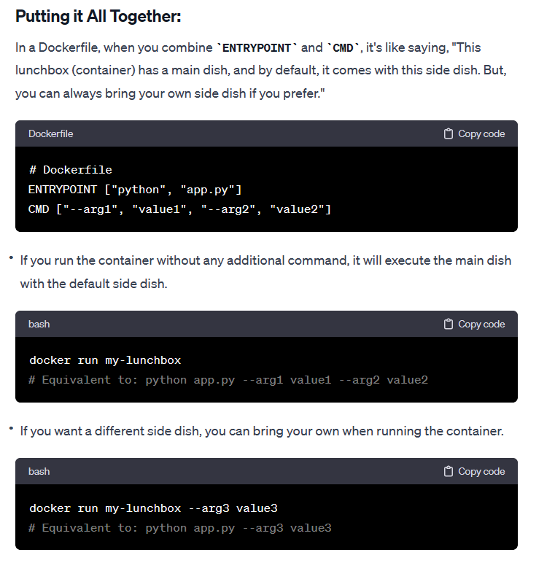
Different between CMD and ENTRYPOINT
II. Practice Docker basics

Slide 23
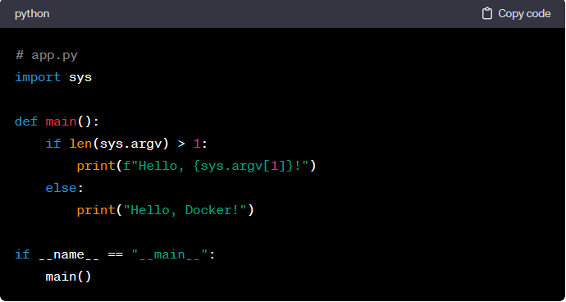
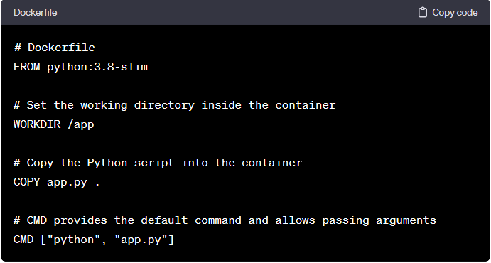
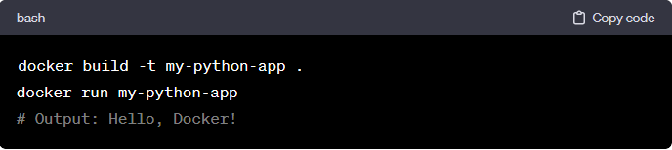
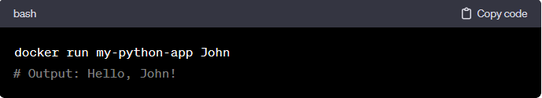
Different between CMD and ENTRYPOINT
II. Practice Docker basics
Default command
Command with custom argument

Slide 24
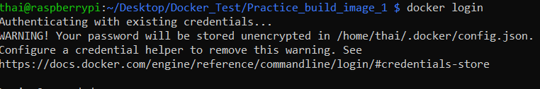
Push image to docker hub
II. Practice Docker basics
Step 1: Tag image
docker tag your-image-name:tag your-dockerhub-username/your-repository-name:tag
Step 2: Login to the docker hub

Slide 25
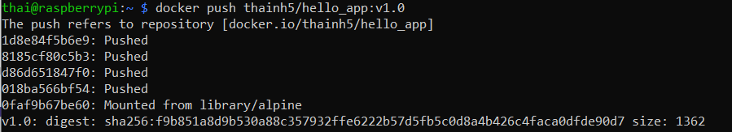
Push image to docker hub
II. Practice Docker basics
Step 3: Create repository in DockerHub
Step 4: Push the docker image to the DockerHub

Slide 26
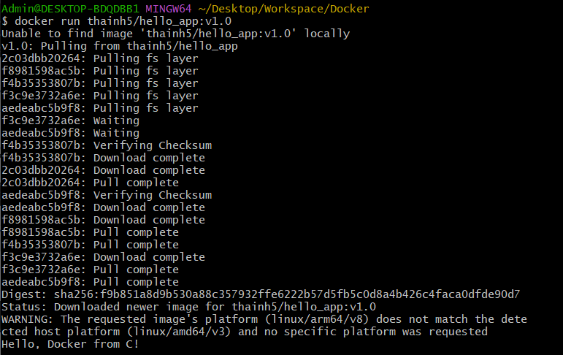
Build multi platform images
II. Practice Docker basics
Why?
Hello_app:1.0 was created default by arm64 host architecture
=> It cannot run in the amd64 host architecture

Slide 27
Buildx solution
II. Practice Docker basics
Step1: Install buildx
Step2: Create a builder instance
Step3: Build the multi platform image

Slide 28
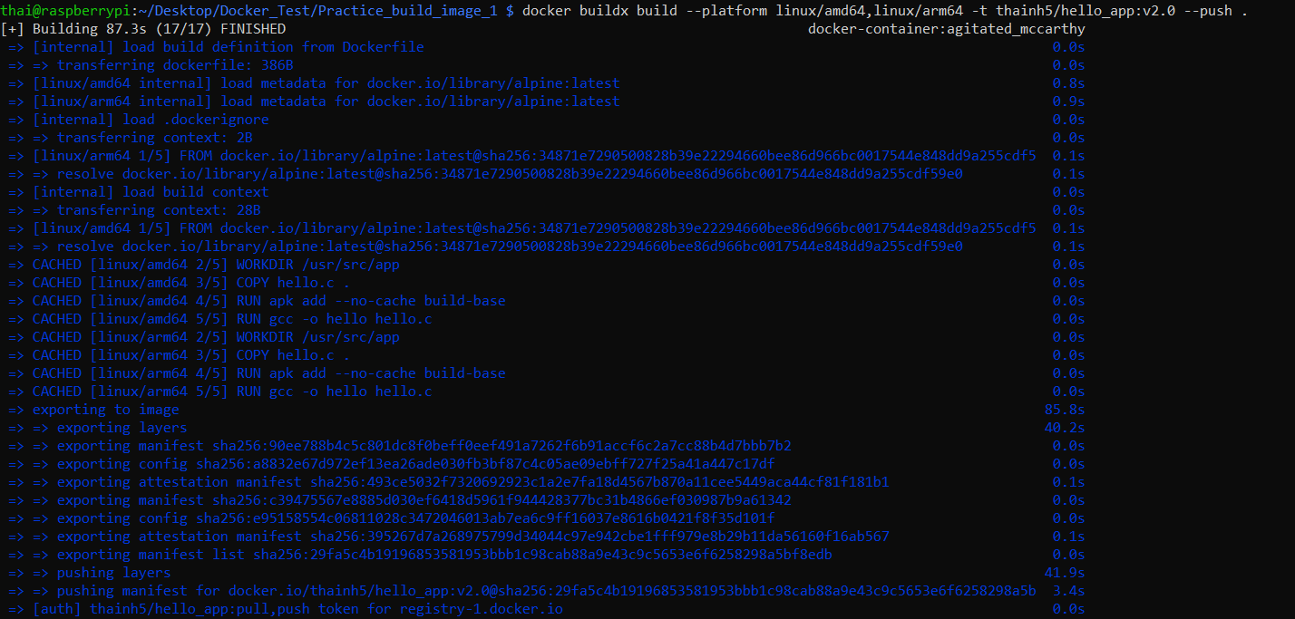
Buildx solution
II. Practice Docker basics
Step3: Build the multi platform image

Slide 29
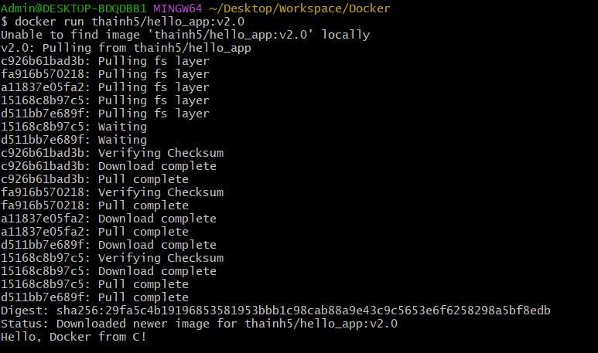
Buildx solution
II. Practice Docker basics
Step4: Try to run multi platform image on amd64 host architecture

Slide 30
III. Network and volume
1. Networking
Understanding container networking.
Exposing ports.
Linking containers.
2. Volumes
Introduction to Docker volumes.
Mounting volumes to persist data.
Managing data with volumes.

Slide 31
1. Networking 1.1 Understanding
III. Network and volume
Networking refers to the mechanisms that allow communication between different Docker containers, as well as between containers and the host system or external networks.

Slide 32
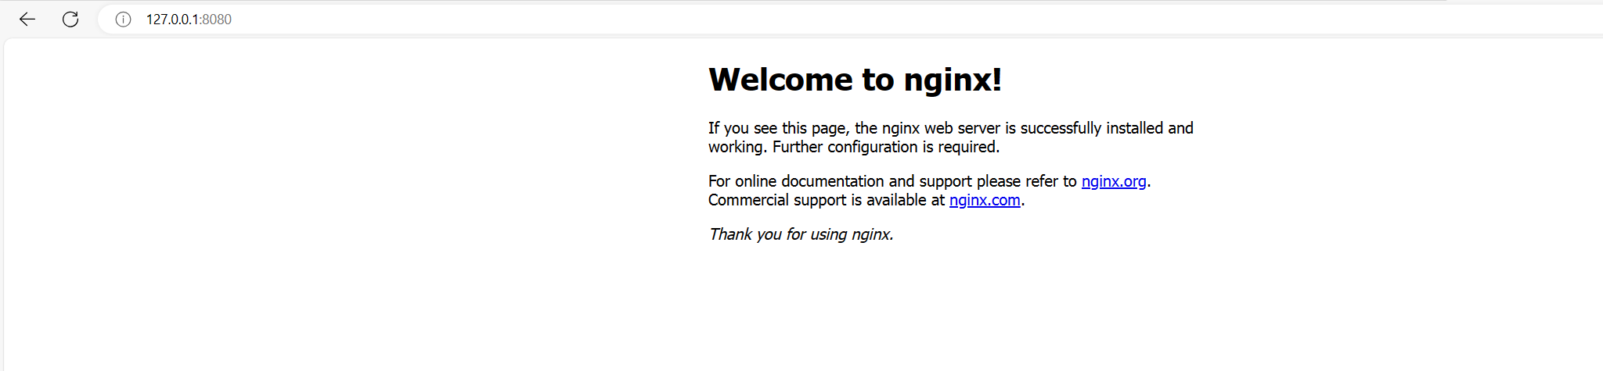
1. Networking 1.2 Expose
III. Network and volume
Allow communication between containers and the host system or external networks
docker run -d -p 8080:80 --name my-nginx nginx
Expose local network

Slide 33
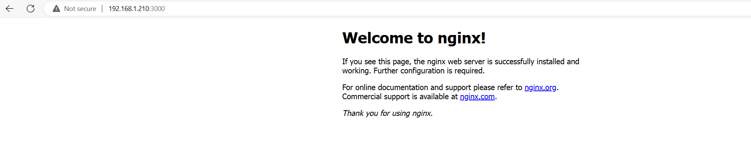
1. Networking 1.2 Expose
III. Network and volume
Allow communication between containers and the host system or external networks
Pi has IpAdress
Expose to external network:
Access from pc same network

Slide 34
1. Networking 1.3 Linking containers
III. Network and volume
Allow communication between different containers
https://www.youtube.com/watch?v=42H28M9rQq8

Slide 35
2. Volume
III. Network and volume

Slide 36
IV. Docker compse
1. Introduction to Docker Compose:
Overview of Compose.
Writing a docker-compose.yml file.
2. Defining Multi-Container Applications:
Configuring services in Docker Compose.
Networking between services.
3. Running Multi-Container Applications:
Starting and stopping multi-container applications.
Scaling services.

