Slide 1
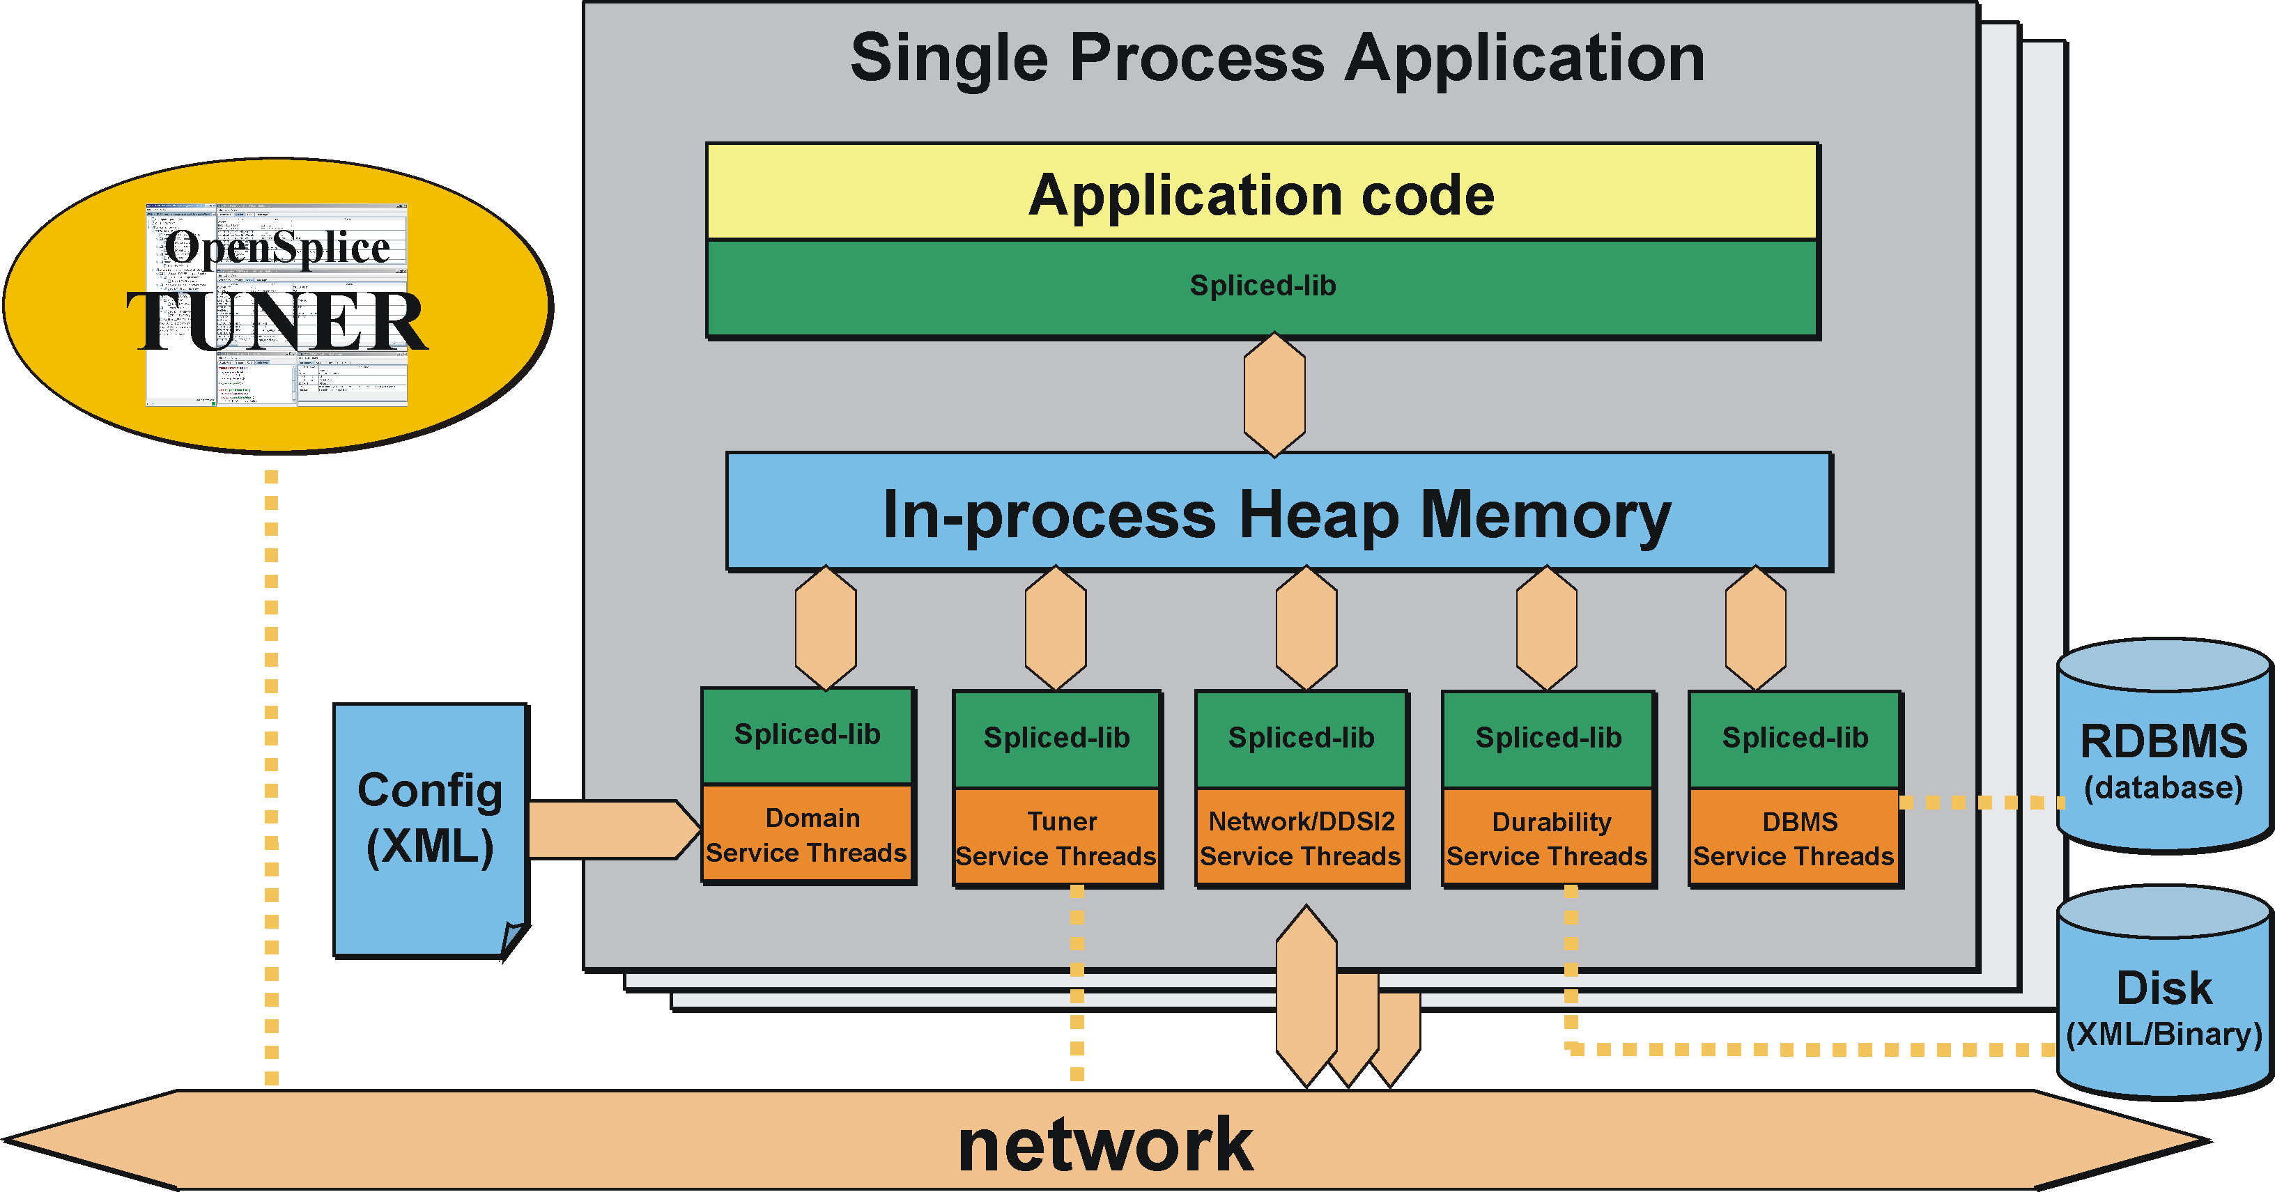
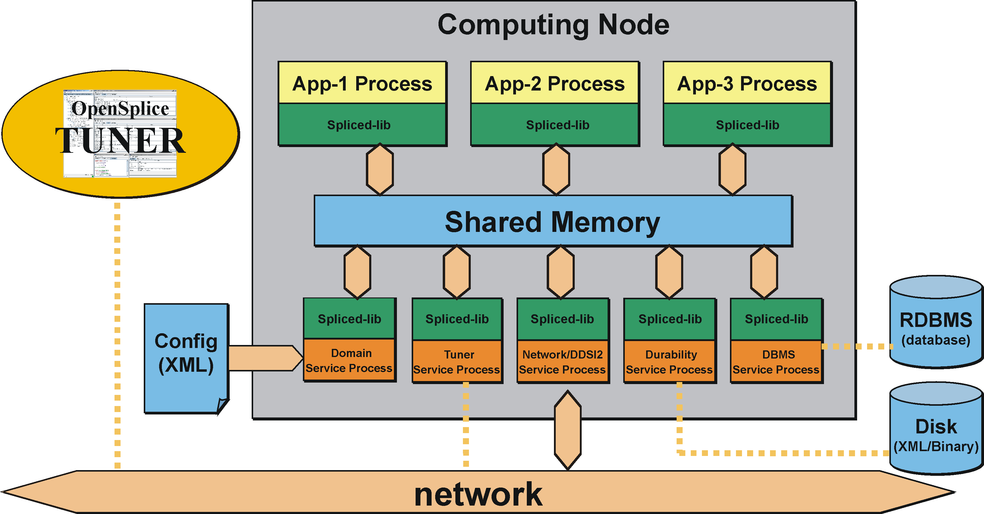
DDS Deployment Mode

Slide 2
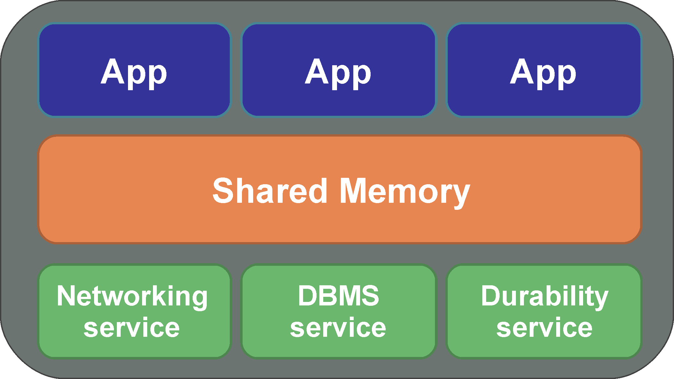
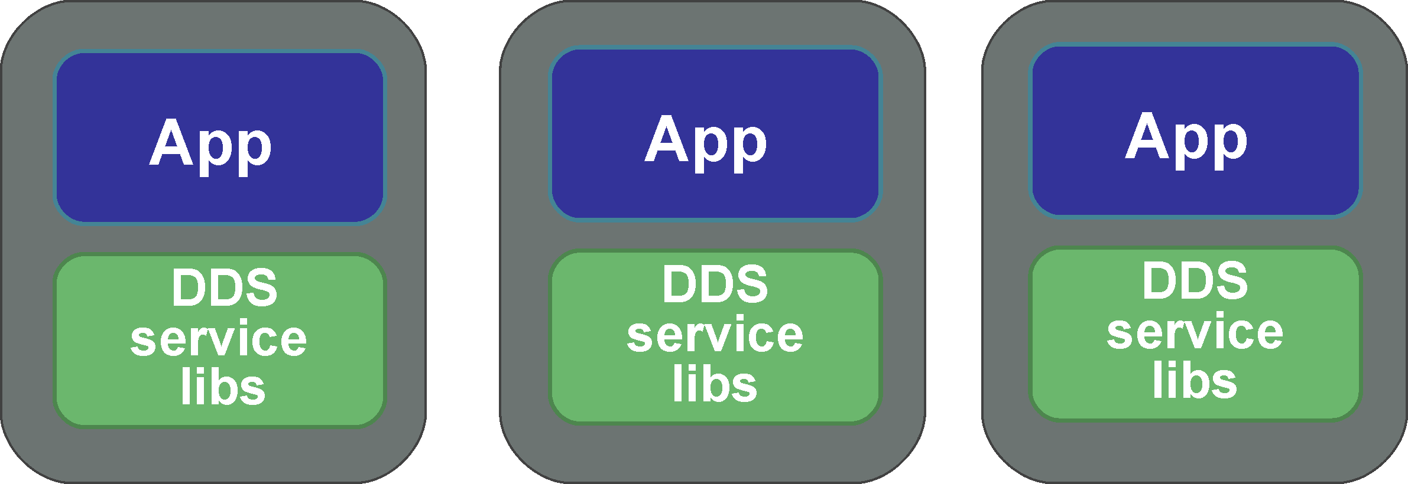
DDS Deployment Mode

Slide 3
Application Stacks
Application
Application
SDK
SDK
com_middle
com_middle
DNN service libs
DDS service libs
DDS service libs
SDK position in Pi’s application
SDK position in EPH’s application

Slide 4
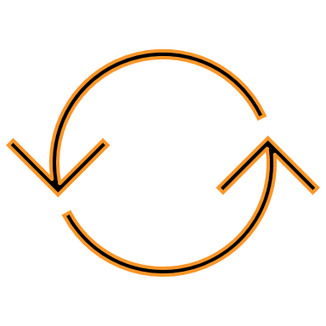

Worker Thread
Application
Pi & EPH SDK
Worker Thread
J1
Timer
thread
push
Worker process
J2
[NON_CYCLIC_MSG]
J3
Message queue
…
NON_CYCLIC_MSG
(5)
TIMER_MSG
pop
J4
J5
Periodic job list
[TIMER_MSG]
…
J1
J4
J3
J2
J1
Non-periodic job
J2
Periodic job
J3
J4

