Slide 1
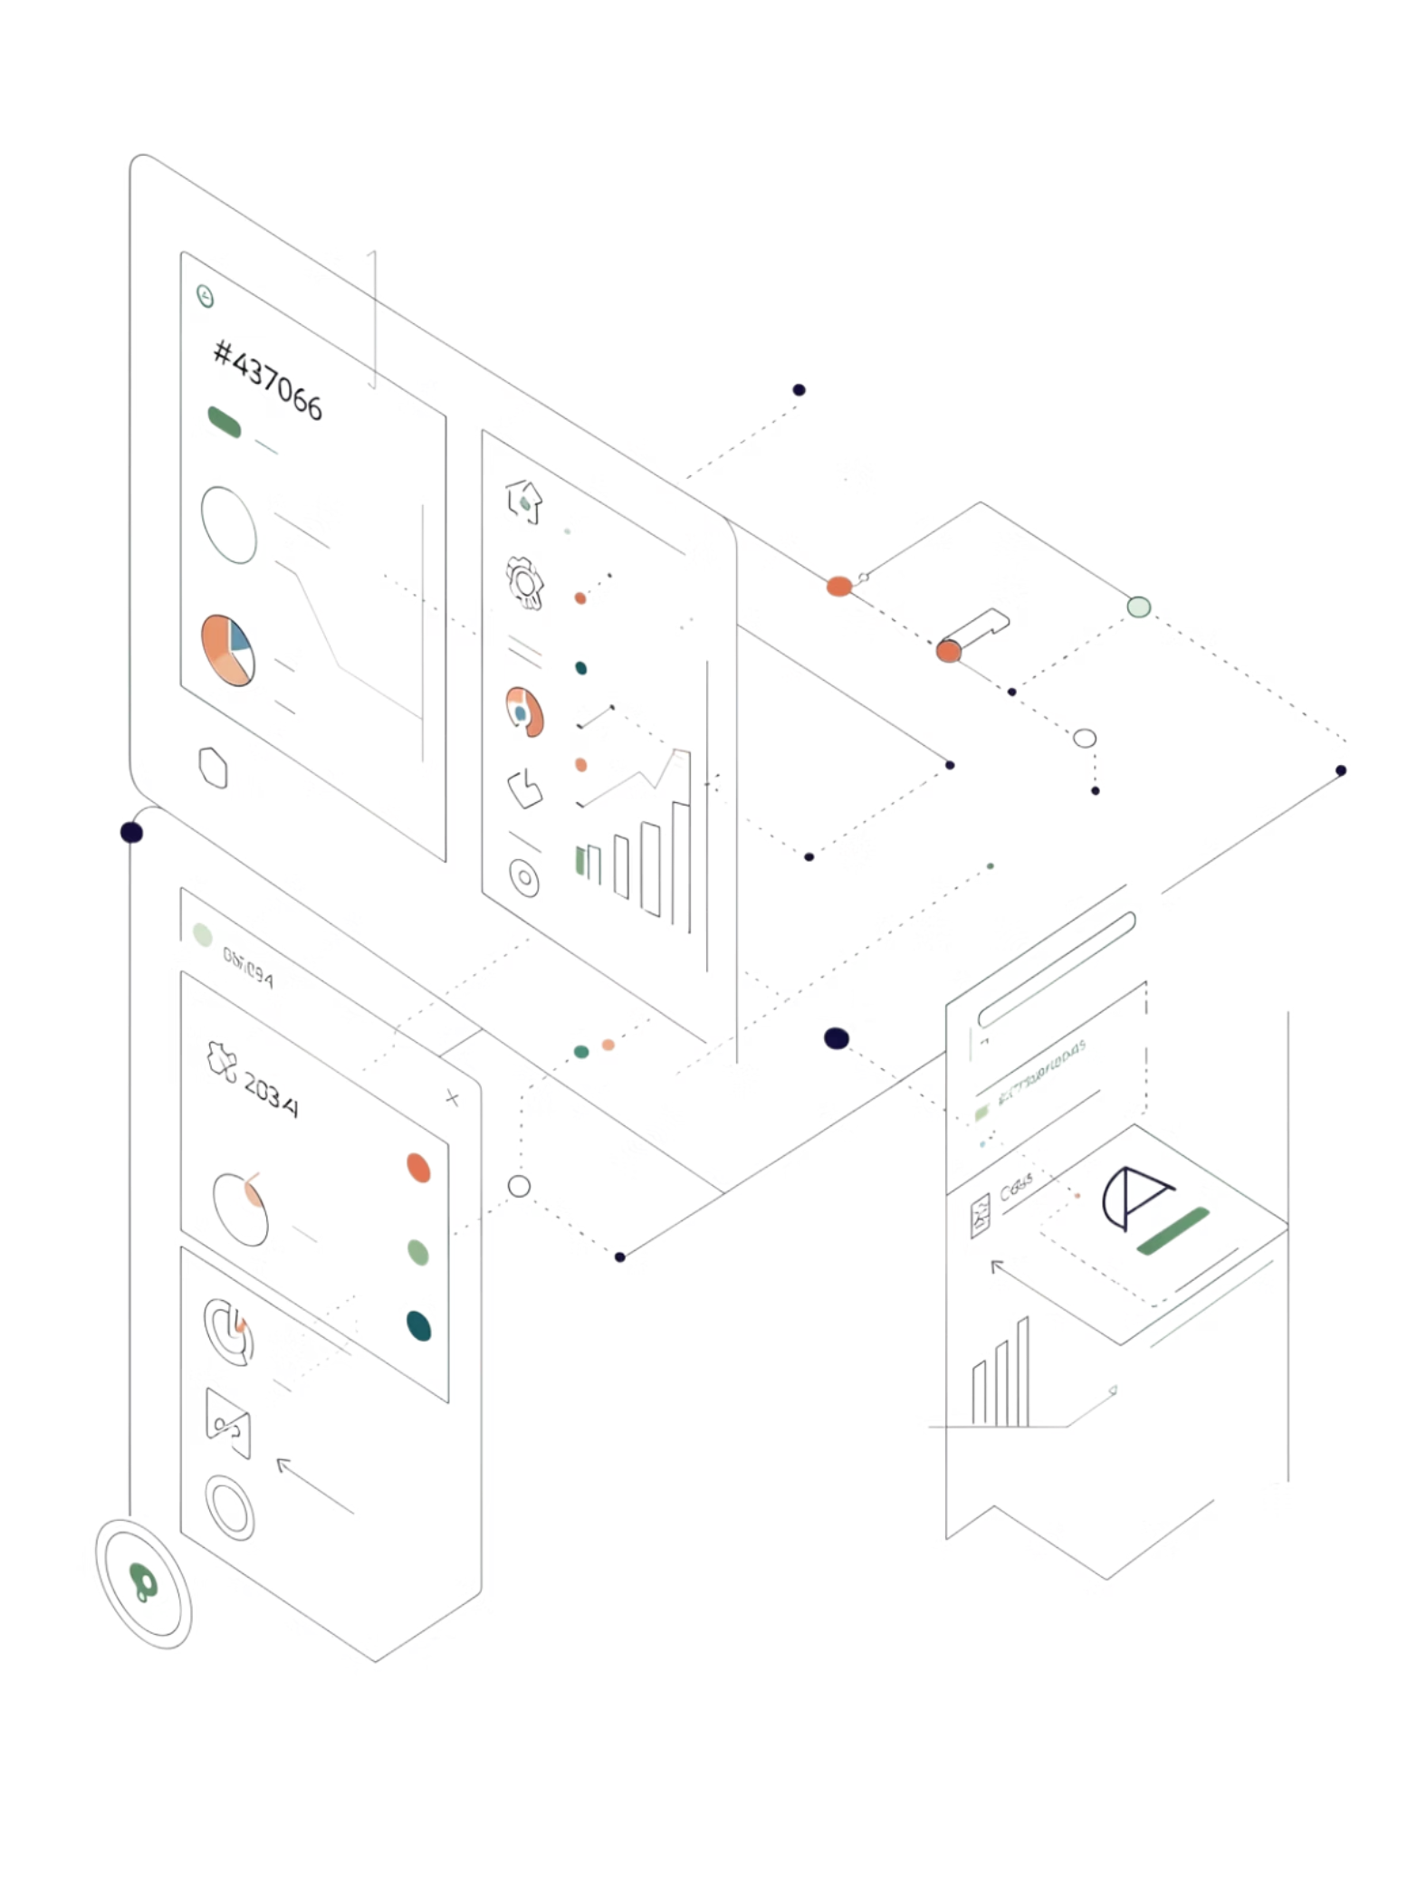
Data Storytelling & Statistical Validation
ApexPlanet Data Analytics Internship — Task 4
PRESENTED BY LUCKY GHANGHAS

Slide 2

Project Objective
The goal of this project was to analyze real business data, uncover meaningful patterns, validate findings through rigorous statistical methods, and deliver actionable, data-driven recommendations to support smarter business decision-making.
1
Analyze Trends
Explore customer behavior and sales performance across time periods.
2
Identify KPIs
Surface the metrics that matter most to business health and growth.
3
Build Insights
Transform raw data into structured, meaningful business narratives.
4
Validate Statistically
Apply hypothesis testing to confirm findings with confidence.
5
Present Professionally
Deliver a polished, stakeholder-ready business presentation.

Slide 3
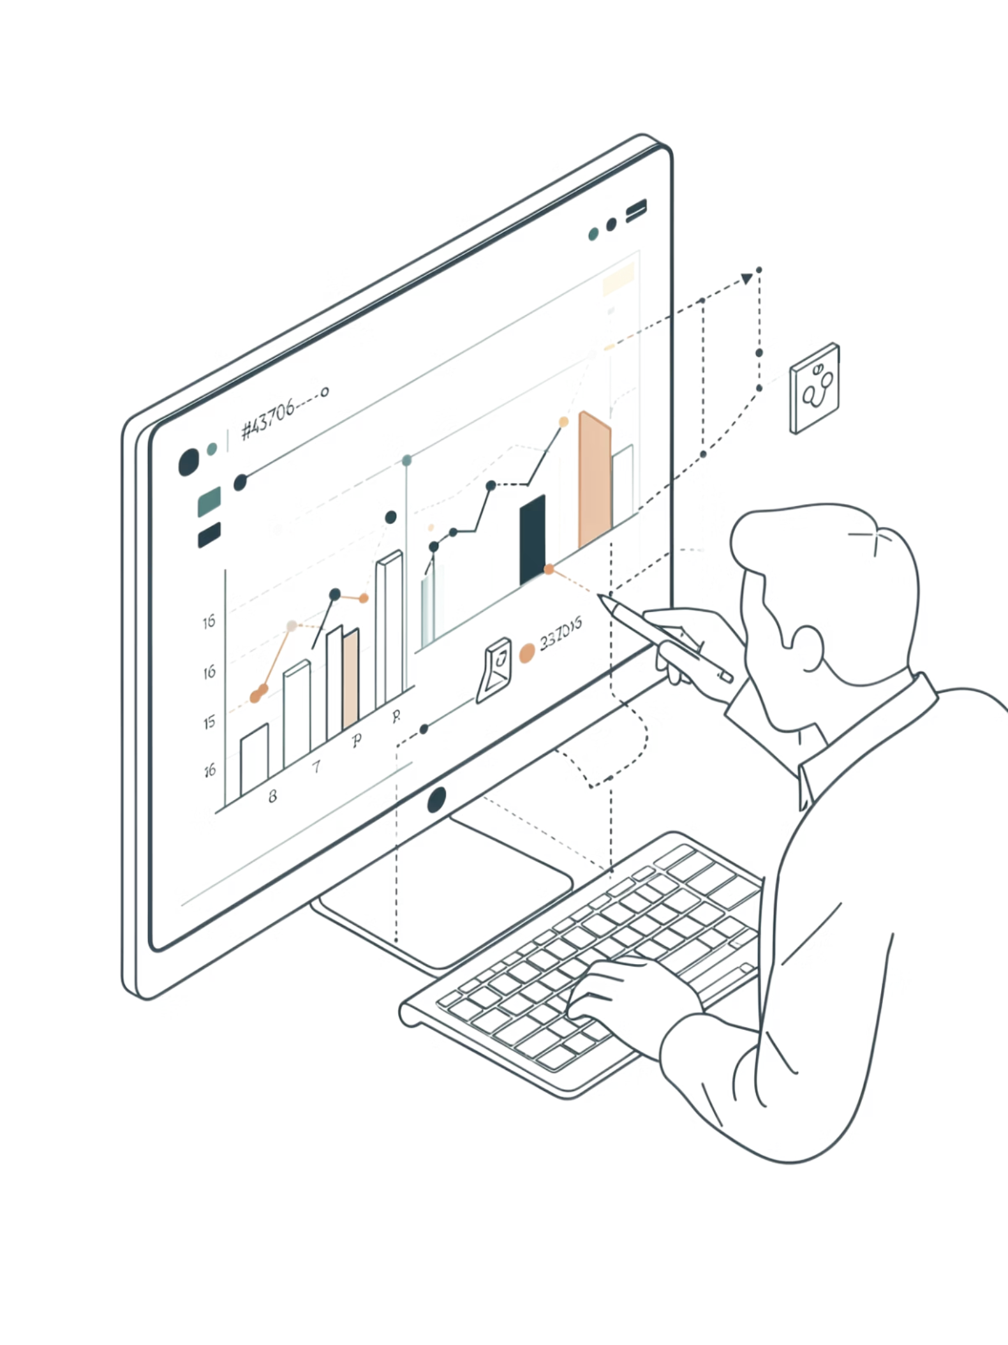
Key Insights from Data Analysis
The analysis surfaced critical patterns across sales cycles, customer behavior, and product performance — forming the backbone of all strategic recommendations.
Continuous Sales Growth
Monthly revenue trended upward consistently, driven by seasonal campaigns and product mix optimization.
Improved Customer Retention
Retention rates improved quarter-over-quarter as targeted loyalty initiatives took effect.
High-Value Product Categories
Specific product segments generated disproportionately higher revenue, informing future inventory strategy.
High-Value Customer Segments
Customer segmentation identified top-tier users contributing the majority of total revenue.

Slide 4

Critical KPIs at a Glance
Four core metrics were tracked throughout the analysis to measure business health and validate the impact of strategic initiatives.
18%
74%
Revenue Growth
Retention Rate
Year-over-year increase in total revenue across all product lines.
Customer retention rate achieved following loyalty campaign rollout.
3.2x
$142
Conversion Rate
Avg. Order Value
Uplift in conversion observed after strategy implementation.
Average order value across all customer segments and channels.

Slide 5
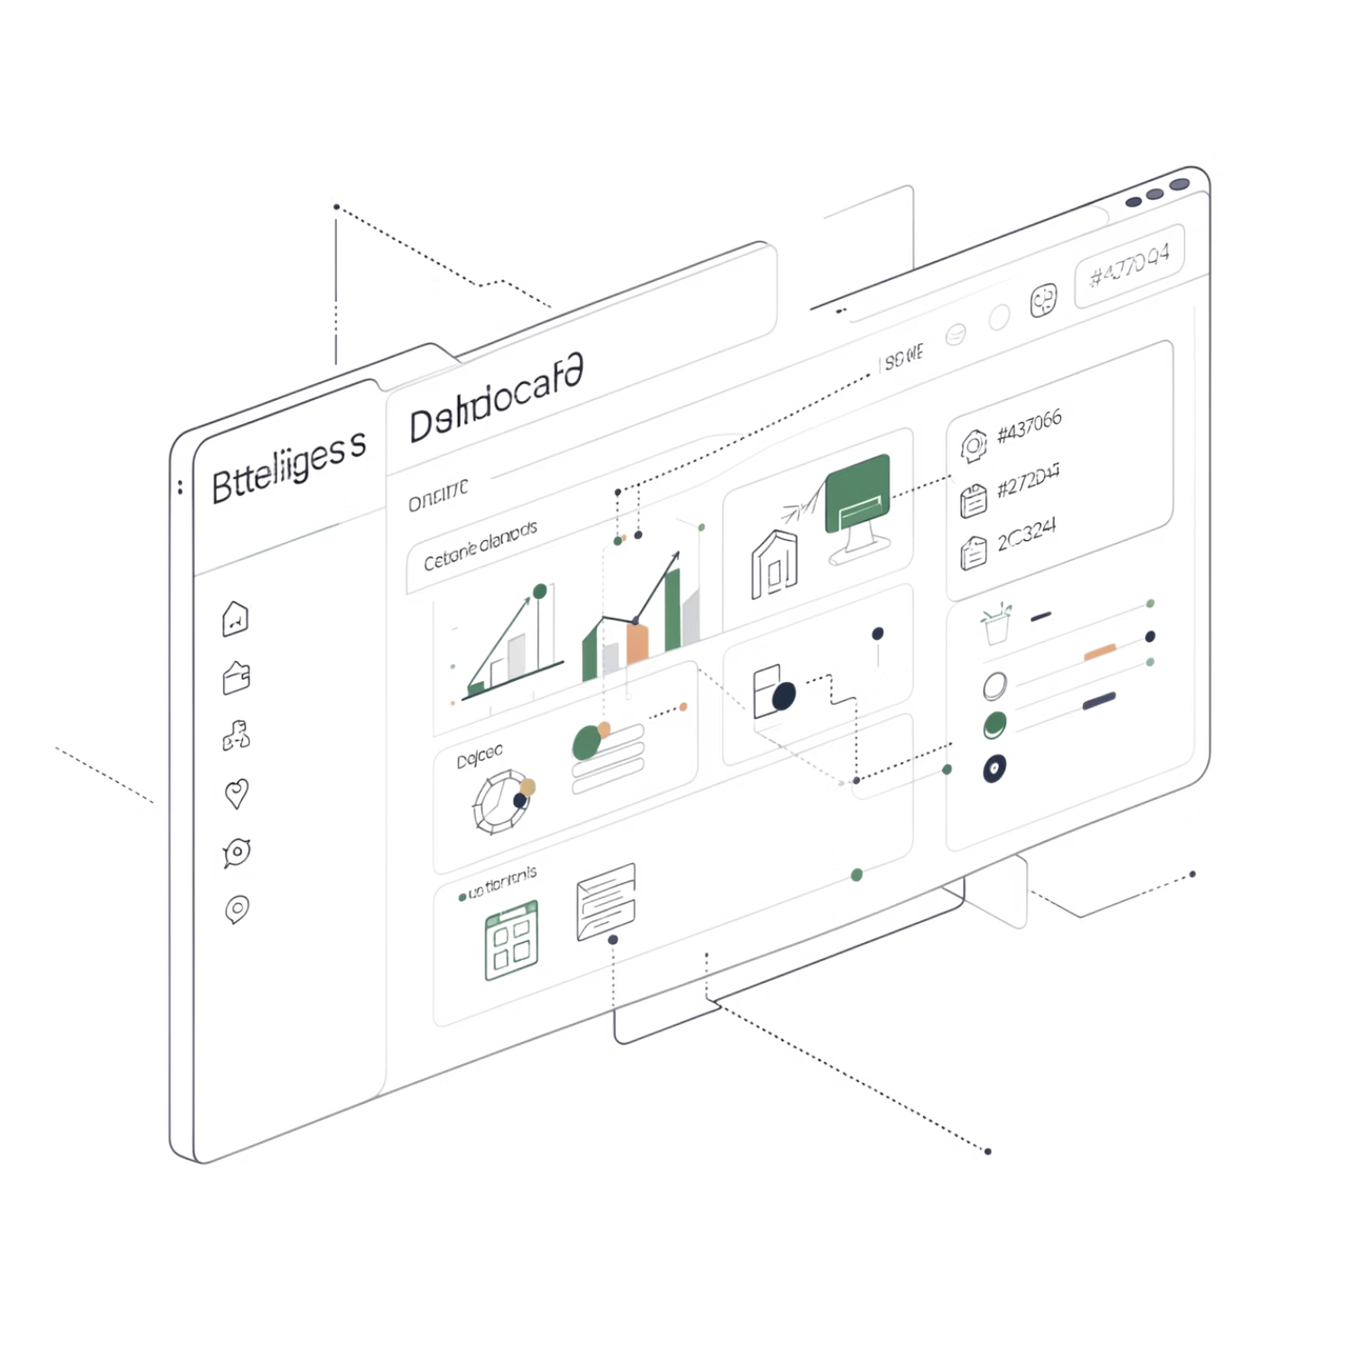


Interactive Dashboard Findings
What the Dashboard Reveals
An interactive dashboard was built to centralize business performance monitoring and enable faster, evidence-based decisions.
The dashboard empowers management to monitor KPIs in real time and act on emerging trends without delay.
KPI Tracking
Revenue Analysis
Customer Segments
Funnel Analysis

Slide 6
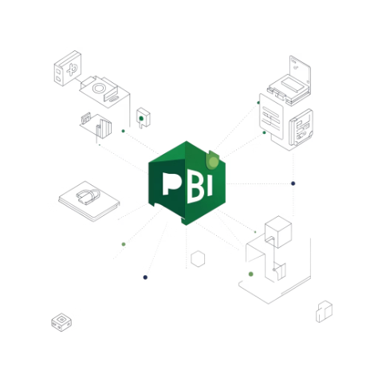
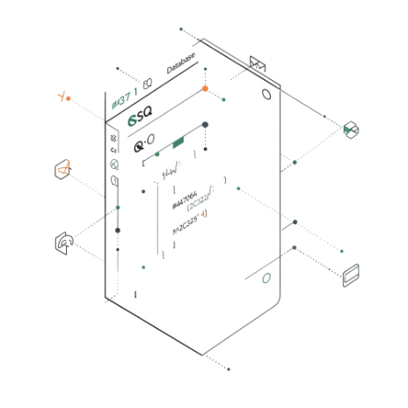
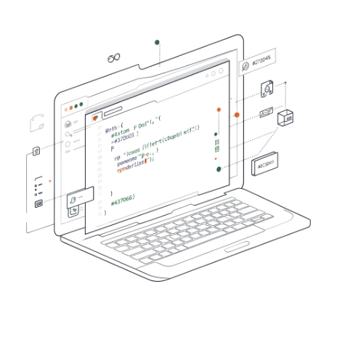



Tools & Technology Stack
The dashboard and analytical pipeline were built using an industry-standard toolkit — ensuring scalability, accuracy, and reproducibility of all findings.
Power BI
SQL
Python
Excel
Built interactive dashboards and dynamic visualizations for stakeholder reporting.
Queried and cleaned large datasets, enabling precise, structured data extraction.
Performed statistical analysis, hypothesis testing, and data wrangling pipelines.
Used for preliminary exploration, pivot analysis, and stakeholder-ready data exports.

Slide 7


Statistical Validation & Hypothesis Testing
The Business Hypothesis
Test Results
"The new business strategy significantly increased customer conversion rate."
p-value
Confidence Level
0.0029 — well below the 0.05 threshold
95% — results are statistically robust
Decision
Reject the Null Hypothesis ✓
The strategy produced a measurable, statistically confirmed uplift in conversion performance.
H₀ — Null Hypothesis
H₁ — Alternative Hypothesis
There is no significant improvement in the customer conversion rate following the strategy change.
There is a statistically significant improvement in conversion rate attributable to the new strategy.

Slide 8

Hypothesis Test — Visual Summary
Define Hypotheses
Decision
Reject H0 — strategy effective
H0 vs H1 stated clearly
Run Test
Compute p-value = 0.0029
With a p-value of 0.0029 — far below the 0.05 significance threshold at a 95% confidence level — the null hypothesis was decisively rejected, confirming that the new business strategy drove a real, measurable improvement in customer conversion.

Slide 9
Skills Developed During This Project
This internship project provided hands-on experience across the full analytics lifecycle — from raw data to boardroom-ready insights.
Data Analysis
SQL Querying
Explored, cleaned, and structured complex datasets to extract business-relevant signals.
Wrote advanced queries to extract, filter, and aggregate data from relational databases.
Dashboard Development
Business Intelligence
Designed interactive Power BI dashboards for real-time KPI monitoring.
Translated analytical outputs into strategic insights aligned with business goals.
Hypothesis Testing
Data Storytelling
Applied t-tests and p-value analysis to statistically validate business assumptions.
Communicated findings through clear narratives and professional visual presentations.

Slide 10
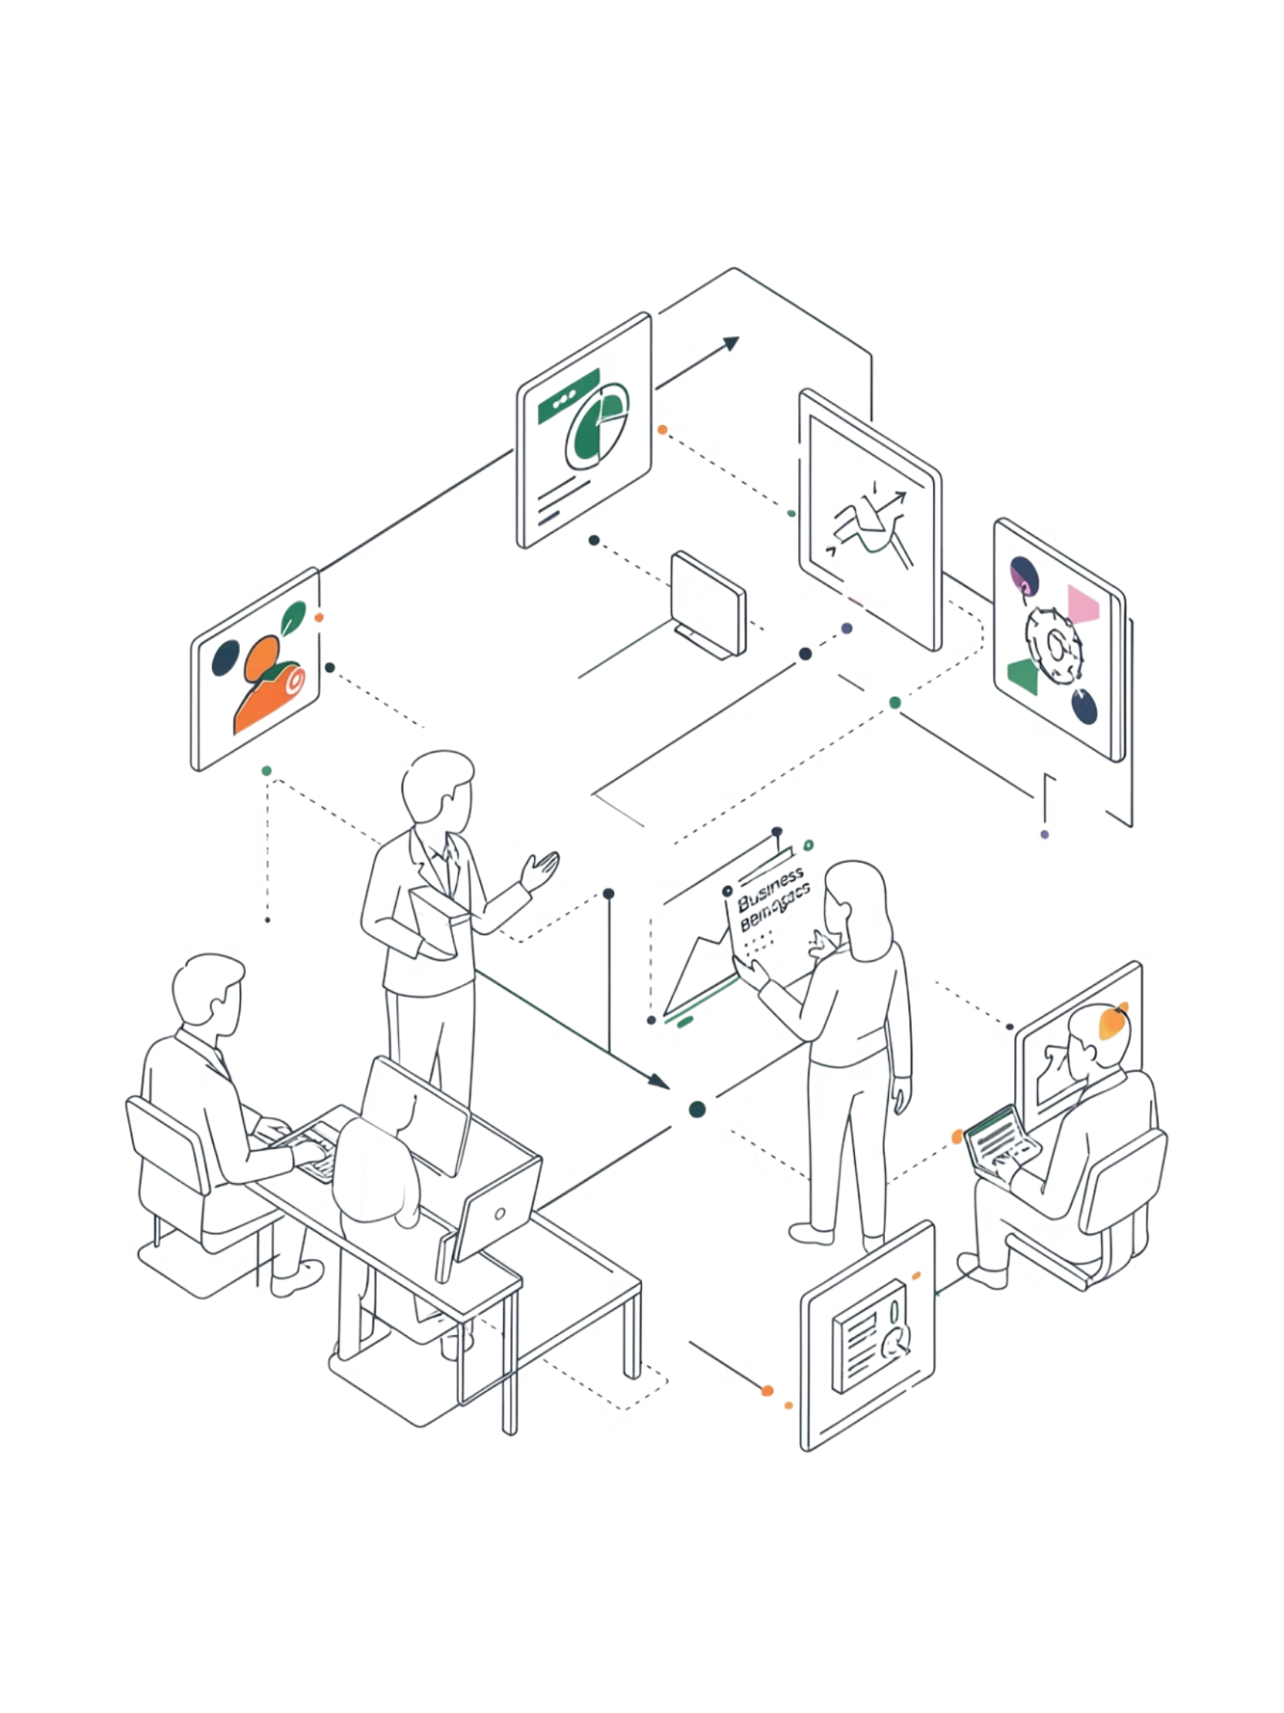
Conclusion & Final Outcome
This project demonstrated a complete, end-to-end analytics workflow — from raw data exploration through statistical validation to professional business storytelling.
🎯 Objective Met
📊 Insights Delivered
All analytical goals were achieved, from trend analysis to KPI identification and statistical validation.
Raw business data was transformed into clear, actionable recommendations for management.
✅ Results Confirmed
Hypothesis testing provided statistical confidence that the new strategy delivered measurable impact.
Thank you for this opportunity. — Lucky Ghanghas | ApexPlanet Data Analytics Internship, Task 4

