Slide 1



CFA
Simone Campanoni simonec@eecs.northwestern.edu

Slide 2
Problems with Canvas?
Problems with slides?
Problems with H0?
Any problems?

Slide 3
CFA Outline
Why do we need Control Flow Analysis?
Basic blocks
Control flow graph

Slide 4
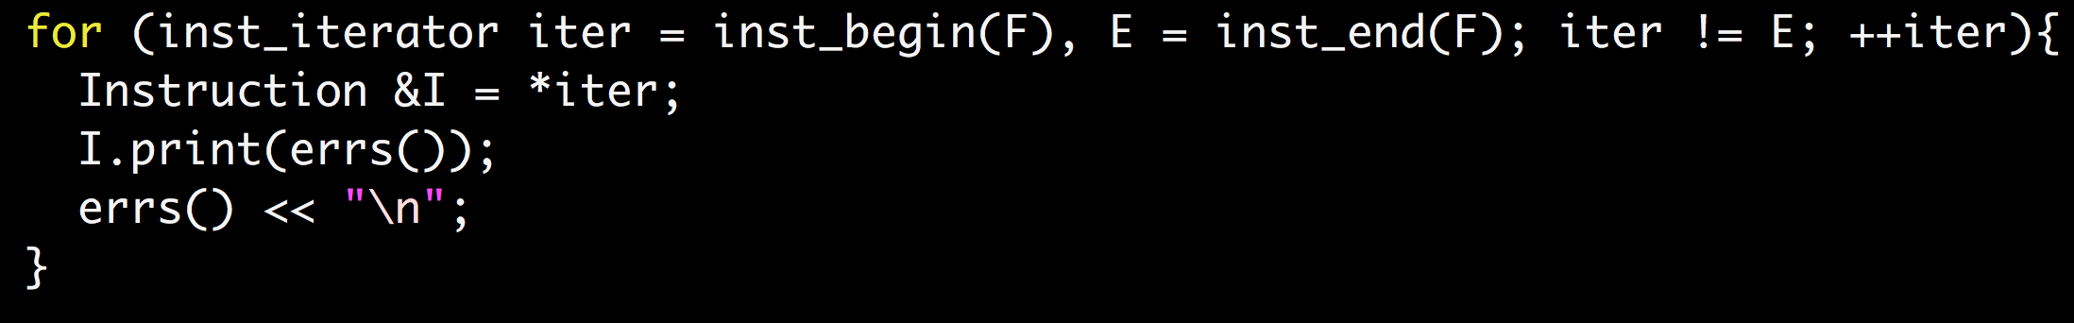
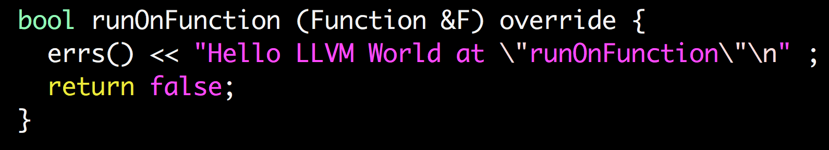
Functions and instructions
runOnFunction’s job is to analyze/transform a function F
… by analyzing/transforming its instructions
The order of instructions isn’t the execution one

Slide 5

Storing order $≠$ executing order
Common pitfall 2: if instruction i1 has been stored before i2, then i2 can execute after i1
int myF (int a){
int x = a + 1;
if (a > 5){
x++;
} else {
x--;
}
return x; }
int x = a + 1
tmp = a > 5
branch_ifnot tmp L1
x++
branch L2
L1: x--
L2: return x
int x = a + 1
tmp = a > 5
branch_if tmp L1
x--
branch L2
L1: x++
L2: return x
To improve/transform the code,
we need to analyze the execution paths
This is the job of Control Flow Analysis
Common pitfall 1: if instruction i1 has been stored before i2, then i2 is always executed after i1
When the storing order is chosen (compile time), the execution order isn’t known

Slide 6
Optimization example:constant propagation
int sumcalc (int a, int b, int N){
int x,y;
x = 0;
y = 0;
for (int i=0; i <= N; i++){
x = x + (a * b);
x = x + b*y;
}
return x;
}
Replace a variable use
with a constant
while preserving the original semantics of the code

Slide 7
Constant propagation and CFA
Find a constant expression
Instruction i: varX = CONSTANT_EXPRESSION
Replace the use of the variable defined in a constant expression with that constant if
All paths to the use of varX passes its assignment I
There are no intervening definition of that variable
We need to know the “control flow” of the program
Control flow: sequence of instructions in a program ignoring data values and arithmetic operations
Control Flow Analysis discovers facts about control flows

Slide 8
CFA Outline
Why do we need Control Flow Analysis?
Basic blocks
Control flow graph

Slide 9
Representing the control flow of the program
Most instructions
Jump instructions
Branch instructions

Slide 10
Representing the control flow of the program
A graph where nodes are instructions
Very large
Lot of straight-line connections
Can we simplify it?
Basic block
Sequence of instructions that
is always entered at the beginning
and exited at the end

Slide 11
Basic blocks
A basic block is a maximal sequence of instructions such that
Only the first one can be reached from outside this basic block
All instructions within are executed consecutively if the first one get executed
Only the last instruction can be a branch/jump
Only the first instruction can be a label
Is the storing sequence = execution order in a basic block?

Slide 12

Basic blocks in compilers
Inst = F.entryPoint()
B = new BasicBlock()
While (Inst){
if Inst is Label {
B = new BasicBlock()
}
B.add(Inst)
if Inst is Branch/Jump{
B = new BasicBlock()
}
Inst = F.nextInst(Inst)
}
Add missing labels
Add explicit jumps
Delete empty basic blocks
Automatically identified
Algorithm:
Code changes trigger the re-identification
Increase the compilation time
Enforced by design
Instruction exists only within the context of its basic block
To define a function:
you define its basic blocks first
Then you define the instructions of each basic block
What about calls?
Program exits
Exceptions

Slide 13
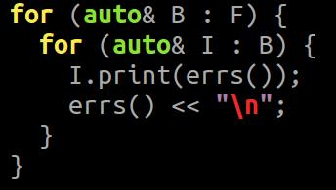
Basic blocks in LLVM
Every basic block in LLVM must
Have a label associated to it
Have a “terminator” at the end of it
The first basic block of LLVM (entry point) cannot have predecessors
LLVM organizes “compiler concepts” in containers
A basic block is a container of ordered LLVM instructions
A function is a container of basic blocks
A module is a container of functions

Slide 14
Basic blocks in LLVM (2)
LLVM C++ Class “BasicBlock”
Uses:
BasicBlock *b = … ;
Function *f = b.getParent();
Module *m = b.getModule();
Instruction *i = b.getTerminator();
Instruction *i = b.front();
size_t b.size();

Slide 15
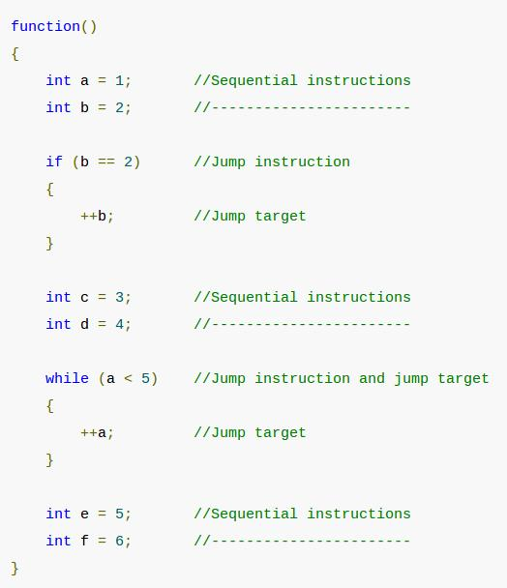
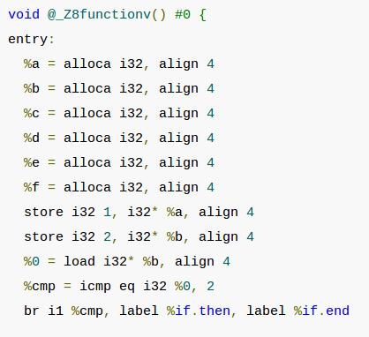
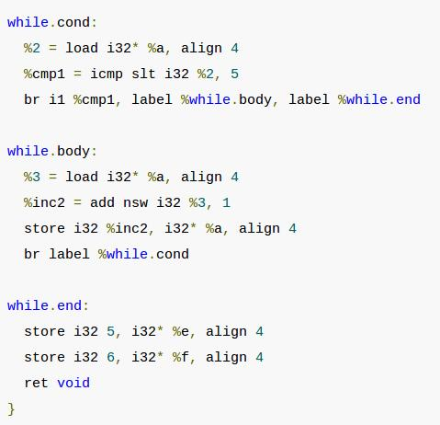
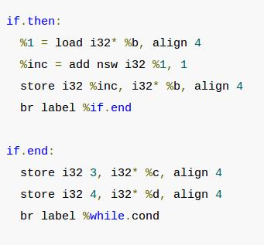
Basic blocks in LLVM in action
Bitcode generation
Bitcode generation
Bitcode generation
Bitcode generation
Bitcode generation
Bitcode generation

Slide 16
CFA Outline
Why do we need Control Flow Analysis?
Basic blocks
Control flow graph

Slide 17
Control Flow Graph (CFG)
A CFG is a graph G = <Nodes, Edges>
Nodes: Basic blocks
Edges: (x,y) ϵ Edges iff
first instruction in basic block y might be executed just after the last instruction of the basic block x
Predecessor
…
...
Ix
Successor
Iy
...
...

Slide 18
Control Flow Graph (CFG)
Entry node: block with the first instruction of the function
Exit nodes: blocks with the return instruction
Some compilers make a single exit node by adding a special node
ret
ret

Slide 19
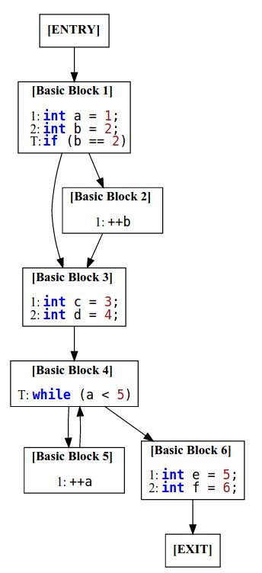
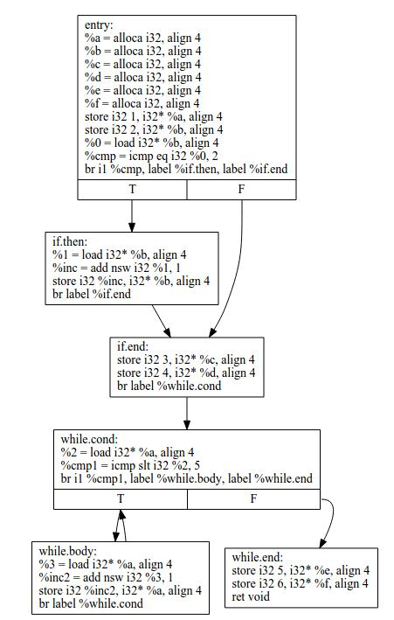
CFG in LLVM
Differences?
Bitcode generation
opt -view-cfg
F.viewCFG();

Slide 20
Navigating the CFG in LLVM
Successors of a basic block
Predecessors of a basic block

Slide 21
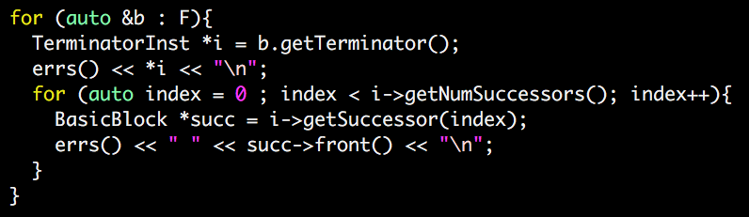
Navigating the CFG in LLVM (2)

Slide 22
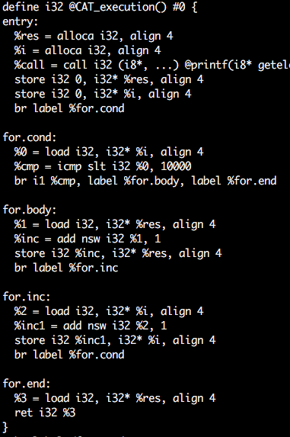
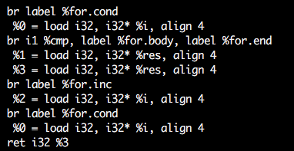
H0/tests/test1

Slide 23
Sometimes “might” isn’t enough
How to differentiate between the two situations by using only successor/predecessor relations?
…
...
y = 0
y = 3
x = y
...
...

Slide 24
Dominators
Definition: Node d dominates node n in a graph (d dom n) if every path from the start node to n goes through d. Every node dominates itself.
What is the relation between instructions within a basic block?
What is the relation between basic blocks 1, 2, and 3?
What is the relation between basic blocks 1 and 2?
1
2
3

Slide 25
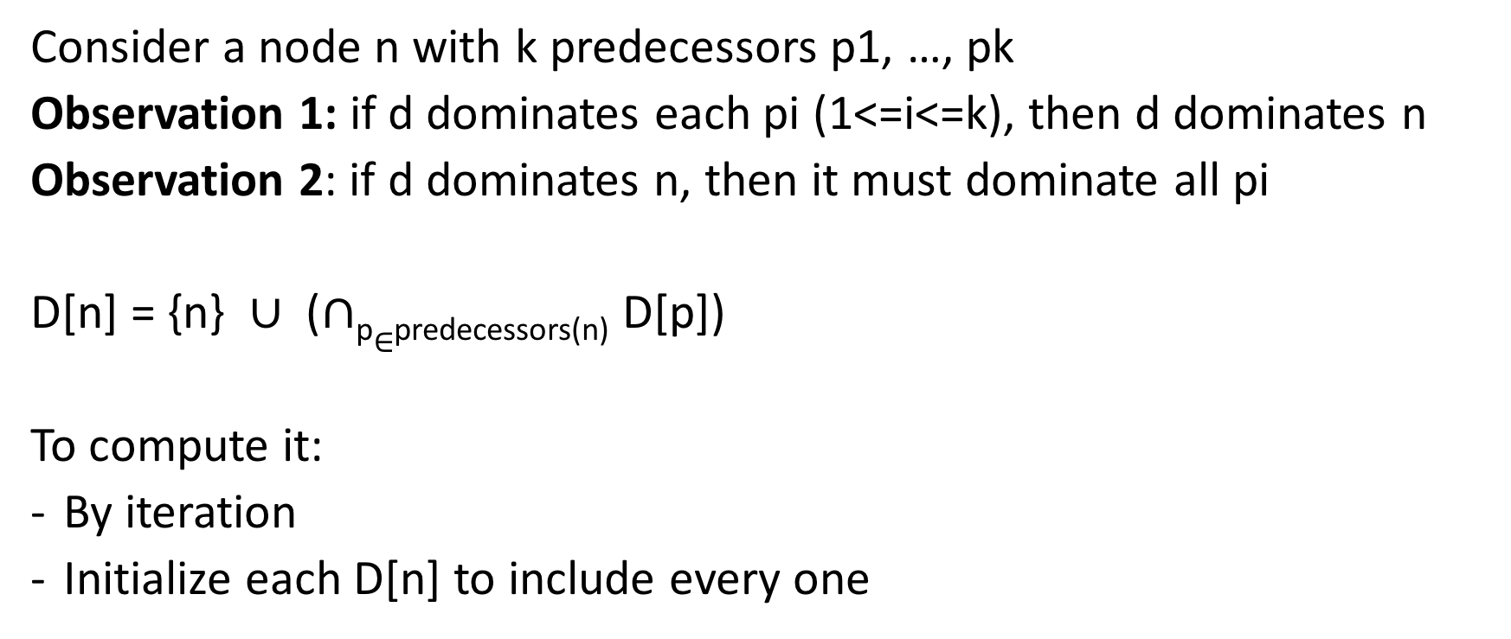
Finding dominators
p1
pk
n
Consider a node n with k predecessors p1, …, pk
Observation 1: if d dominates each pi (1<=i<=k), then d dominates n
Observation 2: if d dominates n, then it must dominate all pi
D[n] = {n} $∪$ ($∩$_{p}$∈$_{predecessors(n)} D[p])
To compute it:
By iteration
Initialize each D[n] to include every one

Slide 26
Immediate dominators
Definition: the immediate dominator of a node n is the unique node that strictly dominates n (i.e., it isn’t n) but does not strictly dominate another node that strictly dominates n
1
1
1
Dominator tree
2
2
2
3
3
3
CFG
Immediate dominators

Slide 27
Post-dominators
Assumption: Single exit node in CFG
Definition: Node d post-dominates node n in a graph if every path from n to the exit node goes through d
B
D
B: if (par1 > 5)
C: varX = par1 + 1
D: print(varX)
C
C
B
Immediate post-dominator tree
How to compute post-dominators?
D
CFG

Slide 28
Post-dominators
Assumption: Single exit node in CFG
Definition: Node d post-dominates node n in a graph if every path from n to the exit node goes through d
B
D
B: if (par1 > 5)
C: varX = par1 + 1
C2: …
D: print(varX)
C
C2
B
C2
C
D
Immediate post-dominator tree
CFG

