Slide 1
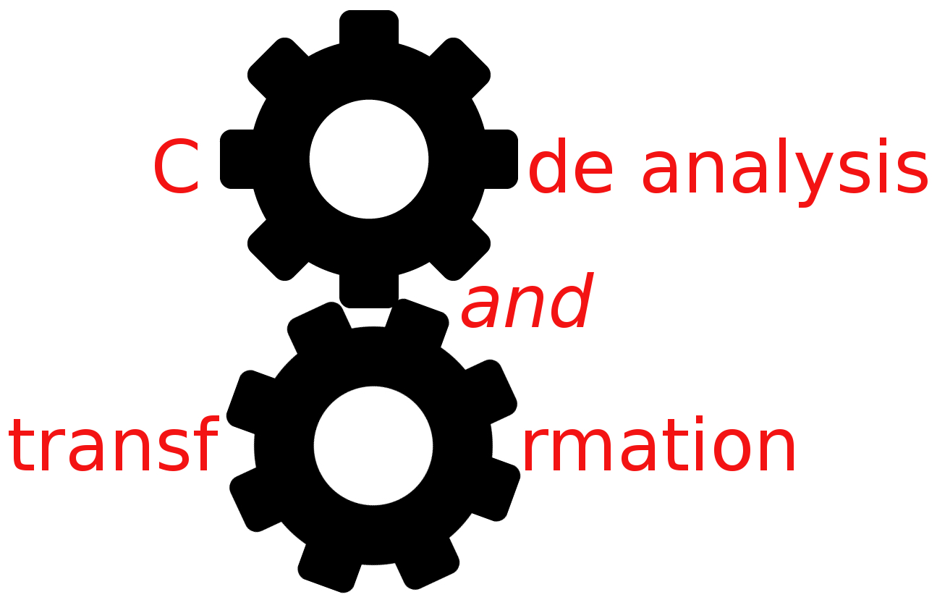


DFA
Simone Campanoni simonec@eecs.northwestern.edu

Slide 2
Who needs LLVM 3.8.1 on Wilkinson lab machines?
Working on installing LLVM 3.8.1 on them
Old software is creating an endless list of problems …
In the meanwhile: use a virtual machine
Any other problem?
CANVAS
LLVM
H1

Slide 3
DFA outline
Why do we need data-flow analysis?
Data-flow sets and transfer functions
An example of data-flow analysis: reaching definitions
Implementation of data-flow analysis

Slide 4
Constant propagation
Find a constant expression
Instruction i: varX = CONSTANT_EXPRESSION
Replace the use of the variable defined in a constant expression with that constant if
All paths to the use of varX passes its assignment I
There are no intervening definition of that variable

Slide 5
Optimization example: constant propagation
int sumcalc (int a, int b, int N){
int x,y;
x = 0;
y = 0;
if (a > b){
x = x + N;
}
if (b > N){ return y;}
return x;
}
Data-flow analysis is a collection of techniques for compile-time reasoning about the run-time flow of values
if (b > N){ return 0;}
We need to know the “data-flow” of the program
Understanding the data-flow requires understanding the control-flow

Slide 6
But constant propagation (CP) has been done already …
CP has been already designed and implemented
Why should we study it? Why don’t we design and implement all possible transformations and analyses in a compiler and move on?
It is always possible to invent new/better transformations
Full employment theorem for compiler writers

Slide 7
New transformations and analyses
New transformations will probably need to understand specific and new code properties related to how data might change through the code
So we need to know how to design a new data flow analysis that identifies such new properties
Generic recipe
Data flow analysis (DFA): traverse the CFGs collecting information about what may happen at run time (Conservative approximation)
Transformation: Modify the code based on the result of data flow analysis (Correctness guaranteed by the conservative approximation of DFA)
Data flow value

Slide 8
Outline
Why do we need data-flow analysis?
Data-flow sets and transfer functions
An example of data-flow analysis: reaching definitions
Implementation of data-flow analysis

Slide 9
Static program vs. dynamic execution
b = b + 1
Static: Finite program
Dynamic: Can have infinitely many possible execution paths
Data flow analysis abstraction: For each point in the program: combines information of all the possible instances of the same program point.
Example of a data flow question:
Which definition defines the value used in statement “b = a”?
If (b > N)

Slide 10
Data-flow expressed in CFG
{ }
int x,y
x = 0
y = 0
If (a > b)
Data-flow value:
set of all possible program states that can be observed at a given program point
e.g., all definitions in the program that might have been executed before that point
IN=
{ x=0 }
=OUT
x = x +N
If (b > N)
return y
Data-flow analysis computes IN and OUT sets
return x
by computing the DFA-specific transfer functions

Slide 11
Transfer functions
Let i be an instruction: IN[i] and OUT[i] are the set of data-flow values before and after the instruction i of a program
A transfer function fs relates the data-flow values before and after an instruction i
In a forward data-flow problem
OUT[ s ] = fs( IN[ s ] )
In a backward data-flow problem
IN[ s ] = fs( OUT[ s ] )
IN=
{ }
int x,y
x = 0
y = 0
If (a > b)
{ x=0 }
=OUT
fs is DFA-specific

Slide 12
Transfer function internals: Y[ s ] = fs ( X[ s ] )
It relies on information that reaches s
It transforms such information to propagate the result to the rest of the CFG
To do so, it relies on information specific to s
Encoded in GEN[s], KILL[s]
fs uses GEN[s] and KILL[s] to compute its output
GEN[s] and KILL[s] are DFA-specific and constant!
IN=
{ }
int x,y
x = 0
y = 0
If (a > b)
{ x=0 }
=OUT

Slide 13
DFA steps
Set the DFA-specific GEN[s] and KILL[s] for all s
Implement the DFA-specific transfer function fs
Compute all IN[s] and OUT[s]
OUT[s] = fs ( IN[s] )
IN[s] = fs ( OUT[s] )
Compilers have a data flow framework to help developing new DFAs
following a DFA-generic algorithm

Slide 14
Outline
Why do we need data-flow analysis?
Data-flow sets and transfer functions
An example of data-flow analysis: reaching definitions
Implementation of data-flow analysis

Slide 15
Optimization example: constant propagation
int sumcalc (int a, int b, int N){
int x,y;
x = 0;
y = 0;
if (a > b){
x = x + N;
}
if (b > N){ return y;}
return x;
}
Information needed just before s: what are the definitions that might execute before s?
reach
if (b > N){ return 0;}
IN[return y] = {y=0} IN[return x] = {x=0, x = x + N}

Slide 16
Data-flow example: reaching definitions
A definition D reaches a program point X if there is a path from the point immediately following D to X such that D is not killed along that path
The data-flow problem for a flow graph is to compute all definitions that reach an instruction i
(i.e., IN[i], OUT[i])
for all i in that graph
…
D: v = 0
…
J : v = v + n
…
X: ... = v ...
GEN[D] = {D}
KILL[J] = {D}

Slide 17
Computing INs and OUTs
GEN[0] = { }
GEN[1] = {1}
GEN[2] = {2}
GEN[3] = { }
Forward or backward?
OUT[i] = fs (IN[i] )
GEN[i] = what i generates
KILL[i] = what i removes
fs within a basic block?
Let i be an instruction and p be its only predecessor
IN[i] = OUT[p]
OUT[i] = GEN[i] U (IN[i] – KILL[i])
IN=
{ }
0: int x,y
1: x = 0
2: y = 0
3: If (a > b)
{ x=0 }
=OUT
Local reaching definitions

Slide 18
Data-flow example: reaching definitions
A definition d reaches a program point X if there is a path from the point immediately following d to X such that d is not killed along that path
The data-flow problem for a flow graph is to compute IN[i] and OUT[i] for all i in that graph
IN[i] = OUT[p]
OUT[i] = GEN[i] U (IN[i] – KILL[i])
IN[entry] = { }
Global reaching definitions
0: int x,y
1: x = 0
2: y = 0
3: If (a > b)
Up a predecessor of i
4: x = x +N
5: If (b > N)

Slide 19
Outline
Why do we need data-flow analysis?
Data-flow sets and transfer functions
An example of data-flow analysis: reaching definitions
Implementation of data-flow analysis

Slide 20
We defined data-flow equations (i.e., IN and OUT equations)
How can we actually compute them?

Slide 21
Iterative algorithm for reaching definitions
Given GEN[i], KILL[i] for all instructions i, we compute IN[i] and OUT[i] for all i
OUT[ENTRY] = { };
for (each instruction i other than ENTRY) OUT[i] = { };
while (changes to any OUT occur) for (each instruction i other than ENTRY) { IN[i] = ∪p a predecessor of i OUT[p];
OUT[i] = GEN[i] ∪ (IN[i] ─ KILL[i]); }
}
ß
ß

Slide 22
Reaching definition in action
GEN[0] = {}
GEN[1] = {1}
GEN[2] = {2}
GEN[3] = {}
GEN[4] = {4}
GEN[5] = {}
KILL[0] = {}
KILL[1] = {4}
KILL[2] = {}
KILL[3] = {}
KILL[4] = {1}
KILL[5] = {}
0: int x,y
1: x = 0
2: y = 0
3: If (a > b)
4: x = x +N
Done?
Why do we need to reach a fixed point?
5: If (b > N)
IN[0] = { }
IN[1] = { }
IN[2] = { }
IN[3] = { }
IN[4] = { }
IN[5] = { }
OUT[0] = { }
OUT[1] = { }
OUT[2] = { }
OUT[3] = { }
OUT[4] = { }
OUT[5] = { }
1
1
1,2
IN[i] = Up a predecessor OUT[p]
OUT[i] = GEN[i] U (IN[i] – KILL[i])
1,2
1,2
1,2
2,4
1,2,4
1,2,4

Slide 23
Implementation aspects
OUT[ENTRY] = { };
for (each instruction i other than ENTRY) OUT[i] = { };
while (changes to any OUT occur) for (each instruction i other than ENTRY) { IN[i] = ∪p a predecessor of i OUT[p];
OUT[i] = GEN[i] ∪ (IN[i] ─ KILL[i]); }
}
Memory representation of data flow values
Operations performed on them
What is an element in a set?

Slide 24
Can we optimize the analysis?
OUT[ENTRY] = { };
for (each instruction i other than ENTRY) OUT[i] = { };
while (changes to any OUT occur) for (each instruction i other than ENTRY) { IN[i] = ∪p a predecessor of i OUT[p];
OUT[i] = GEN[i] ∪ (IN[i] ─ KILL[i]); }
}
... that’s a lot of iterations repeated for each while iteration
Is this always necessary ?

Slide 25
Optimization 1: basic blocks
OUT[ENTRY] = { };
for (each basic block B other than ENTRY) OUT[B] = { };
while (changes to any OUT occur) for (each basic block B other than ENTRY) { IN[B] = ∪p a predecessor of B OUT[p];
OUT[B]= GEN[B]∪ (IN[B] ─ KILL[B]); }
}
Contains all definitions killed
by instructions in block B
Contains all definitions in block B that are visible immediately after B

Slide 26
Optimization 2: bit-sets
OUT[ENTRY] = { };
for (each basic block B other than ENTRY) OUT[B] = { };
while (changes to any OUT occur) for (each basic block B other than ENTRY) { IN[B] = ∪p a predecessor of B OUT[p];
OUT[B]= GEN[B]∪ (IN[B] ─ KILL[B]); }
}

Slide 27
Optimization 2: bit-sets
Assign a bit to each element that might be in the set
Union: bit OR
Intersection: bit AND
Subtraction: bit NEGATE and AND
Fast implementation
64 elements packed to each word on today’s commodity processors
AND and OR are single machine code instructions (single cycle latency)

Slide 28
Optimization 3: work list
OUT[ENTRY] = { };
for (each basic block B other than ENTRY) OUT[B] = { };
while (changes to any OUT occur) for (each basic block B other than ENTRY) { IN[B] = ∪p a predecessor of B OUT[p];
OUT[B]= GEN[B]∪ (IN[B] ─ KILL[B]); }
}

Slide 29
Optimization 3: work list
OUT[ENTRY] = { };
for (each basic block B other than ENTRY) OUT[B] = { };
workList = all basic blocks
while (workList isn’t empty)
B = pick and remove a block from workList
oldOUT = OUT[B] IN[B] = ∪p a predecessor of B OUT[p];
OUT[B]= GEN[B]∪ (IN[B] ─ KILL[B]);
if (oldOut != OUT[B]) workList = workList U {all successors of B}
}

Slide 30
Optimization 4: block order
OUT[ENTRY] = { };
for (each basic block B other than ENTRY) OUT[B] = { };
workList = all basic blocks
while (workList isn’t empty)
B = pick and remove a block from workList
oldOUT = OUT[B] IN[B] = ∪p a predecessor of B OUT[p];
OUT[B]= GEN[B]∪ (IN[B] ─ KILL[B]);
if (oldOut != OUT[B]) workList = workList U {all successors of B}
}

Slide 31
What we learned was for forward data-flow analysis
OUT[ s ] = fs( IN[ s ] )
What about backward data-flow analysis?
IN[ s ] = fs( OUT[ s ] )
OUT[ENTRY] = { };
for (each instruction i other than ENTRY) OUT[i] = { };
while (changes to any OUT occur) for (each instruction i other than ENTRY) { IN[i] = ∪p a predecessor of i OUT[p];
OUT[i] = GEN[i] ∪ (IN[i] ─ KILL[i]); }
}

Slide 32
Food for thought
Correctness: is the answer ALWAYS correct?
Meaning: what is exactly the meaning of the answer?
Precision: how good is the answer?
Convergence:
Will the analysis ALWAYS terminate?
Under what conditions does the iterative algorithm converge?
Speed: how long does it take to converge?

