Slide 1
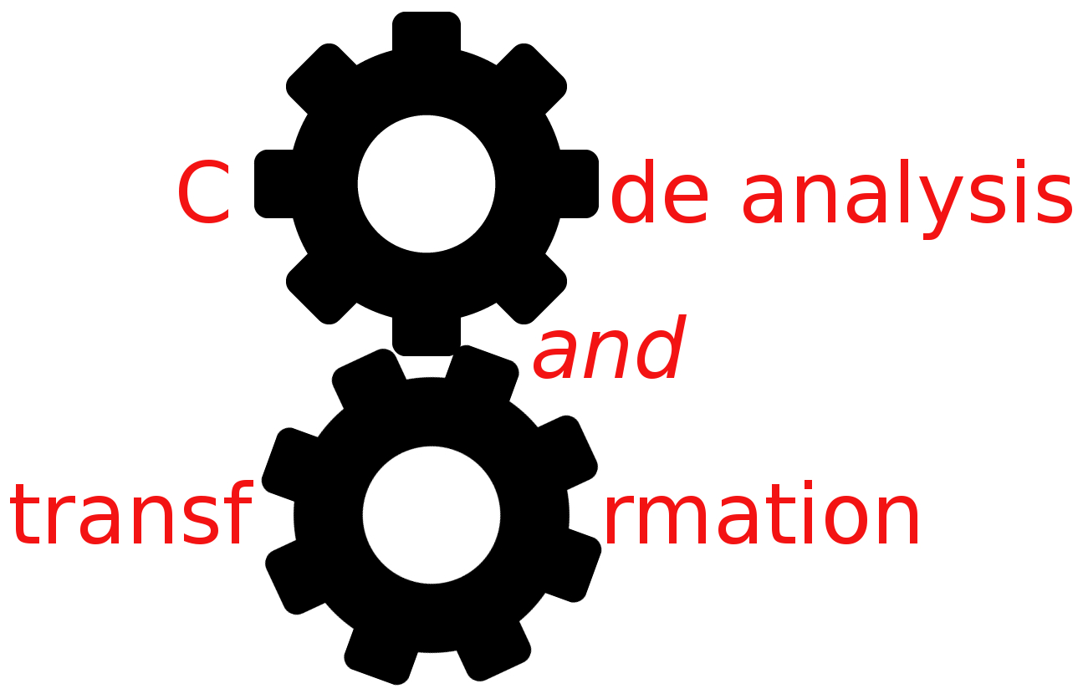


More DFAs
Simone Campanoni simonec@eecs.northwestern.edu

Slide 2
Any problems with H2?
Today: points, points, and points!

Slide 3
Outline
More DFAs
Complete DFAs
Other uses of DFA

Slide 4
Constant propagation: problem definition
Given a program, we would like to know for every point in that program, which variables have constant values, and which do not.
We say that a variable has a constant value at a certain point if every execution that reaches that point, gives that variable the same constant value.
i: x = 0
j: N = N + 1
k: Z = x + N

Slide 5
Reaching definition summary
Reaching definition data-flow analysis computes IN[i] and OUT[i] for every instruction i
IN[i] (OUT[i]) includes definitions that reach just before (just after) instruction i
Each IN/OUT set contains a mapping for every variable in the program to a “value”

Slide 6
Constant propagation
1: int x,y
2: x = 0
3: y = 0
4: If (a > b)
IN[2]={ }
IN[3]={2}
IN[4]={2,3}
For a use of variable v in statement n,
n: x = ... v ...
If the definitions of v that reach n are all of the form
d: v = c [c a constant]
then replace the use of v in n with c
Any problem?
5: x = x +N
IN[5]={2,3}
IN[7]={2,3,5}
IN[6]={2,3,5}
IN[8]={2,3,5}
6: If (b > N)
7: return y
8: return x

Slide 7
Constant propagation problem?
1: int x,y
3: y = 0
4: If (a > b)
Better solutions?
New analysis
Customize reaching definitions
What about in
The CAT language?
CATData CAT_create_signed_value (int64_t value);
IN[3]={}
IN[4]={3}
5: x=5
IN[5]={3}
IN[7]={3,5}
IN[6]={3,5}
IN[8]={3,5}
6: If (b > N)
7: return y
8: return x

Slide 8
Copy propagation: problem definition
Given a program, we would like to know for every point in the program, if a variable contains always the same value of another one.
Copy propagation
1: x = y
2: a = 5
3: b = x + 3
1: x = y
2: a = 5
3: b = y + 3
Any idea how to implement it?

Slide 9
Reaching definition summary
Reaching definition data-flow analysis computes IN[i] and OUT[i] for every instruction i
IN[i] (OUT[i]) includes definitions that reach just before (just after) instruction i
Each IN/OUT set contains a mapping for every variable in the program to a “value”;

Slide 10
Copy propagation
1: int x,y
2: x = a
3: y = x
4: If (a > b)
IN[2]={ }
IN[3]={2}
IN[4]={2,3}
For a use of variable v in statement n,
n: x = ... v ...
If the definitions of v that reach n are all of the form
d: v = z [z is another variable]
then replace the use of v in n with z
Any problem?
5: x = x +N
IN[5]={2,3}
IN[7]={2,3,5}
IN[6]={2,3,5}
IN[8]={2,3,5}
6: If (b > N)
7: return y
8: return x

Slide 11
Thinking about what we have done
What’s the value of these propagations?
Constant propagation: less variable uses
Redundant use of variables
Copy propagation: less variable uses
Redundant use of variables
Redundancy operations are the principal source of optimization in compilers
Front-end
…
Back-end

Slide 12
Dead code elimination: problem definition
Given a program, we would like to know statements/instructions
that do not influence the program at all (i.e., dead code)
1: y = …
2: x = y
3: return x
Copy propagation
1: y = …
2: x = y
3: return y
Any idea?

Slide 13
Liveness analysis
A variable is live at a particular point in the program if its value at that point will be used in the future (dead, otherwise)
To compute liveness at a given point, we need to look into the future
How to use variable liveness information for eliminating dead-code?

Slide 14
Example of variable liveness and dead-code elimination
What are in IN/OUT sets?
IN[0] = {}
OUT[0] = {a}
IN[1] = {a}
OUT[1] = {a, b}
IN[2] = {a, b}
OUT[2] = {b}
IN[3] = {b}
OUT[3] = {b}
IN[4] = {b}
OUT[4] = {}
0: a = 0
0: a = 0
1: b = a + 1
1: b = a + 1
1: b = 0 + 1
2: a = a + b
4: return 1
4: return b
3: d = b * 2
4: return b
Any dead-code?

Slide 15
Liveness analysis
A variable v is live at a given point of a program p if
Exist a directed path from p to a use of v and
that path does not contain any definition of v
Is liveness data-flow analysis forward or backward?
Liveness flows backwards through the CFG, because the behavior at future nodes determines liveness at a given node
GEN[i]=? KILL[i]=?
IN[i] = GEN[i] ∪(OUT[i] – KILL[i])
OUT[i] = ∪_{s a successor of i} IN[s]
IN[ s ] = fs( OUT[ s ] )
i: a = 5
…
j: a = v + 1
…
k: x = a + 1

Slide 16
Liveness analysis
A variable is live at a particular point in the program if its value at that point will be used in the future (dead, otherwise)
Another use: register allocation
A program contains an unbounded number of variables
Must execute on a machine with a bounded number of registers
Two variables can use the same register if they are never in use at the same time
EECS 322 Compiler Construction

Slide 17
Common sub-expression elimination: problem definition
Given a program, we would like to know for every point in the program, which expressions are available
1: y = x + 3
2: b = x + 3
1: y = x + 3
2: b = y

Slide 18
Available expressions
Elements in data-flow sets?
GEN and KILL?
Forward or backward?
IN and OUT?
IN[i] = ∩ _{p a predecessor of i} OUT[p]
OUT[i] = GEN[i] U (IN[i] – KILL[i])
How to use available expressions for eliminating redundant code?
i: y = x + 3
j: z = x + 3
k: …
1: y = x + 3
2: b = x + 3

Slide 19
So far …
Reaching definitions
Constant propagation
Copy propagation
Variable liveness
Dead-code elimination
Available expressions
Common sub-expression elimination

Slide 20
Dominators
Definition: Node d dominates node n in a graph (d dom n) if every path from the start node to n goes through d. Every node dominates itself.
1
1
Dominator tree
2
2
3
3
GEN ? KILL ? IN ? OUT?
CFG

Slide 21
Outline
More DFAs
Complete DFAs
Other uses of DFA

Slide 22
What about function parameters?
IN[0a] = { }
OUT[0a] = {0a}
IN[0b] = {0a}
OUT[0b] = {0a,0b}
… let’s compute the reaching definition analysis
Which information is missing?
0a: NOP
0b: NOP
int myFunction (int a, int b){
if (a > b){
a = 5;
}
return a;
}
IN[1] ={ }
OUT[1]={ }
1: If (a > b)
0a,0b
0a,0b
IN[2] ={ }
OUT[2]={2 }
Can we exploit SSA properties?
2: a = 5
0a,0b
, 0b
IN[3] = {2 }
3: return a
,0a,0b
CP algorithm replaces “a” with “5” in instruction 3!

Slide 23
What about escaped variables?
… let’s compute the reaching definition analysis
Which information is missing?
OUT[1] ={ }
OUT[2] ={2 }
OUT[3] ={2,3}
OUT[4] ={2,3}
1: int a
2: int *q = &a
3: int *p = f(q)
4: If (a > b)
int myFunction (void){
int a;
int *p = f(&a);
if (a > b){
a = 5;
} else {
*p = 6;
}
return a;
}
5: a = 5
IN[5] ={2,3 }
OUT[5] ={2,3,5}
IN[6] ={2,3 }
OUT[6] ={2,3,6}
6: *p = 6
IN[7] = {2,3,5,6}
7: return a
CP algorithm replaces “a” with “5” in instruction 7!

Slide 24
What about memory references?
int myFunction (void){
int a;
int *p = f();
a = *p;
return a;
}

Slide 25
Outline
More DFAs
Complete DFAs
Other uses of DFA

Slide 26
Identifying software bugs
“x” can be undefined at instruction 7
Can we build a tool to analyze the code and notify a developer about this bug?
Let’s define precisely the problem
Conservativeness
What are the data flow values?
GEN[i] = ?
KILL[i] = ?
IN[i] and OUT[i] ?
1: int x,y
2: y = 0
3: If (a > b)
4: x=5
5: If (b > N)
6: return y
7: return x

Slide 27
Identifying software bugs (2)
What about now?
Let’s define precisely the problem
Conservativeness
What are the data flow values?
GEN[i] = ?
KILL[i] = ?
IN[i] and OUT[i] ?
1: int x
2: call f(&x)
3: If (a > b)
4: x=5
5: return x

Slide 28

Data-flow analysis: food for thought
Correctness: is the answer ALWAYS correct?
Meaning: what is exactly the meaning of the answer?
Precision: how good is the answer?
Convergence:
Will the analysis ALWAYS terminate?
Under what conditions does the iterative algorithm converge?
Speed: how long does it take to converge in the worst case?

