Slide 1
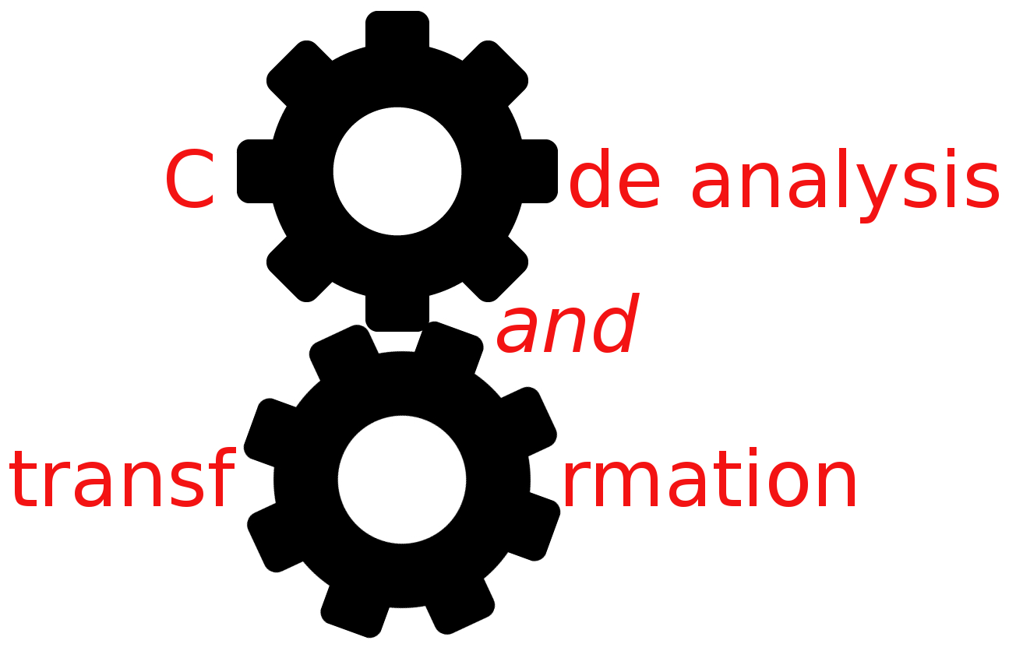


Dependencies
Simone Campanoni simonec@eecs.northwestern.edu

Slide 2
Reviewing your H2 code … (GEN/KILL sets)
Problem 1: API identification
Checking if the name of a callee starts with “CAT” and has 3 parameters isn’t enough to conclude it is part of the CAT API
Problem 2: complexity O
Common solution adopted in your assignment
GEN[i] = {i} or { }
KILL[i] = defs(t) – {i} or { }
What is the complexity for computing GEN and KILL for all instructions?

Slide 3
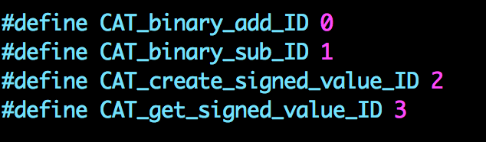
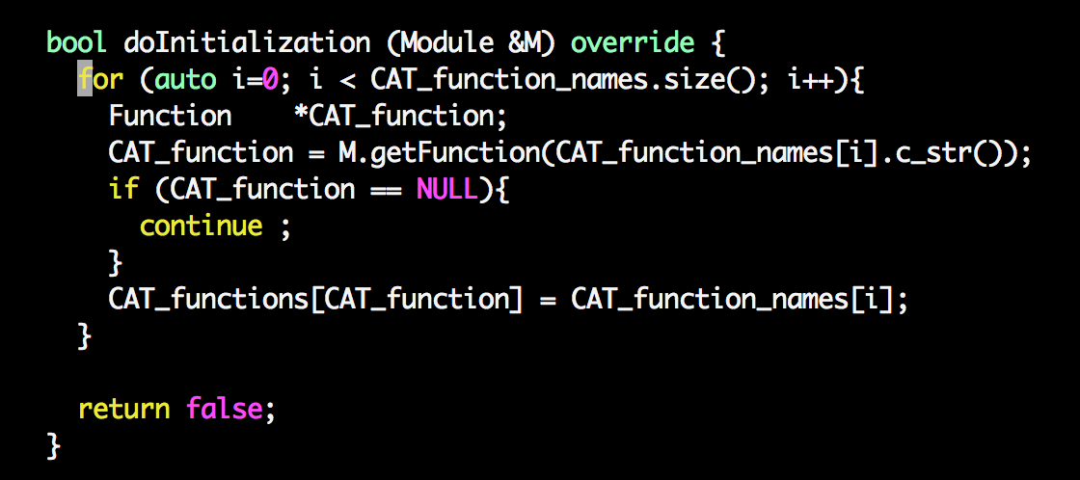

Slide 4
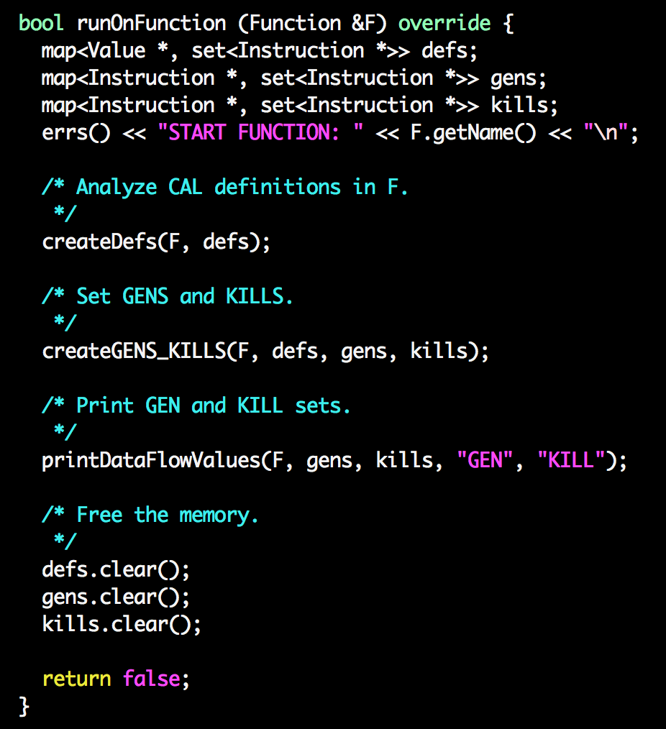
GEN[i] = {i} or { }
KILL[i] = defs(t) – {i} or { }

Slide 5
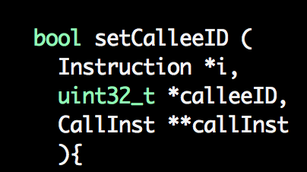
Utility functions

Slide 6
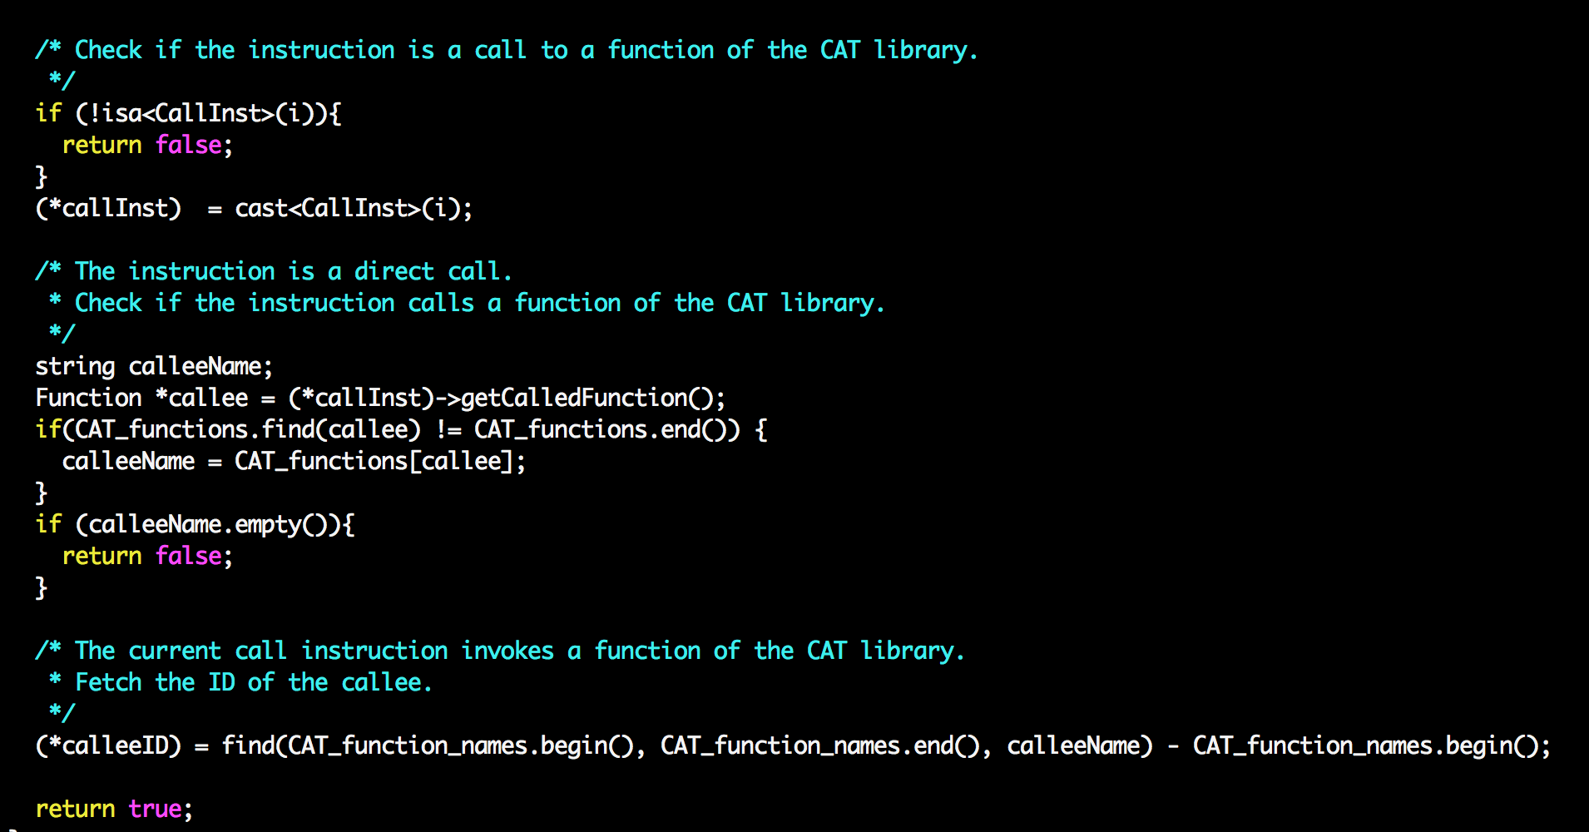

Slide 7
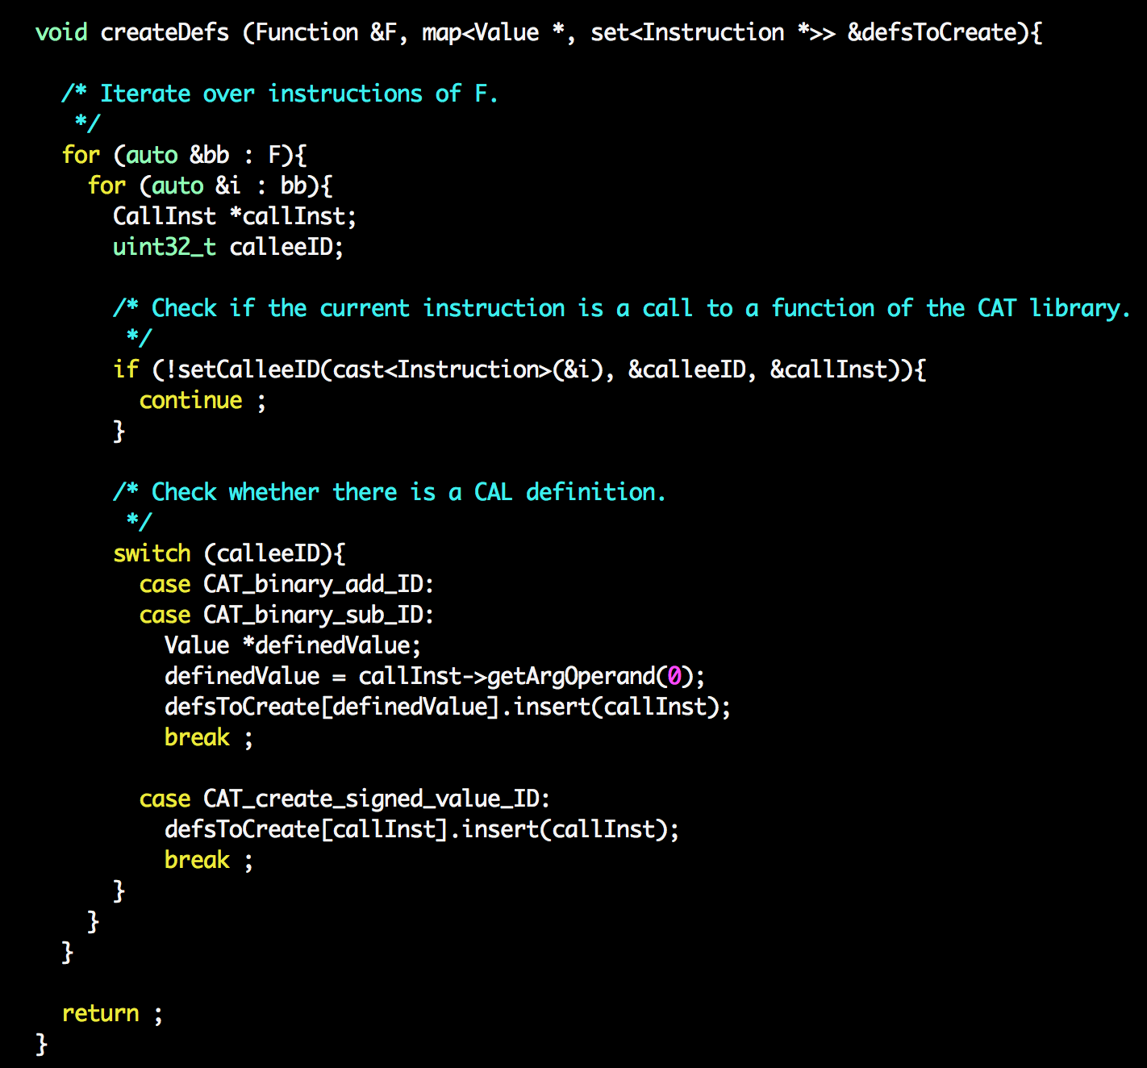

Slide 8
GEN[i] = {i} or { }
KILL[i] = defs(t) – {i} or { }

Slide 9
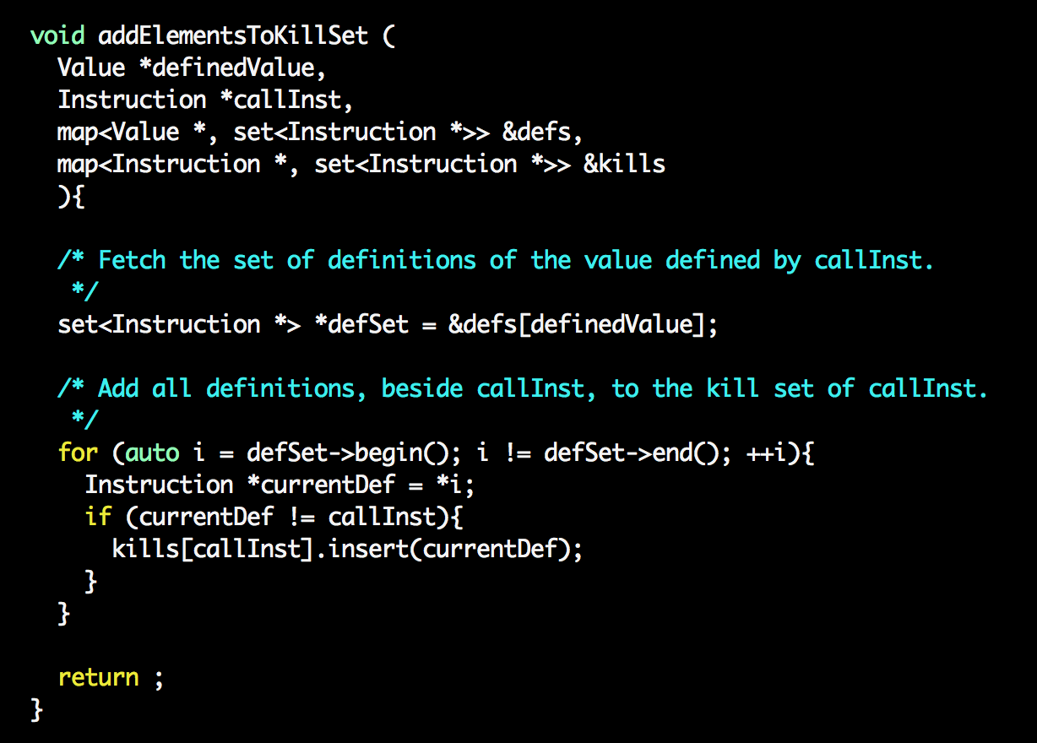
KILL[callInst] = defs(definedValue) - callInst

Slide 10
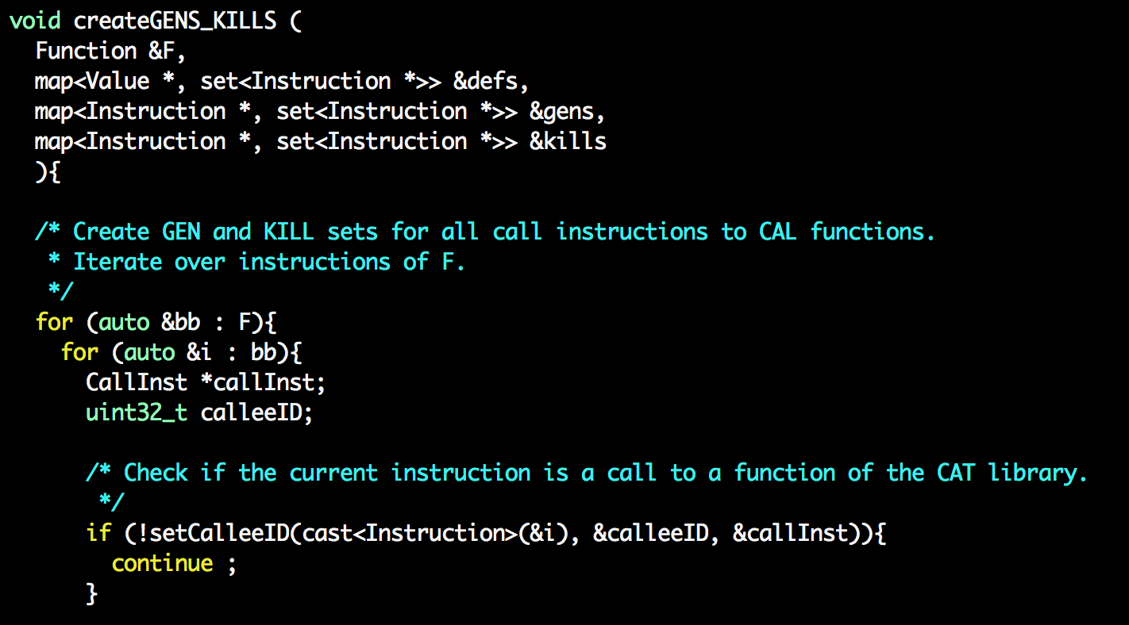

Slide 11
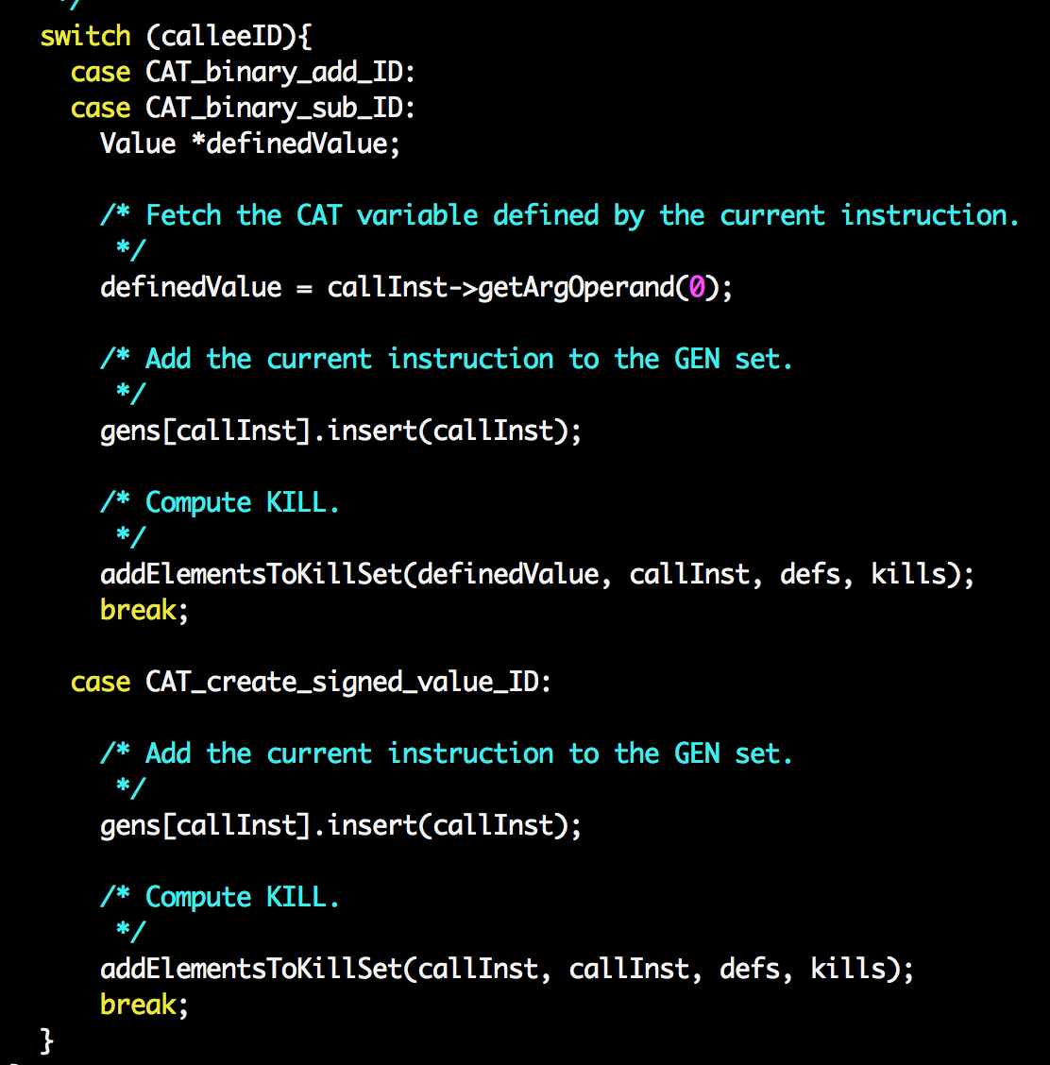

Slide 12
Questions: 1 point each
how to find out the time spent by each LLVM pass invoked?
opt -time-passes
How can we find the actual sequence of passes invoked? (including their dependencies)
opt --debug-pass=Structure
how to print the CFG?
opt -view-cfg
what "llc -march=cpp <bitcode>.bc -o output.cpp" does?

Slide 13
Dependencies: the big picture
Code transformations are designed to preserve the “semantics” of the code given as input
What is the “semantics” of a program?
If we satisfy all dependences in the code, then we will preserve I => O
1: varX = par1 + 1
2: varY = par2 + par1
3: varZ = varY + varX
4: print(varZ)
4: print(varZ)
1: varX = par1 + 1
2: varY = par2 + par1
3: varZ = varX + varY
2: varY = par2 + par1
1: varX = par1 + 1
3: varZ = varX + varY
4: print(varZ)
A: varX = 1;
B: if (par1 > 5)
C: varX = par1 + 1
D: print(varX)

Slide 14
Outline
Control dependencies
Data dependencies
Memory alias analysis

Slide 15
Control dependence intuition
Dependence: C will be executed depending on B
How to identify C? (automatically)
A: varX = 1;
B: if (par1 > 5)
C: varX = par1 + 1
D: print(varX)

Slide 16
Dominators
Definition: Node d dominates node n in a graph if every path from the start node to n goes through d
B
B
B: if (par1 > 5)
C: varX = par1 + 1
D: print(varX)
C
C
D
Immediate dominator tree
D
CFG
Are dominators useful to identify the control dependence between C and B?

Slide 17
Post-Dominators
Assumption: Single exit node in CFG
Definition: Node d post-dominates node n in a graph if every path from n to the exit node goes through d
B
D
B: if (par1 > 5)
C: varX = par1 + 1
D: print(varX)
C
C
B
Immediate post-dominator tree
D
CFG
How can we identify C and B with the post-dominator tree and the CFG?
B determines whether C executes or not

Slide 18
Control dependence in our example
Node C is control-dependent on B because
C is the successor of B
B is not post-dominated by C
B
D
B: if (par1 > 5)
C: varX = par1 + 1
D: print(varX)
C
C
B
Immediate post-dominator tree
D
CFG
How can we identify C and B with the post-dominator tree and the CFG?
B determines whether C executes or not

Slide 19
Control dependencies
A node X is control-dependent on another node Y if and only if
There is a path from X to Y such that every node in that path other than X and Y is post-dominated by Y
X is not post-dominated by Y
B
D
A: varX = 1;
B: if (par1 > 5)
C: varX = par1 + 1
D: print(varX)
C
C
B
Immediate post-dominator tree
D
CFG

Slide 20
Post-dominators
Assumption: Single exit node in CFG
Definition: Node d post-dominates node n in a graph if every path from n to the exit node goes through d
B
D
A: varX = 1;
B: if (par1 > 5)
C: varX = par1 + 1
C2: …
D: print(varX)
C
C2
B
C2
C
D
Immediate post-dominator tree
CFG

Slide 21
Control dependencies
A node X is control-dependent on another node Y if and only if
There is a path from X to Y such that every node in that path other than X and Y is post-dominated by Y
X is not post-dominated by Y
B
D
A: varX = 1;
B: if (par1 > 5)
C: varX = par1 + 1
C2: …
D: print(varX)
C
C2
B
C2
C
D
Immediate post-dominator tree
CFG

Slide 22
Control dependence graph (CDG)
Graph (N, E) where
N are basic blocks
Exist an edge (x,y) in E if and only if y is control dependent on x
B
B
D
C
C
C2
CDG
C2
An use of CDG:
Sequential program: fixed order of execution
Goal: remove unnecessary order
Useful for parallelism
D
CFG

Slide 23
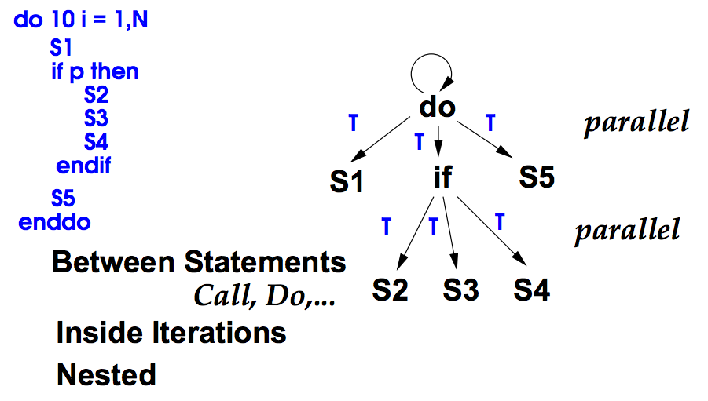
Potential parallelism

Slide 24
Control dependence graph: algorithm
A node X is control-dependent on another node Y if and only if
There is a path from X to Y such that every node in that path other than X and Y is post-dominated by Y
X is not post-dominated by Y
B
D
C
B
(B,C)
(B,C2)
C
C2
B
C
C2
C2
CDG
C
D
Immediate post-dominator tree
Any idea?
CFG

Slide 25
Outline
Control dependencies
Data dependencies
Memory alias analysis

Slide 26
Data dependence
Three types of data dependence (assuming int a,b,c):
Flow (True) dependence : read-after-write
a = c * 10;
b = 2 * a + c;
Anti Dependency: write-after-read
a = b* 4+ c;
c = b + 40;
Output Dependence: write-after-write
a = b *c ;
a = b + c + 10;

Slide 27
Data dependencies
Gives constraints on parallelism that must be satisfied
Must be satisfied to have correct program
How can we satisfy data dependencies?
Any order that does not violate these dependencies is correct!

Slide 28
Data dependence graph (DDG)
Graph (N, E) where
N are instructions
Exist an edge (x,y) in E if and only if y is data dependent on x
Differences between CDG and DDG?
Granularity
Structure vs. content

Slide 29
Dependence example
A
A
E
B
A
C
D
B
D
B
C
D
E
C
DDG
CDG
E
What are the possible executions that preserve the original semantics of the program?
A B C E A D E
A C B E A E D A C E B
CFG

Slide 30
Data dependence analysis and others
Data dependence analysis
Code transformation
Code analysis
Code transformation

Slide 31
(Variable) Data dependencies in LLVM
Any idea?

Slide 32



(Memory) Data dependencies in LLVM
Data dependencies are computed by DependenceAnalysis
To get the output of the data dependence analysis:
To check if inst2 depends on data generated by inst1:

Slide 33
Program dependence graph
Program Dependence Graph = Control Dependence Graph + Data Dependences
Facilitates performing most traditional optimizations
Constant folding, scalar propagation, common subexpression elimination, code motion, strength reduction
Requires only single walk over PDG
Incremental changes
Update data dependence when control dependence changes

Slide 34
Outline
Control dependencies
Data dependencies
Memory alias analysis

Slide 35

Memory alias analysis: the problem
We want to
Execute j in parallel with i (extracting parallelism)
Move j before i (code scheduling)
Does j depend on i ?
Do p and q point to the same memory location?
Does q alias p?
i: (*p) = varA + 1
j: varB = (*q) * 2
i: obj1.f = varA + 1
j: varB= obj2.f * 2

Slide 36
Memory alias/data dependence analysis
Memory alias analysis
Data dependence analysis
Code
Aliases: {
(p, q, strength, location) }
Data dependencies: {
(i1, i2, type, strength)
}

Slide 37
Memory alias/data dependence analysis
Great
memory alias analysis
??
Great data dependence analysis
??
1: *p1 = ...
2: *p2 = …
3: v1 = *p2
Aliases: {
(p, q, strength, location) }
Aliases: { }
Data dependencies: {
(i1, i2, type, strength)
}
Data dependencies: {
(2, 3, RAW, must)
}
Oracle:
p2 and p1 points to different memory locations always

Slide 38
Memory alias/data dependence analysis
Not great
memory alias analysis
Great
data dependence analysis
1: *p1 = ...
2: *p2 = …
3: v1 = *p2
Aliases: {
(p1, p2, may, 1)
(p1, p2, may, 2)
(p1, p2, may, 3) }
Data dependences: {
(2, 3, RAW, must), (1, 2, WAW, may)
}
Oracle:
p2 and p1 points to different memory locations always

Slide 39
Memory alias/data dependence analysis
Not great
memory alias analysis
Not great
data dependence analysis
1: *p1 = ...
2: *p2 = …
3: v1 = *p2
Aliases: {
(p1, p2, may, 1)
(p1, p2, may, 2)
(p1, p2, may, 3) }
Data dependences: {
(2, 3, RAW, must), (1, 2, WAW, may),
(1, 3, RAW, may)
}
Oracle:
p2 and p1 points to different memory locations always
Analysis output:
Everything depends on everything else

Slide 40
Memory alias/data dependence analysis
Inaccuracies on either memory alias analysis or data dependence analysis leads to “apparent” dependencies
More constraints on code transformations
Reduce the aggressiveness of code transformations
Reduce performance obtained
Oracle:
p2 and p1 points to different memory locations always
Analysis output:
Everything depends on everything else

Slide 41
Memory alias/data dependence analysis
Can we optimize the code
knowing these dependencies?
Great
memory alias analysis
Great data dependence analysis
1: *p1 = ...
2: *p2 = …
3: v1 = *p2
Aliases: {
(p1, p2, must, 1)
(p1, p2, must, 2)
(p1, p2, must, 3) }
Data dependences: {
(2, 3, RAW, must), (1, 2, WAW, must)
}
Oracle:
p2 and p1 points to the same memory location always

Slide 42
Memory alias/data dependence analysis
We cannot delete instruction 1
Not great
memory alias analysis
Great data dependence analysis
1: *p1 = ...
2: *p2 = …
3: v1 = *p2
Aliases: {
(p1, p2, may, 1)
(p1, p2, may, 2)
(p1, p2, may, 3) }
Data dependences: {
(2, 3, RAW, must), (1, 2, WAW, may),
}
Oracle:
p2 and p1 points to the same memory location always

Slide 43

Memory alias/data dependence analysis
Useless output
Alias analysis: a pointer may alias to another one
Data dependence analysis: an instruction may depend on another one
… may ...

Slide 44
Memory alias/data dependence analysis and code analysis/transformation
Code analysis and transformation that rely on memory alias analysis
and/or data dependence analysis
must be correct
independently with the accuracy of
memory alias analysis
and/or data dependence analysis

Slide 45
Constant propagation revisited
int x, y;
int *p;
… = &x;
…
x = 5;
*p = 42;
y = x + 1;
We need to know which variables escape.
How can we do it in LLVM?
Is x constant here?
If p does not point to x, then x = 5
If p definitely points to x, then x = 42
If p might point to x, then we have two reaching definitions that reach this last statement, so x is not constant
Yes, because x doesn’t “escape” and therefore only one value of x reaches this last statement
Yes, only one value of x reaches this last statement
Goal of memory alias analysis: understanding

Slide 46
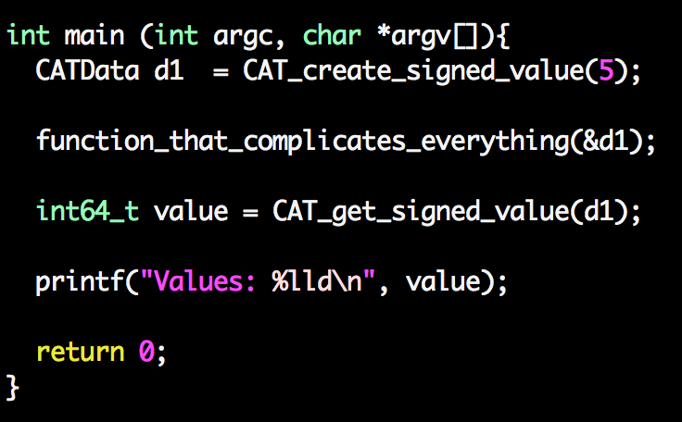
(Identify escaped variables in LLVM)

Slide 47
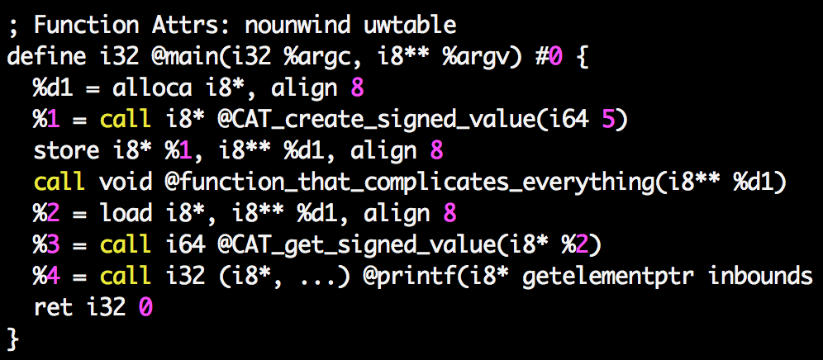
(Identify escaped variables in LLVM)

Slide 48
Do you remember liveness analysis?
A variable v is live at a given point of a program p if
Exist a directed path from p to an use of v and
that path does not contain any definition of v
Liveness analysis is backwards
What is the most conservative output of the analysis?
GEN[i] = ? KILL[i] = ?
IN[i] = GEN[i] ∪(OUT[i] – KILL[i])
OUT[i] = ∪_{s a successor of i} IN[s]

Slide 49
Liveness analysis revisited
int x, y;
int *p;
… = &x;
x = 5;
…(no uses/definitions of x)
*p = 42;
y = x + 1;
How can we modify liveness analysis?
Is x alive here?
If p does not point to x, then
yes
If p definitely points to x, then
no
If p might point to x, then
yes
Yes, because x doesn’t “escape” and therefore the value of x stored there will be used later
Yes, the value 5 stored in x there will be used later

Slide 50
Liveness analysis revisited
mayAliasVar : variable -> set<variable>
mustAliasVar: variable -> set<variable>
GEN[i] = {v | variable v is used by i}
KILL[i] = {v’ | variable v’ is defined by i}
IN[i] = GEN[i] ∪(OUT[i] – KILL[i])
OUT[i] = ∪_{s a successor of i} IN[s]
How can we modify conventional liveness analysis?

Slide 51
Liveness analysis revisited
mayAliasVar : variable -> set<variable>
mustAliasVar: variable -> set<variable>
GEN[i] = {mayAliasVar(v) U mustAliasVar(v) | variable v is used by i}
KILL[i] = {mustAliasVar(v) | variable v is defined by i}
IN[i] = GEN[i] ∪(OUT[i] – KILL[i])
OUT[i] = ∪_{s a successor of i} IN[s]

Slide 52
Trivial analysis: no code analysis
int x, y;
int *p;
… = &x;
x = 5;
…(no uses/definitions of x)
*p = 42;
y = x + 1;
Trivial memory alias analysis
Nothing must alias
Anything may alias everything else
GEN[i] = {mayAliasVar(v) U mustAliasVar(v) | v is used by i}
KILL[i] = {mustAliasVar(v) | v is defined by i}
IN[i] = GEN[i] ∪(OUT[i] – KILL[i])
OUT[i] = ∪_{s a successor of i} IN[s]

Slide 53
Great alias analysis impact
int x, y;
int *p;
… = &x;
x = 5;
…(no uses/definitions of x)
*p = 42;
y = x + 1;
Great memory alias analysis
How to use dependencies to compute them?
No aliases
GEN[i] = {mayAliasVar(v) U mustAliasVar(v) | v is used by i}
KILL[i] = {mustAliasVar(v) | v is defined by i}
IN[i] = GEN[i] ∪(OUT[i] – KILL[i])
OUT[i] = ∪_{s a successor of i} IN[s]
5

Slide 54
Reaching definition and constant propagation revisited
int x, y;
int *p;
… = &x;
…
x = 5;
*p = 42;
y = x + 1;
Memory alias analysis
Memory
data dependence analysis
Dependencies
Think about how we can use dependencies to enhance both
reaching definition analysis and
constant propagation

Slide 55
(Memory) Data dependencies in LLVM
Data dependencies are computed by DependenceAnalysis
To get the output of the data dependence analysis:
To check if inst2 depends on data generated by inst1:

Slide 56
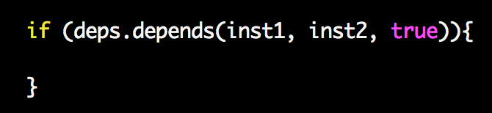
Loop-carried data dependencies
while(…){
i: x = …;
j: *p = x + 1;
…
}
i
j
while(…){
j: *p = x + 1;
i: x = …;
…
}
i
LC
j

Slide 57
Loop-carried data dependencies
while(…){
j: *p = x + 1;
i: x = …;
…
}
i
LC
Distance =1
j
while(…){
j: *p = A[i-2] + 1;
i: A[i] = …;
k: i++;
}
i
LC
Distance =2
j

Slide 58
Using dependence analysis in LLVM
int x, y;
int *p;
… = &x;
x = 5;
…(no uses/definitions of x)
*p = 42;
y = x + 1;
Trivial memory alias analysis
Trivial memory data dependence analysis
Every memory instruction depends on
every instruction
that might access memory
Nothing must alias
Anything may alias everything else
opt -no-aa -CAT bitcode.bc -o optimized_bitcode.bc

Slide 59
Using dependencies
int x, y;
int *p;
… = &x;
x = 5;
…(no uses/definitions of x)
*p = 42;
y = x + 1;
Local memory
alias analysis
Memory data dependence analysis
opt -basicaa -CAT bitcode.bc -o optimized_bitcode.bc

Slide 60
Memory alias analysis
Assumption: no dynamic memory, pointers can point only to variables
Goal: at each program point, compute set of (p->x) pairs if p points to variable x
Approach:
Based on data-flow analysis
May information

Slide 61
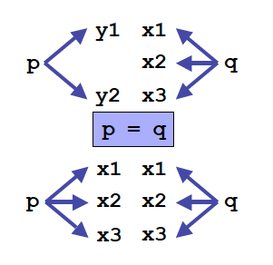
May points-to analysis
…
print *p
Where does p point to?
Data flow values: {(v, x) | v is a pointer variable and x is a variable}
Direction: forward
i: p = &x
GEN[i] = {(p, x)} KILL[i] = {(p, v) | v “escapes”}
OUT[i] = GEN[i] U (IN[i] – KILL[i])
IN[i] = U_{p is a predecessor of i} OUT[p]
Different OUT[i] equation for different instructions
i: p = q
GEN[i] = { } KILL[i] = { } OUT[i] = {(p, z) | (q, z) ∈ IN[i]} U (IN[i] – {(p,x) for all x})
Why?

Slide 62
Code example
1: p = &x ;
2: q = &y;
3: if (…){
4: z = &v;
}
5: x++;
6: p = q;
GEN[1] = {(p, x)}
GEN[2] = {(q, y)}
GEN[3] = { }
GEN[4] = {(z, v)}
GEN[5] = { }
GEN[6] = { }
KILL[1] = {(p, x), (p, y), (p,v)}
KILL[2] = {(q, x), (q, y), (q,v)}
KILL[3] = { }
KILL[4] = {(z, x), (z, y), (z, v)}
KILL[5] = { }
KILL[6] = { }
IN[1] = { }
IN[2] = {(p,x)}
IN[3] = {(q,y),(p,x)}
IN[4] = {(q,y),(p,x)}
IN[5] = {(z,v),(q,y),(p,x)}
IN[6] = {(z,v),(q,y),(p,x)}
OUT[1] = {(p,x)}
OUT[2] = {(q,y),(p,x)}
OUT[3] = {(q,y),(p,x)}
OUT[4] = {(z,v),(q,y),(p,x)}
OUT[5] = {(z,v),(q,y),(p,x)}
OUT[6] = {(p,y),(z,v),(q,y)}

Slide 63
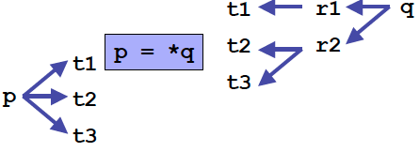
May points-to analysis
IN[i] = U_{p is a predecessor of i} OUT[p]
i: p = &x
GEN[i] = {(p,x)} KILL[i] = {(p,v) | v “escapes”}
OUT[i] = GEN[i] U (IN[i] – KILL[i])
i: p = q
GEN[i] = { } KILL[i] = { } OUT[i] = {(p,z) | (q,z) ∈ IN[i]} U (IN[i] – {(p,x) for all x})
i: p = *q
GEN[i] = { } KILL[i] = { } OUT[i] = {(p,t) | (q,r)∈IN[i] & (r,t)∈IN[i]} U (IN[i] – {(p,x) for all x})
i: *q = p ?? (3 points)

Slide 64
Memory alias analysis: dealing with dynamically allocated memory
Issue: each allocation creates a new piece of memory
p = new T; p = malloc(10);
What about generating at compile-time a new “variable” to stand for new memory?
Extending our data-flow analysis
OUT[i] = {(p, newVar)} U (IN[i] – {(p,x) for all x})
Problem:
Domain is unbounded (why)?
Iterative data-flow analysis may not converge

Slide 65
Memory alias analysis: dealing with dynamically allocated memory
Simple solution
Create a summary “variable” for each allocation statement
Domain is now bounded
Data-flow equation
i: p = new T
OUT[i] = {(p,inst_{i})} U (IN[i] – {(p,x) for all x})
Alternatives
Summary variable for entire heap
Summary node for each type
Analysis time/precision tradeoff

Slide 66
Representations of aliasing
Alias pairs
Pairs that refer to the same memory
High memory requirements
Equivalence sets
All memory references in the same set are aliases
Points-to pairs
Pairs where the first member points to the second
Specialized solution

Slide 67
How hard is the memory alias analysis problem?
Undecidable
Landi 1992
Ramalingan 1994
All solutions are conservative approximations
Is this problem solved?
Numerous papers in this area
Haven’t we solved this problem yet? [Hind 2001]

Slide 68
Limits of intra-procedural analysis
foo() {
int x, y, a;
int *p;
p = &a;
x = 5;
foo(&x);
y = x + 1;
}
foo(int *p){
return p;
}
Does the function call modify x?
With our intra-procedural analysis, we don’t know
Make worst case assumptions
Assume that any reachable pointer may be changed
Pointers can be “reached” via globals and parameters
Pointers can be passed through objects in the heap

Slide 69
Quality of memory alias analysis
Quality decreases
Across functions
When indirect access pointers are used
When dynamically allocated memory is used
Partial solutions to mitigate them
Inter-procedural analysis
Shape analysis

