Slide 1
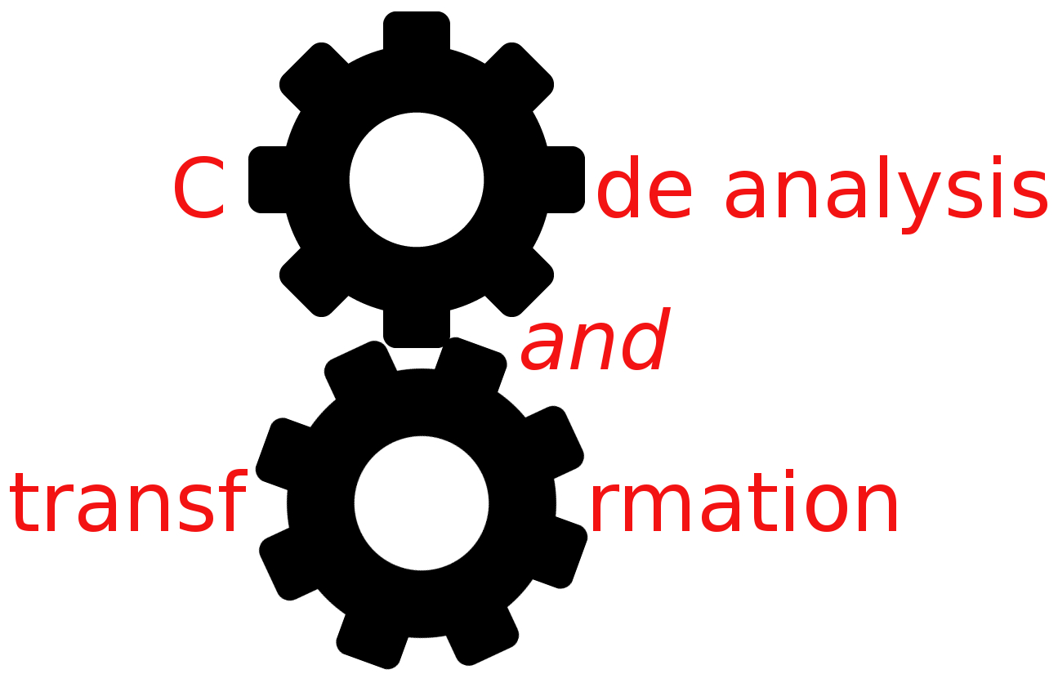


Inter-procedural analysis
Simone Campanoni simonec@eecs.northwestern.edu

Slide 2
Procedures
bar
void bar (void){
x = 5;
px = &x;
foo(px);
y = x + 5;
}
Abstraction
Cornerstone of programming
Introduces barriers to analysis
So far looked at intra-procedural analysis
Analyzing a single procedure
Inter-procedural analysis uses calling relationships among procedures
(Call Graph)
Enables more precise analysis information
foo
Is x constant?

Slide 3
Inter-procedural analysis
Goal: Avoid making overly conservative assumptions about the effects of procedures and the state at call sites
Terminology
int a, e; // Globals
void foo(int *b, int *c){ // Formal parameters
(*b) = e;
}
bar(){
int d; // Local variables
foo(a, d); // Actual parameters
}

Slide 4
Inter-procedural analysis vs. inter-procedural transformation
Inter-procedural analysis
Gather information across multiple procedures (typically across the entire program)
Can use this information to improve intra-procedural analyses and transformation (e.g., CP)
Inter-procedural transformation
Transformations that involve multiple procedures e.g., Inlining, procedure cloning, inter-procedural register allocation

Slide 5
Outline
Sensitivity of analysis
Single compilation
Separate compilations
Caller -> callee vs. callee -> caller propagations
Final remarks

Slide 6
Sensitivity of intra-procedural analysis
Flow-sensitive vs. flow-insensitive
A
B
A
C
B
C

Slide 7
Flow sensitivity example
Is x constant?
void f (int x){
A: x = 4;
…
B: x = 5;
}
Flow-sensitive analysis
Computes one answer for every program point
x is 4 after A
x is 5 after B
Requires iterative data-flow analysis or similar technique
Flow-insensitive analysis
Computes one answer for the entire procedure
x is not constant
Can compute in linear time
Less accurate (ignores control flow)

Slide 8
Sensitivity of intra-procedural analysis
Flow-sensitive vs. flow-insensitive
Path-sensitive vs. path-insensitive
A
B
A
C
B
C

Slide 9
Path sensitivity example
Is x constant?
if (x == 0)
x = 4; x = 5;
print(x)
Path-sensitive analysis
Computes one answer for every execution path
x is 4 at the end of the left path
x is 5 at the end of the right path
Subsumes flow-sensitivity
Very expensive
Path-insensitive analysis
Computes one answer for all path
x is not constant

Slide 10
Sensitivity of inter-procedural analysis
Flow-sensitive vs. flow-insensitive
Path-sensitive vs. path-insensitive
Context-sensitive vs. context-insensitive
A
B
A
C
B
C

Slide 11
Context sensitivity example
Is x constant?
a = id(4); b = id(5);
id (x) { return x;}
Context-sensitive analysis
Computes one answer for every call-site
x is 4 in the first call
x is 5 in the second call
Re-analyzes callee for each caller
Context-insensitive analysis
Computes one answer for all call-sites:
x is not constant
Perform one analysis independent of callers
Suffers from unrealizable paths:
Can mistakenly conclude that id(4) can return 5 because we merge information from all call-sites

Slide 12
Call graph
First problem: how do we know what procedures are called from where?
Especially difficult in higher-order languages, languages where functions are values
What about C programs?
We’ll ignore this for now
Let’s assume we have a (static) call graph
Indicates which procedures can call which other procedures, and from which program points
void foo (int a, int (*p_to_f)(int v)){
int l = (*p_to_f)(5);
a = l + 1;
return a;
}

Slide 13
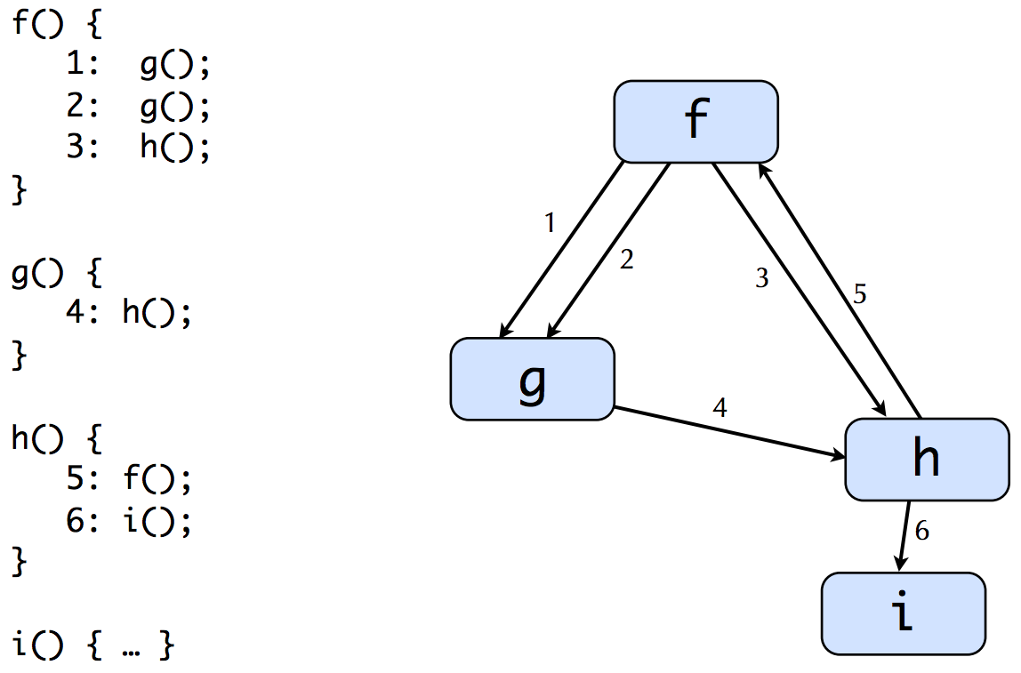
Call graph example
From now on we assume we have a static call graph

Slide 14
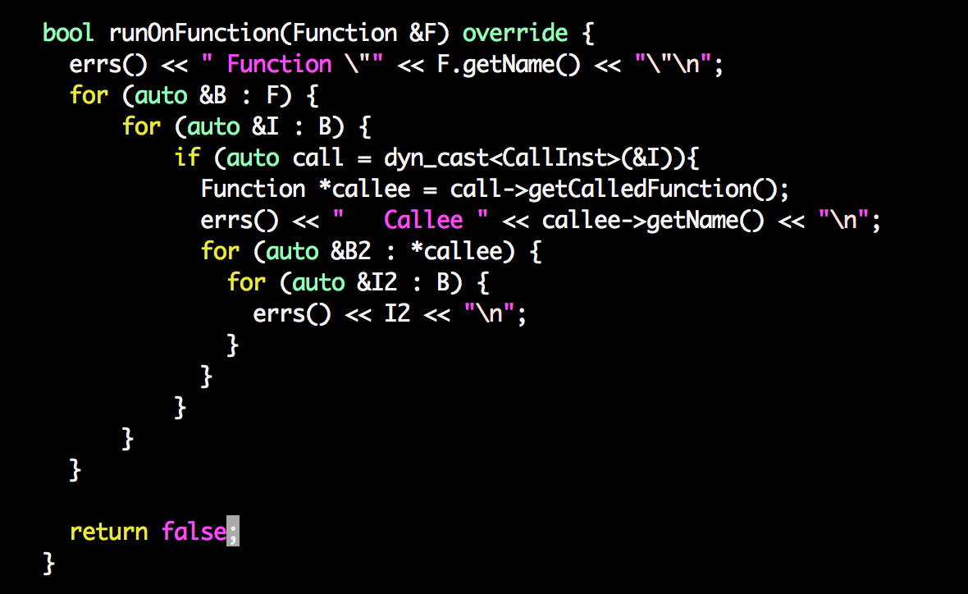
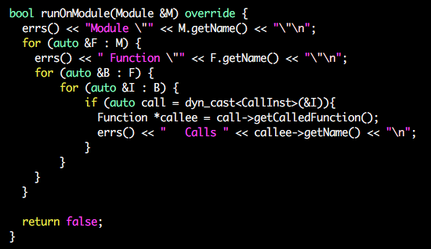
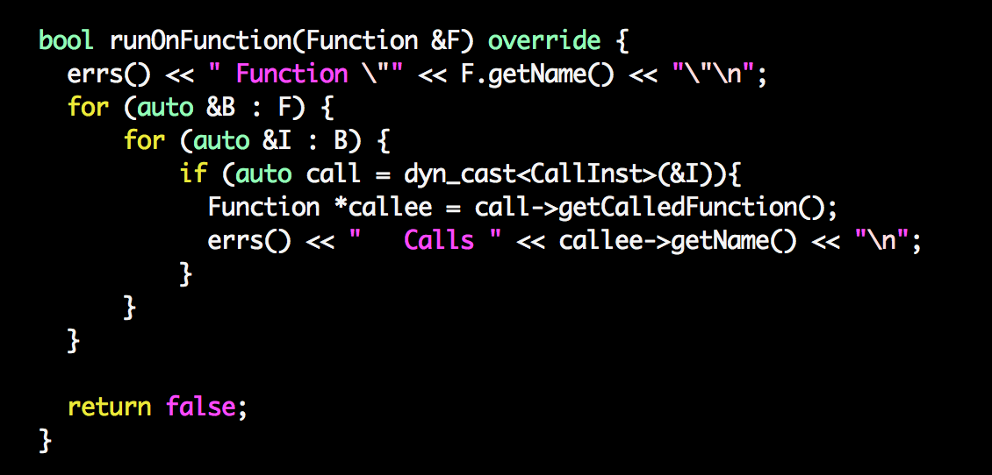
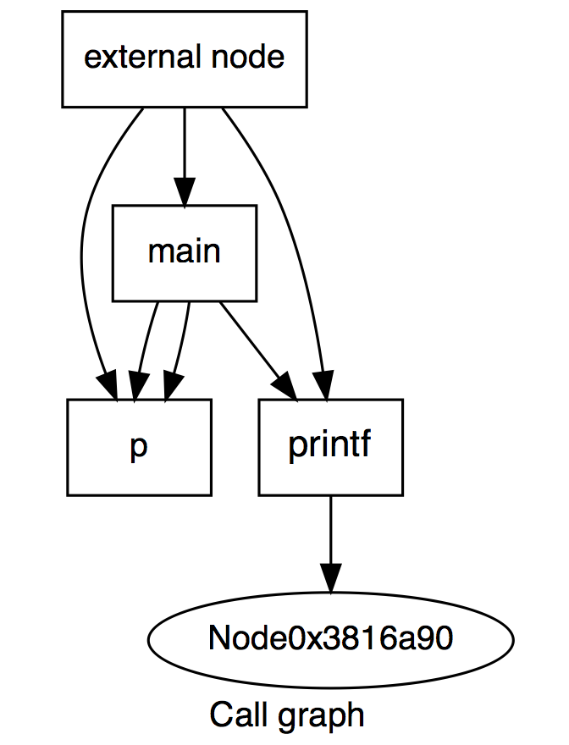
Generating a call graph with LLVM
From the command line:
opt -dot-callgraph program.bc -disable-output
(see test0)
From your pass:
See iterate_over_functions
CallGraphWrappingPass

Slide 15
Outline
Sensitivity of analysis
Single compilation
Separate compilations
Caller -> callee vs. callee -> caller propagations
Final remarks

Slide 16
Intra-procedural dataflow analysis
How do we do in H6?
main() {
A: x = 7;
B: r = p(x);
C: y = 80;
D: t = p(y);
E: print t, r;
}
int p (int v) {
F: if (v < 10)
G: m = 1;
else
H: m = 2;
I: return m;
}
main
p
IN = { }
A
IN = {A}
F
B
IN = {A, B}
IN = { }
IN = { }
C
H
G
IN = {A, B, C}
D
IN = {G, H}
IN = {A, B, C, D }
E
I

Slide 17
Inter-procedural dataflow analysis flow-sensitive
Accuracy?
Performance?
No separate analysis
Problem of invalid paths: dataflow facts from one call site “tainting” results at other call site
p analyzed with merge of dataflow facts from all call sites
How to address this problem?
How can we handle procedure calls?
Obvious idea: make one big CFG (control-flow supergraph)
main() {
A: x = 7;
B: r = p(x);
C: y = 80;
D: t = p(y);
E: print t, r;
}
int p (int v) {
F: if (v < 10)
G: m = 1;
else
H: m = 2;
I: return m;
}
A
IN = {A, G, H, C}
IN = {A}
F
B
IN = {A, G, H, C}
IN = {A,G,H,C}
IN = {A,G,H,C}
C
H
G
IN = {A, G, H, C}
D
IN = {A, G, H, C }
IN = {A, G, H, C}
E
I

Slide 18
Inter-procedural dataflow analysis flow/context-sensitive
main() {
A: x = 7;
B: r = p(x);
C: y = 80;
D: t = p(y);
E: print t, r;
}
int p (int v) {
F: if (v < 10)
G: m = 1;
else
H: m = 2;
I: return m;
}
Accuracy?
Performance?
A
IN = {B:{A},D:{A,C,G,H}}
IN = {A}
F
B
IN={B:{A}, D:{A,C,G,H}}
IN = {B:{A}, D:{A,C,G,H}}
IN = {A, B:{G, H}}
C
H
G
IN = {A, C, B:{G, H}}
IN = {B:{A,G,H}, D:{A,C,G,H}}
D
IN = {A, C, B:{G,H}, D:{G,H}}
E
I

Slide 19
Inlining
Inlining
Use a new copy of a procedure’s CFG at each call site

Slide 20

Inter-procedural dataflow analysis flow/context-sensitive
main() {
A: x = 7;
B: r = p(x);
C: y = 80;
D: t = p(y);
E: print t, r;
}
int p (int v) {
F: if (v < 10)
G: m = 1;
else
H: m = 2;
I: return m;
}
What did it change?
Solutions?
A
IN = {A}
F
H
G
I
IN = {A, G, H}
C
IN = {A, C, G, H}
F’
H’
G’
I’
IN = {A, C, G, H, G’,H’}
E

Slide 21
Inlining
Inlining
Use a new copy of a procedure’s CFG at each call site
Useful if not used always
Problems?
May be expensive! Exponential increase in size of CFG
You can’t always determinate callee at compile time (e.g., in OO languages)
Library source is usually unavailable
What about recursive procedures?
p(int n) { … p(n-1); … }
More generally, cycles in the call graph

Slide 22
Inter-procedural dataflow analysis flow/context/path-sensitive
Accuracy?
Performance?
main() {
A: x = 7;
B: r = p(x);
C: y = 80;
D: t = p(y);
E: print t, r;
}
int p (int v) {
F: if (v < 10)
G: m = 1;
else
H: m = 2;
I: return m;
}
A
IN = {B:{A},D:{A,C,B:{G}}}
IN = {A}
F
B
IN={D:{A,C,B:{G}}}
IN = {B:{A}}
IN = {A, B:{G}}
C
H
G
IN = {A, C, B:{G}}
IN = {B:{A,G}, D:{A,C,B:{G},H}}
D
IN = {A, C, B:{G}, D:{H}}
E
I

Slide 23
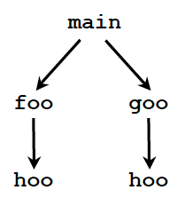
Inter-procedural dataflow analysis flow/context-sensitive
What about programs with a deep hierarchy of many procedures?
Re-analyze callee for all distinct calling paths
Pro: precise
Cons: exponentially expensive
Solution: separate compilation
main() {
A: x = 7;
B: r = p(x);
C: y = 80;
D: t = p(y);
E: print t, r;
}
int p (int v) {
F: if (v < 10)
G: m = 1;
else
H: m = 2;
I: return m;
}
A
IN = {B:{A},D:{A,C,G,H}}
IN = {A}
F
B
IN={B:{A}, D:{A,C,G,H}}
IN = {B:{A}, D:{A,C,G,H}}
IN = {A, B:{G, H}}
C
H
G
IN = {A, C, B:{G, H}}
IN = {B:{A,G,H}, D:{A,C,G,H}}
D
IN = {A, C, B:{G,H}, D:{G,H}}
E
I

Slide 24
Outline
Sensitivity of analysis
Single compilation
Separate compilations
Caller -> callee vs. callee -> caller propagations
Final remarks

Slide 25
Summary context: example
Summary context: summarize effect of called procedure for callers
main
main
p
IN = { }
A
IN = {A}
F
p
B
IN = {A, B}
IN = { }
IN = { }
Accuracy? compared to
Intra-procedural
Inter-procedural flow-sensitive
Inter-procedural flow/context sensitive
C
H
G
IN = {A, B, C}
D
IN = {G, H}
IN = {A, B, C, D }
E
I
Summary: p returns not constants

Slide 26
Summary context: example 2
Summary context: summarize effect of called procedure depending on formal parameters for callers
main
p
IN = { }
A
main
IN = {A}
F
B
IN = {A, B}
IN = { }
IN = { }
p
C
H
G
IN = {A, B, C}
Accuracy? compared to
Intra-procedural
Inter-procedural flow-sensitive
Inter-procedural flow/context sensitive
D
IN = {G, H}
IN = {A, B, C, D }
E
I
Summary: p returns
Constant 1 if parameter is < 10
Constant 2 otherwise

Slide 27
Designing an inter-procedural analysis
Summary information e.g., constant/not-constant
e.g., no summary (single compilation)
What to summarize
Sensitivity e.g., context

Slide 28
Context sensitivity
Simple solution: make a small number of copies of contexts (e.g., even just 1 per procedure) (e.g., all callees of a procedure from a caller)
Advanced solutions: use context information to determine when to share a copy
Choice of what to use for context will produce different tradeoffs between precision and scalability
Common choice: approximation of call stack

Slide 29
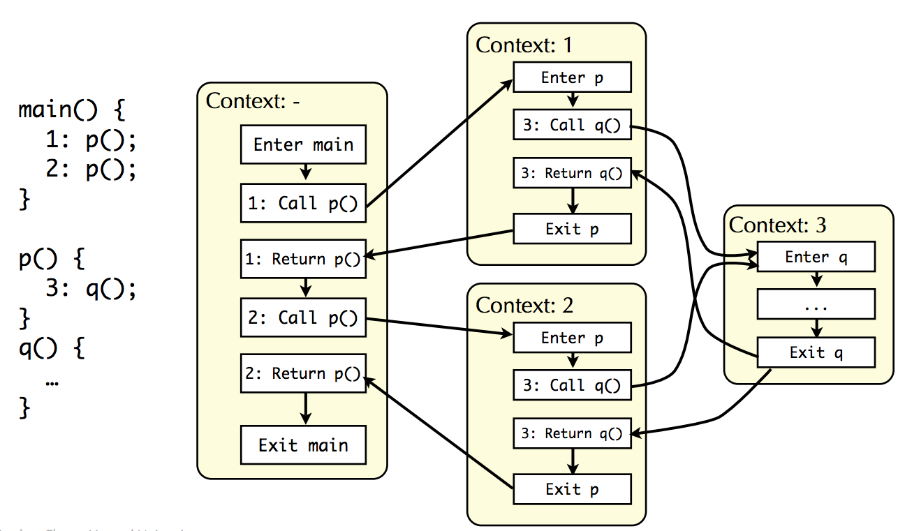
Context sensitivity example

Slide 30
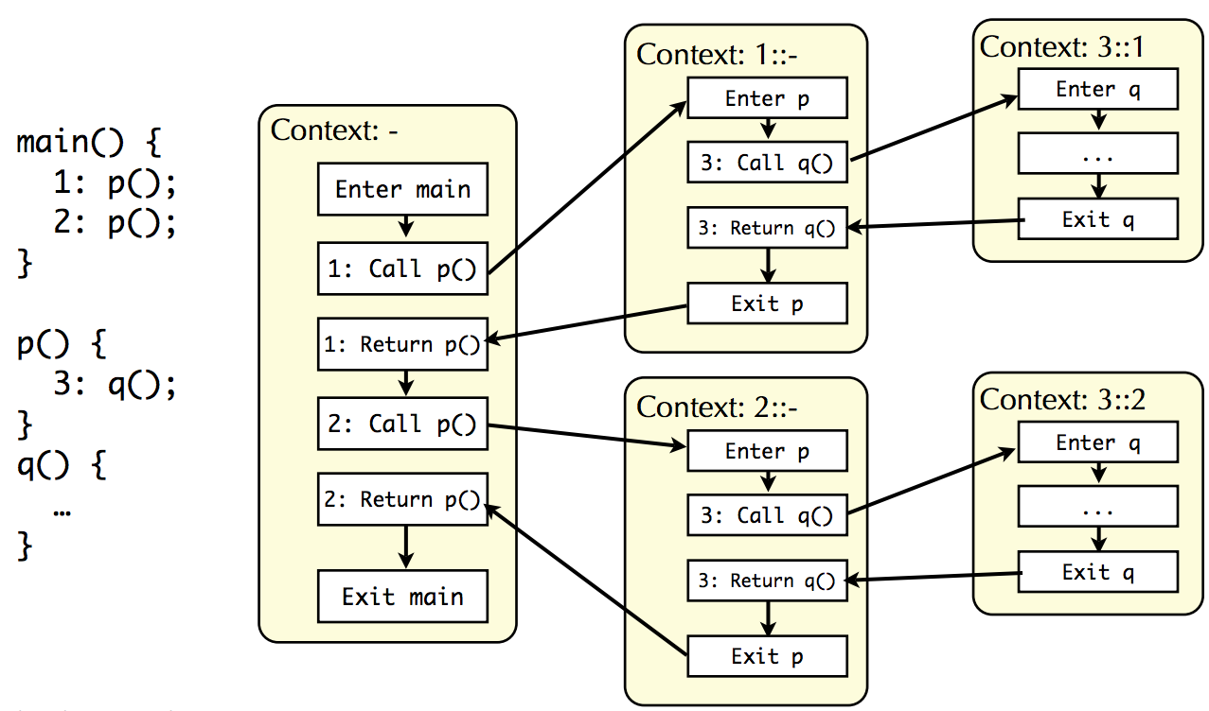
Context sensitivity example

Slide 31
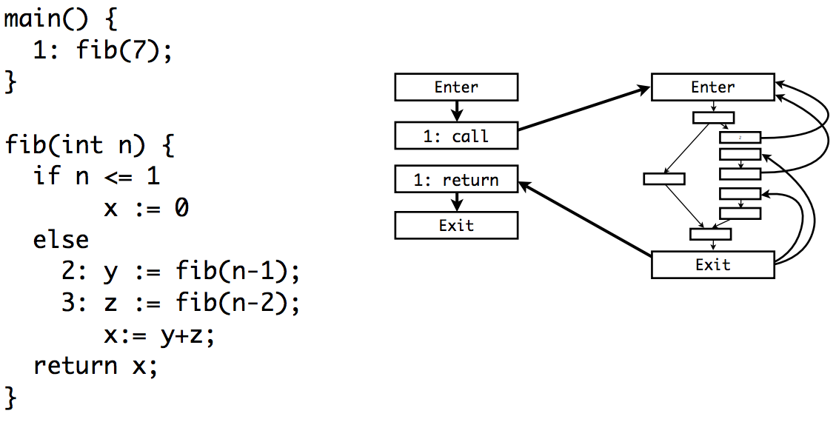
Fibonacci: context insensitive

Slide 32
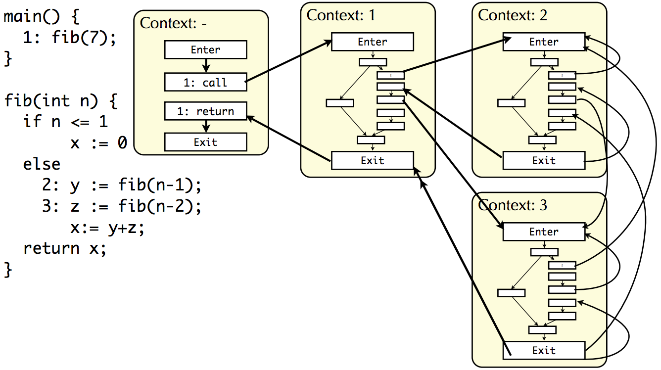
Fibonacci: context sensitive, stack depth 1

Slide 33
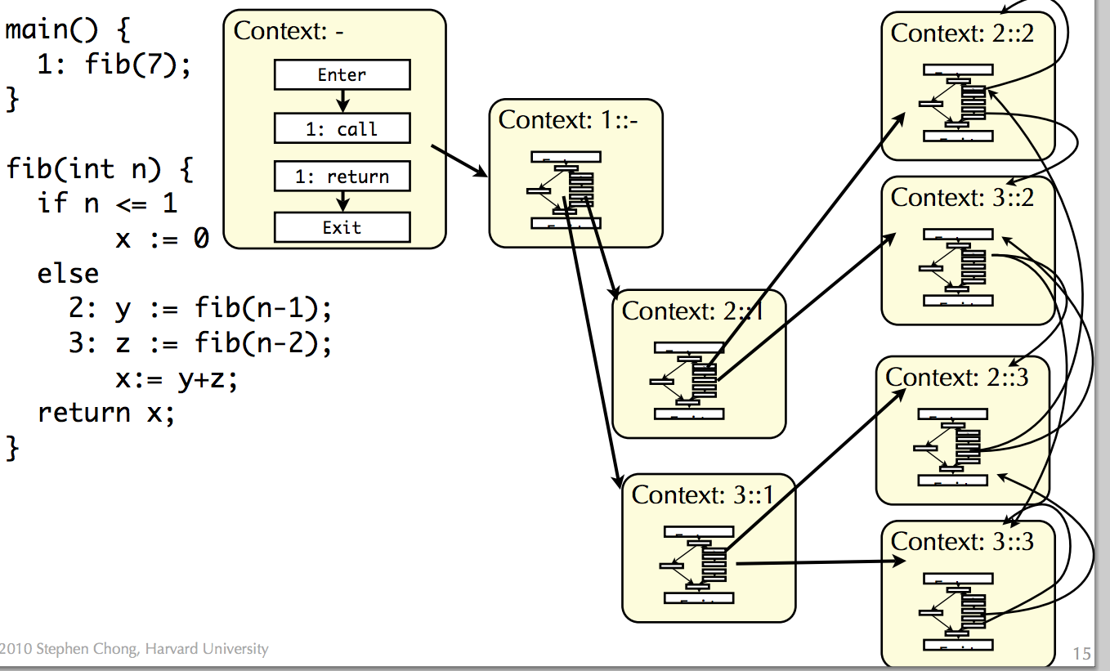
Fibonacci: context sensitive, stack depth 2

Slide 34
Designing an inter-procedural analysis
Summary information e.g., constant/not-constant
e.g., no summary (single compilation)
What to summarize
How to
propagate
Sensitivity e.g., context

Slide 35
Outline
Sensitivity of analysis
Single compilation
Separate compilations
Caller -> callee vs. callee -> caller propagations
Final remarks

Slide 36
Inter-procedural analysis: summary contexts
Compute summary information for each procedure
Summarize effect of called procedure for callers
Summarize effect of callers for called procedure
Store summaries in database
Use later when optimizing procedures
Pros
Concise
Can be fast to compute and use
Separate compilation is practical
Cons
Imprecise if only have one summary per procedure

Slide 37
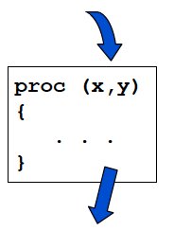
Two types of information
Track information that flows into a procedure
Also known as propagation problems
e.g., What formals are constant?
e.g., Which formals are aliased to globals?
Track information that flows out of a procedure
Also known as side effect problems
e.g., Which globals are def’d/used by a procedure?
e.g., Which locals are def’d/used by a procedure?
e.g., Which actual parameters are def’d by a procedure?

Slide 38
Computing inter-procedural summaries
Top-down
Summarize information about the caller (MAY-ALIAS, MUST-ALIAS)
Use this information inside the procedure body
int a;
void foo(int &b, &c){
. . .
}
foo(a,a);
Bottom-up
Summarize the effects of a call (MOD, REF, KILL)
Use this information around procedure calls
x = 7;
foo(x);
y = x + 3;

Slide 39
Example: identify functions that might get affected by rand()
Ideas?
Check test2, test3
Pass: llvm/random

Slide 40
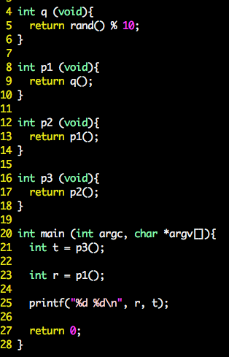
Example: identify functions that might get affected by rand()
Functions affected:
Level 0: q
Level 1: p1
Level 2: p2
Level 3: p3
Level 2: main
Functions not affected:

Slide 41
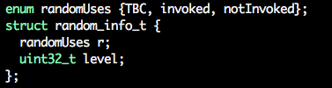
Example: identify functions that might get affected by rand()
Data structures:
Summary

Slide 42
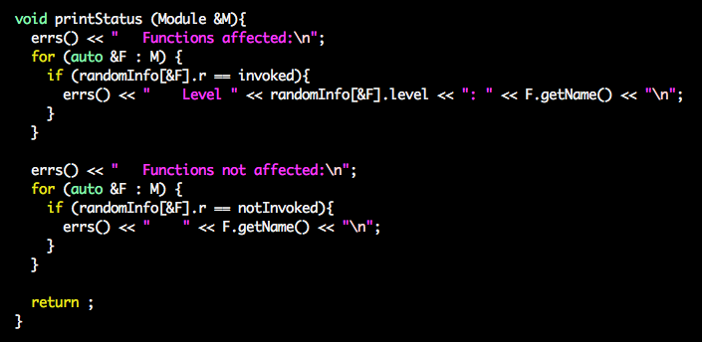
Example: identify functions that might get affected by rand()
Functions affected:
Level 0: q
Level 1: p1
Level 2: p2
Level 3: p3
Level 2: main
Functions not affected:

Slide 43
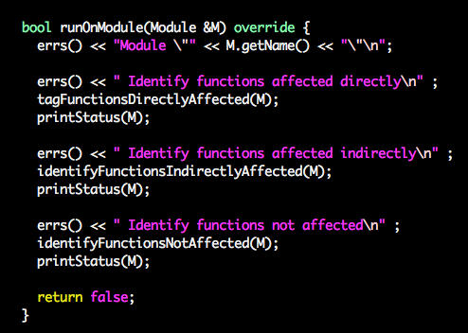
Example: identify functions that might get affected by rand()

Slide 44
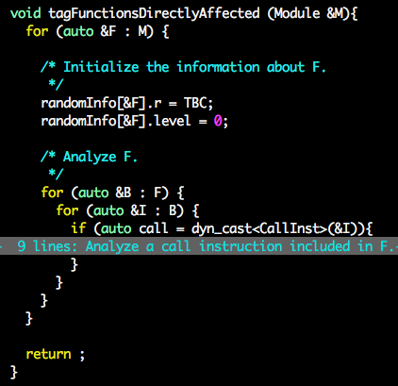
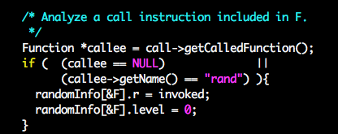
Example: identify functions that might get affected by rand()

Slide 45
Example: identify functions that might get affected by rand()

Slide 46
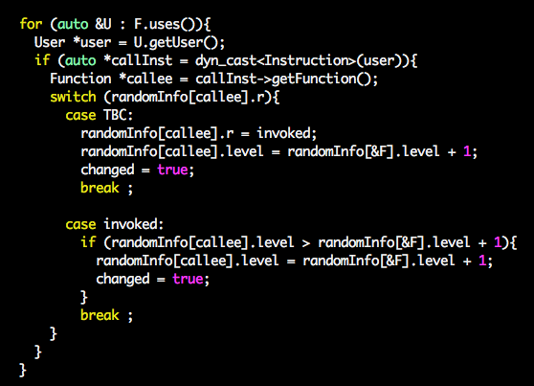
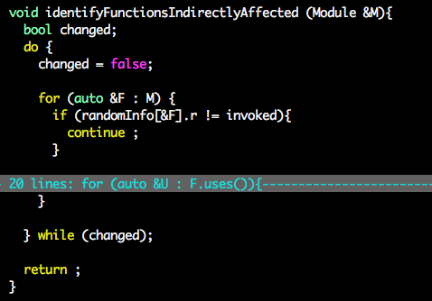
Example: identify functions that might get affected by rand()

Slide 47
Example: identify functions that might get affected by rand()

Slide 48
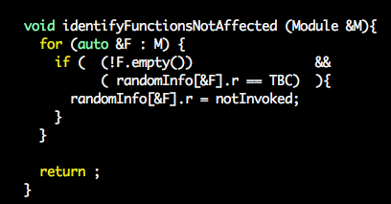
Example: identify functions that might get affected by rand()

Slide 49
Computing inter-procedural summaries
Top-down
Summarize information about the caller (MAY-ALIAS, MUST-ALIAS)
Use this information inside the procedure body
int a;
void foo(int &b, &c){
. . .
}
foo(a,a);
Bottom-up
Summarize the effects of a call (MOD, REF, KILL)
Use this information around procedure calls
x = 7;
foo(x);
y = x + 3;
Is our pass Top-down or bottom-up?

Slide 50
Other summary examples
Propagation Summaries
MAY-ALIAS: The set of formals that may be aliased to globals and each other
MUST-ALIAS: The set of formals that are definitely aliased to globals and each other
CONSTANT: The set of formals that must be constant
Side-effect Summaries
MOD: The set of variables possibly modified (defined) by a call to a procedure
REF: The set of variables possibly read (used) by a call to a procedure
KILL: The set of variables that are definitely killed by a procedure (e.g., in the liveness sense)

Slide 51
Context-sensitivity of summaries
None ( zero levels of the call path )
Forward propagation: Meet information from all callers to particular callee
Side-effects: Use side-effect information for callee at all call-sites
Call-site ( one level of the call path )
Forward propagation: Label data-flow information with call-site
Side-effects: Affects alias analysis, which in turn affects side-effects

Slide 52
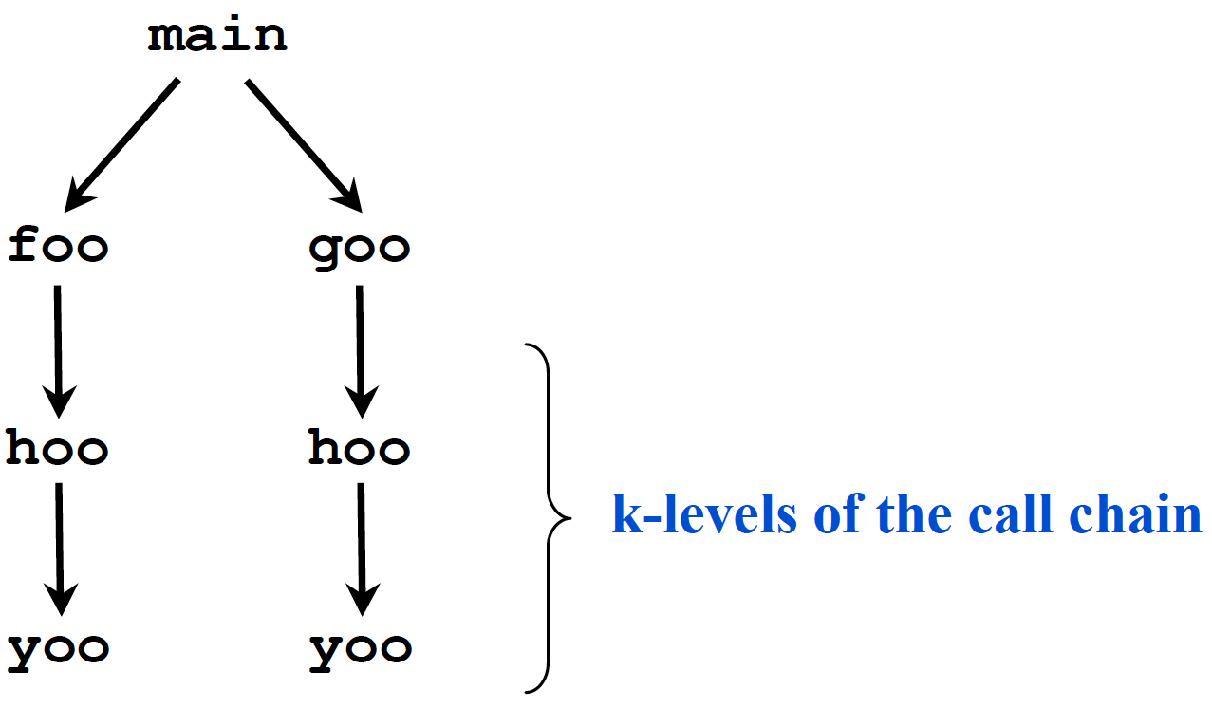
Context-sensitivity of summaries (2)
k levels of call path (k-limiting )
Forward propagation: Label data-flow information with k levels of the call path
Side-effects: Affects alias analysis, which in turn affects side-effects

Slide 53
Outline
Sensitivity of inter-procedural analysis
Single compilation
Separate compilations
Caller -> callee vs. callee -> caller propagations
Final remarks

Slide 54
What about cycles in the call graph?

Slide 55
Handling cycles in the call graph
Long story short: iterate until a fixed point is reached
It can take a while for naïve solutions …
Strongly connected components: A directed graph is called strongly connected if there is a path in each direction between each pair of vertices of the graph
A
B
C
D
E
F
G
H

Slide 56
Handling cycles in the call graph
To reach the fixed point faster:
Identify strongly-connected-components (SCC)
do{
For each SCC in SCCs:
Iterate among functions within SCC
Iterate among every node in the call graph
} while (anyChange);
A
B
C
D
E
F
G
H

Slide 57
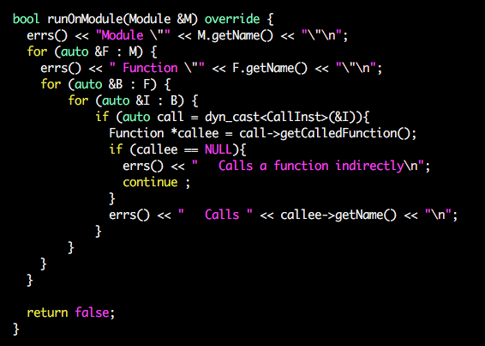
Indirect calls
void foo (int a, int (*p_to_f)(int v)){
int l = (*p_to_f)(5);
a = l + 1;
return a;
}
How can we identify indirect calls in LLVM?
How can we handle indirect calls?
Is l constant?

Slide 58
Bi-directional inter-procedural summaries
Inter-procedural Constant Propagation (ICP)
Information flows from caller to callee and back
int a, b, c, d;
void foo(e){
a = b + c;
d = e + 2;
}
foo(3);
Inter-procedural Alias Analysis
Forward propagation: aliasing due to reference parameters
Side-effects: points-to relationships due to multi-level pointers
The calling context tells us that the formal e is bound to the constant 3, which enables constant propagation within foo()
After calling foo() we know that the constant 5 (3+2) propagates to the global d

Slide 59
Other contexts
Context sensitivity distinguishes between different calls of the same procedure
Choice of contexts determines which calls are differentiated
Other choices of context are possible
Caller stack
Less precise than call-site stack
E.g., context “2::2” and “2::3” would both be “fib::fib”
Object sensitivity: which object is the target of the method call?
For OO languages
Maintains precision for some common OO patterns
Requires pointer analysis to determine which objects are possible targets
Can use a stack (i.e., target of methods on call stack)

Slide 60
Other contexts
More choices
Assumption sets What state (i.e., dataflow facts) hold at the call site?
Combinations of contexts
e.g., Assumption set and object

Slide 61
Today’s compilers
Most compilers avoid inter-procedural analysis
It’s expensive and complex
Not beneficial for most classical optimizations
Separate compilation + inter-procedural analysis requires recompilation analysis [Burke and Torczon’93]
Can’t analyze library code
When is it useful?
Pointer analysis
Constant propagation
Object oriented class analysis
Security and error checking
Program understanding and re-factoring
Code compaction
Parallelization
Modern uses of compilers

Slide 62
Other trends
Cost of procedures is growing
More of them and they’re smaller (OO languages)
Modern machines demand precise information (memory op aliasing)
Cost of inlining is growing
Code bloat degrades efficacy of many modern structures
Procedures are being used more extensively
Programs are becoming larger
Cost of inter-procedural analysis is shrinking
Faster/more parallel machines
Better methods

Slide 63
Procedure cloning
Procedure Cloning/Specialization
Create a customized version of procedure for particular call sites
Compromise between inlining and inter-procedural optimization
Pros
Less code bloat than inlining
Recursion is not an issue (as compared to inlining)
Better caller/callee optimization potential (versus inter-procedural analysis)
Cons
Still some code bloat (versus inter-procedural analysis)
May have to do inter-procedural analysis anyway e.g. Inter-procedural constant propagation can guide cloning

Slide 64
Example: make functions with level >=3 not affected by rand()
Check test2, test4
Pass: llvm/random_with_cloning

Slide 65
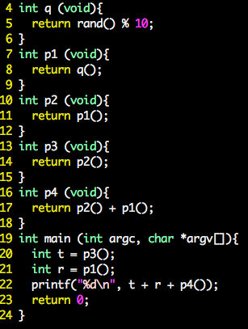
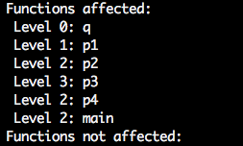
Example: reduce by >=1 the level of functions affected by rand() at level 3 or above
Ideas?

Slide 66
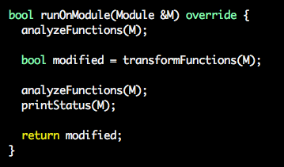
Example: reduce by >=1 the level of functions affected by rand() at level 3 or above
Previous inter-procedural analysis
Inter-procedural transformation

Slide 67
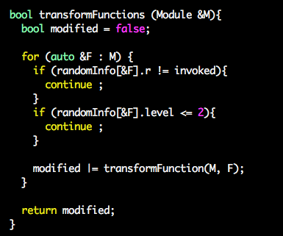
Example: reduce by >=1 the level of functions affected by rand() at level 3 or above

Slide 68
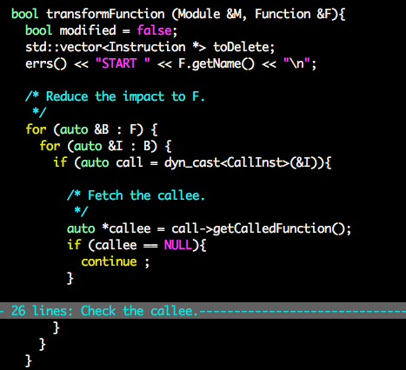
Example: reduce by >=1 the level of functions affected by rand() at level 3 or above
Checking if
the callee is “rand()”
Substitute call rand() with “1”
The callee invokes another function F2 at level – 1
Clone F2: F2’
Invoke F2’ instead of F2
Make F2’ not affected by rand

Slide 69
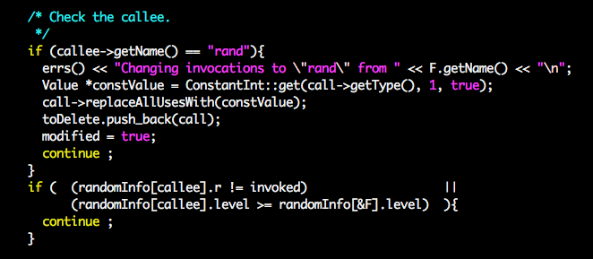
Example: reduce by >=1 the level of functions affected by rand() at level 3 or above

Slide 70
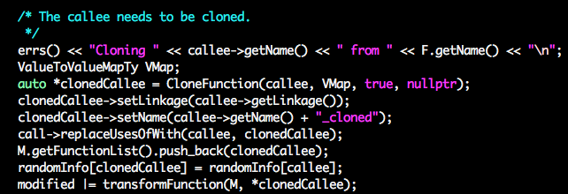
Example: reduce by >=1 the level of functions affected by rand() at level 3 or above

Slide 71
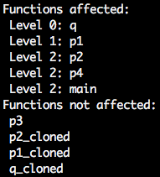
Example: reduce by >=1 the level of functions affected by rand() at level 3 or above
Does this inter-procedural transformation converge always?

