Slide 1
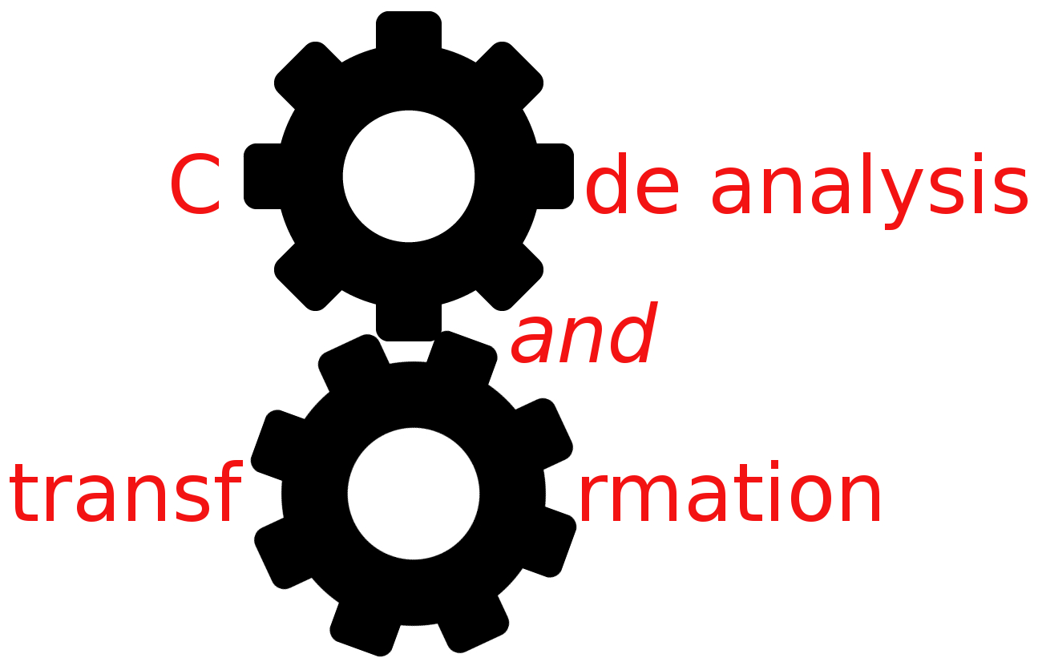


IPA example analysis
Simone Campanoni simonec@eecs.northwestern.edu

Slide 2
Research paper
Title: Practical and Accurate Low-Level Pointer Analysis
Authors: Bolei Guo Matthew J. Bridges Spyridon Triantafyllis Guilherme Ottoni Easwaran Raman David I. August
CGO, 2005
VLLPA

Slide 3
Outline
Motivation
Abstractions used
Data-flow intra-procedural analysis
Inter-procedural analysis
Evaluation

Slide 4
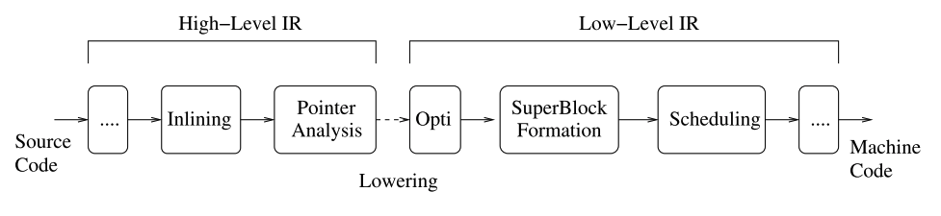
Alias analysis for C programs
Usually run once at the source level (the DDG is also computed)
Compilation passes modify the IR, so they must update the DDG
Add complexity to each pass
Updates are conservative

Slide 5
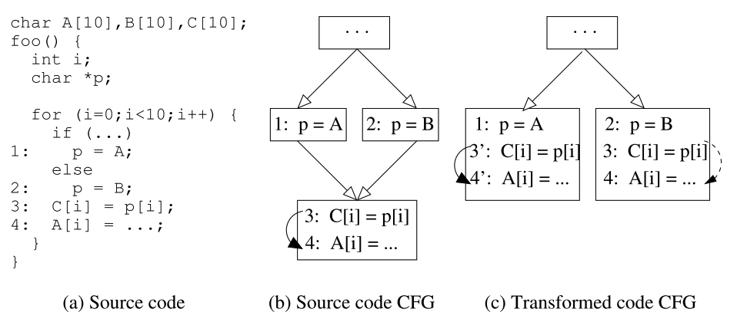
Alias analysis for C programs

Slide 6
VLLPA: a low level pointer analysis for C programs
This paper proposes an alias analysis at the IR level
It can be run multiple times
No conservative updates
Passes are simpler
No data type information (not very useful for C anyway)
The first context-sensitive and partially flow-sensitive low-level points-to analysis algorithm

Slide 7
Outline
Motivation
Abstractions used
Data-flow intra-procedural analysis
Inter-procedural analysis
Evaluation

Slide 8
Memory abstraction
Memory location at analysis time = abstract address
Abstract structure = contiguous set of abstract addresses
Memory is divided into a set of abstract structures, each with a unique name
Each structure can correspond to multiple blocks at runtime
Unbounded set of memory blocks -> finite set of abstract names
An abstract structure is created for each global variable

Slide 9
Memory abstraction
Activation frame:
One abstract structure for each
Incoming parameter space
Outgoing parameter space
Local variable space
Heap object allocated:
Named according to the context (2 call stack depth)

Slide 10
Abstract structures
<S,o>
S is a structure name
o is an offset
VLLPA merges all array elements
myArray[5] is the same location of myArray[42]
Conservative assumption
More aliases
Much faster analysis

Slide 11
Abstract structures, pointer aliases, and dependencies
Two pointers alias if there is an abstract address that they can both point to
There is a dependence between wo instructions if the pointers used by them alias

Slide 12
Unknown Initial Values (UIVs)
Represent memory blocks accessible by a function, but not created by either that function or its callees
UIVs are created for memory blocks reachable (directly or indirectly) through parameters or global variables
They encode the “unknown”

Slide 13
Unknown Initial Values (UIVs)
For a parameter A, [A] represents the memory block pointed by A
void myF (void *P0){
Var1 = P0
…
}
What is the abstract address pointed by Var1?
<[P0],0>

Slide 14
Unknown Initial Values (UIVs)
If [A] has a field at offset o, which is a pointer, then the following new UIV is created: [A]@o
void myF (void *P0){
Var1 = P0
…
Var2 = Mem[Var1+4]
…
}
UIVs are created lazily
Abstract structure pointed by Var1: <[P0],0>
What is the abstract structure pointed by Var2?
<[P0]@4,0>

Slide 15
Outline
Motivation
Abstractions used
Data-flow intra-procedural analysis
Inter-procedural analysis
Evaluation

Slide 16
Main challenge
Common memory operations (array and field accesses) do not appear explicit in the code
Vx = Vy + 10
Vz = Mem[Vx]
The analysis has to infer whether a memory operation “looks like” a field and/or array access

Slide 17
Intra-procedural analysis
Assume SSA
One assignment per variable. Therefore
For each variable, we need to maintain a single points-to set
R(var) = mapping from a variable to a set of abstract addresses that might point to
Not flow-sensitive for pointers in memory
Single points-to set for each abstract memory location
M(addr) = mapping from an abstract address to a set of abstract addresses that might point to
UIVs of the function analyzed
I(f) = set of UIVs of function f
Propagated

Slide 18
VLLPA main blocks
Intra-procedural analysis:
Compute R, M, I
Inter-procedural analysis:
Propagate M, I through the call graph
Map abstract addresses to UIVs
Update the call graph

Slide 19
Intra-procedural analysis
Modify R, M, and I with a data-flow analysis
Var1 = Mem[Var2]
R(var1) = { M(<S,o>) | <S,o> ∈R(var2) }
Mem[Var1] = Var2
For each <S,o> ∈ R(Var1):
M(<S,o>) ∪= R(Var2)
Var1 = Var2 + c
R(Var1) = { <S,o+c> | <S,o> ∈ R(Var2)}

Slide 20
Intra-procedural analysis
Var1 = Var2 + Var3
R(Var1) = { <S,o+c> | <S,o> ∈ R(Var2) and c = infer_offset(Var3)} ∪
{ <S,o+c> | <S,o> ∈ R(Var3) and c = infer_offset(Var2)}
VarX = PHI(Var1, Var2, … VarN)
R(VarX) = R(Var1) ∪ R(Var2) ∪ … ∪ R(VarN)
Offset assumed to follow i x l + c
l is the size of array elements
c is a constant displacement (non-zero if the array is a structure field)

Slide 21
Intra-procedural analysis
In all equations:
If <[UIV],c> ∈ R and <[UIV]@N,c> ∈ R then remove the latter
If <S,o1> ∈ R and
<S,o2> ∈ R and o1 < o2 then remove <S,o2>
Elements of the same array are represented as a single abstract address

Slide 22
Termination
Data-flow analysis can only add new elements in R, M, and I
They increase monotonically
To ensure termination: there is an upper bound to R, M, and I
Finite number of abstract addresses
Problem 1: unbounded UIVs?
Problem 2: unbounded offsets?

Slide 23
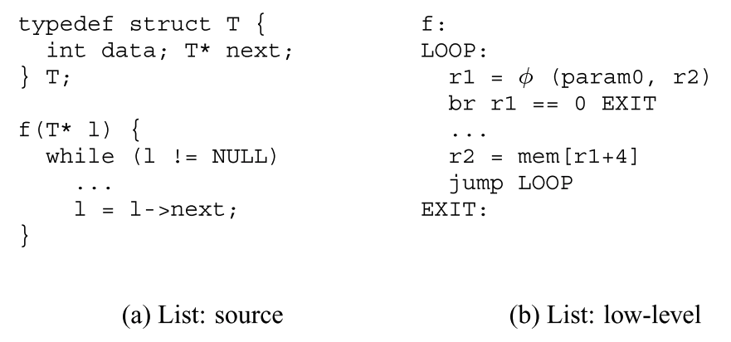
Termination: unbounded UIVs?
R(r1) ={<[P0],0>,
<[P0]@4,0>,
<[P0]@4@4,0>
UIV: P0
If <[UIV],c> ∈ R and <[UIV]@N,c> ∈ R , then remove the latter

Slide 24
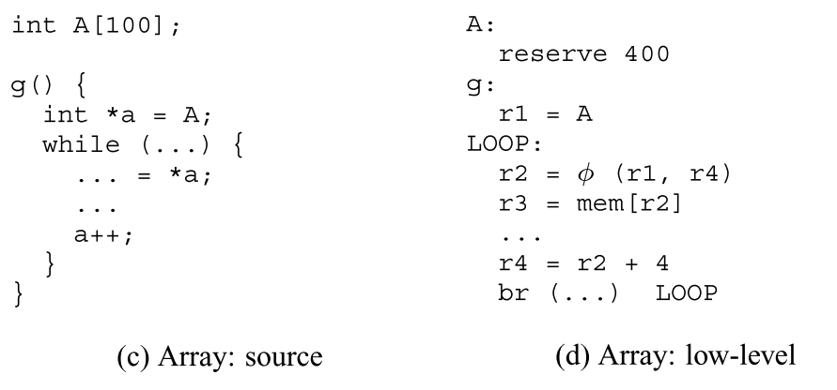
Termination: unbounded offsets?
R(r2) ={ <[P0],0>,
<[P0],4>, <[P0],8>, …
If <S,o1> ∈ R and <S,o2> ∈ R and o1 < o2 then remove <S,o2>

Slide 25
Outline
Motivation
Abstractions used
Data-flow intra-procedural analysis
Inter-procedural analysis
Evaluation

Slide 26
VLLPA summary
Summary: set of memory locations that might be referenced by each variable of a function
Transfer function
F1
F2

Slide 27
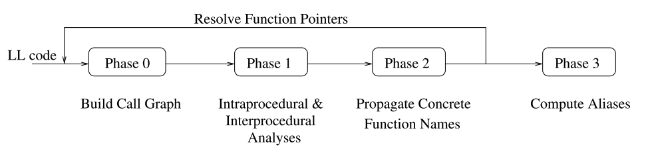
Algorithm outline
SCC-DAG is traversed in reverse topological order
Unknown initial values (UIV) assumed
First iteration: indirect calls have no target
Call graph is augmented with later iterations
SCC-DAG is computed from the call graph

Slide 28
Algorithm outline
SCC-DAG is traversed in reverse topological order
Unknown initial values (UIV) assumed
SCC-DAG traversed in topological order to resolve UIVs and indirect calls
If any indirect calls change: start over at phase 0

Slide 29
Algorithm outline
The now complete SCC-DAG is traversed once more in topological order to compute aliases

Slide 30
Inter-procedural analysis
Mapping abstract addresses of F to UIVs of G
M_{f}, I_{f}, R_{f}
M_{g}, I_{g}
F
G

Slide 31
Outline
Motivation
Abstractions used
Data-flow intra-procedural analysis
Inter-procedural analysis
Evaluation

Slide 32
VLLPA evaluation
Comparing against high-level language alias analysis
Analysis time
Accuracy of the analysis
Performance of the generated binary

Slide 33
Evaluation: Comparing alias analyses
Evaluation

Slide 34
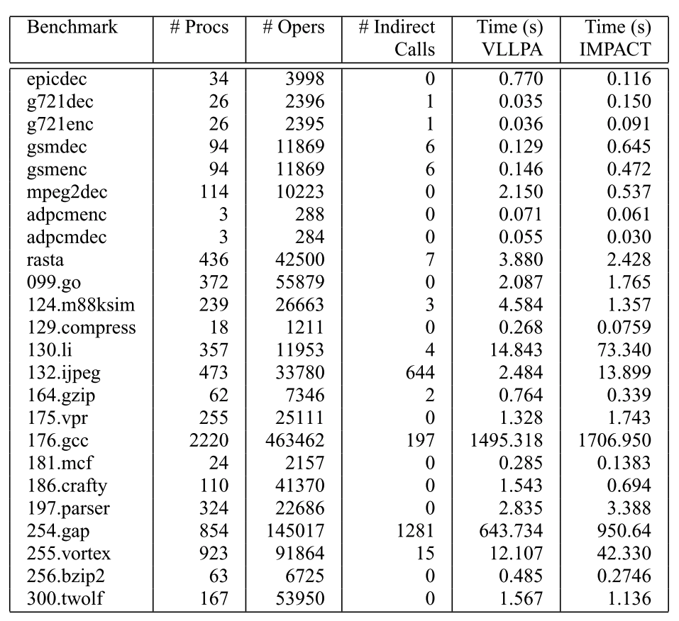
Evaluation: analysis time

Slide 35
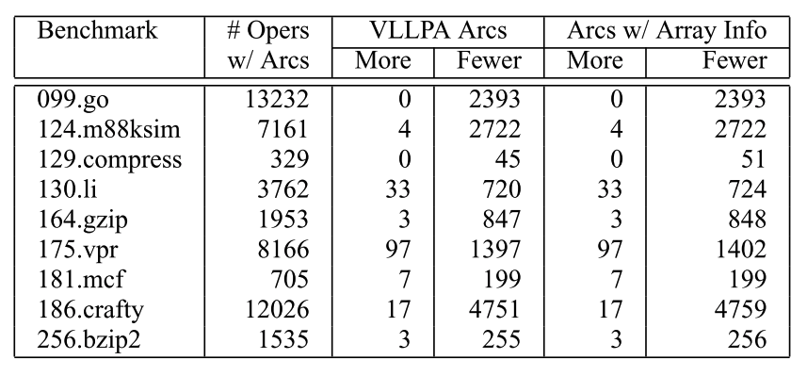
Evaluation: accuracy

Slide 36
Evaluation: problem of alias analysis at the source language
Evaluation

Slide 37
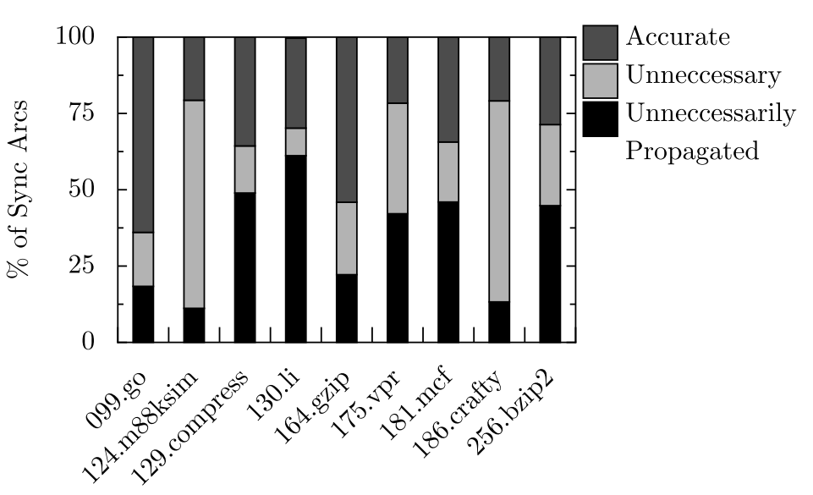
Evaluation: problem of alias analysis at the source language
Same deps
Better accuracy of VLLPA
Apparent deps generated by the conservative pass updates

Slide 38
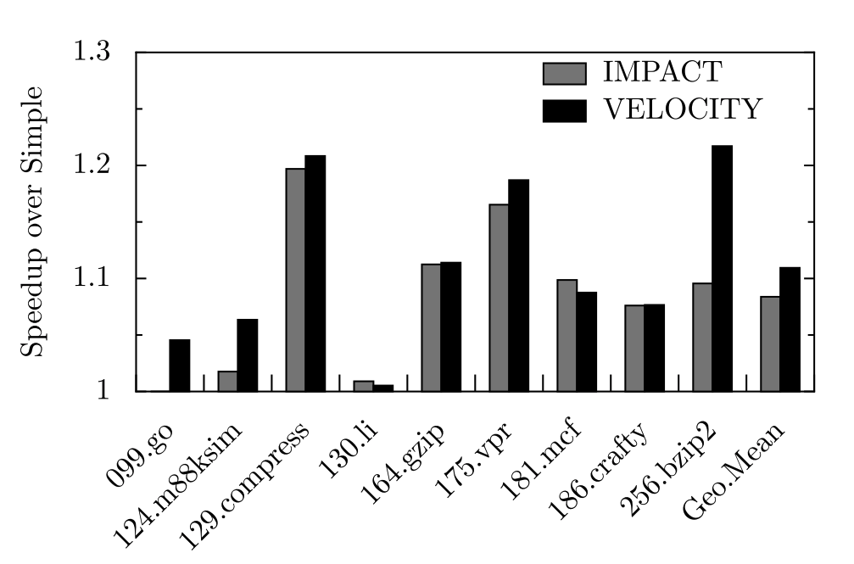
Evaluation: performance of the generated binary

Slide 39
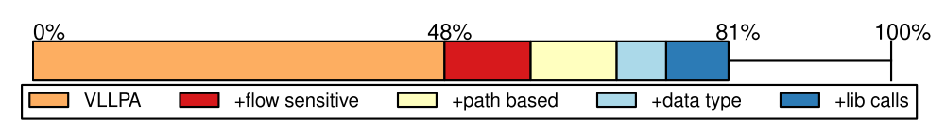
Improved VLLPA in HELIX-RC (ISCA 2014)

Slide 40
After 2014
Approximating Flow-Sensitive Pointer Analysis Using Frequent Itemset Mining Vaivaswatha Nagaraj and R. Govindarajan CGO 2015
… many others
A Collaborative Dependence Analysis Framework Nick P. Johnson, Jordan Fix, Taewook Oh, Stephen R. Beard, Thomas B. Jablin, and David I. August CGO 2017

