Slide 1
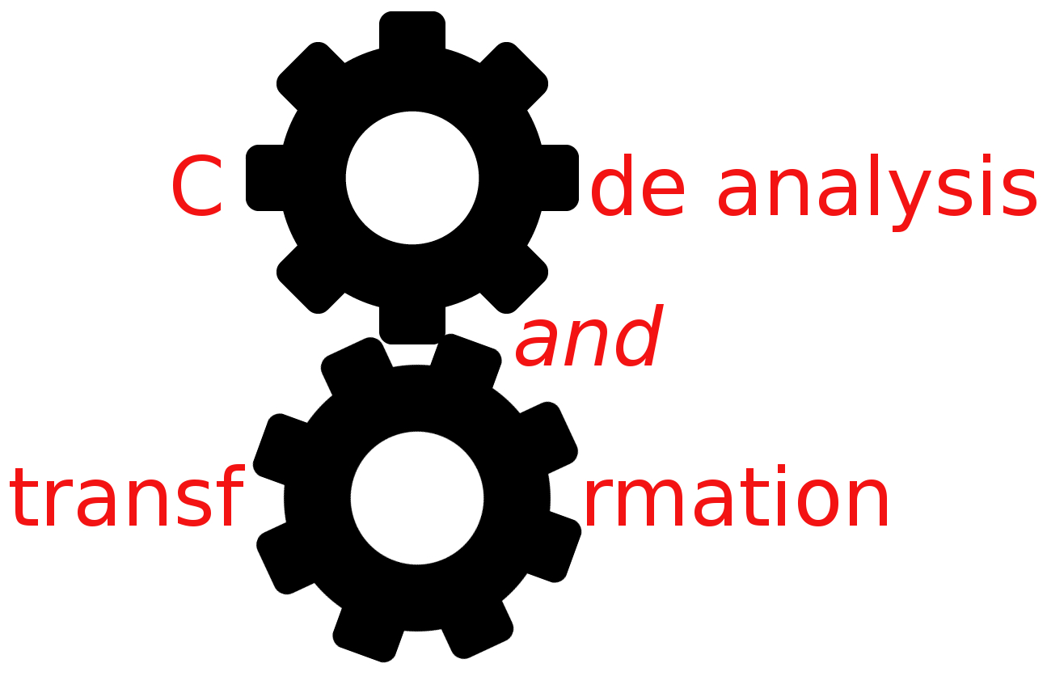


LLVM
Simone Campanoni simonec@eecs.northwestern.edu

Slide 2
Problems with Canvas?
Problems with slides?
Any problems?
Makefile tutorial: http://www.cs.colby.edu/maxwell/courses/tutorials/maketutor

Slide 3

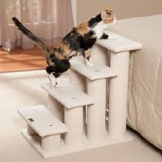

Outline
Introduction to LLVM
CAT steps
Hacking LLVM

Slide 4
LLVM
LLVM is a great, hackable compiler for C/C++-like languages
But it’s also
A JIT
A compiler for other languages (Java, CIL bytecode, etc…)
LLVM is modular and well documented
Started from UIUC
It’s now the research tool of choice
It’s an industrial-strength compiler
Apple, AMD, Intel, NVIDIA

Slide 5
LLVM common use at 10000 feet
Source files
clang
Lib/tool…
Lib/tool…
Lib/tool 1
Lib/tool 2
Lib/tool…
Lib/tool…
Lib/tool 3
Lib/tool 4
Lib/tool…
Lib/tool…
LLVM
We talk bitcode
Binary

Slide 6
LLVM internals
Each component is composed of pipelines
Each stage: reads something as input and generates something as output
To develop a stage: specify how to transform the input to generate the output
Complexity lies in linking stages
In this class: we’ll look at concepts/internals of middle-end
But some of them are still valid for front-end/back-end

Slide 7
LLVM and other compilers
LLVM is designed around it’s IR
Multiple forms (human readable, bitcode on-disk, in memory)
IR
Front-end (Clang)
IR
Pass
Pass manager
IR
Middle-end
Pass
IR
IR
Back-end
…
Machine code

Slide 8
Pass manager
The pass manager orchestrates passes
It builds the pipeline of passes in the middle-end
The pipeline is created by respecting the dependences declared by each pass
Pass X depends on Y Y will be invoked before X

Slide 9
Pass types
Use the “smallest” one for your CAT
CallGraphSCCPass
ModulePass
ImmutablePass
FunctionPass
LoopPass
BasicBlockPass

Slide 10
Learning LLVM
Download the pre-compiled LLVM 3.8.1
On Mac OS: brew install --with-clang homebrew/versions/llvm38
On Linux: apt-get or others package manager or simply unpack the pre-compiled binaries
Read the documentation
Read the documentation
Read the documentation
Get familiar with LLVM documentation
Doxygen pages (API docs)
Language reference manual (IR)
Programmer’s manual (LLVM-specific data structures, tools)
Writing an LLVM pass

Slide 11
Homework: build your own compiler
Source files
cat-c
Your work
CAT
A bash script
LLVM IR
clang
Binary

Slide 12
LLVM IR
RISC-based
Instructions operate on variables
Load and store to access memory
Include high level instructions
Function calls (call)
Pointer arithmetics (getelementptr)

Slide 13
LLVM IR (2)
Strongly typed
No assignments of variables with different types
You need to explicitly cast variables
Load and store to access memory
Variables
Global (@myVar)
Local (%myVar)
Function parameter (define i32 @myF (i32 %myPar))

Slide 14
LLVM IR (3)
3 different (but 100% equivalent) formats
Assembly: human-readable format (FILENAME.ll)
Bitcode: machine binary on-disk (FILENAME.bc)
In memory: in memory binary
Generating IR
Clang for C-like languages (similar options w.r.t. GCC)
Different front-ends available

Slide 15
LLVM IR (4)
It’s a Static Single Assignment (SSA) representation
A variable is set only by one instruction in the function body
%myVar = …
A static assignment can be executed more than once
We’ll study SSA later

Slide 16
SSA and not SSA example
float myF (float par1, float par2, float par3){ return (par1 * par2) + par3; }
define float @myF(float %par1, float %par2, float %par3) {
%1 = fmul float %par1, %par2
%1 = fadd float %1, %par3
ret float %1 }
NOT SSA
define float @myF(float %par1, float %par2, float %par3) {
%1 = fmul float %par1, %par2
%2 = fadd float %1, %par3
ret float %2 }
SSA

Slide 17
SSA and not SSA
CATs applied to SSA-based code are faster!
Old compilers aren’t SSA-based
Transforming IR in its SSA-form takes time
When designing your CAT, think carefully about SSA
Take advantage of its properties

Slide 18
LLVM tools
clang to compile/optimize/generate LLVM IR code
To generate binaries from source code/IR code
Check Makefile you have in LLVM.tar.bz2
lli to execute (interpret/JIT) LLVM IR code
lli FILE.bc
llc to generate assembly from LLVM IR code
llc FILE.bc

Slide 19
LLVM tools
opt to analyze/transform LLVM IR code
Read LLVM IR file
Load external passes
Run specified passes
Respect pass order you specify as input
opt -pass1 -pass2 FILE.ll
Optionally generate transformed IR
Useful passes
opt -view-cfg FILE.ll
opt -view-dom FILE.ll
opt -help

Slide 20
LLVM summary
LLVM is an industrial-strength compiler also used in academia
Very hard to know in detail every component
Focus on what’s important to your goal
Become a ninja at jumping around the documentation
It’s well organized, documented with a large community behind it
Basic C++ skills are required

Slide 21
Final tips
LLVM includes A LOT of passes
Analyses
Transformations
Normalization
Take advantage of existing code
Try llc -march=cpp <bitcode>.bc -o APIs.cpp
I have a pointer to something. What is it?
getName() works on most things
errs() << TheThingYouDon’tKnow ;

Slide 22
Outline
Introduction to LLVM
CAT steps
Hacking LLVM

Slide 23
Code analysis and transformation
Code normalization
Analysis
Transformation

Slide 24
CAT example: loop hoisting
Do {
Work(varX);
varY = varZ + 1;
varX++;
} while (varX < 100);
varY = varZ + 1;
Do {
Work(varX);
varX++;
} while (varX < 100);
Loop hoisting

Slide 25
CAT example: loop hoisting (2)
Do {
Work(varX);
varY = varZ + 1;
varX++;
} while (varX < 100);
while (varX < 100) {
Work(varX);
varY = varZ + 1;
varX++;
}
And now?

Slide 26
Loop normalization
What: loop normalization pass
When: before running loop hoisting
Declare a dependence to your pass manager
Advantages?
Disadvantages?

Slide 27
CAT design
Understand the problem
Create representative code examples you expect to optimize
Optimize them by hand to test the best benefits of your optimization
Identify the common case
Define the normalized input code
Define the information you need to make your transformation safe
Design the analyses to automatically generate this information
Design the transformation
Test, test, test

Slide 28
Improving CAT
Improve your CAT by better handling your common cases
Improve your CAT by improving the normalization passes
Handle corner cases
Before we just simply ignored them (i.e., no transformation)

Slide 29
Let’s start hacking LLVM
As Linus Torvalds says …
Talk is cheap. Show me the code.
H0 assignment
(Homework/H0.tar.bz2)
LLVM use examples
(code/LLVM.tar.bz2)

