Slide 1
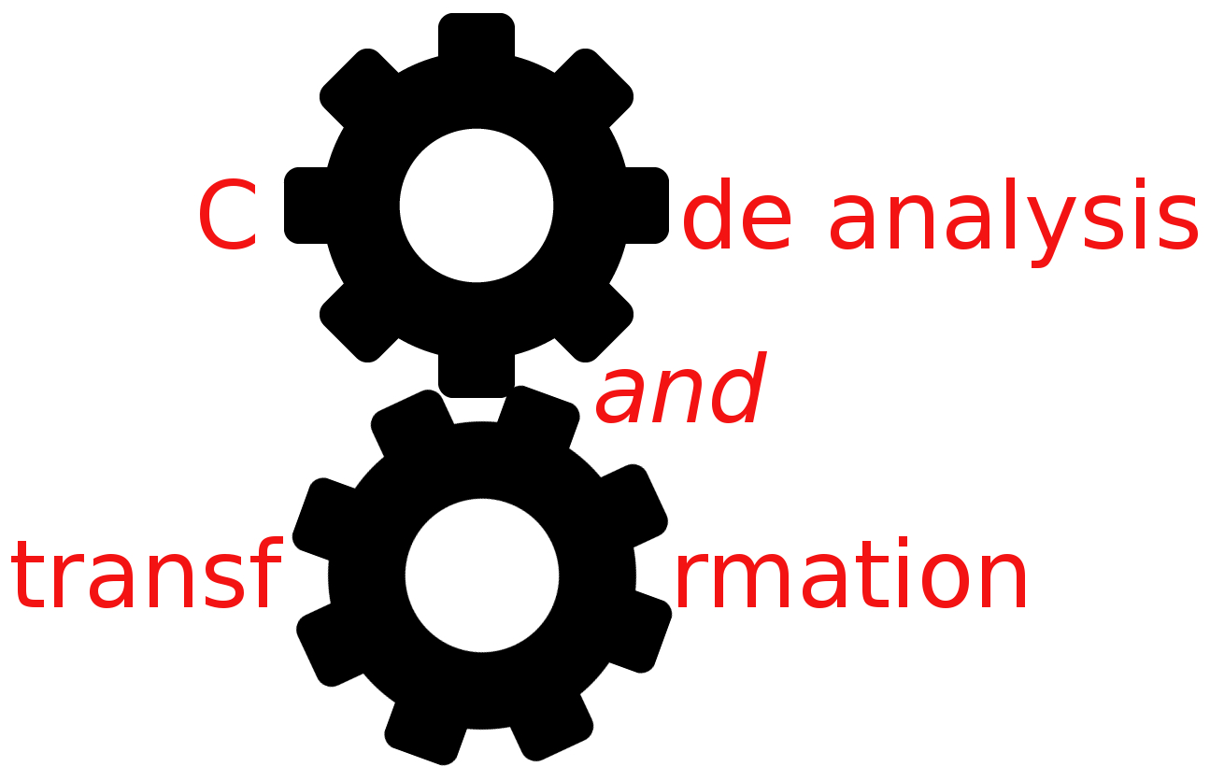


DFA foundations
Simone Campanoni simonec@eecs.northwestern.edu

Slide 2
Any problems with H2?
Or DFAs?

Slide 3
Data-flow analysis
Correctness: is the answer ALWAYS correct?
Meaning: what is exactly the meaning of the answer?
Precision: how good is the answer?
Convergence:
Will the analysis ALWAYS terminate?
Under what conditions does the iterative algorithm converge?
Speed: how long does it take to converge?

Slide 4
Outline
Lattice and data-flow analysis
DFA correctness
DFA convergence
DFA precision
DFA complexity

Slide 5
Understanding DFAs
We need to understand all of them
Liveness analysis: is it correct? Precision? Convergence?
Reaching definitions: is it correct? Precision? Convergence?
…
Idea: create a framework to help reasoning about them
Goal:
Provide a single formal model that describes all data-flow analyses
Formalize the notions of “safe,” “conservative,” and “optimal”
Correctness proof for DFAs
Place bounds on time complexity of iterative DFAs

Slide 6
Lattices
Lattice L = (V, ≤):
V is a (possible infinite) set of elements
≤ is a binary relation over elements of V
Properties of ≤:
≤ is a partial order (reflexive, transitive, anti-symmetric)
Every pair of elements in V has
A unique greatest lower bound (a.k.a. meet) and
A unique least upper bound (a.k.a. join)
Height of L: longest path through partial order from greatest to least
Infinite large lattice can still have finite height
Top (T) = unique greatest element of V (if it exists)
Bottom (⊥) = unique least element of V (if it exists)

Slide 7



Lattice example
How many apples I must have?
V = sets of apples
≤ = set inclusion
T = (best case) = all apples
⊥ = (worst case) no apples (empty set)
Apples, definitions, variables, expressions …
T={ , , }
{ , }
{ , }
{ , }
{ } ≤
{ , }
{ }
{ }
{ }
⊥={ }

Slide 8
How can we use this mathematical framework
, lattice,
to study DFA?

Slide 9
Use of lattice in DFA
Define domain of program properties (flow values --- apple sets) computed by data-flow analysis, and organize the domain of elements as a lattice
Define flow functions and a merge function over this domain using lattice operations
Exploit lattice theory in achieving goals

Slide 10
Data-flow analysis and lattice
Elements of the lattice (V) represent flow values (IN[] and OUT[] sets)
e.g., Sets of apples
T “best-case” information (initial flow value)
e.g., Empty set
⊥ “worst-case” information
e.g., Universal set
If x ≤ y, then x is a conservative approximation of y
e.g., Superset
T={ , , }
{ , }
{ , }
{ , }
{ }
{ }
{ }
⊥={ }

Slide 11
Data-flow analysis and lattice
Elements of the lattice (V) represent flow values (IN[] and OUT[] sets)
e.g., Sets of live variables for liveness
⊥ “worst-case” information
e.g., Universal set
T “best-case” information (initial flow value)
e.g., Empty set
If x ≤ y, then x is a conservative approximation of y
e.g., Superset
T={ }
{ v1 }
{ v2 }
{ v3 }
{v1,v2}
{v1,v3}
{v2,v3}
⊥={v1,v2,v3}

Slide 12
Data-flow analysis and lattice (reaching defs)
Elements of the lattice (V) represent flow values (IN[], OUT[])
e.g., Sets of definitions
T represents “best-case” information (initial flow value)
e.g., Empty set
⊥ represents “worst-case” information
e.g., Universal set
∧ (meet) merges flow values
e.g., Set union
If x ≤ y, then x is a conservative approximation of y
e.g., Superset

Slide 13
How do we choose which element in our lattice is the data-flow value of a given point of the input program?

Slide 14
Computing a data-flow value (ideal)
For a forward problem, consider all possible paths from the entry to a given program point, compute the flow values at the end of each path, and then meet these values together
Meet-over-all-paths (MOP) solution at each program point
It’s a correct solution
V_{entry}
Entry

Slide 15
Computing MOP solution for reaching definitions
V_{entry}
T={ }
Entry
d3
{d1}
d1
d2
{d1,d2}
{d1,d2,d3}

Slide 16
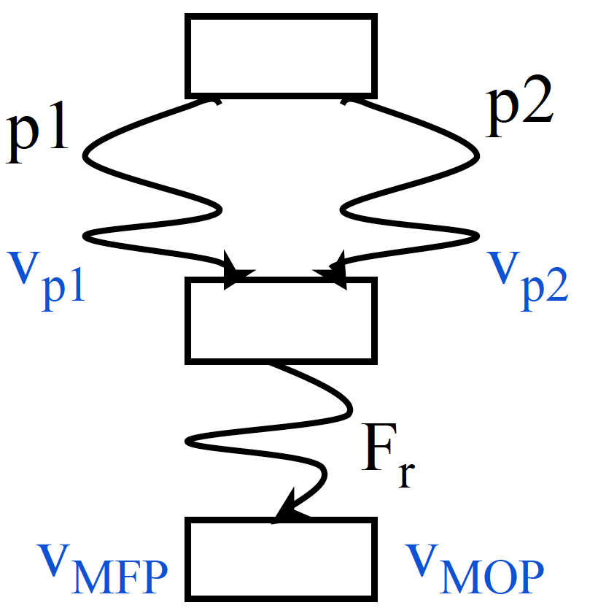
From ideal to practical solution
Problem: statements following merge must be analyzed for all preceding paths
Exponential blow-up
Solution: compute meets early (at merge points) rather than at the end
Maximum fixed-point (MFP)
Questions:
Is MFP correct?
What’s the precision of MFP?

Slide 17
Outline
Lattice and data-flow analysis
DFA correctness
DFA convergence
DFA precision
DFA complexity

Slide 18
Correctness
V_{correct} ≤
V_{MOP}
V_{entry}
T={ }
Entry
{ d1 }
{ d2 }
{ d3 }
d1
d2
{d1,d2}
{d1,d3}
{d2,d3}
⊥={d1,d2,d3}

Slide 19
Correctness
Key idea:
“Is MFP correct?” iff V_{MFP} ≤ V_{MOP}
Focus on merges:
V_{MOP} = fs(V_{p1}) ∧ fs(V_{p2})
V_{MFP} = fs(V_{p1} ∧ V_{p2} )
V_{MFP} ≤ V_{MOP} iff fs(V_{p1} ∧ V_{p2} ) ≤ fs(V_{p1}) ∧ fs(V_{p2})
X ≤ Y then fs(X) ≤ fs(Y) (monotonic fs)
So fs(V_{p1} ∧ V_{p2} ) ≤ fs(V_{p1}) ∧ fs(V_{p2})
And therefore V_{MFP} ≤ V_{MOP}
MFP is correct!

Slide 20
Monotonicity
X ≤ Y then fs(X) ≤ fs(Y)
If the flow function f is applied to two members of V, the result of applying f to the “lesser” of the two members will be under the result of applying f to the “greater” of the two
More conservative inputs leads to more conservative outputs (never more optimistic outputs)

Slide 21
Outline
Lattice and data-flow analysis
DFA correctness
DFA convergence
DFA precision
DFA complexity

Slide 22
Convergence
From lattice theory Because fs is monotonic, then the maximum number of times fs can be applied w/o reaching a fixed point is Height(V) – 1
Iterative DFA is guaranteed to terminate if the fs is monotonic and the lattice has finite height

Slide 23
Precision
V_{MOP}: the best solution
V_{MFP} ≤ V_{MOP}
fs(V_{p1} ∧ V_{p2} ) ≤ fs(V_{p1}) ∧ fs(V_{p2})
Distributive fs over ∧
fs(V_{p1} ∧ V_{p2} ) = fs(V_{p1}) ∧ fs(V_{p2})
V_{MFP} = V_{MOP}
Is reaching definition fs distributive?

Slide 24
Example: reaching constants
Goal
Compute the value of each variable at each program point (if possible) (must)
Flow values (V)
Set of (variable,constant) pairs
Merge function
Intersection
Data-flow equations
Effect of node n x = c
KILL[n] = {(x,k)| ∀k}
GEN[n] = {(x,c)}
Effect of node n x = y + z
KILL[n] = {(x,k)| ∀k}
GEN[n] = {(x,c) | c=valy+valz, (y, valy) ∈ in[n], (z, valz) ∈ in[n]}

Slide 25
Reaching constants: characteristics
⊥ = ?
IN = ?
OUT = ?
Let’s study this analysis
Correctness?
Convergence?
is fs monotonic? Has the lattice a finite height?
Precision?
is fs distributive?

Slide 26
Complexity
OUT[ENTRY] = { };
for (each instruction i other than ENTRY) OUT[i] = { };
while (changes to any OUT occur){ for (each instruction i other than ENTRY) { IN[i] = ∪p a predecessor of i OUT[p];
OUT[i] = GEN[i] ∪ (IN[i] ─ KILL[i]); }
}

Slide 27
Complexity
N=500
Worst case: 62,500,000,000
Optimized average case: 500 – 250,000
N instructions (N definitions at most)
Each IN/OUT set has at most N elements
Each set-union operation takes O(N) time
The for loop body
constant # of set operations per node
O(N) nodes ⇒ O(N²) time for the loop
Each iteration of the repeat loop can only make the set larger
Each iteration modifies at least one set
N iterations to reach the fixed point at most
Worst case: O(N⁴)
Typical case: 2 to 3 iterations with good ordering & sparse sets
O(N) to O(N²)

Slide 28
Optimization: work list
OUT[ENTRY] = { };
for (each basic block B other than ENTRY) OUT[B] = { };
workList = all basic blocks
while (workList isn’t empty)
B = pick and remove a block from workList
oldOUT = OUT[B] IN[B] = ∪p a predecessor of B OUT[p];
OUT[B]= GEN[B]∪ (IN[B] ─ KILL[B]);
if (oldOut != OUT[B]) workList = workList U {all successors of B}
}

