Slide 1



Loop transformations
Simone Campanoni simonec@eecs.northwestern.edu

Slide 2
Outline
Loop invariants
Induction variables
Loop transformations

Slide 3
Optimizations in small, hot loops
Most programs: 90% of time is spent in few, small, hot loops
while (){
statement 1
statement 2
statement 3
}
Deleting a single statement from a small, hot loop might have a big impact (100 seconds -> 70 seconds)

Slide 4
Loop example
1: if (N>5){ k = 1; z = 4;} 2: else {k = 2; z = 3;}
do {
3: a = 1;
4: y = x + N;
5: b = k + z;
6: c = a * 3; 7: if (N < 0){ 8: m = 5; 9: break; }
10: x++;
11:} while (x < N);
Observation: each statement in that loop will contribute to the program execution time
Idea: what about moving statements from inside a loop to outside it?
Which statements can be moved outside our loop?
How to identify them automatically? (code analysis)
How to move them? (code transformation)

Slide 5
Loop-invariant computations
Let d be the following definition
(d) t = x op y
d is a loop-invariant of a loop L if (assuming x, y do not escape)
x and y are constants or
All reaching definitions of x and y are outside the loop, or
Only one definition reaches x (or y), and that definition is loop-invariant

Slide 6
Loop example
1: if (N>5){ k = 1; z = 4;} 2: else {k = 2; z = 3;}
do {
3: a = 1;
4: y = x + N;
5: b = k + z;
6: c = a * 3; 7: if (N < 0){ 8: m = 5; 9: break; }
10: x++;
11:} while (x < N);
d is a loop-invariant of a loop L if
x and y are constants or
All reaching definitions of x and y are outside the loop, or
Only one definition reaches x (or y), and that definition is loop-invariant
??

Slide 7
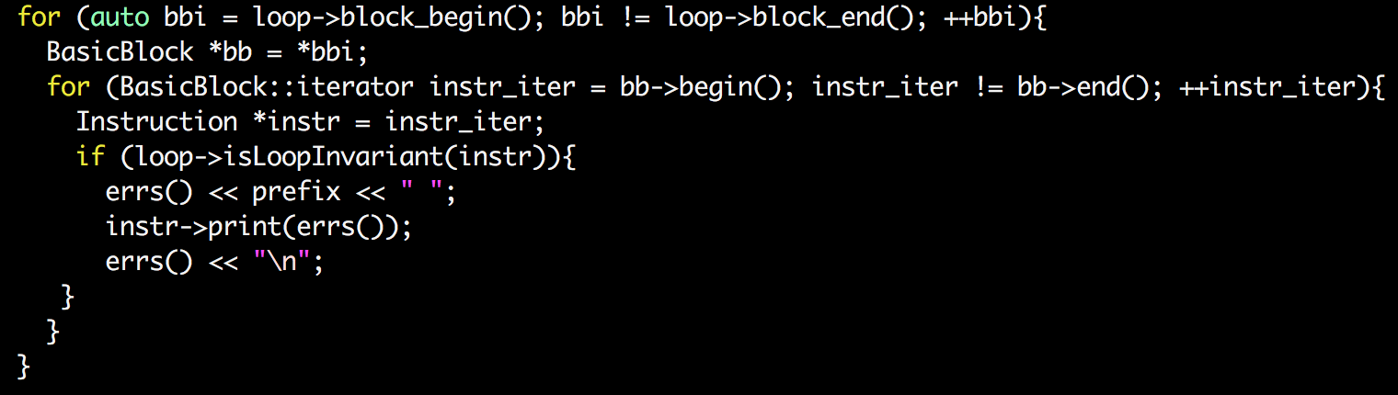
Loop-invariant computations in LLVM

Slide 8
Hoisting code
In order to “hoist” a loop-invariant computation out of a loop, we need a place to put it
We could copy it to all immediate predecessors of the loop header...
...But we can avoid code duplication (and bugs) by taking advantage of loop normalization that guarantees the existence of the pre-header
for (auto it = pred_begin(H); it != pred_end(H); ++it){
BasicBlock *pBB = *it;
p = pBB->getTerminator(); inv->moveBefore(p);
}
n1
n2
n3
Header
Is it correct?

Slide 9
Hoisting code
In order to “hoist” a loop-invariant computation out of a loop, we need a place to put it
We could copy it to all immediate predecessors of the loop header...
...But we can avoid code duplication (and bugs) by taking advantage of loop normalization that guarantees the existence of the pre-header
pBB = loop->getLoopPreheader();
p = pBB->getTerminator();
inv->moveBefore(p);
Pre-header
Header
Exit node
Latch
Body

Slide 10
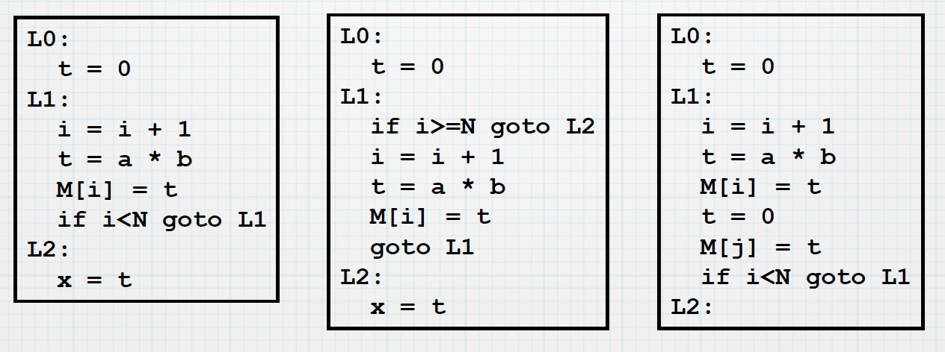

Hoisting conditions
For a loop-invariant definition
(d) t = x op y
We can hoist d into the loop’s pre-header if
d’s block dominates all loop exits at which t is live-out, and
there is only one definition of t in the loop, and
t is not live-out of the pre-header
Loop invariant code motion
??
1,3
2

Slide 11
Outline
Loop invariants
Induction variables
Loop transformations

Slide 12
Loop example
1: if (N>5){ k = 1; z = 4;} 2: else {k = 2; z = 3;}
do {
3: a = 1;
4: y = x + N;
5: b = k + z;
6: c = a * 3; 7: if (N < 0){ 8: m = 5; 9: break; }
10: x++;
11:} while (x < N);
Assuming a,b,c,m are used after our code
Do we have to execute 4 for every iteration?
Do we have to execute 10 for every iteration?

Slide 13
Loop example
1: if (N>5){ k = 1; z = 4;} 2: else {k = 2; z = 3;}
do {
3: a = 1;
4: y = x + N;
5: b = k + z;
6: c = a * 3; 7: if (N < 0){ 8: m = 5; 9: break; }
10: x++;
11:} while (x < N);
y=N
Do we have to execute 4 for every iteration?
Compute manually values of x and y for every iteration
What do you see?
Do we have to execute 10 for every iteration?

Slide 14
Loop example
1: if (N>5){ k = 1; z = 4;} 2: else {k = 2; z = 3;}
do {
3: a = 1;
4:
5: b = k + z;
6: c = a * 3; 7: if (N < 0){ 8: m = 5; 9: break; }
10: x++;y++;
11:} while (x < N);
y=N
Do we have to execute 4 for every iteration?
Do we have to execute 10 for every iteration?

Slide 15
Loop example
1: if (N>5){ k = 1; z = 4;} 2: else {k = 2; z = 3;}
do {
3: a = 1;
4:
5: b = k + z;
6: c = a * 3; 7: if (N < 0){ 8: m = 5; 9: break; }
10: x++;y++;
11:} while (y < (2*N));
y=N
Do we have to execute 4 for every iteration?
Do we have to execute 10 for every iteration?

Slide 16
Loop example
1: if (N>5){ k = 1; z = 4;} 2: else {k = 2; z = 3;}
do {
3: a = 1;
4:
5: b = k + z;
6: c = a * 3; 7: if (N < 0){ 8: m = 5; 9: break; }
10: y++;
11:} while (y < (2*N));
y=N
Do we have to execute 4 for every iteration?
Do we have to execute 10 for every iteration?

Slide 17
Loop example
1: if (N>5){ k = 1; z = 4;} 2: else {k = 2; z = 3;}
do {
3: a = 1;
4:
5: b = k + z;
6: c = a * 3; 7: if (N < 0){ 8: m = 5; 9: break; }
10: y++;
11:} while (y < tmp);
y=N;tmp=2*N;
Do we have to execute 4 for every iteration?
x, y are induction variables
Do we have to execute 10 for every iteration?

Slide 18
Is the code transformation worth it?
1: if (N>5){ k = 1; z = 4;} 2: else {k = 2; z = 3;}
do {
3: a = 1;
4: y = x + N;
5: b = k + z;
6: c = a * 3; 7: if (N < 0){ 8: m = 5; 9: break; }
10: x++;
11:} while (x < N);
1: if (N>5){ k = 1; z = 4;} 2: else {k = 2; z = 3;}
A :y=N;tmp=2*N;
do {
3: a = 1;
5: b = k + z;
6: c = a * 3; 7: if (N < 0){ 8: m = 5; 9: break; }
10: y++;
11:} while (y < tmp);
Induction variable elimination

Slide 19
… and after Loop Invariant Code Motion ...
1: if (N>5){ k = 1; z = 4;} 2: else {k = 2; z = 3;}
do {
3: a = 1;
4: y = x + N;
5: b = k + z;
6: c = a * 3; 7: if (N < 0){ 8: m = 5; 9: break; }
10: x++;
11:} while (x < N);
1: if (N>5){ k = 1; z = 4;} 2: else {k = 2; z = 3;}
A :y=N;tmp=2*N;
3 :a=1;
5 :b=k+z;
6: c=a*3;
do{ 7: if (N < 0){ 8: m = 5; 9: break; }
10: y++;
11:} while (y < tmp);

Slide 20
… and with a better Loop Invariant Code Motion ...
1: if (N>5){ k = 1; z = 4;} 2: else {k = 2; z = 3;}
do {
3: a = 1;
4: y = x + N;
5: b = k + z;
6: c = a * 3; 7: if (N < 0){ 8: m = 5; 9: break; }
10: x++;
11:} while (x < N);
1: if (N>5){ k = 1; z = 4;} 2: else {k = 2; z = 3;}
A :y=N;tmp=2*N;
3 :a=1;
5 :b=k+z;
6: c=a*3;
7: if (N < 0){
8: m=5;
}
do{ 10: y++;
11:} while (y < tmp);

Slide 21
… and after dead code elimination ...
1: if (N>5){ k = 1; z = 4;} 2: else {k = 2; z = 3;}
do {
3: a = 1;
4: y = x + N;
5: b = k + z;
6: c = a * 3; 7: if (N < 0){ 8: m = 5; 9: break; }
10: x++;
11:} while (x < N);
1: if (N>5){ k = 1; z = 4;} 2: else {k = 2; z = 3;}
3 :a=1;
5 :b=k+z;
6: c=a*3;
7: if (N < 0){
8: m=5;
}
Assuming a,b,c,m are used after our code

Slide 22
Induction variable observation
Observation: some variables change by a constant amount on each loop iteration
x initialized at 0; increments by 1
y initialized at N; increments by 1
These are all induction variables
How can we identify them?

Slide 23
Induction variable elimination
Suppose we have a loop variable
i initially set to i₀; each iteration i = i + 1
and a variable that linearly depends on it
x = i * c₁ + c₂
We can
Initialize x = i_{o} * c₁ + c₂
Increment x by c₁ each iteration
constants

Slide 24
Is it faster?
On some hardware, adds are much faster than multiplies
Strength reduction
Furthermore, one fewer value is computed, thus potentially saving a register
and decreasing the possibility of spilling

Slide 25
Induction variables
Basic induction variables
i = i op c
c is loop-invariant
a.k.a. independent induction variable
Derived induction variables
j = i * c₁ + c₂
a.k.a. dependent induction variable

Slide 26
Identify induction variables: step 1
Find the basic IVs
Scan loop body for defs of the form x = x + c, where c is loop-invariant
Record these basic IVs as
x = (x, 1, c)
this represents the IV: x = x * 1 + c

Slide 27
Identify induction variables: step 2
Find derived IVs
Scan for derived IVs of the form k = i * c1 + c2 where i is a basic IV and this is the only definition of k in the loop
Record as k = (i, c1, c2) We say k is in the family of i

Slide 28
Identified induction variables
i: basic
j: basic
q: derived from i
k: derived from i
x: derived from j
z: derived from k
A forest of induction variables

Slide 29
Many optimizations rely on IVs
Like induction variable elimination we have seen before

Slide 30
Induction variable elimination: step 1
Iterate over IVs k = j * c1 + c2
where IV j =(i, a, b), and
this is the only def of k in the loop, and
there is no def of i between the def of j and the def of k
Record as k = (i, a*c1, b*c1+c2)
i = …
…
j = i …
…
k = j …

Slide 31
Induction variable elimination: step 2
For an induction variable k = (i, c1, c2)
Initialize k = i * c1 + c2 in the pre-header
Replace k’s def in the loop by k = k + c1
Make sure to do this after i’s definition

Slide 32
Normalize induction variables
Basic induction variables are normalized to
Initial value: 0
Incremented by 1 at each iteration
Explicit final value (either constant or loop-invariant)
x = x*1 + 1
(x, 1, 1)

Slide 33
Normalize induction variables in LLVM
indvars:
normalize induction variables
highlight the basic induction variables
scalar-evolution:
Scalar evolution analysis
Represent scalar expressions (e.g., x = y op z)
It supports induction variables (e.g., x = x + 1)
It lowers the burden of explicitly handling the composition of expressions

Slide 34
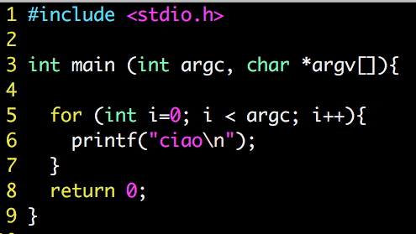
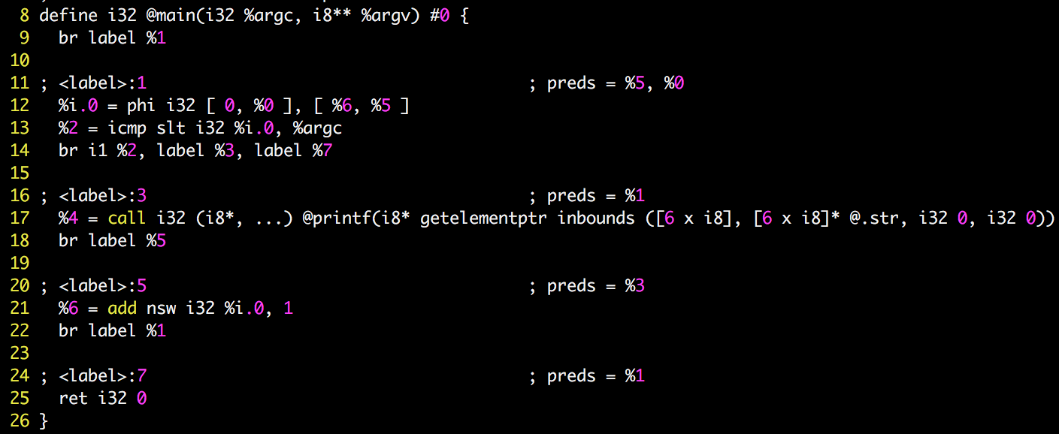
LLVM scalar evolution example
SCEV: {A, B, C}<flag>*<%D>
A: Initial; B: Operator; C: Operand; D: basic block where it get defined

Slide 35
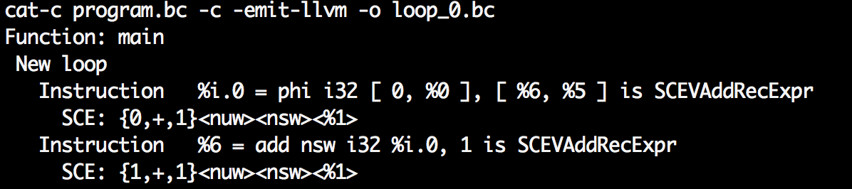
LLVM scalar evolution example
SCEV: {A, B, C}<flag>*<%D>
A: Initial; B: Operator; C: Operand; D: basic block where it get defined

Slide 36
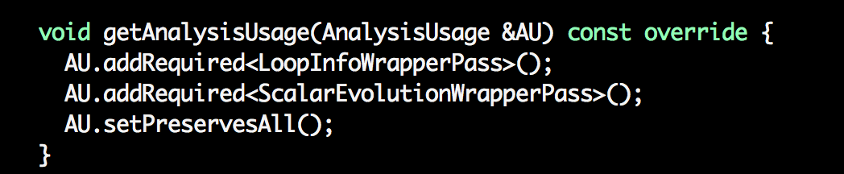
LLVM scalar evolution example: pass deps

Slide 37
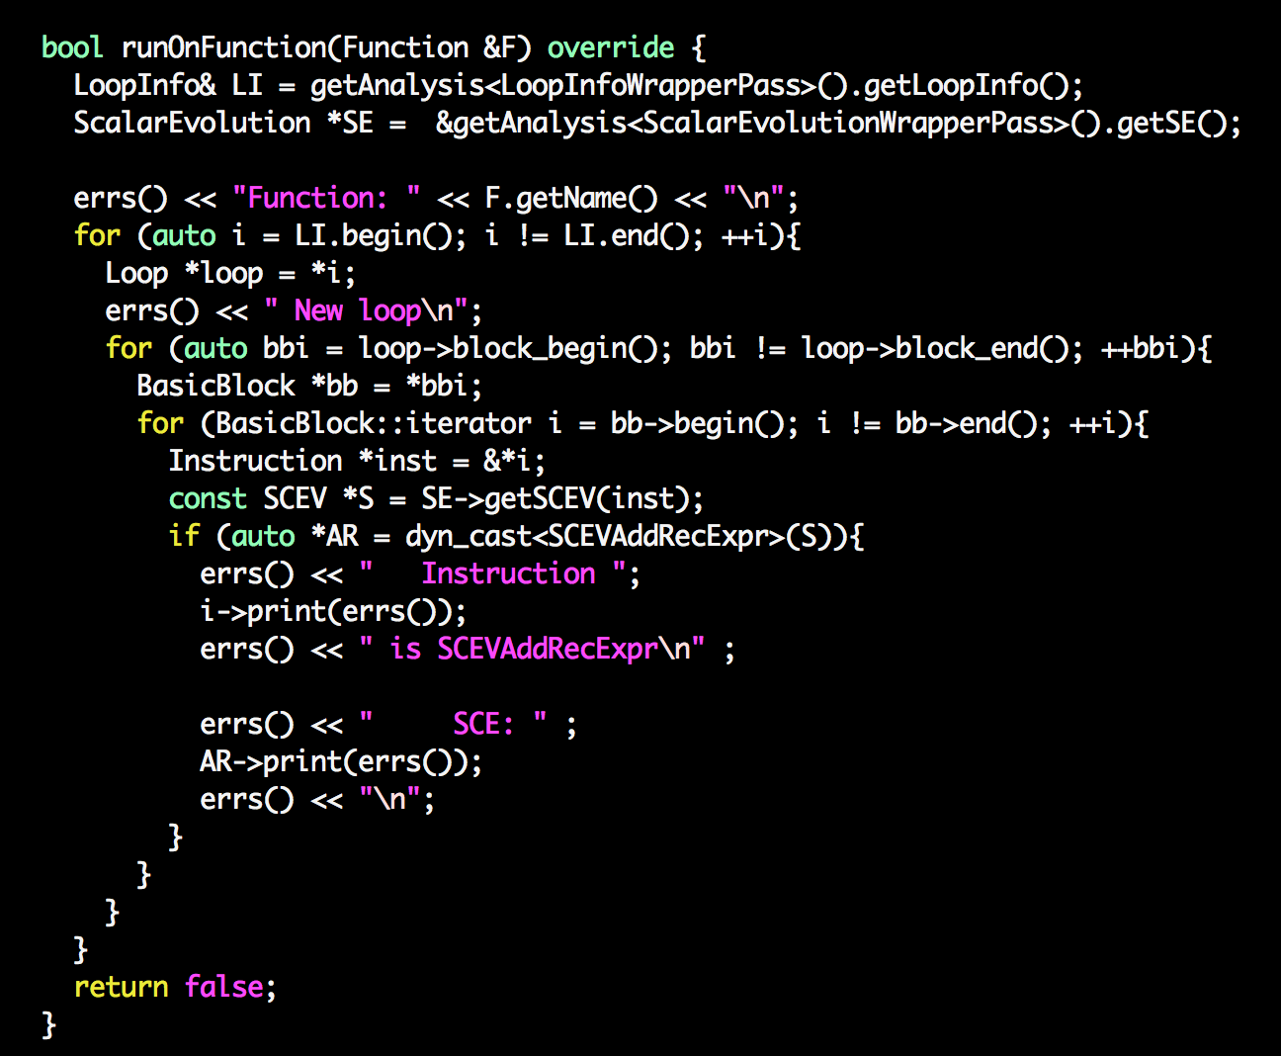

Slide 38
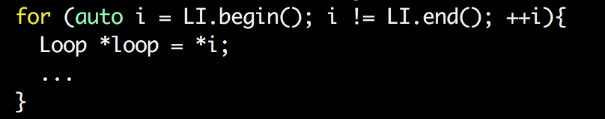
An use of the Scalar Evaluation pass
Problem: we need to infer the number of iterations that a loop will execute
for (int i=0; i < 10; i++){
BODY
}
Solution for this loop: 10
Any idea?

Slide 39
Scalar evolution in LLVM
Analysis used by
Induction variable substitution
Strength reduction
Vectorization
…
SCEVs are modeled by the llvm::SCEV class
There is a sub-class for each kind of SCEV (e.g., llvm::SCEVAddExpr)
A SCEV is a tree of SCEVs
Leaves:
Constant : llvm:SCEVConstant (e.g., 1)
Unknown: llvm:SCEVUnknown
To iterate over a tree: llvm:SCEVVisitor

Slide 40
Outline
Loop invariants
Induction variables
Loop transformations

Slide 41
Loop transformations
Restructure a loop to expose more optimization opportunities and/or transform the “loop overhead”
Loop unrolling, loop peeling, loop splitting, …
Reorganize a loop to improve memory utilization
Cache blocking, skewing, loop reversal
Distribute a loop over cores/processors
DOACROSS, DOALL, DSWP, HELIX

Slide 42
Loop unrolling
%a=cmp %a, 10 branch %a
%a=cmp %a, %5 branch %a
Unrolling factor: 2
Body
Body
%a=add %a, 1
Body
%a=add %a, 2

Slide 43
Loop peeling
%a=cmp %a, 10 branch %a
Body %a = add %a, 1
Peeling factor: 1
Body
%a=cmp %a, %10 branch %a
%a=add %a, 1
Body
%a=add %a, 1

Slide 44
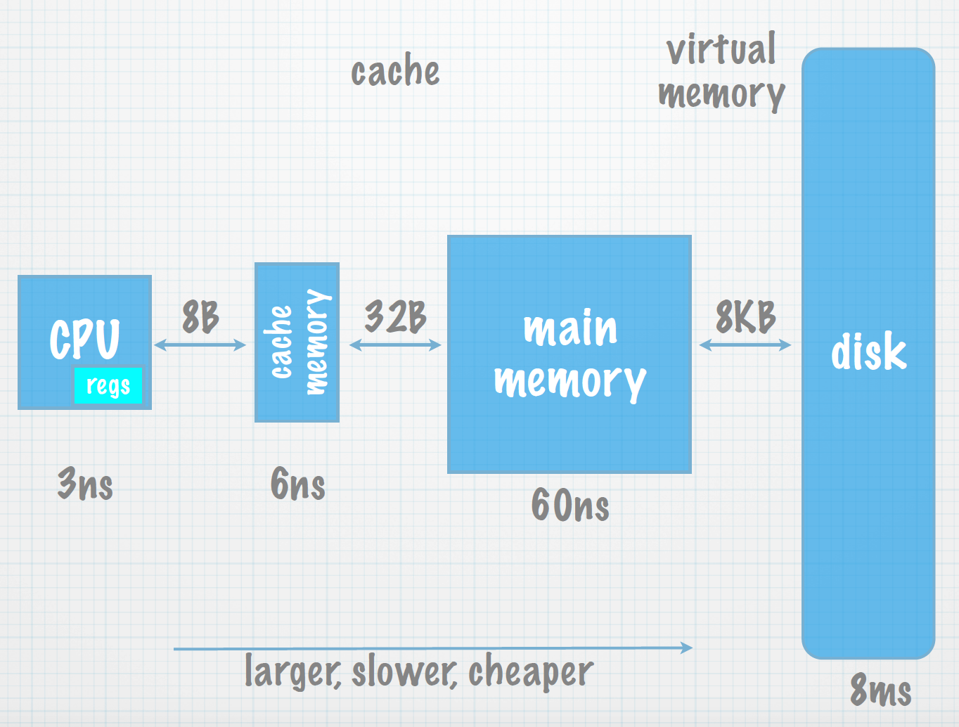
Loop transformations for memory optimizations
Performance goal: reduce program clock cycles
How many clock cycles will it take?
…
varX = array[5];
...

Slide 45
Goal: improve cache performance
To enhance
Temporal locality
A resource that has just been referenced will more likely be referenced again in the near future
Spatial locality
The likelihood of referencing a resource is higher if a resource near it was just referenced
What to minimize: bad replacement decisions

Slide 46
What a compiler can do
Time:
When is an object accessed?
Space:
Where does an object exist in the address space?
These are the two “knobs” a compiler can manipulate

Slide 47
Manipulating time and space
Time: Reordering computation
Determine when an object will be accessed, and predict a better time to access it
Space: Changing data layout
Determine an object’s shape and location, and determine a better layout

Slide 48
First understand cache behavior ...
When do cache misses occur?
Use locality analysis
Can we change the visitation order to produce better behavior?
Evaluate costs
Does the new visitation order still produce correct results?
Use dependence analysis

Slide 49
… and then rely on loop transformations
loop interchange
cache blocking
loop fusion
loop reversal
...

Slide 50
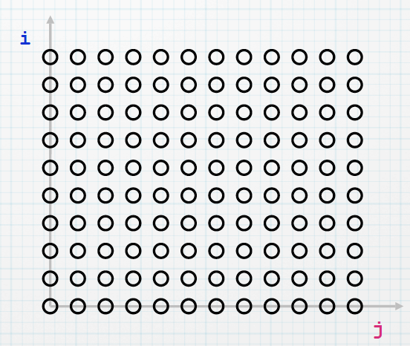
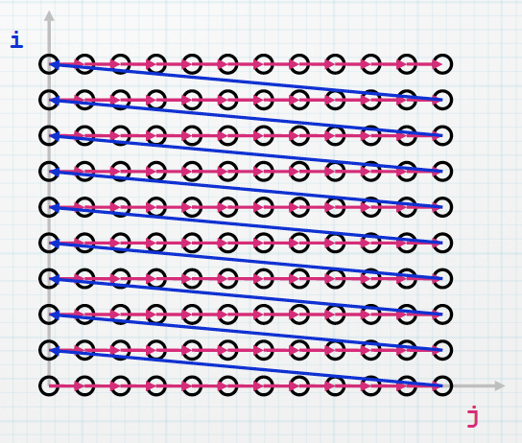
Code example
double A[N][N], B[N][N];
…
for i = 0 to N-1{
for j = 0 to N-1{
... = A[i][j] ...
}
}
Iteration space for A

Slide 51
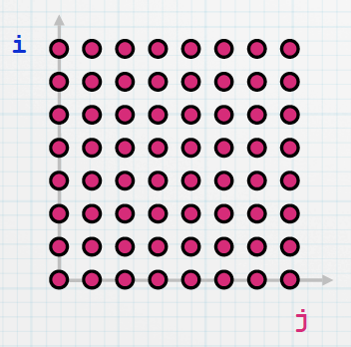
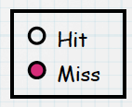
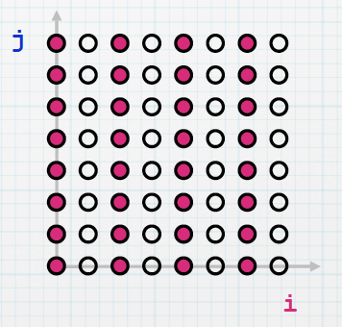
Loop interchange
for i = 0 to N-1
for j = 0 to N-1
… = A[j][i] …
For j = 0 to N-1
for i = 0 to N-1
… = A[j][i] …
Assumptions: N is large; A is row-major; 2 elements per cache line
A[][] in C? Java?

Slide 52
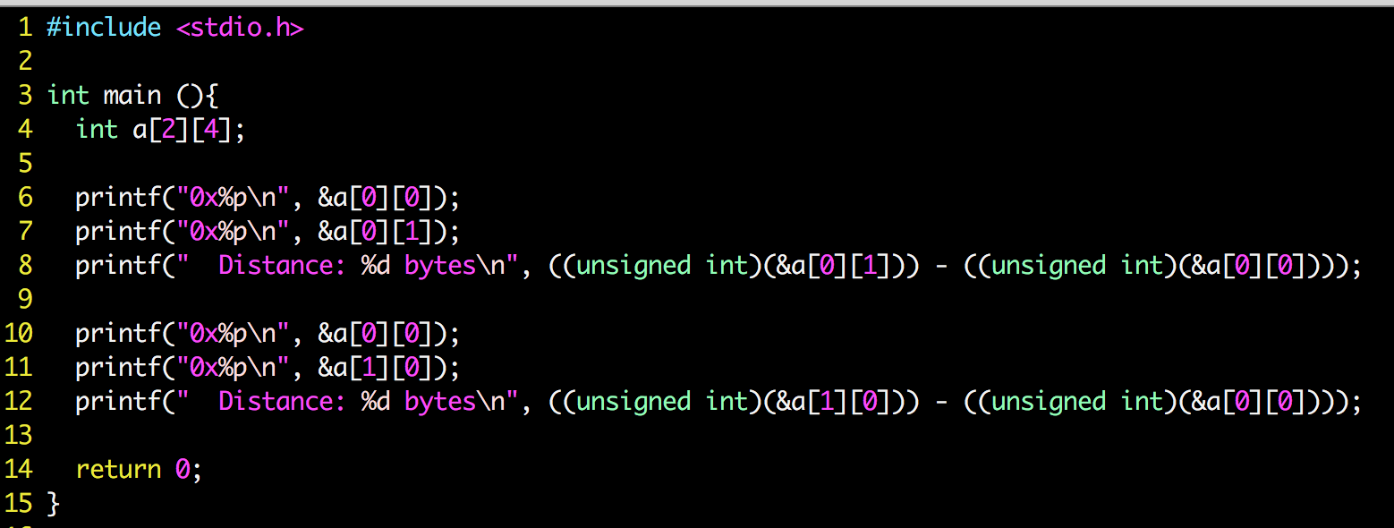

Slide 53
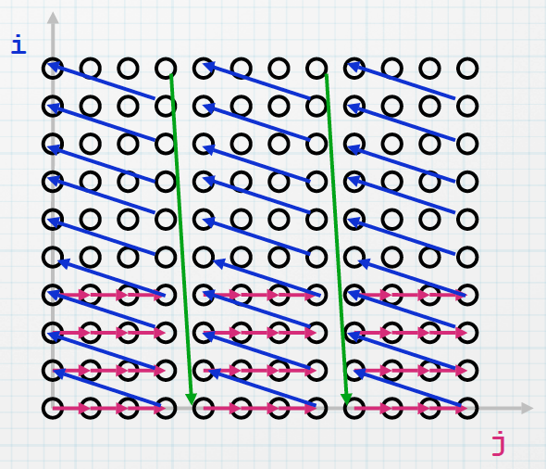
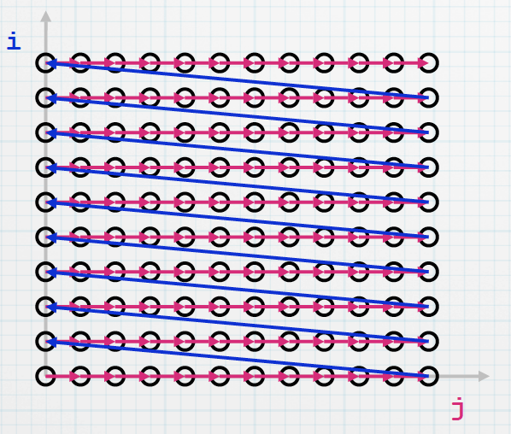
Cache blocking (a.k.a. tiling)
for JJ = 0 to N-1 by B
for i = 0 to N-1
for j = JJ to min(N-1,JJ+B-1)
f(A[i], A[j])
for i = 0 to N-1
for j = 0 to N-1
f(A[i], A[j])

Slide 54
Loop fusion
for i = 0 to N-1
C[i] = A[i]*2 + B[i]
for i = 0 to N-1
D[i] = A[i] * 2
for i = 0 to N-1
C[i] = A[i] * 2 + B[i]
D[i] = A[i] * 2
Reduce loop overhead
Improve locality by combining loops that reference the same array
Increase the granularity of work done in a loop

Slide 55
Locality analysis
Reuse: Accessing a location that has been accessed previously
Locality: Accessing a location that is in the cache
Observe:
Locality only occurs when there is reuse!
… but reuse does not imply locality

Slide 56
Steps in locality analysis
Find data reuse
Determine “localized iteration space”
Set of inner loops where the data accessed by an iteration is expected to fit within the cache
Find data locality
Reuse ∩ localized iteration space ⇒ locality

