Slide 1



Loops
Simone Campanoni simonec@eecs.northwestern.edu

Slide 2
… points …
Grade | Points
A | 95 – 100
A - | 90 – 94
B + | 80 – 89
B | 70 – 79
B - | 61 – 69
C + | 57 – 60
C | 50 – 56
D | 25 – 49
F | 0 – 24
H0, H1, H2, H3, H4, H5, H6 …
… up to 70 points … … (excluding extra points) …
… out of 100
H7, H8, H9
Late submission: -1 point
Final strict deadline: December 1st

Slide 3

Homework H6 is due tomorrow!

Slide 4
Outline
Loops
Identify loops
Loop normalization

Slide 5
Impact of optimized code to program
Code transformation
1 second
10 seconds
How much did we optimize the overall program?
Coverage of optimized code
10% coverage: Speedup=~1.10x (100->91 seconds)
20% coverage: Speedup=~1.22x (100->82 seconds)
90% coverage: Speedup=~5.26x (100->19 seconds)

Slide 6

90% of time is spent in 10% of code
Cold code
Loop
Hot code
Identify hot code to succeed!!!

Slide 7
Loops …
... but where are they?
... How can we find them?

Slide 8
Loops in source code
for (i=0; i < 10; i++){
…
}
i=0;
do {
…
i++;
} while (i < 10);
S={0,1,…,10}
foreach (i in S){
…
}
i=0;
while (i < 10){
…
i++;
}
Is there a LLVM IR instruction “for”?
There is no IR instruction for “loop”

Slide 9
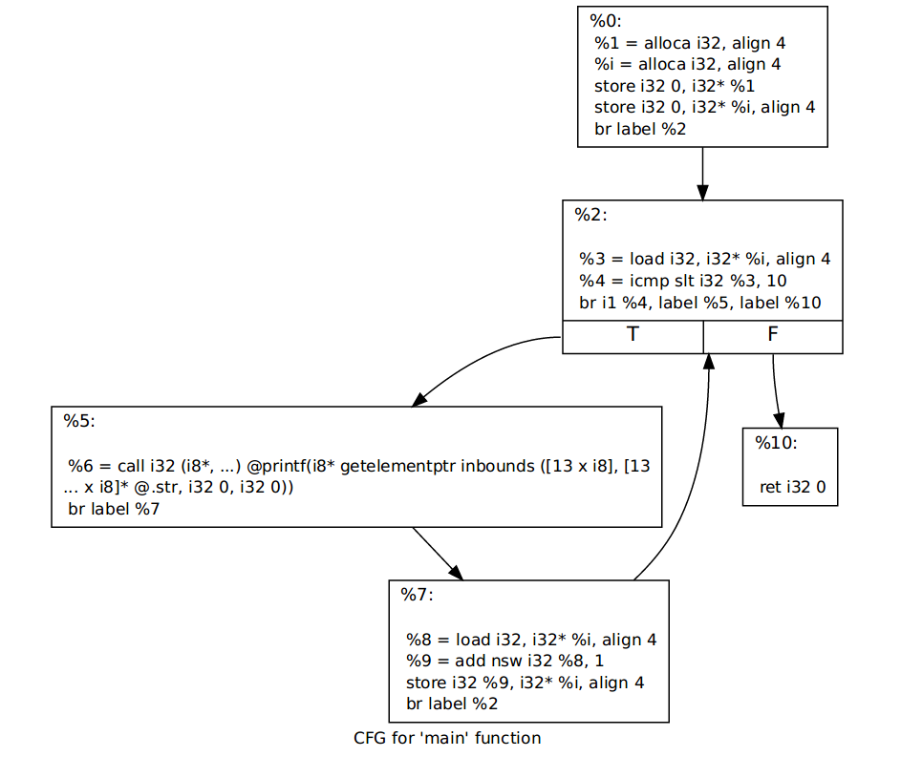
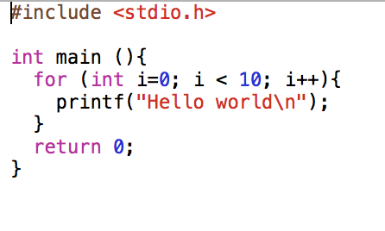
Target optimization: we need to identify loops
There is no IR instruction for “loop”
How to identify an IR loop?

Slide 10
Loops in IR
Loop identification:
Input: Control-Flow-Graph
Output: loops in CFG
Not sensitive to input syntax: a uniform treatment for all loops
Define a loop in graphic-theoretic terms
Intuitive properties of a loop
Single entry point
Edges must form at least a cycle in CFG
How to check these properties automatically?

Slide 11
Outline
Loops
Identify loops
Loop normalization

Slide 12
Natural loops in CFG
Header: node that dominates all other nodes in a loop
Single entry point of a loop
Back edge: edge (tail -> head) whose head dominates its tail
Natural loop of a back edge: smallest set of nodes that includes the head and tail of the back edge, and has no predecessors outside the set, except for the predecessors of the header.

Slide 13
Identify natural loops
Find the dominator relations in a flow graph
Identify the back edges
Find the natural loop associated with the back edge

Slide 14
Immediate dominators
Definition: the immediate dominator of a node n is the unique node that strictly dominates n (i.e., it isn’t n) but does not strictly dominate another node that strictly dominates n
1
1
1
Dominator tree
2
2
2
3
3
3
CFG
Immediate dominators

Slide 15
Finding back-edges
Definition: a back-edge is an arc (tail -> head) whose head dominates its tail
(A) Depth-first spanning tree

Slide 16
Spanning tree of a graph
Definition: A tree T is a spanning tree of a graph G if T is a subgraph of G that contains all the vertices of G.
1
2
3
4

Slide 17
Depth-first spanning tree of a graph
Idea: Make a path as long as possible, and then go back (backtrack) to add branches also as long as possible.
Algorithm
s = new Stack(); s.add(G.entry); mark(G.entry);
While (!s.empty()){
1: v = s.pop();
2: if (v’ = adjacentNotMarked(v, G)){
3: mark(v’) ; DFST.add((v, v’));
4: s.push(v’);
} }
1
2
3
4

Slide 18
Finding back-edges
Definition: a back-edge is an arc (tail -> head) whose head dominates its tail
(A) Depth-first spanning tree
Compute retreating edges in CFG:
Advancing edges: from ancestor to proper descendant
Retreating edges: from descendant to ancestor
(B) For each retreating edge t->h, check if h is in t’s dominator list
1
2
3
4

Slide 19
Finding natural loops
Definition: the natural loop of a back edge is the smallest set of nodes that includes the head and tail of the back edge, and has no predecessors outside the set, except for the predecessors of the header
Let t->h be the back-edge
Delete h from the flow graph
Find those nodes that can reach t (those nodes plus h and t form the natural loop of t->h)
1
2
2
3
3
1
4
4

Slide 20
Natural loop example
0: i=0
For (int i=0; i < 10; i++){
A();
while (j < 5){
j = B(j);
}
}
1: i < 10
Exit
5: i++
2: A()
3: j < 5
4: j = B(j)

Slide 21
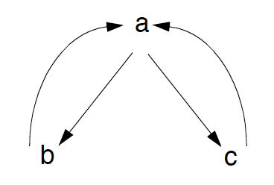
Identify inner loops
If two loops do not have the same header
They are either disjoint, or
One is entirely contained (nested within) the other
Outer loop, inner loop
Loop nesting relation
What about if two loops share the same header?
while (a: i < 10){
b: if (i == 5) continue;
c: … }
Graph/DAG/tree? Why?

Slide 22
Loop nesting tree
Loop-nest tree: each node represents the blocks of a loop, and parent nodes are enclosing loops.
The leaves of the tree are the inner-most loops.
1
1,2,3,4
2
2,3
3
How to compute the loop-nest tree?
4

Slide 23
Loop nesting forest
void myFunction (){
1: while (…){
2: while (…){ … }
}
…
3: for (…){
4: do {
5: while(…) {…}
} while (…)
}
}
1
3
Outermost loops
2
4
5
Innermost loops

Slide 24
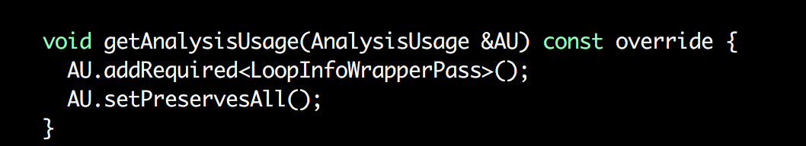
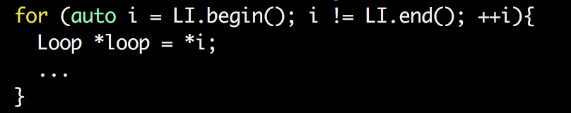
Loops in LLVM
Rely on other passes to identify loops
Fetch the result of the LoopInfoWrapperPass analysis
Iterate over outermost loops

Slide 25
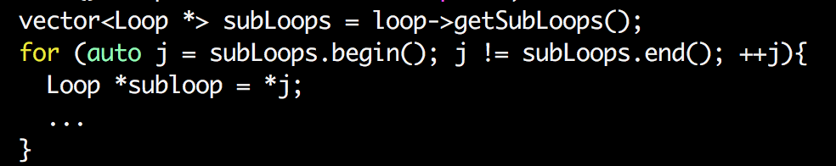
Loops in LLVM: sub-loops
Iterate over sub-loops of a loop

Slide 26
Defining loops in graphic-theoretic terms
Is it good? Bad? Implications?
L1: …
if (X < 10) goto L2;
goto L1;
L2: ...
if (…) goto L1;
…
do {
…
L1: …
} while (X < 10);
The good
The bad
Implications?

Slide 27
Outline
Loops
Identify loops
Loop normalization

Slide 28
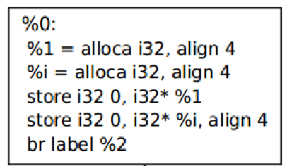

Slide 29
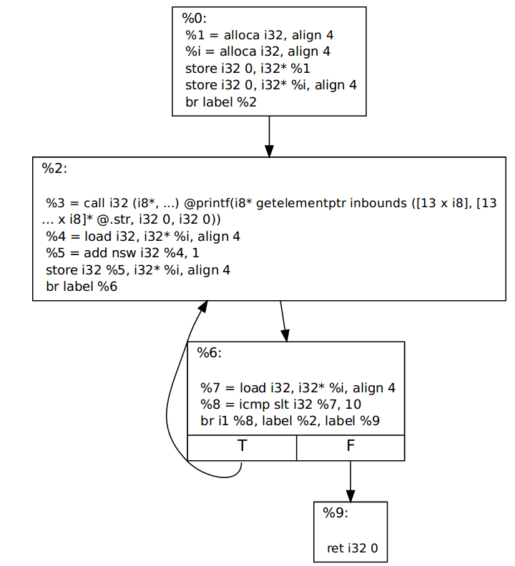
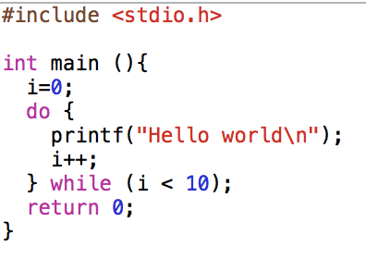
We need to normalize loops
so CATs can expect a single pre-defined shape!

Slide 30
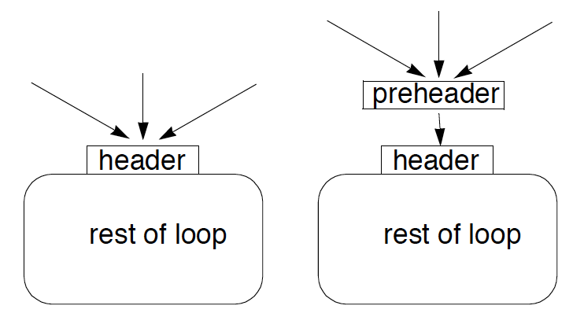
First normalization: adding a pre-header
Optimizations often require code to be executed once before the loop
Create a pre-header basic block for every loop

Slide 31
Common loop normalization
Pre-header
Header
Pre-header
Header
Body
Body

Slide 32
Common loop normalization
Pre-header
Header
Pre-header
Header
Body
Body
Can we normalize where the exit edges are?
Should we normalize where the exit edges are?

Slide 33
Loop normalization in LLVM
The loop-simplify pass normalize natural loops
Output of loop-simplify:
Pre-header: the only predecessor of the header
Latch: node executed just before starting a new loop iteration
Exit node: ensures it is dominated by the header
n1
n2
n3
nX
Header
exit
Body

Slide 34
Loop normalization in LLVM
The loop-simplify pass normalize natural loops
Output of loop-simplify:
Pre-header: the only predecessor of the header
Latch: node executed just before starting a new loop iteration
Exit node: ensures it is dominated by the header
n1
n2
n3
Pre-header
nX
Header
exit
Body

Slide 35
Loop normalization in LLVM
The loop-simplify pass normalize natural loops
Output of loop-simplify:
Pre-header: the only predecessor of the header
Latch: node executed just before starting a new loop iteration
Exit node: ensures it is dominated by the header
n1
n2
n3
Pre-header
nX
Header
Latch
exit
Body

Slide 36
Loop normalization in LLVM
The loop-simplify pass normalize natural loops
Output of loop-simplify:
Pre-header: the only predecessor of the header
Latch: node executed just before starting a new loop iteration
Exit node: ensures it is dominated by the header
n1
n2
n3
nX
Pre-header
Header
Exit node
Latch
exit
Body

Slide 37
(Critical edges)
Definition: A critical edge is an edge which is neither the only edge leaving its source block, nor the only edge entering its destination block.
These edges must be split: a new block must be created in the middle of the edge, in order to insert computations on the edge without affecting any other edges.
If (…){
while (…){
…
}
}
A()
nA
nB
n1
n2

Slide 38
Loop normalization in LLVM
Pre-header llvm::Loop:getLoopPreheader()
Header llvm::Loop::getHeader()
Latch llvm::Loop::getLoopLatch()
Exit llvm::Loop::getExitBlocks()
opt -loop-simplify bitcode.bc -o normalized.bc
Pre-header
Header
Exit node
Latch
Body

Slide 39
Further normalizations in LLVM
Loop representation can be further normalized:
loop-simplify normalize the shape of the loop
What about definitions in a loop?
Problem: updating code in loop might require to update code outside loops for keeping SSA
Loop-closed SSA form: no var is used outside of the loop in that it is defined
Keeping SSA form is expensive with loops
lcssa insert phi instruction at loop boundaries for variables defined in a loop body and used outside
Isolation between optimization performed in and out the loop
Faster keeping the SSA form
Propagation of code changes outside the loop blocked by phi instructions

Slide 40
Loop pass example
while (){
d = …
}
… ... = d op ...
while (){
d = …
...
if (...){
d = ...
}
}
… ... = d op ...
while (){
d = …
...
if (...){
d2 = ...
}
}
… ... = d op ...
while (){
d = …
...
if (...){
d2 = ...
}
d3=phi(d,d2)
}
…
... = d op ...
while (){
d = …
...
if (...){
d2 = ...
}
d3=phi(d,d2)
}
…
... = d3 op ...
Changes to code outside our loop

Slide 41
Further normalizations in LLVM
Loop representation can be further normalized:
loop-simplify normalize the shape of the loop
What about definitions in a loop?
Problem: updating code in loop might require to update code outside loops for keeping SSA
Keeping SSA form is expensive with loops
Loop-closed SSA form: no var is used outside of the loop in that it is defined
lcssa insert phi instruction at loop boundaries for variables defined in a loop body and used outside
Isolation between optimization performed in and out the loop
Faster keeping the SSA form
Propagation of code changes outside the loop blocked by phi instructions

Slide 42
Loop-closed SSA form in LLVM
opt -lcssa bitcode.bc -o transformed.bc
llvm::Loop::isLCSSAForm(DT)
formLCSSA(…)

Slide 43
Further normalizations in LLVM
Last loop-related normalization: Induction variable normalization

Slide 44

Coding time

