Slide 1
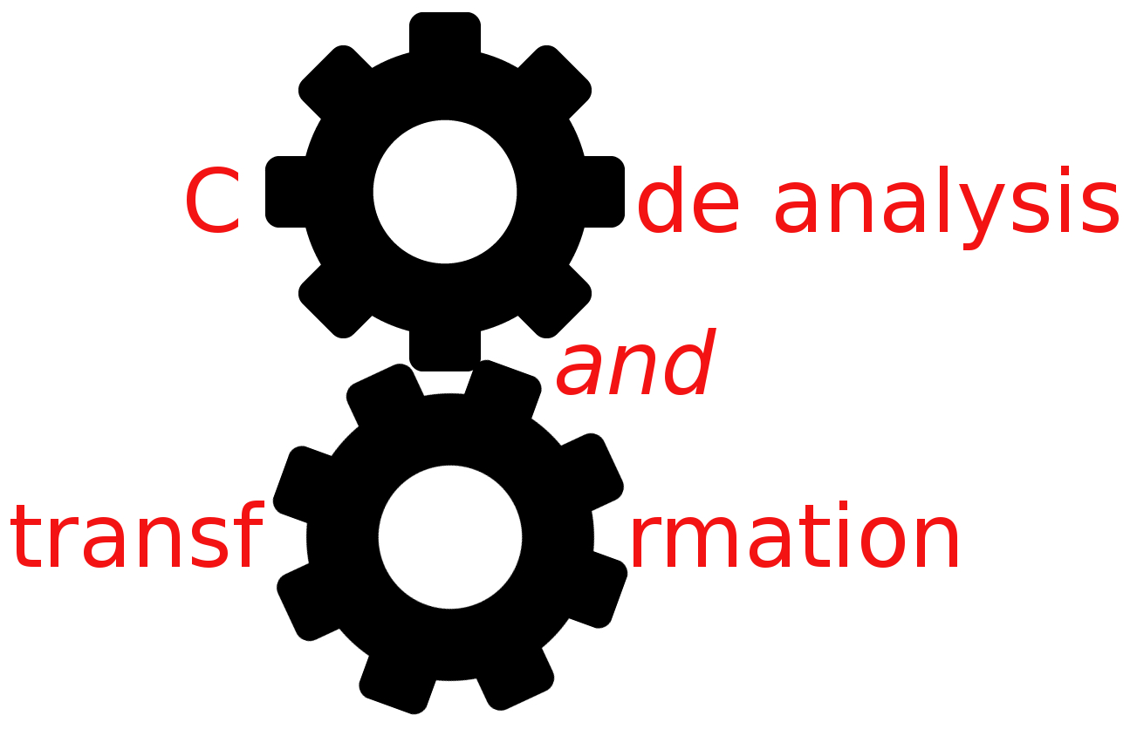


SSA
Simone Campanoni simonec@eecs.northwestern.edu

Slide 2
LLVM 3.8.1 is installed on Wilkinson lab machines
/home/software/llvm
Steps to follow:
$ ssh hanlon.wot.eecs.northwestern.edu
$ bash
$ export PATH=/home/software/llvm/bin:$PATH
$ scl enable devtoolset-4 python27 bash
$ export CC=gcc
$ export CXX=g++
$ edit run_me.sh to invoke “cmake3” instead of “cmake”
$ ./run_me.sh

Slide 3
Def-use chain
OUT[ENTRY] = { };
for (each instruction i other than ENTRY) OUT[i] = { };
while (changes to any OUT occur) for (each instruction i other than ENTRY) { IN[i] = ∪_{p a predecessor of i} OUT[p];
OUT[i] = GEN[i] ∪ (IN[i] ─ KILL[i]); }
}
Given a variable t, we need to find all definitions of t in the CFG
How can we do it in LLVM?
i: t <- …
GEN[i] = {i}
KILL[i] = defs(t) – {i}
i: …
GEN[i] = {}
KILL[i] = {}

Slide 4
LLVM IR (4)
It’s a Static Single Assignment (SSA) representation
A variable is set only by one instruction in the function body
%myVar = …
A static assignment can be executed more than once
While (…){
%myVar = ...
}

Slide 5
SSA and not SSA example
float myF (float par1, float par2, float par3){ return (par1 * par2) + par3; }
define float @myF(float %par1, float %par2, float %par3) {
%1 = fmul float %par1, %par2
%1 = fadd float %1, %par3
ret float %1 }
NOT SSA
define float @myF(float %par1, float %par2, float %par3) {
%1 = fmul float %par1, %par2
%2 = fadd float %1, %par3
ret float %2 }
SSA

Slide 6
Consequences of SSA
Unrelated uses of the same variable in source code become different variables in the SSA form
Use—def chain are greatly simplified
Data-flow analysis are simplified (… in the next slides)
Code analysis (e.g., data flow analysis) can be designed to run faster
v = 5;
print(v);
v = 42;
print(v);
v1 = 5
call print(v1)
v2 = 42
call print(v2)
To SSA IR

Slide 7
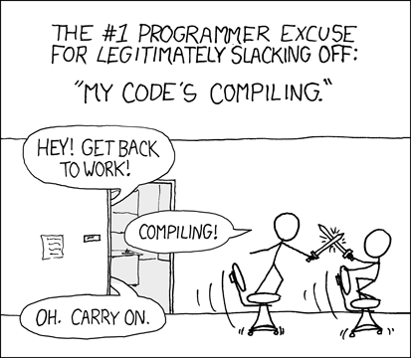
Motivation for SSA
Code analysis needs to represent facts at every program point
What if
There are a lot of facts and
there are a lot of program points?
Potentially takes a lot of space/time
Code analyses run slow
Compilers run slow
define float @myF(float %par1, float %par2, float %par3) {
%1 = fmul float %par1, %par2
%2 = fadd float %1, %par3
ret float %2 }
Definition of %1 reaches here
Definition of %1 reaches here

Slide 8
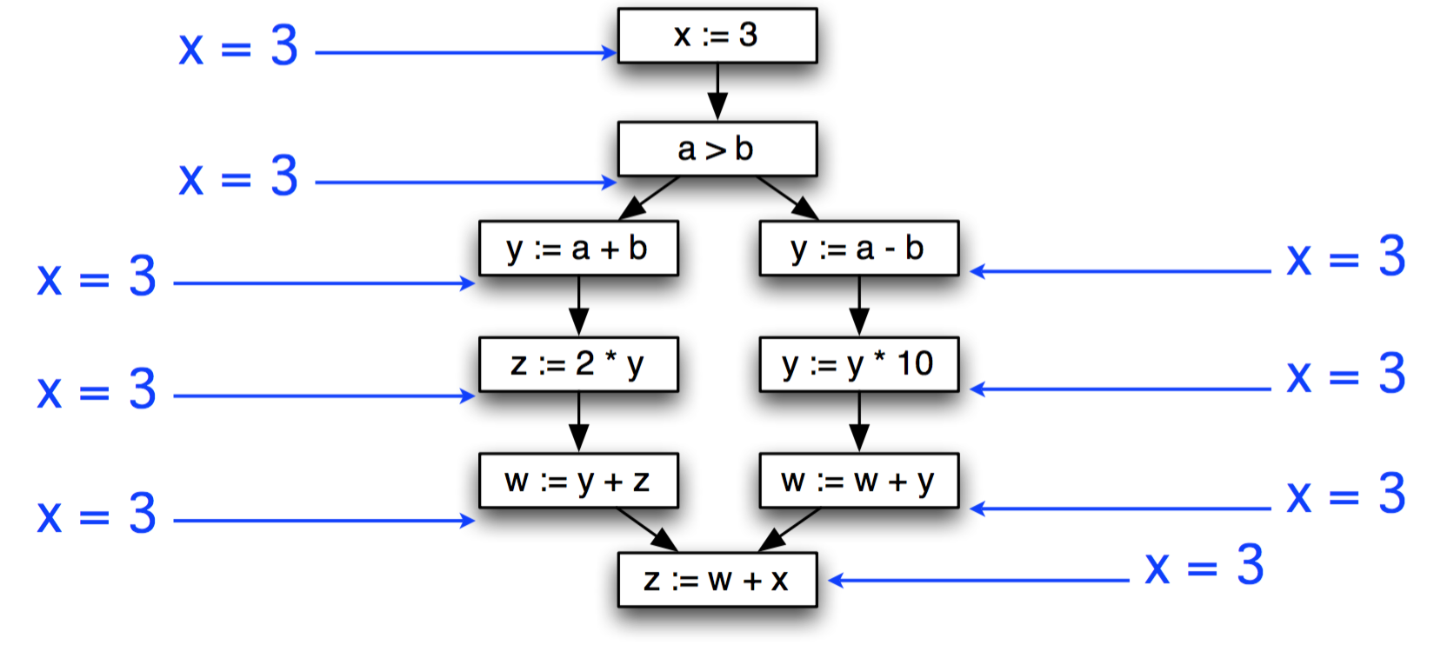
Example

Slide 9
Sparse representation
Instead, we’d like to use a sparse representation
Only propagate facts about x where they’re needed
Enter static single assignment form
Each variable is defined (assigned to) exactly once
But may be used multiple times

Slide 10
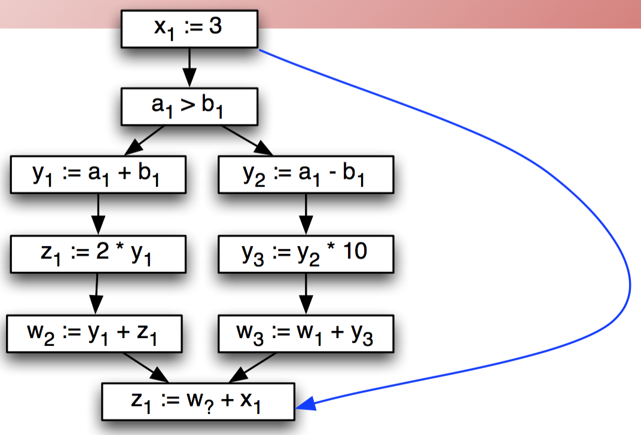
Static Single Assignment (SSA)
Add SSA edges from definitions to uses
No intervening statements define variable
Safe to propagate facts about x only along SSA edges
In our pass llvm/4
call->uses()

Slide 11
What about join nodes in the CFG?
Add Φ functions to model joins
One argument for each incoming branch
Operationally
selects one of the arguments based on how control flow reach this node
The backend needs to eliminate Φ nodes
b = c + 1
b = d + 1
b1 = c + 1
b2 = d + 1
b1 = c + 1
b2 = d + 1
If (b > N)
If (? > N)
b3=Φ(b1, b2)
If (b3 > N)
Not SSA
Still not SSA
SSA

Slide 12
Eliminating Φ
Basic idea: Φ represents facts that value of join may come from different paths
So just set along each possible path
b1 = c + 1
b2 = d + 1
b1 = c + 1
b3 = b1
b2 = d + 1
b3 = b2
b3=Φ(b1, b2)
If (b3 > N)
If (b3 > N)
Not SSA

Slide 13
Eliminating Φ in practice
Copies performed at Φ may not be useful
Joined value may not be used later in the program
(So why leave it in?)
Use dead code elimination to kill useless Φs
Subsequent register allocation will map the variables onto the actual set of machine register

Slide 14
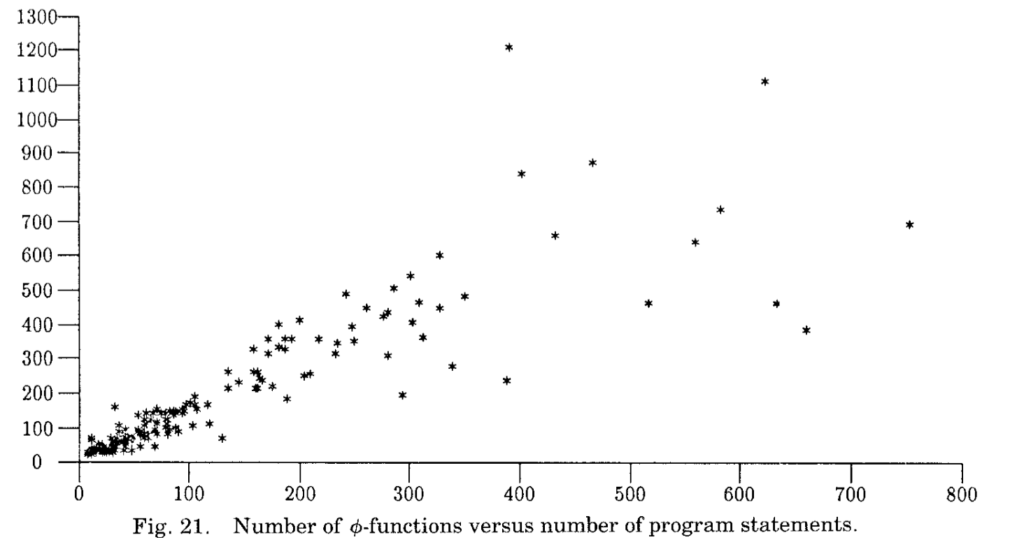
SSA efficiency in practice

Slide 15
Consequences of SSA
Unrelated uses of the same variable in source code become different variables in the SSA form
Use—def chain are greatly simplified
Data-flow analysis are simplified
Code analysis (e.g., data flow analysis) can be designed to run faster
v = 5;
print(v);
v = 42;
print(v);
v1 = 5
call print(v1)
v2 = 42
call print(v2)
To SSA IR

Slide 16
Def-use chain
OUT[ENTRY] = { };
for (each instruction i other than ENTRY) OUT[i] = { };
while (changes to any OUT occur) for (each instruction i other than ENTRY) { IN[i] = ∪_{p a predecessor of i} OUT[p];
OUT[i] = GEN[i] ∪ (IN[i] ─ KILL[i]); }
}
i: t <- …
GEN[i] = {i}
KILL[i] = defs(t) – {i}
i: …
GEN[i] = {}
KILL[i] = {}

Slide 17

Def-use chain with SSA
OUT[ENTRY] = { };
for (each instruction i other than ENTRY) OUT[i] = { };
while (changes to any OUT occur) for (each instruction i other than ENTRY) { IN[i] = ∪_{p a predecessor of i} OUT[p];
OUT[i] = GEN[i] ∪ (IN[i] ─ KILL[i]); }
}
i: t <- …
GEN[i] = {i}
KILL[i] = {}
i: …
GEN[i] = {}
KILL[i] = {}

Slide 18
Code example
i: b0 = 1
?: b0 = b0 + 2
j:b1 = b0 + 1
Question answered by reaching definition analysis: does the definition “i” reach “j”?

Slide 19
Code example
How should we design
constant propagation for SSA IRs?
i: b0 = 1
j:b1 = 1 + 1
k:b2 = 2
p:b3=Φ(b1, b2) z:return b3
Does it mean we can always propagate constants to variable uses?
What are the definitions of b3 that reach “z”?

Slide 20
SSA in LLVM
The IR must be in SSA all the time
Checked at boundaries of passes
No time wasted converting automatically IR to its SSA form
CAT designed with this constraint in mind
Φ instructions only at the top of a basic block
Must have exactly 1 entry for every predecessor
Must have at least one entry
May include undef values

Slide 21
SSA in LLVM: changing variable values
Let’s say we have a LLVM IR variable and we want to add code to change its value
How should we do it?
%v = …
%v = …
%v = %v + 1
Builder.CreateAdd(i, const1)
And then?
replaceAllUsesWith

Slide 22
SSA in LLVM: changing variable values
Let’s say we need to generate LLVM IR for the C code
How should we do it?
Memory isn’t in SSA, just registers (e.g., stack locations---alloca)
Exploit already existing passes to reduce inefficiencies (mem2reg)
mem2reg maps memory locations to registers when possible
int n = n+1;
opt –mem2reg mybitcode.bc –o mybitcode.bc

Slide 23
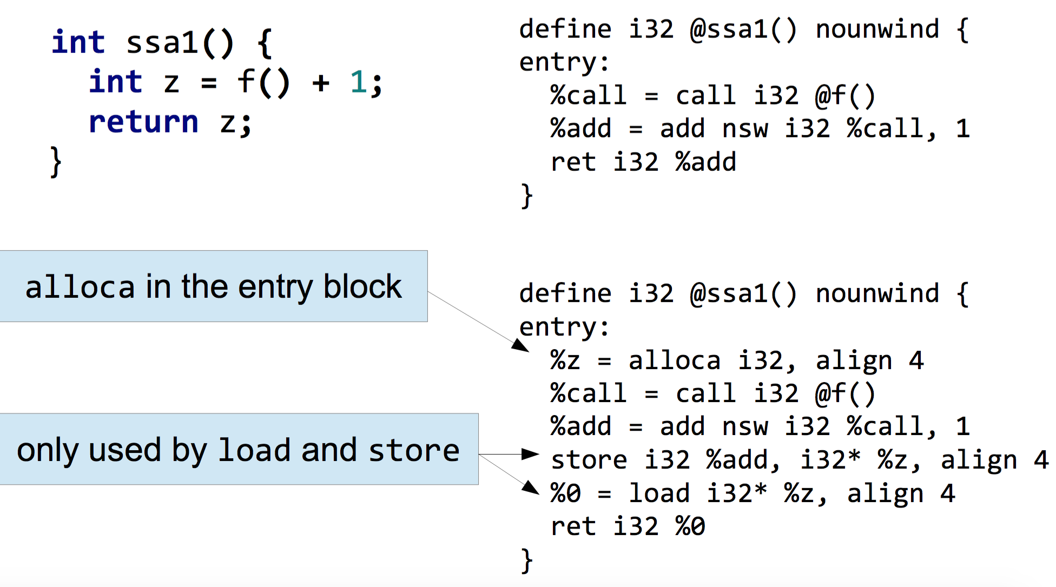
The mem2reg LLVM pass

Slide 24
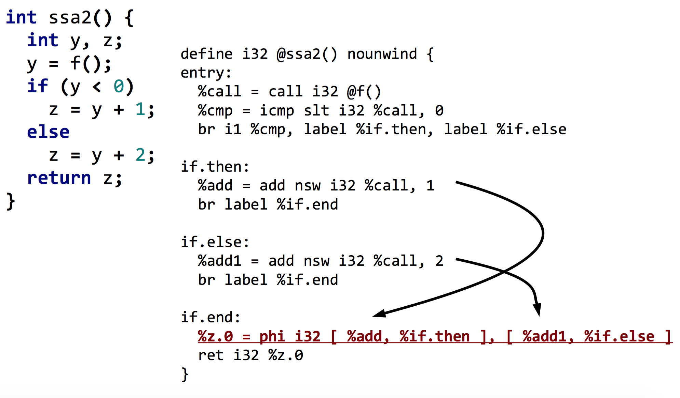
mem2reg might add new instructions

Slide 25
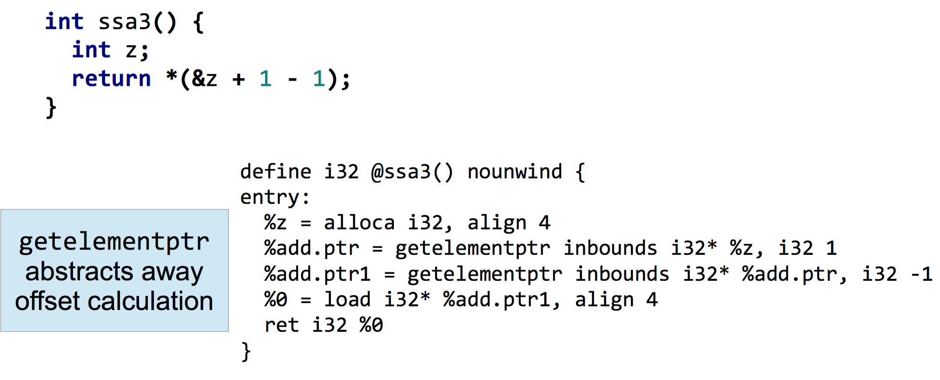
mem2reg get confused easily

