Slide 1
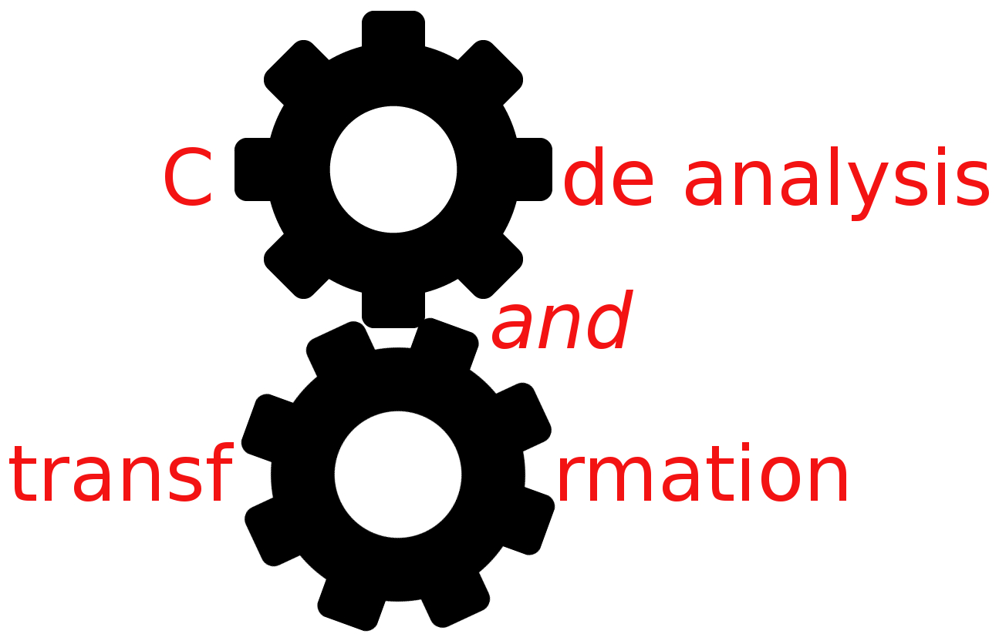


Welcome!
Simone Campanoni simonec@eecs.northwestern.edu

Slide 2


Slide 3
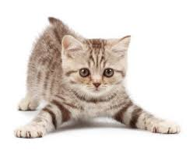
Outline
Structure of the course
CAT and compilers
CAT and computer architecture
CAT and programming language

Slide 4
CAT in a nutshell
About: understanding and transforming code automatically
EECS 395/495
Satisfy the system depth for CS major
Tuesday/Thursday 2:00pm – 3:20pm at L221 Tech (here ;))
Office hours: Friday 2:00pm – 5:00pm
But feel free to stop by at my office (2.217@Ford) any time
CAT is on Canvas
Materials/Calendar/Assignments/Grades on Canvas
You’ll upload your assignments on Canvas

Slide 5

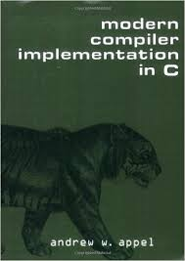
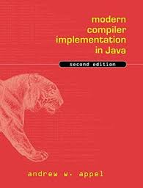
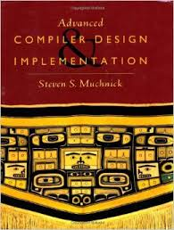
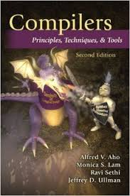

CAT materials
Modern compiler implementation
Slides and assigned papers
LLVM documentation
http://llvm.org

Slide 6
The CAT structure
Topic & homework
Today 12/8
Week
Tuesday
Thursday
Homework

Slide 7
The CAT grading
Grade | Points
A | 95 – 100
A - | 90 – 94
B + | 80 – 89
B | 70 – 79
B - | 61 – 69
C + | 57 – 60
C | 50 – 56
D | 25 – 49
F | 0 – 24
Homework: 100 points
10 points per assignment
The first 2 assignments are trivial
Extra points
Extra homework
Answering (correctly) make-concepts-in-action questions during pre-announced lectures
Last year best: 114 points!

Slide 8
Rules for homework
No copying of code is allowed
Tool, infrastructure help is allowed
First try it on your own (google and tool documentation are your friends)
Avoid plagiarism
www.northwestern.edu/provost/policies/academic-integrity/how-to-avoid-plagiarism.html
If you don’t know, please ask: simonec@eecs.northwestern.edu

Slide 9
Summary
My duties
Teach you code analysis and transformation
And how to implement them in a production compiler (LLVM)
Your duties
Learn code analysis and transformation
Implement a few of them in LLVM
Write code
Test your code
Then, think much harder about how to actually test your code
(Sometimes) Answer my questions about your code
No final exam

Slide 10
Structure & flexibility
CAT is structured w/ topics
Best way to learn is to be excited about a topic
Interested in something?
Speak
I’ll do my best to include your topic on the fly

Slide 11
Topic & homework
Today 12/8
Week 1
Today
Welcome/Structure
Compiler/CAT
Thursday
LLVM
F.E.
M.E.
B.E.

Slide 12



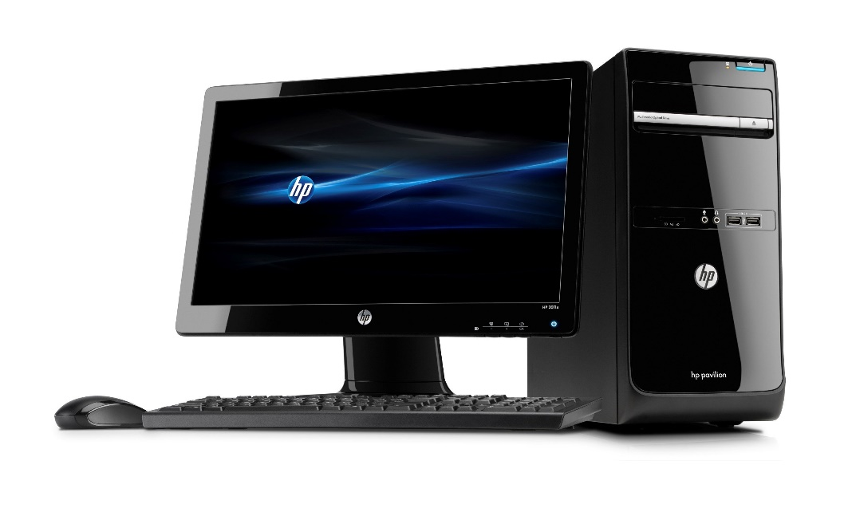
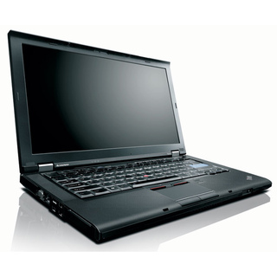
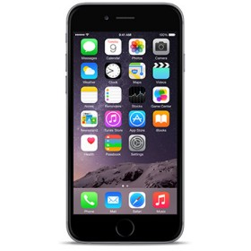
The role of compilers
If there is no coffee, if I still have work to do,
I’ll keep working, I’ll go to the coffee shop
If there is no coffee{
if I still have work to do{
I’ll keep working;
}
I’ll go to the coffee shop;
}
Code analysis and transformation
Compilers
???
00101010111001010101001010101011010

Slide 13
Theory
Inter-fields
Practice
Compilers& CATs

Slide 14
Example of CAT
varX = 5
…
…
…
…
print varX
…
What will it print?

Slide 15
Example of CAT
varX = 5
…
…
…
…
print 5
…
print varX
What will it print?

Slide 16
Example of CAT
varX = 5
…
…
…
…
print 5
…
varX = 5
…
…
…
…
print varX
…
Code
Analysis
Property
Transformation
Is it worth transforming?
Transformed code

Slide 17
Designing CATs
Choose a goal
Performance, energy, identifying bugs, discovering code properties
Design automatic analysis to obtain the required information
Occasionally design the code transformation

Slide 18
Use of CATs
Compilers
Optimize performance
energy efficiency
code generation
Developing tools (e.g., VIM, EMACS)
Understanding code (e.g., scopes, variables)
Computer architecture

Slide 19
Structure of a compiler
Character stream (Source code)
i
n
t
m
a
i
n
…
Lexical analysis
Tokens
INT
SPACE
STRING
SPACE
…
Syntactic & semantic analysis
int main (){
printf(“Hello World!\n”);
return 0;
}
Function signature
Return type
Function name
AST
INT
STRING

Slide 20
Structure of a compiler
Character stream (Source code)
i
n
t
m
a
i
n
…
Lexical analysis
Tokens
INT
SPACE
STRING
SPACE
…
Syntactic & semantic analysis
Function signature
Return type
Function name
AST
INT
STRING

Slide 21
Structure of a compiler
Syntactic & semantic analysis
Function signature
Return type
Function name
AST
INT
STRING
IR code generation
IR
; Function Attrs: nounwind uwtable
define int @main() {

Slide 22
Structure of a compiler
Character stream (Source code)
i
n
t
m
a
i
n
…
Front-end
EECS 322: Compiler Construction
IR
; Function Attrs: nounwind uwtable
define int @main() {
Middle-end
Code analysis and transformation
IR
; Function Attrs: nounwind uwtable
define int @main() {
Back-end
EECS 322: Compiler Construction
Machine code
010101110101010101

Slide 23
Structure of a compiler
Character stream (Source code)
Character stream (Source code)
Front-end
Front-end
Middle-end
Back-end
IR
Middle-end
IR
Back-end
Machine code
Machine code

Slide 24
Structure of a compiler
C
Java
C
Front-end
Front-end
Middle-end
Back-end
IR
Middle-end
IR
Back-end
Machine code
Machine code

Slide 25
Structure of a compiler
C
Java
Front-end
Front-end
Middle-end
Back-end
IR
Middle-end
IR
Back-end
Machine code
Machine code

Slide 26
Structure of a compiler
C
Java
Java
Front-end
FE
Front-end
Middle-end
Back-end
IR
Middle-end
IR
Back-end
Machine code
M2
Machine code

Slide 27
Structure of a compiler
C
Java
Java
Front-end
FE
Front-end
Middle-end
Back-end
IR
Middle-end
IR
Back-end
BE
Machine code
M2
M2

Slide 28
Structure of a compiler
L 1
L 2
Front-end 1
Front-end 2
IR
Middle-end
IR
Back-end A
Back-end B
M A
M B

Slide 29
Multiple IRs
IR needs to be easy
to produce
to translate into machine code
to transform/optimize
Abstract Syntax Tree
Register-based representation (three-address code)
R1 = R2 add R3
Stack-based representation
push 5; push 3; add; pop ;
R1
+
R2
R3

Slide 30

Example of IR
LLVM
define i32 @main(i32 %argc, i8** %argv) {
entry:
%add = add i32 %argc, 1
ret i32 %add
}

Slide 31
Multiple IRs used together
L1
Static compiler
IR1
Dynamic compiler FE
IR2
Dynamic compiler BE
Machine code

Slide 32
Multiple IRs used together
Java
Java compiler
Java bytecode
Java VM FE
IR2
Java VM BE
Machine code

Slide 33
CATs that we’ll focus on
Semantics-preserving transformations
Correctness guaranteed
Goal: performance
Automatic
Efficient

Slide 34
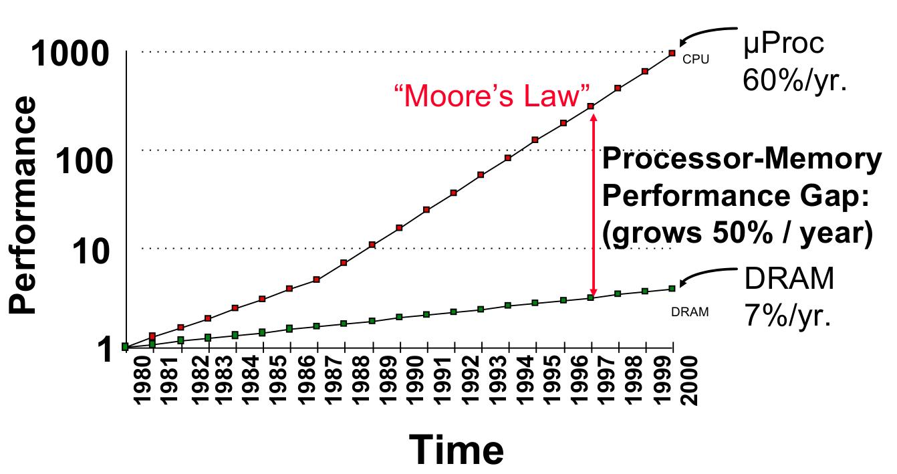
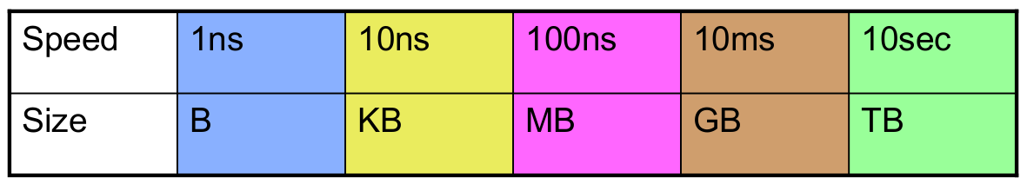
Evolution of CATs (hardware point of view)
Simple hardware (few resources), simple CATs
Core
Size
Registers
Latency
Cache L1
Cache L2
Memory

Slide 35
Evolution of CATs (hardware point of view)
Compilers/CATs are developed in the processor-design stage!
Simple hardware (few resources), simple CATs
More hardware resources available to compilers
Opportunities to improve programs
Challenging CATs
Execution model mismatch between source code and hardware
Challenging CATs

Slide 36


Evolution of CATs (hardware point of view) (2)
1960 - ?: Complex instruction set computing (CISC)
1980 - ?: Reduced instruction set computer (RISC)

Slide 37
Evolution of CATs (hardware point of view) (3)
Superscalar
Very long instruction word (VLIW)
Inst 1
Inst 1
Inst 4
Inst 7
Inst 8
Inst 2
CATs
Inst 3
Inst 2
Inst 5
Inst 3
Inst 6
Inst 4
Inst 5
Inst 6
Inst 7
Inst 8

Slide 38

Evolution of CATs (PL point of view)
First electronic computers appeared in the ’40s
They were programmed in machine language
Low level operations only
Move data from one location to another
Add the contexts of two registers
Compare two values
Programming: slow, tedious, and error prone
00101010111001010101001010101011010

Slide 39
Evolution of CATs (PL point of view)
Low level programming language, simple CATs
Not very productive
More abstraction in programming language, more work for CATs to reduce their performance overhead
Macros -> Fortran, Cobol, Lisp -> C, C++, Java, C#, Python, PHP, SQL, …
CATs enable new programming languages

Slide 40
Evolution of CATs (PL point of view)
Abstractions are great for productivity
CATs remove their overhead
But abstractions must be carefully evaluated considering CATs
A simple abstraction in PL can generate challenges for CATs
CATs need to be understood

Slide 41
Evolution of CATs (PL point of view)(2)
PL without procedures
void main (){
Int v1,v2;
v1 = 1;
v2 = 2;
…
}

Slide 42
Evolution of CATs (PL point of view)(3)
Let’s add procedures to our PL
Call-by-Value
void proc1 (int a){…}
proc1(myVar1);
Call-by-Reference
void proc1 (int a){…}
proc1(myVar1);
void proc1 (int *a){…}
proc1(&myVar1);

Slide 43
Evolution of CATs (PL point of view)(2)
void myProc (int *v1, int *v2){
(*v1) = 1;
(*v2) = 2;
}
What’s the problem for CATs?
… if v1 and v2 alias …
Understanding if pointers alias: pointer alias analysis
This is one of the most challenging problem in CATs

Slide 44
Conclusion
CATs used for multiple goals
Enable PLs
Enable hardware features
CATs are effected by
Their input language
The target hardware
When you design a PL or a new hardware platform, you need to understand what CATs can and can’t do
Some cant’s become can thanks to research on CATs

Slide 45
Ideal CATs
Proved to be correct
Improve performance of many important programs
Minor compilation time
Negligible implementation efforts

Slide 46

Demo time
As Linus Torvalds says …
Talk is cheap. Show me the code.

