Slide 1
Merge sort vs Quick sort vs Heap sort vs Insertion sort vs Radix sort
Abhishek Yadav(1001373886)
Nitin Kanwar(1001376013)

Slide 2
Insertion Sort
Insertion sort works by taking elements from the list one by one and inserting them in their correct position into a new sorted list.
Time complexity for insertion sort is O(n^2)

Slide 3
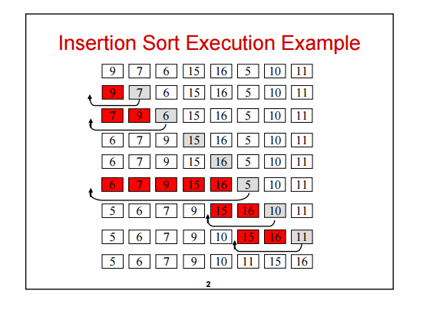

Slide 4
Merge sort
Merge sort takes advantage of the ease of merging already sorted lists into a new sorted list. It starts by comparing every two elements (i.e., 1 with 2, then 3 with 4...) and swapping them if the first should come after the second. It then merges each of the resulting lists of two into lists of four, then merges those lists of four, and so on; until at last two lists are merged into the final sorted list
Merge sort has worst-case time complexity of Ο(n log n)

Slide 5
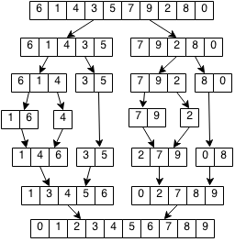
Example

Slide 6
Quick sort
Quick sort is a divide and conquer algorithm which relies on a partition operation: to partition an array an element called a pivot is selected. All elements smaller than the pivot are moved before it and all greater elements are moved after it. This can be done efficiently in linear time and in-place. The lesser and greater sublists are then recursively sorted.
Quick sort has an average time complexity of O(n log n)

Slide 7
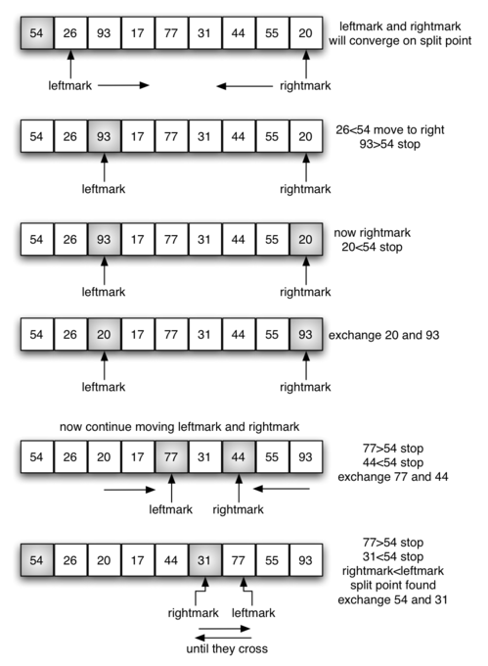
Example

Slide 8
Heap sort
Heapsort works by determining the largest (or smallest) element of the list, placing that at the end (or beginning) of the list, then continuing with the rest of the list, it accomplishes this task efficiently by using a data structure called a heap, a special type of binary tree. Once the data list has been made into a heap, the root node is guaranteed to be the largest (or smallest) element. When it is removed and placed at the end of the list, the heap is rearranged so the largest element remaining moves to the root.
Heap sort has worst case time complexity of O(n log n) time

Slide 9
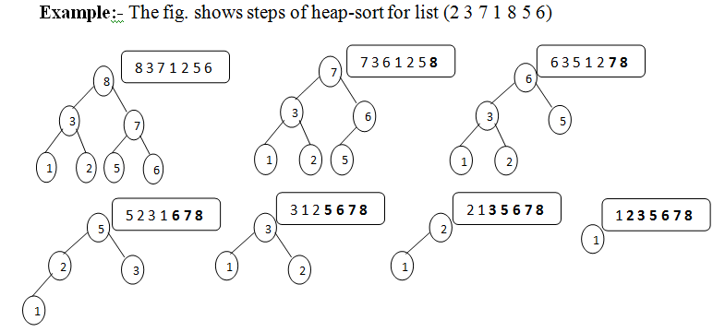

Slide 10
Radix sort
Radix sort can process digits of each number either starting from the least significant digit (LSD) or starting from the most significant digit (MSD). The LSD algorithm first sorts the list by the least significant digit while preserving their relative order using a stable sort. Then it sorts them by the next digit, and so on from the least significant to the most significant, ending up with a sorted list.
Radix sort is an algorithm that sorts numbers by processing individual digits. n numbers consisting of k digits each are sorted in O(n · k) time.

Slide 11
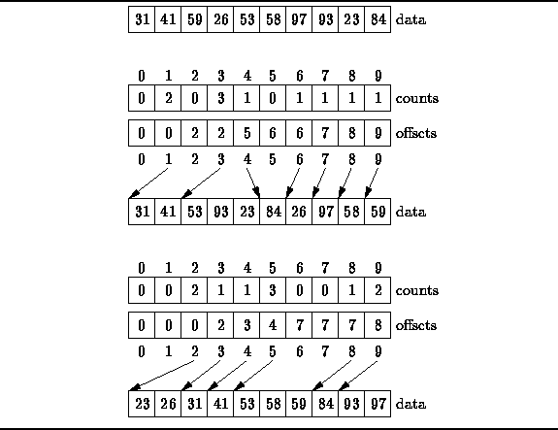
Example

Slide 12
Testing Conditions
Processor: Intel i5 5th gen 1.7GHz*4
Ram: 8gb
OS:Ubuntu 16.10 32 bit
Gcc compiler for c implementations of algorithms
R studio to create graphs

Slide 13
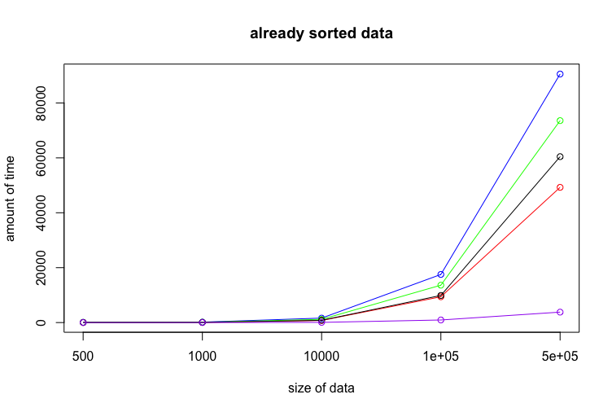
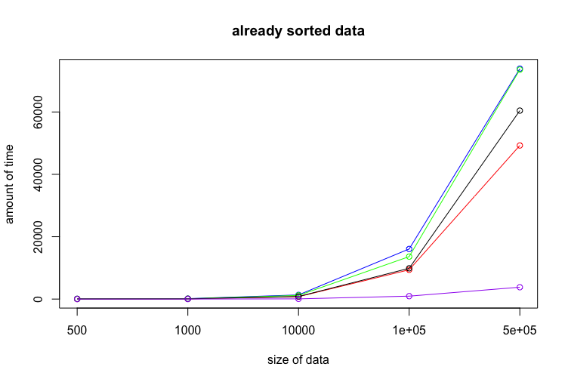
Quicksort- Red
Heapsort- Blue
Radix sort- Black
Mergesort- Green
Insertion Sort- Purple
Quicksort- Red
Heapsort- Blue
Radix sort- Black
Mergesort- Green
Insertion Sort- Purple

Slide 14
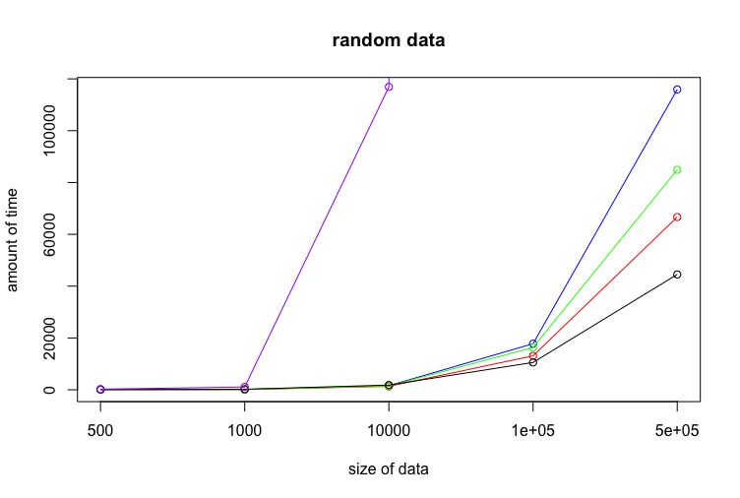
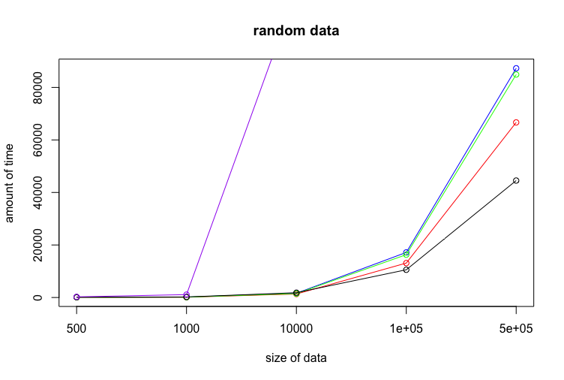
Quicksort- Red
Heapsort- Blue
Radix sort- Black
Mergesort- Green
Insertion Sort- Purple
Quicksort- Red
Heapsort- Blue
Radix sort- Black
Mergesort- Green
Insertion Sort- Purple

Slide 15
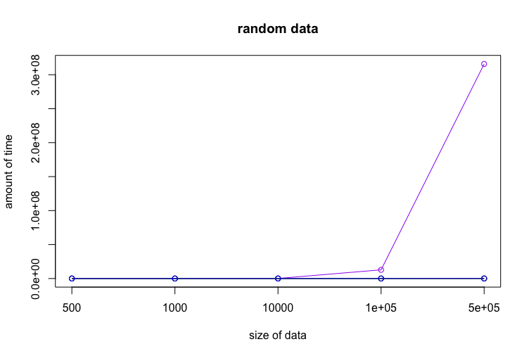

Quicksort- Red
Heapsort- Blue
Radix sort- Black
Mergesort- Green
Insertion Sort- Purple
Quicksort- Red
Heapsort- Blue
Radix sort- Black
Mergesort- Green
Insertion Sort- Purple

Slide 16
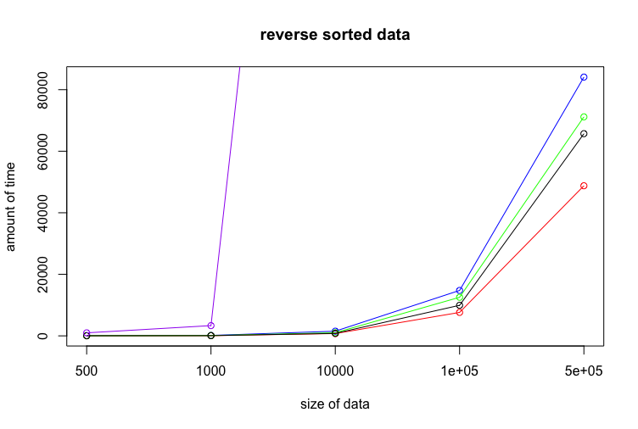
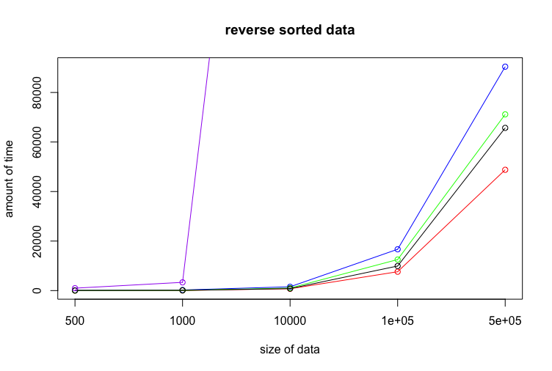
Quicksort- Red
Heapsort- Blue
Radix sort- Black
Mergesort- Green
Insertion Sort- Purple
Quicksort- Red
Heapsort- Blue
Radix sort- Black
Mergesort- Green
Insertion Sort- Purple

Slide 17
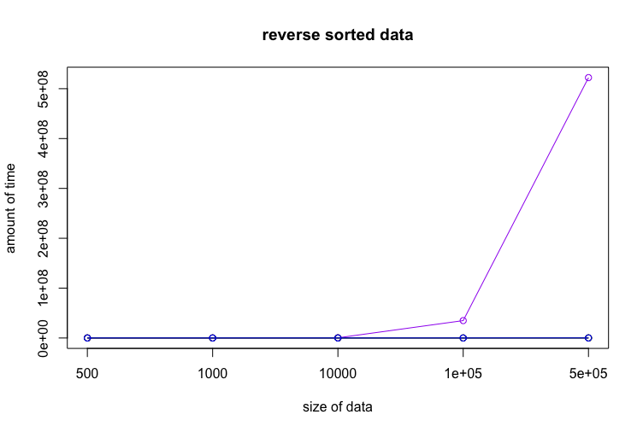

Quicksort- Red
Heapsort- Blue
Radix sort- Black
Mergesort- Green
Insertion Sort- Purple
Quicksort- Red
Heapsort- Blue
Radix sort- Black
Mergesort- Green
Insertion Sort- Purple

Slide 18
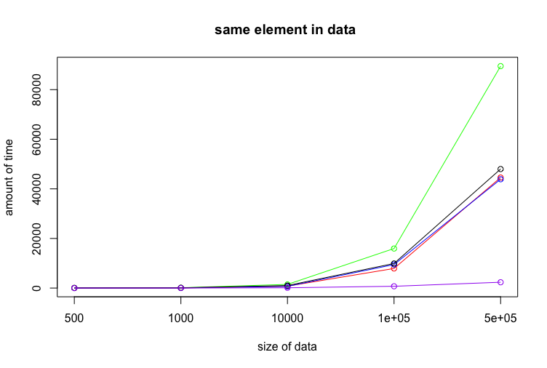
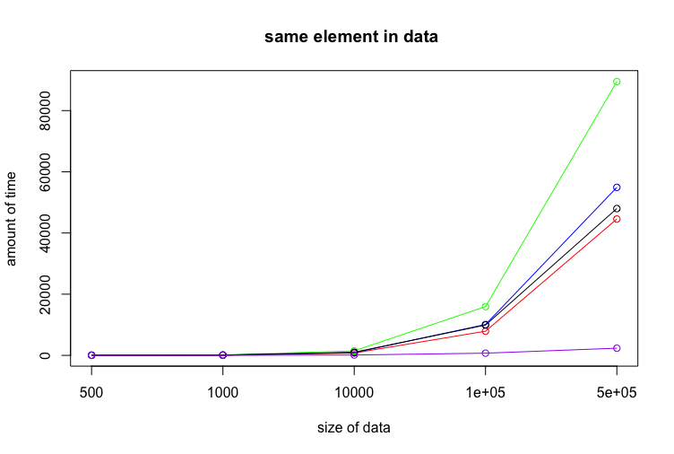
Quicksort- Red
Heapsort- Blue
Radix sort- Black
Mergesort- Green
Insertion Sort- Purple
Quicksort- Red
Heapsort- Blue
Radix sort- Black
Mergesort- Green
Insertion Sort- Purple

Slide 19
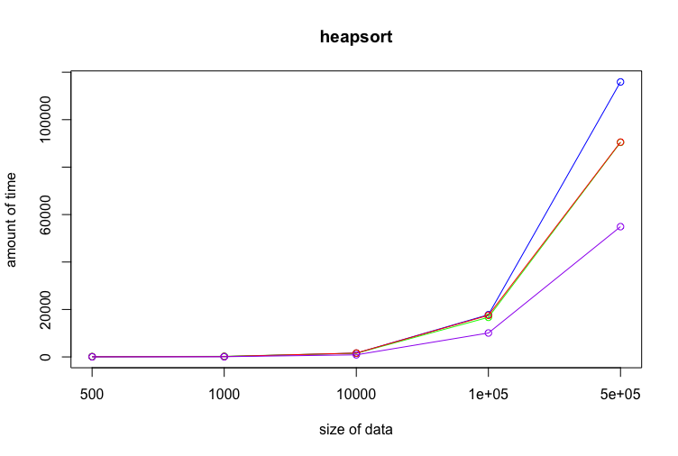
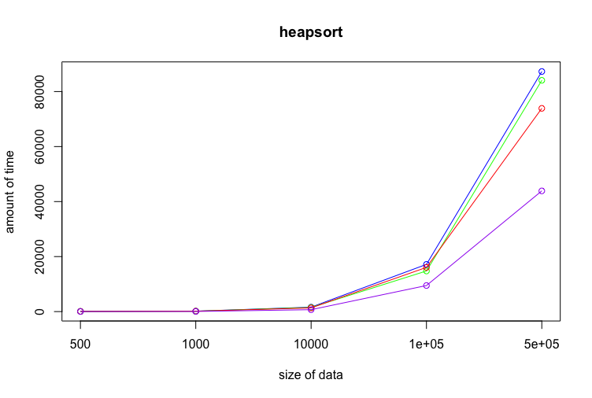
Random data – blue
Reverse sorted data – green
Sorted – red
Same - purple
Random data – blue
Reverse sorted data – green
Sorted – red
Same - purple

Slide 20
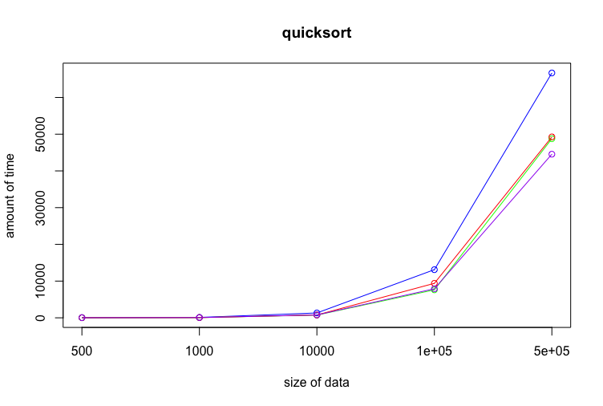
Random data – blue
Reverse sorted data – green
Sorted – red
Same - purple

Slide 21
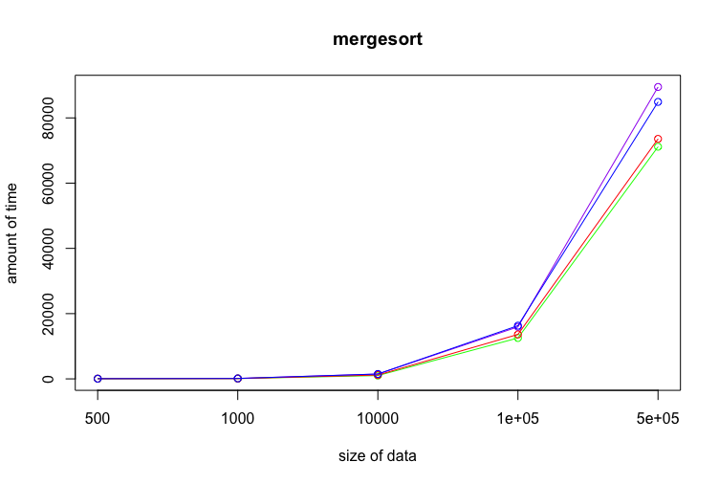
Random data – blue
Reverse sorted data – green
Sorted – red
Same - purple

Slide 22
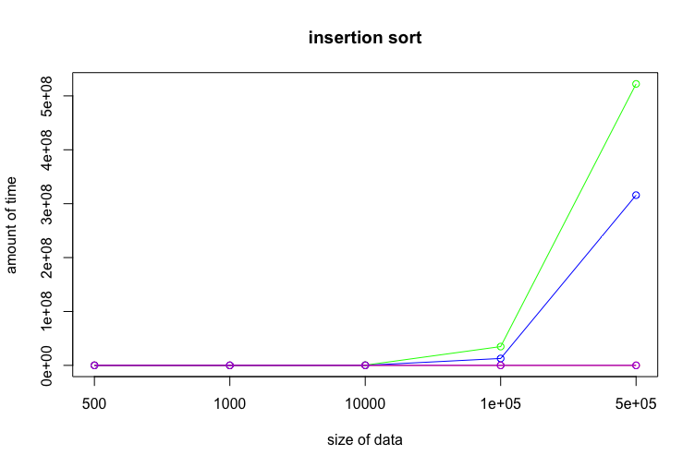
Random data – blue
Reverse sorted data – green
Sorted – red
Same - purple

Slide 23
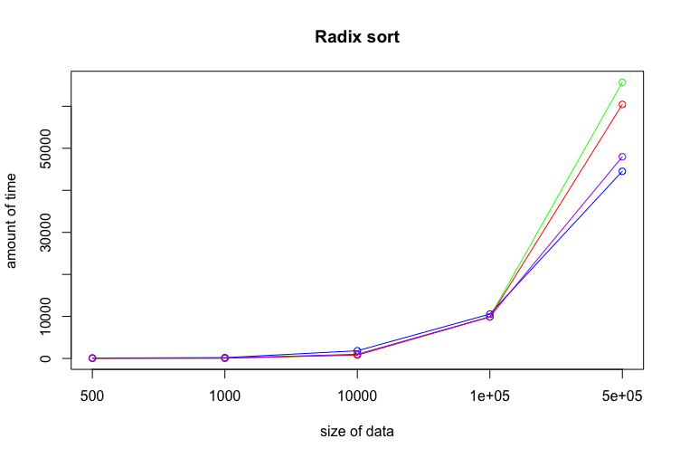
Random data – blue
Reverse sorted data – green
Sorted – red
Same - purple

Slide 24
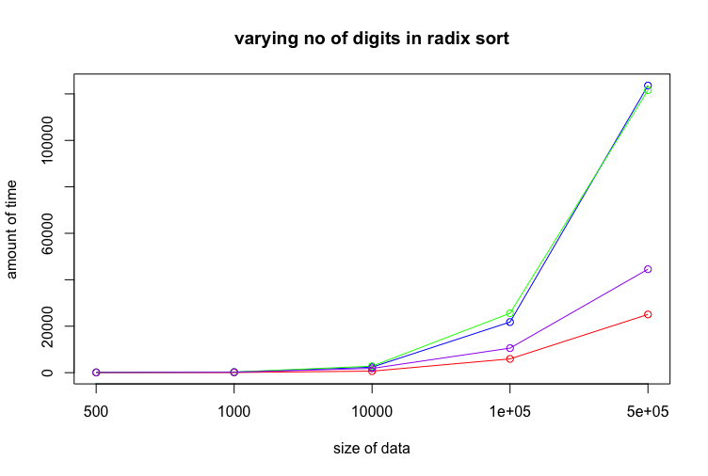
Max No of digits 2- Red
Max No of digits 4- Purple
Max No of digits 6- Blue
Max No of digits 7- Green
Max No of digits 2- Red
Max No of digits 4- Purple
Max No of digits 6- Blue
Max No of digits 7- Green

Slide 25
Conclusion
Insertion sort works well for small data sets but performs horribly when n starts becoming large.
Merge sort has similar performance on all kinds of data set but is much slower in comparison to other data sets when the data set contains same elements.
Heap sort is an efficient sorting algorithm with good overall performance.
Quick sort proves to be faster than heap sort algorithm but quick sort and heap sort have comparable performance when all elements in the data set are the same.
Radix sort seems to be faster than all the algorithms but it heavily depends on the number of digits of the largest element in the data set and may prove to be slower than quick sort.
The most startling observation was related to the worst case time of Quicksort. Theoretically, the worst case performance of quick sort should be in quadratic terms but we did not observe that. We found that the program was usually at par with the logarithmic average time.

Slide 26
Thank You

