Slide 1
Introduction To Ansible
Presented by
Ayush BISARIA

Slide 2
Introduction
What is Ansible
Simple IT automation tool which is easy to install/configure/understand.
What it can do
Configuration of servers
Continuous deployment
Provisioning
Orchestration
Automation of tasks

Slide 3
Why Ansible
It is open source (https://github.com/ansible/ansible)
Agent-less -> No need for agent installation and management
Idempotent: f(x) = f(f(x)) -> Provides Consistent state of environment
Immutable infrastructure
Easy to understand YAML styled configuration
Large number of ready to use modules for system management
Requires python installed on the managed node
Only requires one CLI invocation to run tasks in sequential manner

Slide 4
Compare to Other tools
Other tools are – puppet , chef and saltstack
Huge overhead on infrastructure as they are not agentless
High license cost for agent
Complex setup
Lot of Learning required

Slide 5
Compare to Other tools
Metrics | Chef | Puppet | Saltstack | Ansible
Ease of Setup | Not very Easy(has backup server) | Not very Easy(Multi Master setup) | Not very Easy(Multi Master setup) | Easy
Management | Not very Easy | Not very Easy | Not very Easy | Easy
Agent required | Yes | Yes | Yes | No(Agentless)
Licensed | Yes | Yes | Yes | No
Pricing upto 100 nodes | $13700 | $19900 | $15000 | Free

Slide 6
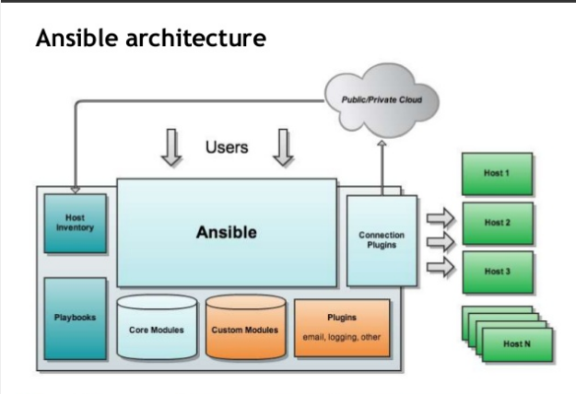
Ansible Architecture - 1

Slide 7
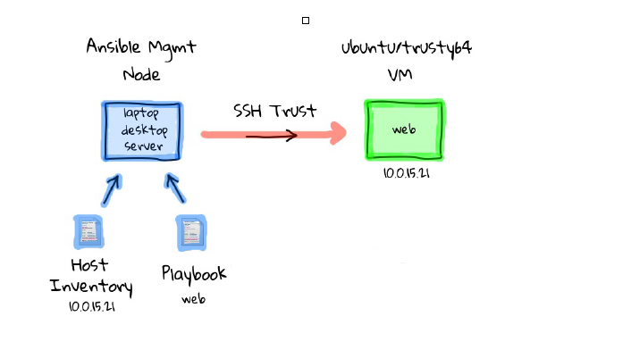
Ansible Architecture - 2

Slide 8
Installation - requirements
Control machine requirements
Minimum Python 2.6
Any OS except Windows
Managed node requirements
Python 2.6 or later

Slide 9
Installation of Ansible
Linux RHEL 7
Ubuntu –
Using yum
wget http://dl.fedoraproject.org/pub/epel/7/x86_64/e/epel-release-7-9.noarch.rpm
yum localinstall epel-release-7-9.noarch.rpm
yum --enablerepo=epel install ansible
Using pip
pip install ansible
Using apt-get
apt-get update
apt-add-repository ppa:ansible/ansible
apt-get install ansible
apt-get install sshpass

Slide 10
Configuration of Ansible
Verify Ansible installation
Create the key pair on the Server machine
Once you have entered the Gen Key command, you will get a few more questions:
Copy the Public Key
Repeat the same process for other machines you wish to login automatically with.
Ensure the <user> username has SUDO access to the remote clients
ansible --version
ssh-keygen –t rsa
Enter file in which to save the key (/home/user/.ssh/id_rsa):
Enter no password for the next prompt
ssh-copy-id user@192.168.85.135

Slide 11
Configuration of Ansible (ctd..)
Create the list of client machines you wish to access via this server
vim /etc/ansible/hosts ( And enter the following lines and save file)
Run the ping command below to see if indeed you are reaching both client nodes
[Servers]
192.168.85.135
192.168.85.136
ansible -m ping all

Slide 12
Modules
Modules are bits of code transferred to the target system and executed to satisfy the task declaration. Ansible ships with several hundred today!
apt/yum
Copy
File
get_url
Git
Ping
Debug
Service
template

Slide 13
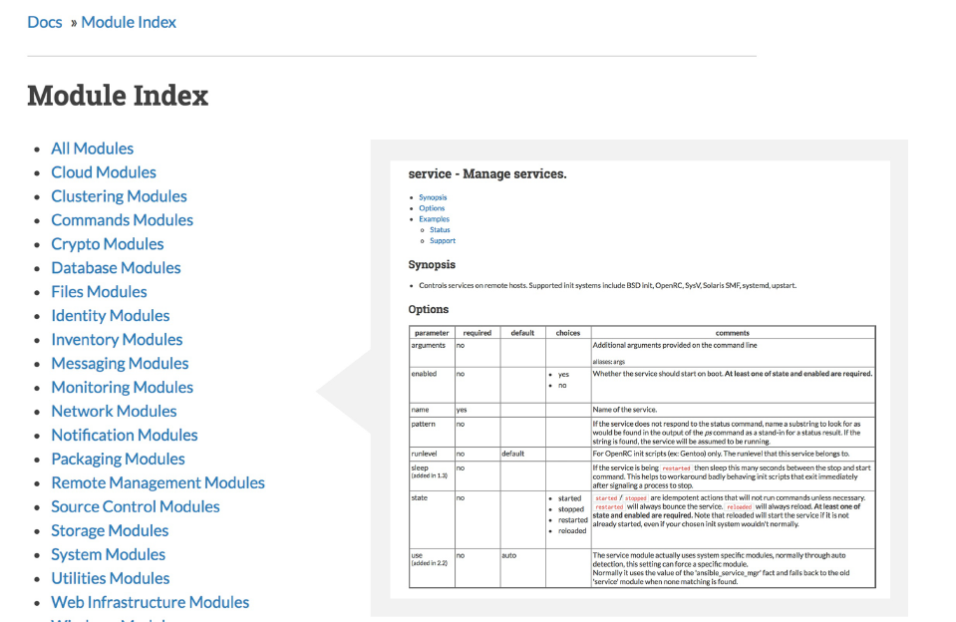
Modules - Documentation
http://docs.ansible.com/

Slide 14
Modules - Documentation
# List out all modules installed
$ ansible-doc -l
...
copy
cron
...
# Read documentation for installed module
$ ansible-doc copy
> COPY
The [copy] module copies a file on the local box to remote locations. Use the [fetch] module to copy files from remote locations to the local
box. If you need variable interpolation in copied files, use the [template] module.
* note: This module has a corresponding action plugin.
Options (= is mandatory):

Slide 15
Modules – Run Commands
If Ansible doesn’t have a module that suits your needs there are the “run command” modules:
command: Takes the command and executes it on the host. The most secure and predictable.
shell: Executes through a shell like /bin/sh so you can use pipes etc. Be careful.
script: Runs a local script on a remote node after transferring it.
raw: Executes a command without going through the Ansible module subsystem.

Slide 16
Inventory
Inventory is a collection of hosts (nodes) with associated data and groupings that Ansible can connect and manage(default inventory file - /etc/ansible/hosts).
Hosts (nodes)
Groups
Inventory-specific data (variables)
Static or dynamic

Slide 17
Static Inventory Example
[control]
Control ansible_host=10.42.0.2
[web]
node-[1:3] ansible_host=10.42.0.[6:8]
[haproxy]
haproxy ansible_host=10.42.0.100
[all:vars]
ansible_user=vagrant ansible_ssh_private_key_file=~/.vagrant.d/insecure_private_key

Slide 18
Inventory File – Communication Variables
ansible_connection : local, ssh, winrm
ansible_ssh_host : the name of the host to connect to
ansible_ssh_port : the ssh port number if not 22
ansible_ssh_user : the ssh user name to use
ansible_ssh_pass : the ssh password to use (insecure)
ansible_ssh_private_key_file : private key file used by ssh
ansible_user : provide user
ansible_password: provide password for connection

Slide 19
Ad-Hoc Commands
An ad-hoc command is a single Ansible task to perform quickly, but don’t want to save for later.
ansible <host-pattern> -m <module_name> -a “key=value key=value” (– K –b → required if any root operation in needed)
# check all my inventory hosts are ready to be managed by Ansible
$ ansible all –i localhost, -m ping
# collect and display the discovered facts for the localhost
$ ansible all –i localhost, -m setup
# run the uptime command on all hosts in the web group
$ ansible all -l web -m command -a "uptime"

Slide 20
Discovered Facts
Facts are bits of information derived from examining a host systems that are stored as variables for later use in a play
$ ansible localhost -m setup
localhost | success >> {
"ansible_facts": {
"ansible_default_ipv4": {
"address": "192.168.1.37",
"alias": "wlan0",
"gateway": "192.168.1.1",
"interface": "wlan0",
"macaddress": "c4:85:08:3b:a9:16",
"mtu": 1500,
"netmask": "255.255.255.0",
"network": "192.168.1.0",
"type": "ether"
}}

Slide 21
Variables
Ansible can work with metadata from various sources and manage their context in the form of variables.
Command line parameters
Inventory
Discovered facts
Roles
Host-vars
Group-vars

Slide 22
Tasks
Tasks are the application of a module to perform a specific unit of work
file: A directory should exist
yum: A package should be installed
service: A service should be running
template: Render a configuration file from a template
get_url: Fetch an archive file from a URL
git: Clone a source code repository

Slide 23
Example Tasks in a Play
tasks:
- name: httpd package is present
yum:
name: httpd
state: latest
- name: latest index.html file copy from host to remote
copy:
src: files/index.html
dest: /var/www/html/
- name: restart httpd service
service:
name: httpd
state: restarted

Slide 24
Handler Tasks
Handlers are special tasks that run if notified by another task when a change occurs
tasks:
- name: httpd package is present
yum:
name: httpd
state: latest
notify: restart httpd
- name: latest index.ht ml file copy from host to remote
copy:
src: files/index.html
dest: /var/www/html/
handlers:
- name: restart httpd
service:
name: httpd
state: restarted

Slide 25
Plays & Playbooks
Plays are ordered sets of tasks to execute against host selections from your inventory.
A playbook is a file containing one or more plays.

Slide 26
Playbook Example
---
- name: install and start apache
hosts: web
become: yes
vars:
http_port: 80
tasks:
- name: httpd package is present
yum:
name: httpd
state: latest
- name: latest index.html file is present
copy:
src: files/index.html
dest: /var/www/html/

Slide 27
Human-Meaningful Naming
---
- name: install and start apache
hosts: web
become: yes
vars:
http_port: 80
tasks:
- name: httpd package is present
yum:
name: httpd
state: latest
- name: latest index.html file is copied from host to remote
copy:
src: files/index.html
dest: /var/www/html/

Slide 28
DAY - 1
Q & A

Slide 29
Playbooks Features
Here are some more essential playbook features that you can apply
Templates
Loops
Conditionals
Tags
Blocks

Slide 30
Templates
Ansible embeds the jinja2 template engine that can be used to dynamically
Set and modify play variables
Conditional logic
Generate files such as configurations from variables
Documentation -https://docs.ansible.com/ansible/2.6/user_guide/playbooks_filters.html#forcing-variables-to-be-defined

Slide 31
Loops
Loops can do one task on multiple things, such as create a lot of users, install a lot of packages, or repeat a polling step until a certain result is reached.
- yum:
name: "{{ item }}"
state: latest
with_items:
- httpd
- mod_wsgi

Slide 32
Conditionals
Ansible supports the conditional execution of a task based on the run-time evaluation of variable, fact, or previous task result.
- yum:
name: httpd
state: latest
when: ansible_os_family == "RedHat"

Slide 33
Tags
Tags are useful to be able to run a subset of a playbook on-demand.(ansible-playbook play.yml –tags “packages,”)
- yum:
name: "{{ item }}"
state: latest
with_items:
- httpd
- mod_wsgi
tags:
- packages
- template:
src: templates/httpd.conf.j2
dest: /etc/httpd/conf/httpd.conf
tags:
- configuration

Slide 34
Blocks
Blocks cut down on repetitive task directives, allow for logical grouping of tasks and even in play error handling.
- block:
- yum:
name: "{{ item }}"
state: latest
with_items:
- httpd
- mod_wsgi
- template:
src: templates/httpd.conf.j2
dest: /etc/httpd/conf/httpd.conf
when: ansible_os_family == "RedHat"

Slide 35
Roles
Roles are a packages of closely related Ansible content that can be shared more easily than plays alone.
Improves readability and maintainability of complex plays
Eases sharing, reuse and standardization of automation processes
Enables Ansible content to exist independently of playbooks, projects --even organizations
Provides functional conveniences such as file path resolution and default values

Slide 36
DAY - 2
Q & A

Slide 37
Roles Example
site.yml
roles/
common/
files/
templates/
tasks/
handlers/
vars/
defaults/
meta/
apache/
Files/
templates/
tasks/
handlers/
vars/
defaults/

Slide 38
Roles Example …ctd
# site.yml
---
- hosts: web
roles:
- common
- apache

Slide 39
Variables precedence
--------------------------------------------------LEAST TO MOST IMPORTANT-------------------------------------------
role defaults
inventory file or script group vars
inventory group_vars/all
playbook group_vars/all
inventory group_vars/*
playbook group_vars/*
inventory file or script host vars
inventory host_vars/*
playbook host_vars/*
host facts
play vars
role vars (defined in role/vars/main.yml)
block vars (only for tasks in block)
task vars (only for the task)
include_vars
set_facts / registered vars
extra vars (always win precedence)

Slide 40
Ansible Galaxy
Command line tool to download different roles
Roles can be dropped into Ansible PlayBooks and immediately put to work
Galaxy site to find your roles - https://galaxy.ansible.com/home
Documentation site - https://docs.ansible.com/ansible/latest/reference_appendices/galaxy.html#the-command-line-tool

