Slide 1
Automatic Diagram Generation by Python
For drawio&Lucid

Slide 2
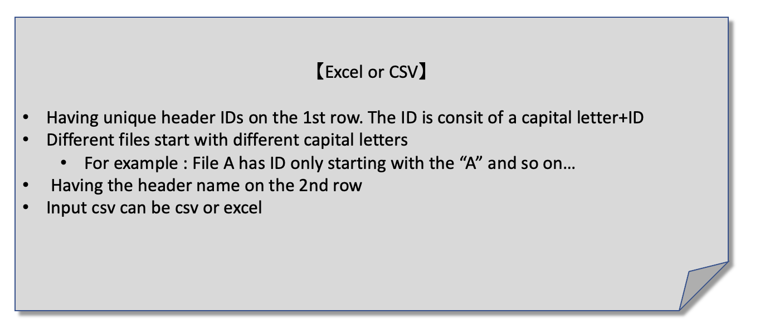


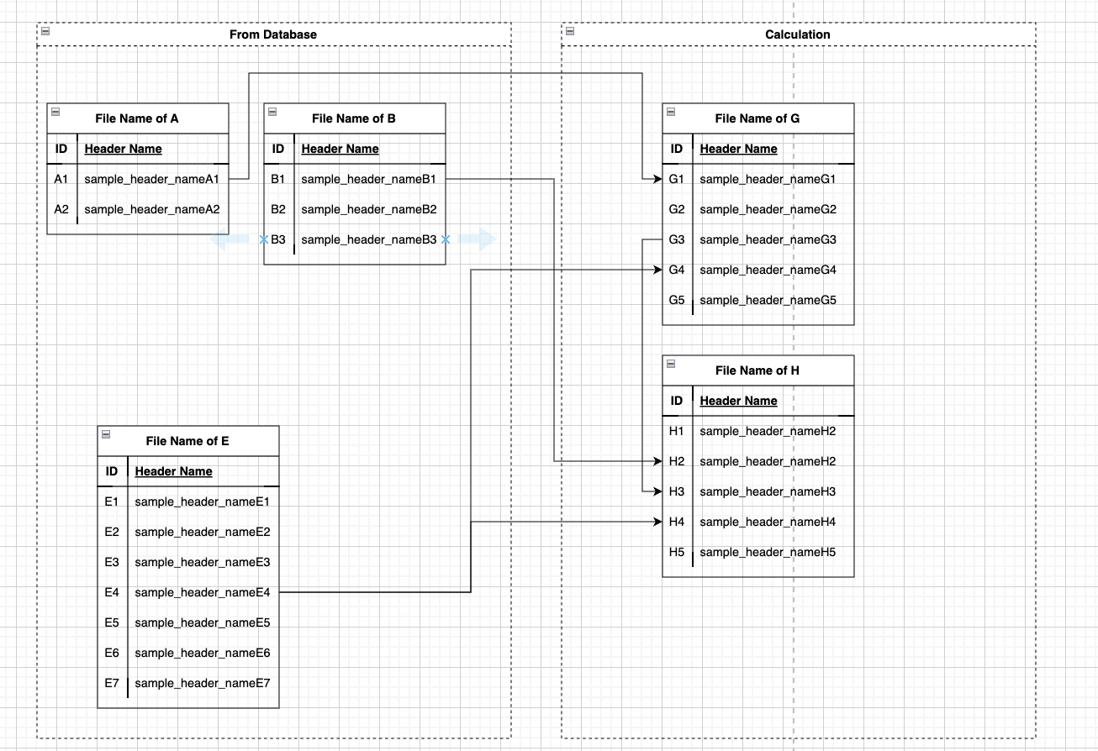


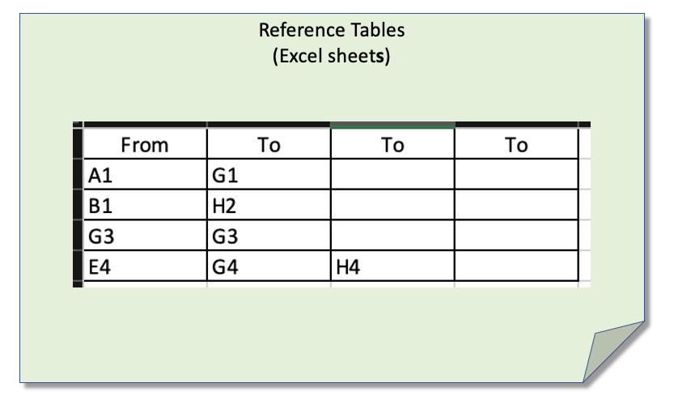
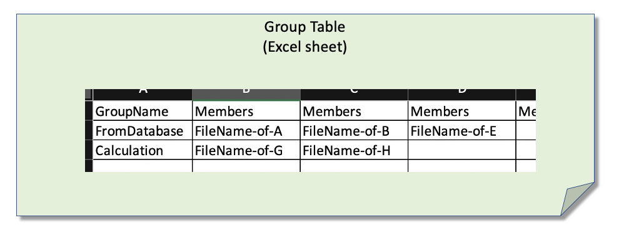
Your python needs to; 1.Imoport the input data files, reference table(excel) and group table(excel) 2.Generate the csv or any importable file for drawio and Lucid
Input data files
(Many)
Reference Table
*The linked fields need to be colored if possible
Group Table

Slide 3

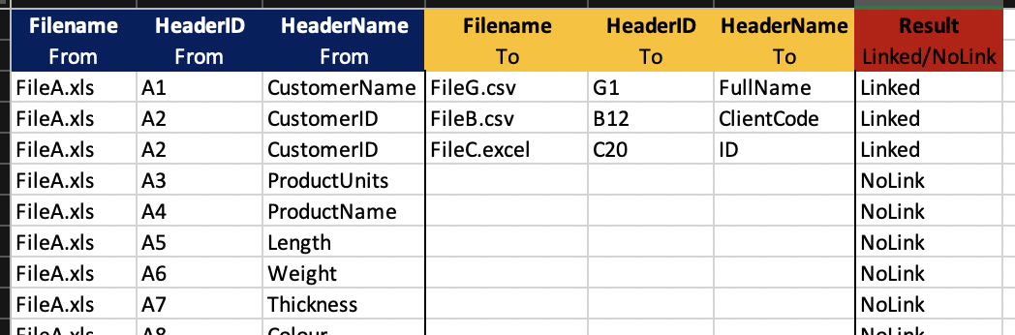
Your python needs to; 3.Generate excels sheets for headers of different files
New Excel Sheets
Different sheets for different input data fiels
Input data files
(Many)
Reference Table
SheetName: The input data file name of “FROM”
Column A-C: Parameters from input data files
Column D-F: Linked Parameters
ColumnG: Status of “Linked” or “NoLink” or “NoFound”
*If there are many “TO” linked parameters,
Add rows. Check the “A2” rows on the sample image
Group Table

Slide 4
Input Data Files I will provide the sample files
【Data files(csv and excel)】
Input Data files are csv or excel files existing under the folders under the parent directly specified by your python
Having unique header IDs on the 1st row.
The ID is consit of a capital letter+ID
Different file’s IDs start with different capital letters
For example : File A has ID only starting with the “A”, File B’s ID starts with “B” and so on…*File A and B are just example of the file names
Having the header name on the 2nd row
Header names can be shift-JIS and EUC-JP. The python should be compatible with the codecs.

Slide 5
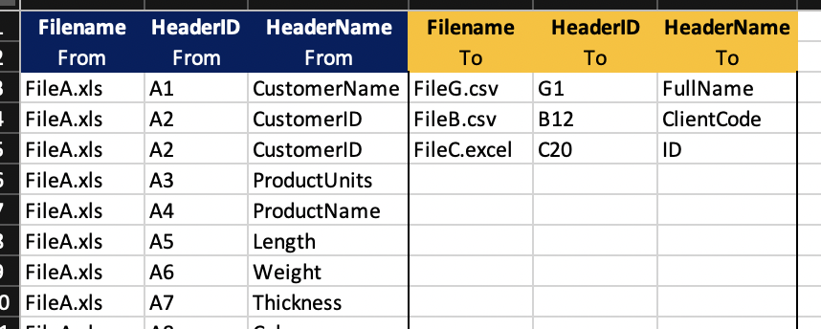
Reference Table for Lines *Sample
Reference Tables
(Excel sheets)
*The reference table may exist on a single or many sheets on the same excel

Slide 6
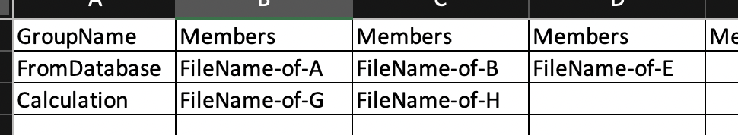
Grouping for Files *Sample
Grouping Table
(Excel sheet)
*This is for the diagram only

Slide 7
Sample Diagram to be generated
*The linked fields need to be colored if possible

