Slide 1
Munich
city
Leipzig University | AutoSlides
18.04.2017
Page 0

Slide 2
Table of Contents
Intro
General Information
Location
Leader
Important People
Simple Pedia
Impressions
Sources
Leipzig University | AutoSlides
18.04.2017
Page 1

Slide 3
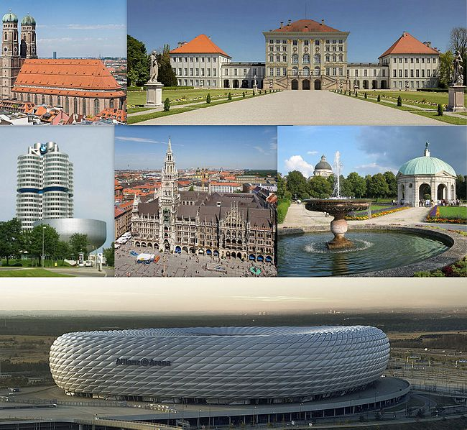
Intro
Munich (/ˈmjuːnɪk/; also /ˈmjuːnɪx/ in UK English; German: München, [ˈmʏnçn̩], Bavarian: Minga [ˈmɪŋ(ː)ɐ]) is the capital and largest city of the German state of Bavaria, on the banks of River Isar north of the Bavarian Alps. Munich is the third largest city in Germany, after Berlin and Hamburg and the 12th biggest city of the European Union with a population of above 1.5 million.
https://upload.wikimedia.org/wikipedia/commons/thumb/5/59/Munchen_collage.jpg/650px-Munchen_collage.jpg
Leipzig University | AutoSlides
18.04.2017
Page 2
Notes:
Sources used for this Slide:
http://dbpedia.org/resource/Munich (http://en.wikipedia.org/wiki/Munich?oldid=708070974)
https://upload.wikimedia.org/wikipedia/commons/thumb/5/59/Munchen_collage.jpg/650px-Munchen_collage.jpg

Slide 4
General Information
Country: Germany
Population: 1 517 868 (as of 31.10.2015)
Area code: 089, M
Total Area: 310 km²
Leipzig University | AutoSlides
18.04.2017
Page 3
Notes:
Sources used for this Slide:
test

Slide 5
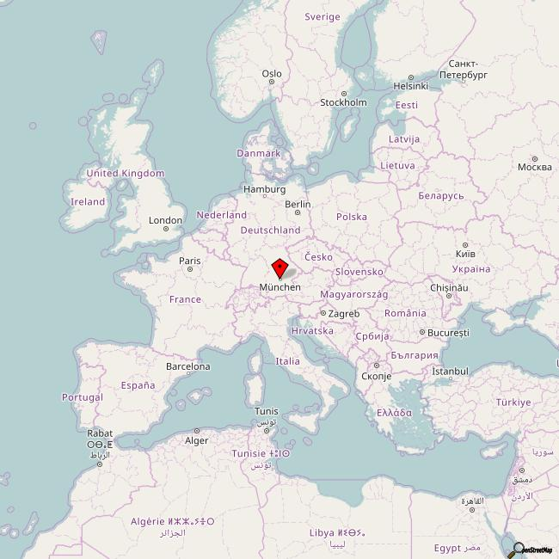
Location
http://staticmap.openstreetmap.de/staticmap.php?zoom=4&size=650x650&center=48.13333511352539,11.56666660308838&markers=48.13333511352539,11.56666660308838,ol-marker
Leipzig University | AutoSlides
18.04.2017
Page 4
Notes:
Sources used for this Slide:
http://staticmap.openstreetmap.de/staticmap.php?zoom=4&size=650x650&center=48.13333511352539,11.56666660308838&markers=48.13333511352539,11.56666660308838,ol-marker

Slide 6
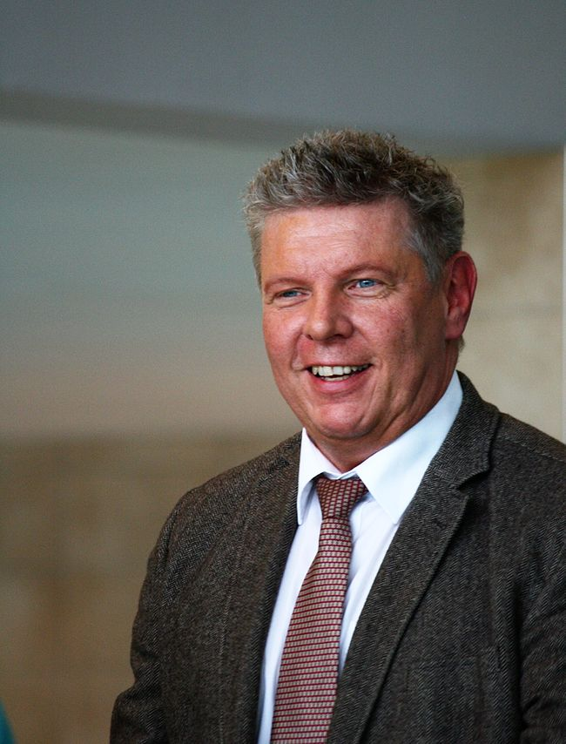
Leader
Dieter Reiter
Social Democratic Party of Germany
Dieter Reiter (born 19 May 1958 in Rain, Swabia) is a German politician and the current mayor of Munich, the capital of the state of Bavaria.
https://upload.wikimedia.org/wikipedia/commons/thumb/f/f0/Dieter_reiter_2013.jpg/650px-Dieter_reiter_2013.jpg
Leipzig University | AutoSlides
18.04.2017
Page 5
Notes:
Sources used for this Slide:
http://dbpedia.org/resource/Dieter_Reiter (http://en.wikipedia.org/wiki/Dieter_Reiter?oldid=702547044)
https://upload.wikimedia.org/wikipedia/commons/thumb/f/f0/Dieter_reiter_2013.jpg/650px-Dieter_reiter_2013.jpg

Slide 7
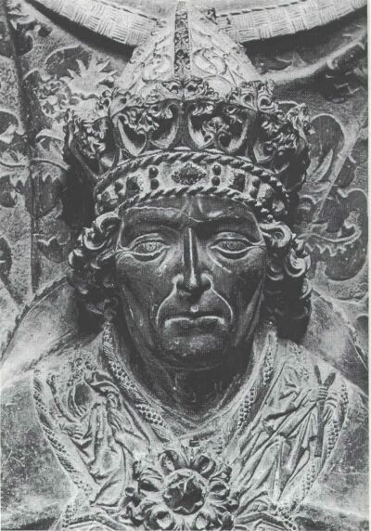
Important People
Louis IV, Holy Roman Emperor
Louis IV (German: Ludwig; 1 April 1282 – 11 October 1347), called the Bavarian, of the house of Wittelsbach, was King of the Romans from 1314, King of Italy from 1327, and Holy Roman Emperor from 1328.
https://upload.wikimedia.org/wikipedia/commons/5/54/Ludovico_il_Bavaro.jpeg
Leipzig University | AutoSlides
18.04.2017
Page 6
Notes:
Sources used for this Slide:
http://dbpedia.org/resource/Louis_IV,_Holy_Roman_Emperor (http://en.wikipedia.org/wiki/Louis_IV,_Holy_Roman_Emperor?oldid=699530302)
https://upload.wikimedia.org/wikipedia/commons/5/54/Ludovico_il_Bavaro.jpeg

Slide 8
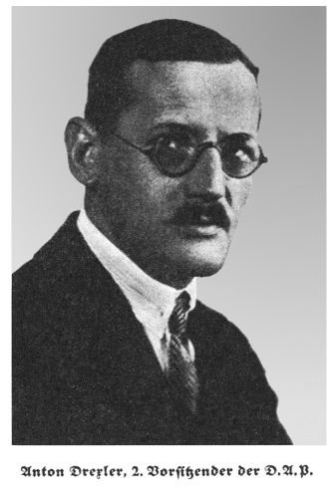
Important People
Anton Drexler
Anton Drexler (13 June 1884 – 24 February 1942) was a German far-right political leader of the 1920s who was instrumental in the formation of the pan-German and anti-Semitic German Workers' Party (Deutsche Arbeiterpartei – DAP), the antecedent of the Nazi Party (Nationalsozialistische Deutsche Arbeiterpartei – NSDAP).
https://upload.wikimedia.org/wikipedia/commons/c/c5/Anton_Drexler.jpg
Leipzig University | AutoSlides
18.04.2017
Page 7
Notes:
Sources used for this Slide:
http://dbpedia.org/resource/Louis_IV,_Holy_Roman_Emperor (http://en.wikipedia.org/wiki/Louis_IV,_Holy_Roman_Emperor?oldid=699530302)
http://dbpedia.org/resource/Anton_Drexler (http://en.wikipedia.org/wiki/Anton_Drexler?oldid=703780048)
https://upload.wikimedia.org/wikipedia/commons/c/c5/Anton_Drexler.jpg

Slide 9
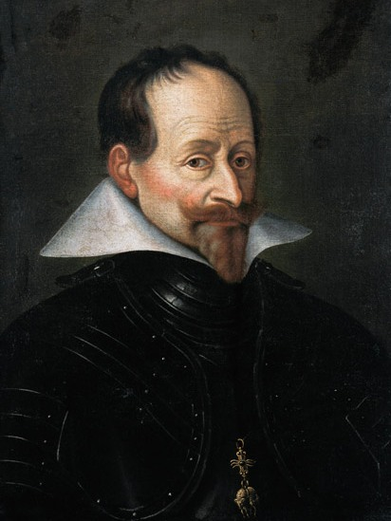
Important People
Maximilian I, Elector of Bavaria
Maximilian I, Duke/Elector of Bavaria (17 April 1573 – 27 September 1651), called \"the Great\", was a Wittelsbach ruler of Bavaria and a prince-elector (Kurfürst) of the Holy Roman Empire.
https://upload.wikimedia.org/wikipedia/commons/f/fe/Maximilian_I._%28Bayern%29.jpg
Leipzig University | AutoSlides
18.04.2017
Page 8
Notes:
Sources used for this Slide:
http://dbpedia.org/resource/Louis_IV,_Holy_Roman_Emperor (http://en.wikipedia.org/wiki/Louis_IV,_Holy_Roman_Emperor?oldid=699530302)
http://dbpedia.org/resource/Anton_Drexler (http://en.wikipedia.org/wiki/Anton_Drexler?oldid=703780048)
http://dbpedia.org/resource/Maximilian_I,_Elector_of_Bavaria (http://en.wikipedia.org/wiki/Maximilian_I,_Elector_of_Bavaria?oldid=703015432)
https://upload.wikimedia.org/wikipedia/commons/f/fe/Maximilian_I._%28Bayern%29.jpg

Slide 10
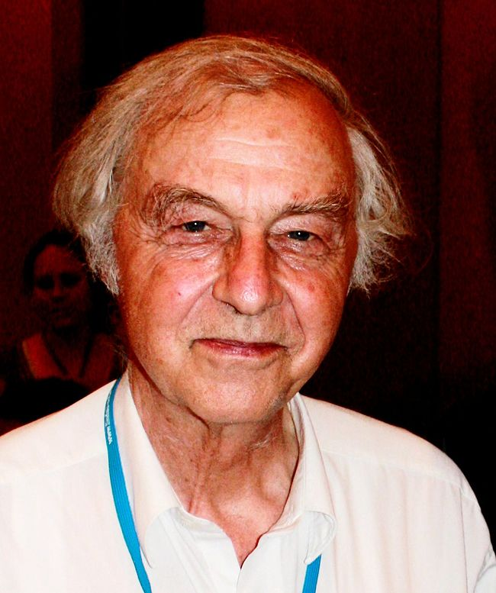
Important People
Robert Huber
Robert Huber ForMemRS is a German biochemist and Nobel laureate.
https://upload.wikimedia.org/wikipedia/commons/thumb/0/0a/Robert-huber.jpg/650px-Robert-huber.jpg
Leipzig University | AutoSlides
18.04.2017
Page 9
Notes:
Sources used for this Slide:
http://dbpedia.org/resource/Louis_IV,_Holy_Roman_Emperor (http://en.wikipedia.org/wiki/Louis_IV,_Holy_Roman_Emperor?oldid=699530302)
http://dbpedia.org/resource/Anton_Drexler (http://en.wikipedia.org/wiki/Anton_Drexler?oldid=703780048)
http://dbpedia.org/resource/Maximilian_I,_Elector_of_Bavaria (http://en.wikipedia.org/wiki/Maximilian_I,_Elector_of_Bavaria?oldid=703015432)
http://dbpedia.org/resource/Robert_Huber (http://en.wikipedia.org/wiki/Robert_Huber?oldid=707354192)
https://upload.wikimedia.org/wikipedia/commons/thumb/0/0a/Robert-huber.jpg/650px-Robert-huber.jpg

Slide 11
Economy
Munich has the strongest economy of any German city.[3] They have the lowest unemployment rate (5.6%) of any German city with more than a million people.[4][5] Munich is the largest publishing city in Europe.[6] It is home to the Süddeutsche Zeitung, one of Germany's largest daily newspapers. Munich is also home to Germany's largest public broadcasting network, ARD, and its largest commercial network, Pro7-Sat1 Media AG. The headquarters of the German branch of Random House, the world's largest publishing house, is in Munich. The Bavaria Film Studios are in the suburb of Grünwald. They are one of Europe's biggest and most famous movie production studios.[7] Lufthansa has opened a second hub at Munich's Franz Josef Strauss International Airport. It is the second-largest airport in Germany, after Frankfurt International Airport.
Leipzig University | AutoSlides
18.04.2017
Page 10
Notes:
Sources used for this Slide:
https://simple.wikipedia.org/wiki/Munich

Slide 12
Airport
Munich Airport - Franz Joseph Strauss (IATA: MUC, ICAO: EDDM)
Leipzig University | AutoSlides
18.04.2017
Page 11
Notes:
Sources used for this Slide:
https://simple.wikipedia.org/wiki/Munich

Slide 13
Boroughs
Munich has 25 boroughs (Bezirke in German, also sometimes called districts in English).
Leipzig University | AutoSlides
18.04.2017
Page 12
Notes:
Sources used for this Slide:
https://simple.wikipedia.org/wiki/Munich

Slide 14
Sports
Munich is the most successful city in Bundesliga history. FC Bayern Munich have won 20 national championship along with 13 DFB Cups, 5 UEFA Champions League/European Championship, 1 UEFA Cup and 1 UEFA Cup Winners Cup for 39 trophies. Munich hosted the 1972 Summer Olympics. They were one of the host cities for the 2006 Football World Cup. Munich bid to host the 2018 Winter Olympic Games but lost to Pyeongchang.[8] In September 2011 the DOSB President Thomas Bach said that Munich would bid again for the Winter Olympics in the future.[9]
Leipzig University | AutoSlides
18.04.2017
Page 13
Notes:
Sources used for this Slide:
https://simple.wikipedia.org/wiki/Munich

Slide 15
History
1158 - The settlement was founded as Munichen by Henry the Lion
1255 - Residence of Upper Bavaria.
1806 - Munich became the capital of the Bavarian monarchy
1923 - Beer Hall Putsch of the Nazis
Leipzig University | AutoSlides
18.04.2017
Page 14
Notes:
Sources used for this Slide:
https://simple.wikipedia.org/wiki/Munich

Slide 16
History
1939-45 - 45% was destroyed in World War II
1972 - 1972 Summer Olympics
2016 - 2016 Munich shooting
Leipzig University | AutoSlides
18.04.2017
Page 15
Notes:
Sources used for this Slide:
https://simple.wikipedia.org/wiki/Munich

Slide 17
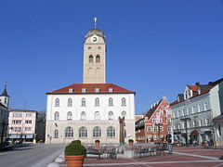
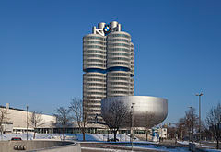
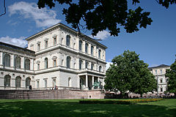
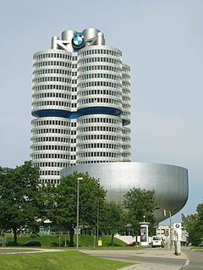
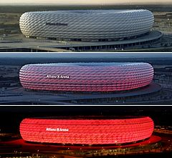
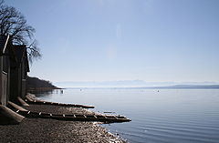
Impressions
sources are in the notes
Leipzig University | AutoSlides
18.04.2017
Page 16
Notes:
Sources used for this Slide:
https://upload.wikimedia.org/wikipedia/commons/thumb/6/6b/109_0994.JPG/240px-109_0994.JPG
https://upload.wikimedia.org/wikipedia/commons/thumb/3/3c/4_Cilindros%2C_M%C3%BAnich%2C_Alemania%2C_2013-02-11%2C_DD_02.JPG/240px-4_Cilindros%2C_M%C3%BAnich%2C_Alemania%2C_2013-02-11%2C_DD_02.JPG
https://upload.wikimedia.org/wikipedia/commons/thumb/2/23/Akademie_Muenchen.jpg/240px-Akademie_Muenchen.jpg
https://upload.wikimedia.org/wikipedia/commons/thumb/5/50/Allianz_Arena_zu_verschiedenen_Zeiten.jpg/240px-Allianz_Arena_zu_verschiedenen_Zeiten.jpg
https://upload.wikimedia.org/wikipedia/commons/thumb/2/22/Ammersee.JPG/240px-Ammersee.JPG
https://upload.wikimedia.org/wikipedia/commons/thumb/7/72/BMW-HQ.jpg/240px-BMW-HQ.jpg

Slide 18
Impression Slide Source
https://upload.wikimedia.org/wikipedia/commons/thumb/6/6b/109_0994.JPG/240px-109_0994.JPG
https://upload.wikimedia.org/wikipedia/commons/thumb/3/3c/4_Cilindros%2C_M%C3%BAnich%2C_Alemania%2C_2013-02-11%2C_DD_02.JPG/240px-4_Cilindros%2C_M%C3%BAnich%2C_Alemania%2C_2013-02-11%2C_DD_02.JPG
https://upload.wikimedia.org/wikipedia/commons/thumb/2/23/Akademie_Muenchen.jpg/240px-Akademie_Muenchen.jpg
https://upload.wikimedia.org/wikipedia/commons/thumb/5/50/Allianz_Arena_zu_verschiedenen_Zeiten.jpg/240px-Allianz_Arena_zu_verschiedenen_Zeiten.jpg
Leipzig University | AutoSlides
18.04.2017
Page 17

Slide 19
Impression Slide Source
https://upload.wikimedia.org/wikipedia/commons/thumb/2/22/Ammersee.JPG/240px-Ammersee.JPG
https://upload.wikimedia.org/wikipedia/commons/thumb/7/72/BMW-HQ.jpg/240px-BMW-HQ.jpg
Leipzig University | AutoSlides
18.04.2017
Page 18

Slide 20
Sources
http://dbpedia.org/resource/Munich (http://en.wikipedia.org/wiki/Munich?oldid=708070974)
http://dbpedia.org/resource/Dieter_Reiter (http://en.wikipedia.org/wiki/Dieter_Reiter?oldid=702547044)
http://dbpedia.org/resource/Louis_IV,_Holy_Roman_Emperor (http://en.wikipedia.org/wiki/Louis_IV,_Holy_Roman_Emperor?oldid=699530302)
http://dbpedia.org/resource/Anton_Drexler (http://en.wikipedia.org/wiki/Anton_Drexler?oldid=703780048)
Leipzig University | AutoSlides
18.04.2017
Page 19

Slide 21
Sources
http://dbpedia.org/resource/Maximilian_I,_Elector_of_Bavaria (http://en.wikipedia.org/wiki/Maximilian_I,_Elector_of_Bavaria?oldid=703015432)
http://dbpedia.org/resource/Robert_Huber (http://en.wikipedia.org/wiki/Robert_Huber?oldid=707354192)
https://simple.wikipedia.org/wiki/Munich
Leipzig University | AutoSlides
18.04.2017
Page 20

