Slide 1



Club members are required to pay weekly membership fee in order to continue having access to the club missions
Membership Fee
When players click pay and fee is deducted from players account this button should say Paid. This will last a week before players will have to click pay again
10
Pay
Search Mission
All
Active
Sort By:
“Sort by” drop down menu should have the following options:
Longest Reward Period
Shortest Reward Period
Character Rewards
Boost Rewards
Safe Rewards
Pass Rewards
Lowest Requirement
Highest Requirement
When user clicks All, it should show all the missions available both online and offline missions
When user clicks Active it should show all the missions player is currently taking part on
When player search for words such as mission names, reward name, reward type such as boost, nft and pass. The missions that either have the same name, rewards should be shown

Slide 2
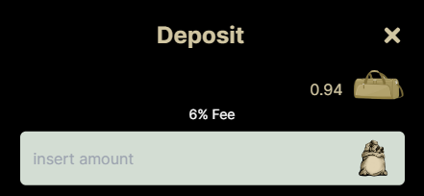




Stake
Unstake
234
234
Staked
234
234
Staked
234
234
Staked
234
Staked
stake
unstake
This window should pop up when user clicks Stake
This window should pop up when user clicks unstake

Slide 3
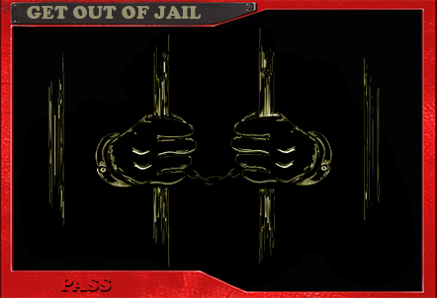

Membership Fee
This tab is to switch between online and offline depending if the mission is currently available or not
10
Pay
Search Mission
All
Active
Sort By:
Search Mission
Mission
Mission Requirements
Your Progress
Reward Period
Reward
“Say hello to my lil friend”
Boost “Enforcer”
10/2000
Daily
1
Start
10/40
Lock Period
stake
Unstake
2K
40
10/2000
1K
4K
20/4000
20 Days
Claim
Online

Slide 4
Mission
Mission Requirements
Your Progress
Reward Period
Reward
“Time Traveller”
Boost “Safe Reset”
10/10000
Every 2 Days
2
Start
10/40
Lock Period
stake
Unstake
2K
40
10/1000
1K
4K
Online
20/15000
27 Days
Claim
Mission
Mission Requirements
Your Progress
Reward Period
Reward
“Good Fellas”
Boost “Gang Hire”
10/10000
Every 2 Days
3
Start
10/40
Lock Period
stake
Unstake
2K
40
10/1000
1K
4K
Online
20/15000
35 Days
Claim

Slide 5
Mission
Mission Requirements
Your Progress
Reward Period
Reward
“Mo money, Mo problems”
Boost “Safe Boost”
10/10000
Every 3 Days
4
Start
10/40
Lock Period
stake
Unstake
2K
40
10/1000
1K
4K
Online
20/15000
40 Days
Claim
Mission
Mission Requirements
Your Progress
Reward Period
Reward
“Cages are for birds”
Boost “Skip Jail time”
10/10000
Every 3 Days
5
Start
10/40
Lock Period
stake
Unstake
2K
40
10/1000
1K
4K
Online
20/15000
65 Days
Claim

Slide 6
Mission
Mission Requirements
Your Progress
Reward Period
Reward
“Power & Respect”
Boost “Production Boost”
10/25000
Daily
6
Start
10/1000
Lock Period
stake
Unstake
2K
40
10/5000
1K
4K
Online
20/35000
120 Days
Claim
Mission
Mission Requirements
Your Progress
Reward Period
Reward
“A Dogs Day”
Boost “Safe Ultimate Boost”
10/25000
Daily
7
Start
10/100
Lock Period
stake
Unstake
2K
40
10/5000
1K
4K
Online
20/40000
120 Days
Claim

Slide 7
Mission
Mission Requirements
Your Progress
Reward Period
Reward
“Boss Life”
Pass “Immunity”
10/35000
Every 2 Days
8
Start
10/1000
Lock Period
stake
Unstake
2K
40
10/5000
1K
4K
Online
20/35000
97 Days
Claim
Mission
Mission Requirements
Your Progress
Reward Period
Reward
“Fuck The Police”
Pass “Get Out Of Jail”
10/35000
Every 2 Days
9
Start
10/1000
Lock Period
stake
Unstake
2K
40
10/5000
1K
4K
Online
20/35000
97 Days
Claim

Slide 8
Mission
Mission Requirements
Your Progress
Allowed Mints
Reward
“Lost Soul”
Character “Epic Hustler”
10/35000
0/1
10
Start
10/1000
Lock Period
stake
Unstake
2K
40
10/5000
1K
4K
Online
20/35000
65 Days
Claim
Mission
Mission Requirements
Your Progress
Allowed Mints
Reward
“Thug Life”
Character “Epic Gangster”
10/35000
0/1
11
Start
10/1000
Lock Period
stake
Unstake
2K
40
10/5000
1K
4K
Online
20/35000
65 Days
Claim

Slide 9
Mission
Mission Requirements
Your Progress
Allowed Mints
Reward
“Street Science”
Character “Epic Chemist”
10/35000
0/1
12
Start
10/1000
Lock Period
stake
Unstake
2K
40
10/5000
1K
4K
Online
20/35000
65 Days
Claim
Mission
Mission Requirements
Your Progress
Allowed mints
Reward
“Baller”
Character “Large Safe”
10/35000
0/1
13
Start
10/1000
Lock Period
stake
Unstake
2K
40
10/5000
1K
4K
20/35000
65 Days
Claim
Online

