Slide 1
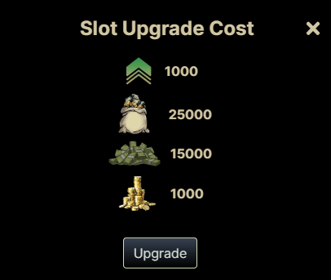
Trap House
Unlock Area
The Trap House is similar to The Corner except it will be locked, player will be able to see the area but will not be able to access it. The area should be locked and slightly greyed out and players should only be able to access the area when they click “unlock area and pay the required fee.
When player clicks unlock area a window like this should pop up.
Players unlock the area and the unlock area button should disappear and the grey fog should dissapear
Cost
Unlock

Slide 2
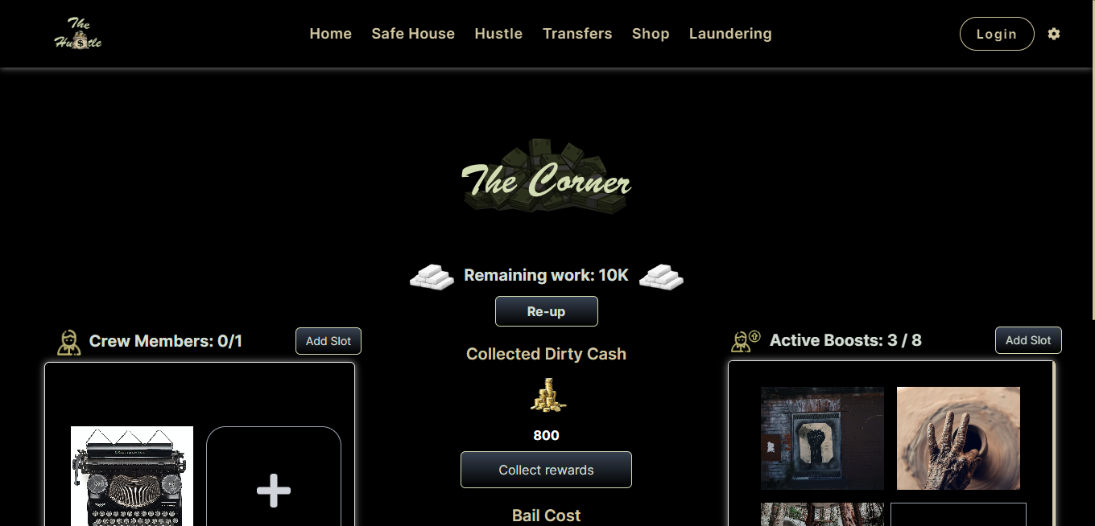
Locked view
Unlock Area

Slide 3
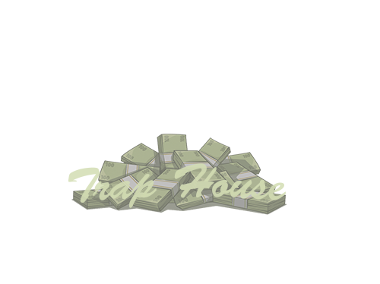
Unlocked view

Slide 4
Cladestine Lab
Unlock Area
The Cladestine Lab is similar to The Trap House it will be locked, player will be able to see the area but will not be able to access it. The area should be locked slightly greyed out and players should only be able to access the area when they click “unlock area and pay the required fee.
When player clicks unlock area a window like this should pop up.
Players unlock the area and the unlock area button should disappear and the grey fog should be removed.
Cost
Unlock

Slide 5
Locked view
Unlock Area
+15% Bonus Reward

Slide 6
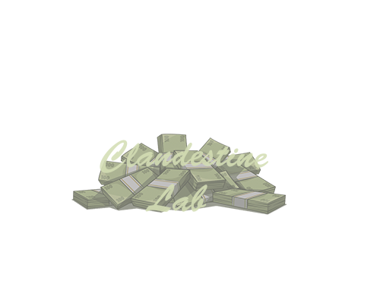
Unlocked view
+15% Bonus Reward

