Slide 1
SIH 2026 · PS 26018
Intelligent Land Record Digitization
Reads Indian land records, validates them, scores its own confidence, and routes anything uncertain to a human.
Department of Land Resources

Slide 2
THE PROBLEM
A wrong khasra number is not a data error. It is a property dispute.
Decades of khatauni and 7/12 extracts sit in tehsil offices as paper.

Slide 3
WHY THIS IS HARD
Reading characters is the easy part
The difficulty is knowing which field a value belongs to.
BILINGUAL ROWS
Value follows the final separator
REGIONAL UNITS
A bigha differs by state
RIVAL LABELS
Two date fields collide

Slide 4
HOW IT WORKS
Three stages, each one auditable
01
02
03
Extract
Classify
Validate
Text layer, then OCR, then degraded mode.
Map lines onto 17 land-record fields.
Rules, master data, then route.

Slide 5
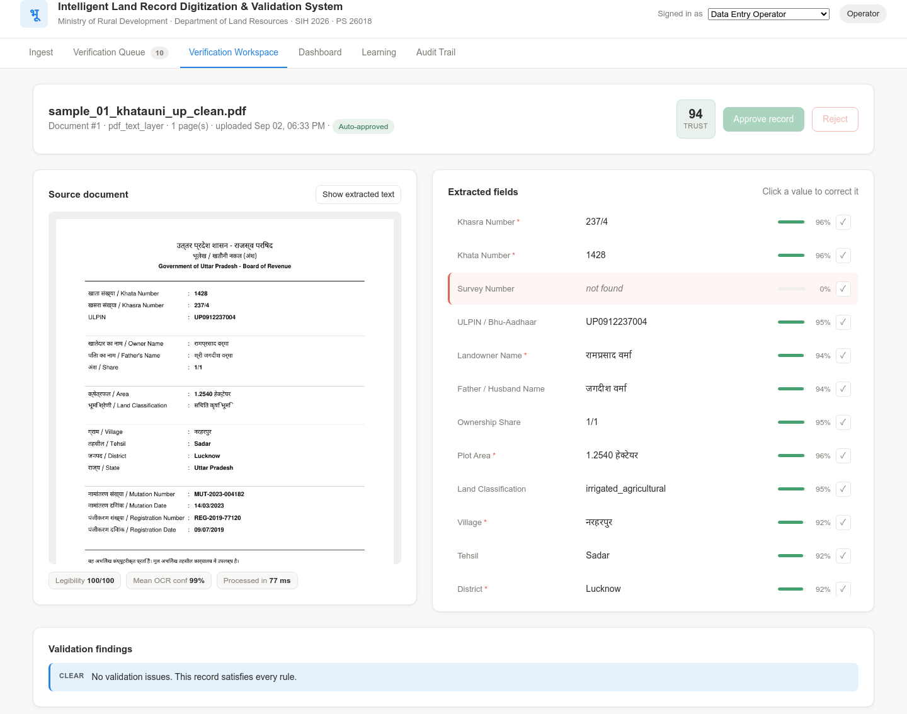
VERIFICATION
Page and reasoning, side by side
Each field carries a confidence bar and a one-click confirm. Clicking a value makes it editable, and trust recalculates on save. This record scored 94.

Slide 6
MEASURED, NOT ESTIMATED
What it does today
13
94%
342 ms
documents end to end
completeness, clean records
average per page
17
0
100%
fields classified
installs required
actions audited

Slide 7
ROUTING
The system sorts its own output
Seven blocked is the correct answer: three are degraded scans, the rest carry real defects.

Slide 8
VALIDATION
Rules firing on the sample corpus
Findings name the field and the rule, so a reviewer is told what to fix.
Rule | Severity | What it caught
REQUIRED_MISSING | Error | Mandatory field absent, 18 times
DUPLICATE_CONFLICT | Error | Same parcel, different owner
DATE_FUTURE | Error | Trust fell to 26
DISTRICT_UNKNOWN | Warning | Suggested 'Kanpur Nagar'
AREA_REGIONAL_UNIT | Warning | Bigha to 6,322.98 m², flagged
OWNER_FATHER_SAME | Error | Same person in both fields

Slide 9
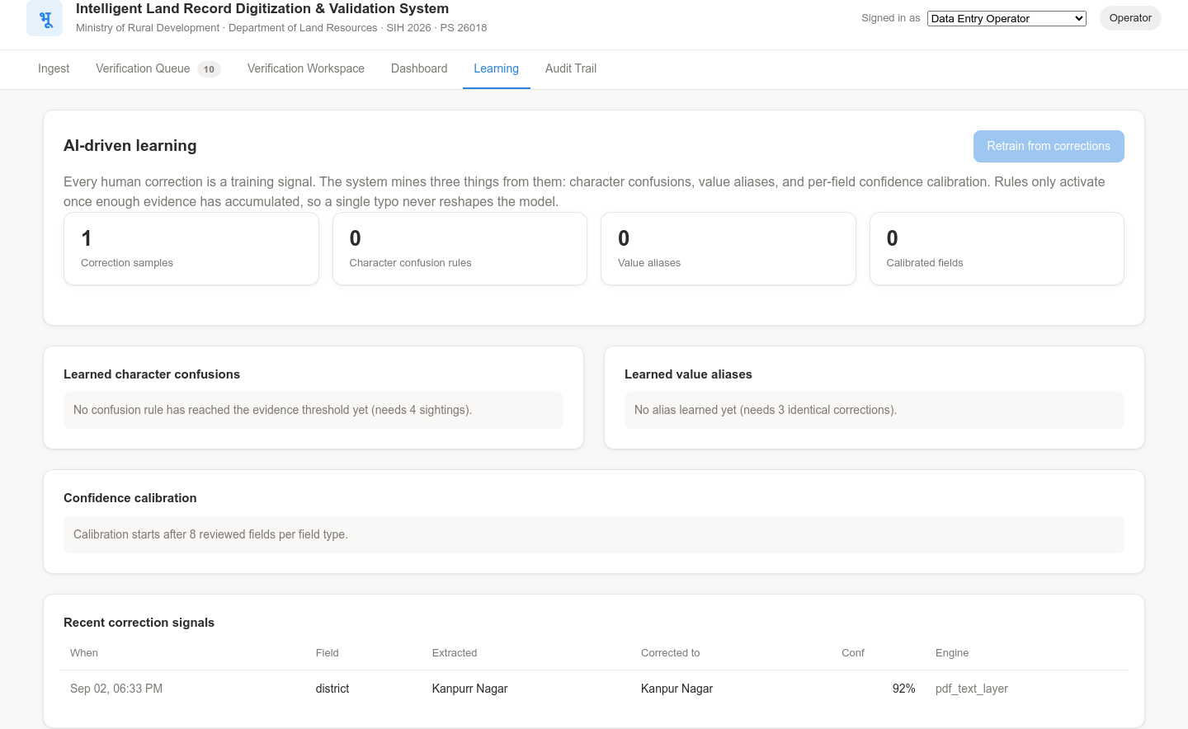
LEARNING LOOP
Corrections become improvements
Confusions, aliases and confidence calibration are mined from human corrections. Rules activate only past a support threshold, so one typo never reshapes the model.

Slide 10
GOVERNANCE
Access control and audit are enforced
Four roles, server-side
Append-only trail
Operators upload and correct. Inspectors approve and reject. Officers retrain and export. The audit cell is read-only. An operator attempting approval gets a 403.
Ingestion, corrections with old and new value, approvals and rejections are written with actor and timestamp. Nothing can edit a past entry.

Slide 11
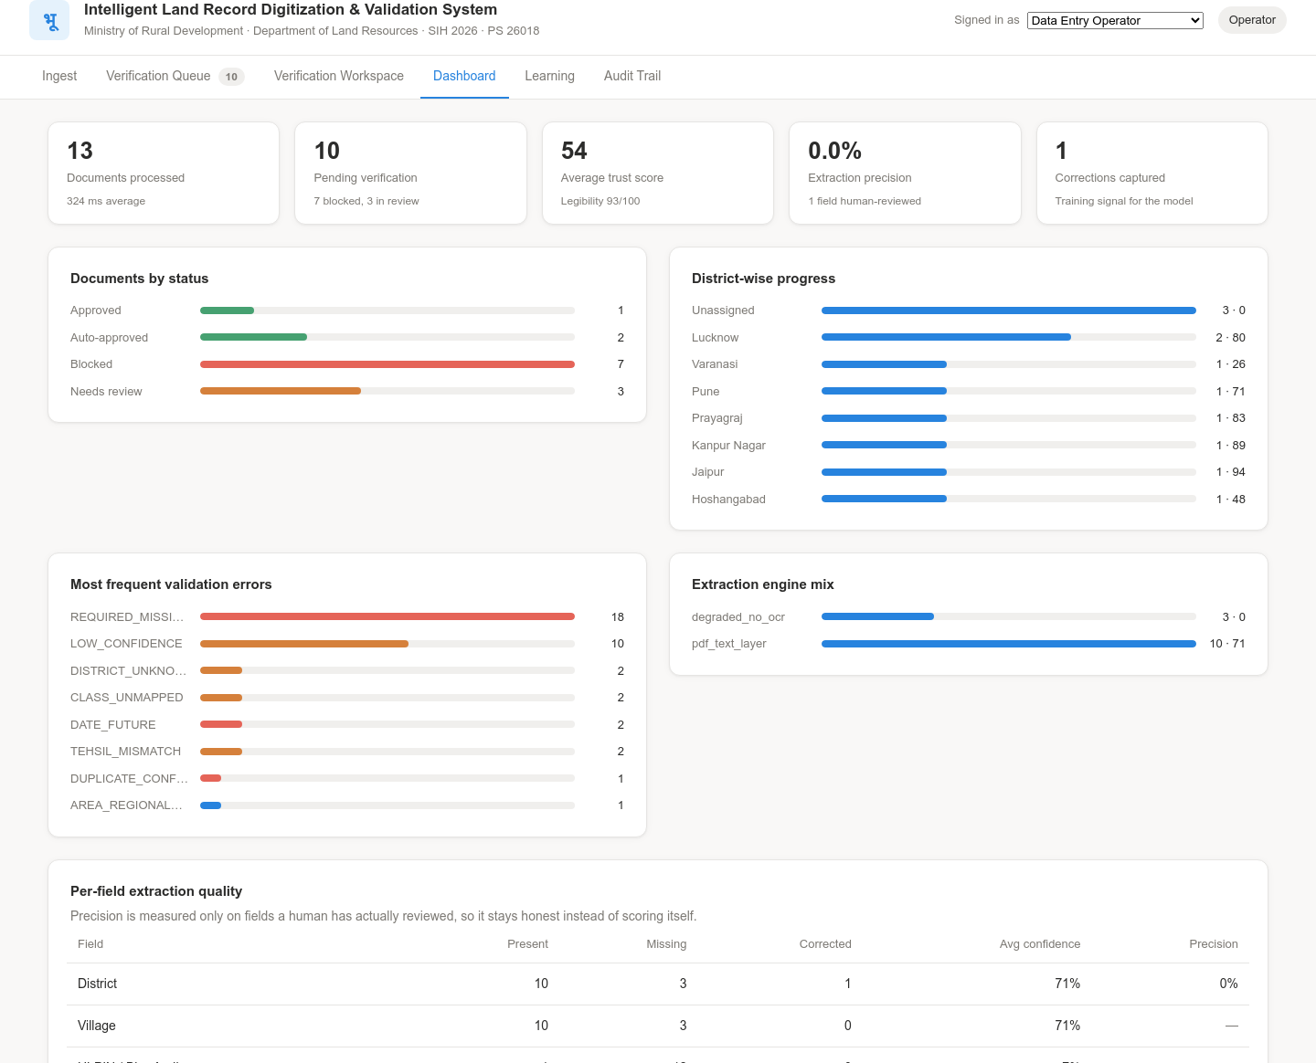
DASHBOARD
Reporting the department can act on
Volume, pending review, trust, district progress, error frequency and per-field quality. Precision reads 0.0% rather than an invented number, because only one field is reviewed so far.

Slide 12
ENGINEERING CHOICES
Two decisions that make the demo survivable
01
02
Zero install. Python standard library only, plus plain HTML and JavaScript. The biggest demo risk is a venue with no internet and a failing pip install.
Honest degraded mode. With no OCR engine, a scan is blocked with trust 0 and enters the queue as work, never as a silent success.

Slide 13
ROADMAP
From prototype to district pilot
Now
Stage 2
Stage 3
Stage 4
Stage 5
Working prototype
Indic HTR
Full LGD data
DILRMP connectors
District pilot

Slide 14
SUMMARY
Three things to remember
01
A running system, not a mockup.
02
Confidence is explainable, not a bare score.
03
It refuses to fake success.

Slide 15
NOTES
Scope and limitations
SOURCE 1
Source 1
PS 26018, Dept of Land Resources
SOURCE 2
Source 2
No dataset supplied; corpus generated
SOURCE 3
Source 3
OCR tier pluggable, not yet benchmarked
SOURCE 4
Source 4
Handwriting needs an Indic HTR model
SOURCE 5
Source 5
Bigha conversion uses UP values
SOURCE 6
Source 6
Master data covers eight states

