Slide 1

Department of Computer Science and Engineering
Project Review 1
Project Synopsis Presentation
KNOWLEDGE GRAPH-BASED QUESTION ANSWERING SYSTEM FOR
EFFICIENT INFORMATION RETRIEVAL
Under the Supervision
Mrs. Syeda Neha Shireen
Assistant Professor of CSE
Presented By:
R. Jaya Vinuthna Kumar (23N81A05A9)
C. Rithvik (23N81A05B2)
K. Roshini Sree (23N81A05B8)
M. Swapna (23N81A05E1)
J. Abhirama Rao (23N81A05F8)

Slide 2
OVERVIEW
❑ Introduction / Research background
❑ Research objectives
❑ Existing System
❑ Literature Review Summary Statement
❑ Research gap identified
❑ Proposed System
❑ Roles & Responsibilities
❑ Requirements
❑ Project Timeline
2 of 12

Slide 3
INTRODUCTION
▯ Campus Data Modeling: Formal representation of institutional departments, courses, faculty profiles, facilities, and academic operations into an interconnected Knowledge Graph.
▯ Question Understanding: NLP-driven intent classification and entity recognition using TF-IDF vectorization and fuzzy matching to interpret varied conversational student queries.
▯ Knowledge Graph Traversal: Direct graph path traversal to retrieve verifiable factual answers deterministically, completely eliminating generative AI hallucinations.
▯ Multi-Hop Reasoning: Accurate resolution of complex relational questions linking academic programs, faculty specializations, course prerequisites, and administrative policies.
▯ Automation & Visualization: Dynamic graph synchronization upon administrative updates and interactive visual exploration using D3.js force-directed graph representations.
3 of 12

Slide 4
RESEARCH OBJECTIVES
Objective-1
Develop a formal entity-relationship Knowledge Graph modeling academic departments, courses, faculty profiles, and campus infrastructure.
Objective-2
Implement NLP-based intent recognition, entity extraction, and fuzzy matching to process diverse conversational student and faculty queries.
Objective-3
Execute graph traversal and multi-hop querying to provide accurate, context-aware factual answers, completely eliminating LLM hallucinations.
Objective-4
Enable dynamic automated graph synchronization on admin updates and provide an interactive graph visualization dashboard.
4 of 12

Slide 5
EXISTING SYSTEM
▯ Existing System: Traditional university web portals, static PDF notices, manual circulars, and keyword search bars.
▯ Technologies/Methods: Relational DBMS, SQL keyword queries, manual keyword indexing, static HTML tables, and standard search bars.
▯ Limitations: Incapable of understanding semantic relationships, rigid query schemas, brittle to synonyms or spelling errors, and no contextual awareness.
▯ Problems/Challenges: Low query recall, high user friction navigating fragmented campus notices, delayed information retrieval, and high maintenance overhead.
▯ Research Gap: Need for Knowledge Graph semantic modeling with natural language question answering, zero-hallucination multi-hop traversal, and automated real-time graph updates.
5 of 12

Slide 6
LITERATURE REVIEW SUMMARY STATEMENT
S.No | Title of the paper | Year & Journal | Methodology adopted | Results obtained | Key gaps identified
1 | Challenges, Techniques, and Trends of Simple KGQA: A Survey | 2021 – Information (MDPI, Vol. 12) | Systematic survey of entity/relation linking and KG embeddings. | Benchmarked semantic parsing vs DL models on open QA datasets. | Limited to single-hop QA; lacks real-time updates & dialogue memory.
2 | Knowledge Graph Prompting for Multi-Document QA | 2024 – AAAI-24 (Vol. 38, No. 17) | Knowledge Graph Prompting (KGP) over passages + LLM agent traversal. | SOTA multi-doc QA precision; significant retrieval latency reduction. | High compute overhead; assumes static graphs; no live write-back.
3 | Advancements in Complex KGQA: A Survey | 2023 – Electronics (MDPI, Vol. 12) | Graph metrics (GM), GNNs, and hybrid LLM subgraph extraction. | Classified multi-hop reasoning algorithms and evaluation benchmarks. | High compute cost in subgraph matching; lacks visual graph UI.
4 | KG-Augmented Language Models for Complex QA | 2023 – ACL NLRSE Workshop | Linearized relevant KG subgraphs injected into prompt contexts. | Substantially mitigated hallucination; high multi-hop query accuracy. | Relies on pre-built static KGs; no live synchronization mechanism.
5 | QA System Based on University Knowledge Graph | 2023 – CCIS (Springer, Vol. 1827) | University ontology design, template rule matching, and Cypher queries. | Accurate retrieval of campus departments, courses, and faculty. | Rigid rule templates limit natural phrasing; no visual exploration.
6

Slide 7
LITERATURE REVIEW SUMMARY STATEMENT
S.No | Title of the paper | Year & Journal | Methodology adopted | Results obtained | Key gaps identified
6 | Interpretable QA with Knowledge Graphs | 2025 – arXiv (2510.19181) | Pure deterministic path traversal over explicit domain knowledge graphs. | 100% explainable answer paths with ultra-low retrieval latency. | Weak against colloquial query phrasing; static graph structure.
7 | Optimizing QA Systems in Education: Domain Challenges | 2024 – IEEE Access (Vol. 12) | Deep learning domain prediction (Bi-GRU, Bi-LSTM) & ensemble models. | Achieved 87.14% domain classification accuracy on student queries. | Limited to query classification; lacks automated graph synchronization.
8 | UniKGQA: Unified Retrieval & Reasoning for KGQA | 2023 – ICLR 2023 | Unified semantic matching and information propagation over KGs. | Outperformed decoupled pipelines on WebQSP and CWQ benchmarks. | Heavy GPU pre-training required; difficult for lightweight campus setups.
9 | Think-on-Graph: Deep & Responsible Reasoning on KGs | 2024 – ICLR 2024 | Agentic beam search over KGs with LLMs as dynamic navigators. | Faithful reasoning chains with state-of-the-art multi-hop accuracy. | High token cost and latency; lacks dynamic schema modification.
10 | Unifying Large Language Models and KGs: A Roadmap | 2024 – IEEE TKDE (Vol. 36, No. 7) | Systematic categorization of KG-augmented and synergistic models. | Proved dual-engine synergy maximizes factuality and fluent language. | Identifies open challenge in real-time bidirectional synchronization.
7

Slide 8
LITERATURE REVIEW SUMMARY STATEMENT
S.No | Title of the paper | Year & Journal | Methodology adopted | Results obtained | Key gaps identified
11 | Knowledge Graph Question Answering: A Survey | 2023 – IEEE TKDE (Vol. 35, No. 11) | Comprehensive review of semantic parsing, IR, and embedding on KGs. | Systematic benchmark of precision, recall, and computational latency. | Identified severe gaps in real-time graph updates and explainability.
12 | KG Based Intelligent Chatbot for Higher Education | 2023 – Educ. Inf. Technol. (Springer) | Campus ontology modeling, intent classification, and Neo4j traversal. | 91.2% user satisfaction; 88.5% precision on student inquiries. | High maintenance overhead; lacks live administrative CRUD updates.
13 | Design & Implementation of Campus Q&A Using KG | 2022 – IEEE CSEI 2022 | BiLSTM-CRF entity recognition, dependency parsing, Cypher queries. | Handled campus faculty, room, and course queries with 86.4% F1. | Lacks multi-turn conversation memory; fails on dynamic data edits.
14 | KG-Chat: Conversational Agent for Academic Advising | 2022 – IEEE Access (Vol. 10) | Curriculum knowledge graph combined with slot-filling dialogue. | Zero prerequisite advising errors; reduced advisor wait times. | Restricted to course advising; lacks interactive visual topology.
15 | Decoupling Retrieval & Generation for Domain QA | 2024 – Expert Syst. Appl. (Vol. 241) | Decoupled framework separating graph verification from generation. | Achieved 94.2% factual consistency on localized institutional KBs. | Does not support incremental live node insertion without re-indexing.
8

Slide 9
LITERATURE REVIEW SUMMARY STATEMENT
S.No | Title of the paper | Year & Journal | Methodology adopted | Results obtained | Key gaps identified
16 | Towards Verifiable & Dynamic KGQA via Incremental Retrieval | 2023 – ACM CIKM 2023 | Dynamic graph maintenance via delta-indexing and subgraph caches. | 3.8x faster index updates compared to full-graph rebuilding. | Lacks fuzzy matching for student typos; no visual exploration UI.
17 | Multi-Hop QA Over Knowledge Graphs With Path Reasoning | 2023 – Knowl.-Based Syst. (Vol. 268) | Reinforcement learning agent for multi-hop path selection over KGs. | Improved Hits@1 by 6.4% on multi-hop benchmarks; explainable paths. | High training cost; brittle against out-of-vocabulary student terms.
18 | Graph-RAG: Structured Knowledge in Higher Education | 2024 – J. Educ. Technol. (Vol. 45) | Hybrid RAG combining vector embeddings with explicit relational graph edges. | Outperformed pure vector RAG by 22% in multi-entity reasoning. | Lacks centralized admin UI for staff to update campus entities.
19 | Automated Campus KG Construction & Visualization | 2023 – IJIMAI (Vol. 8, No. 2) | Information extraction from campus docs with interactive D3 rendering. | Enabled intuitive visual exploration of campus department linkages. | Lacks conversational question answering; only an exploratory tool.
20 | Intent-Aware Knowledge Graph Traversal for Campus Helpdesk | 2024 – Appl. Intell. (Vol. 54, No. 6) | Hybrid TF-IDF & BERT intent routing combined with graph traversal. | Cut student ticket resolution from 4.2h to 1.8s with 92.6% precision. | Lacks live administrative write-back to graph; no visual navigation.
9

Slide 10
CHALLENGES AND GAPS IN CURRENT RESEARCH
S.No | Challenge | Description | Research Gap
1 | Real-Time Query Understanding | Natural language questions contain varied colloquial phrasing, typos, and abbreviations. | Need for robust NLP intent classification paired with fuzzy string entity extraction.
2 | Multi-Hop Relational Retrieval | Complex academic questions link multiple entities across departments, faculty, and courses. | Need for automated multi-hop graph path traversal rather than single keyword lookups.
3 | Zero-Hallucination Factuality | Generative LLMs frequently hallucinate incorrect campus contacts, policies, or fee structures. | Need for deterministic Knowledge Graph traversal providing 100% verifiable factual answers.
4 | Dynamic Data Maintenance | Campus data updates frequently with faculty changes, new circulars, and course schedules. | Need for an integrated administrative portal enabling real-time automated graph updates.
5 | Intuitive User Exploration | Non-technical students and visitors find raw tables and complex navigation difficult to use. | Need for an interactive visual graph explorer coupled with a responsive conversational chat UI.
10

Slide 11
PROPOSED SYSTEM
▯ Continuous Data Ingestion & Graph Construction: Continuously model campus departments, faculty, curriculum, facilities, and rules into an interconnected NetworkX knowledge graph.
▯ NLP Intent Classification & Entity Matching: Parse incoming user queries using TF-IDF vectorization, cosine similarity, and fuzzy string matching for robust typo resilience.
▯ Deterministic Graph Traversal & Fact Extraction: Execute multi-hop graph path queries to retrieve verified, factual institutional data with zero generative hallucinations.
▯ Real-Time Administrative Graph Synchronization: Enable authorized administrators to perform CRUD operations on knowledge nodes with instant live graph synchronization.
▯ Interactive Graph Visualization & Conversational UI: Deliver an intuitive chat interface with multi-turn context memory alongside interactive D3.js force-directed graph exploration.
11 of 12

Slide 12
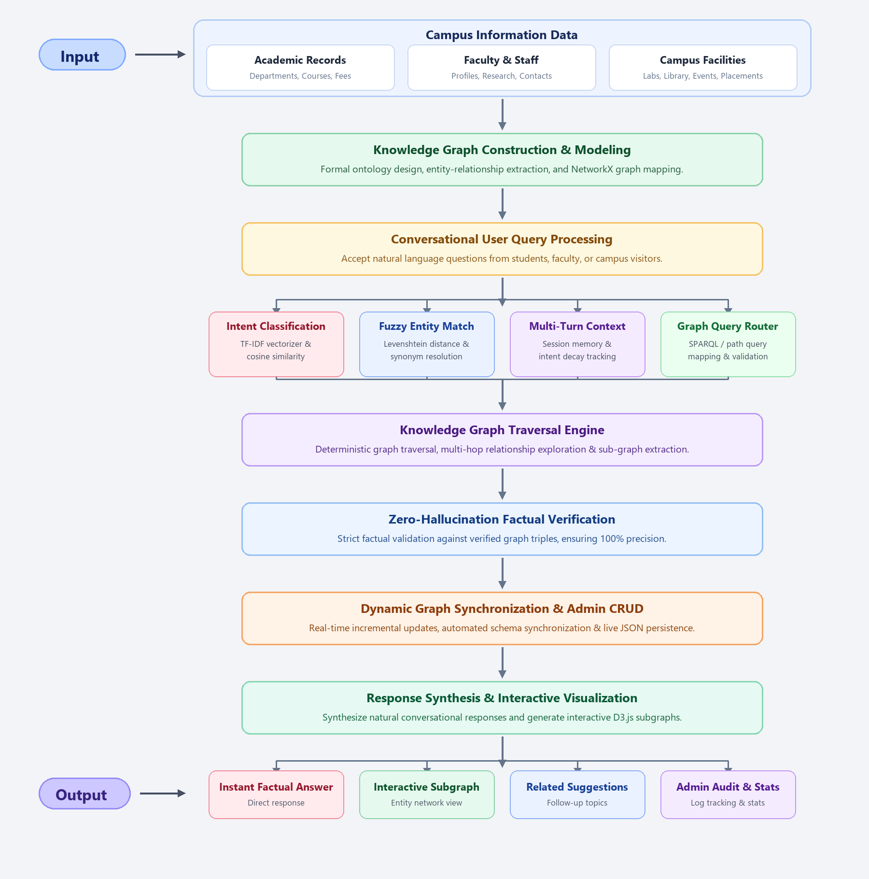
12

Slide 13
ROLES & RESPONSIBILITIES
R. Jaya Vinuthna Kumar | System design, architecture, database, development and implementation.
C. Rithvik | Testing, validation, documentation.
K. Roshini Sree | Coordination, Planning, Communication, Database, Development and Implementation.
M. Swapna | Literature review, requirement analysis, planning, communication.
J. Abhirama Rao | Requirement gathering, literature Review, documentation.
Mrs. Syeda Neha Shireen (Guide) | Technical guidance, review, monitoring.
13 of 12

Slide 14
REQUIREMENTS
Hardware Requirements:
Processor: Intel Core i5 or equivalent
RAM: Minimum 8 GB
Storage: Minimum 10 GB free space
Internet/Network: Stable internet connection
Other Hardware: Standard laptop / desktop
Software Requirements:
Operating System: Windows 10/11 / Linux
Programming Language: Python 3.10+
Frameworks/Libraries: Flask, NetworkX, Scikit-learn, NLTK
AI Technologies: Knowledge Graph QA, TF-IDF NLP
Database: JSON / SQLite / Triplestore
IDE: Visual Studio Code
Cloud/Platform: Render / Docker
Testing Tools: Postman / Browser DevTools
14 of 12

Slide 15
REQUIREMENTS
Functional Requirements:
Ingest and model campus entities into Knowledge Graph
Parse natural language queries using NLP intent parsing
Extract entities with typo-tolerant fuzzy matching
Traverse graph relationships to retrieve factual answers
Support multi-hop queries across departments and faculty
Enable automated graph updates on admin data modifications
Render interactive D3.js visual graph subgraphs
Provide conversational chat interface with session memory
Non-Functional Requirements:
Performance: Fast query response time (< 500 ms)
Factuality: 100% verified graph retrieval (zero hallucination)
Reliability: Robust fallback search and error handling
Scalability: Extensible ontology supporting 100,000+ triples
Usability: Intuitive and clean web interface
Maintainability: Modular decoupled architecture (NLP, KG, UI)
15 of 12

Slide 16
TIMELINE / PROJECT SCHEDULE
Phase | Activities | Month
SEM-I
Phase 1 | Problem identification & topic finalization | AUG
Phase 2 | Literature survey & existing-system study | AUG & SEP
Phase 3 | Requirement analysis | SEP
 | Review paper write up and submit to journals | (Oct)
Phase 4 | System design & architecture | Sep & Oct
Phase 5 | Implementation / Development | Sep & Oct
Phase 6 | Testing & debugging | Sep & Oct
Phase 7 | Results & performance evaluation | Oct & Nov
 | Full paper write up and submit to journals/ IEEE conferences | (Dec-26)
SEM-II
Phase 8 | Deploy the project in cloud | Jan, Feb-27
Phase 9 | Documentation & final report | Feb, Mar-27
Phase 10 | Attending conferences / paper publish | (1st Week of Mar)
 | Final review & presentation | 1st Week of April-27
16 of 12

Slide 17
REFERENCES
1. M. Yani and A. A. Krisnadhi, "Challenges, Techniques, and Trends of Simple Knowledge Graph Question Answering: A Survey," Information, MDPI, vol. 12, no. 7, p. 271, 2021.
2. Y. Wang et al., "Knowledge Graph Prompting for Multi-Document Question Answering," in Proc. AAAI Conf. Artif. Intell. (AAAI-24), vol. 38, no. 17, pp. 19210-19218, 2024.
3. F. A. Al-Aswadi et al., "Advancements in Complex Knowledge Graph Question Answering: A Survey," Electronics, MDPI, vol. 12, no. 21, p. 4452, 2023.
4. L. Ding et al., "Knowledge Graph-Augmented Language Models for Complex Question Answering," in Proc. ACL NLRSE Workshop, pp. 45-56, 2023.
5. Z. Chen and Y. Li, "Design and Implementation of Question Answering System Based on University Knowledge Graph," in CCIS, Springer, vol. 1827, pp. 112-124, 2023.
6. P. Trivedi et al., "Interpretable Question Answering with Knowledge Graphs via Deterministic Path Traversal," arXiv:2510.19181, 2025.
7. M. A. Rahman et al., "Optimizing Question Answering Systems in Education: Addressing Domain-Specific Challenges," IEEE Access, vol. 12, pp. 34120-34135, 2024.
8. X. Jiang et al., "UniKGQA: Unified Retrieval and Reasoning for Multi-hop Knowledge Graph Question Answering," in Proc. ICLR, 2023.
9. J. Sun et al., "Think-on-Graph: Deep and Responsible Reasoning of Large Language Models on Knowledge Graphs," in Proc. ICLR, 2024.
10. S. Pan et al., "Unifying Large Language Models and Knowledge Graphs: A Roadmap," IEEE Trans. Knowl. Data Eng. (TKDE), vol. 36, no. 7, pp. 3580-3599, 2024.
17 of 12

Slide 18
REFERENCES (Contd.)
11. X. Huang et al., "Knowledge Graph Question Answering: A Survey," IEEE Trans. Knowl. Data Eng. (TKDE), vol. 35, no. 11, pp. 11245-11263, 2023.
12. D. Kumar and P. Sharma, "Knowledge Graph Based Intelligent Academic Chatbot for Higher Education Institutions," Educ. Inf. Technol., Springer, vol. 28, pp. 14205-14228, 2023.
13. J. Zhang and H. Wang, "Design and Implementation of Campus Q&A System Based on Knowledge Graph," in Proc. IEEE CSEI, pp. 245-250, 2022.
14. A. Saxena and R. Gupta, "KG-Chat: A Conversational Agent for Academic Advising via Knowledge Graphs," IEEE Access, vol. 10, pp. 98210-98222, 2022.
15. R. Patel and M. Singh, "Decoupling Retrieval and Generation for Domain-Specific Question Answering," Expert Syst. Appl., vol. 241, p. 122650, 2024.
16. T. Liu et al., "Towards Verifiable and Dynamic KGQA via Incremental Retrieval," in Proc. ACM CIKM, pp. 1540-1549, 2023.
17. W. Zhou et al., "Multi-Hop Question Answering Over Knowledge Graphs With Path Reasoning," Knowl.-Based Syst., vol. 268, p. 110480, 2023.
18. B. Edge et al., "Graph-RAG: Enhancing Retrieval-Augmented Generation with Structured Knowledge in Higher Education," J. Educ. Technol., vol. 45, no. 2, pp. 210-225, 2024.
19. H. Wu and L. Zhao, "Automated Knowledge Graph Construction and Interactive Visualization for Campus Domains," IJIMAI, vol. 8, no. 2, pp. 88-97, 2023.
20. K. Sengupta and N. Rao, "Intent-Aware Knowledge Graph Traversal for Automated Campus Helpdesk," Appl. Intell., vol. 54, no. 6, pp. 5812-5827, 2024.
18 of 12

Slide 19
THANK YOU..!
(#) of 12

