Slide 1
Design and Analysis of Algorithms (CS345/CS345A)
Extra Class
Data Structures
* Height Balanced BST: 10 operations
* Range Minima Problem: an inspirational example

Slide 2
Height Balanced BST (Red-black tree, AVL tree)
10 operations

Slide 3
Height Balanced BST (Red-black tree, AVL tree)
Operations you already know
New operations
Search(T,x)
Insert(T,x)
Delete(T,x)
Min(T)
Max(T)
Predecessor(T,x)
Successor(T,x)
A NOTATION
T < T’ :
every element of T is smaller than every element of T’.
8. SpecialUnion(T, T’):
Given T and T’ such that T < T’, compute T*=TUT’.
NOTE: T and T’ don’t exist after the union.
9. Split(T, x):
Split T into T’ and T’’ such that T’ < x < T’’.
10. FindRank(T, x):
return the total number of elements in T that are smaller than x.
Every operation in O(log n) time.

Slide 4
SpecialUnion(T,T’)
Recall:
every element of T is smaller than every element of T’

Slide 5
A trivial algorithm that does not work
Time complexity: O(log n)
Height balance lost
<
T
T’

Slide 6
Towards an O(log n) time for SpecialUnion(T,T’) …
Simplifying the problem
Can we solve some special cases easily ?
Solving the simpler version efficiently
Extending the solution to generic version

Slide 7
Simplifying the problem
Simplified problem:
Given two trees T, T’ of same black height and a key x, such that T<x<T’, transform them into a tree T*=TU{x}UT’
x
<
<
T
T’

Slide 8
Solving the simplified problem
Simplified problem:
Given two trees T, T’ of same black height and a key x, such that T<x<T’, transform them into a tree T*=TU{x}UT’
x
O (1) time
<
<
T
T’

Slide 9
Extending the algorithm to the generic problem
T
T’

Slide 10
Extending the algorithm to the generic problem
x
<
<
T
T’

Slide 11
Extending the algorithm to the generic problem
x
T
T’

Slide 12
Extending the algorithm to the generic problem
x
T
T’

Slide 13
Extending the algorithm to the generic problem
v
x
T
T’’

Slide 14
Extending the algorithm to the generic problem
v
x
T
T’’

Slide 15
Extending the algorithm to the generic problem
Algorithm for SpecialUnion(T,T’):
Let black height of T ≤ black height of T’
Let x be the node storing smallest element of T’.
Delete the node x from T’.
Keep following left pointer of T’ until we reach a node v such that
left(v) is black
The subtree T” rooted at Left(v) has black height same as that of T
left(x)← T;
right(x) ← T”;
Color(x)← red;
Left(v)← x;
parent(x)← v;
If color(v) is red, remove the color imbalance
(like in the usual procedure of insertion in a red-black tree)

Slide 16
Split(T,x)

Slide 17
Achieving O(log n) time for Split(T,x)
Take a scissor and cut T into trees starting from x
Make use of SpecialUnion algorithm.
x
T

Slide 18
RANGE-MINIMA Problem
An interesting example to realize the importance of data structures

Slide 19
Range-Minima Problem
Given an array A storing numbers, design a data structure to answer a sequence of queries of the following type
Range-minima(i,j) : report the smallest element from A[i],…,A[j]
Let A store one million numbers
Let the number of queries be 10 millions
Range-Minima(i,j) = -6
A
3 5 1 8 19 0 -1 30 99 -6 10 2 40 27 44 67
i=4
j=11

Slide 20
Range-Minima Problem
Applications:
Computational geometry
String matching
As an efficient subroutine in a variety of algorithms
( I myself used it in a research problem of shortest paths in graphs)

Slide 21
Range-Minima Problem
Solution 1: Answer each query in a brute force manner using A itself.
Range-minima-trivial(i,j)
{ temp ← i+1;
min ← A[i];
While(temp <= j)
{ if (min > A[temp])
min ← A[temp];
temp← temp+1;
}
return min
}
Time complexity for answering a query: O(n) (equivalent to few milliseconds)
Real Time for answering all queries: a few hours

Slide 22
Range-Minima Problem
Solution 2: Compute and store answer for each possible query in a n×n matrix B.
B[i][j] stores the smallest element from A[i],…,A[j]
Space : O(n²)
j
Solution 2 is
Theoretically inefficient and practically impossible
i
3
Size of B is too large to be kept in RAM. So we shall have to keep most of it in the Hard disk drive. Hence it will take a few milliseconds per query.
B

Slide 23
Range-Minima Problem
You know an efficient solution!
“One of the problems of dynamic sequences”
Solution 3:
Augmented BST.
Time complexity for answering a query: O(log n)

Slide 24
Range-minima problem
Query:
Report_min(A,i,j) : report smallest element from {A[i],…,A[j]}
Aim :
To build a compact data structure which can answer Report_min(A,i,j)
in O(1) time for any 1 ≤ i < j ≤ n.
1
i
j
n
A
29
3.1
99
781
41.5
67.4

Slide 25
Why does O(n²) bound on space appear so hard to break if we want O(1) query time?
… Because of artificial hurdles we have created in our mind about this problem.

Slide 26
Artificial hurdle 1
If we want to answer each query in O(1) time, we must store its answer explicitly. Since there are around O(n²) queries, so O(n²) space is needed.
Spend some time to convince yourself that it is not true at all.…

Slide 27
Artificial hurdle 2
… If we fix the first parameter i for all queries, we need O(n) space.
So
for all i, we need O(n²) space.
i
A
29
3.1
99
781
41.5
67.4
0
n-1
True Fact
A wrong inference because it assumes that data structure for an index i will work in total isolation of others (NO collaboration)

Slide 28

Collaboration (team effort) works in real life
Why not try collaboration for the given problem ?

Slide 29
Range-minima problem: Breaking the O(n²) barrier using collaboration
An Overview:
Keep n tiny data structures:
Each index i stores minimum only for a few j>i.
For a query Range-minima(i,j), if the answer is not stored in the tiny data structure of i,
look up tiny data structure of some index q (chosen carefully).

Slide 30
Range-minima problem: Breaking the O(n²) barrier using collaboration
Details of Collaboration
We may use the tiny data structure of index q to answer Range-Minima(i,j)
i
j
A
1
i
q
n
i stores answers for this range
q stores answers for this range

Slide 31
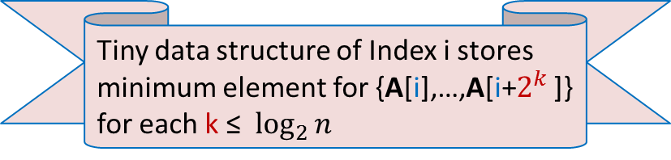

Range-minima problem : Details of tiny data structure stored at each i
$$2^{t}$$
8
4
2
1
A
1
i
n
Tiny data structure of Index i stores minimum element for {A[i],…,A[i+$2^{k}$ ]} for each k ≤ $\log_{2}{n}$

Slide 32



Answering Range-minima query for index i : Collaboration works
$$2^{k+1}$$
$$2^{k}$$
A
1
i
j
n
j ${−2}^{k}$
Look at this picture carefully to design the query algorithm. At least make an attempt

Slide 33
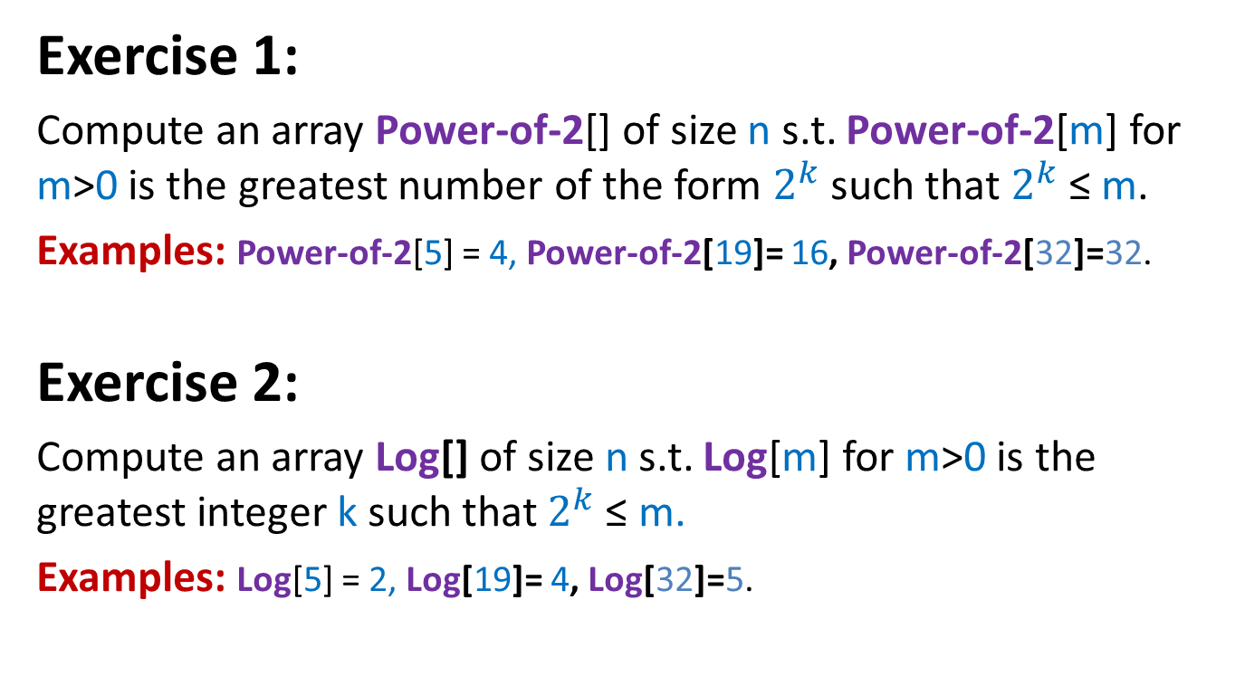
We shall use two additional arrays
Exercise 1:
Compute an array Power-of-2[] of size n s.t. Power-of-2[m] for m>0 is the greatest number of the form $2^{k}$such that $2^{k}$≤ m.
Examples: Power-of-2[5] = 4, Power-of-2[19]= 16, Power-of-2[32]=32.
Exercise 2:
Compute an array Log[] of size n s.t. Log[m] for m>0 is the greatest integer k such that $2^{k}$≤ m.
Examples: Log[5] = 2, Log[19]= 4, Log[32]=5.

Slide 34
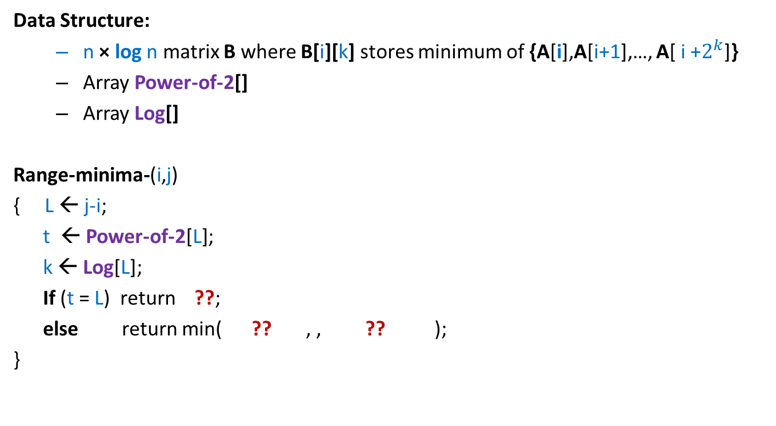
Range-Minima Problem: Data structure with O(n log n) space and O(1) query time
Data Structure:
n × log n matrix B where B[i][k] stores minimum of {A[i],A[i+1],…, A[ i +$2^{k}$]}
Array Power-of-2[]
Array Log[]
Range-minima-(i,j)
{ L ← j-i;
t ← Power-of-2[L];
k ← Log[L];
If (t = L) return ??;
else return min( ?? , , ?? );
}
B[i][k];
B[i][k]
B[j-t][k];

Slide 35
Range-Minima Problem: Data structure with O(n log n) space and O(1) query time
Homework: Design an O(n log n) time algorithm to build the n × log n matrix B used in data structure of Range-Minima problem.
Hint: (Inspiration from iterative algorithm for Fibonacci numbers).
Spend some time before looking at the more explicit hint below. (it is just a click away)…You can do it…
To compute B[i][k], you need to know only two entries from column **.

Slide 36
Range Minima Problem: further extensions
How to achieve O(n) space and O(1) query time ?
Yes it is possible. wait for a few weeks ☺….
(A part of the course CS345)
Extension to 2-dimensions ?
Dynamic RMQ: Augmented BST guarantees O(log n).

