Slide 1
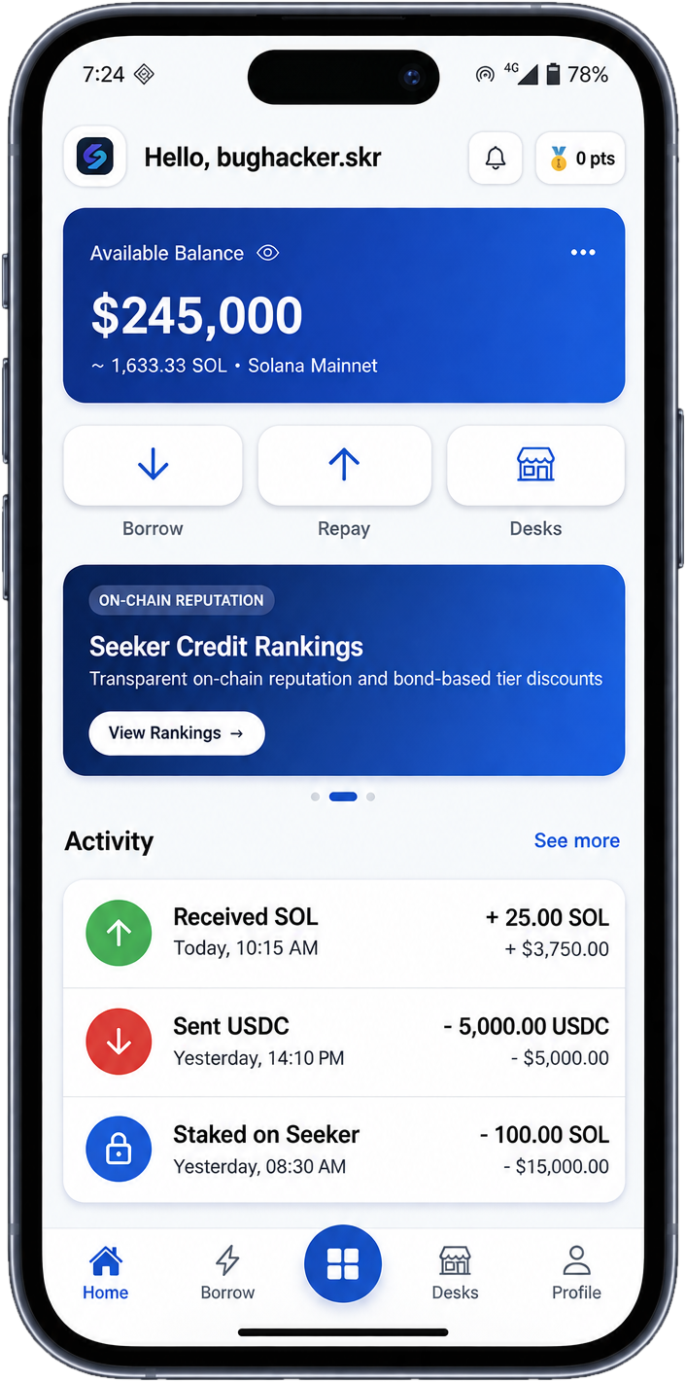
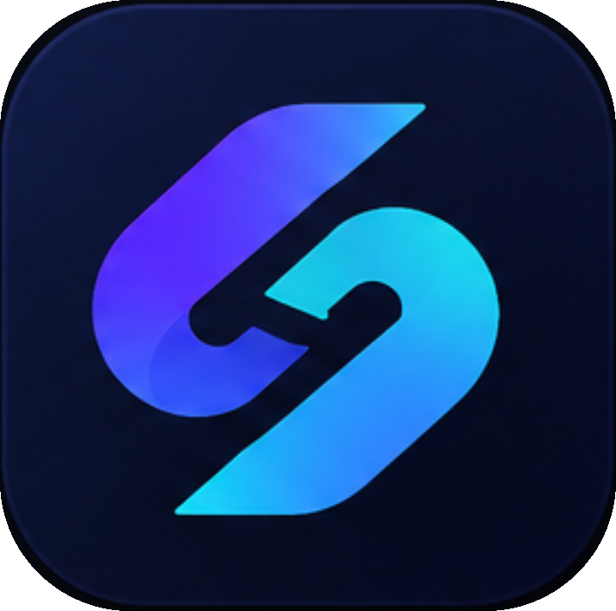
ClockLend
Stake SKR, borrow stablecoin and keep earning while it’s locked.
Solana Mobile CLOCK IN Hackathon

Slide 2



One price dip can wipe out a small crypto loan
Quick to punish
A sudden price dip can trigger an automatic sale of your collateral before you can react.
No social context
Protocols rarely account for trusted circles, friends, communities or bilateral credit.
Mobile gap
Most lending apps are built for desktop experts, not for people borrowing from their phones.

Slide 3
A different safety model from major Solana lenders
KAMINO / MARGINFI
CLOCKLEND
Position health falls below threshold
Loan reaches its due time
THE DIFFERENCE
↓
↓
Kamino and Marginfi use collateral-health and liquidation rules, not a universal missed-payment clock. ClockLend is designed around fixed-term loans with a visible 24-hour rescue window after the due time.
Position becomes eligible for liquidation
24-hour rescue window
↓
↓
Collateral may be seized
Repay — or raise funds before settlement
Why onchain: escrow and loan rules are enforced by the program; the rescue window is a defined rule, not a discretionary promise.

Slide 4
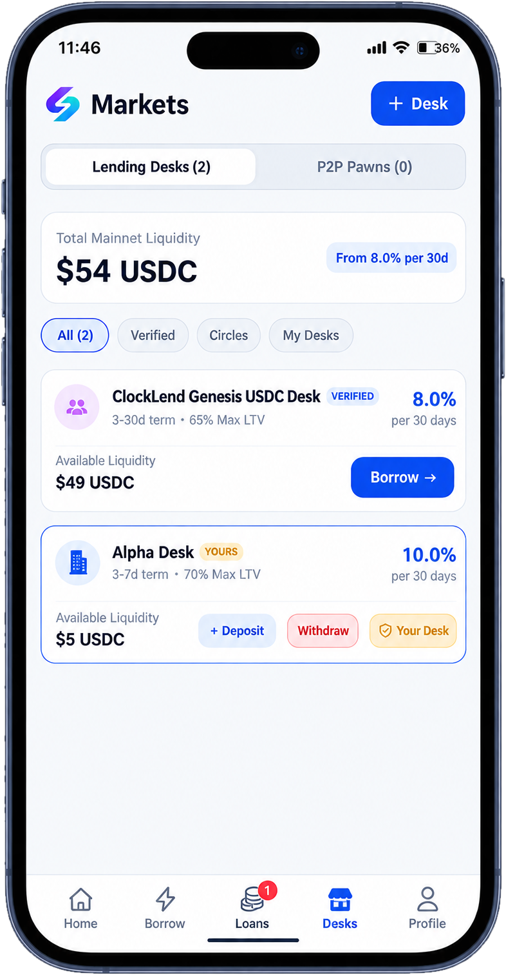
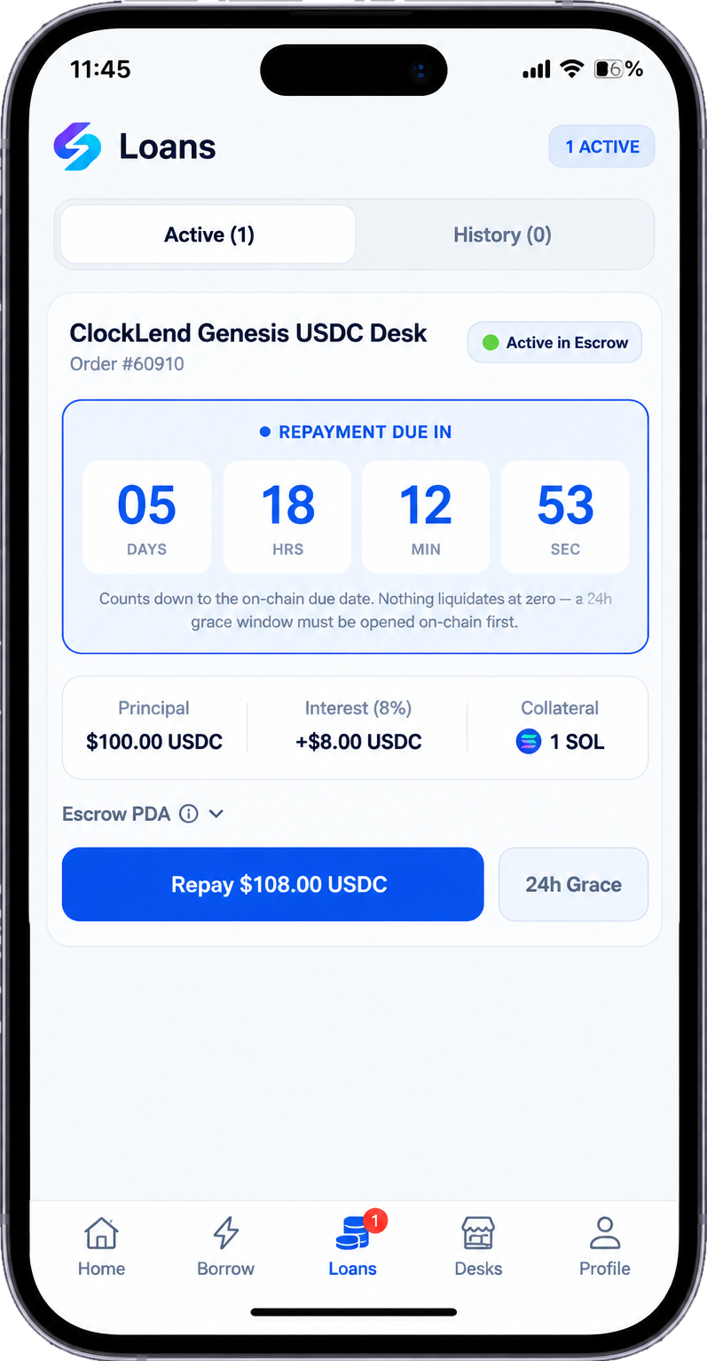
See it working: find a desk, borrow, repay
1 · YOUR HOME BASE
2 · FIND A DESK
3 · REPAY WITH CONFIDENCE
Balance, activity and credit ranking
Compare rates, limits and available funds
Live countdown, locked collateral, one tap

Slide 5


How it works: six steps from request to repayment
1
2
3
4
5
6
Connect
Request
Match
Lock
Receive
Repay
Your Seeker wallet
Amount, collateral and time
We find the best desk
Collateral goes into escrow
Funds land in your wallet
Principal plus interest
Rules enforced by code
A clock you can see
Escrow and loan terms are enforced by the program, not by people.
Every loan shows a live countdown, so you always know what happens next.

Slide 6


Built to keep both sides safe
If you borrow
If you lend
Collateral stays locked in escrow
Every loan is backed by collateral
Held by the program, not a person, and returned when you repay.
A desk lends at most 65–70% of the collateral’s value.
No instant liquidation
You set the rules
A 24-hour grace window opens first, so one late payment isn’t the end.
Open your own desk: you pick the rate, the term and the limits.
You always know where you stand
A clear plan if a loan goes unpaid
Alerts start at −10% and escalate as your collateral nears what you owe.
After the grace window, the collateral is there to cover your funds.
Both sides: keys stay in your phone’s secure Seed Vault, and code enforces the rules.
Alerts begin at −10%, repeat with further drops, and escalate when collateral nears debt + interest. Thresholds depend on oracle pricing.

Slide 7
Why we win: built for borrowers, not just liquidity
Feature | Kamino Lend | Marginfi | ClockLend
Risk / liquidation | Collateral-health and market-risk thresholds; eligible positions may be liquidated. | Account health below maintenance threshold can trigger partial liquidation. | Fixed-term loan with a 24-hour rescue window after due time (design claim).
Repayment model | Generally health-based borrowing; no universal fixed-term deadline. | Generally health-based borrowing; no universal fixed-term deadline. | Clear due time and live countdown.
Lending model | Shared liquidity markets. | Lending pools and collateralized borrowing. | Lender-created desks plus peer / Circle lending.
Social recovery | Not a core protocol feature. | Not a core protocol feature. | Circles and friend-to-friend fundraising concept.
Seeker-first UX | General Solana DeFi UX. | General Solana DeFi UX. | Designed for Seeker / mobile use.
SKR integration | No native ClockLend-style SKR staking benefit. | No native ClockLend-style SKR staking benefit. | SKR staking benefits proposed by ClockLend.

Slide 8
Why now: phones, Solana and community are converging
Phones are wallets
Solana is fast and cheap
SKR gives a reason to stay
Communities hold capital
Solana Mobile phones make secure wallets standard, with a built-in Seed Vault.
Low fees make small loans worth making.
The Seeker token powers rate discounts and builds a loan history.
Groups already pool trust and money online, but lending apps ignore it.
ClockLend sits where all four meet.

Slide 9

Our first users: Seeker owners, communities and lenders
Seeker owners
Communities and friend groups
Lenders who open desks
People who hold SOL or SKR and need a small, quick loan without selling their coins.
Groups that already trust each other and can back a member through a Circle.
Holders who want to earn interest by lending USDC to borrowers.
Starting point: the Solana Mobile community, where ClockLend is built to run.

Slide 10

How ClockLend makes money
EXAMPLE: A $100 LOAN AT 8% INTEREST
A small start fee
$100
+ $8
= $108
0.25–0.50%, withheld at payout — so $100 borrowed nets $99.50–$99.75 in hand.
You borrow
Interest
You repay
15% of the interest
Where the $8 of interest goes
Taken from interest, so we earn when lenders earn.
Lenders keep $6.80 (85%)
ClockLend $1.20 (15%)
50% of the surplus
On a default after grace, half of any collateral value above the debt goes to the protocol. The rest returns to the borrower.
Illustrative model: protocol revenue begins when loans and fees are processed.

Slide 11
SKR: stake it, borrow cheaper, keep earning
Stake to borrow cheaper
Earn dividends
Locked, never slashed
Protocol utility
Your rate slides from 1% at 100 SKR staked to 25% at 10,000.
50% of every origination fee funds a USDC pool that SKR stakers claim against.
Your bond is locked while a loan is live and released after — and keeps earning throughout.
SKR is designed to support borrower rate benefits and participation in the ClockLend ecosystem. Token economics and any future value-accrual mechanisms should be finalized transparently.
Staking never changes LTV — each desk sets its own limit, capped at 70%. Any token incentives remain subject to final design and governance.

Slide 12
Roadmap: from verified program to active lending
Live
122
14
on Solana mainnet, program verified
automated tests across six suites
internal security review rounds
NOW
NEXT
THEN
Harden the foundation
Activate the marketplace
Grow the ecosystem
Independent security review
Reliable price-oracle integration
End-to-end product validation
Onboard lending desks
Bring in borrowers and lenders
Validate repayments and alerts
Grow Seeker adoption
Add more desks and Circles
Partner with Solana Mobile

Slide 13
Meet the team
Mobile-first lending built for the Solana Mobile ecosystem.
PHOTO
FOUNDING TEAM
PHOTO
MOBILE ENGINEERING & DESIGN
Bughacker
Awajimimin
Founder · Offensive Security Engineer
Mobile Engineer · Designer
Code: github.com/luckysitara/ClockLend

Slide 14
ClockLend
Thank you.
Stake SKR, borrow stablecoin — and keep earning while it’s locked.
TRY THE PROTOTYPE · REVIEW THE CODE · BUILD WITH US
github.com/luckysitara/ClockLend
For the Solana Mobile CLOCK IN Hackathon

