Slide 1
Knowledge-based Visual Question Answering
Lucky and Rashi Verma
E1246 - Natural Language Understanding: Course Project Proposal

Slide 2
Introduction

Slide 3
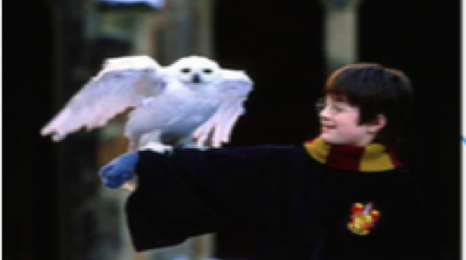
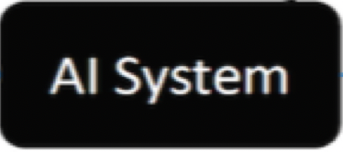
Harry-Potter, Daniel Radcliffe
Harry Potter and the Philosopher's Stone
He opened up about struggling with alcohol
to cope up with Harry-Potter fame
Who is the person holding the owl?
This is which part of Harry-Potter series?
What is the person in picture doing nowadays?

Slide 4
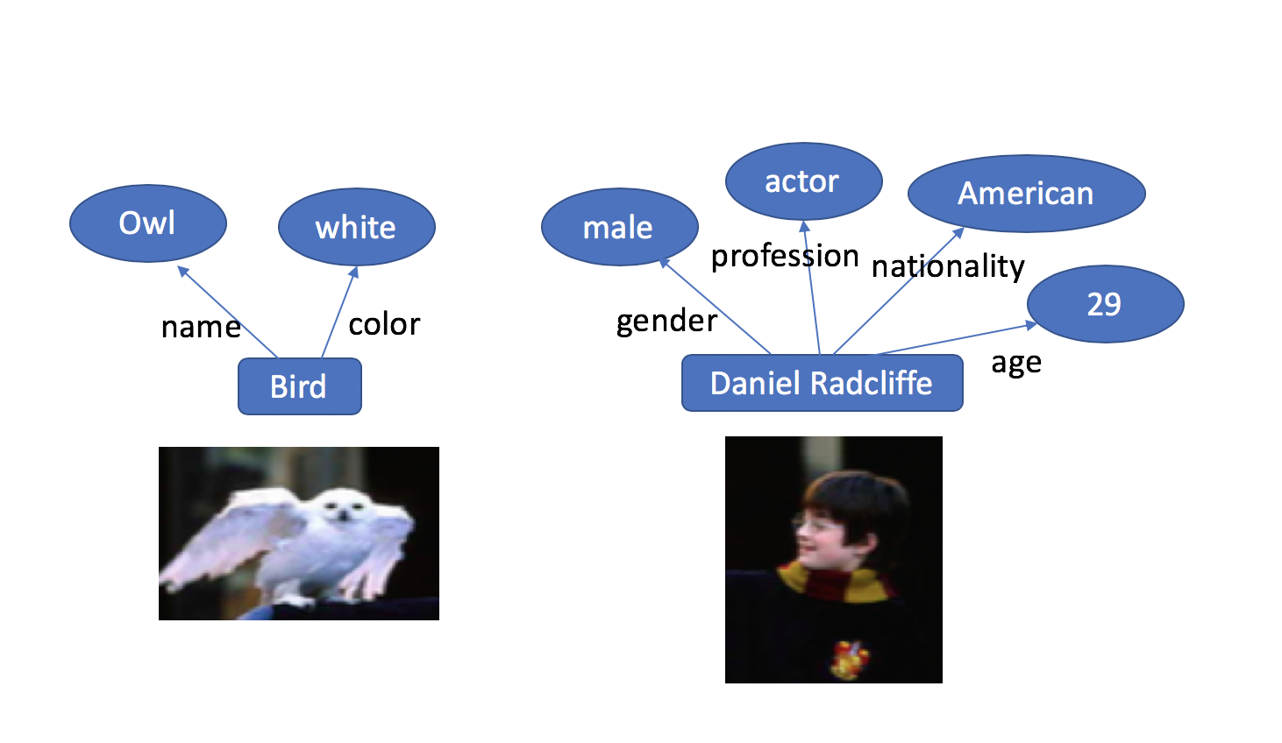
Harry-Potter, Daniel Radcliffe
Harry Potter and the Philosopher's Stone
He opened up about struggling with alcohol
to cope up with Harry-Potter fame
Who is the person holding the owl?
This is which part of Harry-Potter series?
What is the person in picture doing nowadays?

Slide 5
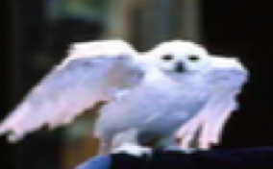
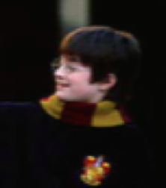
New component: Knowledge Graph (KG)
actor
American
Owl
white
male
profession
nationality
29
name
color
gender
age
Bird
Daniel Radcliffe

Slide 6
Recent work (1)
KB-VQA: Wang et al. , 2017
A method – Ahab, which maps an image and its question to a query that is further applied to large scale structured Knowledge Base (KB) to get the final answer.
Ways in which queries can be applied on knowledge base in this method are limited.
A dataset- KB-VQA

Slide 7
Recent work (2)
FVQA: Wang et al. , 2018
A method – Ahab, which maps an image and its question to a query that is further applied to large scale structured Knowledge Base (KB) to get the final answer.
Ways in which queries can be applied on knowledge base in this method are limited.
A dataset- KB-VQA

Slide 8
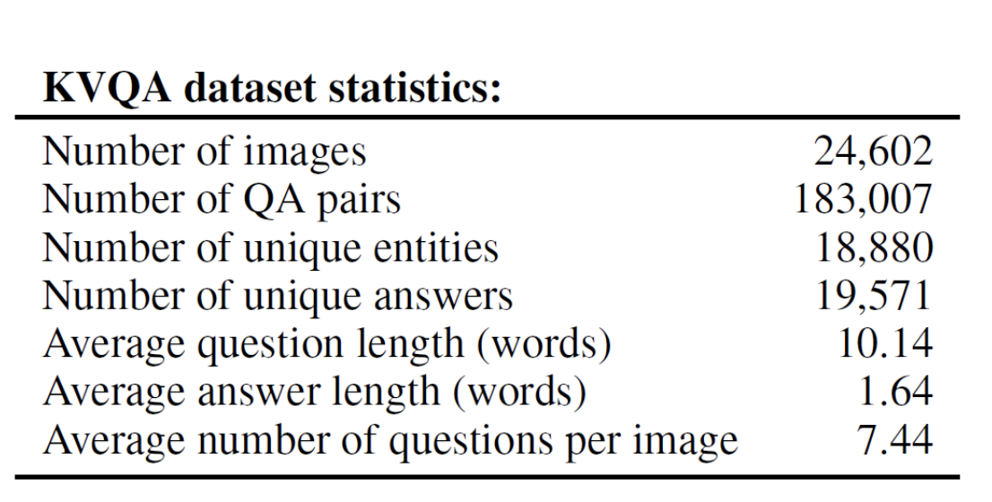
Dataset: KVQA (2019)

Slide 9
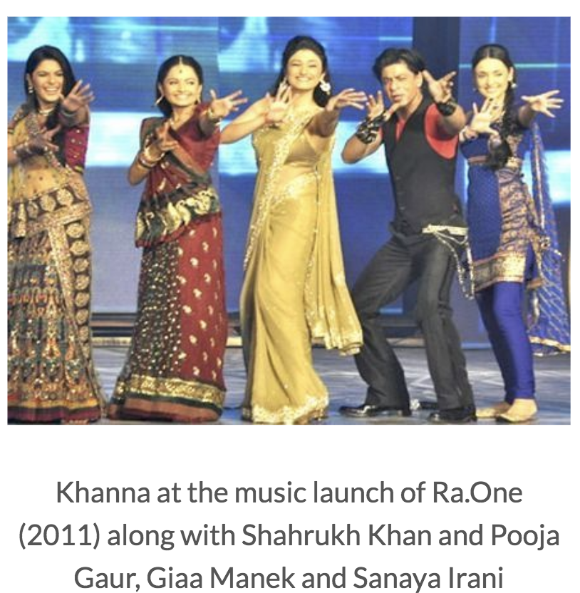
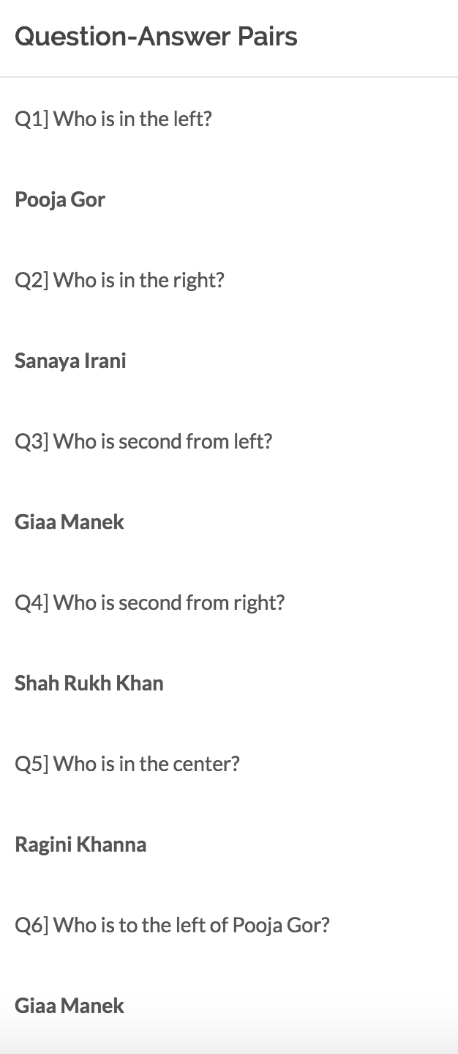
An instance of Image and QA pairs

Slide 10
Knowledge graph (KG)
Wikidata (Vrandecic and Kro ̈tzsch 2014) as Knowledge Graph
Wikidata is a free and open knowledge base that can be read and edited by both humans and machines.
Used the latest RDF dump (dated: 05- 05-2018) of this KG.
Resource Description Framework: (arg1,rel,arg2)

Slide 11
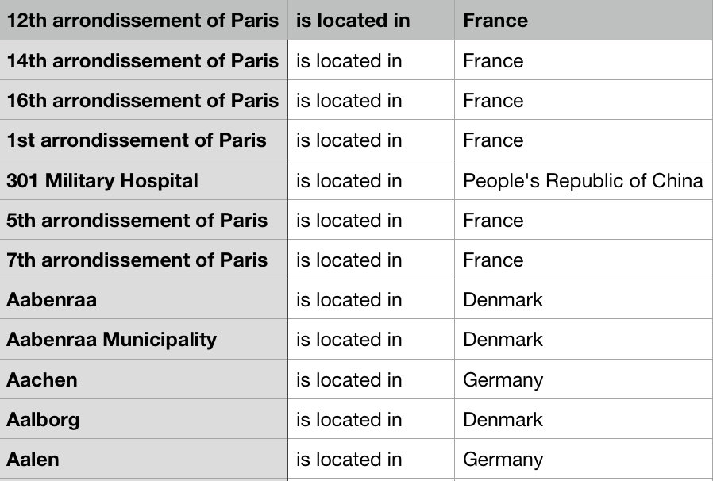
An instance of KG

Slide 12
Evaluation Metric: Top - N
Top-N accuracy means that the correct answer gets in the Top-N probabilities for the corresponding question-image(QI) pair, for it to count as correct.

Slide 13
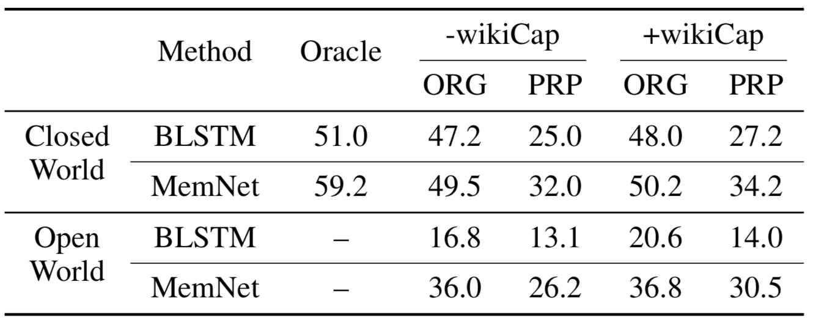
Baselines

Slide 14
Experiment Hypothesis
Observations from KVQA paper:
BLSTMs are ineffective when number of facts increase and memNet outperforms BLSTMs on all settings.
Performance goes down by more than 10% when going from closed world to open world.
memNet is inadequate in handling spatial, multi-hop, multi-relational, subtraction, counting and multi-entity questions, while it performs well on 1-hop, Boolean and inter- section questions.

Slide 15
Two challenges
Face-descriptors like Facenet were not able to handle large number of distractors
Question-answering technique was not able to scale up well with large number of world-knowledge facts associated with multiple entities.

Slide 16
Problem Statement
Conduct many experiments with standard VQA models considering KVQA dataset, and will try to further improve the performance currently achieved by baselines

Slide 17
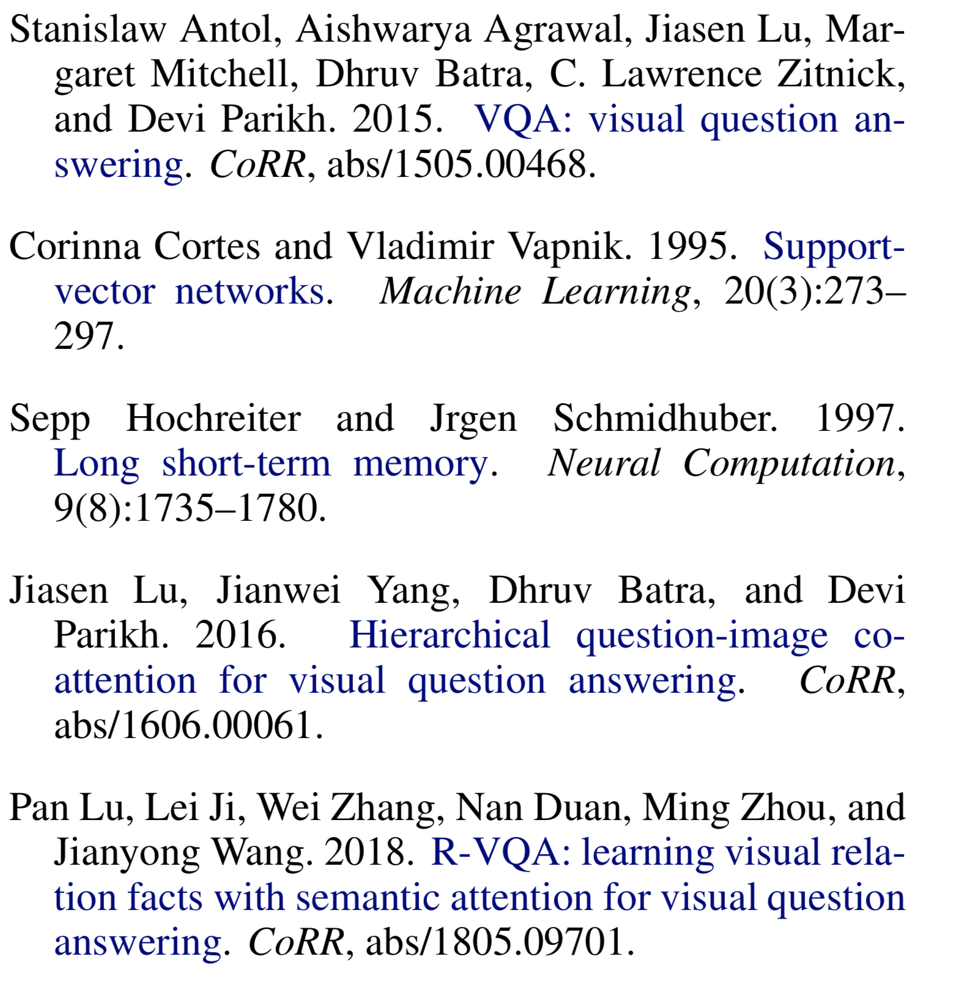
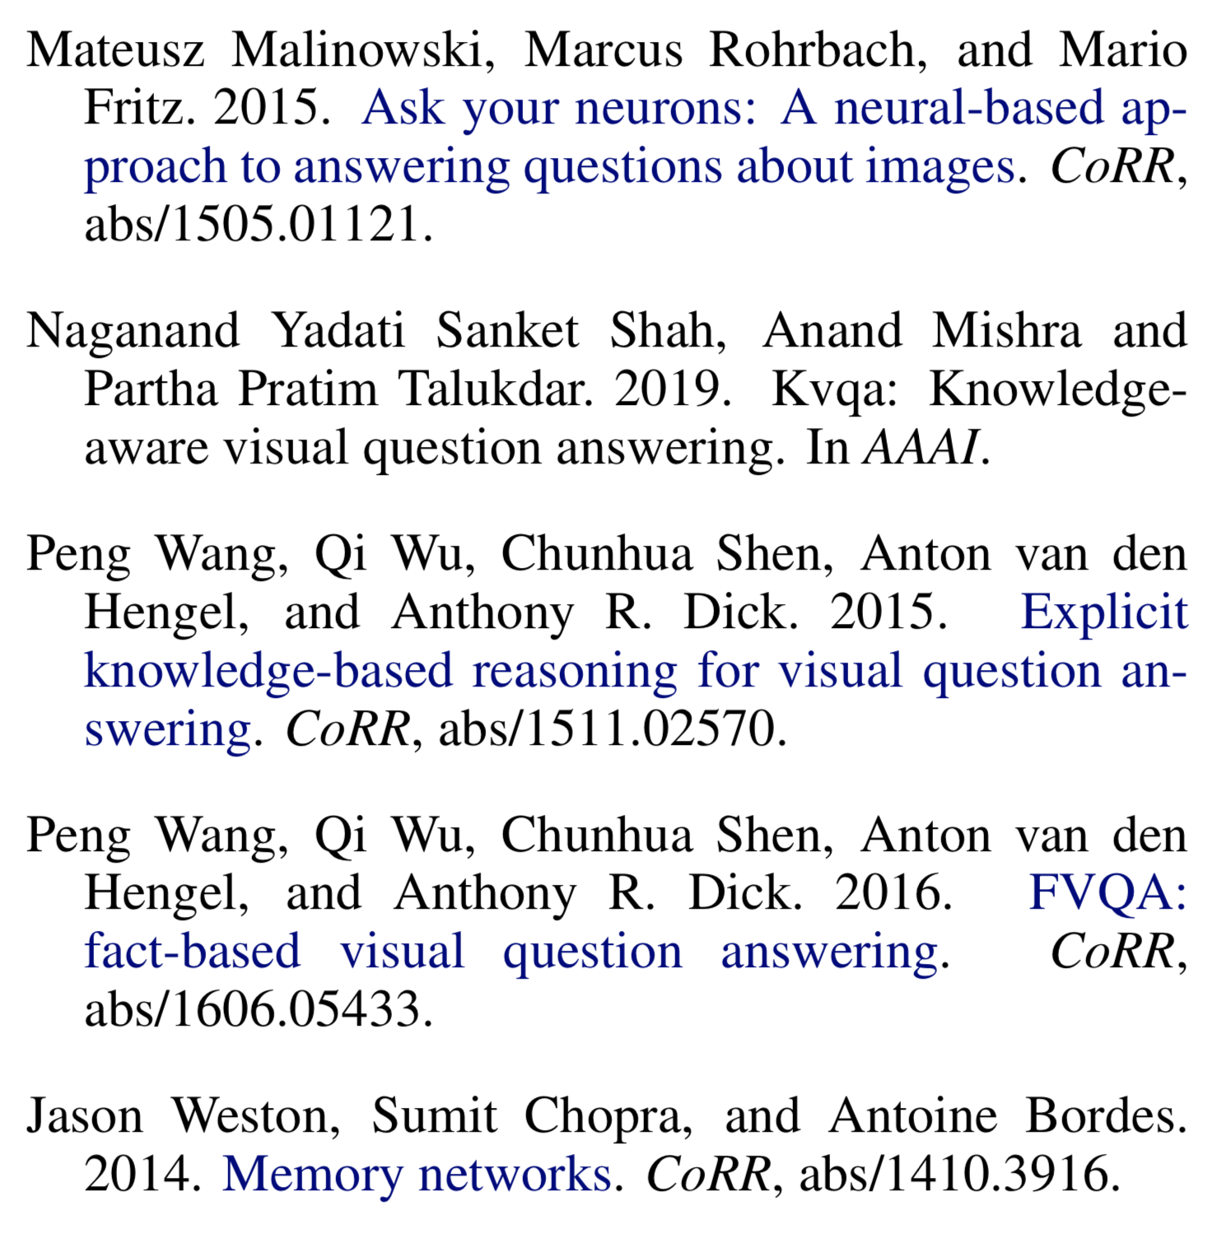
References

