Slide 1


DIGITAL HEALTHCARE GRAND CHALLENGE
TEAM FLASH

Slide 2
Theme:- Detects anomalies and discrepancies in the healthcare claims intake / acquisition and preprocessing / data loading steps.
DATA VALIDATIONS
TECHNICAL LEVEL VALIDATIONS
BUSINESS LOGIC VALIDATIONS
Hey…. your claim form have some invalid data, please check & confirm again.
There are some missing values which are mandatory for your claim approval
Your zip code doesn’t match with your house location, please correct it asap to fasten your claim process.
Your claim form file is corrupt. Fix it & then resend.
It looks like there is double entry of your claim
No No No… your age seems out of our approval range
Beneficiary applying for pregnancy related reimbursement should be female & not male
Our system will identify if there are any Data Validations, technical level validations & business logic validations.
Alerts & notification will be send to the user interface if there are any discrepancies & where resubmissions are required.

Slide 3
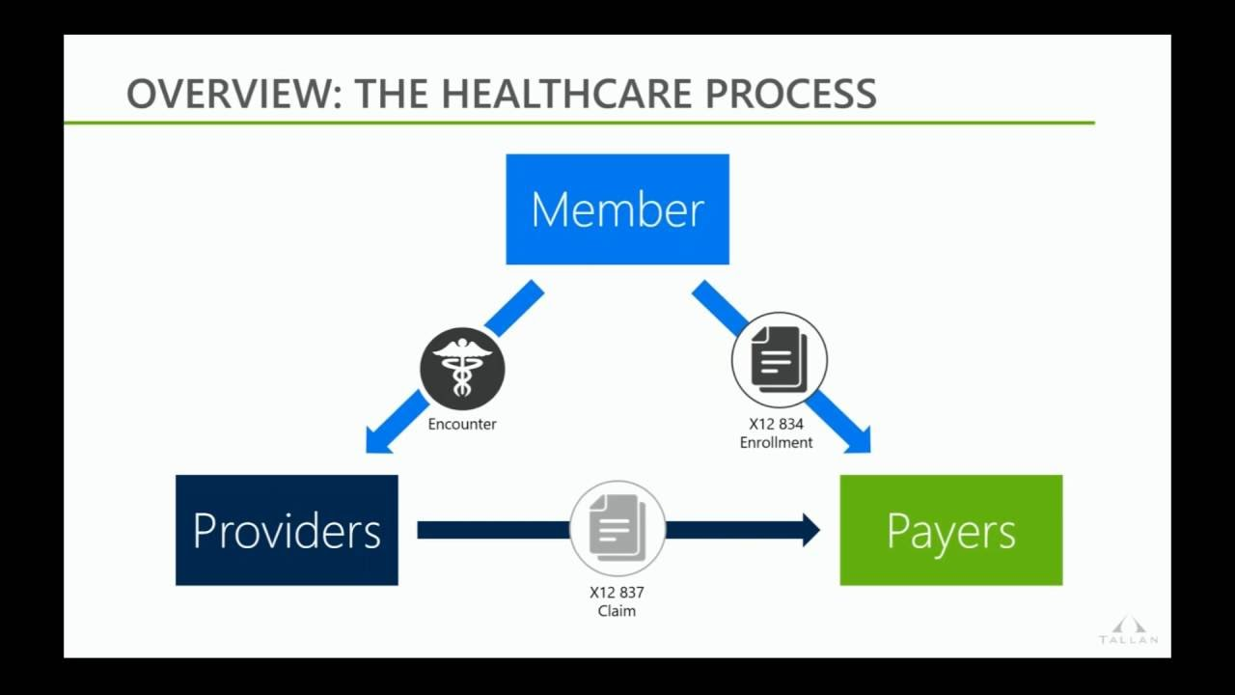
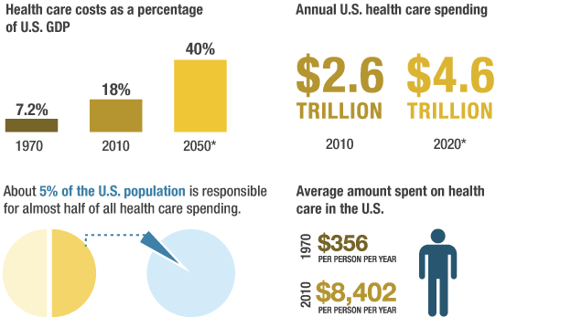
Understanding United States Healthcare Industry
Understanding United States Healthcare expenditure
OUR FOCUS
Claims submitted
Payer pays claims to healthcare provider
Payment received by healthcare provider
AnomalousAI

Slide 4
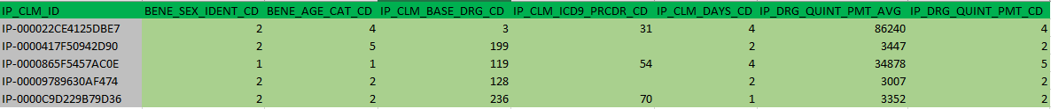
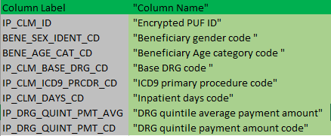

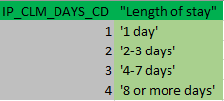
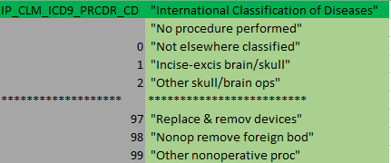
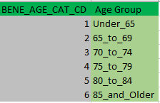
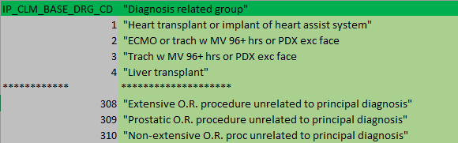
Understanding the Dataset

