Slide 1
Performance, data quality and recovery
Report to the Board of Directors, ahead of the NHS England review (24 March 2025)
Lucky Ukeni, Advanced Healthcare Data Analyst
Every figure in this deck comes from the Q1 2025 extracts (Jan–Mar 2025), cleaned once in Snowflake and shown identically in Power BI, Tableau and the automated Python report.
Notes:
[0:00–0:20] Good morning. I'm Lucky Ukeni, the Trust's analyst. Over the last nine weeks I've rebuilt our performance reporting from the raw extracts upwards: data quality audit, SQL investigation, an agreed KPI framework, dashboards in Power BI and Tableau on Snowflake, and an automated Monday report.
Today I'll do four things in 20 minutes: tell you where we really are, show you what was wrong with the data and what I've fixed, share the five findings that matter most, and ask you to approve three recommendations with their financial impact. Every number I quote comes from our own Q1 2025 extracts, and I'll give you the data-quality caveat with each one.

Slide 2
Fewer than half of our waiting patients are within 18 weeks
74.8%
is what the Board scorecard reports. It comes from a pivot table last refreshed in August 2024.
41.98%
9 of 10
specialties are Red. Only Emergency Medicine meets 92%.
RTT 18-week compliance
NHS Constitution standard: 92%
2
patients have already waited more than 52 weeks; 9 more are at 40–52 weeks.
Red: 50 points below standard
76 of 131 open pathways have waited more than 18 weeks
We are further from target than the Board has been told. Both the performance and the reporting are fixable before the review.
Notes:
[0:20–0:50 — 30 seconds] One number. 41.98% of patients on an open referral-to-treatment pathway are within 18 weeks. The standard is 92%.
The scorecard this Board has been seeing says 74.8%. That figure comes from a pivot table that hasn't been refreshed since August 2024. So the first message is uncomfortable: we are further from target than the Board has been told.
The second message is better: the reporting problem is already fixed, and the performance problem has a plan, which I'll come to at the end.
Caveat if asked: this is the outpatient extract (131 measurable open pathways), not the full patient tracking list. I'm asking for the full PTL to confirm it before week one of the review.

Slide 3
Three constitutional and productivity standards are failing
RTT 18 weeks
ED 4-hour
Theatre utilisation
41.98%
83.2%
64.2%
Standard 92%
Standard 95% · interim 78% met
GIRFT benchmark 85%
9 of 10 specialties Red. Orthopaedics is lowest at 10.5% (17 of 19 breaching).
Above the 78% interim target overall, but 4 of 25 weeks fell below it (lowest 68.0%).
Elective theatres T1–T3, sessions-based. About £180,000 a month of capacity is unused.
Caveat: extract of 131 open pathways. Full PTL needed to confirm.
Caveat: 39 breach flags are blank, so the true figure is 79.9–83.2%.
Caveat: Finance's 71.6% is hours incl. T4 and overruns; our rebuild gives 65.7%.
Notes:
[0:50–2:20 — 1.5 minutes] Three standards are failing.
RTT: 41.98% against 92%. Nine of ten specialties are Red; Orthopaedics is worst at 10.5%, with 17 of 19 open pathways over 18 weeks.
ED four-hour: 83.2% against the 95% constitutional standard. We meet the 78% interim target for the quarter, but in 4 of 25 weeks we fell below it, at worst 68%. Data caveat: 39 breach flags are blank. If every one of those was a breach the figure would be 79.9%, so the honest answer is "between 79.9% and 83.2%". Recalculating from arrival and departure times gives 83.1%, inside that range.
Theatres: 64.2% elective session utilisation against the GIRFT benchmark of 85%. That gap is worth about £180,000 a month. Finance quotes 71.6%; both are arithmetically right but measure different things. I'll come back to which one the Board should use.

Slide 4
Behind the headlines: what drives them and what is working
KPI | Bronings | Target | RAG | So what
Outpatient DNA rate | 13.1% | < 10% (Trust 8%) | Red | 76 lost slots in Q1; Orthopaedics 36.2%
Agency share of shifts | 16.6% | < 8% | Red | £97,020 in 8 weeks; every ward 15–19%
Data quality score (5 datasets) | 81.3% | ≥ 95% | Red | DQMI 52 against the 75 threshold
30-day readmissions | 10.25% | < 10% | Amber | 9.0% on recorded flags; 44 blanks back-filled
HRG coding completeness | 97.7% | 98% | Amber | 28 uncoded episodes = £51,800 at risk
Average length of stay | 3.88 days | < 4.5 days | Green | Within target
ED left without being seen | 2.4% | < 5% | Green | Within target
Notes:
[2:20–3:50 — 1.5 minutes] Behind those three headlines.
DNA: 13.1%, calculated as DNAs divided by attended, DNA, cancelled and referred appointments. That's against a 10% NHS benchmark and our own 8% target. In one quarter that is 76 appointment slots lost, and Orthopaedics, the specialty with the worst waits, has the worst DNA rate at 36.2%.
Agency: 16.6% of shifts, against 8%, costing £97,020 in eight weeks. It is 15–19% on every ward, so this is a Trust-wide vacancy problem, not one ward.
Data quality: 81.3% of rows pass every check across the five systems. Our DQMI is 52 against a threshold of 75.
Readmissions are Amber at 10.25%: 9.0% on recorded flags, 10.25% once 44 blank flags are back-filled using the 30-day rule. The Medical Director may want to challenge that, and I have the workings.
Two things are working: length of stay at 3.88 days and LWBS at 2.4%. I want the Board to see that not everything is Red.

Slide 5
Only 81% of records pass every data quality check
Blank critical fields
44 readmission flags, 39 ED breach flags, 31 discharge dates, 28 HRG codes
Wrong values
Text in number fields, 'attended' for ATT, retired codes (GEN, closed ward W-08)
Duplicates and test data
6 inpatient episodes, 9 ED attendances, 24 ST-99 test staff records
Identity
16 NHS Numbers belong to more than one person; no patient key links PAS, EHR and EDIS
Competing definitions
3 versions of the DNA rate; 2 theatre utilisation figures
Notes:
[3:50–5:20 — 1.5 minutes] Why should you believe my numbers when the old ones were wrong? Because I started by auditing the data. I logged 63 issues across the five source systems and scored every dataset on completeness, validity, uniqueness and consistency.
Only workforce and outpatients come close to the 95% standard. ED is lowest at 56.6%, mainly because 261 attendances carry departure codes like "DIED" and "LEFT" that are not credible, 121 have no NHS Number and 63 have missing times. Inpatients are 79.9%: blank readmission flags, blank HRG codes and open episodes.
Two issues matter beyond reporting. First, 16 NHS Numbers belong to more than one person by name or date of birth. That is a patient-safety and information-governance risk, and it's been referred to the IG lead. Second, there is no common patient key between PAS, EHR and EDIS, so we cannot follow a patient from referral to admission. And we had three versions of the DNA rate in circulation, which is how the Board ended up with figures that didn't agree.

Slide 6
What I fixed: one source, one definition, one figure
Before
Now
Board RTT 74.8% from a stale pivot
41.98% from live, cleaned data
Three versions of the DNA rate
One signed-off definition: 13.1%
Theatres 64.2% vs 71.6% argument
One labelled GIRFT measure: 64.2%
Cleaning by hand in each Excel copy
Rules applied once, in Snowflake views
Monday report: 90 minutes, lapses on leave
Python report: under 60 seconds, scheduled 07:00
DQ score calculated separately by hand
Scored weekly and automatically for the DSP Toolkit
Notes:
[5:20–6:50 — 1.5 minutes] Here's what has changed.
The RTT figure now comes from live, cleaned data instead of a pivot table nobody refreshed.
The DNA rate has one definition, signed off in the KPI workshop: DNAs over attended, DNA, cancelled and referred. 13.1%, everywhere.
Theatre utilisation has one headline measure, sessions used over sessions available in elective theatres, which is the GIRFT basis, so it's comparable with the 85% benchmark. Finance's hours-based 71.6% is still reported, clearly labelled, alongside it.
The cleaning rules are applied once, in Snowflake views, rather than by hand in every spreadsheet. Power BI, Tableau and the Python report all read the same views, so they show the same numbers.
Sarah's 90-minute Monday report now runs in under a second and is scheduled for 7am. It no longer lapses when she's on leave, and it has an audit log. The data quality score now updates every week, ready for the DSP Toolkit submission.

Slide 7
Findings 1–2: the problem is concentrated in Orthopaedics
1
9 of 10 specialties are Red
Only Emergency Medicine (37 pathways, 100%) meets 92%. Respiratory has all 9 open pathways breaching. The Board scorecard's 74.8% hid this.
2
Orthopaedics: the longest waits and the most DNAs
17 of 19 open pathways breaching; average wait 253 days; longest 423 days (60.4 weeks). Clinic CL-103 misses 37.0% of appointments.
Notes:
[6:50–8:50 — 2 minutes] Twelve SQL investigations; here are the five findings that matter.
Finding one: nine of ten specialties are Red on RTT. Only Emergency Medicine meets 92%. Respiratory has every one of its nine open pathways in breach. The 74.8% headline hid all of this.
Finding two: the problem is concentrated in Orthopaedics. 17 of 19 open pathways are breaching, the average wait is 253 days, and the longest is 423 days, which is 60.4 weeks. The same specialty's clinic, CL-103, misses 37% of its appointments. So Orthopaedics has the longest waits and wastes the most capacity on DNAs. That's where the recovery should start.

Slide 8
Findings 3–5: coding, identity and money leaking
3
Cancellations hiding DNAs
4
Patient identity risk
5
Money leaking
29.7%
16
£148,820
of appointments cancelled by EM consultant C-1009, three times the next highest, while EM reports 0% DNA. DNAs are likely coded as Trust cancellations.
NHS Numbers belong to more than one person by name or date of birth. No outpatient patient can be matched to inpatient or ED records.
£51,800 of income from 28 uncoded episodes, plus £97,020 of agency spend in 8 weeks, spread across every ward.
Notes:
[8:50–10:50 — 2 minutes] Finding three: Emergency Medicine reports a 0% DNA rate, which looks excellent, but consultant C-1009 cancels 29.7% of appointments, three times anyone else. The likely explanation is that DNAs are being coded as Trust cancellations. That flatters the DNA rate and makes it look like the Trust is cancelling patients. Until it's checked with the clinic manager, EM's 0% should not be treated as best practice.
Finding four: 16 NHS Numbers are attached to more than one person. That's a patient-safety risk, because letters or results could reach the wrong patient. It's referred to the IG lead for a PDS trace. Separately, no outpatient patient can be matched to the inpatient or ED data, so we can't yet track a pathway from referral to admission.
Finding five: money. 28 inpatient episodes have no HRG code, which is £51,800 of income we won't be paid unless they're coded before the SUS deadline. Eight of them, £14,800, are in Emergency Medicine. And £97,020 of agency spend in eight weeks, at 15–19% of shifts on every ward. That points to a Trust-wide vacancy problem, not one badly run ward.

Slide 9
18 agreed KPIs: one definition, one owner, one source each
Emergency
Elective
Outpatients and flow
K01 ED 4-hour
K02 LWBS
K04 RTT 18 weeks
K05 Waiting list size
K06 52-week waits
K07 Theatre utilisation
K08 Cancelled operations
K03 DNA rate
K09 Bed occupancy
K10 Length of stay
Quality
Finance and workforce
Data quality
K11 30-day readmissions
K15 Safety incidents
K12 HRG coding
K13 Agency spend
K14 Cost per episode
K16 Vacancy rate
K17 DQMI / DSP Toolkit
K18 RTT clock accuracy
Example: DNA rate = DNA ÷ (ATT + DNA + CAN + REF) × 100 = 13.1% · Owner: Performance Manager · Source: PAS
Notes:
[10:50–12:50 — 2 minutes] The reason the Board had three DNA rates is that nobody owned the definition. The KPI framework fixes that.
There are 18 KPIs across six domains. Each has one written formula, one named owner, one source system, a target and RAG thresholds. The definitions were agreed in Sarah Okafor's workshop.
The example at the bottom: DNA rate is DNAs over attended, DNA, cancelled and referred appointments. That gives 13.1%, owned by the Performance Manager, sourced from PAS through Snowflake. Every dashboard and report uses exactly that formula.
Two things I'd highlight. Theatre utilisation is defined as two labelled measures, sessions-based for performance and hours-based for Finance, so the argument doesn't come back. And two of the 18 are data-quality KPIs, DQMI and RTT clock accuracy, because we can't manage performance with data we can't trust.
What I'm asking for: Board endorsement of the framework, so these become the only definitions used in Board papers.

Slide 10
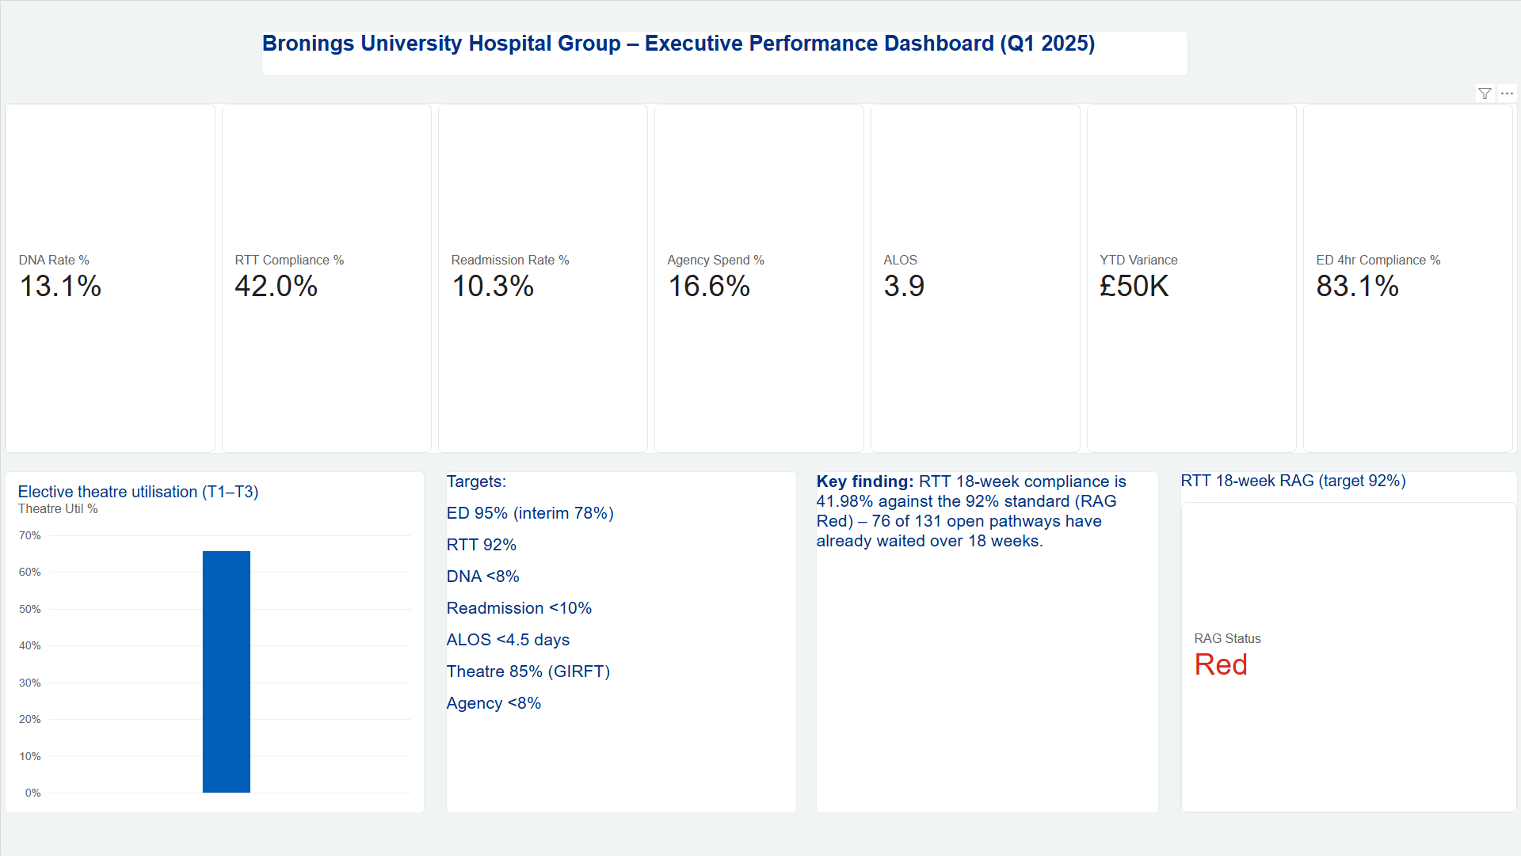
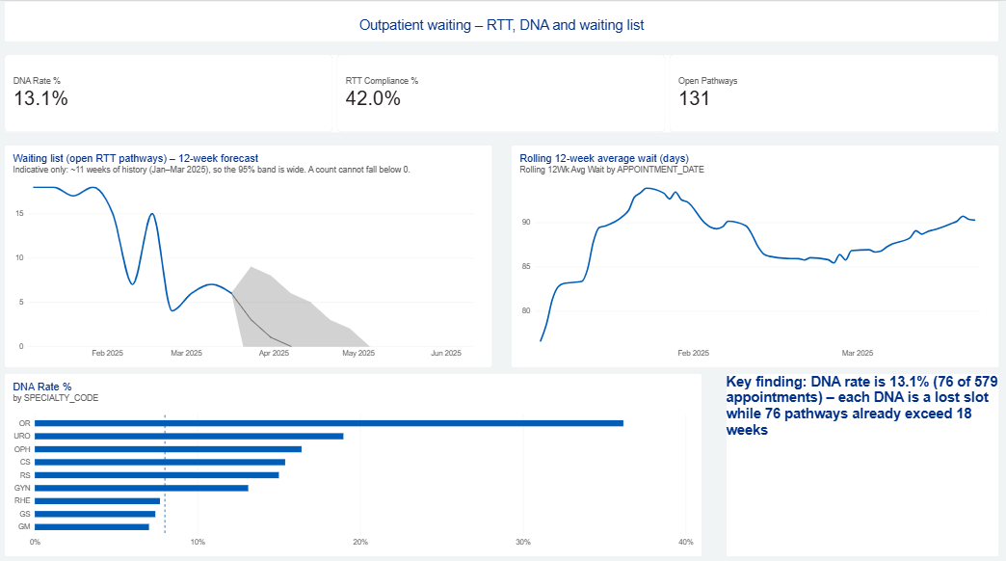
Power BI: six pages, one Snowflake source
Outpatient Waiting: DNA by specialty, rolling 12-week wait, 12-week waiting list forecast
6 pages: Executive, ED, Outpatients, Capacity, Finance, Workforce
12 DAX measures that reconcile to the framework (DNA 13.13, RTT 41.98)
Every KPI shown against its target line
Executive Summary: seven KPI cards, RTT RAG tile, elective theatre utilisation against GIRFT 85%
Notes:
[12:50–14:20 — 1.5 minutes] This is the Board's new view. The Power BI report has six pages: an executive summary, then ED, outpatients, capacity, finance and workforce. It reads directly from the cleaned Snowflake views.
On the left, the executive summary: the KPI cards, the RTT RAG tile in red, and elective theatre utilisation against the 85% GIRFT line. On the right, the outpatient page: DNA rate by specialty against the target, the rolling 12-week average wait, which is about 90 days, and the 12-week waiting-list forecast.
The important point is that the 12 DAX measures reproduce the framework exactly: DNA 13.13%, RTT 41.98%. If you see a number in a Board paper, you can find the same number here, calculated the same way.
Presenter note: refresh these screenshots on the morning of the Board (the YTD Variance card now shows £49,711 in full).

Slide 11
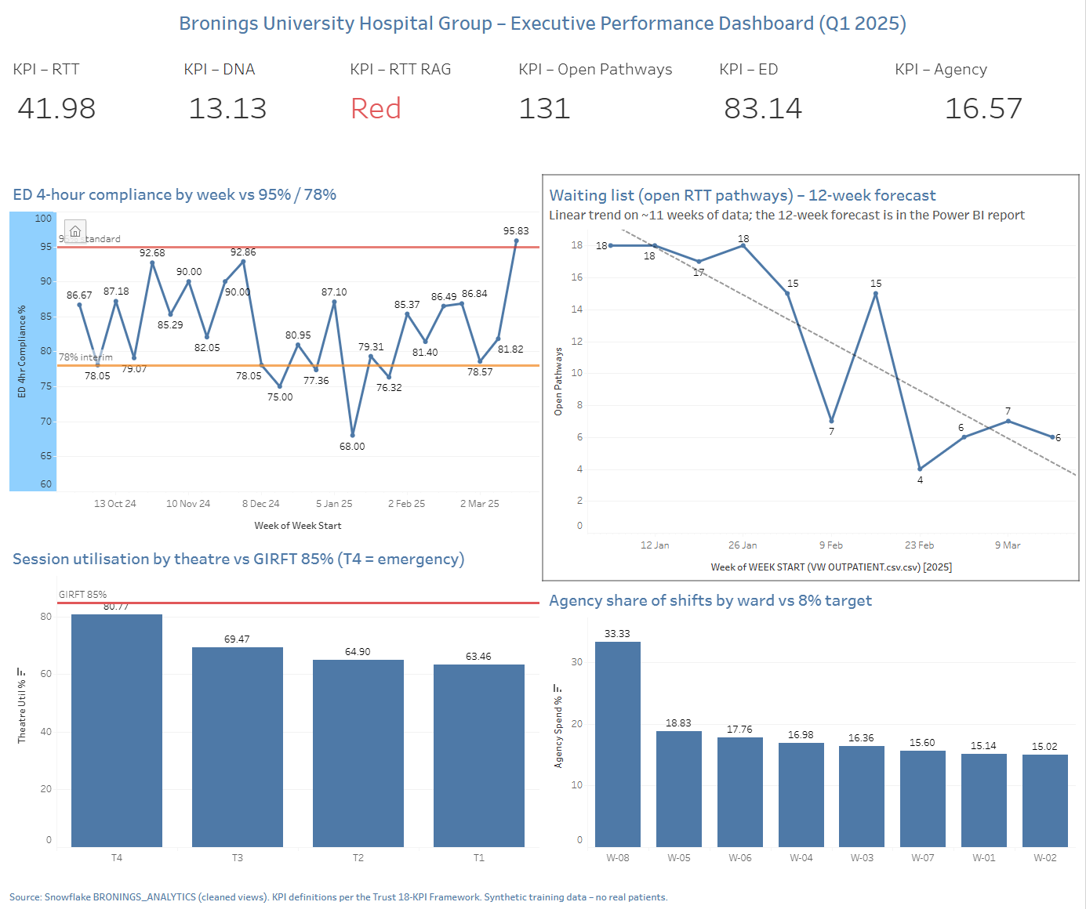
Tableau Public and the pipeline: the same figures in every tool
Source systems
PAS · EHR · EDIS · TMS · Workforce
Snowflake: BRONINGS_ANALYTICS
Raw tables → cleaned views (DQ rules applied once)
Outputs
Power BI Board report · Tableau Public · Python Monday report
Tableau shows RTT 41.98 · DNA 13.13 · ED 83.14 · Agency 16.57: identical to Power BI and the Python report.
Notes:
[14:20–15:50 — 1.5 minutes] The same dashboard published to Tableau Public, which anyone, including the NHS England review team, can open with a link: six KPI tiles, ED weekly compliance against 95% and 78%, the waiting-list trend, theatre utilisation against 85%, and agency share by ward against 8%.
The diagram on the right is why the figures agree. The source systems feed Snowflake. The cleaning rules are applied once, in views. Power BI, Tableau and the Python Monday report all read those views. So RTT is 41.98 and DNA is 13.13 whichever tool you open. That consistency is what the review team will test, and it's what we didn't have three months ago.

Slide 12
Three decisions for the Board today
1
Validate and treat the longest waiters: Orthopaedics first
£126,000
Full PTL validation within 2 weeks. Treat the 11 patients at 40+ weeks. Text reminders and partial booking to halve DNAs (about 38 slots a quarter).
of 52-week penalties avoided (9 patients × £14,000); exposure up to £4.37m on the full list
Owner: Director of Operations
2
Recover elective theatre capacity to the GIRFT standard
£1.1m a year
Adopt the single GIRFT measure. Reallocate under-used T1–T3 sessions to the Orthopaedics and Urology backlog. Target 75% by Q2.
of capacity recovered (each +1 point ≈ £8,650 a month)
Owner: Theatres Manager
3
Fix the data that drives income and the review
£435,000 a year
Code the 28 HRG episodes before the SUS deadline. Complete ED and readmission flags. Agency approval control. DQMI to 75.
£110k HRG coding (£51.8k in 6 months) + £325k agency to 8%; protects £380k CQUIN
Owner: Finance BP and IG Lead
Notes:
[15:50–18:50 — 3 minutes] Three decisions.
One: validate and treat the longest waiters, starting with Orthopaedics. Validate the full patient tracking list within two weeks, because our extract is 131 pathways and the brief puts 312 patients at risk of 52-week breaches. Treat the 11 patients already at 40-plus weeks. Introduce text reminders and partial booking to halve DNAs, freeing around 38 slots a quarter at no cost. Financially: preventing the 9 patients at 40–52 weeks from tipping over avoids £126,000 in penalties at £14,000 each, and the full-list exposure is up to £4.37m. Owner: Director of Operations.
Two: recover elective theatre capacity. Adopt the one GIRFT measure and reallocate persistently under-used T1–T3 sessions to the Orthopaedics and Urology backlog, targeting 75% by Q2. Every point of utilisation is worth about £8,650 a month. Getting from 64.2% to 75% recovers around £93,000 a month, £1.1m a year, and it is the main lever on recommendation one. Owner: Theatres Manager.
Three: fix the data that drives income. Code the 28 uncoded episodes before the SUS deadline: £51,800 now, which is about £110,000 a year at the rate we see in six months of data. Complete the ED and readmission flags. Put an approval control on agency shifts to move from 16.6% towards 8%, about £325,000 a year. Together that's about £435,000 a year. Reach DQMI 75, which protects £380,000 of CQUIN. Owner: Finance Business Partner with the IG lead.
The ask: approve the three actions and owners today. I'll report progress to the next Board from the automated report, so you'll see the same figures I see. [18:50–20:00] Thank you. I'm happy to take questions.

