Slide 1


Slide 2
Nội dung
Giới thiệu, kiến trúc
Cài đặt
Deploy ứng dụng

Slide 3
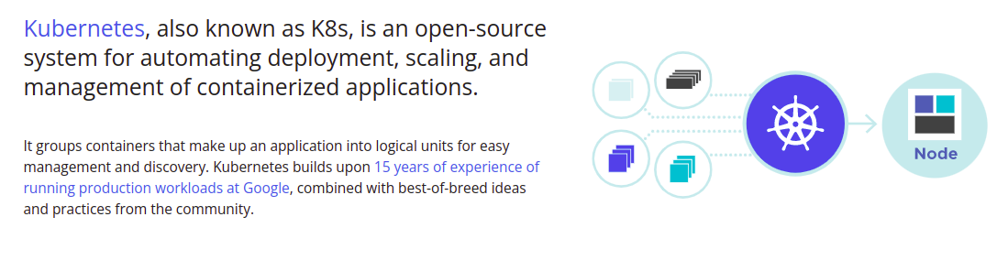
Giới thiệu
Kubernetes là gì?

Slide 4
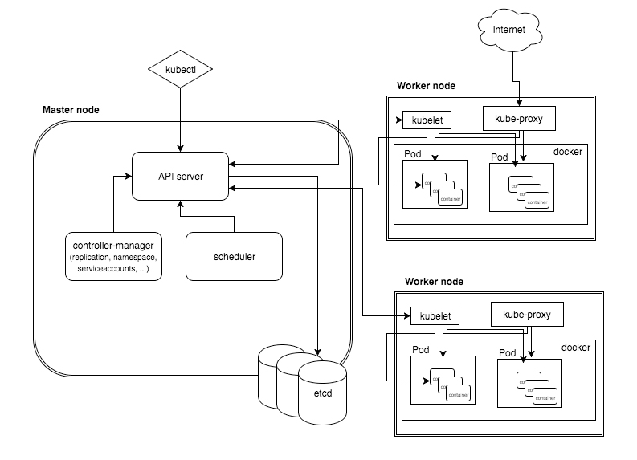
Kiến trúc
Etcd
API server
Schedule
Controller
Kubelet
Kube-proxy

Slide 5
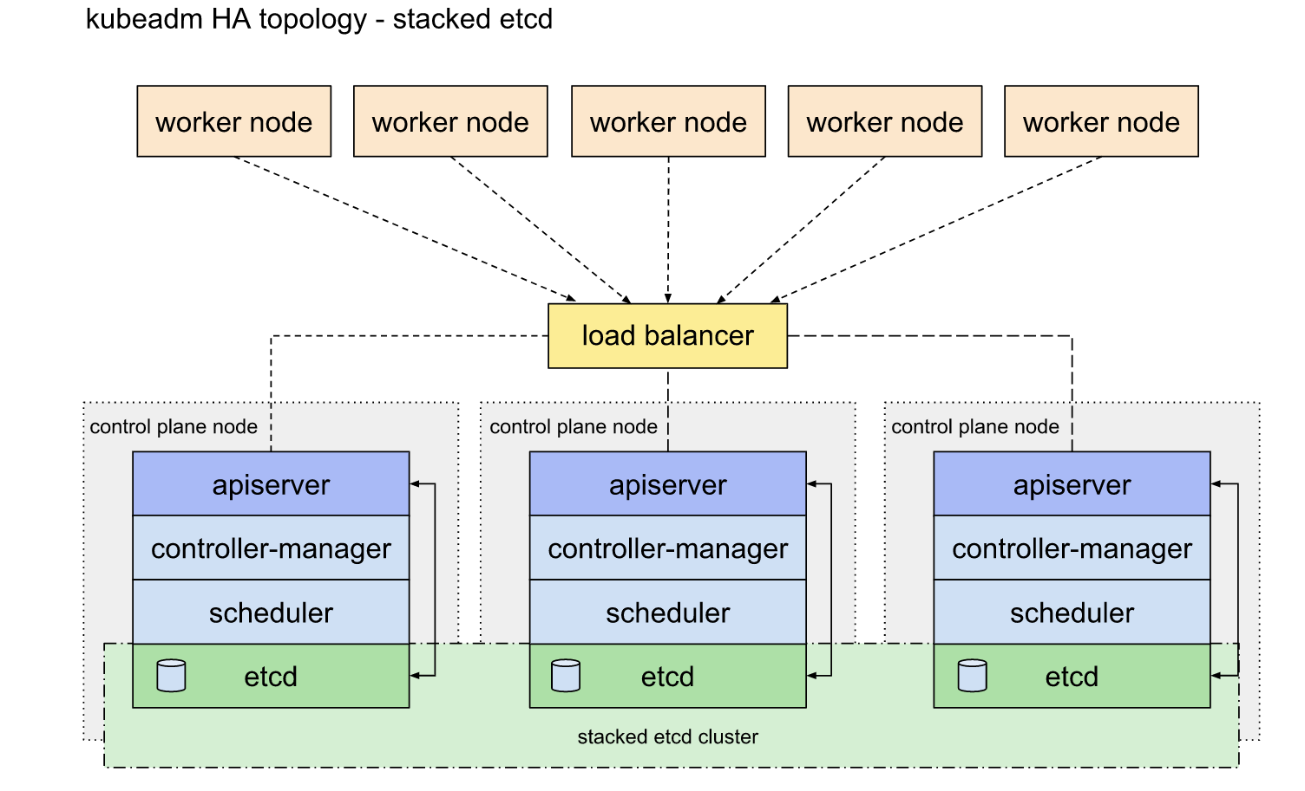
HA Cluster

Slide 6
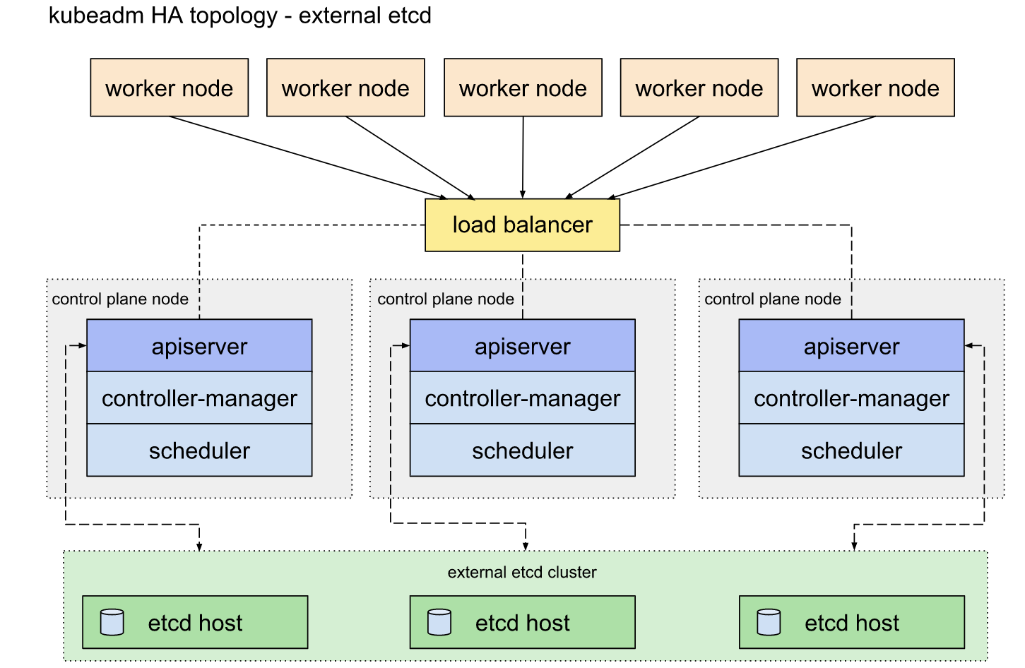
HA Cluster

Slide 7
Cài đặt
Cài đặt Docker
Cài đặt Kubelet
Khởi tạo cluster, join các node worker
Cài đặt mạng cho cluster: sử dụng calico
native.cgroupdriver=systemd
sudo apt-get install -qy kubeadm=1.23.6-00 kubelet=1.23.6-00 kubectl=1.23.6-00
kubeadm init --pod-network-cidr=192.168.0.0/16
kubectl apply -f https://docs.projectcalico.org/v3.20/manifests/calico.yaml

Slide 8
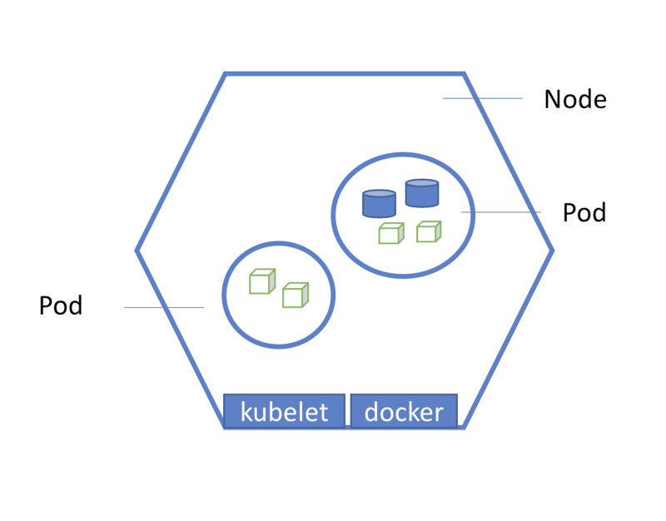
POD
kubectl get pods
kubectl apply -f pod.yaml
kubectl delete -f pod.yaml
kubectl describe pod/pod-name
kubectl logs -f pod/pod-name
kubectl exec -it pod-name bash
kubectl delete pod/pod-name

Slide 9
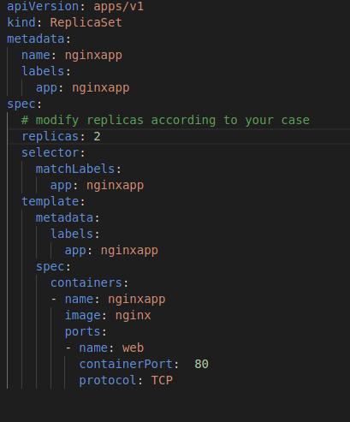
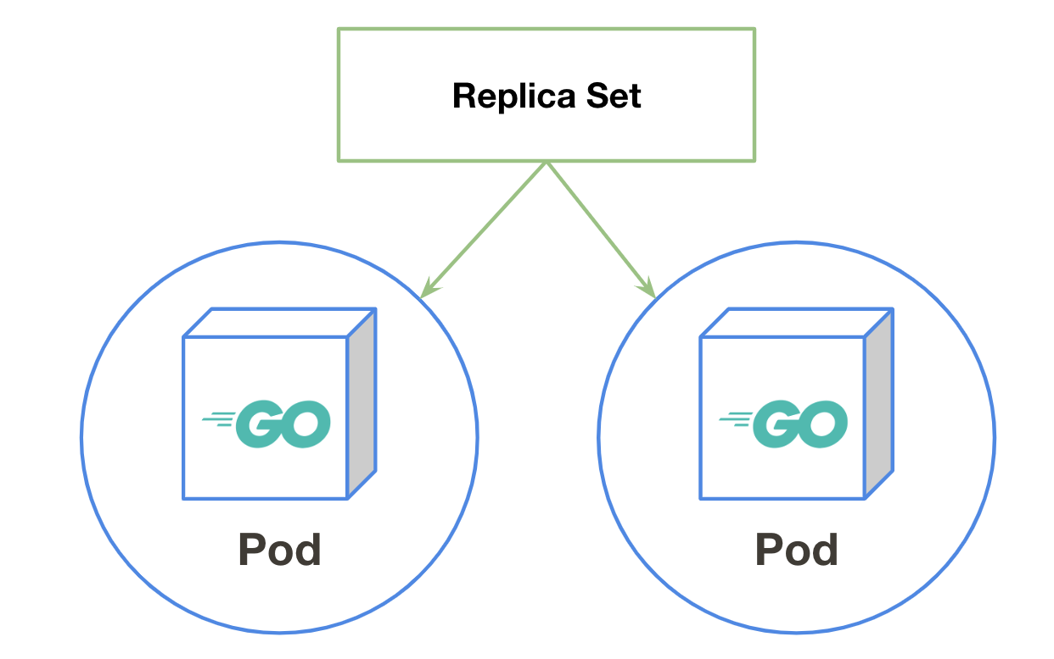
ReplicaSet

Slide 10
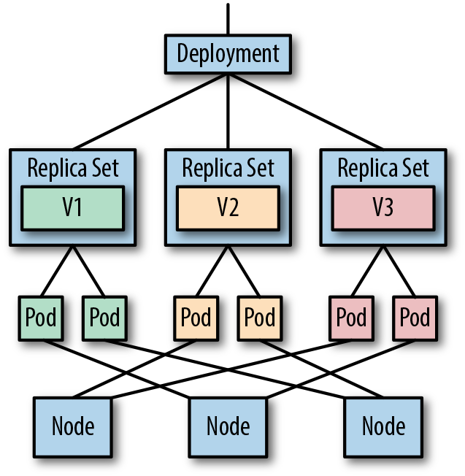
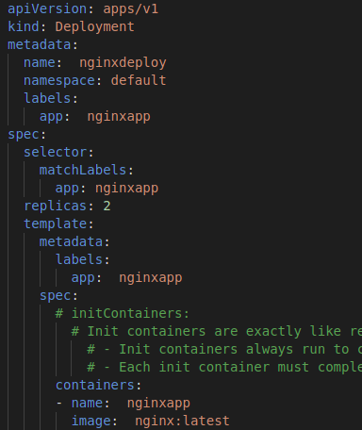
Deployment

Slide 11
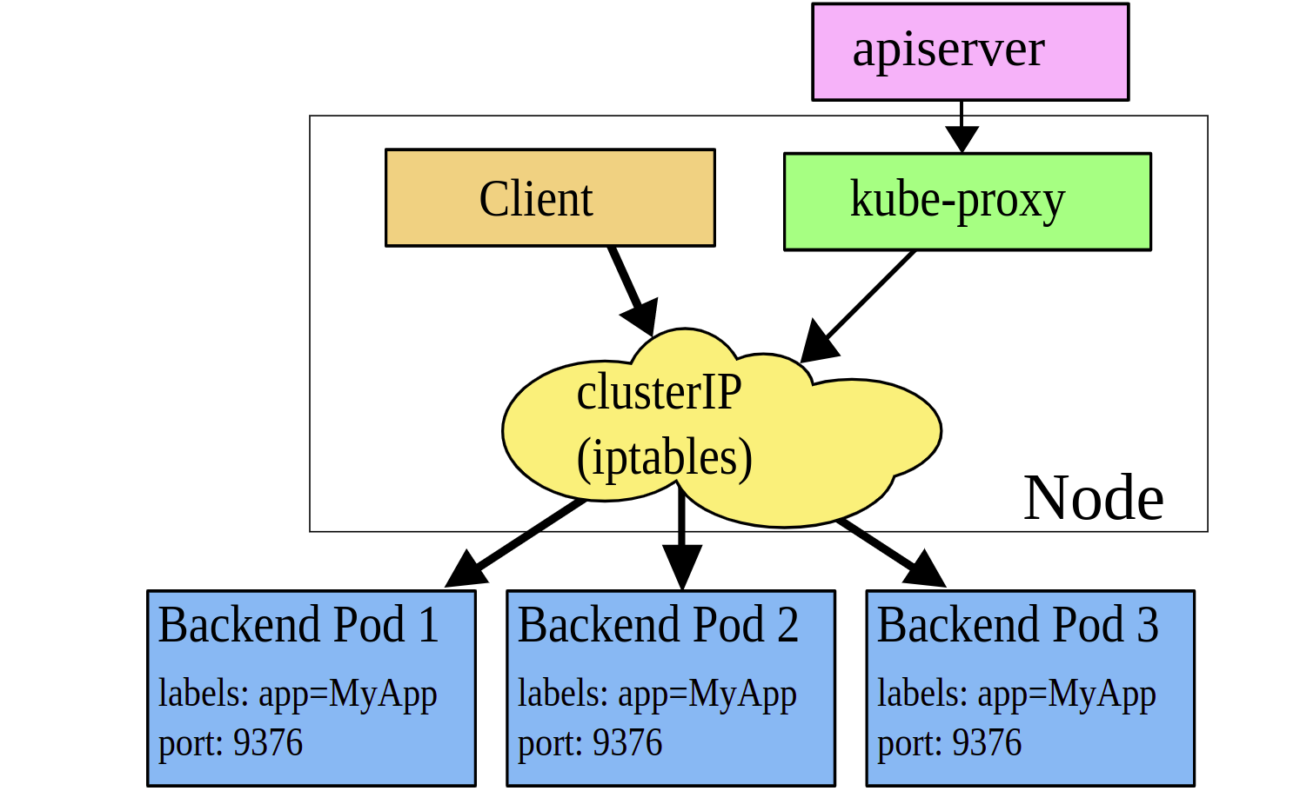
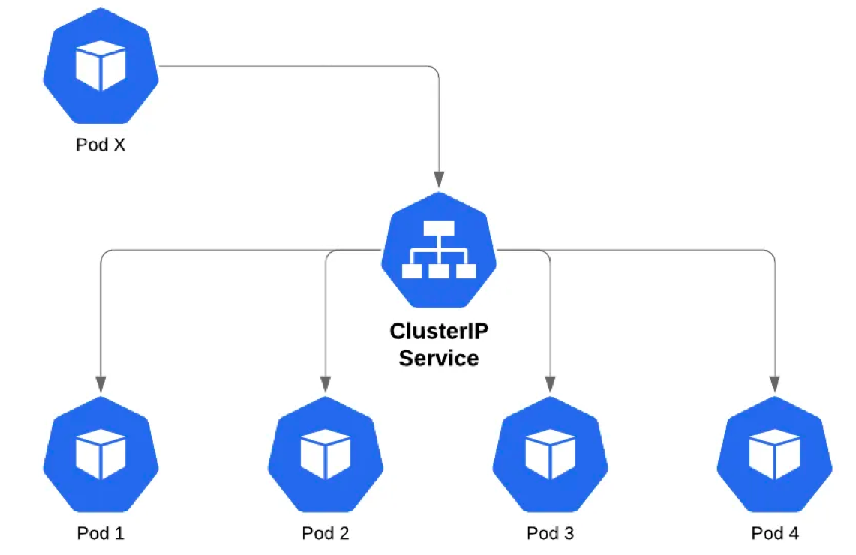
Service
ClusterIP
NodePort

Slide 12
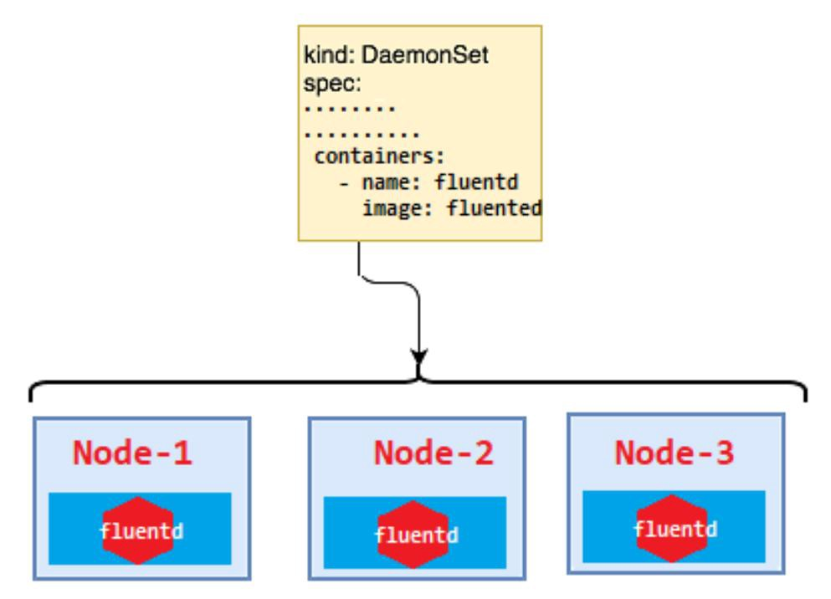
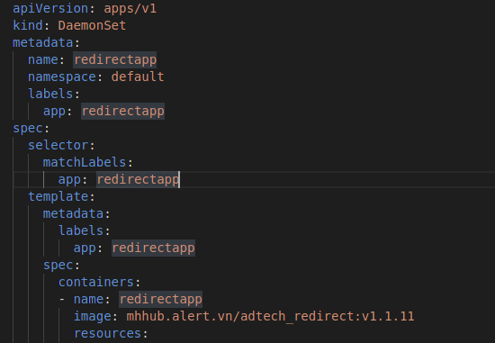
DaemonSet

Slide 13
References
https://kubernetes.io/docs/setup/production-environment/tools/kubeadm/install-kubeadm/
https://kubernetes.io/docs/concepts/services-networking/service
https://kubernetes.io/vi/docs/reference/kubectl/cheatsheet/
https://docs.docker.com/engine/install/ubuntu

Slide 14
Thank you

