Slide 1
Subgoal Discovery and Language Learning in Reinforcement Learning Agents
Marie desJardins University of Maryland, Baltimore County
Université Paris Descartes
September 30, 2014
Collaborators:
Dr. Michael Littman and Dr. James MacGlashan (Brown University)
Dr. Smaranda Muresan (Columbia University)
Shawn Squire, Nicholay Topin, Nick Haltemeyer, Tenji Tembo, Michael Bishoff, Rose Carignan, and Nathaniel Lam (UMBC)
Notes:
NSF Funded

Slide 2
Outline
Learning from natural language commands
Semantic parsing
Inverse reinforcement learning
Task abstraction
“The glue”: Generative model / expectation maximization
Discovering new subgoals
Policy/MDP abstraction
PolicyBlocks: Policy merging/discovery for non-OO domains
P-MODAL (Portable Multi-policy Option Discovery for Automated Learning): Extension of PolicyBlocks to OO domains

Slide 3
Learning from Natural Language Commands

Slide 4
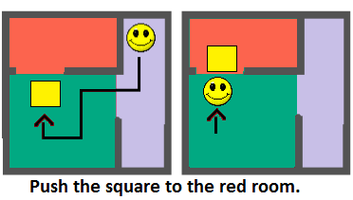
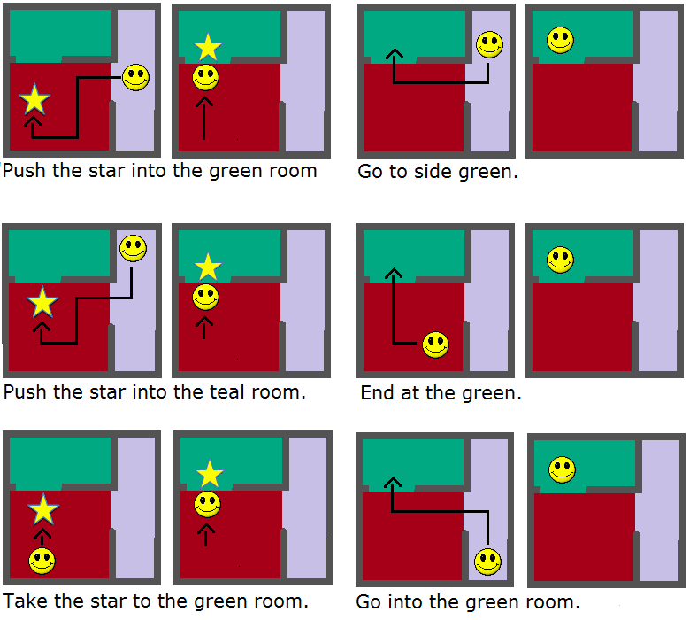
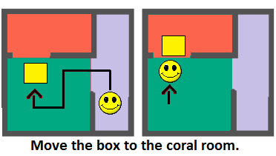
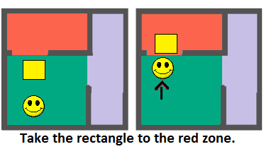
Abstract task: move object to colored room
move square to red room
move star to green room
go to green room
Another Example of A Task of pushing an object to a room. Ex : square and red room

Slide 5
The Problem
Supply an agent with an arbitrary linguistic command
Agent determines a task to perform
Agent plans out a solution and executes task
Planning and execution is easy
Learning task semantics and intended task is hard

Slide 6
The Solution
Use expectation maximization (EM) and a generative model to learn semantics
Pair command with demonstration of exemplar behavior
This is our training data
Find highest-probability tasks and goals

Slide 7

System Structure
Verbal instruction
Language Processing
Task Learning
from Demonstrations
Task Abstraction

Slide 8
System Structure
Verbal instruction
Semantic Parsing
Task Learning
from Demonstrations
Task Abstraction

Slide 9
System Structure
Verbal instruction
Semantic Parsing
Inverse Reinforcement Learning (IRL)
Task Abstraction

Slide 10
System Structure
Object-oriented Markov Decision Process
(OO-MDP) [Diuk et al., 2008]
Semantic Parsing
Inverse Reinforcement Learning (IRL)
Task Abstraction

Slide 11
Representation
Tasks are represented using Object-Oriented Markov Decision Processes (OO-MDP)
The OO-MDP defines the relationships between objects
Each state is represented by:
An unordered set of instantiated objects
A set of propositional functions that operate on objects
A goal description (set of states or propositional description of goal states)

Slide 12
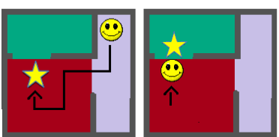
Simple Example
“Push the star into the teal room”
Semantic Parsing
Inverse Reinforcement Learning (IRL)
Task Abstraction

Slide 13
Semantic Parsing
Approach #1: Bag-of-words multinomial mixture model
Each propositional function corresponds to a multinomial word distribution
Given a task, a word is generated by using a word distribution from the task’s propositional functions
Don’t need to learn meaning of words in every task context
Approach #2: IBM Model 2 grammar-free model
Treat as a statistical translation problem
Statistically model alignment of English and machine translation
Notes:
roomIsGreen applies to “green” to agentInRoom and blockInRoom

Slide 14
Inverse Reinforcement Learning
Based on Maximum Likelihood Inverse Reinforcement Learning (MLIRL)¹
Takes demonstration of agent behaving optimally
Extracts a most probable reward function
¹ Babeș¸-Vroman, Marivate, Subramanian, and Littman, “Apprenticeship learning about multiple intentions,” ICML 2011.

Slide 15
Task Abstraction
Handles abstraction of domain into first-order logic
Grounds generated first-order logic to domain
Performs expectation maximization between SP and IRL

Slide 16
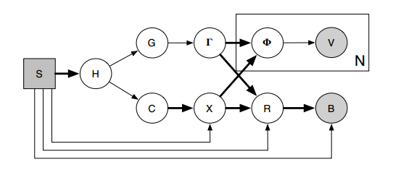
Generative Model
Inputs/Observables
Probability distribution to be learned
Fixed probability distribution
Latent variables
Notes:
boxed nodes are inputs (values provided), circled nodes are random variables, shaded nodes are observables during learning, bold arrow indicates probability distribution is fixed (not learned)

Slide 17
Generative Model
Goal
object
bindings
Goal
conditions
Propositional
function
Vocabulary
word
Hollow
task
Initial
state
Reward
function
Object
constraints
Constraint
object
bindings
Behavioral
trajectory
Notes:
boxed nodes are inputs (values provided), circled nodes are random variables, shaded nodes are observables during learning, bold arrow indicates probability distribution is fixed (not learned)

Slide 18
Generative Model
S: initial state – objects/types and attributes in the world
H: hollow task – generic (underspecified) task that defines the objects/types involved
FOL variables and OO-MDP object classes
∃b,r BLOCK(b)^ROOM(r)

Slide 19
Generative Model
G: abstract goal conditions – class of conditions that must be met, without variable bindings
FOL variables and propositional function classes
blockPosition(b,r)
C: abstract object bindings (constraints) – class of constraints for binding variables to objects in the world
FOL vars and prop. functions that are true in initial state
roomColor(r) ∧ blockShape(b)

Slide 20
Generative Model
Γ: object binding for G – grounded goal conditions
Function instances of prop. function classes
blockInRoom(b, r)
Χ: object binding for C – grounded object constraints
Function instances of prop. function classes
isGreen(r) ∧ isStar(b)

Slide 21
Generative Model
Φ: randomly selected propositional function from Γ or X – fully specified goal description
blockInRoom, isGreen, or isStar
V: a word from vocabulary – natural language description of goal
N: number of words from V in a given command

Slide 22
Generative Model
R: reward function dictating behavior – translation of goal to reward for achieving goal
Goal condition specified in Γ bound to objects in X
blockInRoom(block0, room2)
B: behavioral trajectory – sequence of steps for achieving goal (maximizing reward) from S
Starts in S and derived by R

Slide 23
Expectation Maximization
Iterative method for maximum likelihood
Uses observable variables
Initial state, behavior, and linguistic command
Find distribution of latent variables
Pr(g | h), Pr(c | h), Pr(γ | g), and Pr(v | φ)
Additive smoothing seems to have a positive effect

Slide 24
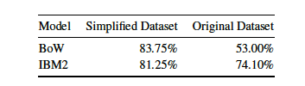
Training / Testing
Two datasets:
Expert data (hand-generated)
Mechanical Turk data (240 total commands on six sample tasks): original version (includes extraneous commentary) and simplified version (includes description of goal only)
Leave-one-out cross validation
Accuracy is based on most likely reward function of the model
Mechanical Turk results:

Slide 25
Discovering New Subgoals

Slide 26
The Problem
Discover new subgoals (“options” or macro-actions) through observation
Explore large state spaces more efficiently
Previous work on option discovery uses discrete state space model
How to discover options in complex state spaces (represented as OO-MDPs)?

Slide 27
The Solution
Portable Multi-policy Option Discovery for Automated Learning (P-MODAL)
Extend Pickett & Barto’s PolicyBlocks approach
Start with a set of existing (learned) policies for different tasks
Find states where two or more policies overlap (recommend the same action)
Add the largest areas of overlap as new options
Challenges in extending to OO-MDPs:
Iterating over states
Computing policy overlap for policies in different state spaces
Applying new policies in different state spaces

Slide 28




Key Idea: Abstraction
Target Task
Abstract Task (Option)
Source Task #1
Source Task #2

Slide 29
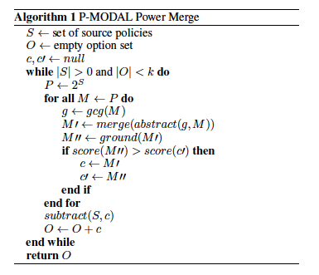
Merging and Scoring Policies
Consider all sets of source policy sets (in practice, only pairs and triples)
Find the greatest common generalization of the state spaces
Abstract the policies and merge them
Ground the resulting abstract policies in the original state spaces and select the highest-scoring options
Remove the states covered by the new option from the source policies

Slide 30
Policy Abstraction
GCG (Greatest Common Generalization) – largest set of objects that appear in all policies being merged
Mapping source policy to abstract policy:
Identify each object in the abstract policy with one object in the source policy.
Number of possible mappings: k_{i} = # objects of type i in source m_{i} = # objects of type i in abstraction T = set of object types
Select the mapping that minimizes the Q-value loss: S = set of abstract states A = set of actions s* = grounded states corresponding to s σ = average Q-value over grounded states

Slide 31
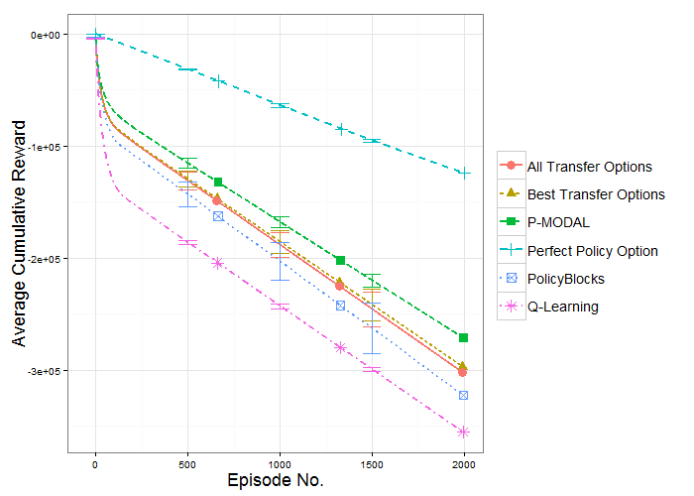
Results
Three domains: Taxi World, Sokoban, BlockDude

Slide 32
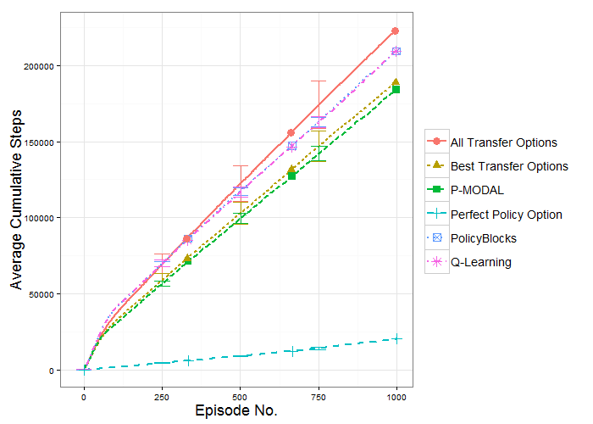
More Results

Slide 33
Current / Future Tasks
Task/language learning:
Extend expressiveness of task types
Implement richer language models, including grammar-based models
Subgoal discovery:
Use heuristic search to reduce complexity of mapping and option selection
Explore other methods for option discovery
Integrate with language learning

Slide 34
Summary
Learn tasks from verbal commands
Use generative model and expectation maximization
Train using command and behavior
Commands should generate correct task goal and behavior
Discover new options from multiple OO-MDP domain policies
Use abstraction to find intersecting state spaces
Represent common behaviors as options
Transfer to new state spaces

