Slide 1
Olivet Nazarene University Comp 120
Collections

Slide 2
In this module
What a collection is
Types of collections in Python
Creating a collection in Python
How the elements of the collection are accessed
Searching collections
Parallel collections
Two-dimensional collections
How arrays are typically stored in memory
Errors that can occur when processing collections

Slide 3
What is a collection?
A collection can be thought of as a single variable that holds a list of items
Some examples might be
List of student names
List of assessment grades
Grocery list
Bowling scores
To-do list
A common type of collection in many programming languages is the array
Most programming languages require that all the elements in the array are the same data type

Slide 4
Types of collections in Python
Arrays
Must import arrays from the array library to use arrays
Must all be the same numeric data type
First element will be at 0
Can use append to add to the end of the array
Lists
May be different data types
First item is at 0
Can use append to add to the end of the list
Very similar to arrays in other programming languages
Dictionaries
Uses name-value pairs to access elements of the dictionary

Slide 5
Why use collections
It is typically easier to store long lists of items in a single variable instead of multiple variables
Imagine writing out variables for a list of 30 students; student1, student2, … student30
Or, they can be stored in a single list called students
Accessing them is easier also (more on that in a minute)

Slide 6
How are lists used
Each item in a list is called an element
The individual elements in the list can be accessed by their position in the list
This is referred to as its subscript or index
Subscripts typically begin at zero and cannot be negative
Students[0] = “Tod” would assign the name Tod to the first element of the Students list
Students[1] = “Sally” would assign Sally to the second element of the Students list

Slide 7
How are lists used
The individual elements in the list are also read by their positions in the list
CurrentStudent = Students[0] would assign the student name at the first position to the variable CurrentStudent
print(Student[1]) would print the second element in the Students list, in our case “Sally” would be printed
Data can also be added to the elements when the program is written
Students = [“Bob”,”Sally”] will add Bob and Sally to positions 0 and 1 of the Students array
Data can be added to the list at run time using the append function

Slide 8
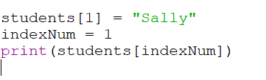
How are lists are used
The index number can be stored in a variable before use
The code below will print the name Sally
This is one of the great advantages to using lists

Slide 9
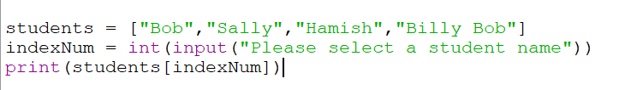
How are lists used
We can use this power to select an individual element from our list while the program is running
The following code allows the user to print a name from the list of students

Slide 10
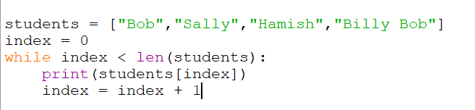
Accessing list elements using loops
Since we can use a variable as an index, we can access each element of our list by using a loop with a counter variable
The following code will print our entire list of students one at a time

Slide 11

Accessing list elements using loops
Count-controlled loops are particularly suited for accessing elements elements
The following code accesses each element in the students list using a count-controlled loop

Slide 12
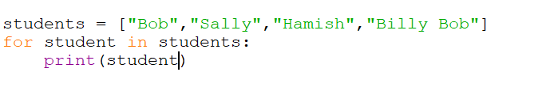
Accessing list elements using loops
Since loops are so handy in accessing list elements, many programming languages have a special loop structure called a for each loop specifically designed for accessing list elements
The following code accesses each element of the students list and assigns it to the student variable

Slide 13
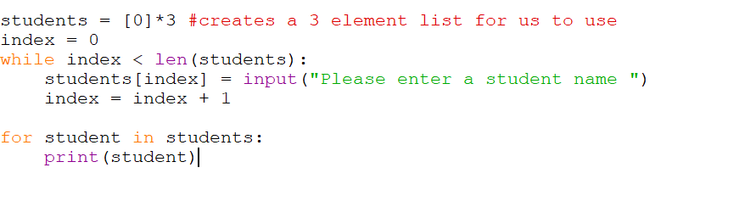
Accessing list elements using loops
We can also add data to our array at runtime using loops
The following code allows the user to enter three names in a while loop and then prints them to the screen

Slide 14
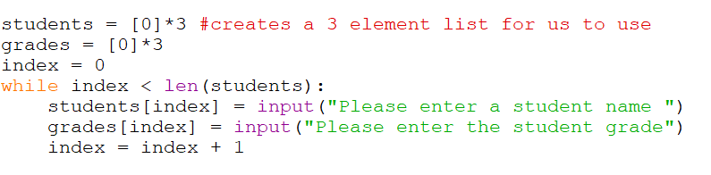
Parallel lists
We can also store related data in a second list and relate them by index. This is known as parallel lists.
This parallel lists example shows students and grades. For example, grade[0] will be the grade for student[0], grade[1] will be the grade for student[1], etc.

Slide 15
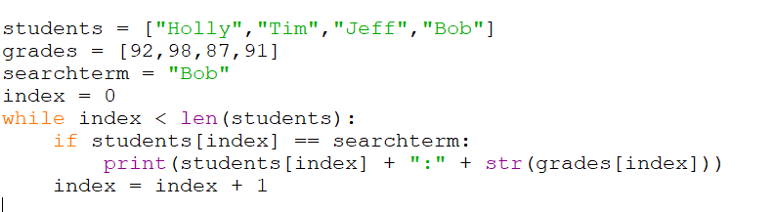
Searching lists
The simplest method for searching a list is the sequential search
In this method, we iterate through our list and compare our search term with each element
The following code searches for the name Bob and outputs the name and grade

Slide 16
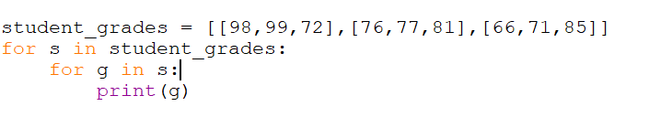
Multi-dimensional lists
Lists can have more than on dimension.
In our grades example, we can use a multi-dimensional list. The row corresponds to individual students and the columns would correspond to individual assignments
We can access the individual elements using a nested loop

Slide 17
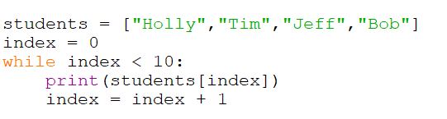
Potential errors
One possible error occurs if we attempt to read outside the range of the list
This can be avoided by bounds checking
The following code will generate an error because we are attempting to read more elements than are included in the list
Attempts to access elements that don’t exist

Slide 18
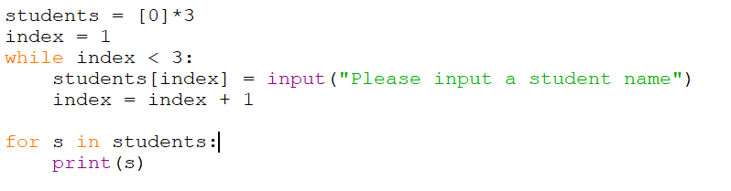
Potential errors
An off-by-one error occurs when our data is stored in the wrong element of the list
The following code generates an off-by-one error because the index begins at one instead of zero
Should begin with zero

Slide 19
How arrays typically store and access data internally
The elements in an array are stored in contiguous memory locations
The array variable stores the memory address that points to the beginning of the first element in the array.
If we declare an array as prices[10]; prices would hold the memory address of the first element in the array.
Many programming languages access the individual elements of the array by multiplying the arrays index by the size of the individual elements.
In this case, the size of a float is 4 bytes. If we wanted to access the prices[5], the program would multiply 5 * 4 to get us an offset of 20 bytes. It would then add 20 bytes to the memory address of prices to access the location of prices[5]

Slide 20
How arrays store and access data internally
0 | 1 | 2 | 3 | 4 | Out of bounds
10.00 | 19.99 | 12.99 | 13.29 | 17.00 | Unknown data
4 bytes | 4 bytes | 4 bytes | 4 bytes | 4 bytes
4 * 0 = 0 | 4 * 1 = 4 | 4 * 2 = 8 | 4 * 3 = 12 | 4 * 4 = 16 | 4 * 5 = 20
The memory address of the beginning of the prices array
To locate the element at index 3, we would add 12 bytes to the memory address at the beginning of the prices array.

Slide 21
Let’s Code!

