Slide 1
JBoss Fuse Service Works
Loosely coupled,
Reusable
& Interoperable
    Simplify Integration and focus on business innovation
Bernard Tison & Luc Pierson
Solutions Architects
Aug 2014

Slide 2
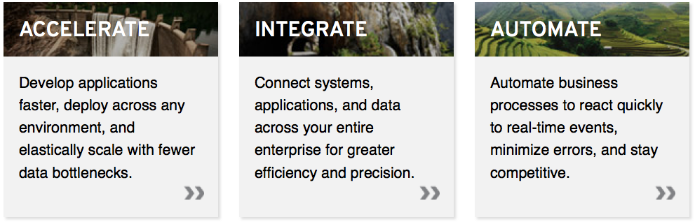
Innovate faster, in a smarter way
A family of a lightweight, enterprise-grade products that are ideal for open hybrid cloud environments.
Red Hat JBoss Fuse Service Works

Slide 3
Innovate faster, in a smarter way
REAL
TIME
AVOID
COMPLEXITY
INTEGRATE
A family of a lightweight, enterprise-grade products that are ideal for open hybrid cloud environments.
SERVICE
ORIENTATION
CONNECT
TO EVERYTHING
AMQ
MULTI
PROTOCOL
ESB
ROUTE
MESSAGES
RULES
SCA
BPMN
SUPPORT
CAMEL
TRANSFORM
Red Hat JBoss Fuse Service Works
Develop Run Govern

Slide 4
Fuse Service Works
DEMO
Imagine : Electric / Telephony
network supplier-distributor
Today : one (or many) HelpDesk opens tickets & send recaps to the supplier (every hour)
Very soon : ability to catch real-time information sent by customer trough the
internet user portal
ASAP : catch other type of information, listen on
new customer related media

Slide 5
ASAP : add NEW customer related media
BUSINESS IT
New marketing capabilities quicky in place
keep customer contact whatever situation
Silent information track down
Multi canal with new Twitter/facebook possibilities
Business Monitoring
Reuse,
Integrate,
Simplify,
Multi components
Track customers who claim a problem
through 2 or more channels !
=> population known to be at risk to be lost
example

Slide 6

Today
HeplDesk platform
Actual process
batch / poorly realTime
Interfaces include in the code
file
Mail
XLS
CSV
eMail
Actions
Action
File
C R M App

Slide 7


On Going (soon on production)
HeplDesk platform
Actual process
batch / poorly realTime
Interfaces include in the code
file
Mail
XLS
CSV
Batch
eMail
Actions
Action
File
Customer
Portal
Real-TIme
Business Services
Platform
eMail
Actions
Action
DB
C R M App

Slide 8

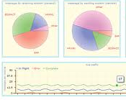
ASAP !
HeplDesk platform
XLS
CSV
New integration service Layer
Multi-component
Intelligent ( rule assisted )
last hour claim
File
To print
Mail
Cust
Portal
eMail
Web service
Twitter
@XX !!!! my #Service Down
Actions
Action
DB
@angry_claim
Monitoring
C R M App
BAM

Slide 9

Future
HeplDesk platform
XLS
CSV
Extract lines
file
Mail
Rule
Depending
eMail
Cust
Portal
WS
Check
CRM
Tweet
back
Web service
V
E
R
I
F
Y
+ Get ZipCode
+ Full Name
Feed actions DB
TW
Actions
Action
DB
@angry_claim
BAM
C R M App

Slide 10
And now....
Play with the demo !!!
Send 1 Tweet to @angry_claim
with #cable or #internet or #tel
Exemple :
@angry_claim my #cable is down. Come with your candle !

Slide 11
JBoss Fuse Service WORKS
ANGRY CLAIM
Demo Installation
Authors
Bernard TISON & Luc Pierson
Red Hat
August 2014

Slide 12
All explanations are located in GITHUB :
https://github.com/lucpierson/AngryClaim
STEP1
create a twitter account and App
- create the twitter account
- download and connect with your account on Mobile device
- create a twitter app on https://dev.twitter.com/
create a Gmail account
Download required apps
jboss-bpms-6.0.0.GA-redhat-1-deployable-eap6.x.zip
jboss-eap-6.1.1.zip
jboss-fsw-installer-6.0.0.GA-redhat-4.jar
twitter4j-core-3.0.5.jar
twitter4j-stream-3.0.5.jar
option : Jboss Developper Studio 7.0.0

Slide 13
All explanations are located in GITHUB :
STEP2
https://github.com/lucpierson/AngryClaim
in your new RHEL 6.4 Virtual Machine
  install maven
    sudo wget http://repos.fedorapeople.org/repos/dchen/apache-maven/epel-apache-maven.repo -O /etc/yum.repos.d/epel-apache-maven.repo
    sudo yum install apache-maven
    sudo mkdir /usr/share/apache-maven/conf/logging
    create a file in /etc/profile.d/maven.sh
  install git
    sudo yum install git
  install mysql (server and connector)
    sudo yum install mysql-server
    sudo yum install mysql-connector-java
    sudo chkconfig mysqld on
# update path with maven link
if ! echo ${PATH} | /bin/grep -q /usr/share/apache-maven/bin ;
then
PATH=/usr/share/apache-maven/bin:${PATH}
fi

Slide 14
All explanations are located in GITHUB :
STEP3
https://github.com/lucpierson/AngryClaim
in your new RHEL 6.4 Virtual Machine
  from your home
    execute git clone https://github.com/lucpierson/AngryClaim.git
    place your downloaded apps in folder ~/AngryClaim/installs
    update init.sh with your twitter and gmail credentials
    run ~/AngryClaim/init.sh
      manual/run instructions generated in ~/AngryClaim/readme.txt

Slide 15
All explanations are located in GITHUB :
https://github.com/lucpierson/AngryClaim
STEP4
Start FSW : ~/AngryClaim/FSW_Launch.sh
Start BPMS : ~/AngryClaim/BAM_Launch.sh
Launch FireFox
  connect on the dashboard
    http://localhost:18080/dashbuilder/index.jsp (admin / redhat123@)
  and install the AngryClaim dashboard
    Step 1 : create jndi externalConnection
    name : AngryClaimDB
    jndi : java:jboss/datasources/AngryTweetDS
    Step 2 : create 2 dataProviders
    AngryClaimTickets
    AngryClaimVeryAngryUsers
    Step 3 : import the dashboard for ~/AngryClaim/etc/BAM/xxx.cex
select * from ticket order by channel_in
select customer, area_code,compteur from( select customer, area_code, count(*) as compteur from (select customer,area_code, urgent from ( select customer, channel_in, area_code, urgent from angrytweet.ticket group by customer,channel_in order by customer, channel_in) AS T) as T2 group by customer) as T3 where compteur>1;

Slide 16
Running the Demo
https://github.com/lucpierson/AngryClaim
RUN 1
Run Instructions are in ~/AngryClaim/readme.txt
value the CRM with known users (restart of FSW required)
  in : ~/AngryClaim/target_fsw/jboss-eap-6.1/standalone/configuration/crm.properties
Feed the server with a CSV file
  putting the CSV file into ~/AngryClaim/etc/csv/demo
Feed the server with a WebService (push only, Portal simulation)
  http://localhost:8080/ticketservice/TicketService?wsdl
  or Load project from : ~/AngryClaim/etc/soapui
Feed with Twitter
  send a tweet your own @xxx containing #ticket or #cable or #tel
see the BAM Dashboard
  http://localhost:18080/dashbuilder/workspace/en/
show the rows
  mysql -u jboss -pjboss -h localhost -e"select * from angrytweet.ticket;"
  mysql -u jboss -pjboss -h localhost -e"select * from angrytweet.ticket_error;"

Slide 17
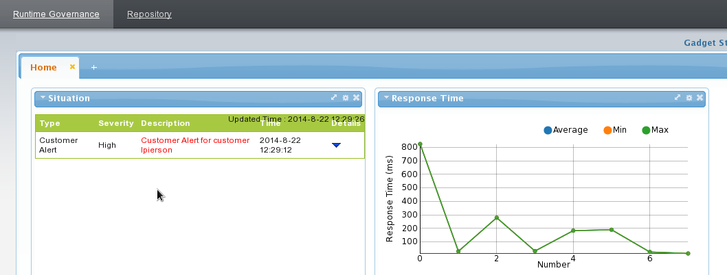
Running the Demo - RTGOV
https://github.com/lucpierson/AngryClaim
RUN 2
Run Instructions are in ~/AngryClaim/readme.txt
In a short period of time, send 2 requests with 2 different channels with same user
  For example with soapUI and with a prepared CSV
Check http://localhost:8080/gadget-web

Slide 18
Running the Demo
https://github.com/lucpierson/AngryClaim
Devel
Download, Install and run JBoss Studio
  java -jar jbdevstudio-product-universal-7.0.0.GA-v20130720-0044-B364.jar
Install extra integration features
  about => software install
  https://devstudio.jboss.com/updates/7.0/integration-stack/
in menu Windows/preferences/xml/XML FIlES
  uncheck "HONOUR ALL xxxxx"
Import from existing maven project
  Location : ~/AngryClaim
  select the 4 pom.xml
Select projet switchyard,
  right clic => maven => updateProject
And remember
to have
FUN !

Slide 19
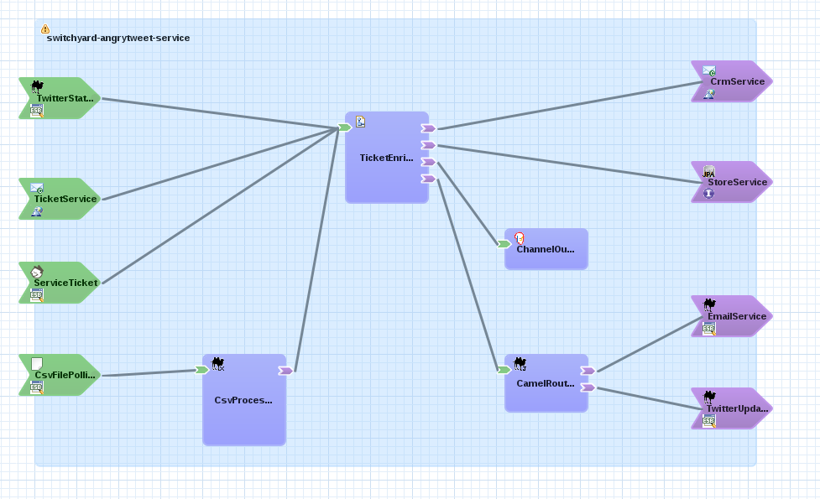
Running the Demo – Add REST binding
https://github.com/lucpierson/AngryClaim
Devel 2
Instructions are in ~/AngryClaim/etc/rest/AddRestBinding.html

Slide 20

High level Arch and demo input
    http://localhost:8080/s-ramp-ui/
    (fswAdmin / AngryCla1!m)
JBoss Fuse SW
  ~/AngryClaim/etc/csv/demo
RT-GOV
CSV
    http://localhost:18080/dashbuilder/index.jsp (admin / redhat123@)
BAM
Web service
http://localhost:8080/ticketservice/TicketService?wsdl
Twitter
JBoss BPMS - BAM
@angry_claim mon #cable
est HS. Venez avec vos bougies !
JBoss EAP
JBoss EAP
AngryClaim
Tickets
and errors
  mysql -u jboss -pjboss -h localhost -e"select * from angrytweet.ticket;"
  mysql -u jboss -pjboss -h localhost -e"select * from angrytweet.ticket_error;"
~/AngryClaim/target_fsw/jboss-eap-6.1
/standalone/configuration/crm.properties
CRM

Slide 21
BACKUP

Slide 22
CSV
CSV Process
XML
Print + send
Rule
eMail
Web service
WS
Check
Twit
?
FeedAction
Twitter
TW
Actions
Actions
DB
BAM
FSW + Polymeta (dashboard.war)
Based on EAP
Mock
Service

Slide 23

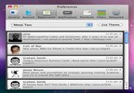
1
CSV
XML
CSV Process
XML
ToPrintXML
FileSender
Print + send
Send
Rule
eMail
2
eMailSender
Web service
WS
Check
TweetSender
Twit
?
3
Feed Action
DataBase
Twitter
TW
Actions
Actions
DB
BAM
Polymeta
FSW + Polymeta (dashboard.war)
Based on EAP
Mock
service

Slide 24
Story 1 - XLS/CSV
Montrer 1 fichier CSV avec libreOffice, positionner ce fichier dans 1 repertoire
Le fichier est traité par FSW ,
  Chaque ligne est transformée en 1 flux (vu dans la log), route camel
vers tronc commun

Slide 25
Story 2 : Web Service
Le Composant s’expose en WebService, structure simple
    ID_Client, code string max 30 car
    Urgence (num, entre 1 et 3)
Avec SoapUI, visualisation du webService, alimentation
    Avec ID_Client qui commence par @
    Avec ID_Client de type eMAIL
    Avec ID_Client sans @
WS : Java Bean,
  vérification que ID_Client et Urgence sont alimentés,
  Formatage pour alimenter Tronc Commun
Tronc commun

Slide 26
Story 3 : TWITTER
Des messages Twitter sont emis, de type
  @provider !!!! my #ServiceIsDown. Please HELP
Pull des messages twitter sur @provider et #ServiceIsDown.
  Création de flux avec ID_Client == emetteur, urgence = 1 si tweet contient mot “please” (2 sinon)
  Formatage pour alimenter Tronc Commun
Tronc commun

Slide 27
Tronc commun de traitement
CHECK (Java Bean)
  Si zipCode absent, chercher dans le MOCK service (webService ?) ZipCode en fonction de l’ID_Client dans CRM,
      si ID_Client non trouvé, retourner 99999
      Sinon, alimenter zipCode et Nom
  Alimenter Type Relation
      si ID_Client commence par @, relation == “T”
      sinon, si ID_Client contient @, relation == “E”
      sinon, relation == “R”
Feed Action DB(java Bean)
  JDBC insert into Action table : (id_client, urgence, nom, zipcode, code relation)
Send Rule
  - if Twitt, twit back, otherwise, if email known, email, otherwise, regular mail (produce XML file)
TweetSender
  Si zipCode == 99999, twitter “@ID_CLIENT, désolé, nous ne pouvons vous localiser, merci de nous conacter par tel”
  Sinon, twiter “@ID_CLIENT, Nous sommes en cours d’intervention sur votre commune, vous serez informés en temsp reel”
EmailSender
  Idem TWEET
ToPrintXMLFileSender
  Bla bla dans 1 fichier XML (schema idem table Action) ou autre format lisible
Le BAM (polymeta) est connecté sur ActionsDB avec les infos,
  F5 sur la console BAM connectée pour rafraichir et visualiser
  si possible Pouvoir faire 1 select * sur la table pour montrer le contenu

Slide 28
Format CSV et table relationnelle
Fichier CSV
URGENCE (1=MAX),
value 1, 2 ou 3
ID_Client | Urgence | Nom
@luc | 1 | Luc pierson
01892 | 2 | Noel Rocher
BT@rh.com | 3 | Bernard Tison
@gabriel | 1 | Tino ROSSI
TypeRelation
T = TWITTER
E = eMail
R = Regular Mail (produire XML en file)
Formats d’échange entre Composants + Formats Table relationnelle pour Action et BAM
ID_Client | Urgence | Nom | ZipCode | Type Relation
@luc | 1 | Luc pierson | 17500 | T
01892 | 2 | Noel Rocher | 75010 | R
BT@rh.com | 3 | Bernard Tison | 92800 | E
@gabriel | 1 |  | 99999 | T

