Slide 1


Illustrate OpenShift usage for presentation
1 – User requests OpenShift a container creation
1 - request
User / operator
OpenShift Platform (Broker)
Where ever they are, in the Cloud powered by OpenShift online
Notes:
What's the solution? A comprehensive integration platform is required to connect all enterprise assets from on-premise packaged apps, on-premise data sources, to new cloud-based SaaS applications & data and devices such as mobile device, the web, delivery vehicles, and sensors.Today's market demands: lightweight, cost effective, agile,and lean integration methods and capabilities. Organizations need a platform that enables them to implement a modern and lightweight architecture using only the features they want and also the flexibility to introduce other features as required.

Slide 2

Illustrate OpenShift usage for presentation
2 – OpenShift retrieves the slideShow App Template
2
get
template
Application
Templates
repo
1 - request
User / operator
OpenShift Platform (Broker)
Where ever they are, in the Cloud powered by OpenShift online
Notes:
What's the solution? A comprehensive integration platform is required to connect all enterprise assets from on-premise packaged apps, on-premise data sources, to new cloud-based SaaS applications & data and devices such as mobile device, the web, delivery vehicles, and sensors.Today's market demands: lightweight, cost effective, agile,and lean integration methods and capabilities. Organizations need a platform that enables them to implement a modern and lightweight architecture using only the features they want and also the flexibility to introduce other features as required.

Slide 3
Illustrate OpenShift usage for presentation
3 – OpenShift instantiates the template as an app
2
get
template
Application
Templates
repo
1 - request
User / operator
OpenShift Platform (Broker)
3
Instantiate
Application
Where ever they are, in the Cloud powered by OpenShift online
Notes:
What's the solution? A comprehensive integration platform is required to connect all enterprise assets from on-premise packaged apps, on-premise data sources, to new cloud-based SaaS applications & data and devices such as mobile device, the web, delivery vehicles, and sensors.Today's market demands: lightweight, cost effective, agile,and lean integration methods and capabilities. Organizations need a platform that enables them to implement a modern and lightweight architecture using only the features they want and also the flexibility to introduce other features as required.

Slide 4

Illustrate OpenShift usage for presentation
4 – User launches the application
2
get
template
Application
Templates
repo
1 - request
User / operator
OpenShift Platform (Broker)
3
Instantiate
App User
4 – Launch application
Application
Where ever they are, in the Cloud powered by OpenShift online
Notes:
What's the solution? A comprehensive integration platform is required to connect all enterprise assets from on-premise packaged apps, on-premise data sources, to new cloud-based SaaS applications & data and devices such as mobile device, the web, delivery vehicles, and sensors.Today's market demands: lightweight, cost effective, agile,and lean integration methods and capabilities. Organizations need a platform that enables them to implement a modern and lightweight architecture using only the features they want and also the flexibility to introduce other features as required.

Slide 5
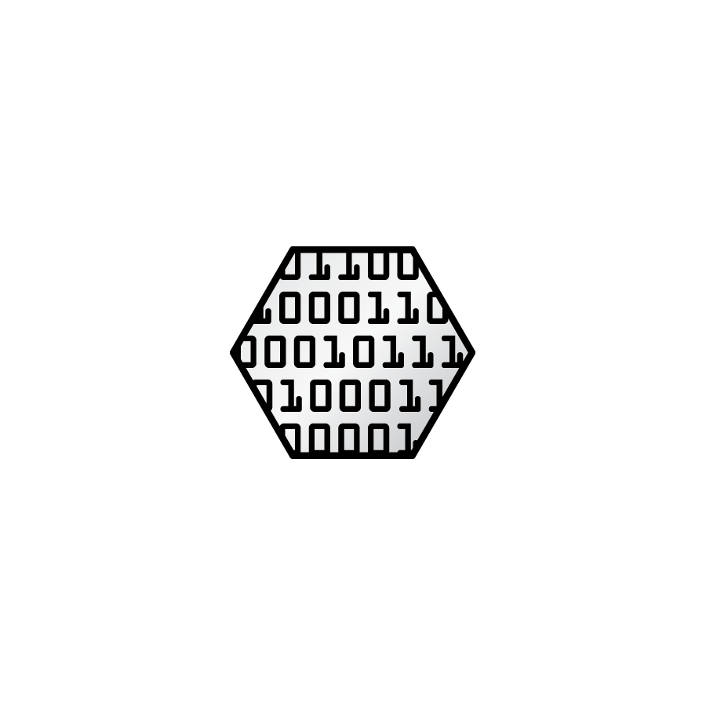
Illustrate OpenShift usage for presentation
5 – upon user request, app uploads the presentation
2
get
template
Application
Templates
repo
1 - request
User / operator
OpenShift Platform (Broker)
3
Instantiate
App User
Application
4 – Launch application
5 – upload
Presentation
Presentation
Where ever they are, in the Cloud powered by OpenShift online
Notes:
What's the solution? A comprehensive integration platform is required to connect all enterprise assets from on-premise packaged apps, on-premise data sources, to new cloud-based SaaS applications & data and devices such as mobile device, the web, delivery vehicles, and sensors.Today's market demands: lightweight, cost effective, agile,and lean integration methods and capabilities. Organizations need a platform that enables them to implement a modern and lightweight architecture using only the features they want and also the flexibility to introduce other features as required.

Slide 6
Illustrate OpenShift usage for presentation
6 – User starts the slideshow
2
get
template
Application
Templates
repo
1 - request
User / operator
OpenShift Platform (Broker)
3
Instantiate
App User
4 – Launch application
Application
6 – Present
5 – upload
Presentation
Presentation
Where ever they are, in the Cloud powered by OpenShift online
Notes:
What's the solution? A comprehensive integration platform is required to connect all enterprise assets from on-premise packaged apps, on-premise data sources, to new cloud-based SaaS applications & data and devices such as mobile device, the web, delivery vehicles, and sensors.Today's market demands: lightweight, cost effective, agile,and lean integration methods and capabilities. Organizations need a platform that enables them to implement a modern and lightweight architecture using only the features they want and also the flexibility to introduce other features as required.

Slide 8
Illustrate OpenShift usage for presentation
1 – demand the openshift container creation
2
get
template
Application
Templates
repo
1 - request
User / operator
OpenShift Platform (Broker)
3
Instantiate
App User
4 – Launch application
Application
6 – Present
5 – upload
Presentation
Presentation
Where ever they are, in the Cloud powered by OpenShift online
Notes:
What's the solution? A comprehensive integration platform is required to connect all enterprise assets from on-premise packaged apps, on-premise data sources, to new cloud-based SaaS applications & data and devices such as mobile device, the web, delivery vehicles, and sensors.Today's market demands: lightweight, cost effective, agile,and lean integration methods and capabilities. Organizations need a platform that enables them to implement a modern and lightweight architecture using only the features they want and also the flexibility to introduce other features as required.

