Slide 1

GOLANG
COMP471

Slide 2

Background
Officially open sourced in 2009 as Go
Created to take advantage of multiprocessors meteoric rise for concurrency
Programmers from Google started the project
Three generic goals
Enable more tools for programmers
Automate mundane formatting
Removing obstacles for large code bases

Slide 3
rationale
Competes with C++ and outclasses Java on speed and ease of use versus Python
Google still uses Go as well as:
Bitbucket, Adobe, Alaska Airlines, Riot Games, Slack, Stack Exchange, Twitter, Twitch, Netflix, Imgur, IBM, Fetch Rewards…
Heavy use of pointers and memory allocation tools
Automatic GC
Channels are functionalty to create concurrency

Slide 4
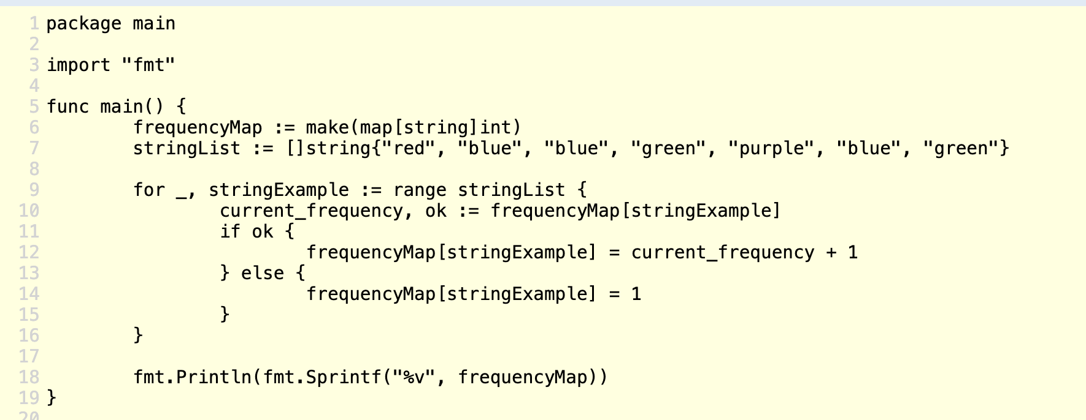
Code sample

Slide 5
Classification – What GO has
Syntactic Consistency: Len() method works on strings, arrays, and maps
Defense in Depth: The ; ok pattern allows easy error handling and frequent validations
Portable and Compilable: Can compile binaries for a specific target with just one variable
Built-in commands: Go build, install, test, fmt, mod clean
Structure: As one example, Go disallows
{
brackets on their own line
}

Slide 6

Classification – What Go isn’t
Abstraction: Go has no generics on purpose to support simplicity and fast executables, instead can use nested objects
Strictly Object-Oriented: No type hierarchy makes the objects in Go lightweight and allows a more pythonic style
Functional: Objects are meant to be created, updated, deleted by GC often. No foldLeft here!

Slide 7
When should I use go?
Microservices
Looking to Pivot from Java
Benefits from Concurrency
Quick Spin Up Time

Slide 8
Key Go commands
Make
Slice
Defer
Panic

Slide 9
Evaluation 31 / 35 88%
Readability: 4/5
Writability/Productivity: 3/5
Reliability: 5/5
Cost: 4/5
Community: 5/5
Ecosystem: 5/5
Coolness: 5/5

Slide 10
Conclusion
Go is rising in popularity – ranked 3rd in languages StackOverflow’s most wanted languages to learn and for good reason!
Useful for most applications, optimal for microservices over enterprise systems
Low skill floor with a very high skill ceiling
Will take questions before I go

Slide 11
Sources
https://medium.com/hackernoon/why-go-doesnt-have-generics-b40ef9e69833
http://lucproglangcourse.github.io/principles.html
https://meritocracy.is/blog/2021/04/06/golang-why-you-should-learn-go-in-2021/

