Slide 1
FORTRAN
Mshari Ghabban and Ryan Hasler

Slide 2
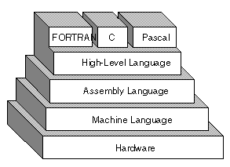
Background and Rationale
FORTRAN stands for FORmula TRANslation
Primarily used in scientific computing
Created in 1954 by John Backus and a team of IBM employees
Released commercially in 1957
Rationale behind it's development?
Writing programs in first and second generation programming languages took a significant amount of time
The readability/writability of FORTRAN was believed to make the development process faster (it did)
3rd
2nd
1st
figure 0.1

Slide 3
History of Releases
FORTRAN II (1958)
Added subroutines and functions
Data types included: Integer, Real, Complex, and Double Precision
FORTRAN IV (1962)
Removed machine-dependent features that made code unportable from machine to machine
Added new features: Logical data type, boolean expressions, logical IF statement
FORTRAN 66 (1966)
The first version of FORTRAN that was defined by a formal standard by ASA now ANSI
Largely based on FORTRAN IV
FORTRAN 90 (1991)
Introduced inline comments, recursive procedures, structured data types, dynamic memory allocation, pointer attribute, and pointer assignment
FORTRAN 2008 (2010)
Standardized Coarray Fortran - a parallel execution model for arrays

Slide 4
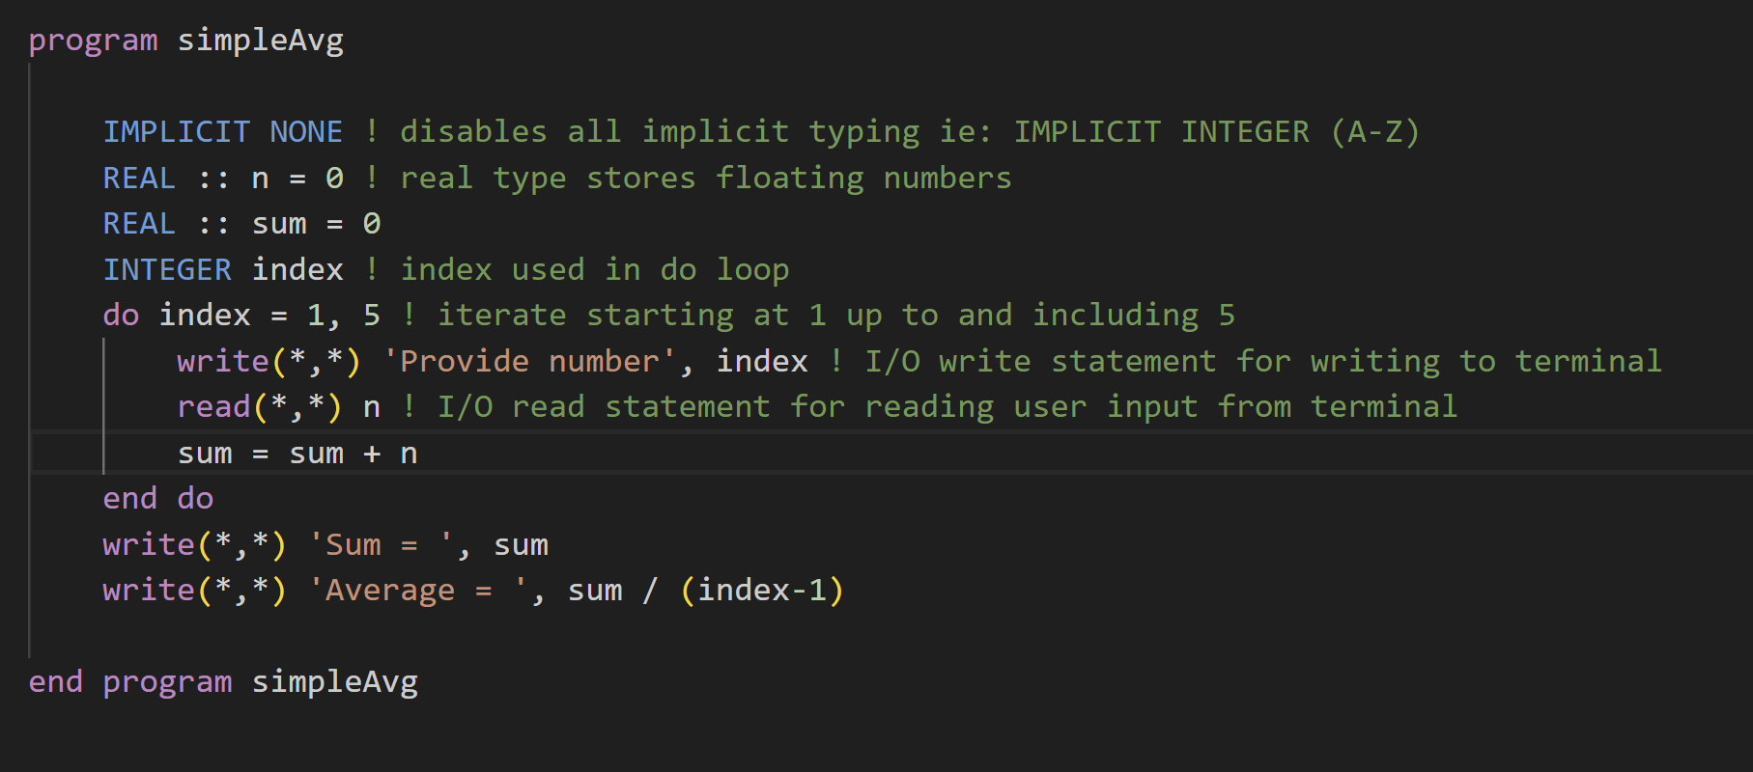
Code Sample and Live Demo

Slide 5
Classification and Taxonomy
Early releases of FORTRAN
Fortran is primarily an imperative programming language in which one explicitly writes a series of statements that change the program’s state.
Procedural programming- In Fortran you can define subroutines and functions to perform tasks and manipulate data.
Later releases of FORTRAN
Later versions of Fortran enable more structured programming, many control structures were introduced in Fortran 90.
Concurrent programming- Fortran 2008 standardized Coarray Fortran
Object-oriented programming- OOP paradigm was introduced in Fortran 2003
Functional programming- Not really

Slide 6
Language Design Principles
Abstraction:
-Fortran has always historically been a language that focused on procedural abstraction, allowing users to capture specific tasks computations.
-Modern Fortran versions introduced more advanced data abstraction allowing users to define complex data structures.
Security:
Fortran does have security issues, but it is less than other languages like C, the language has made strides in type safety and memory management in its newer versions.
Structure:
The evolution of Fortran overtime has shown a transition from a language with limited constructs to one that supports evolution.

Slide 7
Evaluation
Readability:
-Modern versions of Fortran are straightforward and readable.
-Language is less cluttered while using special symbols in comparison to languages like C, C++…
Writability/Productivity:
-Modern Fortran introduced array operations and data structures which is helpful and positive for writability/productivity.
-The readability/writability of Fortran was believed to make the development process faster and was originally designed for numerical and scientific computation.
Reliability:
-Has been used for critical applications for years indicating major trust and reliability.

Slide 8
Evaluation pt.2
Cost:
-Many open-source Fortran compilers are available like GNU Fortran Compiler and Intel oneAPI.
-Considering the longevity of the language there are many resources and experts available.
Ecosystem:
-Many libraries and tools have been added over time.
-collaboration and integration with other languages is accessible benefiting the ecosystem.

Slide 9
Conclusion
Pros:
-Made code comprehensible to people with expertise in fields other than computing, opening programming to mathematicians and scientists.
-Fortran can interoperate with other languages, especially C and C++.
-Being one of the oldest programming language proves the reliability and longevity of Fortran.
Cons:
-Older versions of Fortran had some features that could lead to bugs, but the issues have been addressed.
-Compared to more recent languages, Fortran's ecosystem can be viewed as less cool and vibrant.

Slide 10
Resources
https://www.britannica.com/technology/FORTRAN
https://www.webopedia.com/definitions/machine-language/ (figure 0.1)
https://www.youtube.com/watch?v=RrsoM6wVEWE&ab_channel=SayanPanda
(fortran compiler installation)
https://fortranwiki.org/fortran/show/HomePage
https://web.stanford.edu/class/me200c/tutorial_90/09_modules.html

Slide 11
Thanks!
-Any Question?

