Slide 1
Classification using Neural Network: Basketball vs Football Players
Luc Rulinda
12/6/2021

Slide 2
Task at hand:
Designing a neural network that classifies various points in two categories using M- dimensional feature vectors.

Slide 3
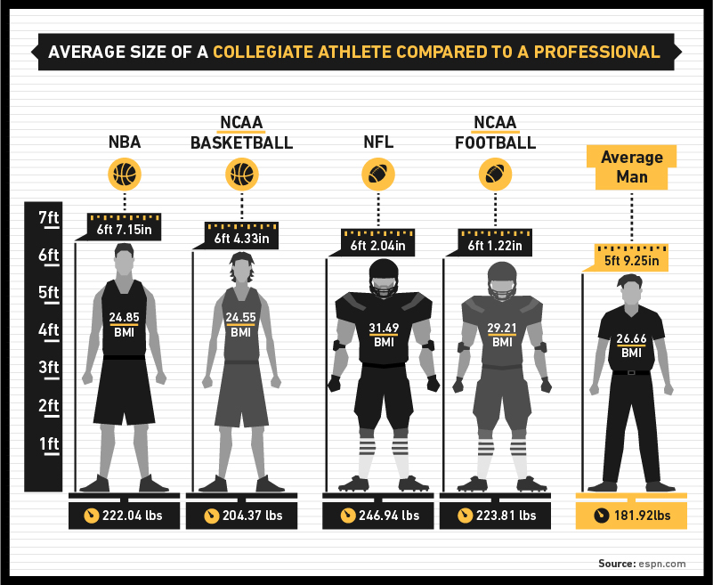
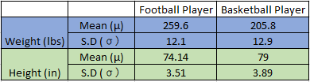
Data used
2 categories: Basketball players and Football players
Feature vectors: height, weight and BMI ( Ref: Sports Encyclopedia of Pro Football and Official NBA basketball Encyclopedia)
Normal distribution of points

Slide 4
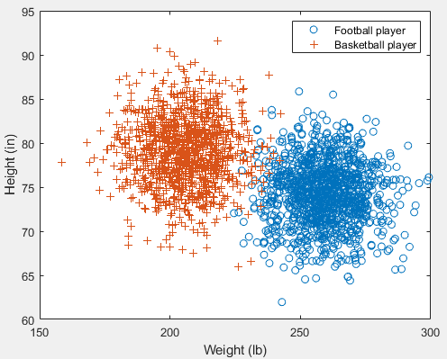
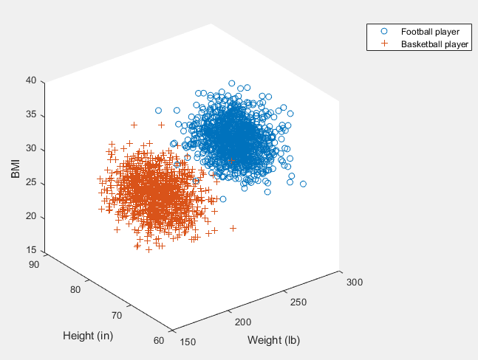
M-dimensional feature vectors (2D vs 3D)

Slide 5
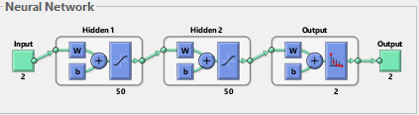
Training the neural network
“Patternet” function in Matlab
Returns a pattern recognition networks (feedforward network) that can be trained to classify inputs according to target classes.
Training function: “traingdx”- Variable Learn.Gradient descent
Performance function: “crossentropy”

Slide 6
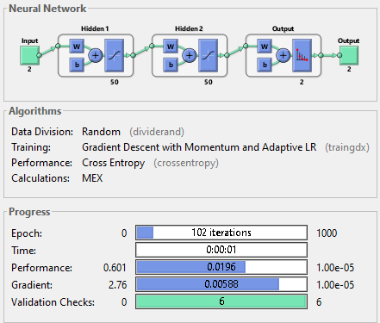
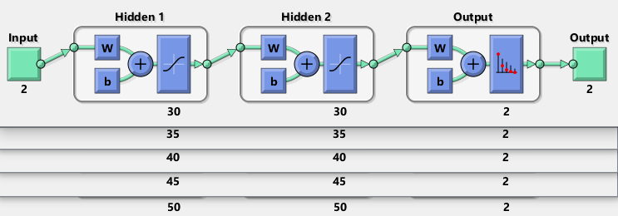
Experimenting with various number of neurons:

Slide 7
Experimenting with multiple hidden layers

Slide 8
M-dimensional feature vectors (2D vs 3D)

Slide 9
Performance and Accuracy (2 D vs 3D)
Observation: Higher performance in 2D feature vectors
Observation: Higher accuracy in 3D feature vectors

Slide 10
Learning rate

Slide 11
Thank you for your time!

