Slide 1
SIMD Introduction, Programming and Demos

Slide 2
SIMD History

Slide 3
1997 - MMX, Pentium with MMX, Multi-media Extended Instructions. 64bit vector
1999 - SSE, Pentium3, Streaming SIMD Extensions, 128bit vector
2000 - SSE2, Pentium 4
2004 - SSE3, Pentium4
2007 - SSE4, Nehalem，SSE4.1 and SSE4.2
2008 - AVX, Sandy Bridge, Advanced Vector Extensions, float operations to 256bit
2011 - AVX2, Haswell, int operations to 256bit, add FMA (fuse and multiply)
2013 - AVX3/512, Knights Landing co-chip, Skylake, extends to 512bit, new instr
No more AVX-1024 because CPU cache line width is 512bit

Slide 4
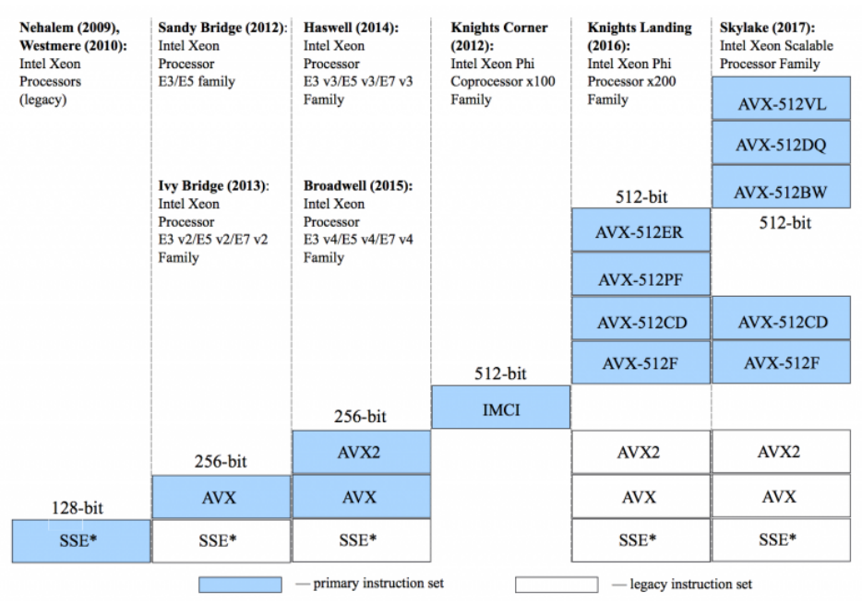
How Intel CPU supports SIMD - 2009-2017

Slide 5
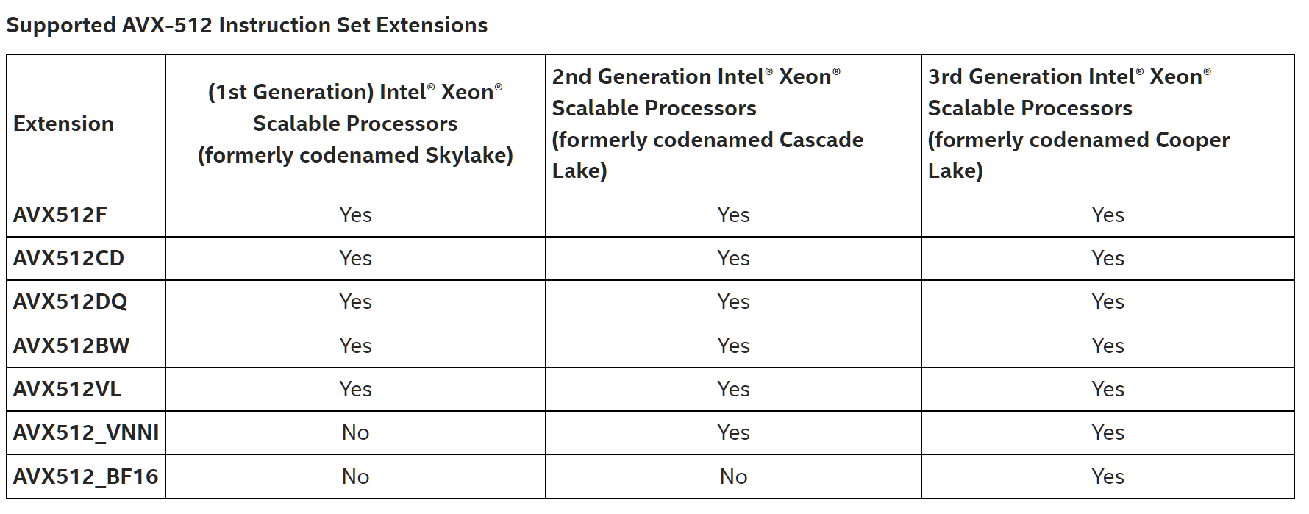
How Intel CPU supports SIMD - 2017-2021

Slide 6
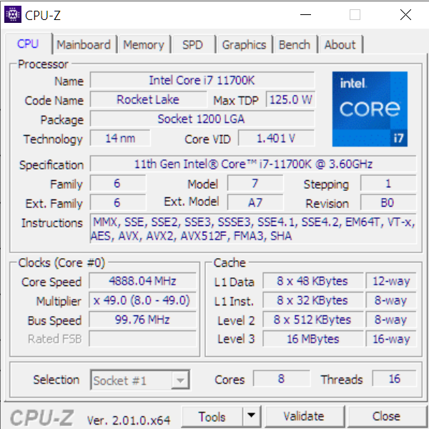
Check SIMD capability
$>lscpu
fpu vme de pse tsc msr pae mce cx8 apic sep mtrr pge mca cmov pat pse36 clflush dts acpi mmx fxsr sse sse2 ss ht tm pbe syscall nx pdpe1gb rdtscp lm constant_tsc art arch_perfmon pebs bts rep_good nopl xtopology nonstop_tsc cpuid aperfmperf pni pclmu lqdq dtes64 monitor ds_cpl vmx smx est tm2 ssse3 sdbg fma cx16 xtpr pdcm pcid dca sse4_1 sse4_2 x2apic movbe popcnt tsc_deadline_timer aes xsave avx f16c rdrand lahf_lm abm 3dnowprefetch cpuid_fault epb cat_l3 cdp_l3 invpcid_single ssbd mba ibrs ibpb stibp ibrs_enhanced tpr_shadow vnmi flexpriority ept vpid ept_ad fsgsbase tsc_adjust bmi1 avx2 smep bmi2 erms invpcid cqm mpx rdt_a avx512f avx512dq rdseed adx smap clflushopt clwb intel_pt avx512cd avx512bw avx512vl xsaveopt xsavec xgetbv1 xsaves cqm_llc cqm_occup_llc cqm_mbm_total cqm_mbm_local dtherm ida arat pln pts hwp hwp_act_window hwp_epp hwp_pkg_req pku ospke avx512_vnni md_clear flush_l1d arch_capabilities

Slide 7
SIMD Registers

Slide 8
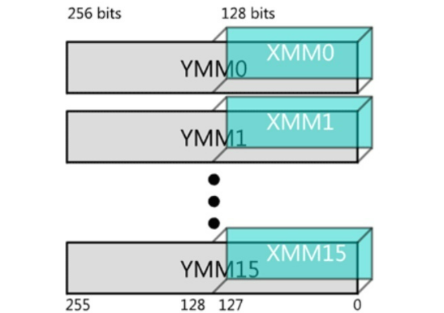
511 256 | 255 128 | 127 0
ZMM0 | YMM0 | XMM0
ZMM1 | YMM1 | XMM1
ZMM2 | YMM2 | XMM2
ZMM3 | YMM3 | XMM3
ZMM4 | YMM4 | XMM4
ZMM5 | YMM5 | XMM5
ZMM6 | YMM6 | XMM6
ZMM7 | YMM7 | XMM7
ZMM8 | YMM8 | XMM8
ZMM9 | YMM9 | XMM9
ZMM10 | YMM10 | XMM10
ZMM11 | YMM11 | XMM11
ZMM12 | YMM12 | XMM12
ZMM13 | YMM13 | XMM13
ZMM14 | YMM14 | XMM14
ZMM15 | YMM15 | XMM15
ZMM16 | YMM16 | XMM16
ZMM17 | YMM17 | XMM17
ZMM18 | YMM18 | XMM18
ZMM19 | YMM19 | XMM19
ZMM20 | YMM20 | XMM20
ZMM21 | YMM21 | XMM21
ZMM22 | YMM22 | XMM22
ZMM23 | YMM23 | XMM23
ZMM24 | YMM24 | XMM24
ZMM25 | YMM25 | XMM25
ZMM26 | YMM26 | XMM26
ZMM27 | YMM27 | XMM27
ZMM28 | YMM28 | XMM28
ZMM29 | YMM29 | XMM29
ZMM30 | YMM30 | XMM30
ZMM31 | YMM31 | XMM31
AVX512 increases to 2X width and 2X count

Slide 9
SSE
16 128bit registers - XMM*
Each XMM*: 4 32-bit float; 4 int, 2 double
AVX
16 256bit registers - YMM*
Add VEX prefix on SSE instructions for backward compliance
Each YMM*: 8 32-bit float; 8 int, 4 double
AVX512
32 512bit registers - ZMM*
Add EVEX prefix for backward compliance
Each ZMM*: 16 32-bit float; 16 int, 8 double

Slide 10
SIMD Instructions

Slide 11
AVX-512 指令分类
子集 | 缩写 | 应用
AVX512-F | Fundamental | 增加了AVX2的指令宽度
AVX512-CD | Conflict Detection | 确保循环中的数据无冲突后，实现循环计算的向量化（直方图计算）
AVX512-ER （仅Phi支持） | Exponential and Reciprocal | 计算2的指数、倒数、开方
AVX512-PF （仅Phi支持） | Prefetch | 实现向量计算的聚集和分散操作，从多个缓冲区中同时读取数据
AVX512-DQ | Double and Quad word | 新的32位和64位指令（数据转换）
AVX512-BW | Byte and word | AVX512-F中扩充了新的8位和16位指令，整数计算
AVX512-VL | Vector length | 扩展AVX512指令可以兼容128位的XMM计算器和256位的YMM寄存器。
AVX512-VNNI | Vector Neural Network Instructions | 实现神经网络计算常用的算法（乘加操作）
AVX512-BF16 | Bfloat16 Type float | 半浮点数计算（AI操作）

Slide 12

SIMD programming

Slide 13
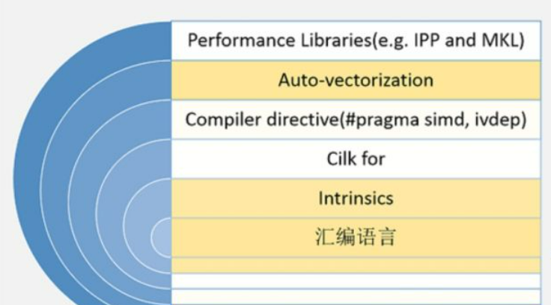
ASM
Manually write asm instructions
Intrinsics (recommended)
SIMD asm are wrapped into C/C++ APIs (intrinsic functions)
Compiler directives
Enforce vec the loop etc. in source code
Auto-vec
Mainstream compilers GCC/Clang/ICC auto vec the loop etc.
IPP(Intel Integrated Performance Primitives)
IPP functions are optimized by SIMD by Intel

Slide 14
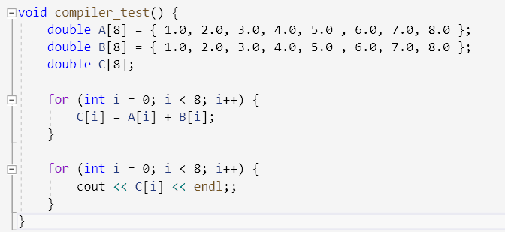
Quick sample: Add 2 double arrays

Slide 15
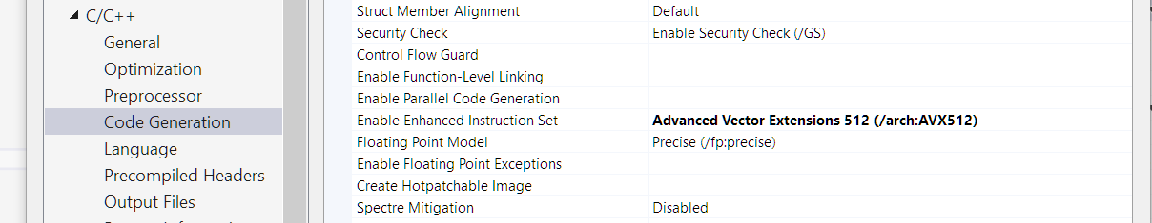
Auto Vec
On Windows:
On Linux GCC:
-O3 -march=skylake-avx512 -mprefer-vector-width=512 to enable AVX512
-mavx512f -mavx512cd -mavx512bw -mavx512dq -mavx512vl -mavx512ifma -mavx512vbmi choose what you want to enable which AVX512 subset

Slide 16
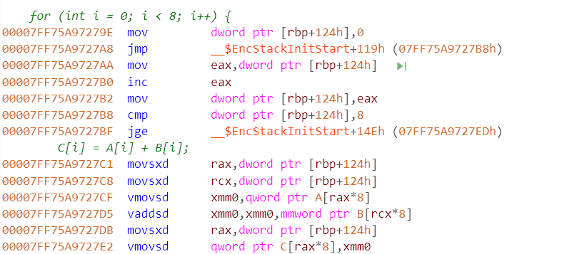
Add two double array
8 doubles in an array fills in 512 bits, fit one AVX512 register (zmm*) capacity
The result shows VS does not correctly generate AVX512 asm
Compiler not optimized for AVX512 may be an opt opportunity

Slide 17
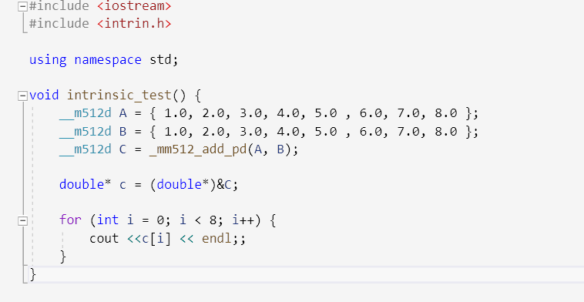
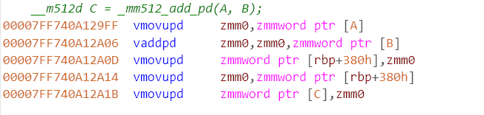
Use intrinsic
__m512_add_pd replace loop add on arrays
(512 bit packed add on double number)
Intrinsic works well

Slide 18
Header files
intrin.h | All Architectures
mmintrin.h | MMX
xmmintrin.h | SSE
emmintrin.h | SSE2
pmmintrin.h | SSE3
smmintrin.h | SSE4.1
nmmintrin.h | SSE4.2
immintrin.h | AVX
Preferred on Windows
Preferred on Linux

Slide 19
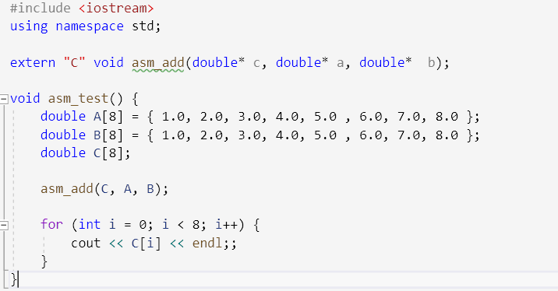
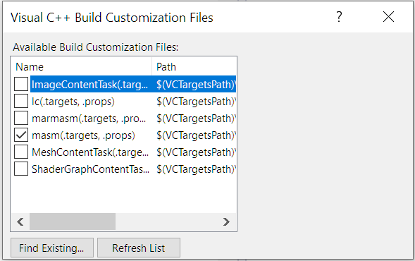
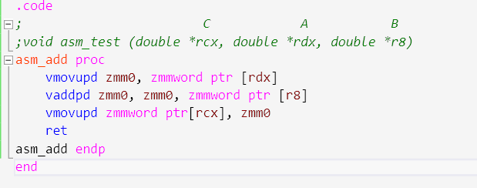
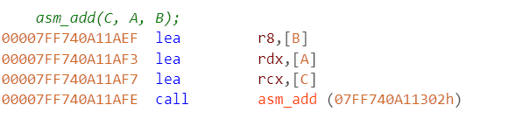
Use ASM
Add masm build dependency
Follow win X64 calling convention
Parameter seq: %rcx, %rdx, %r8, %r9
Follow Intel asm directions (move from right to left)
Caution: handwritten asm may slower than intrinsic

Slide 20
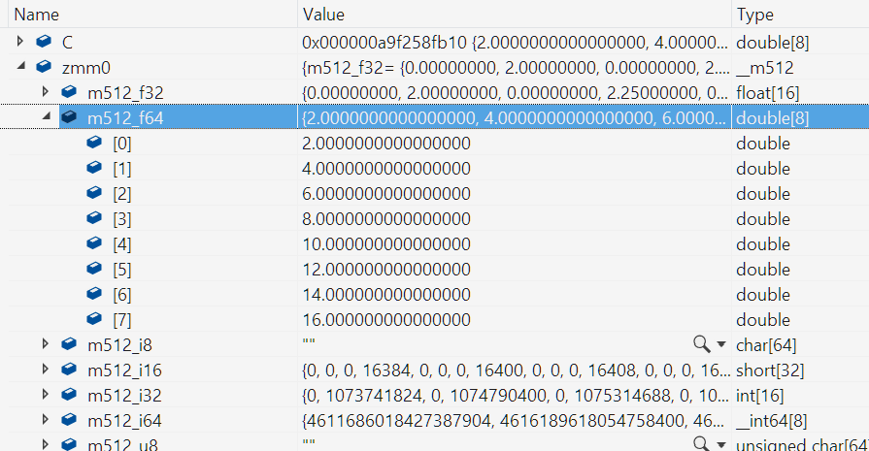
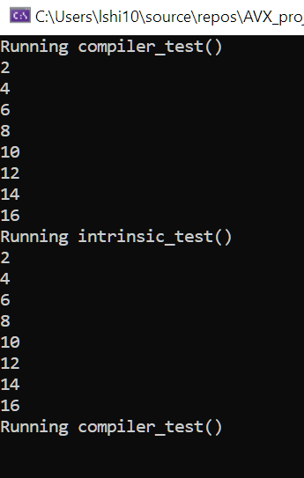
Zmm0 register value can be examined at runtime
Different types of AVX512 register are overlapped
Need manually check which data type (double) is used in current program

Slide 21
SIMD intrinsics

Slide 22
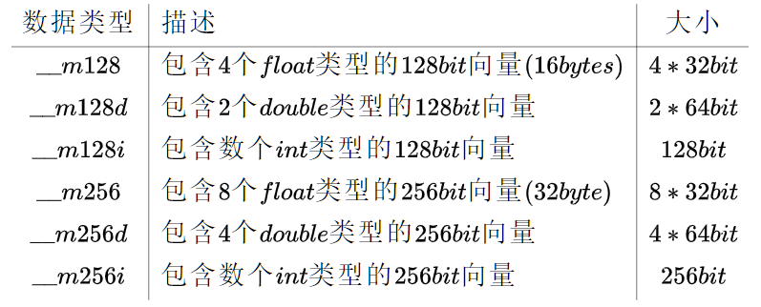
Data type
书写规则
__mBitsType
Bits
128 ： sse
256 ：avx
512：avx512
Type
无：float，一个float=32bit，自己除一下里面有几个
d：double，一个double=64bit，自己除一下里面有几个
i：int，根据int类型不同，个数也不同

Slide 23
API
书写规则: _mmBit_Name_PSType
Bit：256: AVX | 512: AVX512 | 省略: SSE
Name: add, sub, mov for float, adds, subs, movs for int
PS: p: packed vector | s: scalar | ep: int operation instead of float
Type: d: double | s: float | u16: unsigned 16bits int | i32: signed 32bits int
几个简单的例子：
_mm256_add_ps | AVX2 | Add two 8-float-vector
_mm256_add_ss | AVX2 | Add lowest 32bits-float (only 1 float, no vector)
_mm512_add_pd | AVX512 | Add two 8-double-vector
_mm_add_pd | SSE | Add two 2-double-vector
_mm256_adds_epi32 | AVX | Add two 8-int32-vector
_mm256_subs_epu16 | AVX | Sub two 16-unsigned-int16-vector

Slide 24
Commonly used intrinsics
SSE part

Slide 25
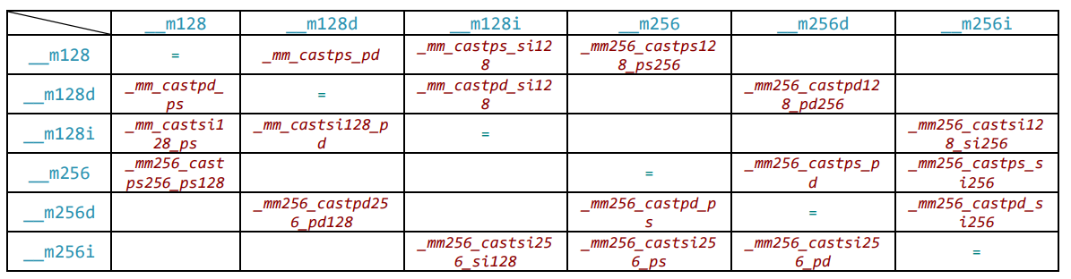
Type cast
Note:
Bit is needed for different width cast
Bit is always needed for int type (siBit)
SRC
DEST
Ref: http://const.me/articles/simd/simd.pdf

Slide 26
Note:
a: aligned move; n: unaligned move
s: single precision => 32b float
ss: first 32b
sd: first 64b
nt: non temporal = no cache
dq: double Quardword => 128b
si: integer
Load/Store
存取
intrinsic | instruction | usage
_mm_load_si128 | movdqa xmm0, m128 | Load 128b int（8个） to xmm0. Memory be aligned to 16 Byte
_mm512_load_ps | vmovaps zmm0, m512 | Load 512b float (16个) to zmm0. Memory must align to 64 Byte
_mm_loadu_si128 | movdqu xmm0, m128 | Load 128b int（8个） to xmm0. Memory no need to align
_mm512_loadu_ps | vmovups zmm0, m512 | Load 512b float (16个) to zmm0. Memory no need to align
_mm_load_ss | movss xmm0, m32 | Load 32b float (1个) to first single 32b lane of xmm0, other 96b are 0
_mm_load_sd | movsd xmm0, m64 | Load 64b double (1个) to first single 64b lane of xmm0, other 64b are 0
_mm_broadcast_i32x2 | vbroadcasti32x2 xmm0, xmm1 | Broadcast the lower two 32b int (64b total) to all lanes of xmm0 (2 replicas)
_mm512_broadcast_f64x2 | vbroadcastf64x2 zmm0, m128 | Broadcast the two double (128b total) to all lanes of zmm0 (4 replicas)
_mm256_stream_pd | vmovntpd m256, ymm0 | Load four double (256b total) from ymm0 to 256b aligned memory

Slide 27
Setup vector
intrinsic | instructions | Usage
_mm_setzero_ps | xorps xmm0, xmm0 | Get a __m128 vector full of 0, SSE only contains two xmm in ASM level
_mm256_setzero_si256 | vpxor ymm0, ymm0, ymm0 | Get a __m256i vector full of 0

Slide 28
Init value
Note:
set1: parameter has multiple value
set: parameter has only one value
intrinsic | instructions | Usage
_mm_set_epi32 | Four 32b move | Copy four int32, to make vector {4,3,2,1}. Note the order
_mm_setr_epi32 | Four 32b move | Copy four int32, make vector {1,2,3,4}. Note the order
_mm2_set1_epi32 | Eight 32b move or vpbroadcastd | Broadcast copy one int32. Make vector {4,4,4,4}.
Assume parameter is 1,2,3,4

Slide 29
Bitwise
intrinsic | Usage
_mm_setzero_ps | Set all bits 0
//__m128i bitwiseNot( __m128i x ) const __m128i zero = _mm_setzero_si128(); const __m128i one = _mm_cmpeq_epi32( zero, zero ); return _mm_xor_si128( x, one ); | Set each bit opposite: First, generate a 0 value vector, 128b Then, compare to generate all 1 vector, four int32 Finally, xor all 1 vector to get all bits opposite
//__m128 bitwiseNot( __m128 x ) const __m128 zero = _mm_setzero_ps(); const __m128 one = _mm_cmpeq_ps( zero, zero ); return _mm_xor_ps( x, one ); | Set each bit opposite: First, generate a 0 value vector, 128b Then, compare to generate all 1 vector, four int32 Finally, xor all 1 vector to get all bits opposite

Slide 30
算数运算
intrinsic | instructions | Usage
_mm_add_ps | addps xmm0, xmm1 | Add four float (128b total) in xmm0 and xmm1, store in xmm0
_mm_sub_pd | subps xmm0, xmm1 | Sub four float in xmm0 by xmm1, store in xmm0
_mm_sqrt_pd | sqrtpd xmm0, xmm1 | Square root of four float in xmm1, store in xmm0
_mm_rcp_ps | rcpps xmm0, xmm1 | 倒数 Reciprocal of four float in xmm1, store in xmm0
_mm_dp_ps | dpps xmm0, xmm1, imm8 | _mm_dp_ps( a, b, 0b01111111 ) Multiple dot product 点积 for first three (0b0111) lanes of a and b, broadcast result to all lanes of result (0b1111)
_mm_min_pd | minpd xmm0, xmm1 | Get the min value of xmm0 and xmm1, store to xmm0
_mm_min_sd | minsd xmm0, xmm1 | Get the min value of xmm0[64L] and xmm1[64L] to xmm0[64L], leave the xmm0[64H]
_mm_hadd_ps | haddps xmm0, xmm1 | In: float[a, b, c, d] and [e, f, g, h] Out: float [a+b, c+d, e+f, g+h]
_mm_addsub_ps | addsubps xmm0, xmm1 | In: float [a, b, c, d] and [e, f, g, h] Out: float [a-e, b+f, c-g, d+h]
_mm256_fmadd_pd | vfmadd132pd ymm0,ymm1,ymm2 | ymm0[lane] = (ymm0[lane] * ymm1[lane]) + ymm2[lane];

Slide 31
Note:
Usually combined with assign and bitwise operations
SS: first 32b
igt: is greater than
ilt: is less than
比较计算
intrinsic | instructions | Usage
_mm_movemask_ps | movmskps r32, xmm | Generate an int16 consist of the 符号位 bit of the four floats
__m128 zero = _mm_setzero_ps(); __m128 eq = _mm_cmpeq_ps( zero, zero ); int mask = _mm_movemask_ps( eq ); printf( "%i\n", mask ); |  | Eq is all 1 vector, so the four 32b float are all 0xFFFF Mask is 0b1111 (15)
_mm_comigt_ss | comiss xmm0, xmm1 | Compare first 32b float in xmm0 and xmm1, return true(1) if greater than
bool isFirstLanePositive( __m128 x ) : (bool)_mm_comigt_ss( x, _mm_setzero_ps() ); |  | Return true(1) if x[first lane] is greater than 0.0f

Slide 32
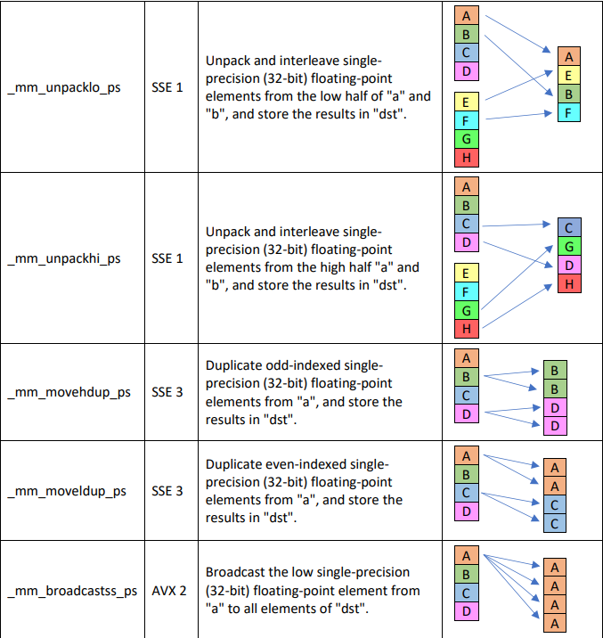
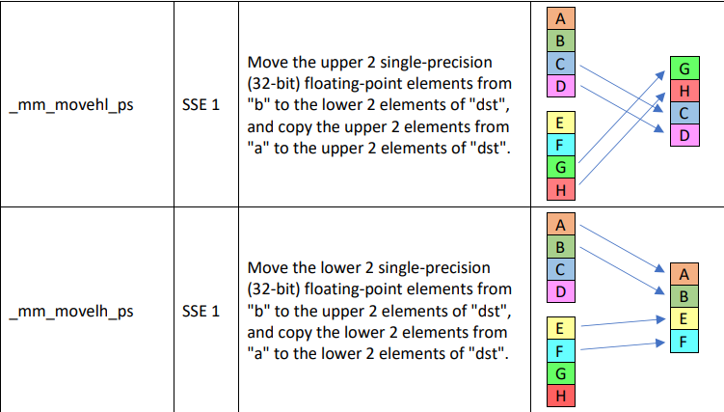
Shuffles
洗牌
L address
H address
a
b

Slide 33
Workshop on Linux ---- How GNU Memcpy utilized SIMD

Slide 34
Links
Design paper: http://cr.yp.to/snuffle/design.pdf; http://cr.yp.to/chacha/chacha-20080128.pdf
IETF RFC: https://www.rfc-editor.org/rfc/rfc7539.txt
Node.JS usage: https://www.derpturkey.com/chacha20poly1305-aead-with-node-js/

Slide 35
backup

Slide 36
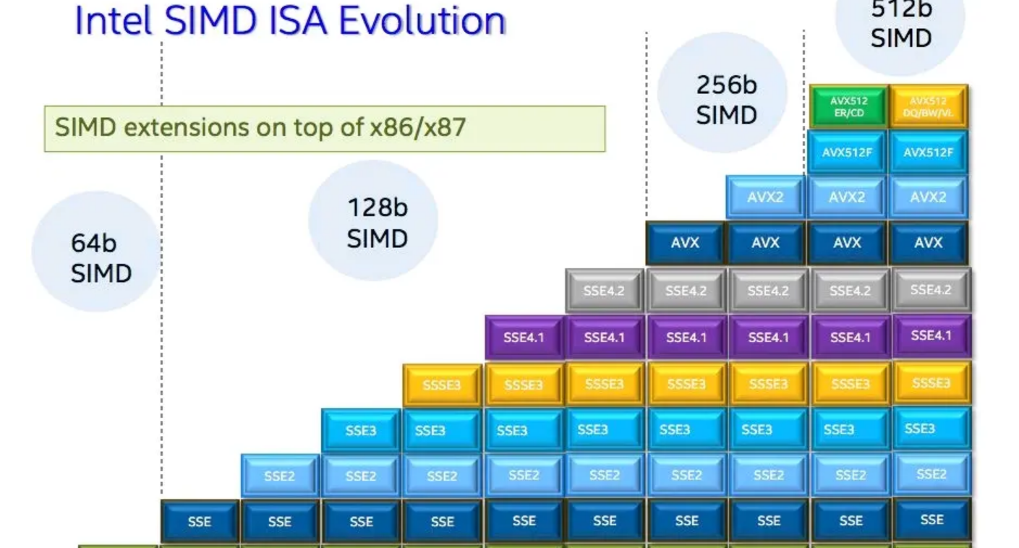

Slide 37
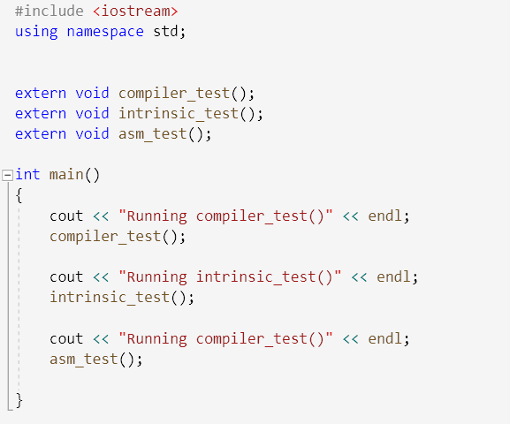
How to program using AVX?
Most popular
C compiler flag
Intrinsic
ASM code
Suggest to use Visual Studio (Win)
or VSCode (Linux)
View disasm code easily
View register value easily
Prompts for AVX types and opcode
Sample code repo: https://github.com/lucshi/AVX_project

Slide 38
A Complicated SIMD Program Chacha20 algorithm in OpenSSL

Slide 39
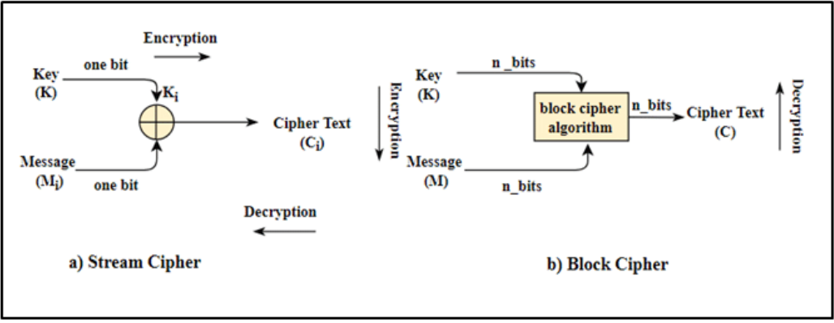
Two symmetric encryption algorithms
Stream cipher (chacha20):
/* encrypt each bit continuously, key size is predefined */
foreach bit i {
Output[i] = Input[i] XOR Key[i]
}
Block cipher (AES-GCM):
/* encrypt blocks one by one internally, block size == key size */
Output[] = Algo_func(Input[])

Slide 40
Chacha20 introduction
Enhancement of Salsa20 algo, invented by Danial J Bernstein in 2008
ChaCha20 offers better on ARM CPU X86 AES instruction set support.
Based on ARX (Addition/Rotation/XOR, 32-bit addition, bitwise rotation and exclusive-OR)
4 32-bit number a, b, c, d
Do below calculation
a += b; d ^= a; d <<<= 16;
c += d; b ^= c; b <<<= 12;
a += b; d ^= a; d <<<= 8;
c += d; b ^= c; b <<<= 7;
+: bitwise ADD
^: bitwise XOR
<<<: bitwise rotation 0xaabbccdd <<< 8 --> 0xbbccddaa

Slide 41
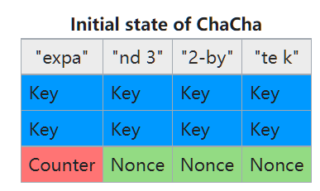
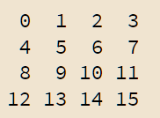
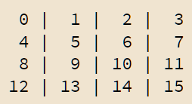
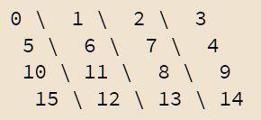
Encryption procedure
Step1: Map {128b constant, 256b key, 32b counter, 96b nounce} to a Matrix A.
Step2: Matrix regarded as 16 32b-size words
Step3: Do ARX on 4 columns in parallel
Step4: Do ARX on 4 diagonals in parallel
Repeat Step3 and Step4 for 10 times in total to get result matrix B
Step5: Matrix A + Matrix B -> Result Matrix -> Result buffer

Slide 42
AVX512 optimization in ARX
OpenSSL generate AVX asm from perl

Slide 43
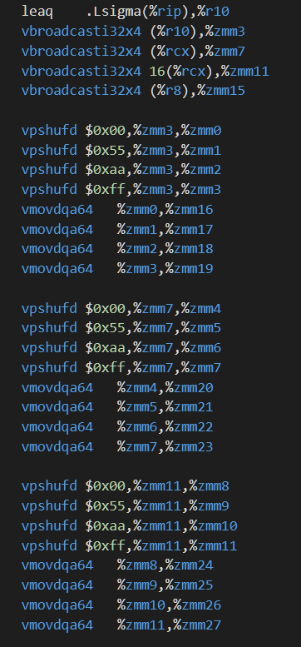
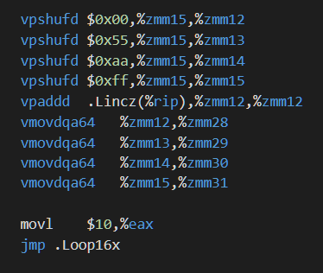
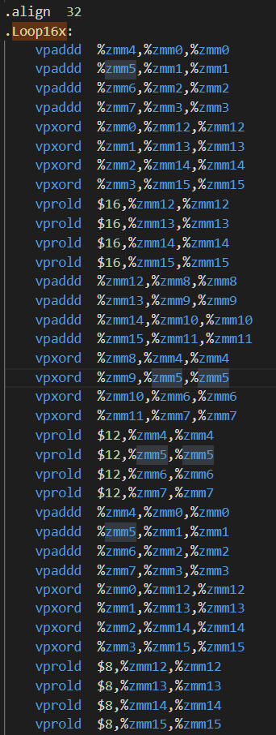
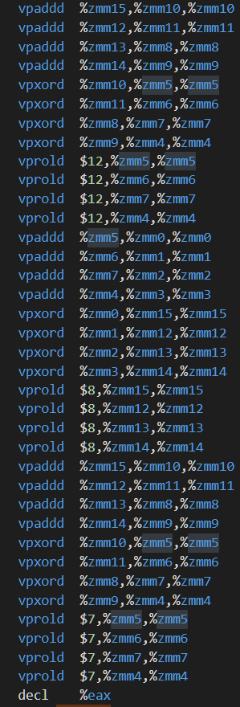

Slide 44
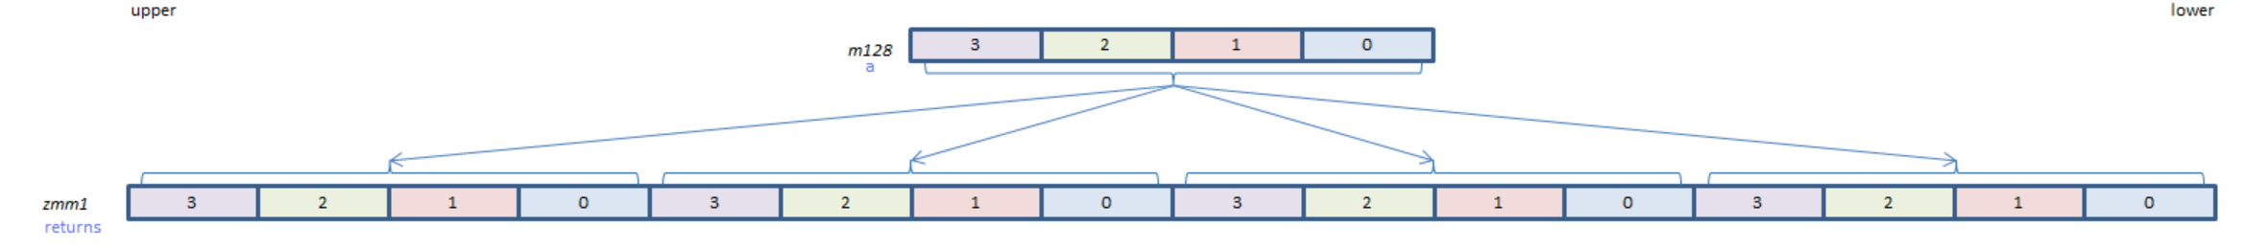
vbroadcasti32x4

Slide 45
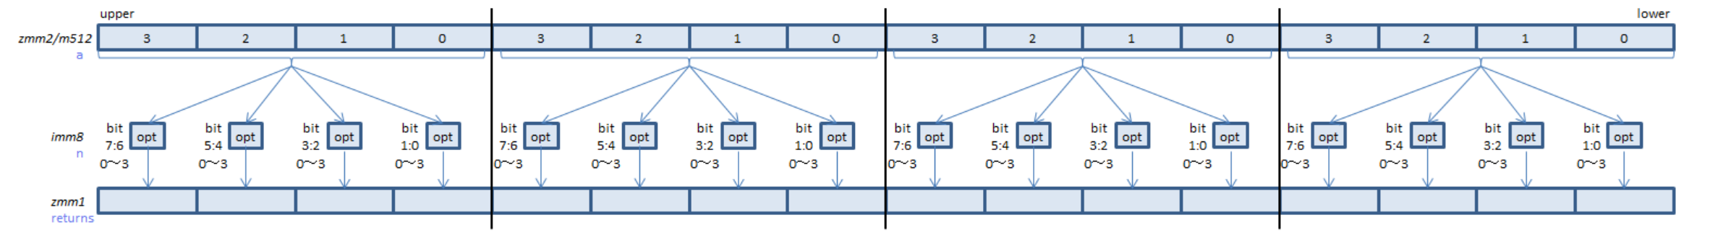
Vpshufd zmm1 zmm2
Copy each 4 int32 after filtered by opt value, to the dest 4 int.
Do above work for 4*4

Slide 46
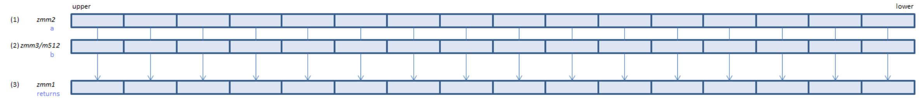
vpaddd
Add 16*int32 in parallel

Slide 47
vprold
Roll the specific bits in each 32int to des position
Other bit remains unchanged

