Slide 1
AVX Learning

Slide 2
SIMD History

Slide 3
1997 - MMX, Pentium with MMX, Multi-media Extended Instructions. 64bit vector
1999 - SSE, Pentium3, Streaming SIMD Extensions, 128bit vector
2000 - SSE2, Pentium 4
2004 - SSE3, Pentium4
2007 - SSE4, Nehalem，SSE4.1 and SSE4.2
2008 - AVX, Sandy Bridge, Advanced Vector Extensions, float operations to 256bit
2011 - AVX2, Haswell, int operations to 256bit, add FMA (fuse and multiply)
2013 - AVX3/512, Knights Landing co-chip, Skylake, extends to 512bit, new instr
No more AVX-1024 because CPU cache line width is 512bit

Slide 4
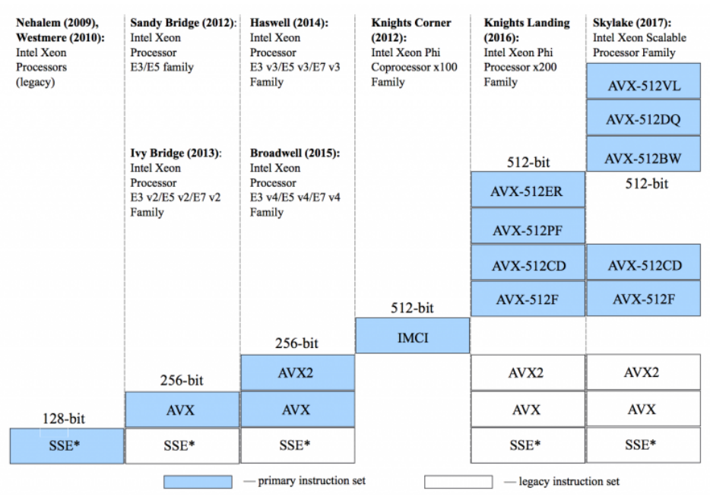
How Intel CPU supports SIMD - 2009-2017

Slide 5
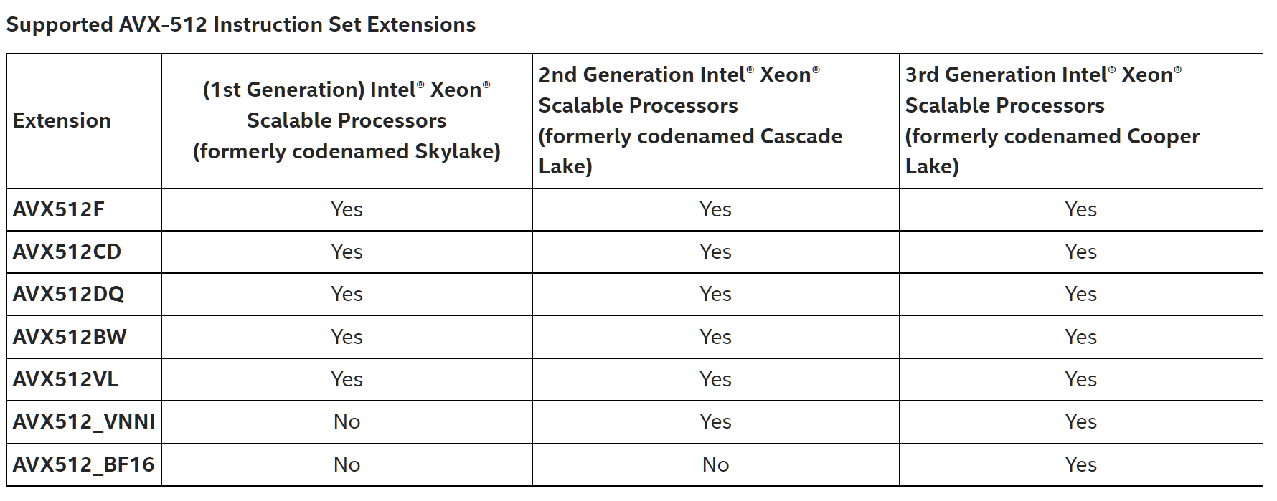
How Intel CPU supports SIMD - 2017-2021

Slide 6
Registers

Slide 7
511 256 | 255 128 | 127 0
ZMM0 | YMM0 | XMM0
ZMM1 | YMM1 | XMM1
ZMM2 | YMM2 | XMM2
ZMM3 | YMM3 | XMM3
ZMM4 | YMM4 | XMM4
ZMM5 | YMM5 | XMM5
ZMM6 | YMM6 | XMM6
ZMM7 | YMM7 | XMM7
ZMM8 | YMM8 | XMM8
ZMM9 | YMM9 | XMM9
ZMM10 | YMM10 | XMM10
ZMM11 | YMM11 | XMM11
ZMM12 | YMM12 | XMM12
ZMM13 | YMM13 | XMM13
ZMM14 | YMM14 | XMM14
ZMM15 | YMM15 | XMM15
ZMM16 | YMM16 | XMM16
ZMM17 | YMM17 | XMM17
ZMM18 | YMM18 | XMM18
ZMM19 | YMM19 | XMM19
ZMM20 | YMM20 | XMM20
ZMM21 | YMM21 | XMM21
ZMM22 | YMM22 | XMM22
ZMM23 | YMM23 | XMM23
ZMM24 | YMM24 | XMM24
ZMM25 | YMM25 | XMM25
ZMM26 | YMM26 | XMM26
ZMM27 | YMM27 | XMM27
ZMM28 | YMM28 | XMM28
ZMM29 | YMM29 | XMM29
ZMM30 | YMM30 | XMM30
ZMM31 | YMM31 | XMM31
SSE
16 128bit registers - XMM*
Each XMM*: 4 32-bit float; 4 int, 2 double;
AVX
16 256bit registers - YMM*
Add VEX prefix on SSE instructions for backward compliance
Each YMM*: 8 32-bit float; 8 int, 4 double;
AVX512
32 512bit registers - ZMM*
Add EVEX prefix for backward compliance
Each ZMM*: 16 32-bit float; 16 int, 8 double;
AVX512 increases to 2X width and 2X count

Slide 8
AVX-512 instructions
subset | usage
AVX512-F | Fundamental
AVX512-CD | Conflict Detection
AVX512-ER （仅Phi支持） | Exponential and Reciprocal
AVX512-PF （仅Phi支持） | Prefetch
AVX512-DQ | Double and Quad word
AVX512-BW | Byte and word
AVX512-VL | Vector length
AVX512-VNNI | Vector Neural Network Instructions
AVX512-BF16 | Bfloat16 Type float

Slide 9
AVX functions
_mm<bit_width>_<name>_<data_type>
<bit_width> 128 for sse, 256 for avx, 512 for avx3
<name> options
<data_type> arguments types
ps : float pd : double epi8/epi16/epi32/epi64 : xxx bit signed int epu8/epu16/epu32/epu64 : xxx bit unsigned int si128/si256 : unknown type 126/256 bit m128/m128i/m128d/m256/m256i/m256d : denote input type that differs output type

Slide 10
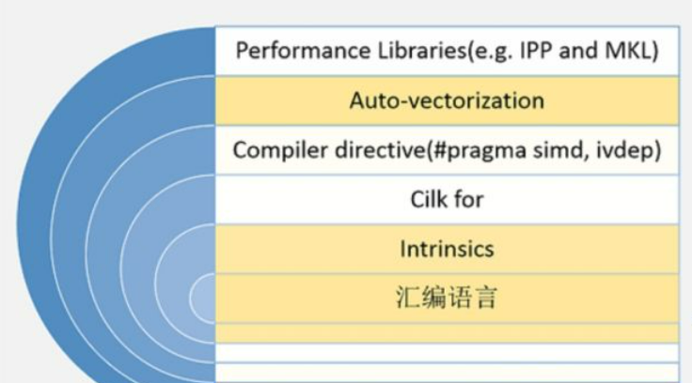
AVX programming

Slide 11
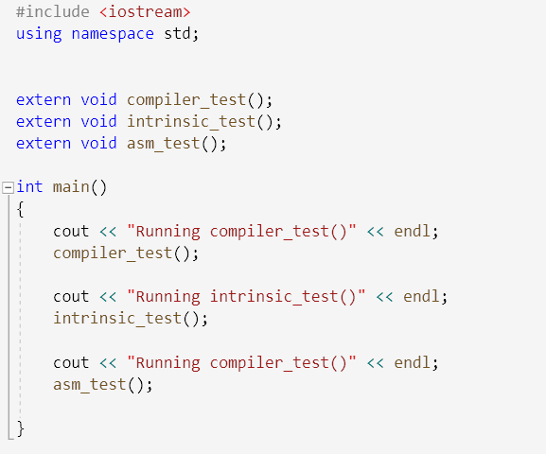
How to program using AVX?
Most popular
C compiler flag
Intrinsic
ASM code
Suggest to use Visual Studio (Win)
or VSCode (Linux)
View disasm code easily
View register value easily
Prompts for AVX types and opcode
Sample code repo: https://github.com/lucshi/AVX_project

Slide 12
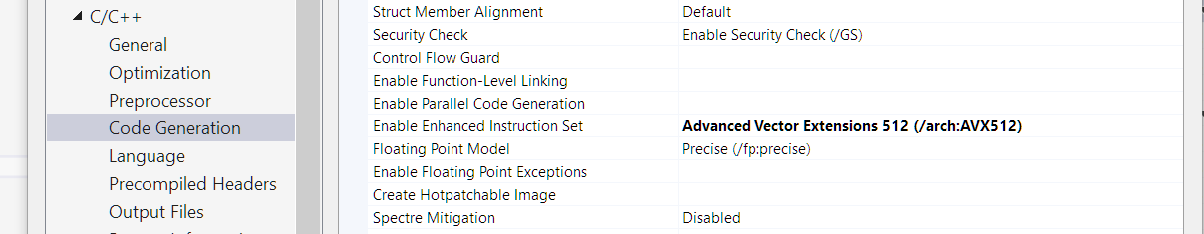
Compiler flag
On Windows:
On Linux GCC:
-O3 -march=skylake-avx512 -mprefer-vector-width=512 to enable AVX512
-mavx512f -mavx512cd -mavx512bw -mavx512dq -mavx512vl -mavx512ifma -mavx512vbmi choose what you want to enable which AVX512 subset

Slide 13
Next a few slides to show AVX programming on Windows
Workshop demo for Linux

Slide 14
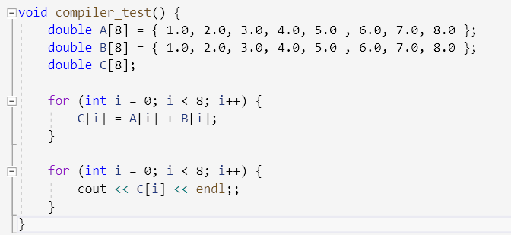
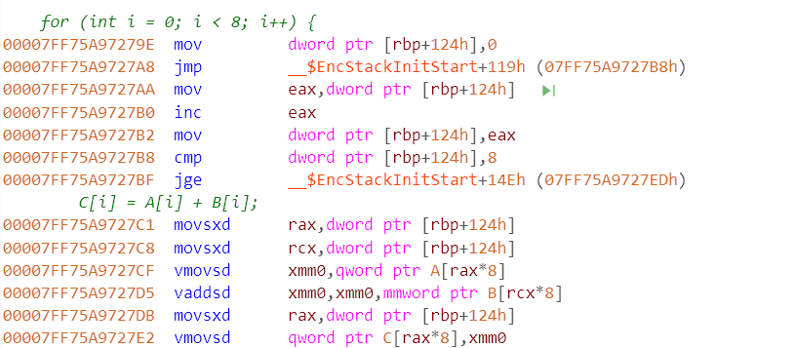
Add two double array
8 doubles in an array fills in 512 bits, fit one AVX512 register (zmm*) capacity
The result shows VS does not correctly generate AVX512 asm
Compiler not optimized for AVX512 may be an opt opportunity

Slide 15
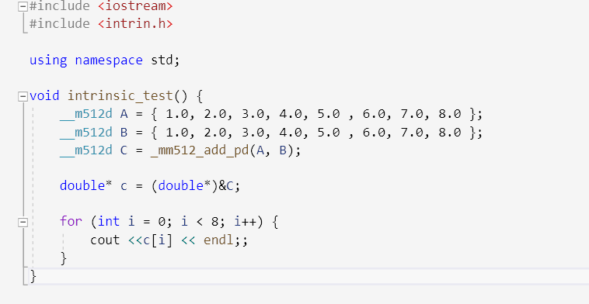
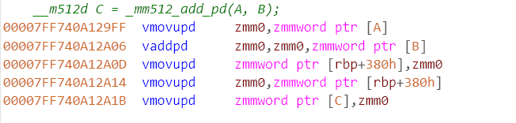
Use intrinsic
__m512_add_pd replace loop add on arrays
(512 bit packed add on double number)
Intrinsic works well

Slide 16
Header files
intrin.h | All Architectures
mmintrin.h | MMX
xmmintrin.h | SSE
emmintrin.h | SSE2
pmmintrin.h | SSE3
smmintrin.h | SSE4.1
nmmintrin.h | SSE4.2
immintrin.h | AVX
Preferred on Windows
Preferred on Linux

Slide 17
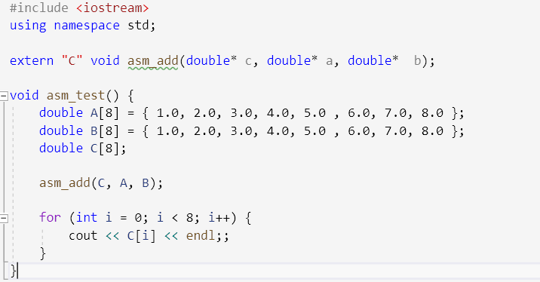
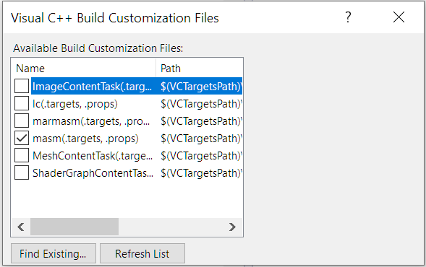
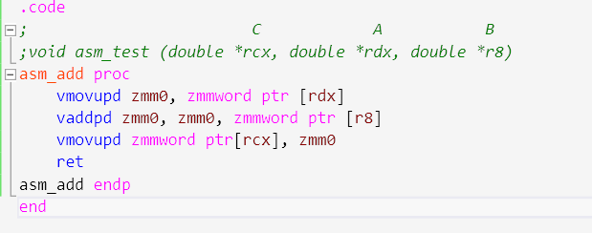
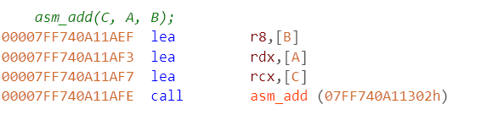
Use ASM
Add masm build dependency
Generate asm of what we wrote
Handwritten asm may have lower performance than intrinsic

Slide 18
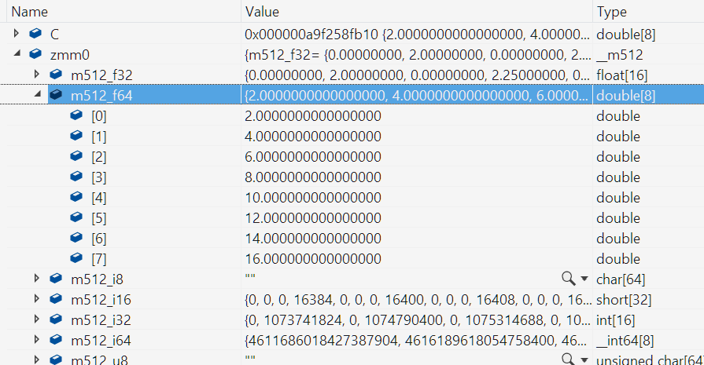
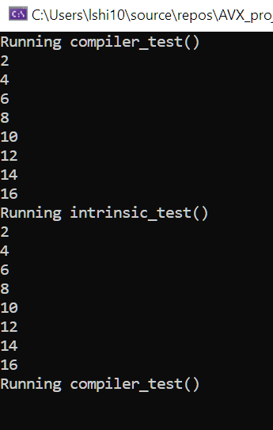
Zmm0 register value can be examined at runtime
Different types of AVX512 register are overlapped
Need manually check which data types is used in current program

Slide 19
Workshop on Linux (Cascade Lake Server)

Slide 20
Use lscpu to check SIMD capability
fpu vme de pse tsc msr pae mce cx8 apic sep mtrr pge mca cmov pat pse36 clflush dts acpi mmx fxsr sse sse2 ss ht tm pbe sysca
ll nx pdpe1gb rdtscp lm constant_tsc art arch_perfmon pebs bts rep_good nopl xtopology nonstop_tsc cpuid aperfmperf pni pclmu
lqdq dtes64 monitor ds_cpl vmx smx est tm2 ssse3 sdbg fma cx16 xtpr pdcm pcid dca sse4_1 sse4_2 x2apic movbe popcnt tsc_deadl
ine_timer aes xsave avx f16c rdrand lahf_lm abm 3dnowprefetch cpuid_fault epb cat_l3 cdp_l3 invpcid_single ssbd mba ibrs ibpb
stibp ibrs_enhanced tpr_shadow vnmi flexpriority ept vpid ept_ad fsgsbase tsc_adjust bmi1 avx2 smep bmi2 erms invpcid cqm mp
x rdt_a avx512f avx512dq rdseed adx smap clflushopt clwb intel_pt avx512cd avx512bw avx512vl xsaveopt xsavec xgetbv1 xsaves c
qm_llc cqm_occup_llc cqm_mbm_total cqm_mbm_local dtherm ida arat pln pts hwp hwp_act_window hwp_epp hwp_pkg_req pku ospke avx
512_vnni md_clear flush_l1d arch_capabilities
Zmm0 register

Slide 21
A Complicated SIMD Program Chacha20 algorithm in OpenSSL

Slide 22
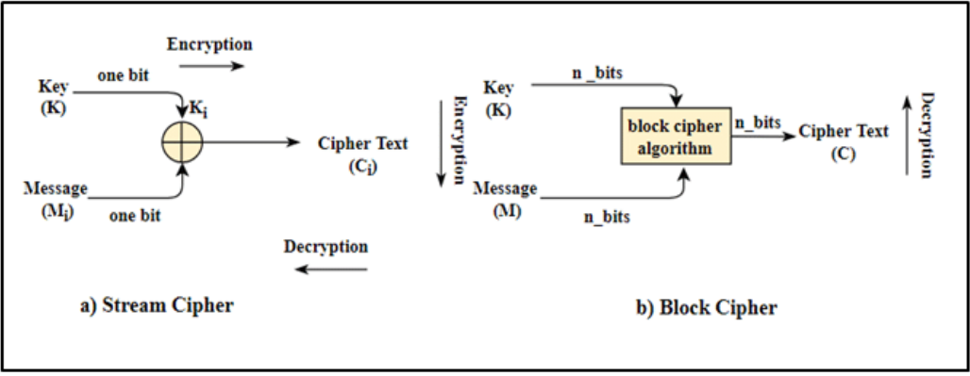
Two symmetric encryption algorithms
Stream cipher (chacha20):
/* encrypt each bit continuously, key size is predefined */
foreach bit i {
Output[i] = Input[i] XOR Key[i]
}
Block cipher (AES-GCM):
/* encrypt blocks one by one internally, block size == key size */
Output[] = Algo_func(Input[])

Slide 23
Chacha20 introduction
Enhancement of Salsa20 algo, invented by Danial J Bernstein in 2008
ChaCha20 offers better on ARM CPU X86 AES instruction set support.
Based on ARX (Addition/Rotation/XOR, 32-bit addition, bitwise rotation and exclusive-OR)
4 32-bit number a, b, c, d
Do below calculation
a += b; d ^= a; d <<<= 16;
c += d; b ^= c; b <<<= 12;
a += b; d ^= a; d <<<= 8;
c += d; b ^= c; b <<<= 7;
+: bitwise ADD
^: bitwise XOR
<<<: bitwise rotation 0xaabbccdd <<< 8 --> 0xbbccddaa

Slide 24
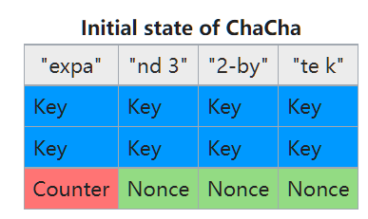
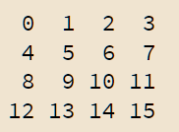
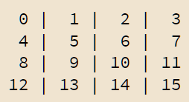
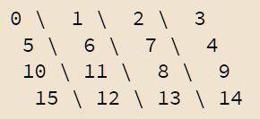
Encryption procedure
Step1: Map {128b constant, 256b key, 32b counter, 96b nounce} to a Matrix A.
Step2: Matrix regarded as 16 32b-size words
Step3: Do ARX on 4 columns in parallel
Step4: Do ARX on 4 diagonals in parallel
Repeat Step3 and Step4 for 10 times in total to get result matrix B
Step5: Matrix A + Matrix B -> Result Matrix -> Result buffer

Slide 25
AVX512 optimization in ARX
OpenSSL generate AVX asm from perl

Slide 26
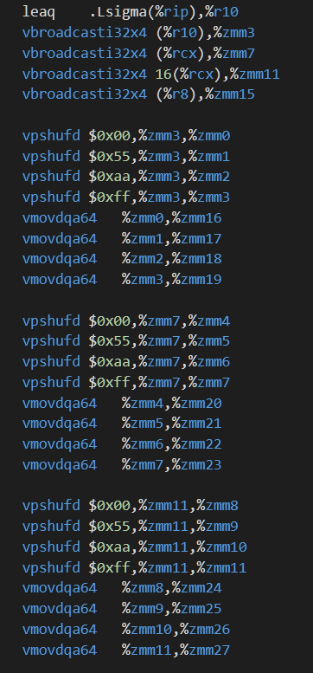
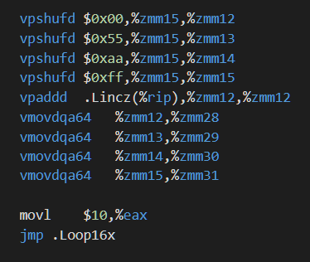
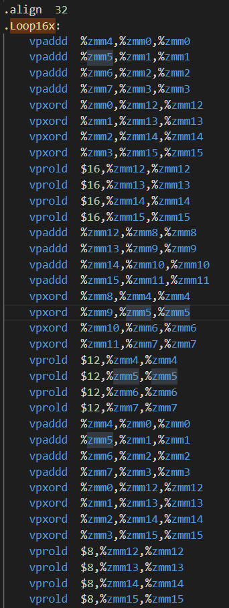
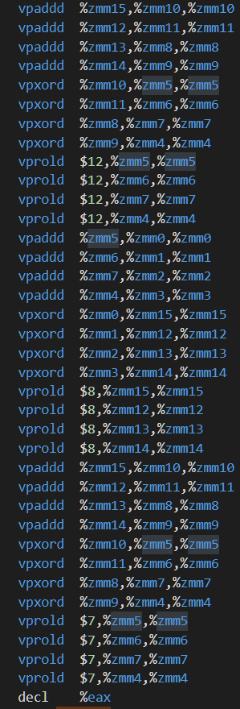

Slide 27
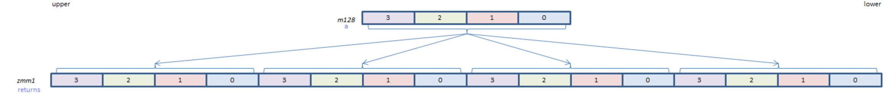
vbroadcasti32x4

Slide 28
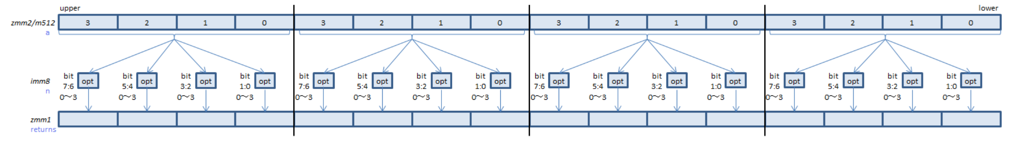
Vpshufd zmm1 zmm2
Copy each 4 int32 after filtered by opt value, to the dest 4 int.
Do above work for 4*4

Slide 29
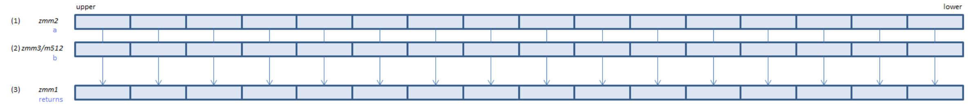
vpaddd
Add 16*int32 in parallel

Slide 30
vprold
Roll the specific bits in each 32int to des position
Other bit remains unchanged

Slide 31
Links
Design paper: http://cr.yp.to/snuffle/design.pdf; http://cr.yp.to/chacha/chacha-20080128.pdf
IETF RFC: https://www.rfc-editor.org/rfc/rfc7539.txt
Node.JS usage: https://www.derpturkey.com/chacha20poly1305-aead-with-node-js/

Slide 32
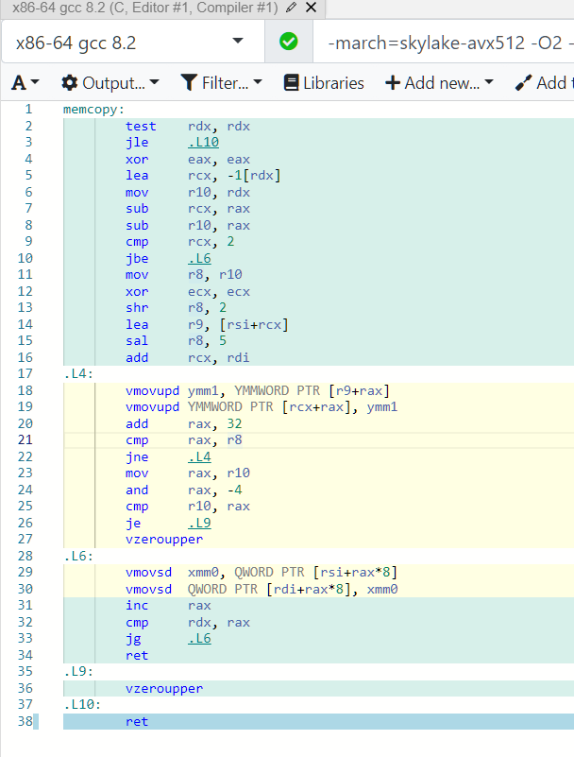
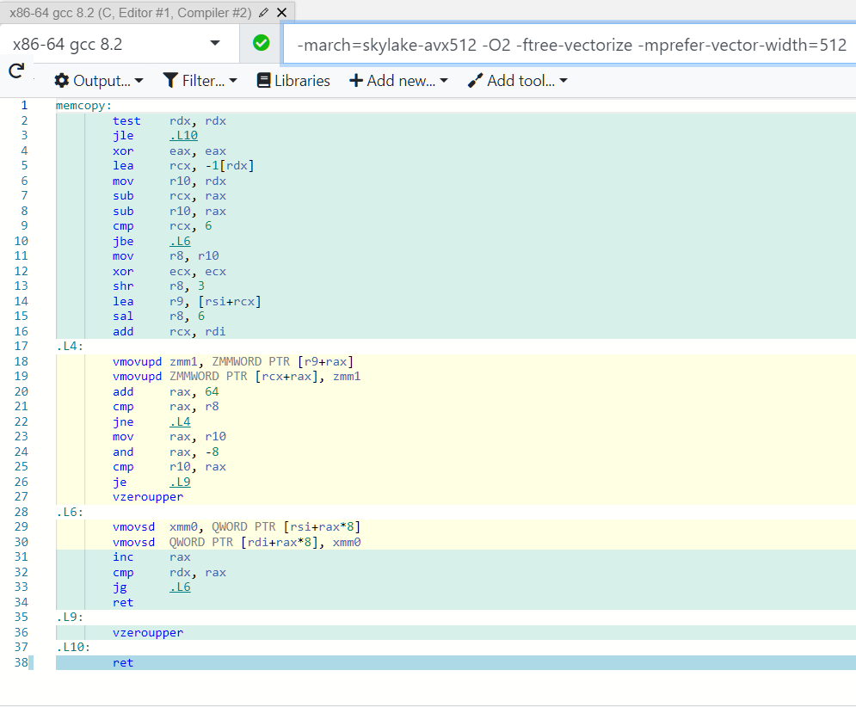
Optimized memcpy in GCC
Code
void memcopy(double* restrict a, double* restrict b, long N){
for (long n; n < N; n++){a[n] = b[n];} }

Slide 33
Full introduction of intrinsic
https://www.intel.com/content/www/us/en/docs/intrinsics-guide/index.html

Slide 34
Category

Slide 35
backup

Slide 36
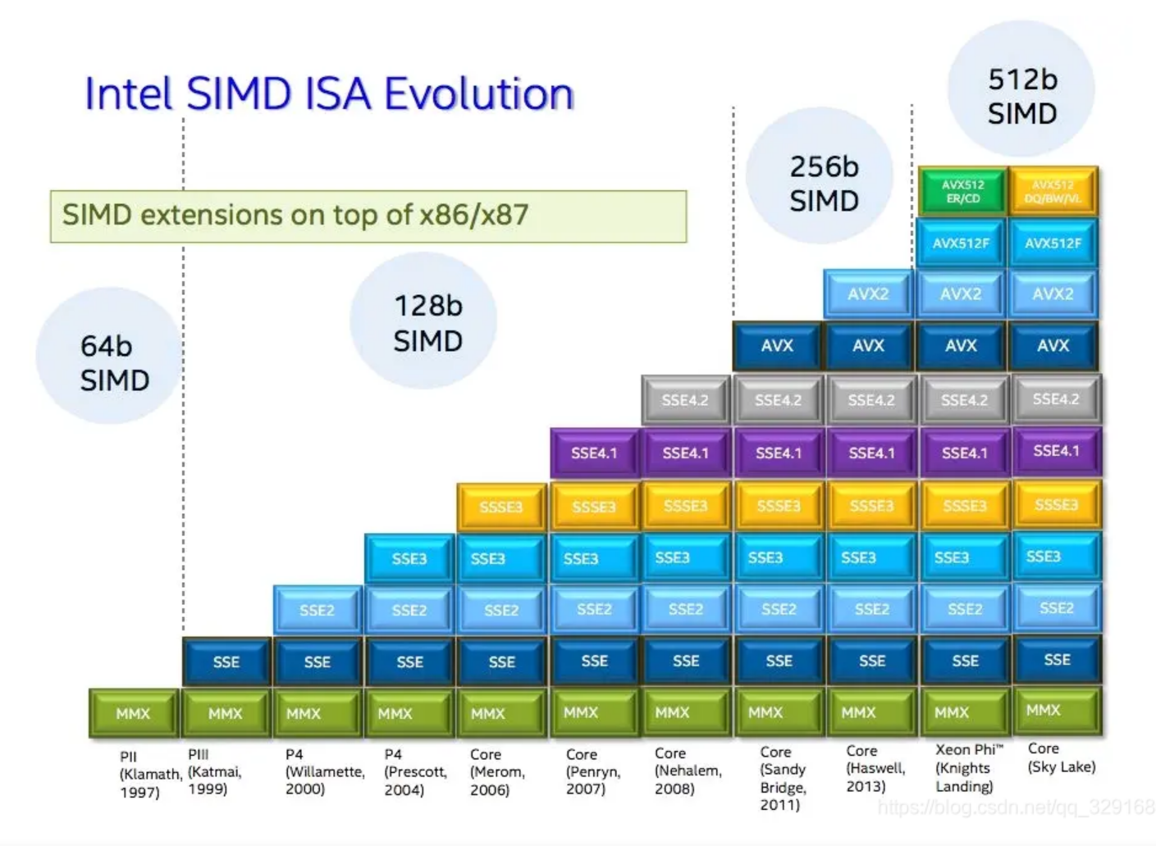

Slide 37
AVX-512 指令分类
子集 | 缩写 | 应用
AVX512-F | Fundamental | 增加了AVX2的指令宽度
AVX512-CD | Conflict Detection | 确保循环中的数据无冲突后，实现循环计算的向量化（直方图计算）
AVX512-ER （仅Phi支持） | Exponential and Reciprocal | 计算2的指数、倒数、开方
AVX512-PF （仅Phi支持） | Prefetch | 实现向量计算的聚集和分散操作，从多个缓冲区中同时读取数据
AVX512-DQ | Double and Quad word | 新的32位和64位指令（数据转换）
AVX512-BW | Byte and word | AVX512-F中扩充了新的8位和16位指令，整数计算
AVX512-VL | Vector length | 扩展AVX512指令可以兼容128位的XMM计算器和256位的YMM寄存器。
AVX512-VNNI | Vector Neural Network Instructions | 实现神经网络计算常用的算法（乘加操作）
AVX512-BF16 | Bfloat16 Type float | 半浮点数计算（AI操作）

Slide 38
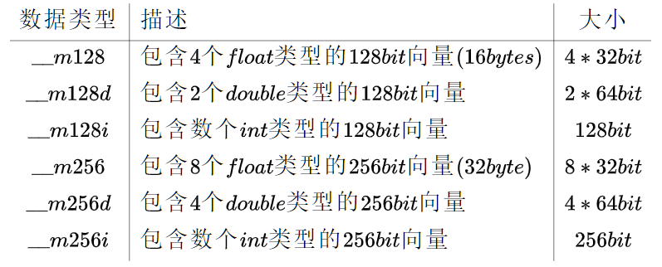
快速识别AVX 数据类型
书写规则
两个下划线 __ 在数据类型之前
看名字：
名字里带128 ： 一个向量包含128个bit = 16 byte
名字里带256 ：一个向量包含256个bit = 32 byte
名字里带512：一个向量包含512个bit = 64 byte
看尾巴：
尾巴啥也不带的：里面都是float，一个float=32bit，自己除一下里面有几个
尾巴带d：里面都是double，一个double=64bit，自己除一下里面有几个
尾巴带i：里面都是整型，根据整型的类型不同，个数也不同
32个char，或16个short，或8个int，或4个long
AVX512

