Slide 1
MOC – Myanmar RAMS
Main characteristics
Architecture and components
Three core functions:
Data Display and visualization
ROMDAS Data import, processing and management
Analysis and reporting
21 March 2018

Slide 2
MRAMS Main characteristics
Objective: Asset Management of ±25 000 miles of MOC managed roads
Focus on Data integration, GIS and Thematic Asset Mapping, query and reporting
Free solution: fully open source / central open relational database / source code available
Integrates ROMDAS / Roadroid / OSM / MIMU Data/ Google Maps
Simulates LRS and Dynamic segmentation
For basic (sporadic) and advanced (almost daily) users

Slide 3
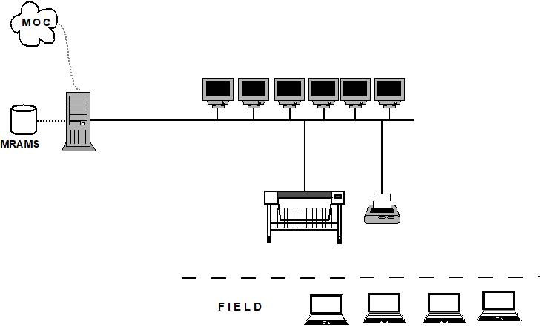
MRAMS System Architecture

Slide 4
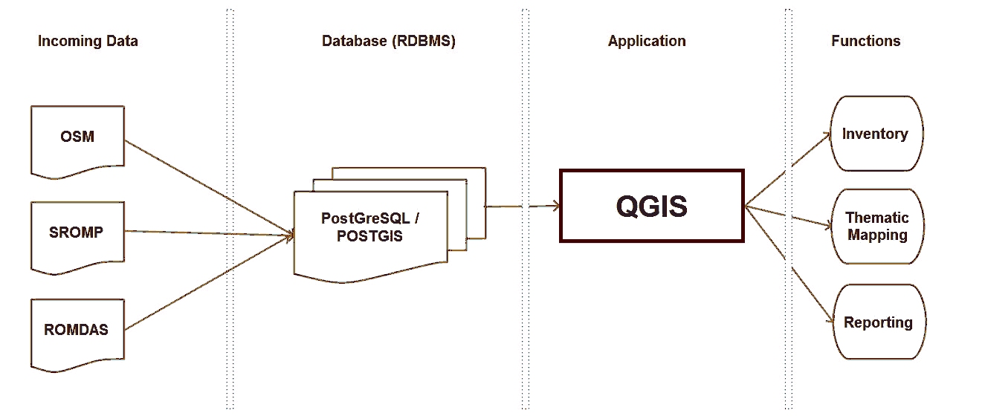
MRAMS Components

Slide 5
Data Display and visualization

Slide 6
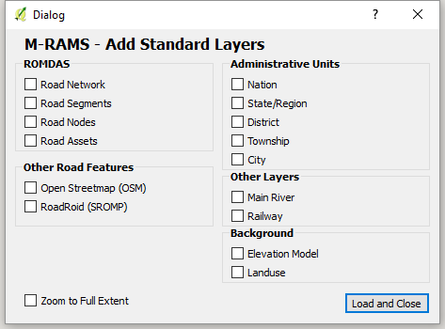
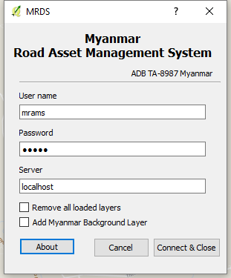
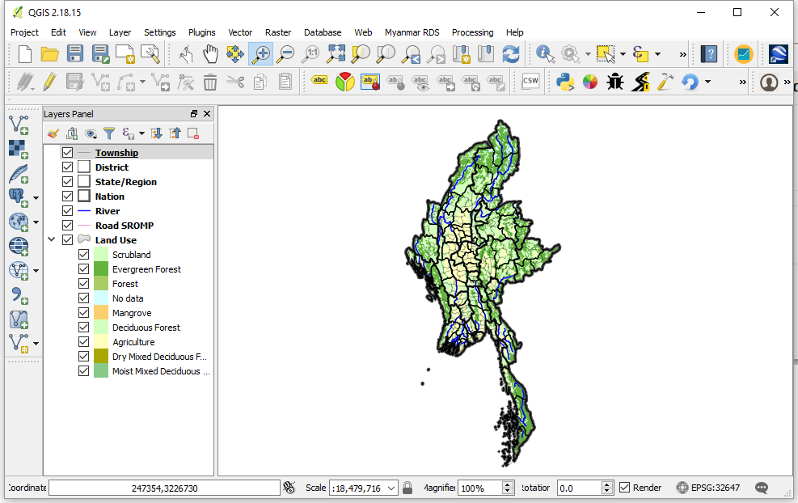
Connect to MRAMS and Load Layers
All data on central server, or local computer. Relational Geodatabase format.

Slide 7
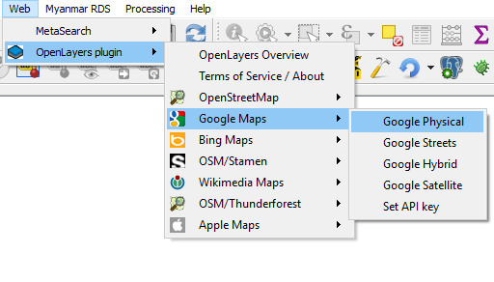
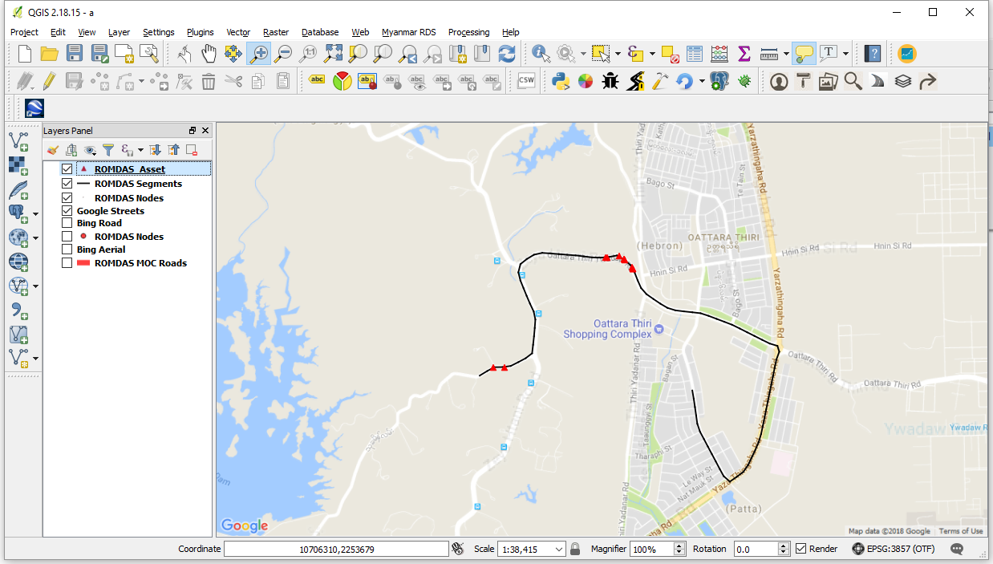
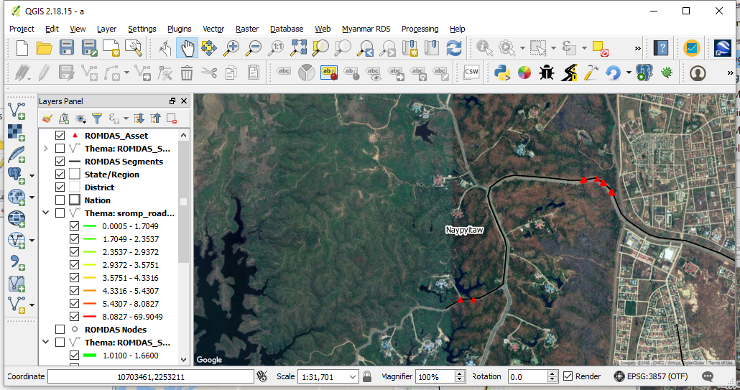
Map Background services
Access to background maps from Google, Bing, Open Street Map etc..

Slide 8
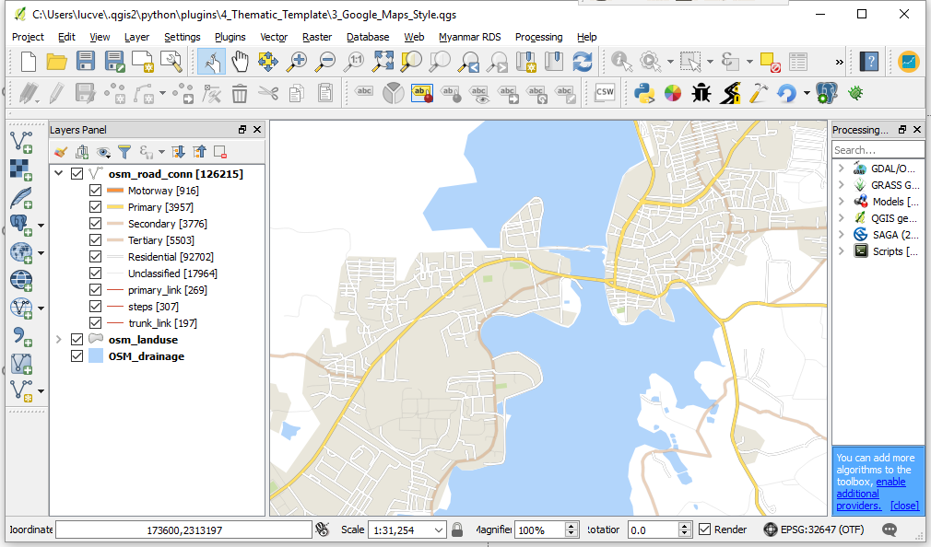
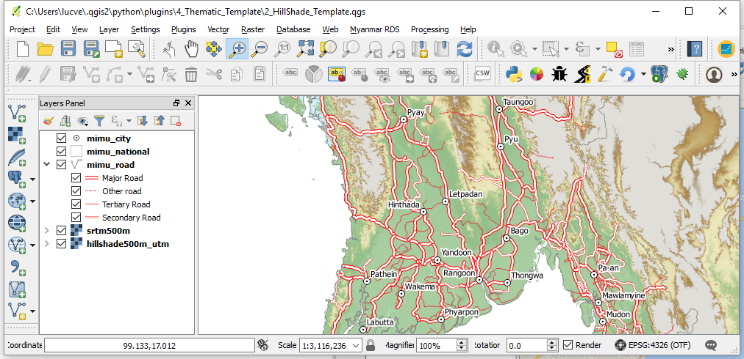
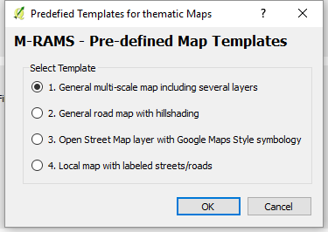
Map templates
These are predefined maps which allow quickly building customized maps at various scales.

Slide 9
ROMDAS Data import, processing and management

Slide 10
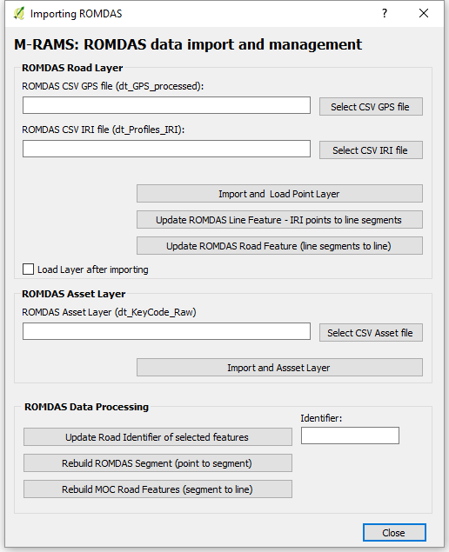
ROMDAS Data Import and processing.
After data collection, validate data and ensure QC via ROMDAS DataView Software
Optionally, use DataView to add data extracted from Video analysis
Import ROMDAS network and IRI related information into RAMS
Import Asset details into RAMS
Process data to insert in valid MOC Road Network GIS

Slide 11
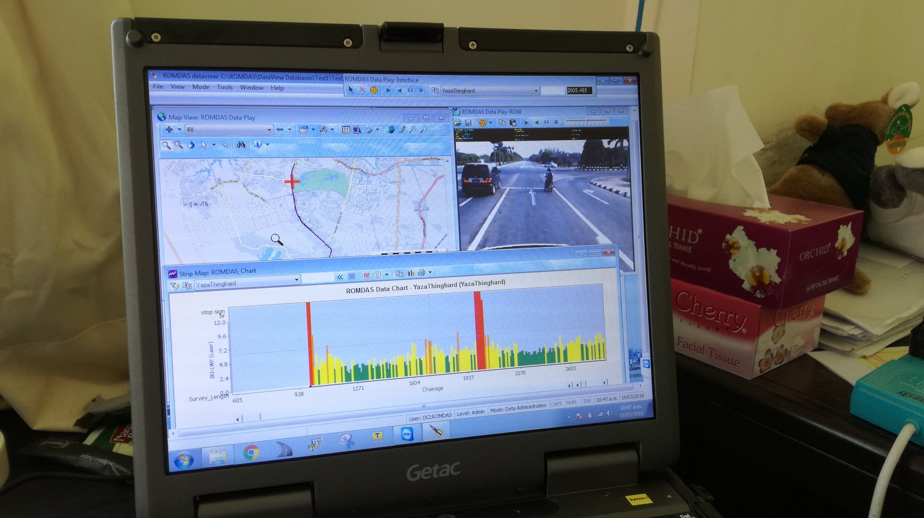
ROMDAS DataView – Quality Control Linking with MRAMS

Slide 12
Analysis

Slide 13
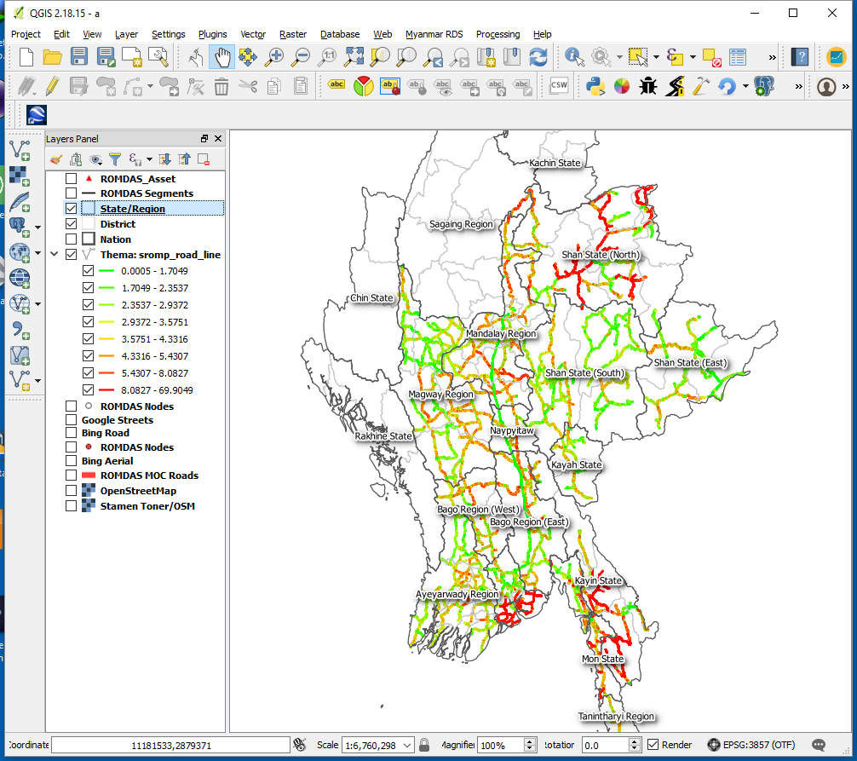
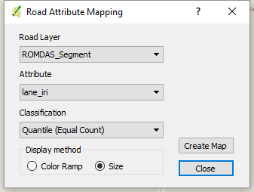
Road Attribute Mapping
Create Road Layer maps using color scheme or line width.

Slide 14
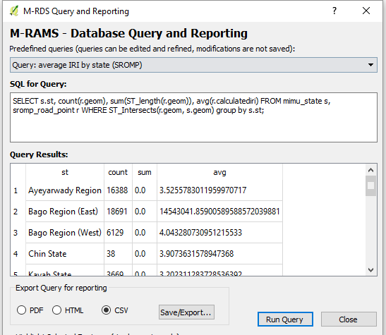
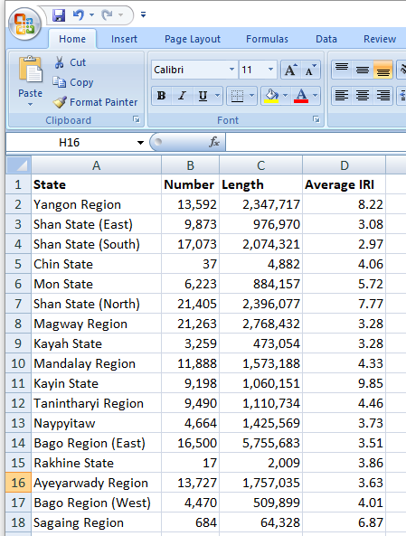
Database & spatial queries - Reporting
Any spatial and or attribute query with export report as PDF / HTML or CSV-Excel. This example shows average IRI by State, exported to Excel for further analysis.

Slide 15
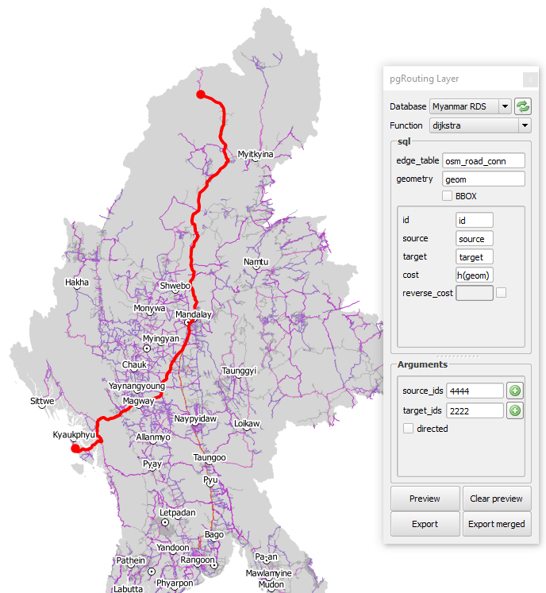
Routing
Shortest route calculation between two points in the network.

Slide 16
QGIS Spatial analysis
Standard QGIS functionality (overlay, buffering, intersection, clipping… ) to link road quality data with any other spatial data for:
planning purposes
budgeting
Monitoring
Based on standard QGIS functions: to be designed and documented

Slide 17
Conclusion

Slide 18
Planning & Future Implementation
Installation MRAMS and Training (Q2/2018, TBC) incl. DataView
Master “MOC Road layer” and identification system
Define Planning and logistics of of ROMDAS data collection by State
Further functional design required for specific needs of MOC regarding RAMS
Use of ROMDAS DataView in combination with QGIS/MRAMS (QA/QC)
RAMS / GIS Lab – making it operational and promote GIS activities with high quality A1-color maps for different divisions (design…)

Slide 19
Thank you!

