Slide 1
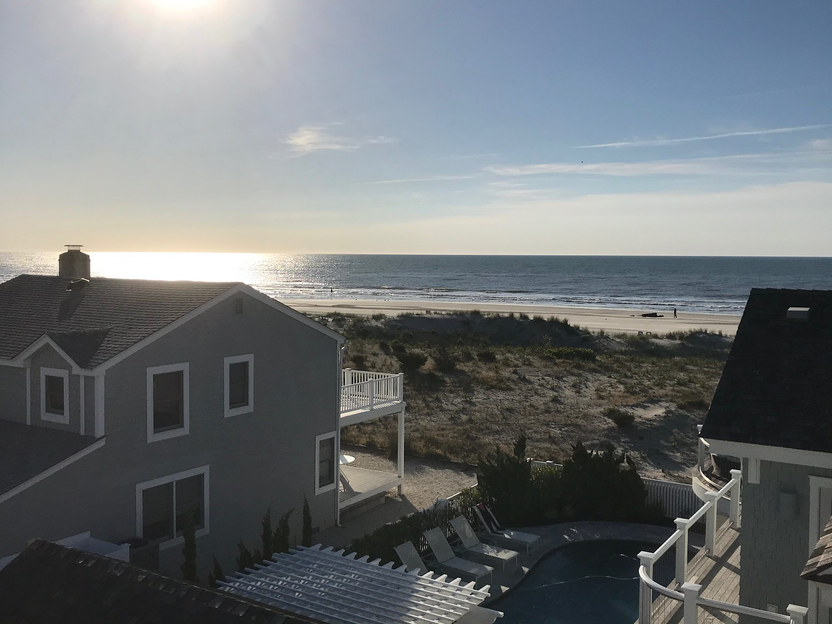
Can I Afford A Beach House??

Slide 2
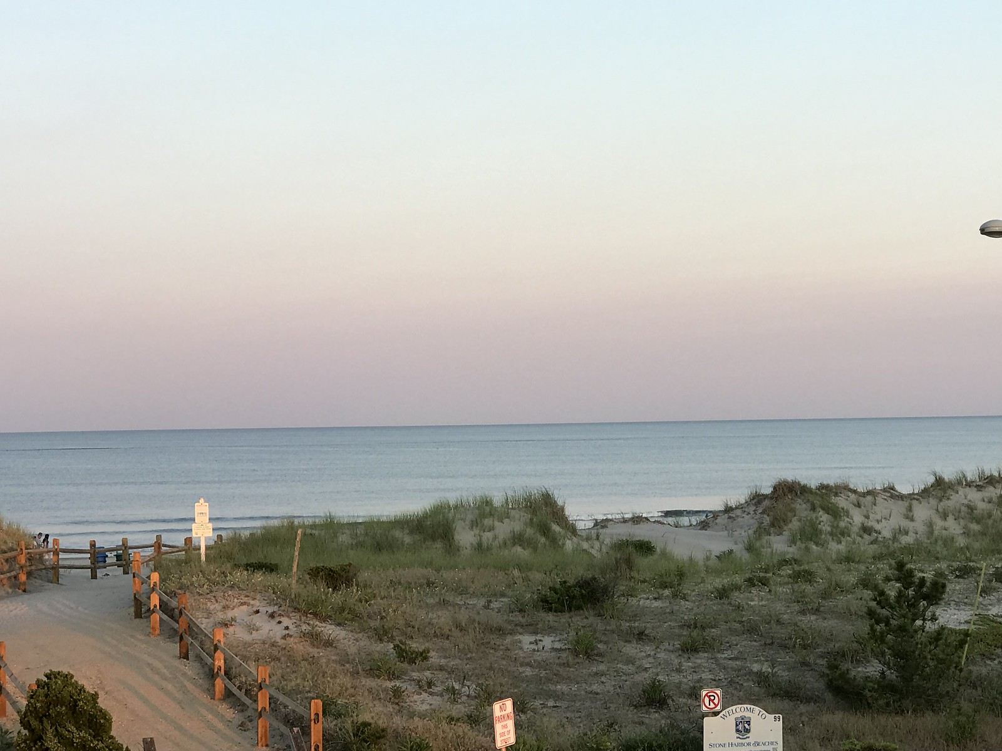
Rental Income: Goal
How Much Rental Income Can I Expect to Earn?
Amount of rental income to expect
Impact of different features of the property
How to use the the rental income prediction

Slide 3


Methodology
Partnering with VRBO
Cape May County Rental Data
Prediction model based on Linear Regression
Features:
Bedrooms
Bathrooms
Type of Property
Distance to Beach

Slide 4
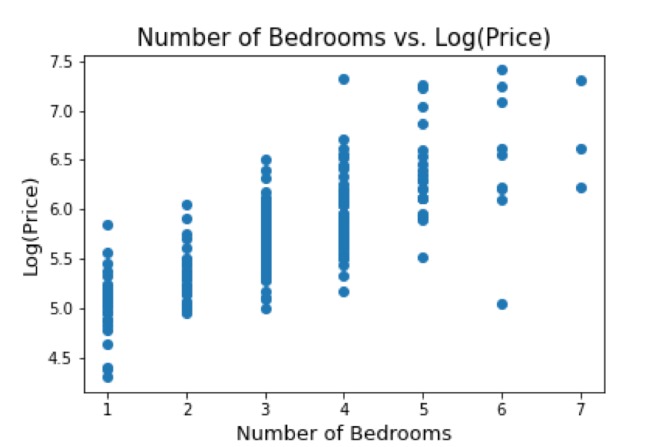
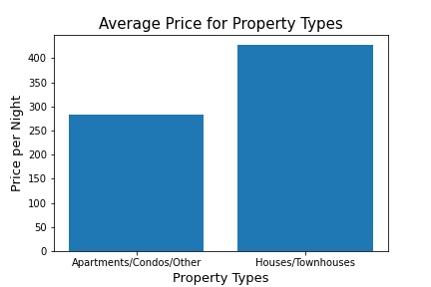
Feature Visuals

Slide 5
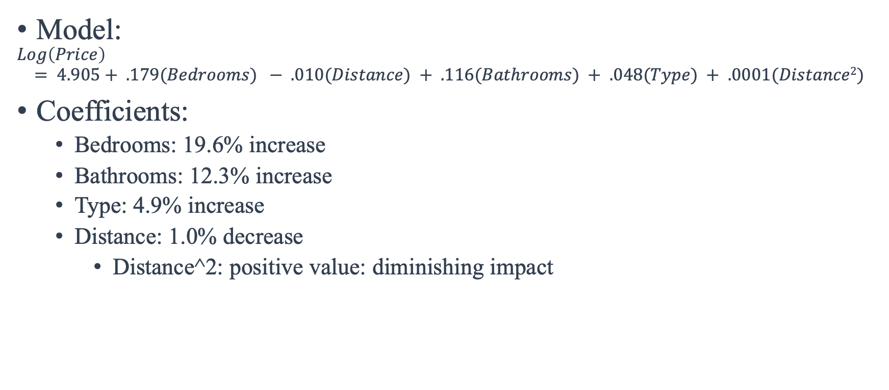
Model Interpretation
Model:
$$Log\left(Price\right)$$
$$= 4.905+ .179(Bedrooms) − .010(Distance) + .116(Bathrooms) + .048(Type) + .0001(Distance2)$$
Coefficients:
Bedrooms: 19.6% increase
Bathrooms: 12.3% increase
Type: 4.9% increase
Distance: 1.0% decrease
Distance^2: positive value: diminishing impact

Slide 6
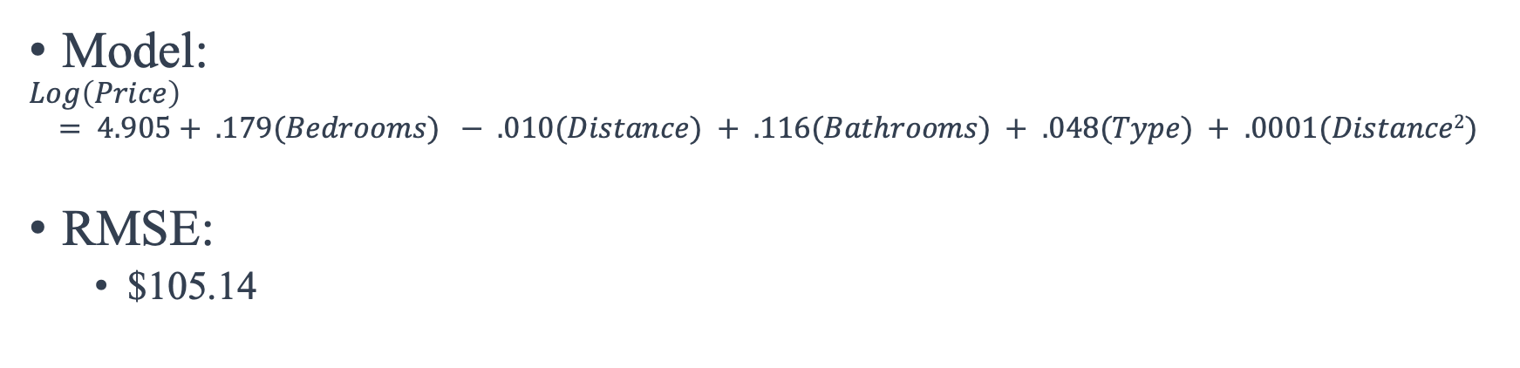
Model Predictions
Model:
$$Log\left(Price\right)$$
$$= 4.905+ .179(Bedrooms) − .010(Distance) + .116(Bathrooms) + .048(Type) + .0001(Distance2)$$
RMSE:
$105.14
 | Bedrooms | Distance | Bathrooms | Type | Distance^2 | Predicted | Actual | Difference
Close Prediction | 4 | 7 min walk | 2 | Condo | 49 | $326.84 | $325 | ($1.84)
Underestimation | 3 | 11 min walk | 2.5 | House | 121 | $294.07 | $350 | $55.93
Overestimation | 3 | 5 min walk | 2 | Condo | 25 | $278.08 | $239 | ($39.08)

Slide 7
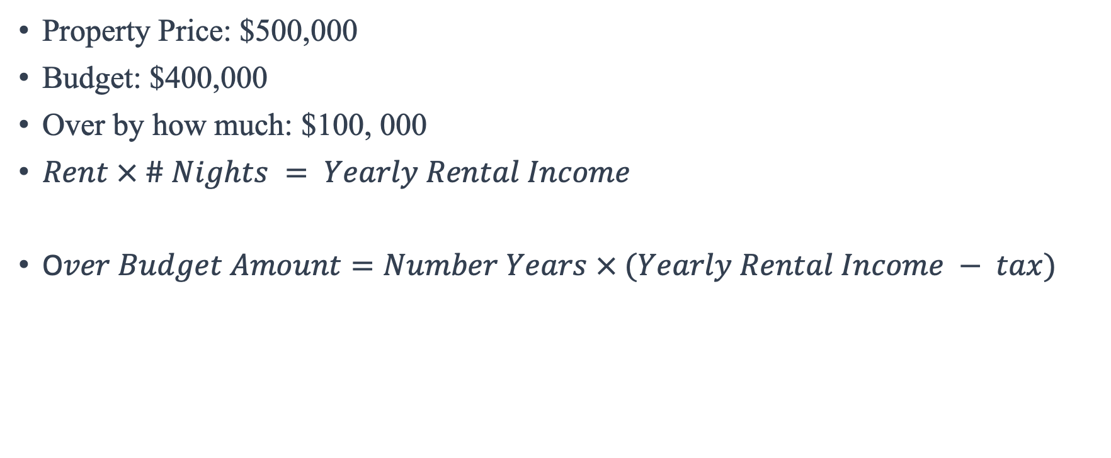
Example
Property Price: $500,000
Budget: $400,000
Over by how much: $100, 000
$Rent × \# Nights = Yearly Rental Income$
O$ver Budget Amount=Number Years × (Yearly Rental Income − tax)$

Slide 8
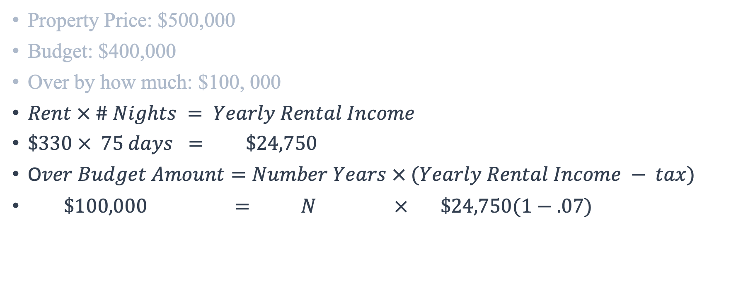
Example
Property Price: $500,000
Budget: $400,000
Over by how much: $100, 000
$Rent × \# Nights = Yearly Rental Income$
$\$330 × 75 days = \$24,750$
O$ver Budget Amount=Number Years × (Yearly Rental Income − tax)$
$\$100,000 = N × \$24,750(1−.07)$

Slide 9
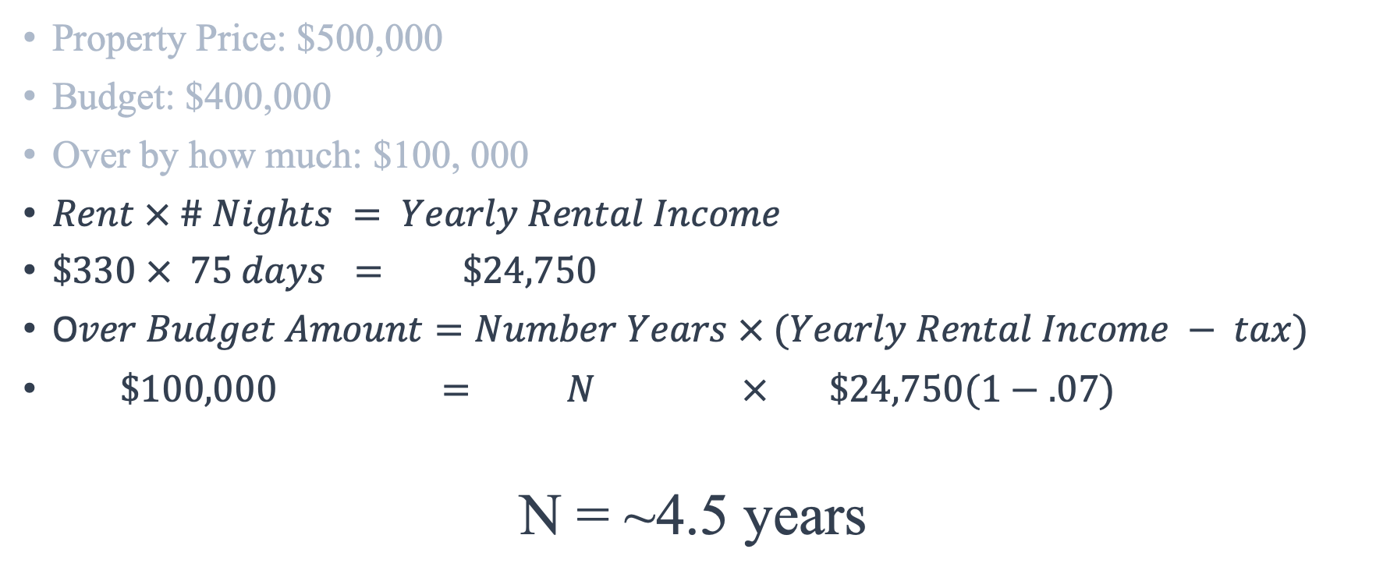
Example
Property Price: $500,000
Budget: $400,000
Over by how much: $100, 000
$Rent × \# Nights = Yearly Rental Income$
$\$330 × 75 days = \$24,750$
O$ver Budget Amount=Number Years × (Yearly Rental Income − tax)$
$\$100,000 = N × \$24,750(1−.07)$
N = ~4.5 years

Slide 10
Key Takeaways
Affordability of a beach home
Know the worth of your property
Decide between properties
Property Renovations

Slide 11
Future Work
Pool
Specific Town
Distance to Downtown
Week during year
Economy

Slide 12
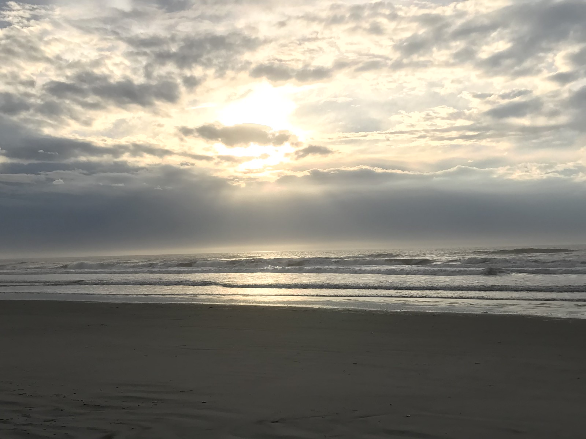
QUESTIONS??

