Slide 1

Detecting the emergence of SARS-COV-2 and its sensitivity to data sharing policies
Pathology and Laboratory Medicine

Slide 2

Background
SARS-COV-2 and Data Sharing Policies

Slide 3
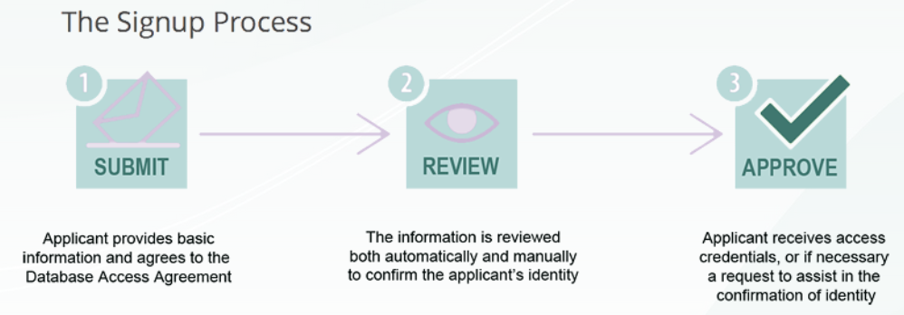
GISAID
World’s largest repository of SARS-CoV-2 sequences (> 10 million)
https://gisaid.org/register/
SARS-COV-2 and Data Sharing Policies

Slide 4
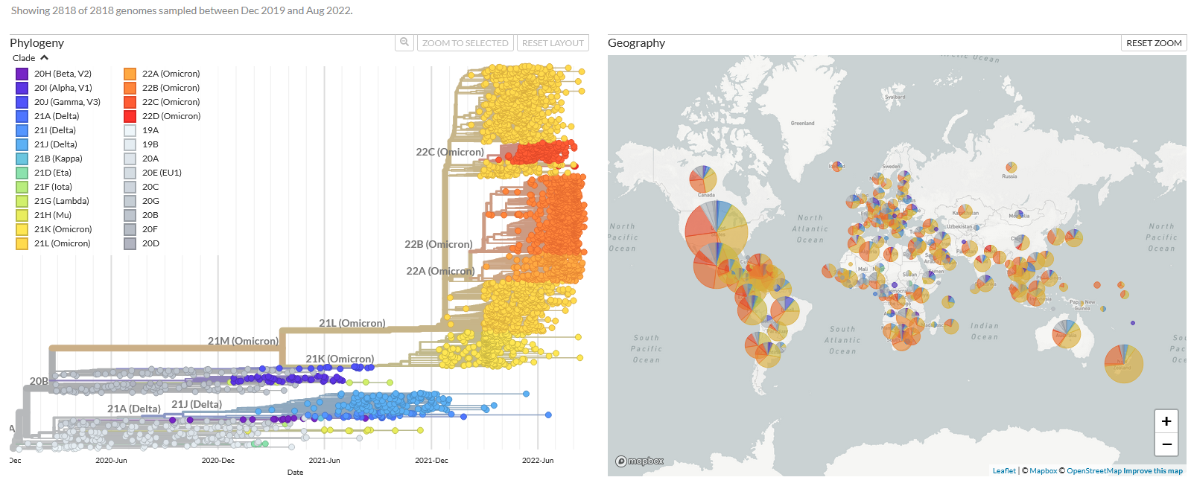
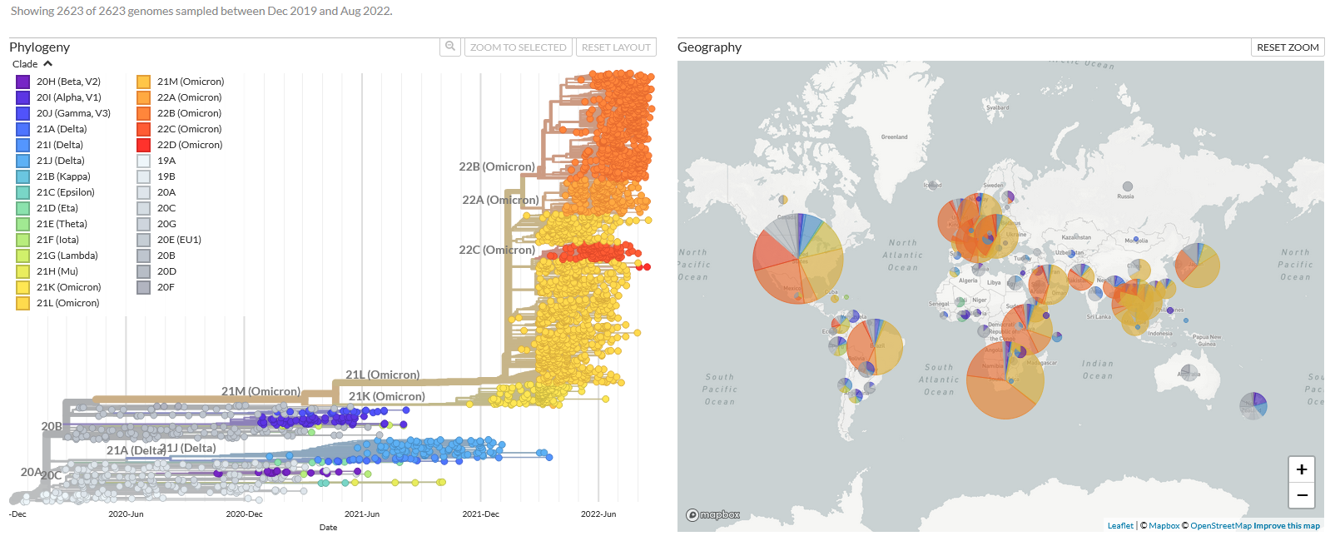
Nextstrain
Open-source repository
GISAID
Nextstrain
https://nextstrain.org
SARS-COV-2 and Data Sharing Policies

Slide 5
Research Question
Would the identification of SARS-CoV-2 variants of concern (alpha, beta, gamma, delta, omicron) have been significantly delayed if the investigators were limited to open data feeds?
SARS-COV-2 and Data Sharing Policies

Slide 6
Methods
SARS-COV-2 and Data Sharing Policies

Slide 7
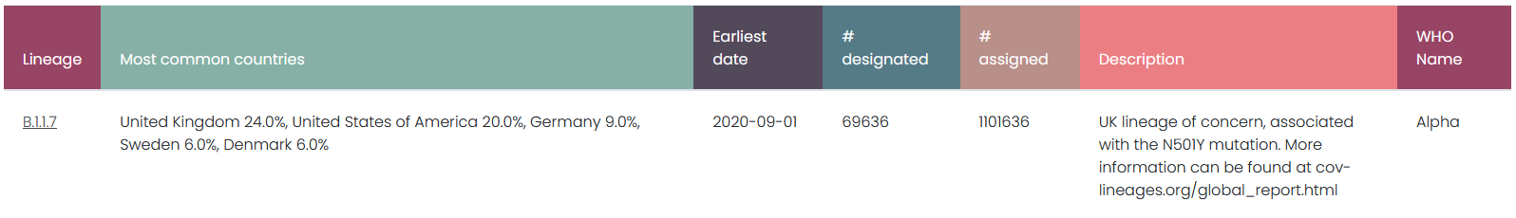
Publication delay
Comparison of the time delay from genome collection to genome submission
Random sample of n = 500
https://cov-lineages.org/
SARS-COV-2 and Data Sharing Policies

Slide 8
Detecting VoCs
Monthly Submission Date cutoffs (October 2020 — May 2022)
01
01
02
02
03
03
04
04
01
02
03
04
01
02
03
04
05
05
06
06
07
07
08
08
05
06
07
08
05
06
07
08
09
09
10
10
11
11
12
12
09
10
11
12
09
10
11
12
2020
2021
2022
SARS-COV-2 and Data Sharing Policies

Slide 9
Detecting VoCs
Monthly Submission Date cutoffs (October 2020 — May 2022)
01
01
02
02
03
03
04
04
01
02
03
04
01
02
03
04
05
05
06
06
07
07
08
08
05
06
07
08
05
06
07
08
09
09
10
10
11
11
12
12
09
10
11
12
09
10
11
12
2020
2021
2022
SARS-COV-2 and Data Sharing Policies

Slide 10
Detecting VoCs
Monthly Submission Date cutoffs (October 2020 — May 2022)
01
01
02
02
03
03
04
04
01
02
03
04
01
02
03
04
05
05
06
06
07
07
08
08
05
06
07
08
05
06
07
08
09
09
10
10
11
11
12
12
09
10
11
12
09
10
11
12
2020
2021
2022
SARS-COV-2 and Data Sharing Policies

Slide 11
Detecting VoCs
Monthly Submission Date cutoffs (October 2020 — May 2022)
01
01
02
02
03
03
04
04
01
02
03
04
01
02
03
04
05
05
06
06
07
07
08
08
05
06
07
08
05
06
07
08
09
09
10
10
11
11
12
12
09
10
11
12
09
10
11
12
2020
2021
2022
SARS-COV-2 and Data Sharing Policies

Slide 12
Detecting VoCs
Monthly Submission Date cutoffs (October 2020 — May 2022)
01
01
02
02
03
03
04
04
01
02
03
04
01
02
03
04
05
05
06
06
07
07
08
08
05
06
07
08
05
06
07
08
09
09
10
10
11
11
12
12
09
10
11
12
09
10
11
12
2020
2021
2022
SARS-COV-2 and Data Sharing Policies

Slide 13
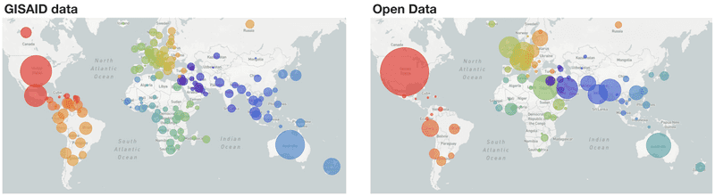
Geographic distribution
Top 10 submitting countries
https://nextstrain.org
SARS-COV-2 and Data Sharing Policies

Slide 14
Results
SARS-COV-2 and Data Sharing Policies

Slide 15
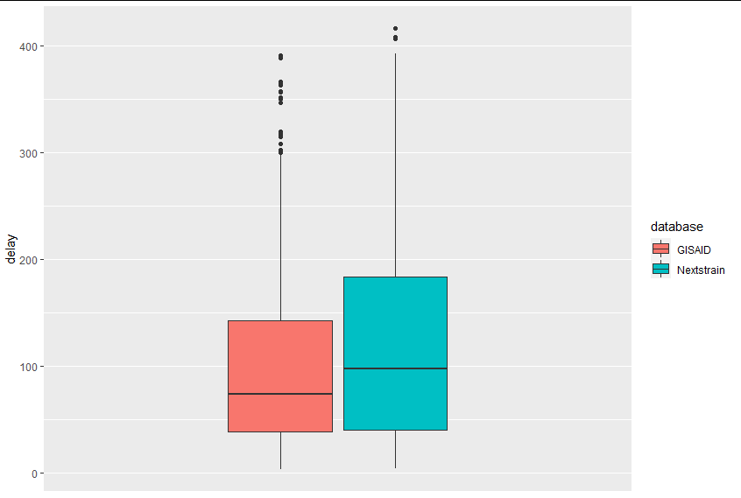
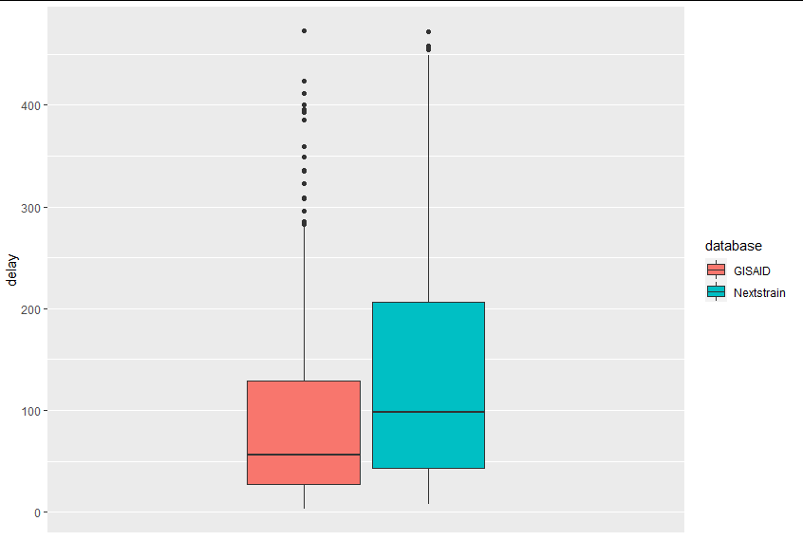
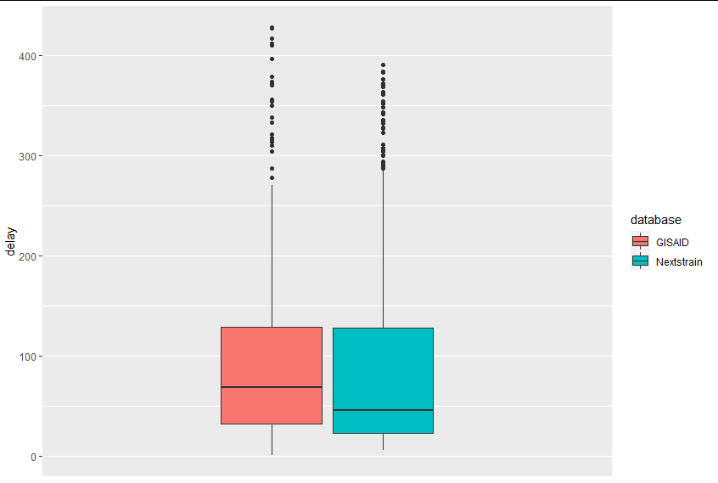
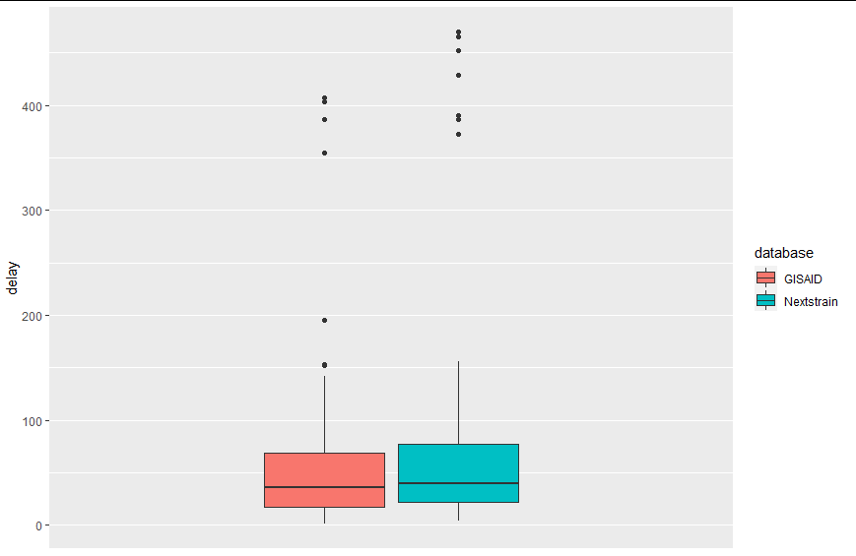
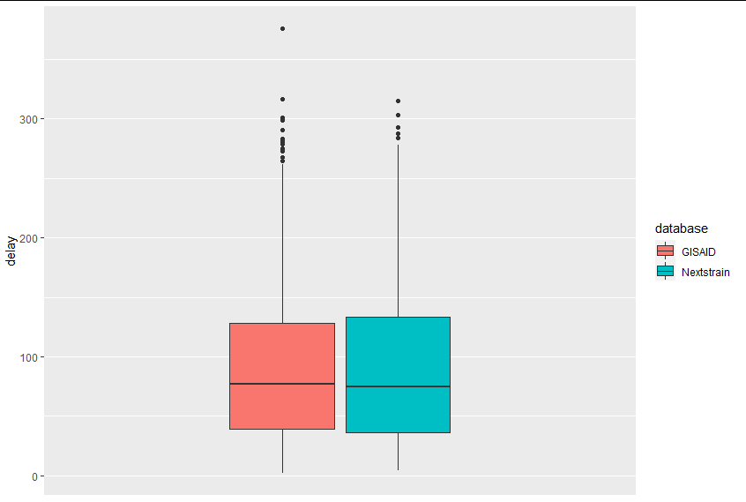
Publication Delay
Alpha
Beta
Gamma
Publication delay (days)
Delta
Omicron
SARS-COV-2 and Data Sharing Policies

Slide 16
Detecting VoCs
 | GISAID | Nextstrain
Alpha | 12-2020 | 02-2021
Beta | 12-2020 | 03-2021
Gamma | 02-2021 | 03-2021
Delta | 04-2021 | 10-2021
Omicron | 12-2021 | 03-2022
Earlier Submission Cut-Off date
SARS-COV-2 and Data Sharing Policies

Slide 17
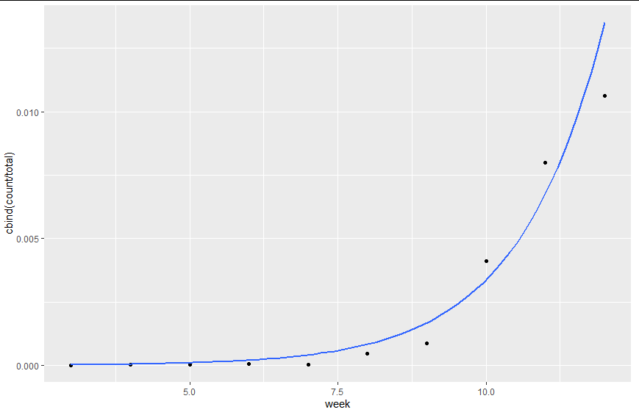
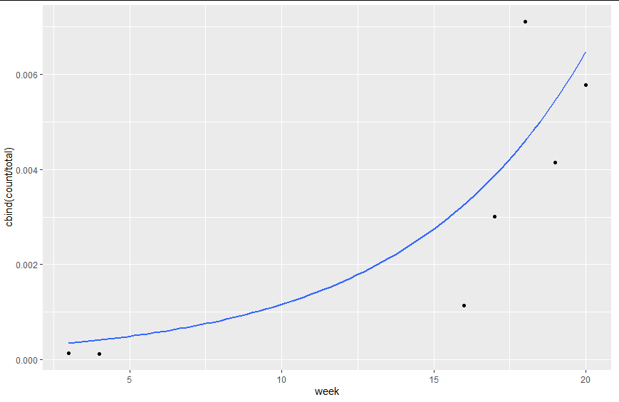
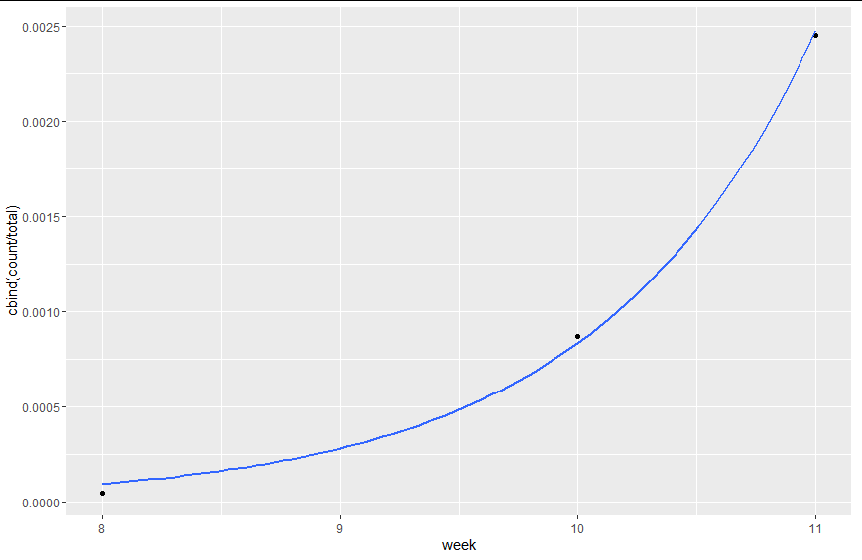
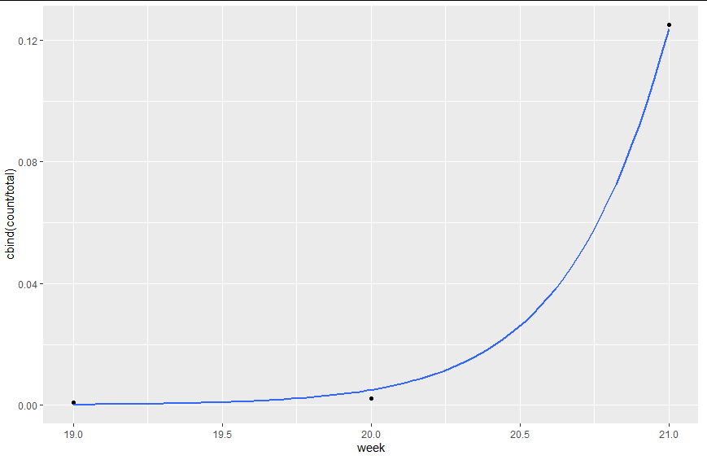
Detecting VoCs
GISAID
Nextstrain
Alpha
Relative Frequency of VoCs/week
Beta
SARS-COV-2 and Data Sharing Policies

Slide 18
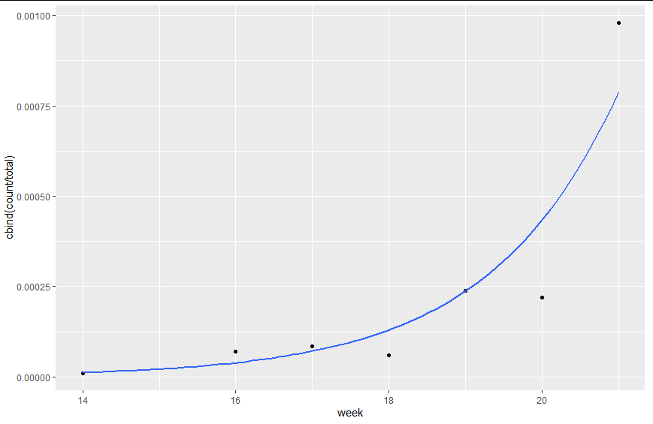

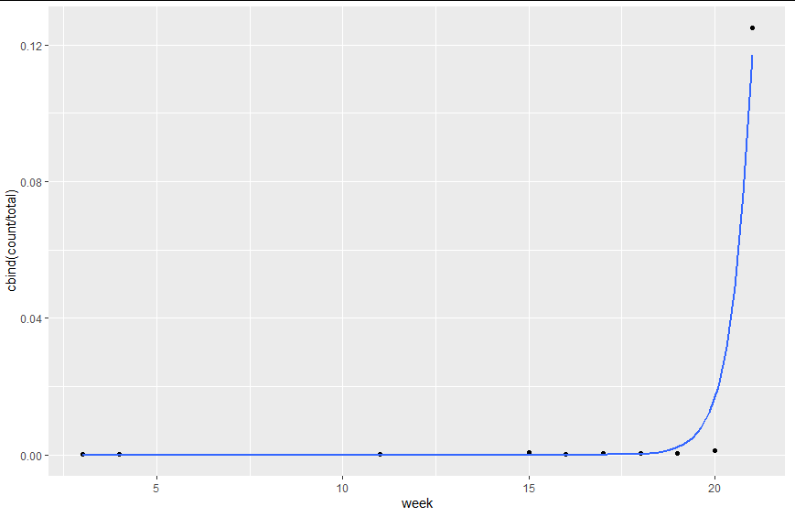
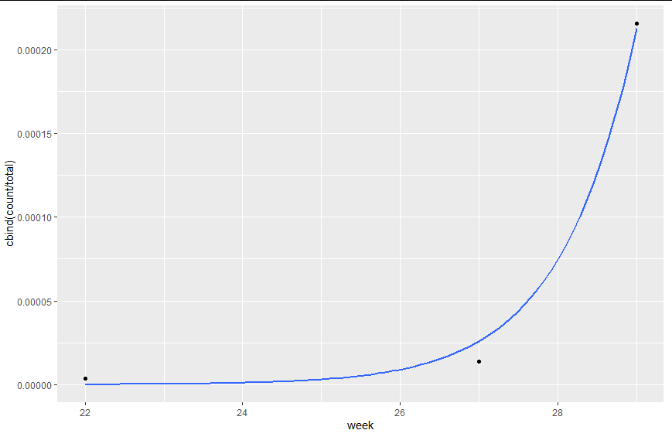
Detecting VoCs
GISAID
Nextstrain
Gamma
Relative Frequency of VoCs/week
Delta
SARS-COV-2 and Data Sharing Policies

Slide 19
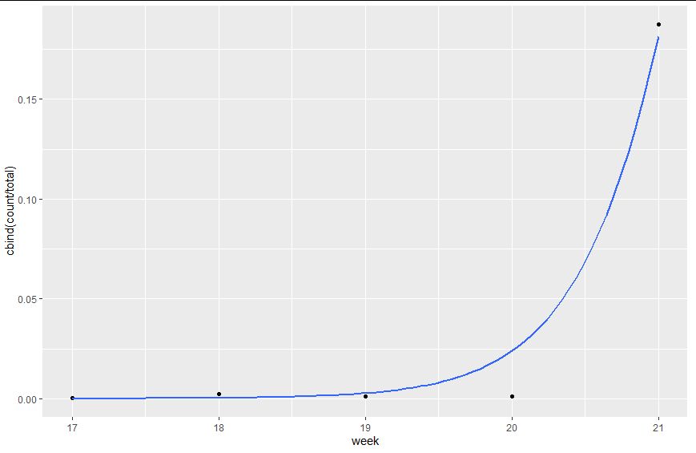
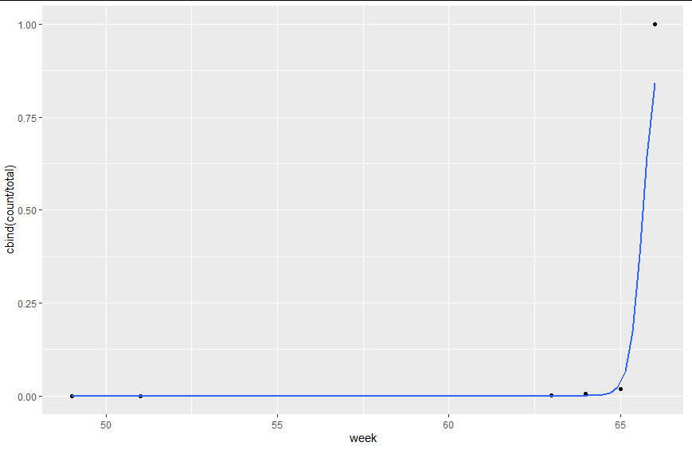
Detecting VoCs
GISAID
Nextstrain
Relative Frequency of VoCs/week
Omicron
SARS-COV-2 and Data Sharing Policies

Slide 20
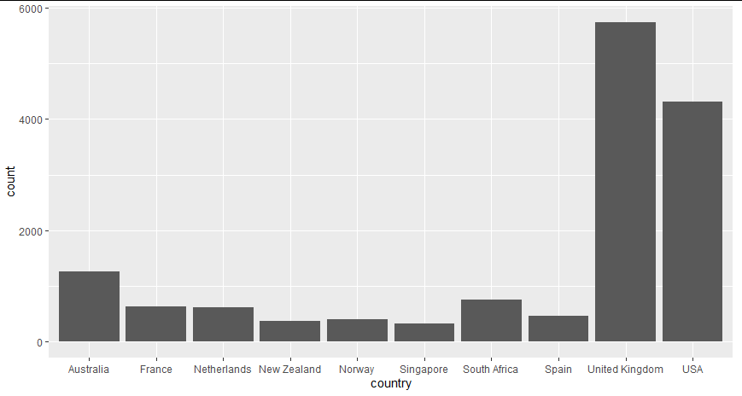
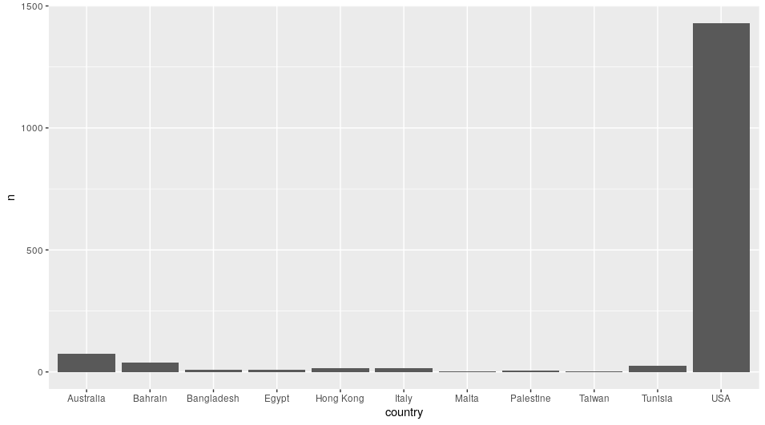
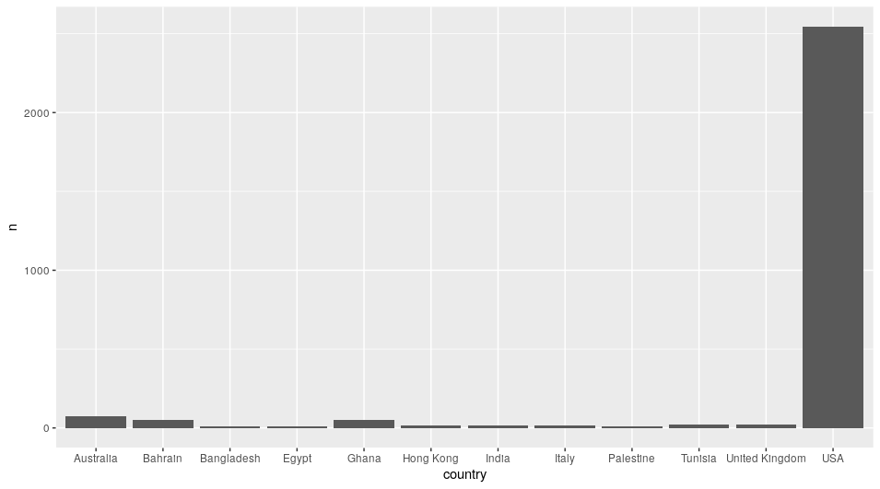
Geographic distribution
GISAID
Nextstrain
Alpha
Beta
SARS-COV-2 and Data Sharing Policies

Slide 21
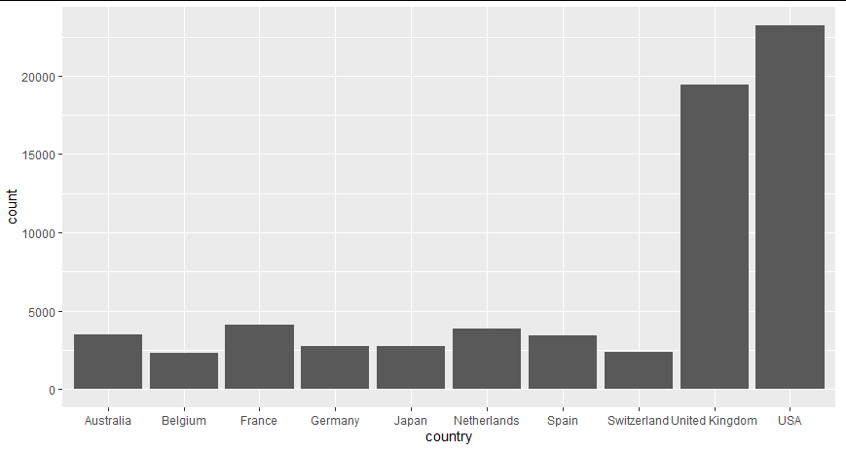
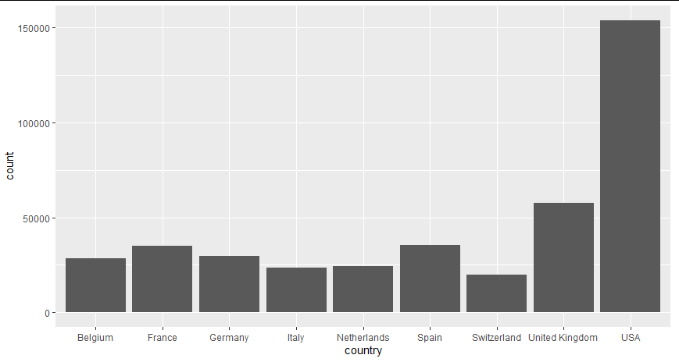
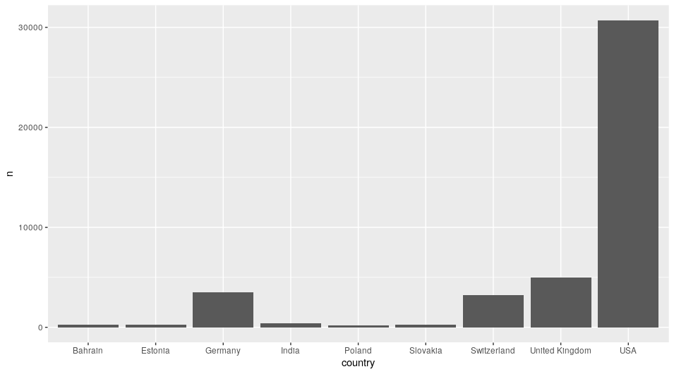
Geographic distribution
GISAID
Nextstrain
Gamma
Delta
SARS-COV-2 and Data Sharing Policies

Slide 22
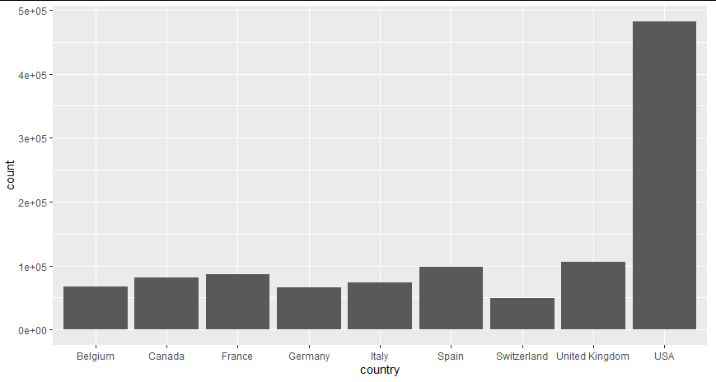
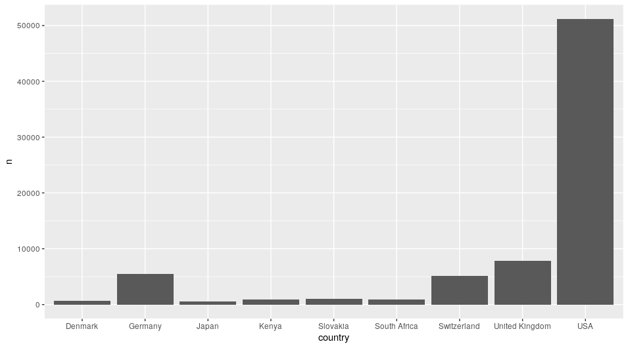
Geographic distribution
GISAID
Nextstrain
Omicron
SARS-COV-2 and Data Sharing Policies

Slide 23
Implications
SARS-COV-2 and Data Sharing Policies

Slide 24


Open data feeds significantly delays the detection of VoCs
Smaller repository of SARS-CoV-2 sequences
Publication delay for certain VoCs
Limited geographic distribution—limits generalizability
SARS-COV-2 and Data Sharing Policies

Slide 25
References
McLaughlin, A., Montoya, V., Miller, R. L., Mordecai, G. J., Worobey, M., Poon, A., & Joy, J. B. (2021) Early and ongoing importations of SARS-CoV-2 in Canada. MedRxiv. https://doi.org/10.1101/2021.04.09.21255131.
Bedford, T., Hadfield, J., Hodcoft, E., Huddlestone. J., Neher, R., & Sibley, T. (2021, July 8) Extension of SARS-CoV-2 data processing to incorporate Open Data through GenBank. Nextstrain. https://nextstrain.org/blog/2021-07-08-ncov-open-announcement.
Bernasconi, A., Canakoglu, A., Masseroli, M., Pinoli, P., & Ceri, S. (2021). A review on viral data sources and search systems for perspective mitigation of COVID-19. Briefings in bioinformatics, 22(2), 664–675. https://doi.org/10.1093/bib/bbaa359.
Cohen, J. (2020, January 11) Chinese researchers reveal draft genome of virus implicated in Wuhan pneumonia outbreak. ScienceInsider. https://www.science.org/content/article/chinese-researchers-reveal-draft-genome-virus-implicated-wuhan-pneumonia-outbreak.
Maxem, A. (2021) Why some researchers oppose unrestricted sharing of coronavirus genome data. Nature, 593, 176-177. https://doi.org/10.1038/d41586-021-01194-6.
Ferreria, R.-C., Wong, E., Gugan, G., Wade, K., Liu, M., MuñozBaena, L., Chato, C., Lu, B., Olabode, A. S, Poon, A. F. Y. (2021) CoVizu: Rapid analysis and visualization of the global diversity of SARS-CoV-2 genomes. Virus Evolution, 7(2), 1-7.
Wadman, M. (2021, March 10). Critics decry access, transparency issues with key trove of coronavirus sequences. ScienceInsider. https://www.science.org/content/article/critics-decry-access-transparency-issues-key-trove-coronavirus-sequences.
SARS-COV-2 and Data Sharing Policies

Slide 26
 | GISAID | Nextstrain
Alpha | December 2020 | February 2021
Beta | December 2020 | March 2021
Gamma | February 2021 | March 2021
Delta | April 2021 | October 2021
Omicron | December 2021 | March 2022

Slide 27
VoC
Collection Date
Submission Date
Country
. . .
Alpha
.
.
.
Beta
Gamma
Delta
Omicron

Slide 28
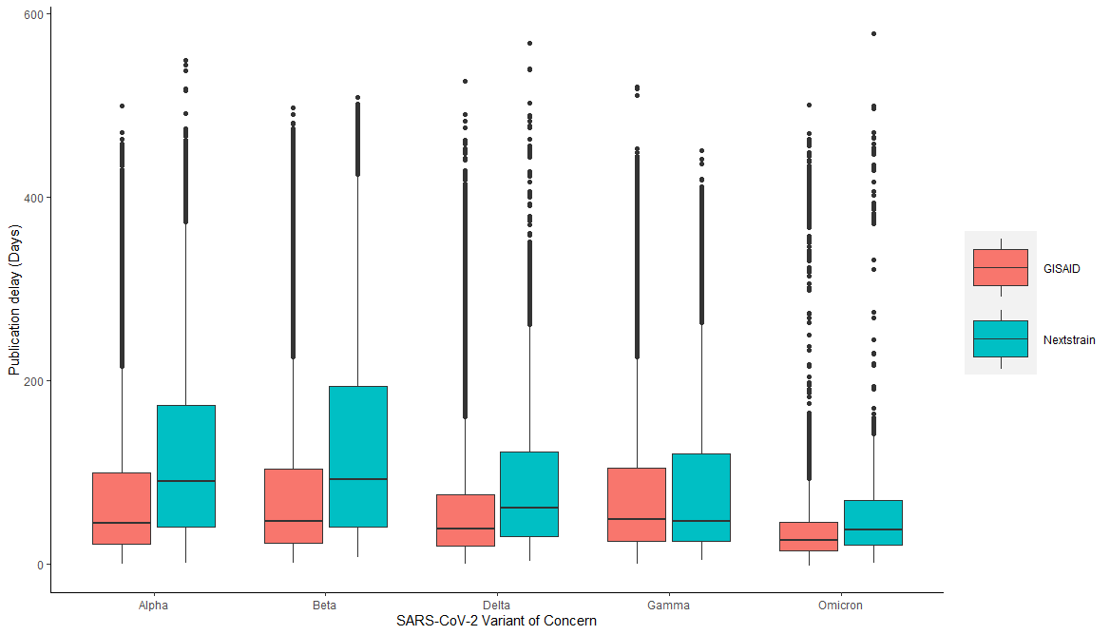
*
*
*
*
*

Slide 29
