Slide 1


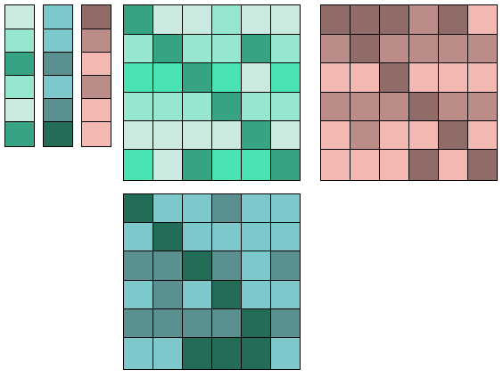

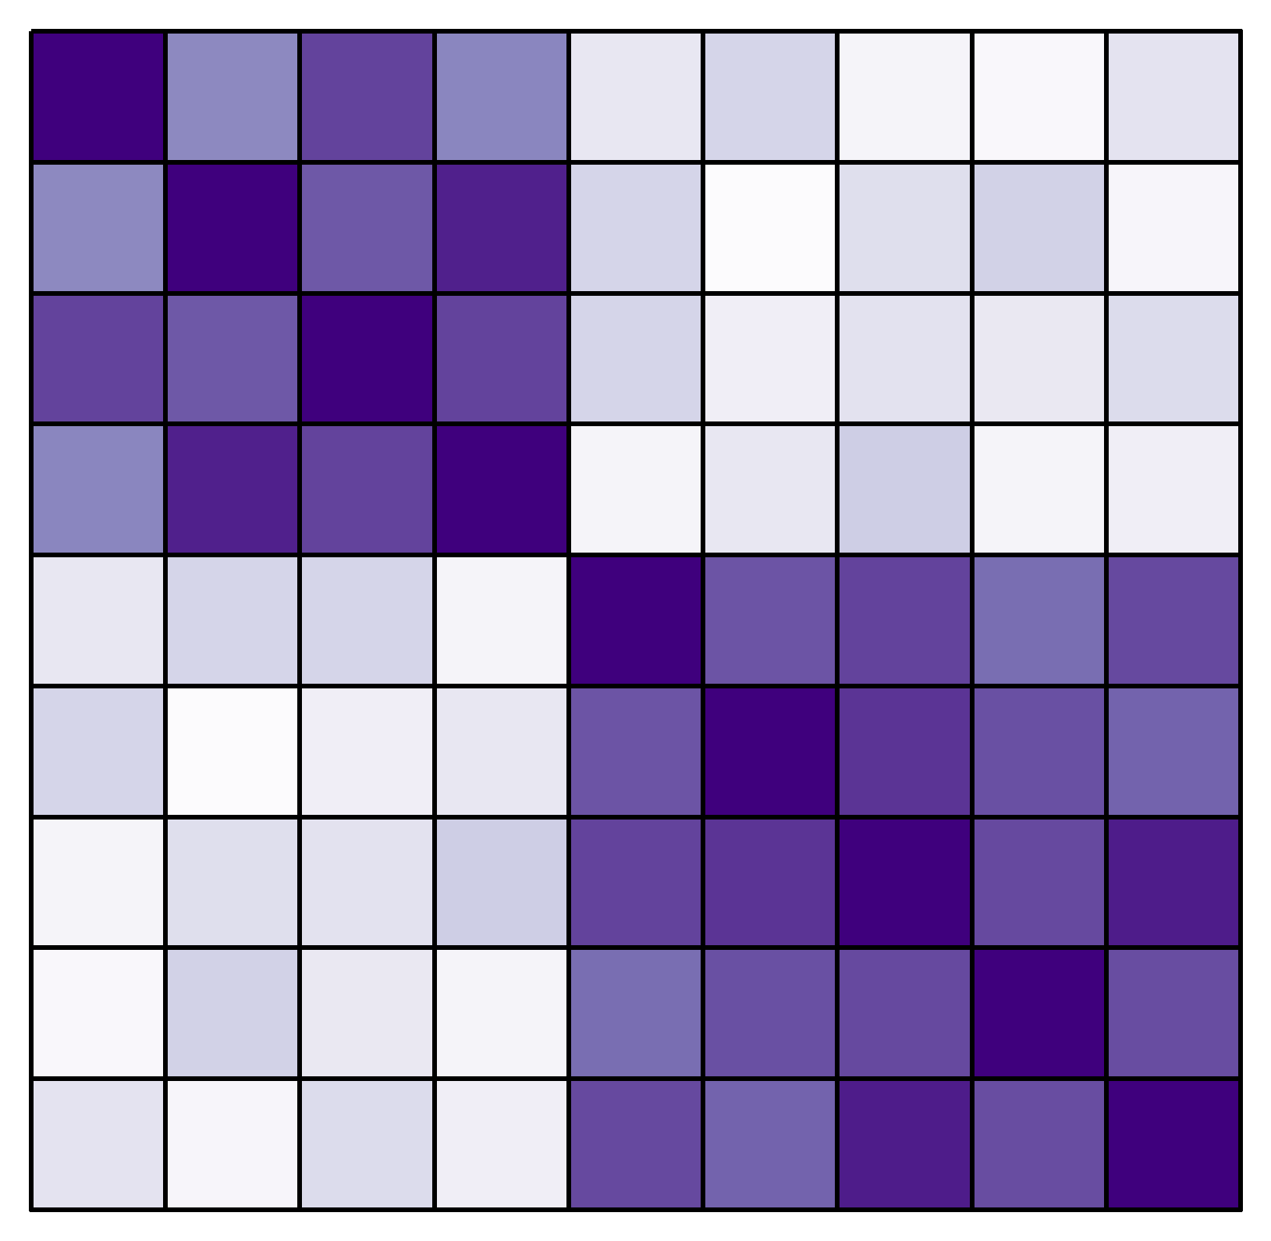
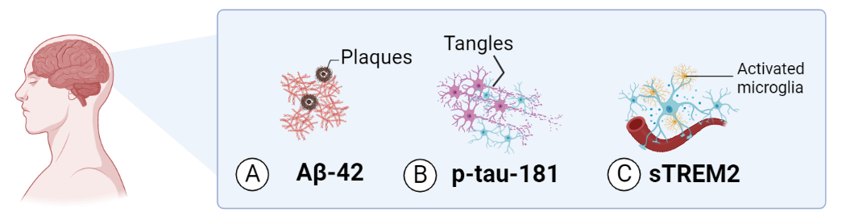

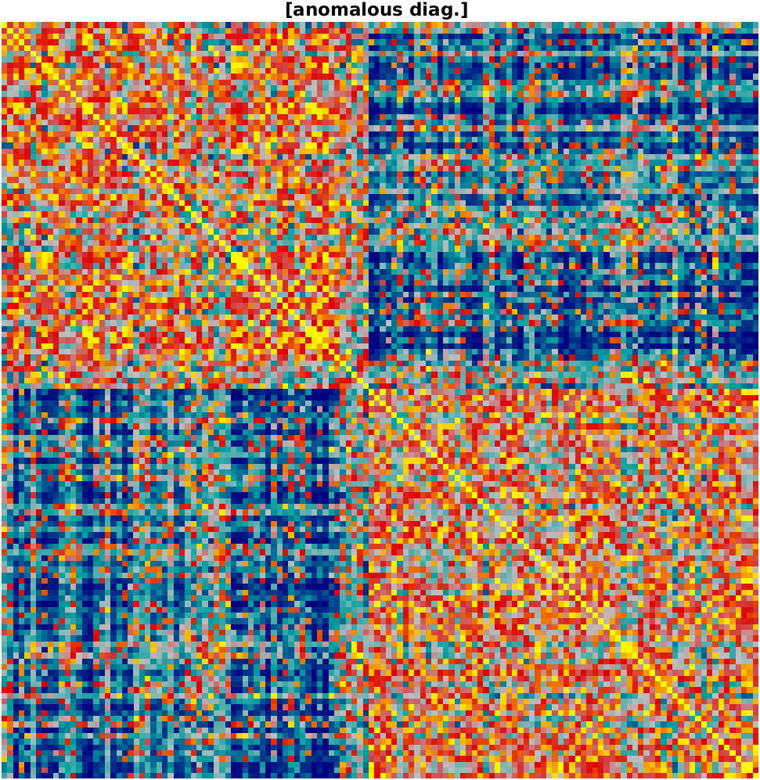
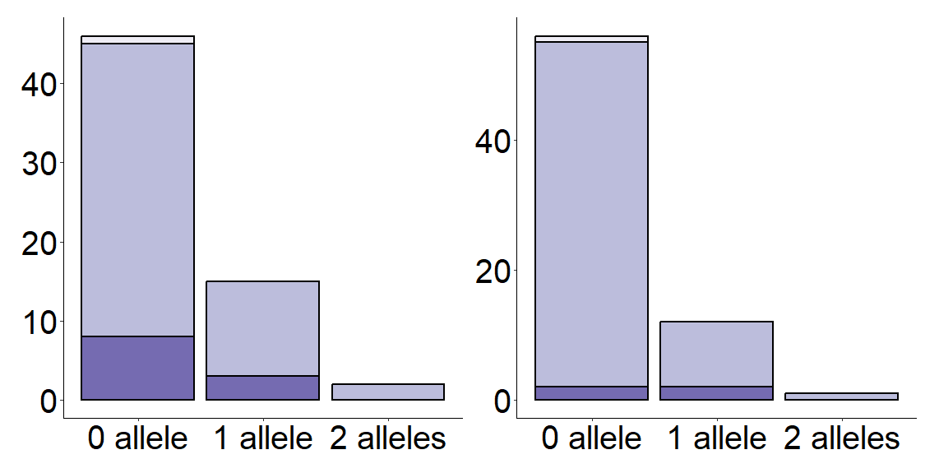
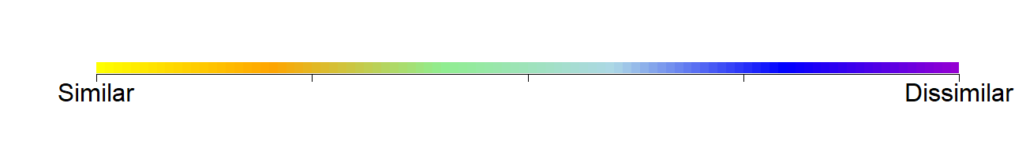
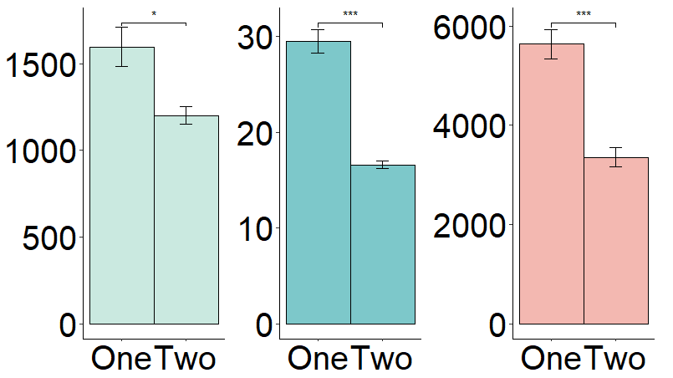
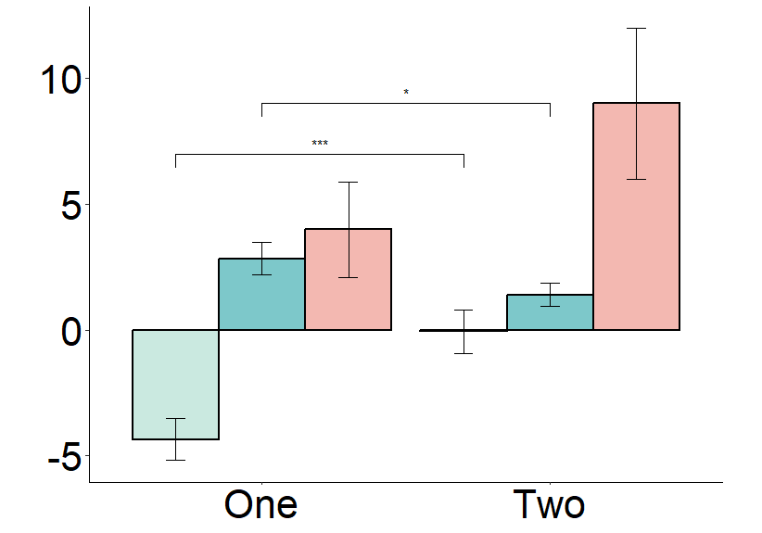
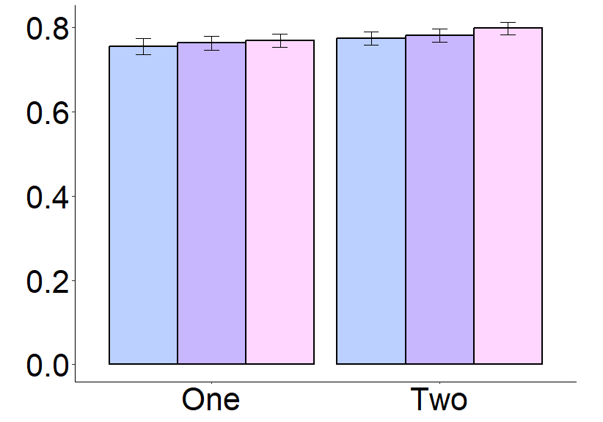
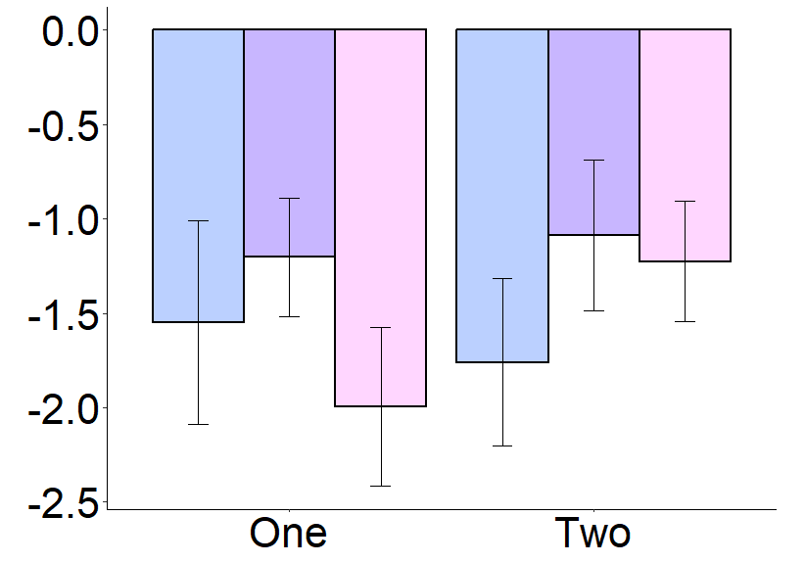
Multivariate analysis of longitudinal cerebrospinal fluid biomarkers
of pathophysiology in preclinical Alzheimer’s disease
Lucy Hui, Bahaaldin Helal, Taylor W. Schmitz
Department of Physiology and Pharmacology, Schulich School of Medicine and Dentistry, University of Western Ontario, London, ON, Canada
BACKGROUND
METHODS
Cerebrospinal Fluid (CSF) Biomarkers
Distinct pathological features of Alzheimer’s disease (AD) [1]:
Senile plaques composed of amyloid β -protein (Aβ)
Neurofibrillary tangles composed of phosphorylated tau (p-tau)
Reactive microglia producing soluble trigger receptors expressed on myeloid cells 2 (sTREM2) [2]
APOE e4 allele
The greatest genetic risk factor encoding apolipoprotein E protein (ApoE) [3]
Similarity Network Fusion (SNF)
Studies evaluating CSF biomarkers have been using univariate and cross-sectional analyses, which fail to capture the dynamic biomarker interactions and trajectories [4]
SNF—a novel data integration technique—presents a balanced analysis of multimodal data while accounting for patient heterogeneity [5]
Alzheimer’s Disease Neuroimaging Initiative (ADNI)
Similarity Network Fusion (SNF)
ADNI (N = 819)
2 Timepoints
4 Modalities
CN Cohort (n = 132)
Raw Matrices
Patient Similarity Matrices
Single Fused Matrix
Clustering
Timepoints
Baseline
Final Follow-up
Baseline
APC
Patients
Patients
Cluster 1
Annual Percentage
Change (APC)
Time 2
365
=
Time 1
Intervals
-1 X 100%
Patients
Patients
Patients
Modalities
Biomarkers
APOE genotype
Cognitive assessments
Diagnosis
Cluster 2
Aβ
p-tau
sTREM2
0 e4 allele
1 e4 allele
2 e4 alleles
Executive Function
Language
Memory
CN
MCI
AD
Similarity
Aβ
ptau
sTREM2
RESULTS — APOE e4 Alleles & Final AD Diagnosis
DISCUSSION
Patients
Similarity
X² = 4.4727
AD
SNF detected two clusters of participants with unique CSF biomarker profiles exhibiting distinct baseline levels of Aβ, p-tau, and sTREM2 as well as distinct trajectories of Aβ and p-tau over the course of the study (Fig. 2 & Fig. 4)
Cognition in all three domains declined in both clusters, suggesting strong age-related effects (Fig. 5)
None of the participants with two e4 alleles transitioned to the AD group by the end of the study. The two participants that transitioned from NC to AD had zero e4 alleles. This suggests that the APOE genotype is not sensitive or specific to the clinical diagnosis of AD (Fig. 3).
Ultimately, the findings from this study demonstrate that longitudinal multivariate analysis of CSF biomarkers do not predict the APOE e4 allele status or identify patients in the preclinical stages of AD
Future studies will investigate whether the integration of imaging biomarkers with CSF biomarkers will detect the asymptomatic trajectories of AD pathology with greater confidence
CN
Patients
Total number of participants
MCI
0 allele 1 allele 2 alleles
0 allele 1 allele 2 alleles
Figure 2. Fused patient similarity network matrix derived from. Cluster one, n=63; Cluster two, n=69.
Cluster one
Cluster two
Figure 3. APOE e4 and final AD diagnosis
Aβ
RESULTS — Cerebrospinal Fluid Biomarkers
Biomarker Levels
ptau
A) Baseline
B) Annual Percentage Change
Aβ
sTREM2
*
***
***
*
ptau
CN
MCI
AD
***
sTREM2
Clinical AD Stage
Average Baseline CSF Biomarker Levels (pg/mL)
Average APC CSF
Biomarker Levels (%)
Figure 1. Dynamic biomarkers of Alzheimer’s pathological cascade. CN = Cognitively Normal. MCI = Mild Cognitive Impairment.
OBJECTIVES
1 2
1 2
1 2
One
Clusters
Two
REFERENCES
Clusters
Detect distinct AD phenotypes based on CSF biomarkers using the patient similarity networks constructed by SNF
Determine whether the CSF biomarker profiles can identify patients in the preclinical stages of AD
Examine whether the APOE genotype is associated with the distinct CSF biomarker profiles detected by SNF
Figure 4. Average CSF biomarker levels at baseline (A) and APC time points (B). *p<0.05, **p<0.01, ***p<0.001.
Anoop A, Singh PK, Jacob RS, and Maji SK (2010) CSF Biomarkers for Alzheimer’s Disease Diagnosis. Int J Alzheimers Dis 2010:606802.
Zhong L, Chen X-F, Wang T, Wang Zhe, Liao C, Wang Zongqi, Huang R, Wang D, Li X, Wu L, Jia L, Zheng H, Painter M, Atagi Y, Liu C-C, Zhang Y-W, Fryer JD, Xu H, and Bu G (2017) Soluble TREM2 induces inflammatory responses and enhances microglial survival. J Exp Med 214:597–607.
Liu C-C, Kanekiyo T, Xu H, and Bu) Apolipoprotein E and Alzheimer disease: risk, mechanisms, and therapy. Nat Rev Neurol 9:106–118. G (2013
Jack CR, Knopman DS, Jagust WJ, Shaw LM, Aisen PS, Weiner MW, Petersen RC, and Trojanowski JQ (2010) Hypothetical model of dynamic biomarkers of the Alzheimer’s pathological cascade. Lancet Neurol 9:119.
Wang B, Mezlini AM, Demir F, Fiume M, Tu Z, Brudno M, Haibe-Kains B, and Goldenberg A (2014) Similarity network fusion for aggregating data types on a genomic scale. Nat Methods 11:333–337, Nature Publishing Group.
RESULTS — Cognitive Assessments
A) Baseline
B) Annual Percentage Change
Executive function
HYPOTHESIS
Average Baseline Composite Cognitive Scores (Percentile)
Average APC Composite Cognitive Scores (%)
Language
Memory
Longitudinal multivariate analysis of CSF biomarkers will reveal clusters of patients associated with the APOE genotype and predict AD disease progression
ACKNOWLEDGEMENTS
One
Clusters
Two
One
Clusters
Two
I would like to thank Bahaaldin Helal and Dr. Taylor Schmitz for their ongoing support and guidance throughout this thesis project.
Figure 5. Cognition at baseline (A) and APC time points (B). Bars represent mean ± SEM.

