Slide 1

Department of Physiology and Pharmacology
Effects of LM11A-31 on longitudinal
cerebrospinal fluid biomarkers
of pathophysiology in
Alzheimer’s disease
Lucy Hui
Supervisor: Dr. Taylor Schmitz

Slide 2

Introduction

Slide 3
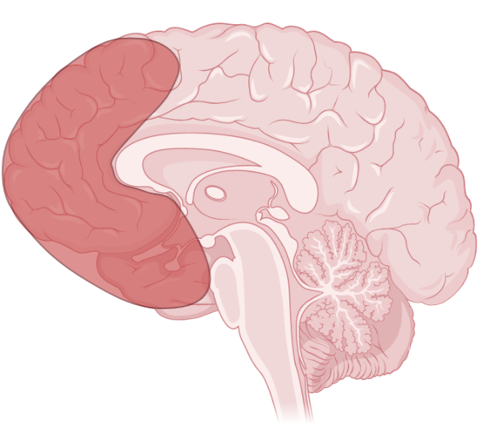
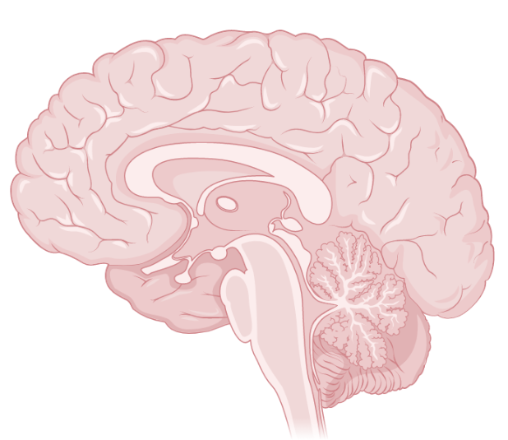
Alzheimer’s Disease (AD)
Basal Forebrain

Slide 4
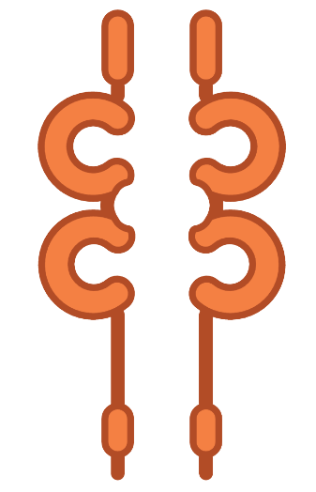

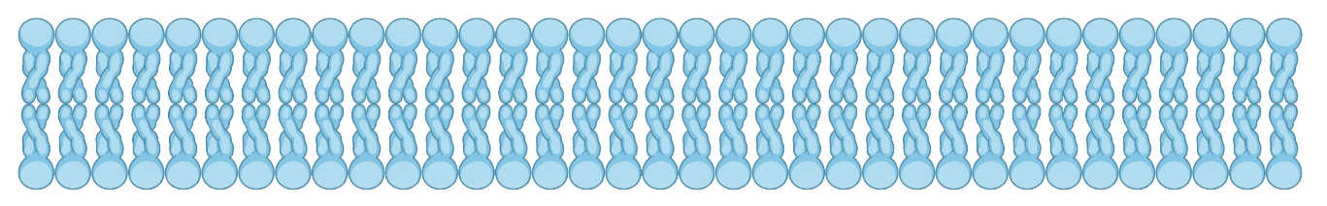
Alzheimer’s Disease (AD)
TrkA
p75
(Costantini et al., 2005, Biochem J)

Slide 5

Alzheimer’s Disease (AD)
TrkA
p75
(Costantini et al., 2005, Biochem J)
Sphingomyelinase

Slide 6

Alzheimer’s Disease (AD)
Sphingomyelin
Ceramide
Sphingomyelinase
(Costantini et al., 2005, Biochem J)

Slide 7
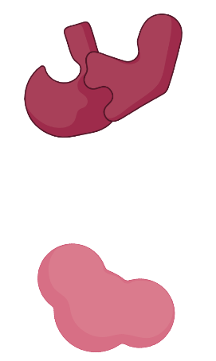
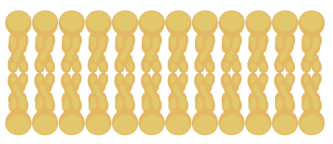
Alzheimer’s Disease (AD)
β secretase
Ceramide
γ secretase
(Takasugi et al., 2015, Biochem Biophys Res Commun)

Slide 8

Alzheimer’s Disease (AD)
β secretase
γ secretase
Amyloid Precursor Protein

Slide 9
Alzheimer’s Disease (AD)
β secretase
Amyloid β (Aβ)
γ secretase
Amyloid Precursor Protein

Slide 10
Alzheimer’s Disease (AD)
p75
Aβ
(Patnaik et al., 2020, Nature)

Slide 11
Alzheimer’s Disease (AD)
p75
Aβ
JNK
(Patnaik et al., 2020, Nature)
CELL DEATH

Slide 12

Alzheimer’s Disease (AD)
Aβ plaques
Aβ
Amyloid Precursor Protein

Slide 13

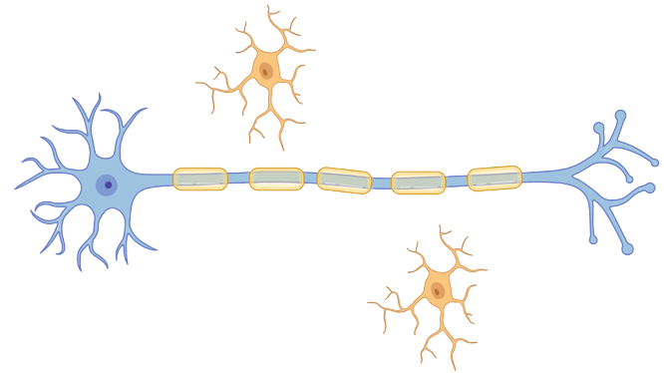
Alzheimer’s Disease (AD)
Aβ plaques
Microglia
(Kinney et al., 2018, Alzheimers Dement)
sTREM2

Slide 14
Alzheimer’s Disease (AD)
Aβ plaques
Microglia
sTREM2
(Kinney et al., 2018, Alzheimers Dement)
CELL DEATH

Slide 15

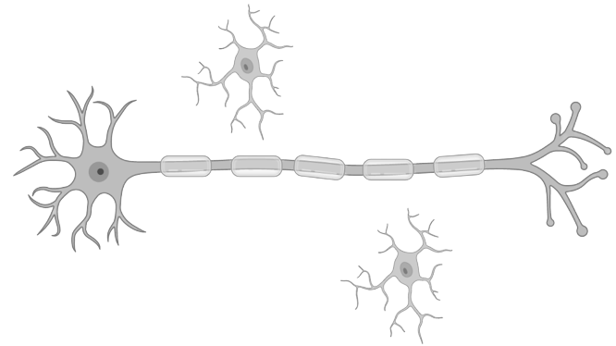
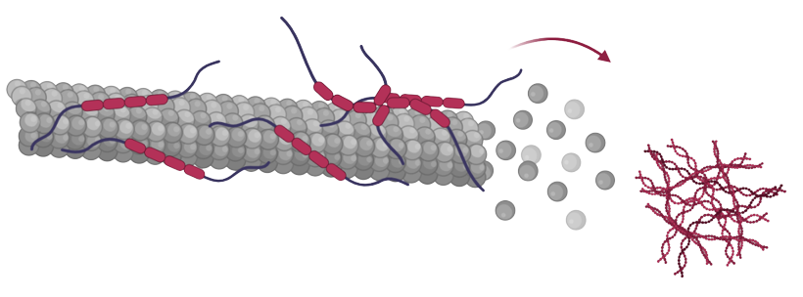
Alzheimer’s Disease (AD)
(Shen et al., 2019, Neurobio dis)
p75
Aβ
Neurofibrillary
tangle
phosphorylated Tau (pTau)

Slide 16

Alzheimer’s Disease (AD)
Neurofibrillary
tangle
pTau
CELL DEATH

Slide 17
Alzheimer’s Disease (AD)
Aβ
p75
LM11A-31
(Simmons et al., 2014, PLoS One)
CELL SURVIVAL

Slide 18

Cerebrospinal fluid (CSF)

Slide 19
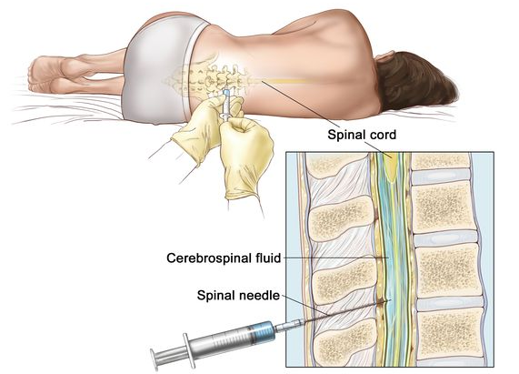
Cerebrospinal fluid (CSF)

Slide 20
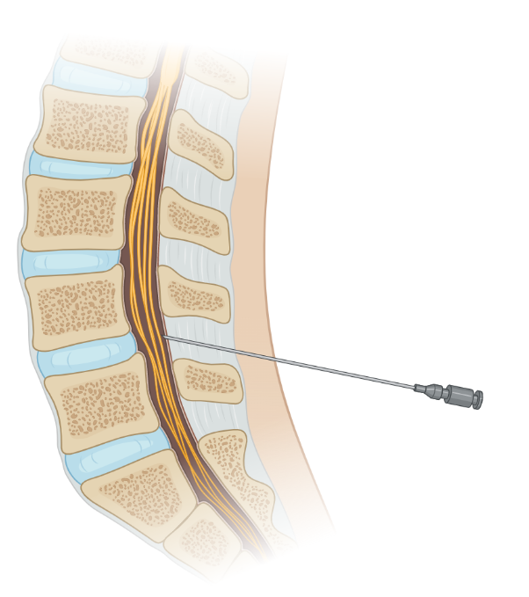
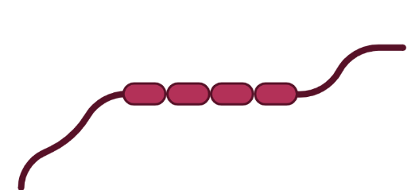
Cerebrospinal fluid (CSF)
Aβ
pTau
sTREM2
TREATMENT EFFECTIVENESS

Slide 21
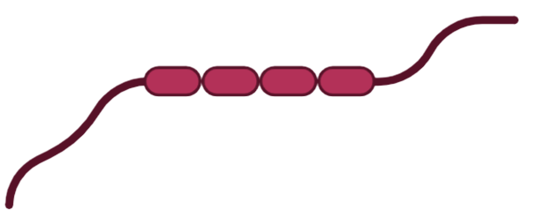
Rationale
Aβ
pTau
sTREM2
Time
UNIVARIATE & CROSS-SECTIONAL

Slide 22
Rationale
Aβ
pTau
sTREM2
Time

Slide 23
Rationale
Aβ
pTau
sTREM2
CSF
biomarker
levels
Time

Slide 24
Rationale
Aβ
pTau
sTREM2
CSF
biomarker
levels
Time
MULTIVARIATE & LONGITUDINAL

Slide 25
Hypothesis
Longitudinal multivariate analysis of CSF biomarkers will detect distinct phenotypes of biomarker interactions and trajectories associated with the treatment responder group in comparison to the treatment non-responder group.
LM11A-31

Slide 26
Methods

Slide 27
Clinical Trial Dataset
n = 150
Baseline
After
Placebo
Treatment
Placebo
Treatment
Aβ
pTau
sTREM2

Slide 28






Similarity Network Fusion (SNF)
Step 1: Original Data
BASELINE
AFTER
Patients
Aβ
pTau
sTREM2

Slide 29
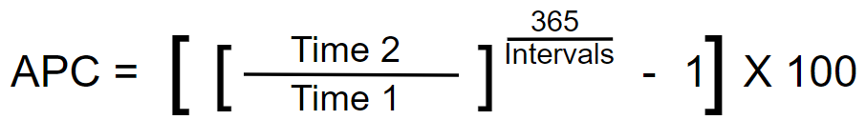
Similarity Network Fusion (SNF)
Step 1: Original Data
Notes:
365

Slide 30
Similarity Network Fusion (SNF)
Step 1: Original Data
BASELINE
APC
Patients
Aβ
pTau
sTREM2

Slide 31
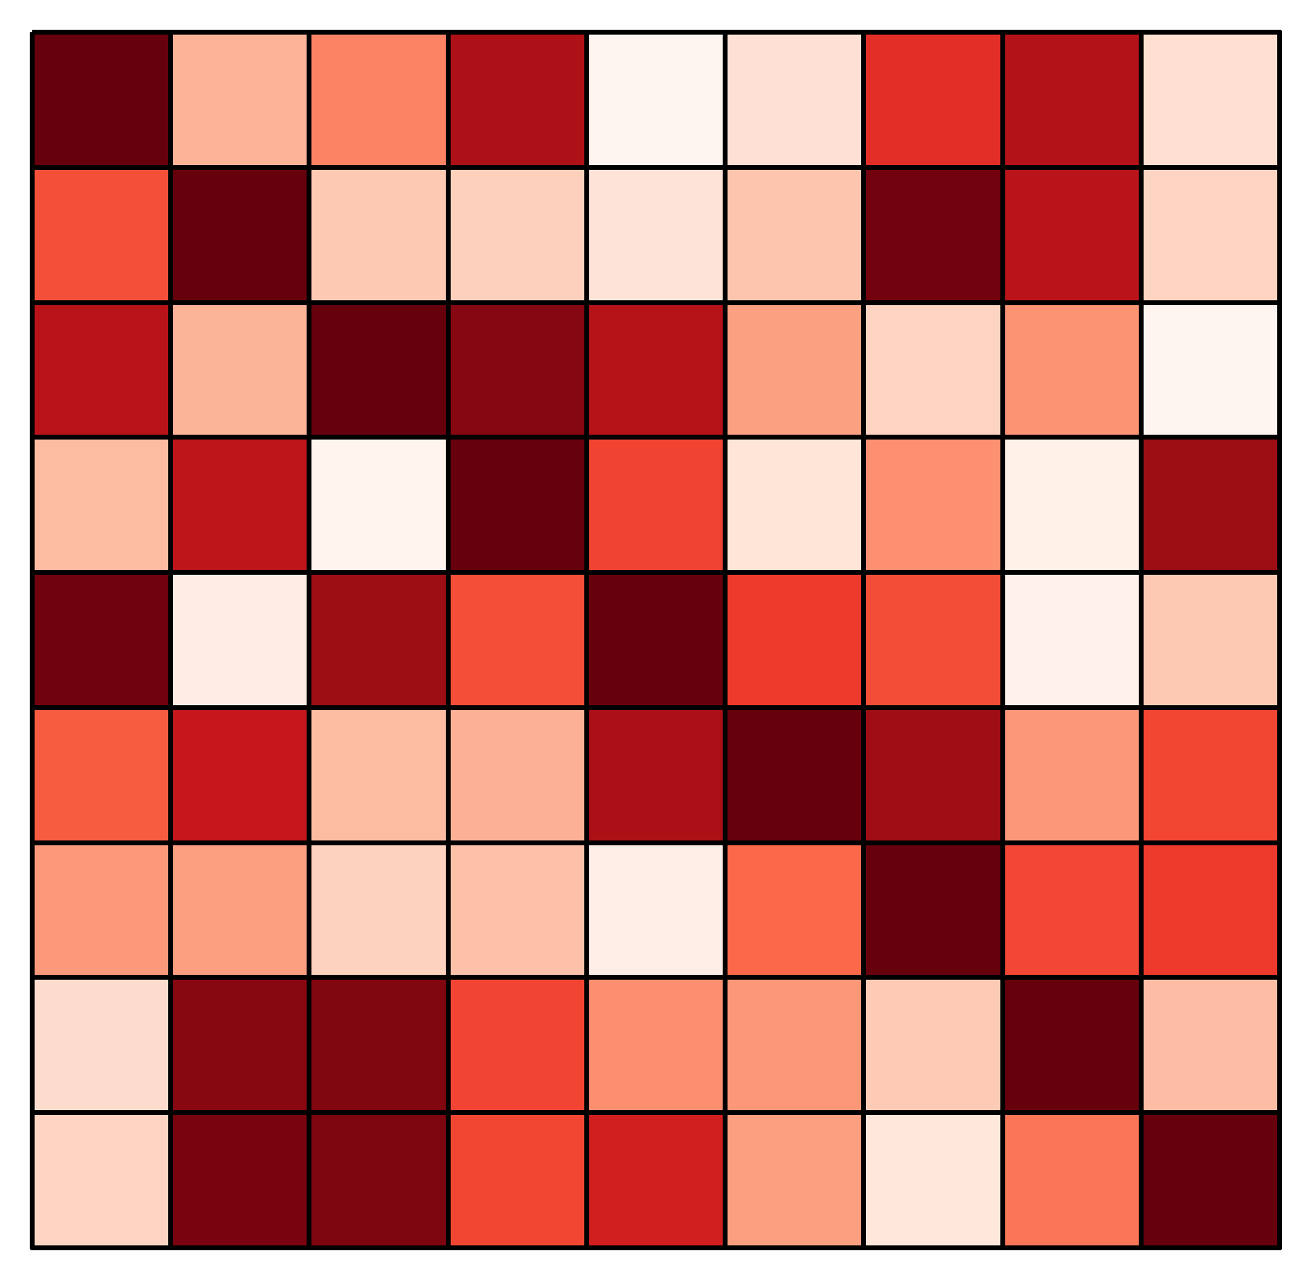
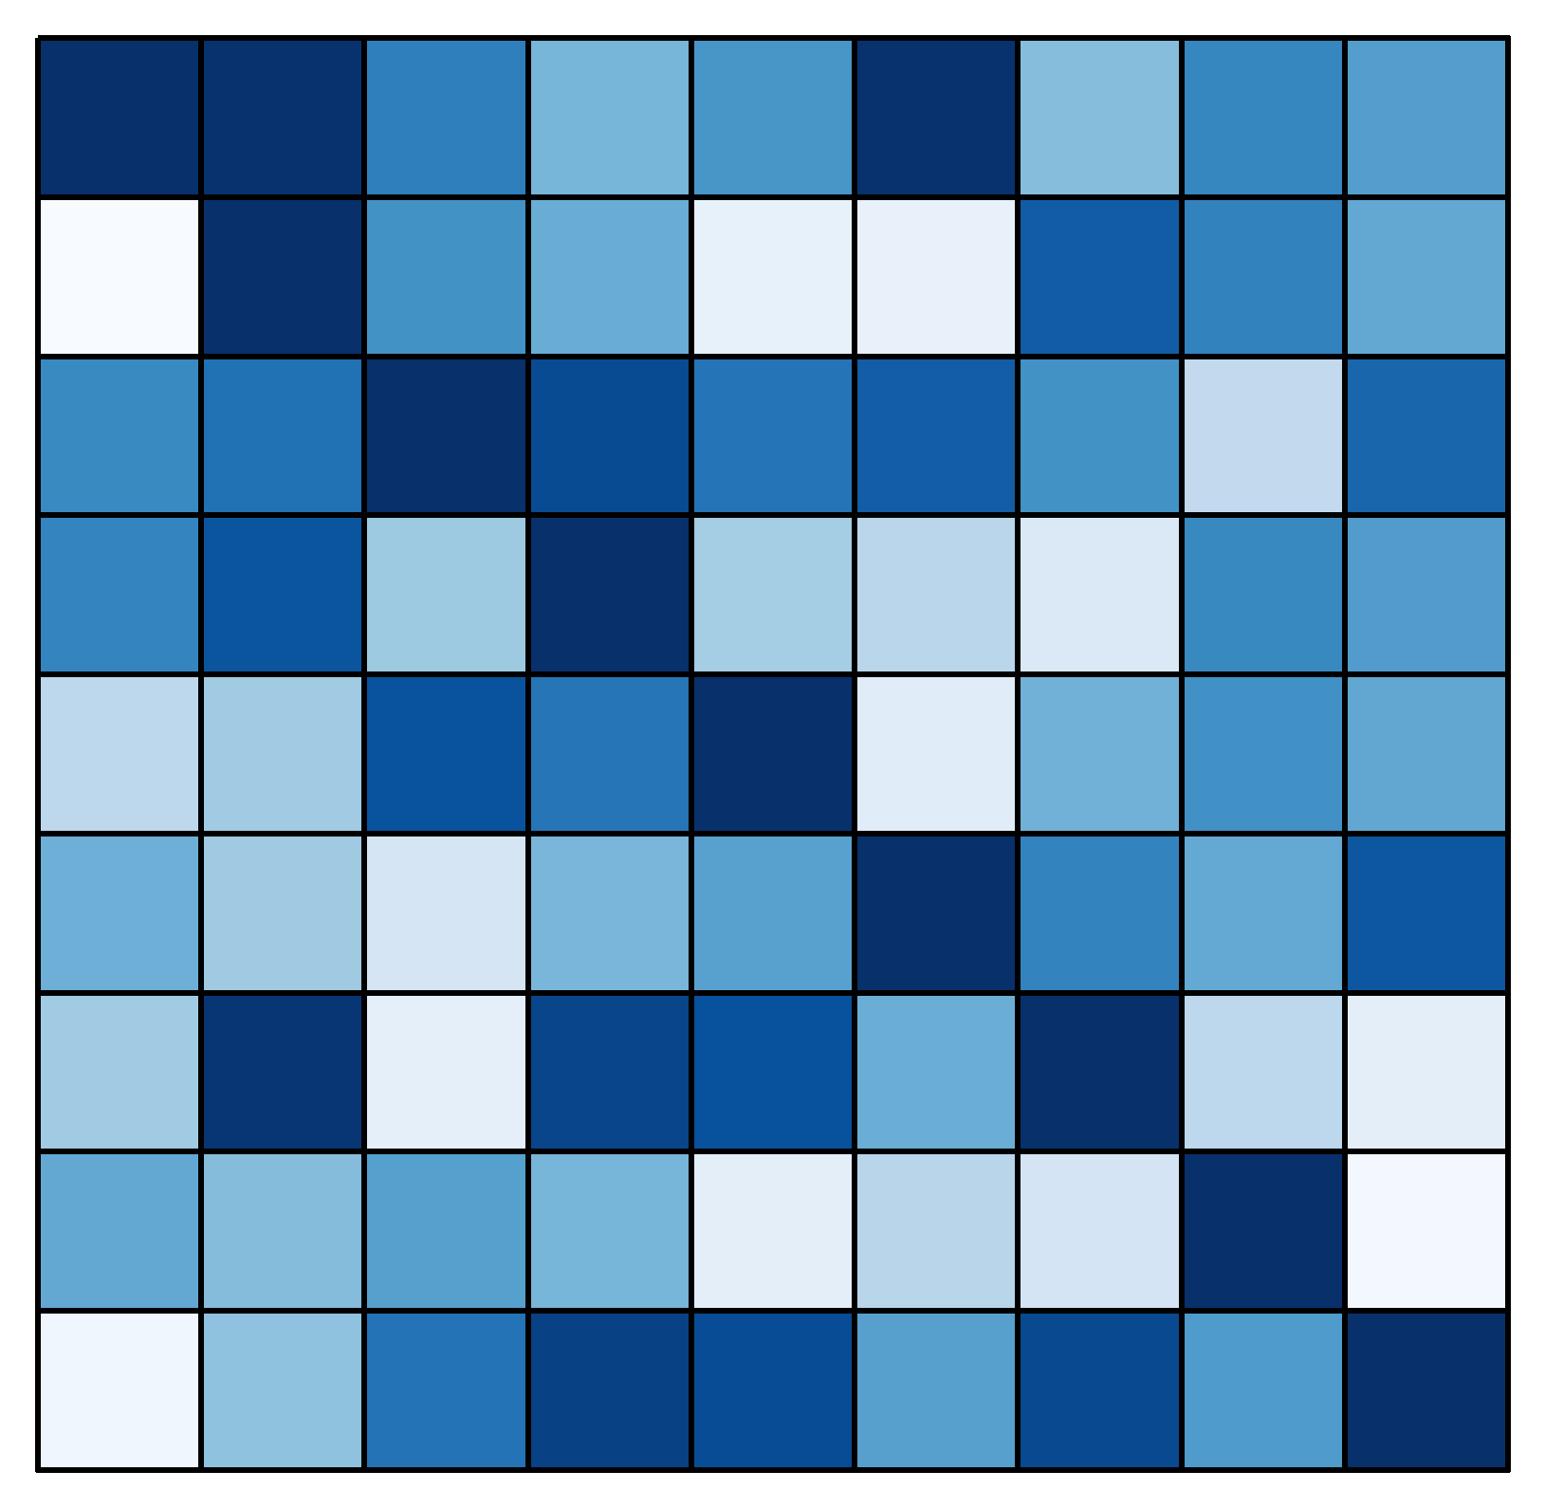
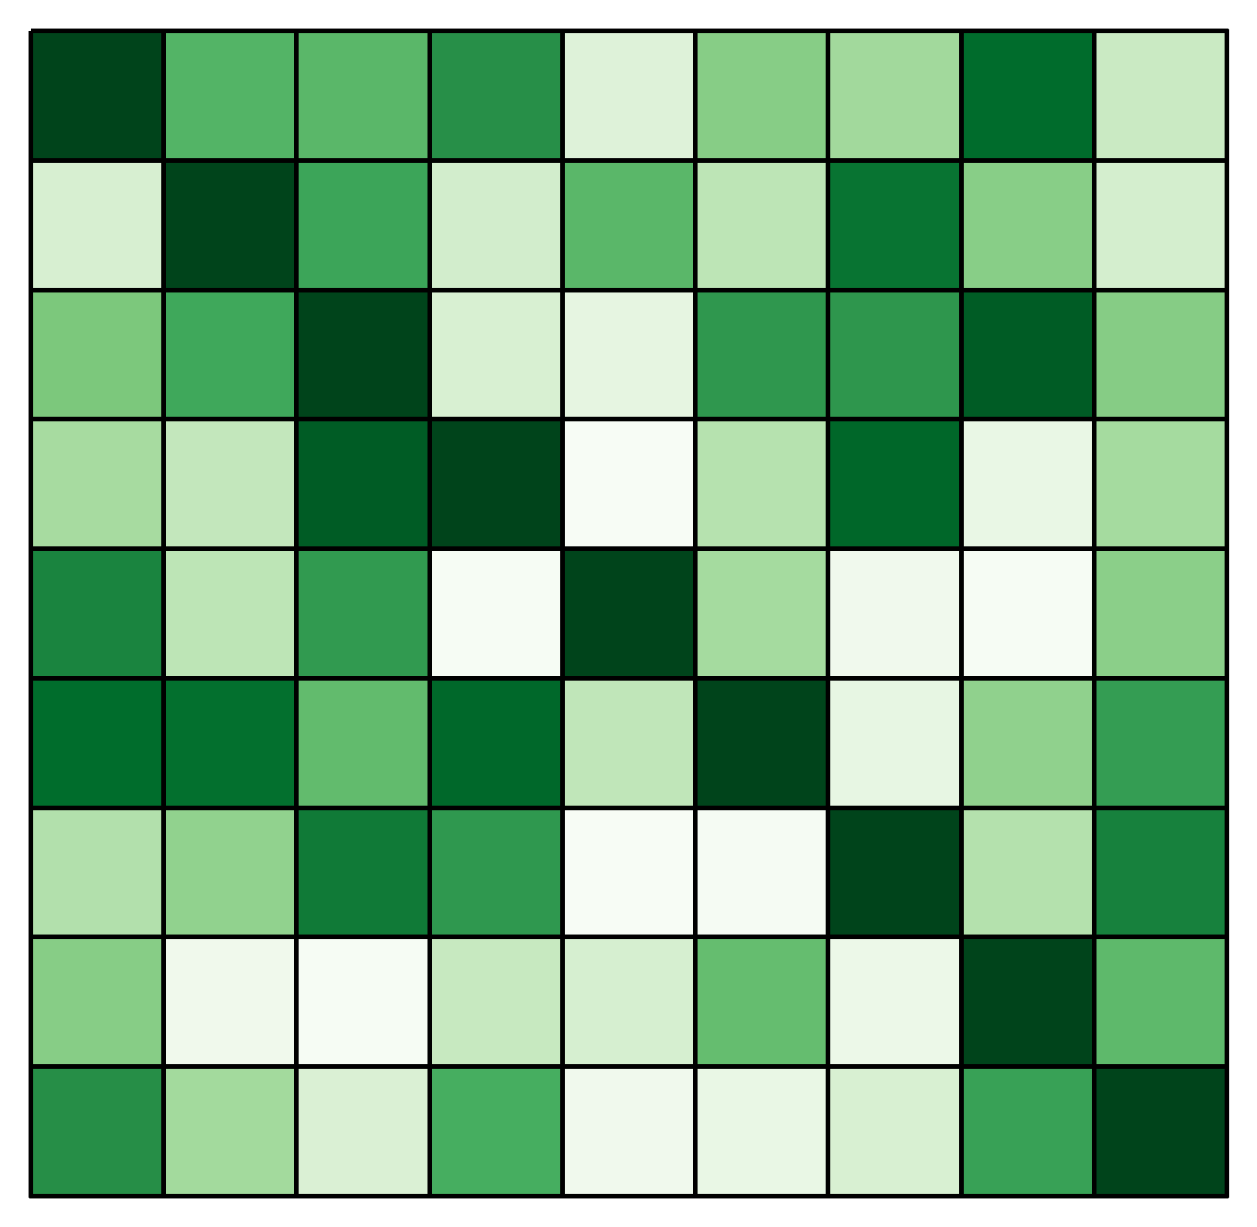
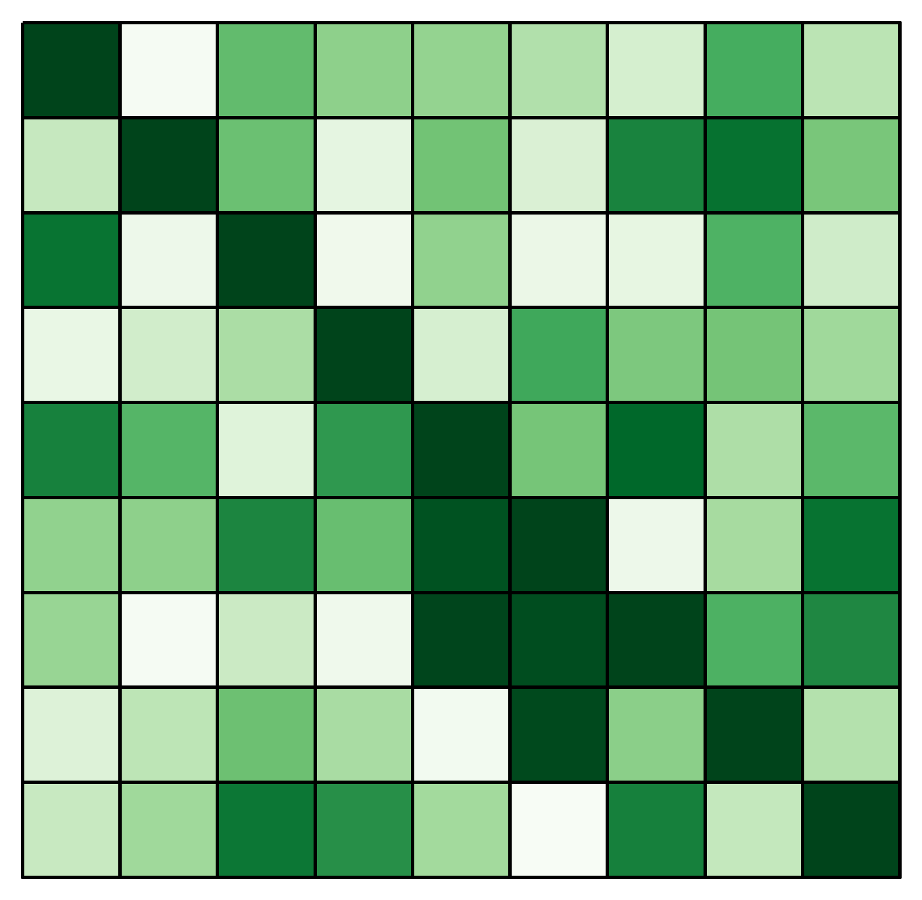
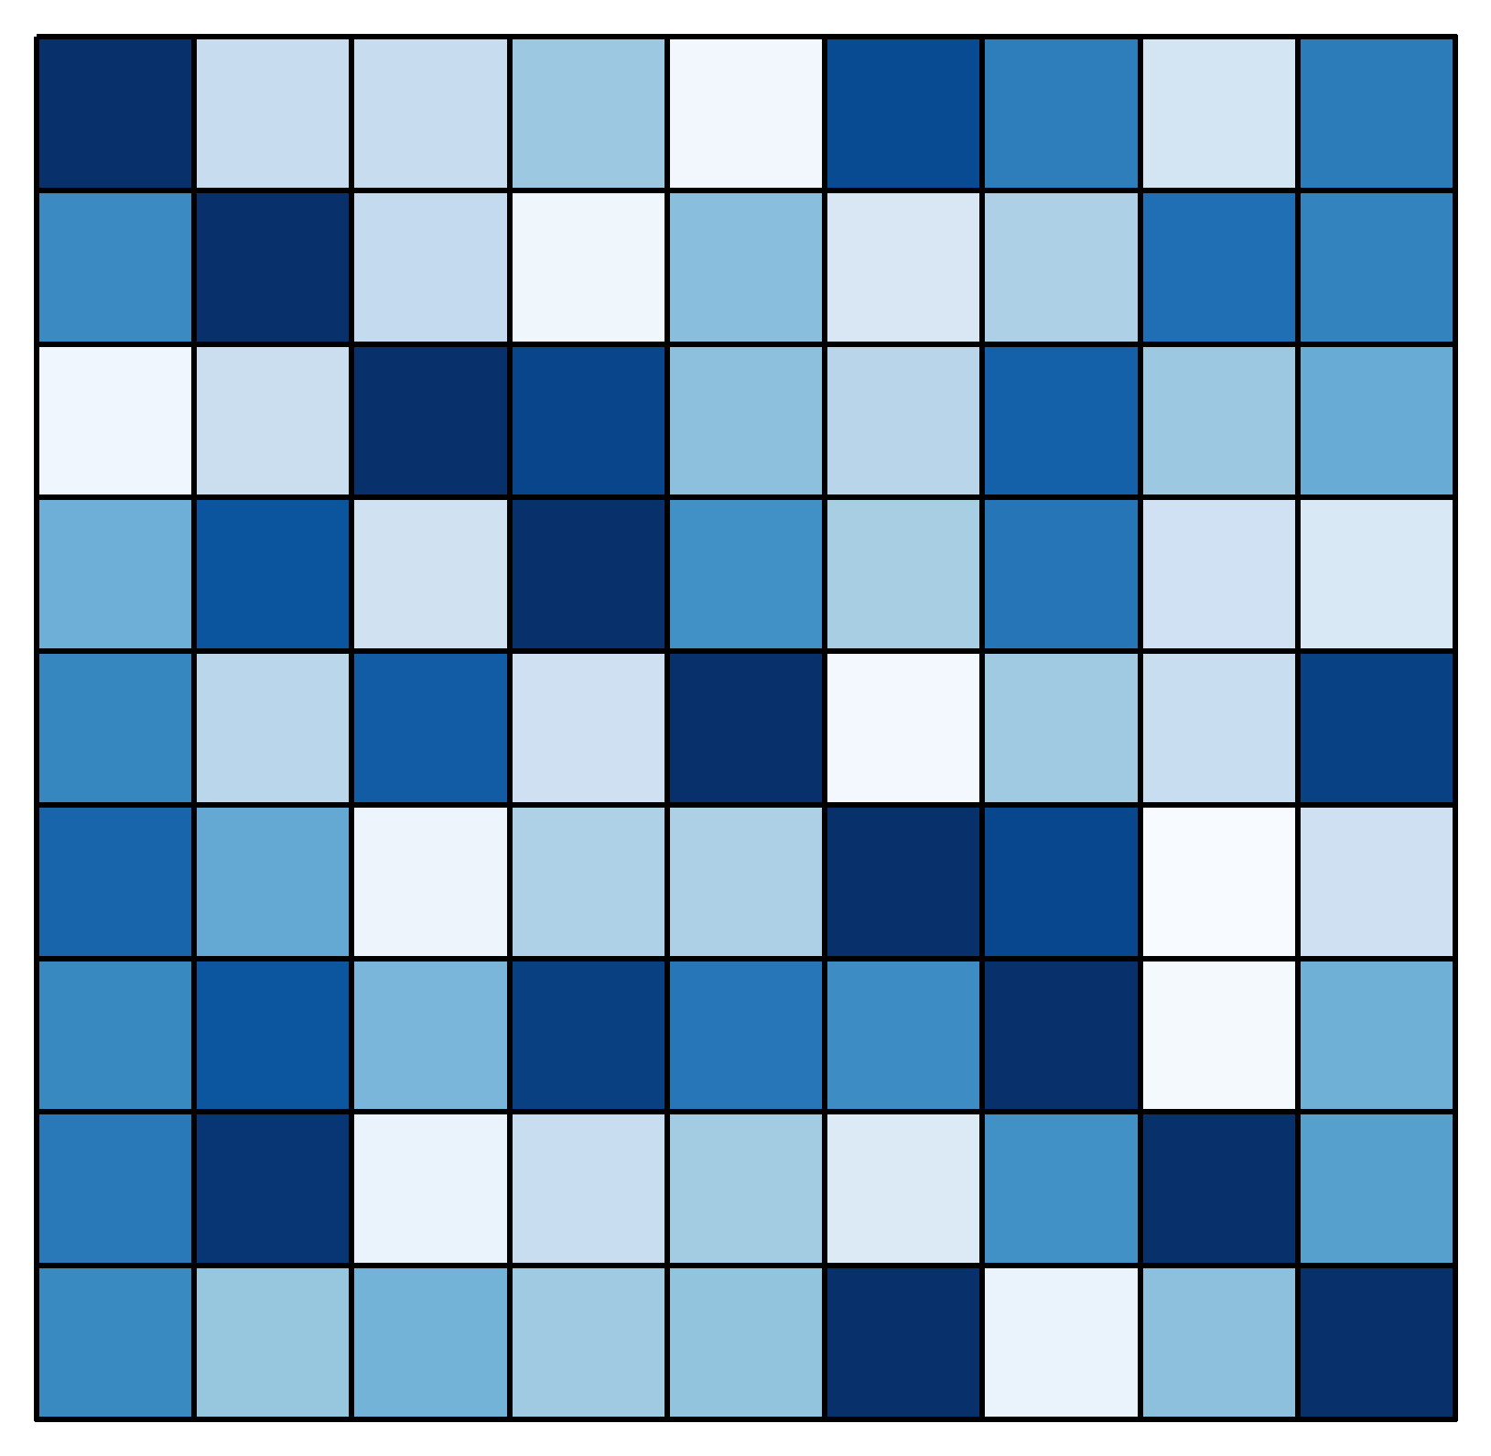
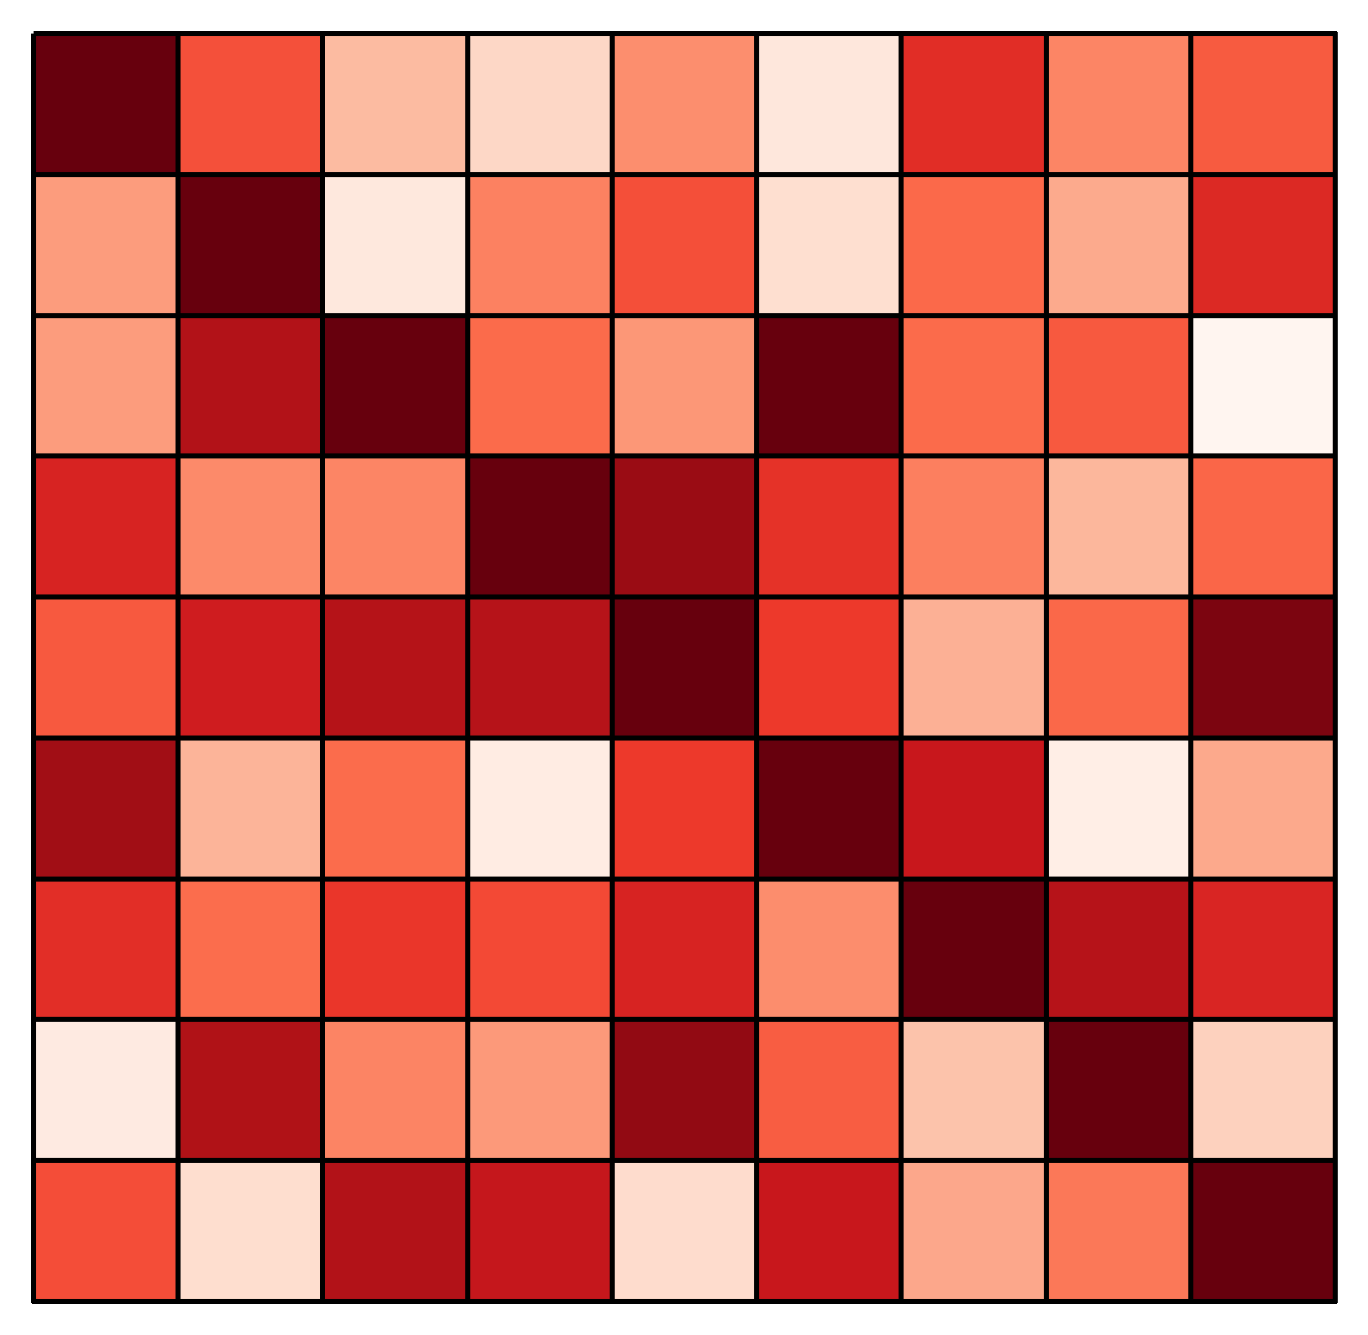
Similarity Network Fusion (SNF)
Step 2: Patient Similarity Matrices
BASELINE
APC
Patients
Patients
Patients
Aβ
pTau
sTREM2

Slide 32
Similarity Network Fusion (SNF)
Step 3: Patient Similarity Networks
BASELINE
APC
Aβ
x 3
x 3
pTau
sTREM2

Slide 33
Similarity Network Fusion (SNF)
Step 4: Patient Network Fusion
BASELINE
APC
Aβ
pTau
sTREM2
x 3
x 3
Supported by all data

Slide 34
Similarity Network Fusion (SNF)
Step 5: Fused Patient Similarity Network
Responder
Non-Responder
Baseline
APC
Supported by all data

Slide 35
Similarity Network Fusion (SNF)
Step 6: Spectral Clustering
Responder
Non-Responder
Baseline
APC
Supported by all data

Slide 36
Post-Hoc Analysis
Ab
pTau
sTREM2
CSF
biomarker
levels
Responder
Non-Responder

Slide 37
Anticipated Results

Slide 38
Clustering
(Blennow, 2005, Front. Neurosci)
Responder
Non-Responder
Before
After
Supported by all data

Slide 39
Aβ
p75
LM11A-31
Aβ
No significant difference between treatment response groups

Slide 40
pTau
p75
Aβ
(Manucat-Tan et al., 2019, Aging)
pTau
Significantly decreased
in response group

Slide 41
sTREM2
(Elshaer et al., 2019, Diabetologia)
Neurofibrillary
tangle
pTau
Significantly decreased
in response group

Slide 42
Significance

Slide 43
Significance
1
Longitudinal & Multivariate
Aβ
pTau
sTREM2
CSF
biomarker
levels
Time

Slide 44
Significance
2
Novel Phenotypes
Responder
Non-Responder

Slide 45
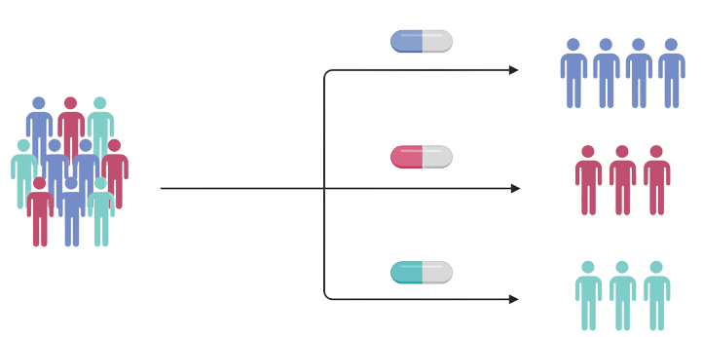
Significance
1
3
Advance Precision Medicine

