Slide 1
Lattice-Based Cryptography

Slide 2
DISCUSSION ROADMAP
Why Post Quantum Cryptography (PQ) ?
Candidates for Post Quantum Cryptography.
Lattices
Hard Problems on Lattices
Components in Lattice Based Cryptography (LBC)
Lattice Based Cryptography Schemes
NTRU Signatures
Comparison of LBC Schemes.
Conclusion

Slide 3

Why Post Quantum Cryptography?
“Factorization is Difficult??”
Present day : Discrete Logarithm and Prime Factorization Problem are underlying hard problems in Public Key Cryptography
Not for the Quantum Algorithm by Peter Shor [1996]
Shor’s Algorithm

Slide 4
Candidates for Post- Quantum Cryptography
Lattice Cryptography
Build on Geometric structures called Lattices.
Code based systems using Error Correcting Codes
Multivariate Cryptography
Difficulty in solving a system of quadratic polynomial over finite field
Hash based Cryptography
Supersingular elliptic curve isogeny cryptography
Potential cryptographic algorithms selected by NIST are among these.

Slide 5
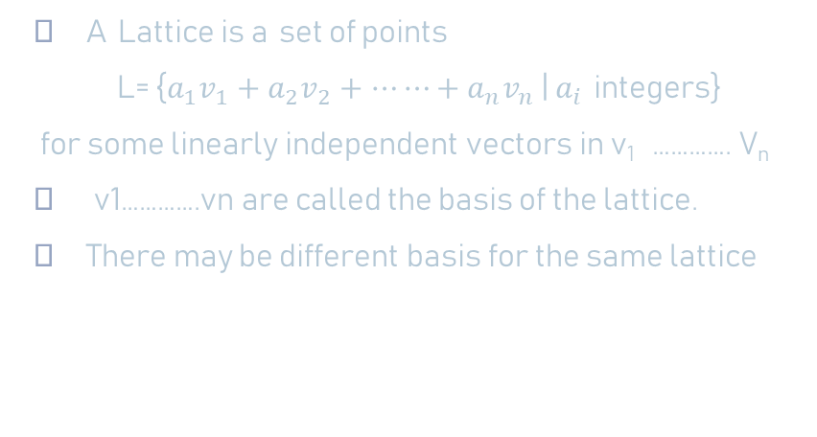
Lattices
V1 * v2
2v1
V1 +2v2
v1
v2
2v2-v1
Key component on which LBC is based on.

Slide 6


Slide 7

Ideal Lattices

Slide 8


Q-ARY LATTICES
Lattice generated by rows of A modulo q

Slide 9


Hard Problems on Lattices
b1
ϒ
b2

Slide 10



t
CVP
b2
b1

Slide 11

x2
x1
b1
x3
b2

Slide 12
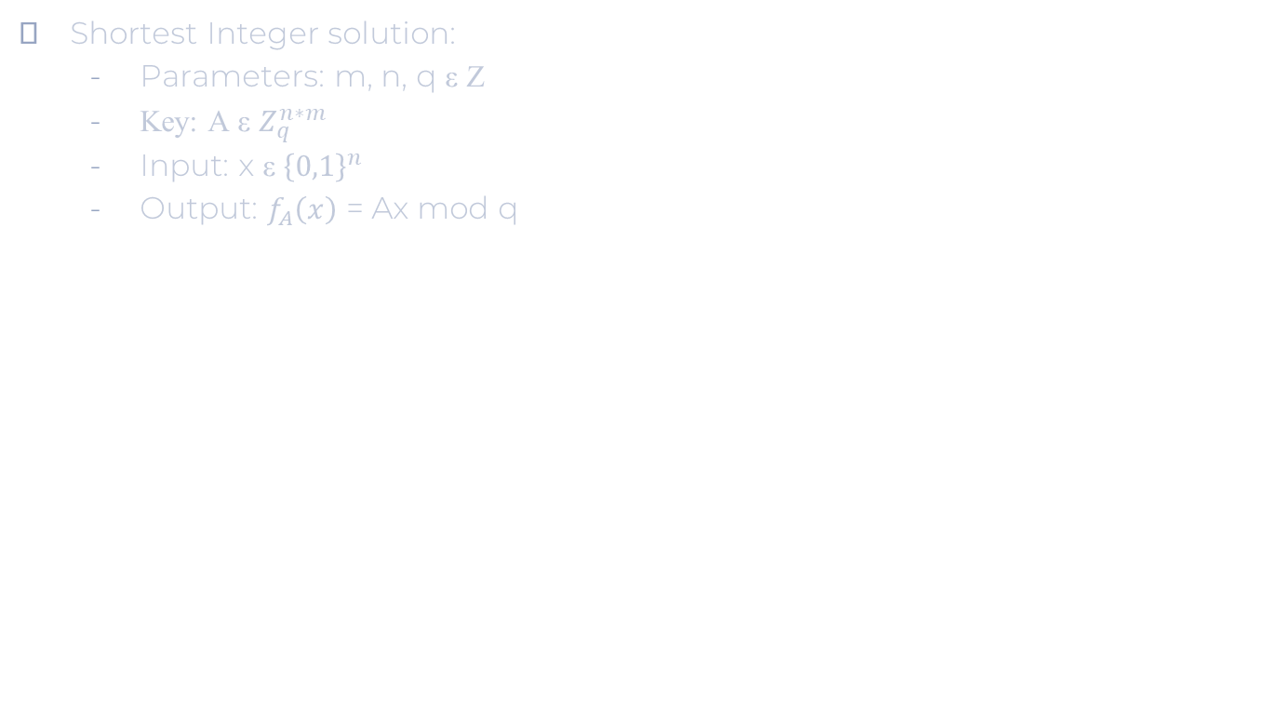

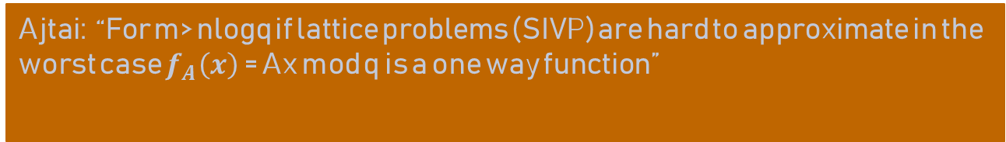
Ax
n
A
Linear function so for an arbitrary x it is easy to invert using Gauss elimination method by solving system of linear equations.
m
X is a short vector. In this setting the preimage will not be short

Slide 13
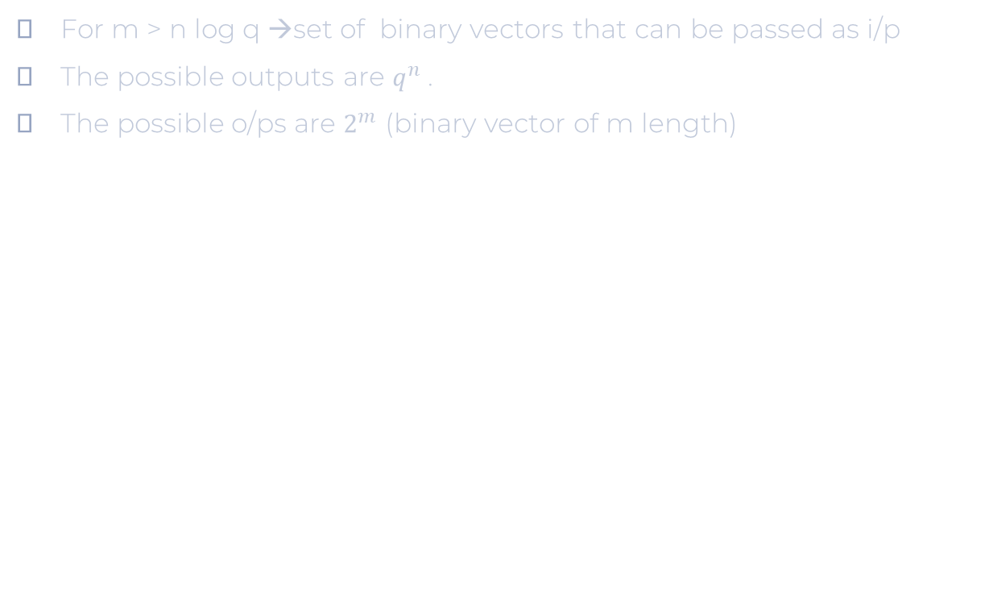


I/P
O/P
Here Domain is bigger than range which makes it a one-way function.

Slide 14
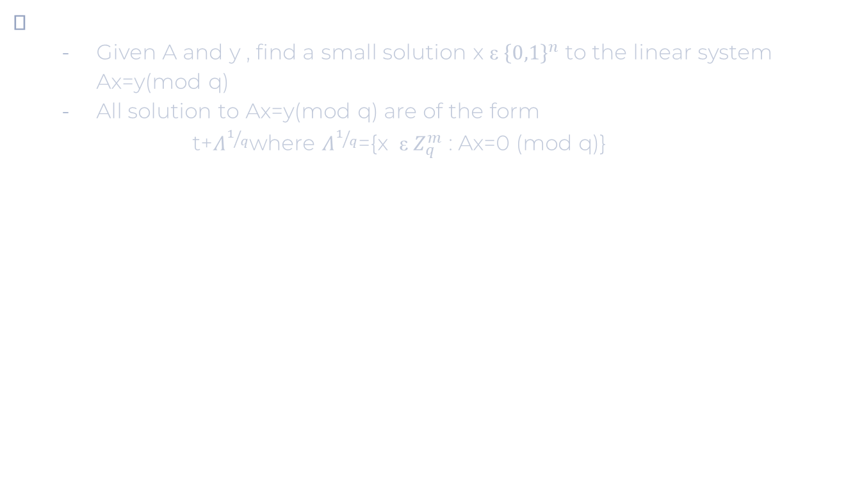
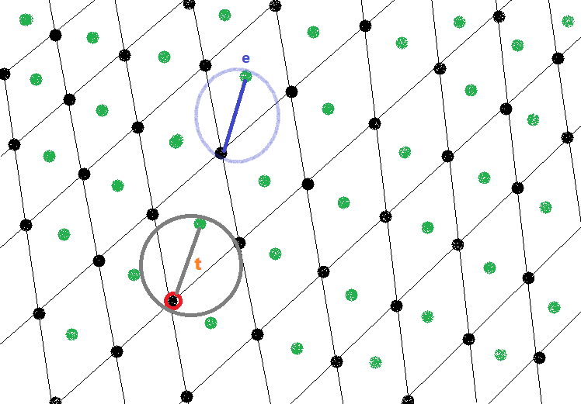

Slide 15
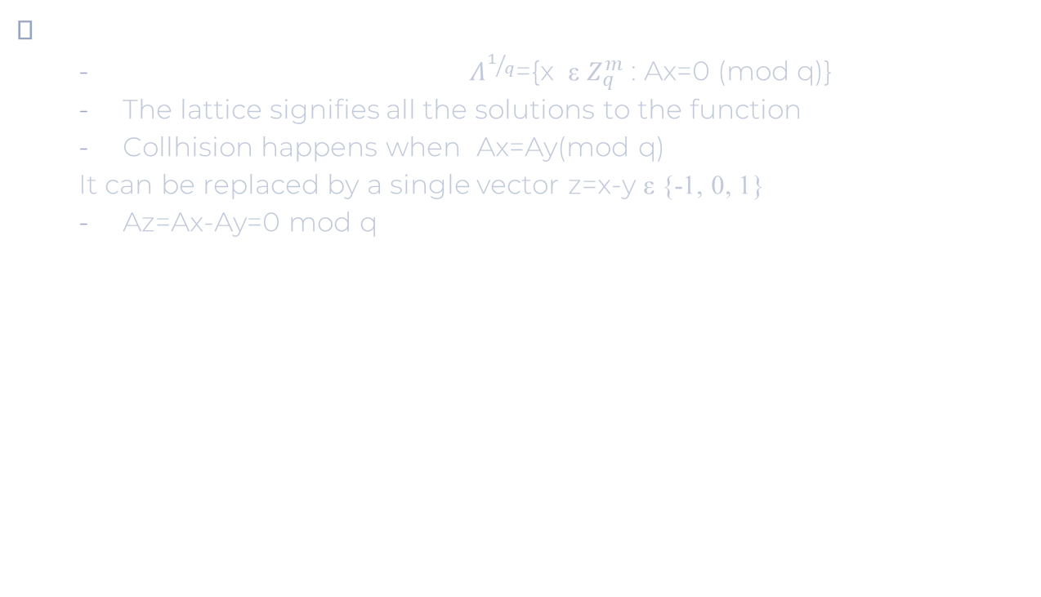
Distinct binary vector from 2 binary vector x and y
Finding a short vector corresponds to finding a collision

Slide 16


Slide 17
Lattice Based Schemes
There are two main classes of lattice based algorithms:
NTRU
Nth Degree Truncated Polynomial Ring Units (or R=Z[X]/(X^N-1))
first public key cryptosystem not based on factorization or discrete logarithmic problems.
lattice-based alternative to RSA and ECC and is based on the shortest vector problem in a lattice.
LWE – Learning with error
Security of NTRU relies on hardness of solving CVP in a lattice
LWE relies on provably reducible solving the SVP
NTRU is more flexible for implementation but suffers from security guarantee.
LWE problems are resistant to quantum attacks but they are efficient.

Slide 18
Working of NTRU
Operations are based on objects in a truncated polynomial ring R=Z[X]/(X^N-1), polynomial degree at most N-1: a 0 + a 1x + a 2x^2 + · · · + aN− 1x^(N−1).
Key Generation:
User B randomly chooses 2 small polynomials f and g in the R (the ring of truncated polynomials).
The values of these polynomials should kept in a secret.
A chosen polynomial must have an inverse
The inverse of f modulo q and the inverse of f modulo p will be computed Properties: f*fq^-1 = 1 (modulo q) and f*fp^-1 = 1 (modulo p)

Slide 19
Product of polynomials will be computed: h = p * ((Fq )*g)mod q. Private key of B: the pair of polynomials f and fp
Public key of B: the polynomial h.
Example of a key generation Public parameters (N, p, q, d) = (7, 3, 41, 2).
Bob chooses: f (x) = x^6−x^4+x^3+x^2−1
Private and g(x) = x^6+x^4−x^2−x. 2.
Fq(x) = f (x)^ −1 (mod q) = 8x^6 + 26x^5 + 31x^4 + 21x^3 + 40x^2 + 2x + 37 (mod 41).
Fp(x) = f (x)^ −1 (mod p) = x^6 + 2x^5 + x^3 + x^2 + x + 1 (mod 3) Private key of Bob
h(x) = p * (Fq )*g(mod q) = 20x^6 + 40x^5 + 2x^4 + 38x^3 + 8x^2 + 26x + 30 (mod 41) - Public key

Slide 20
NTRU Encryption:
User A has a message to transmit:
1st step. Puts the message in the form of polynomial m whose coefficients is chosen modulo p between -p/2 and p/2
2nd step. Randomly chooses another small polynomial r (to obscure the message).
3rd step. Computes the encrypted message: e= r*h + m (modulo q).
Example:
Alice decides to send Bob the message: (N, p, q, d) = (7, 3, 41, 2)
m ( x) = −x5 + x3 + x2 − x + 1 using the ephemeral key
r ( x) = x^6 − x^5 + x − 1.
e(x) ≡ 31x^6+19x^5+4x^4+2x^3+40x^2 +3x+25 (mod 41)

Slide 21
NTRU Decryption
B receives a message e from A and would like to decrypt it.
1st step. Using his private polynomial f he computes a polynomial a= f*e(mod q).
B needs to choose coefficients of a that lie in an interval of length
2nd step.
He computes the polynomial b=a(mod p). B reduces each of the coefficients of a modulo p.
3rd step. B uses the other private polynomial fp to compute c=fp*b(modulo p), which is the original message of A.

Slide 22
Decryption Example:
B computes a ≡ x^6 + 10x^5 + 33x^4 + 40x^3 + 40x^2 + x + 40 (mod 41 ).
B then centerlifts modulo q to obtain b = a(mod p) = x^6 + 10x^5 − 8x^4 − x^3 − x^2 + x − 1 (mod 3)
B reduces a( x) modulo p and computes c = F p ( x)*b ( x) ≡ 2x^5 + x^3 + x^2 + 2x + 1 (mod 3)
Centerlifting modulo p retrieves A's plain text m( x) = −x5 + x3 + x2 − x + 1.

Slide 23

Complexities

Slide 24

Components of LBC

Slide 25


Slide 26
Bernoulli Sampler:
Optimized version of rejection sampler.
Suitable for hardware implementations.
Ziggurat Sampler:
Suitable for resource constrained devices.
Variation of rejection sampler.
Area under probability density function is divided into n rectangles with same area
Size is equal to probability of sampling point in each rectangle
Rectangle Ri and point xi is chosen.
If xi<xi-1; xi resides below the curve and would be accepted.
More rectangles reduces rejection rate.
Cannot be implemented in hardware

Slide 27
Cumulative Distribution Table (CDT):
Faster than Ziggurat rejection sampler.
Since it is cumulative distribution all numbers are less than 1
it is sufficient to use binary expansion of the fraction.
Requires large table to store values of Cumulative Distribution Function (CDF)
Goal i: find x whose probability is p(x) = S[x+1]-S[x] ; S[x]= CDF at x
Performs binary search on CDF
Not practical for constrained devices.
Suitable for digital signature.

Slide 28
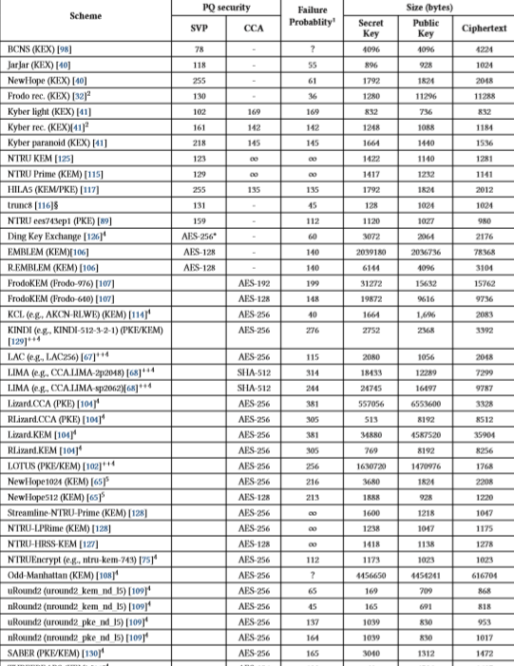

Slide 29
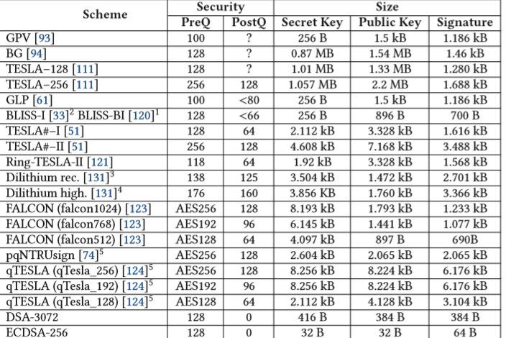

Slide 30
Conclusion
Not only quantum resistant but LBC tackles problems for lightweight cryptography
Some algorithms are heavy but still light weight than other schemes.
Current Designs still lack to tackle trade-offs .U

Slide 31
References
Comparing proofs of security for lattice-based encryption Daniel J. Bernstein 1,21 Department of Computer Science, University of Illinois at Chicago, Chicago, IL 60607–7045, USA 2 Horst G¨ortz Institute for IT Security, Ruhr University Bochum, Germany n
Winter School on Cryptography: Introduction to Lattices - Oded Regev
Simon’s institute of Theory of Computing, University of Berkely - https://simons.berkeley.edu/workshops/schedule/10563
cryptography: Introduction to Lattices - Oded Regev
r School on Cryptography: Introduction to Lattices - Oded Regev
https://www.cufonfonts.com/font/dm-serif-display

Slide 32
Thank You

